Slide 1
Notes:
Slide 1: Company Logo Full Page
Before you start editing the slides of your talk change to the Master Slide view:
Microsoft Office :Menu: View > Slide Master;
Macintosh – View > Master > Slide Master
Edit the following items:
On the Slide Master (first master slide) – lower area
a) On the left Delete the text and write the title of the event/Conference, Location
b) On the right delete the text and write the name and surname of the speaker and the date (day, month , year)
Close Master View

Slide 2
New FPGA platform to upgrade the Cavity BPM Systems at Fermi@Elettra
G. Brajnik, R. De Monte, D. Giuressi
Notes:
Slide 2: Title of the Presentation
Before you start editing the slides of your talk change to the Master Slide view:
Microsoft Office :Menu: View > Slide Master;
Macintosh – View > Master > Slide Master
Edit the following items:
On the Slide Master (first master slide) – lower area
a) On the left Delete the text and write the title of the event/Conference, Location
b) On the right delete the text and write the name and surname of the speaker and the date (day, month , year)
Close Master View
To start adding slides insert a new slide and select a Layout:
For Title & Subtitle
For text with bullet points
For Text
For Picture, graphs, visuals
Two columns
Blank

Slide 3
Outline
Short description of the Cavity BPM for Fermi@elettra
Status of the acquisition system for Cavity BPM
New Digital Carrier Board description
Cavity BPM acquisition system using new DCB
Considerations about systems integrations
Discussion

Slide 4
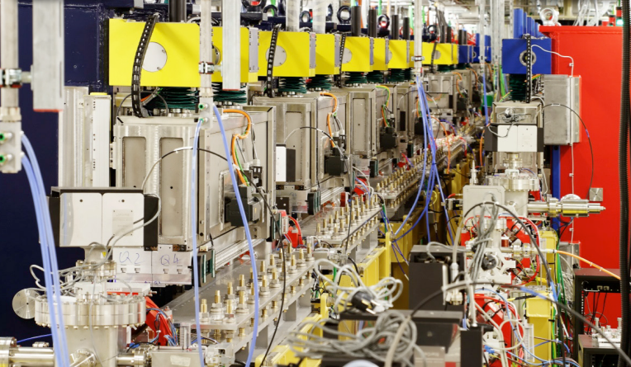
Fermi@elettra Cavity BPM system layout
linac tunnel
Laser Heater
X-band
BC1
BC2
PI
L1
L2
L3
L4
undulator hall
C-BPM
FEL1
Transfer Line
FEL2
The distance
between
FEL1 and FEL2
is ONLY 50cm
Notes:
Slide 3 – (..) : Content of the presentation
Insert a new slide: Home > “New Slide” and choose a slide Layout:
For Title & Subtitle
For text with bullet points
For Text
For Picture, graphs, visuals
Two columns
Blank
If you want Copy & paste an element from the Clip Board to the particular slide:
1. Click on a box to mark it.
2. Position the mouse pointer on the box frame: Copy!
3. Click on the particular slide: Paste!
How you intend to use the elements is your choice.
You can combine the text block style with the background colour in different manner.

Slide 5
Fermi@elettra Cavity BPM system overview
10 C-BPM Installed , tuned and running on FEL1
15 C-BPM Installed , tuned and running on FEL2
9 of the C-BPM FEL2 have shared electronics with FEL1
16 C-BPM RF Front-end installed and calibrated
5 μTCA Crates for signal acquisition with:
  16 ADO fast acquisition boards
  10 ADA fast Cal signal generation boards
  16 OPTO-IO to interface various digital control signals from Xilinx Virtex5 FPGA to a RF Front end in the Fermi tunnel.
  5 MiTich board to generate and manage all of the clocks required by fast acquisition.
3 RealTime Linux CPU with Tango server
10 Hz Real-Time acquisition and position computation
50 Hz Real time acquisition and position computation with the new implemented Gigabit Ethernet port on ADO with UDP protocol stack
Dedicated Tango Graphical User Interface to manage C-BPM from control system
Dedicated Tango server for real time trajectory control
Lot of Tango / Matlab tools to manage trajectory and feedbacks based on CBPM system

Slide 6
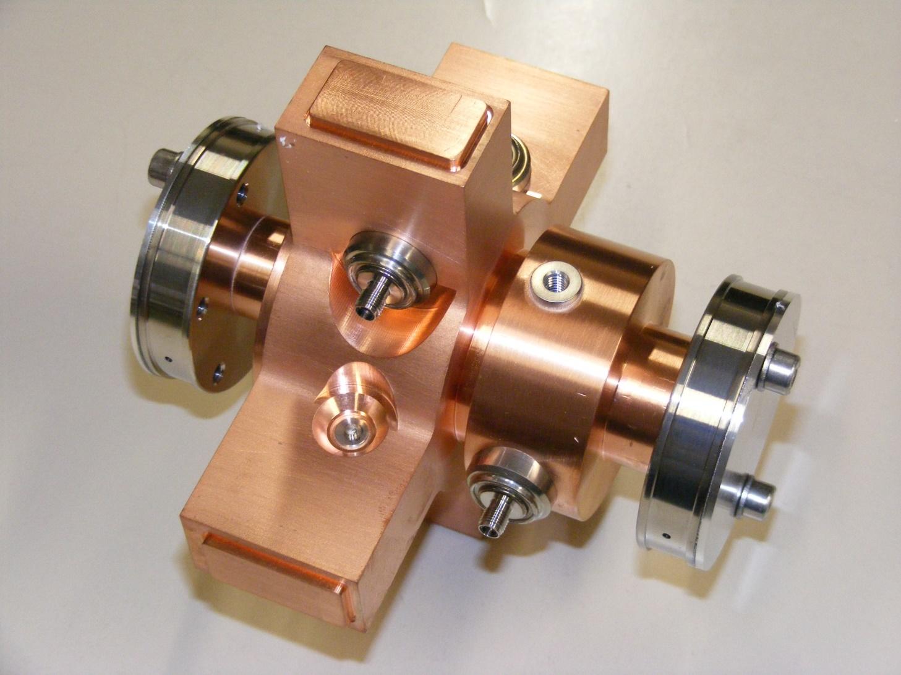
The pick-up Cavities
Fref ≈ Fpos ≈ 6.5 GHz damped Waveform
Duration (T): approx 500ns
Monopole Cavity (called REFERENCE)
627 mV Peak-to-Peak with 270pC of bunch charge
T ≈ 500ns
V(t)
t
Dipole Cavity (called POSITION)
145 mV(Pk-Pk)/mm with 270pC of bunch charge
T ≈ 500ns
Negative position
Positive position
V(t)
V(t)
With Tuners is possible to keep the
difference between the two frequencies
less than 100KHz
t
t

Slide 7

Fermi@elettra Cavity BPM principle of operation
μTCA crate
service area
Double arrow
180° Hybrid
Var
gain
AM
detector
RF FrontEnd
Fermi tunnel
16 bit
160MsmpS
ADC
Σ
PickUps
machine
6.5GHz
BPF
variabile phase
shifter
Var
gain
AM
detector
LNA
Δ
16 bit
160MsmpS
ADC
Position
cavity
φ
6.5GHz
BPF
variabile phase
shifter
Double arrow
180° Hybrid
Var
gain
AM
detector
φ
LNA
Σ
16 bit
160MsmpS
ADC
Power
splitter
Reference
cavity
6.5GHz
BPF
Power
combiner
LNA
Var
gain
AM
detector
Δ
16 bit
160MsmpS
ADC
Optical links
X and Y axis
stepper motor
movers
Calibration
signal
Generator
(on axis signal)
ADA/ADO FPGA
14 bit
320MsmpS
DAC
Fermi control system
Cavity BPM Meeting @ IBIC2003

Slide 8
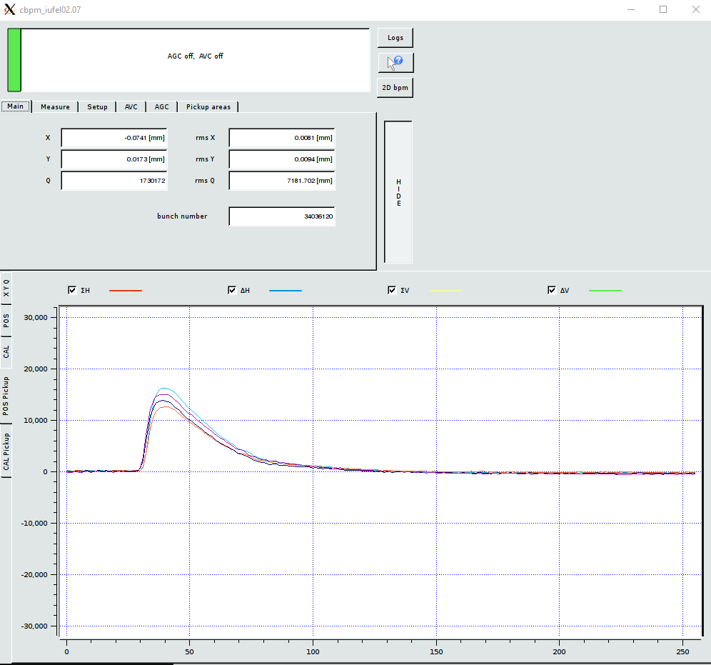
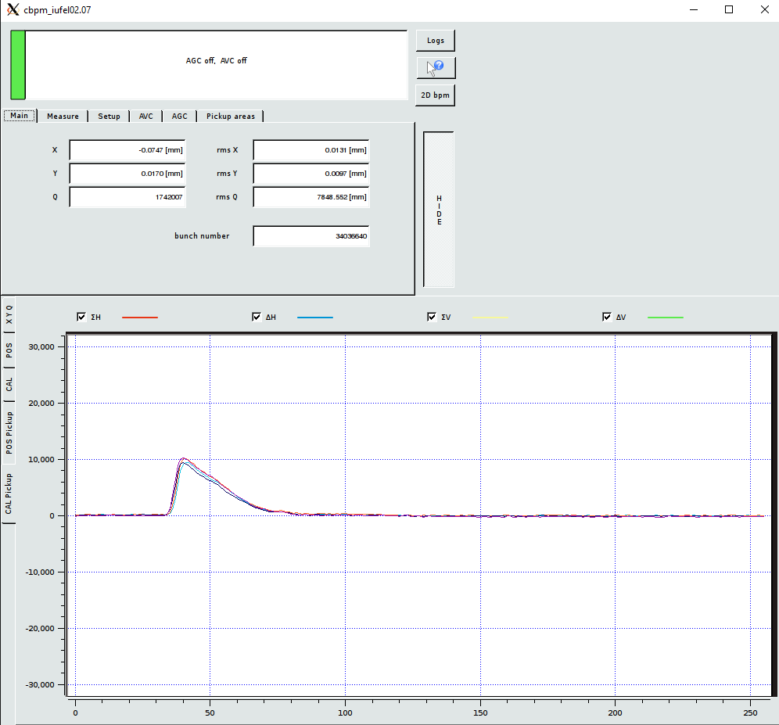
Fermi@elettra Cavity BPM
Electric Signals

Slide 9
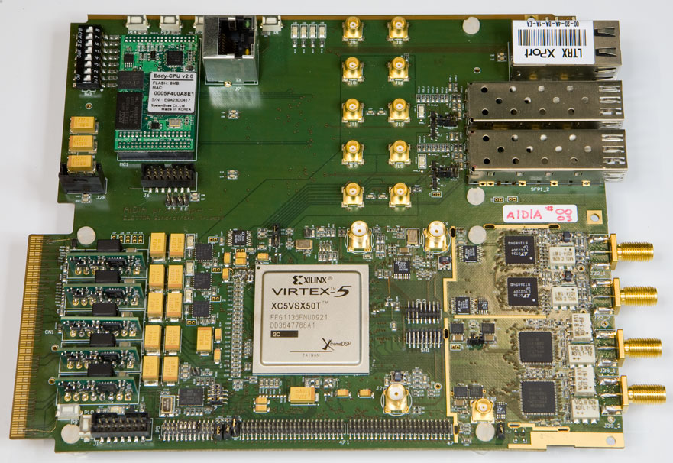
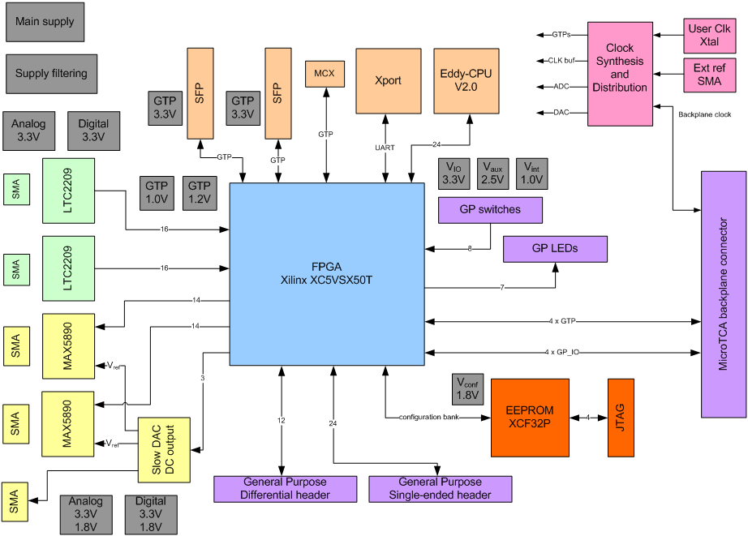
ADA - Analog Digital Analog Converter board
Digital to Analog fast data synthesis
(Cal signal)
A lot of components are out of production
and it is not possible to produce other boards
FPGA
Xilinx Virtex-5 SX50T
2 x ADC
Linear Technology LTC2208
2 x DAC
Maxim MAX5890
Ethernet interface
  Lantronix
  2 x SFPs Gbit Ethernet

Slide 10
A particular DAC circuit
Since we have to manage the amplitude of the Calibration dumped waveform, instead of recalculating the whole waveform and reloading it in to the DAC buffer, we have developed a dedicated circuit to manage the amplitude of the DAC using another ultra low noise serial DAC as a reference voltage.
FPGA
16 bit
1MSmpS
ultra low noise
Serial DAC
Slow serial bus
Vref
14 bit
320MsmpS
DAC
DAC Out
Fast parallel bus
Unfortunately we haven’t found on the market any FMC card with a similar functionality.

Slide 11
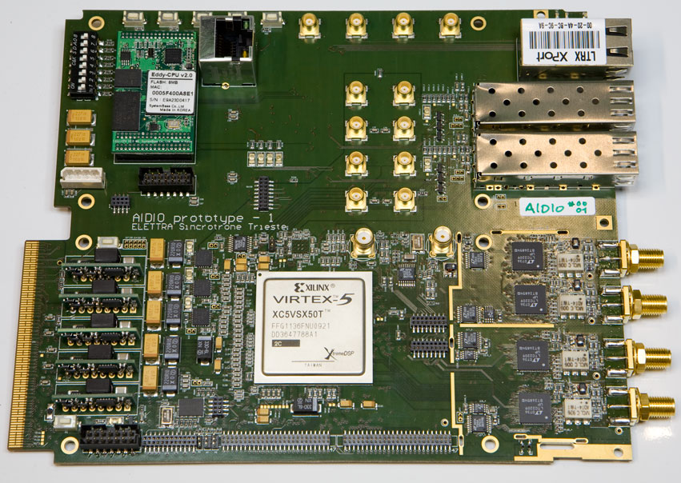
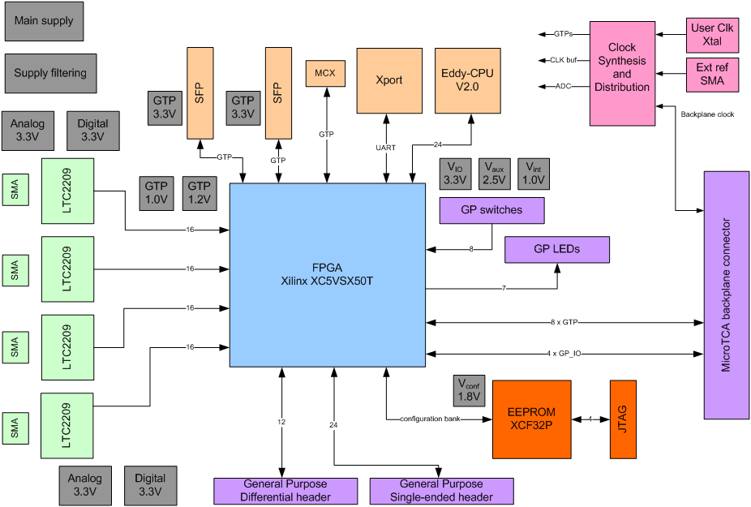
ADO - Analog Digital Only converter board
Analog To Digital 4x 160Msmps 16 bit ADC
A lot of components are out of production
and it is not possible to produce other boards
FPGA
Xilinx Virtex-5 SX50T
4 x ADC
Linear Technology LTC2208
Ethernet interface
  Lantronix
  2 x SFPs GigaBit Ethernet

Slide 12
µTCA acquisition system block diagram
µTCA crate
x Σ
x Δ
y Σ
y Δ
ADO (ADC + FPGA)
C-BPM
FrontEnd
Box
OptoCmd
Opto I/O
Gigabit Ethernet Switch
Cal
x Σ
x Δ
y Σ
y Δ
ADO (ADC + FPGA)
VME
CRATE
C-BPM
FrontEnd
Box
OptoCmd
Control System CPU
Opto I/O
Cal
ADO (DAC + FPGA)
x Σ
x Δ
y Σ
y Δ
ADO (ADC + FPGA)
Event
System
C-BPM
FrontEnd
Box
TRIGGERS
OptoCmd
Opto I/O
Cal
ADO (DAC + FPGA)
clock generator board

Slide 13
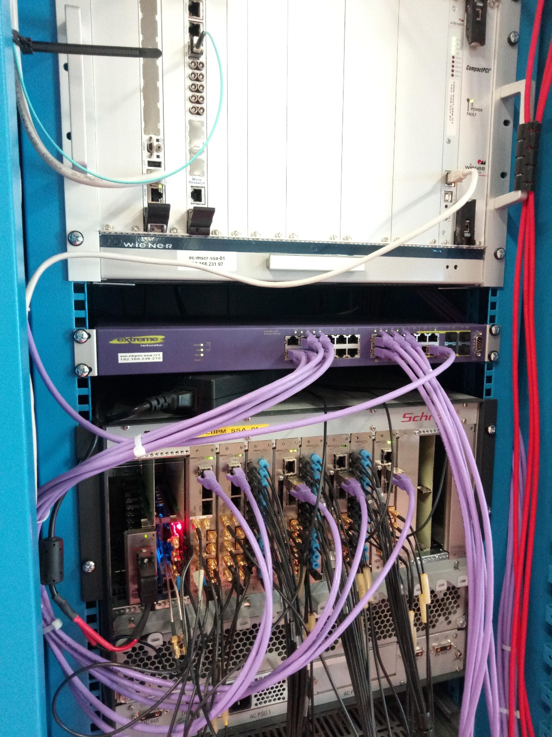
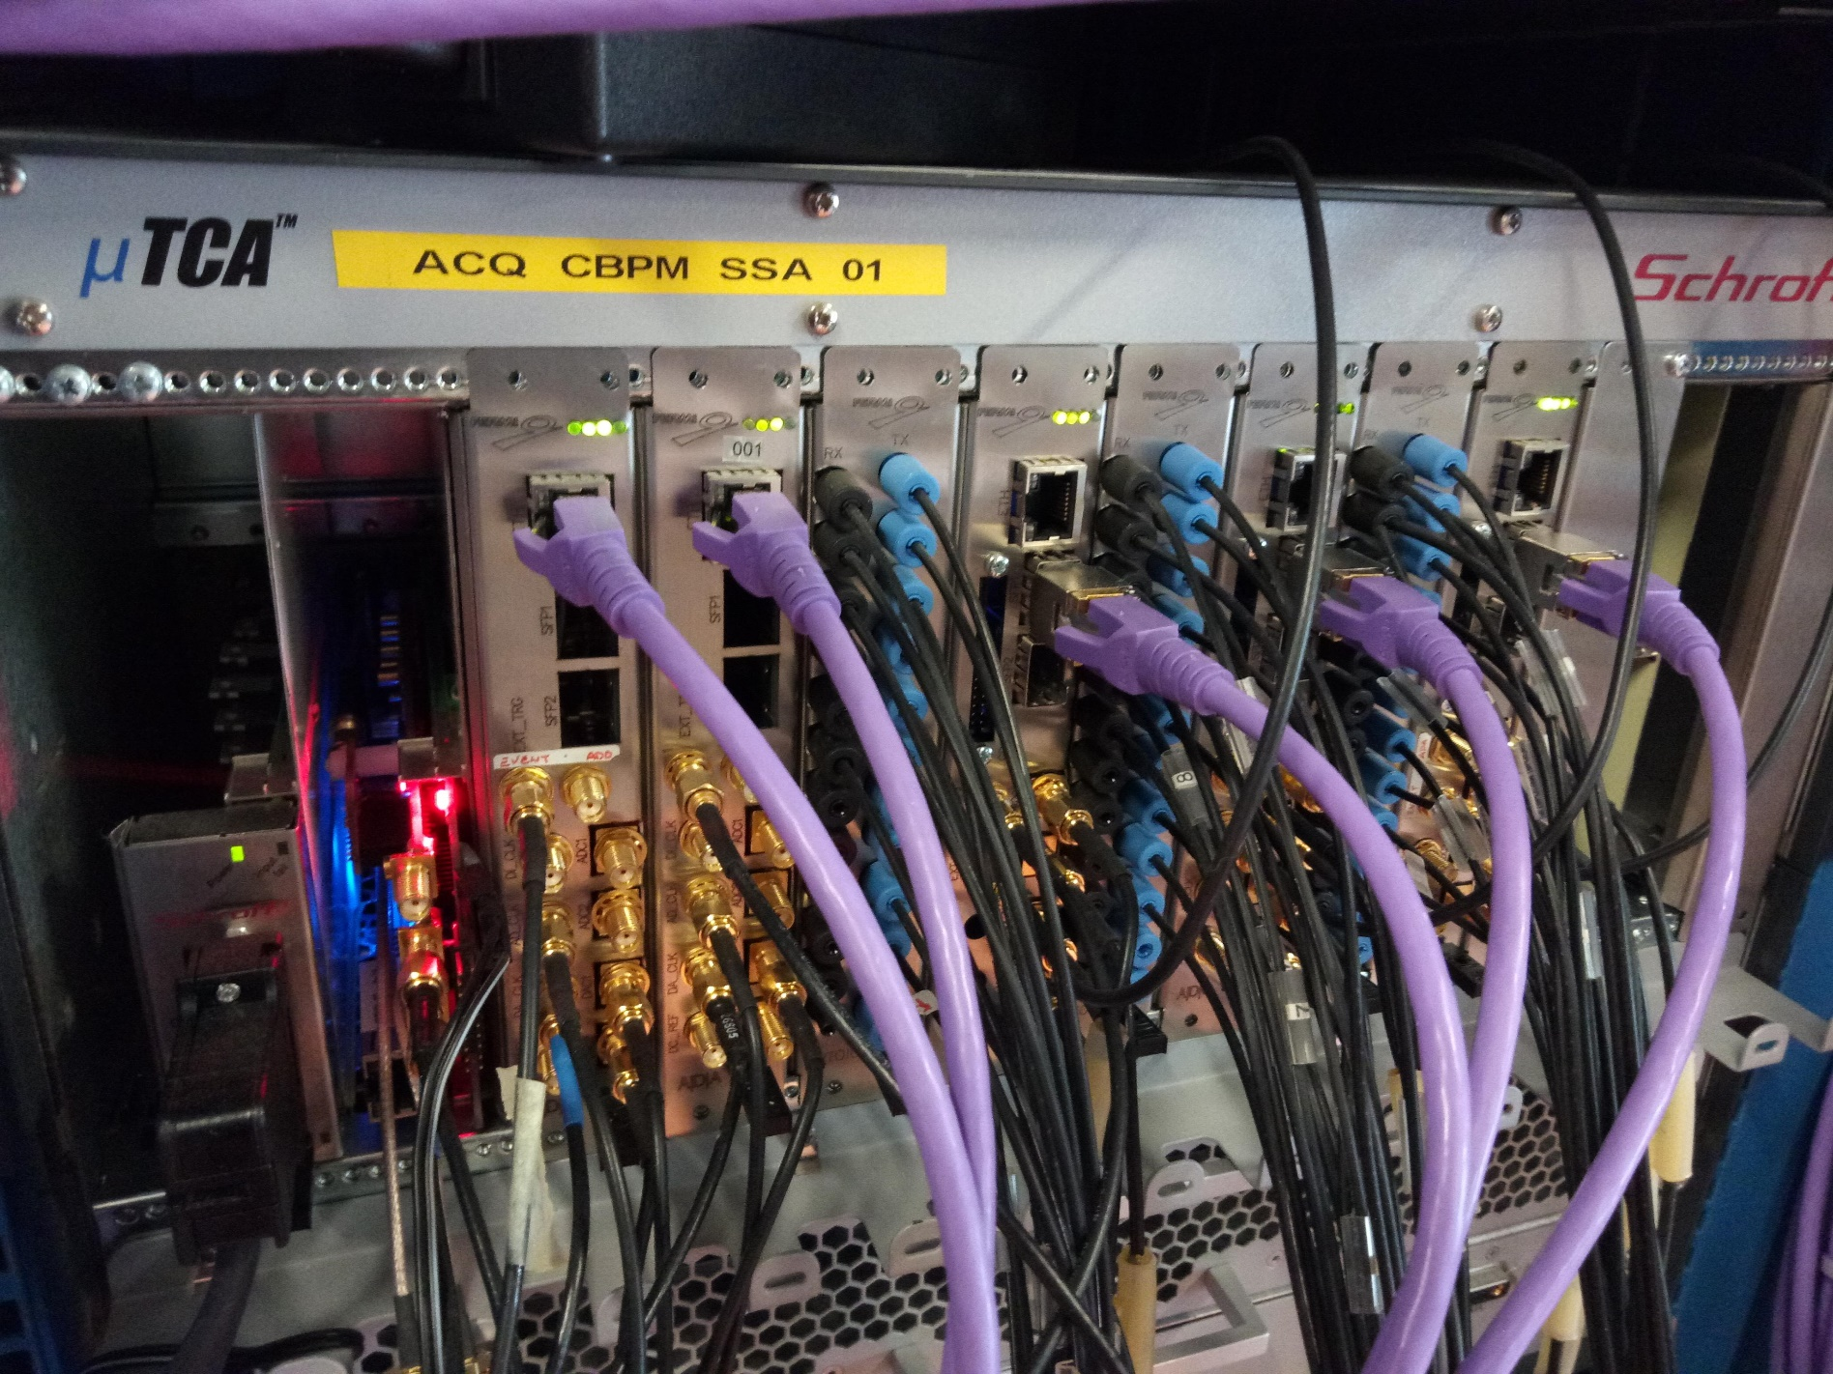
uTCA acquisition system
The uTCA crate is a stand alone crate without CPU and MCH /IPMI.
The ADA and ADO boards can also be used outside the crate uTCA in stand-alone mode.
The Cavity BPM Acquisition system is communicating with the Fermi Control system only via Gigabit ethernet.
The communication protocol is based on UDP packets.

Slide 14
The New Digital Carrier Board: dgDAQ_Arria10GX
DDR3
SODIMM RAM
EEPROM
FMC High Pin Count
4 x SFP
Interfaces
up to 12 Gbit
INTEL-ALTERA
ARRIA 10GX
10AX057H4
F34E3SG
FMC Low Pin Count
1Gbit Ethernet Interface
USB3 Interface
40 x general Purpose I/O
System
CLOCK
Internal Power Supply
+12VDCin
Micro SD
slot

Slide 15
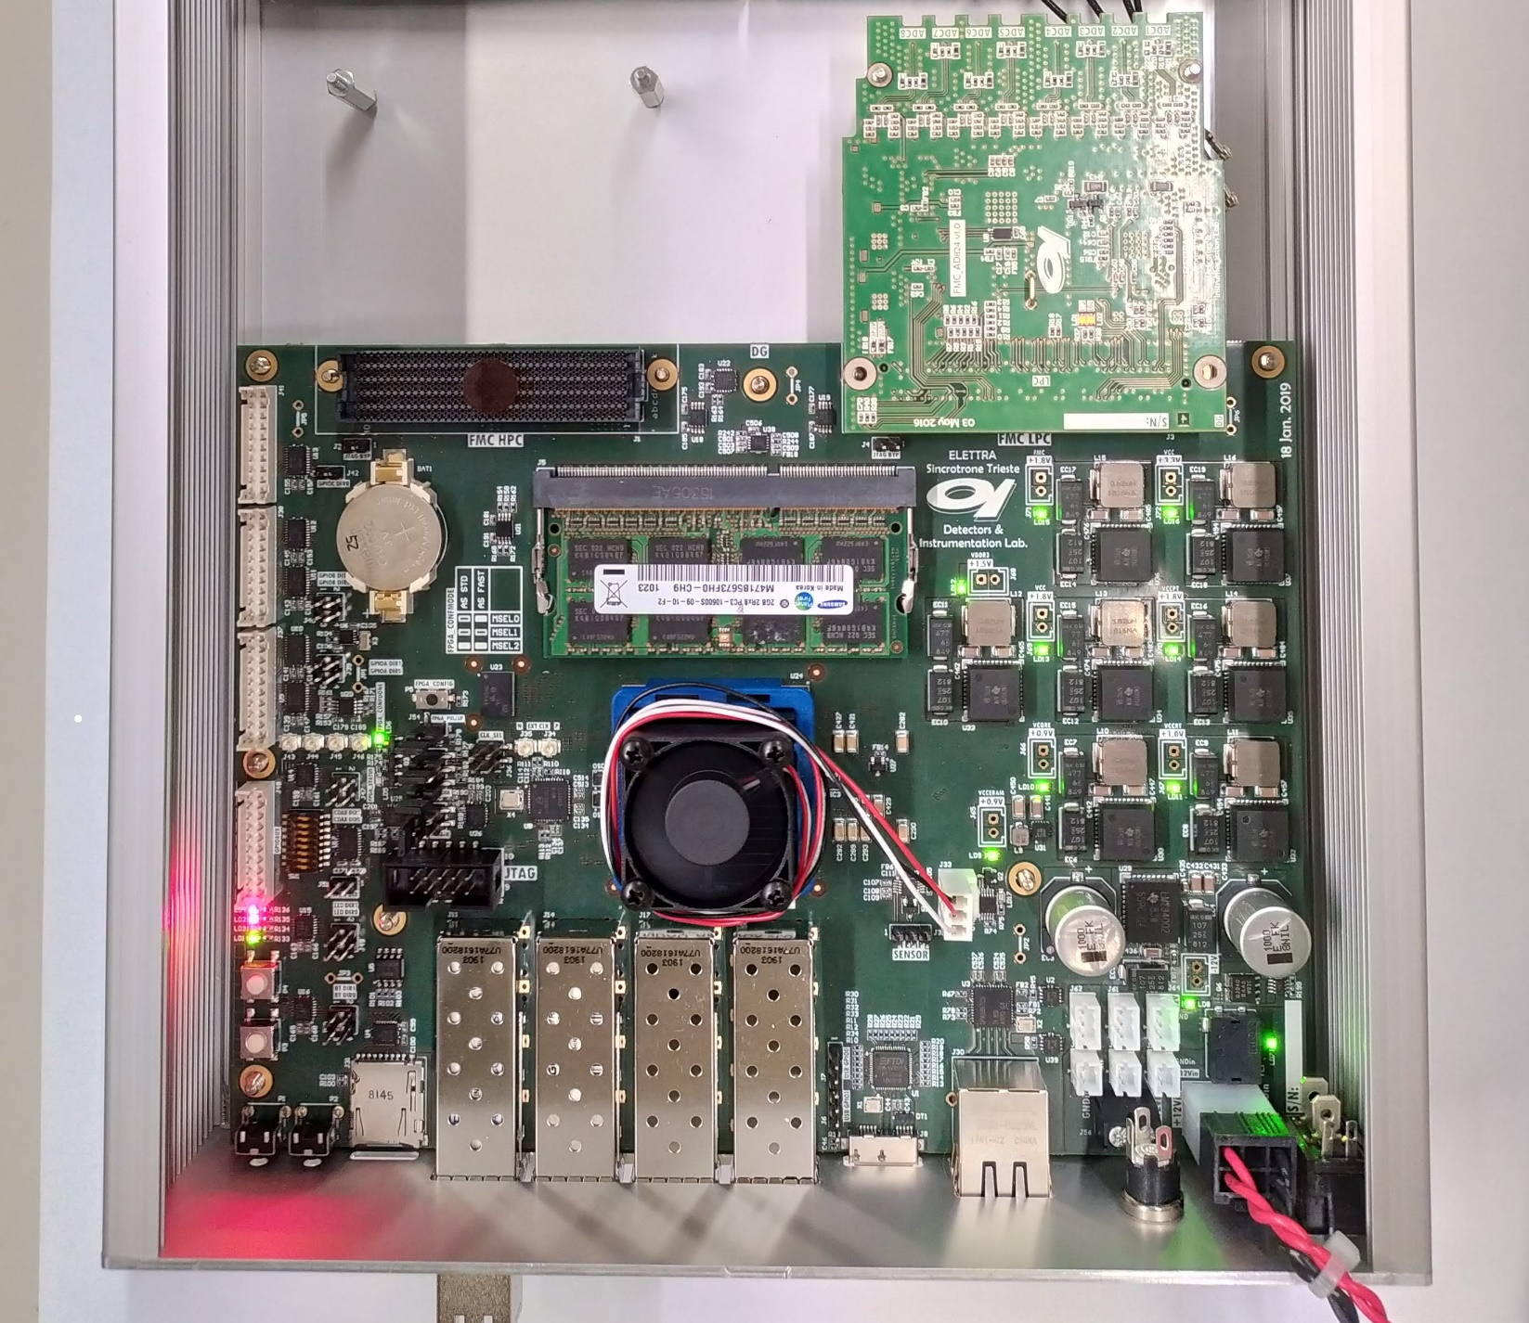
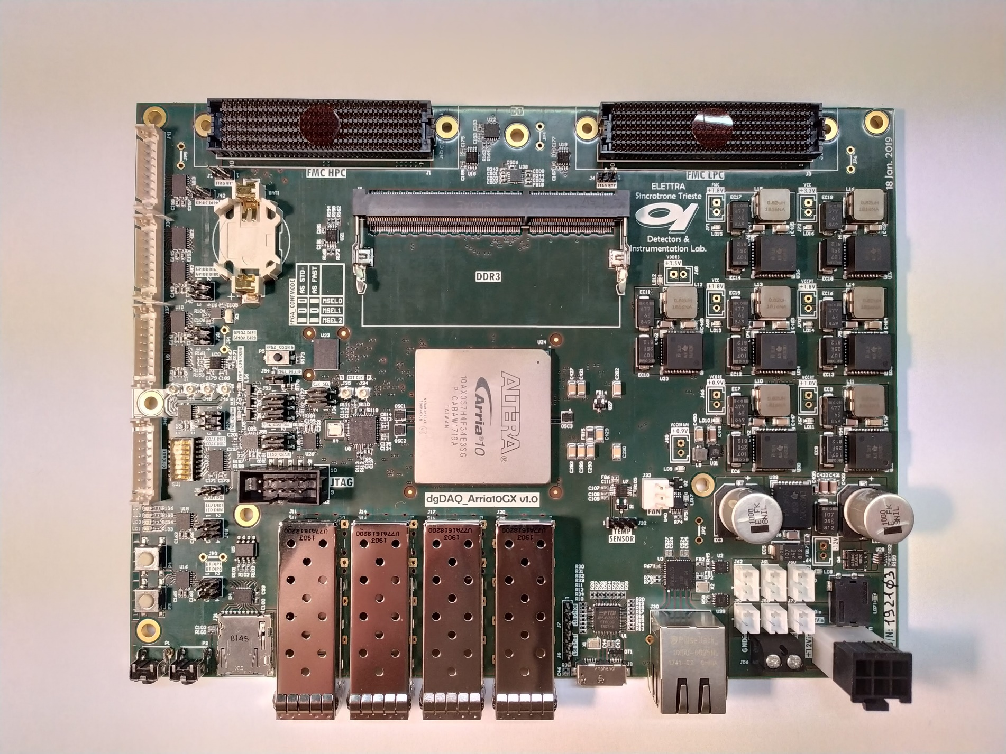
The New Digital Carrier Board: dgDAQ_Arria10GX

Slide 16
Design of the uTCA acquisition system using new dgDAQ_Arria10GX boards
x Σ
x Δ
y Σ
y Δ
FMC
4x ADC
Altera
FPGA
Digital
Carrier
Board
C-BPM
FrontEnd
Box
OptoCmd
Gigabit Ethernet Switch
FMC
4x ADC
Cal
x Σ
x Δ
y Σ
y Δ
Opto I/O
VME
CRATE
C-BPM
FrontEnd
Box
OptoCmd
Control System CPU
Cal
x Σ
x Δ
y Σ
y Δ
FMC
4x ADC
Altera
FPGA
Digital
Carrier
Board
C-BPM
FrontEnd
Box
OptoCmd
Event
System
FMC
4x DAC
TRIGGERS
Cal
Opto I/O

Slide 17
Advantages of Gigabit Ethernet Control System interface
The FPGA communicates with the Control System via UDP Gigabit Ethernet packets. The packet data structure is very simple but at the same time the protocol used is very robust and versatile.
BYTE 0 | BYTE 1 | BYTE 2 | BYTE 3 | BYTE 4 | BYTE 5 | NOTE
16 bit ADDRESS |  | 32 BIT DATA
0 |  | 0 |  |  |  | zero header used to tag the head of the data
1 |  | data |  |  |  | DATA sent/received. Any address in any sequence is allowed
2 |  | data
3 |  | data
4 |  | data
-------- |  | data
0xFFFF |  | data
Using this data structure is very useful for single pass machines. For example in Fermi CBPM the FPGA sends a single (jumbo) packet of 8KB containing the status registers and the 8 x 256 points 16 Bit Waveforms triggered with the injection.
The Control System receives these packets with a RealTime OS (Linux RTAI) and processes it for the whole machine in the RealTimeFeedbacks (‘Feedforwards’)

Slide 18
What we have now...
The Digital Carrier Board dgDAQ_Arria10GX is under debugging without showing (until now) particular problems and/or troubles.
We have already developed and tested FMC card with 4 ADC and relative low jitter timing
All of the firmware for the ADA and ADO was developed in house, so we have the complete source code and the knowledge to how to implement in a different hardware platform and different FPGA.

Slide 19
…and what we have to do…
Develop a new FMC card with 4 fast DACS with programmable reference level.
Modify the already developed 4x ADC FMC to manage low frequency (DC to 100MHz) inputs
Design the simple I/O to POF (Plastic Optic Fiber) adapter.
Fit the old FPGA firmware into the new FPGA.

Slide 20
Conclusions
The world of FPGAs and fast acquisition systems is plagued by component obsolescence which is much faster than the machines (Fel or Synchrotron) in which they are used.
In order to guarantee the long-term operation of the systems, certain precautions must be taken, such as the separation between systems through standard “communication media” that do not become obsolete in the short term.
For this reason, years ago we chose the GigaBit Ethernet which is an upgradable standard but always backwards compatible.
This choice will allow us to completely change the acquisition system, without having to change anything in the control software.
Moreover, the day that the VME that hosts the CPU of the control system will become unbearably obsolete, it can be replaced by a different type of CPU in any format without having to modify anything of the acquisition system.

Slide 22
Notes:
Last Slide 2: Aerial Photo of Elettra

Slide 23
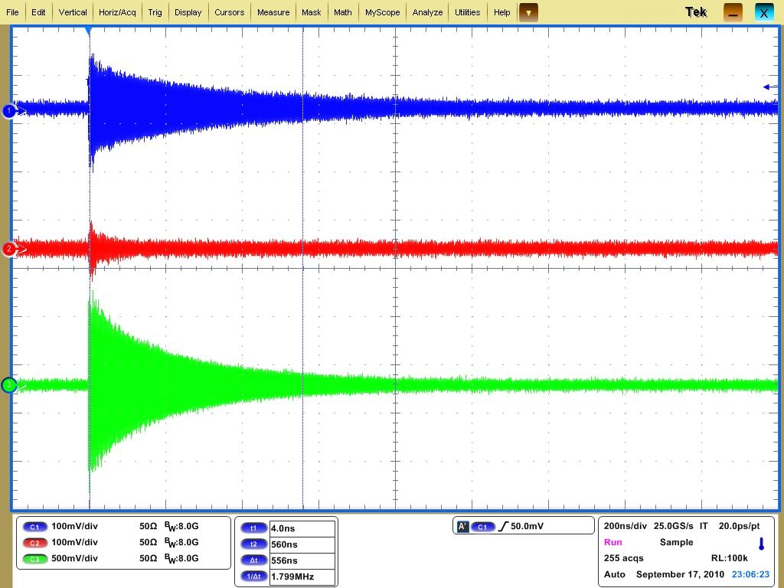
Spare Slide: measured signals from a CBPM with te real beam
OFF center dipole (hor)
Quasi IN center dipole (vert)
Monopole

Slide 24
Clipboard – for copy and paste
Text Box
Text Text Text
Text Text Text
Text Text Text
Text Box
Text Text Text
  Text Text Text
    Text Text Text
Text Box
Text Text Text
Text Text Text
Text Text Text
Text Box
Text Text Text
  Text Text Text
    Text Text Text
Rectangle
Text Text Text
Text Text Text
Text Text Text
Text Text Text
Rectangle
Text Text Text
  Text Text Text
    Text Text Text
Notes:
Clipboard Slide: working slide to be kept at the end of the presentation
Copy & paste an element from the Clip Board to the particular slide:
1. Click on a box to mark it.
2. Position the mouse pointer on the box frame: Copy!
3. Click on the particular slide: Paste!
How you intend to use the elements is your choice.
You can combine the text block style with the background colour in different manner.

