Slide 1
Improvements of Transverse and Longitudinal Beam Diagnostics in SACLA
H. Maesaka, S. Matsubara, T. Ohshima, T. Inagaki, T. Hara
RIKEN SPring-8 Center
Japan Synchrotron Radiataion Research Institute (JASRI)
June 5th, 2019

Slide 2
Outline
Introduction
  X-ray free-electron laser facility, SACLA
  Current problems
L-band transverse RF deflector cavity in the injector section
  Brief introduction and typical results
Improvements of transverse profile monitor
  Mitigation of coherent OTR
  Beam test results
Summary

Slide 3
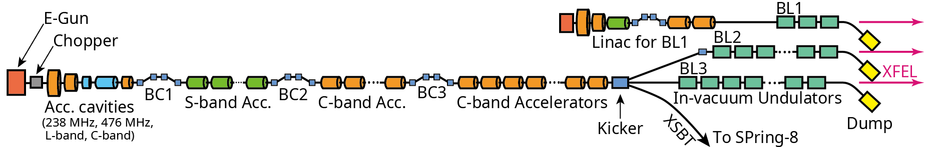
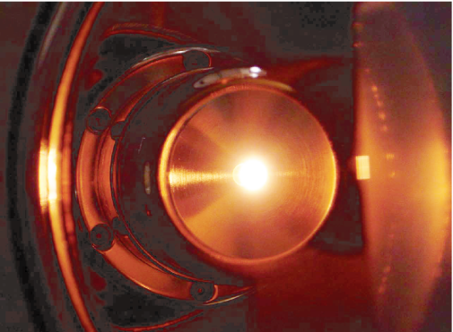
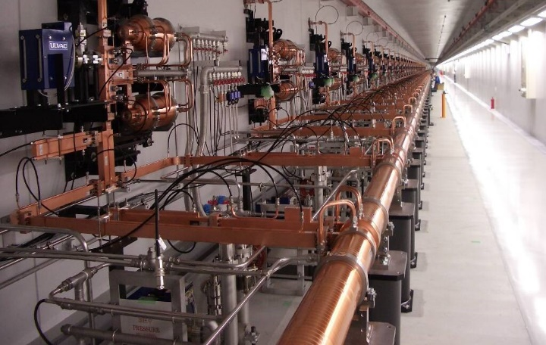
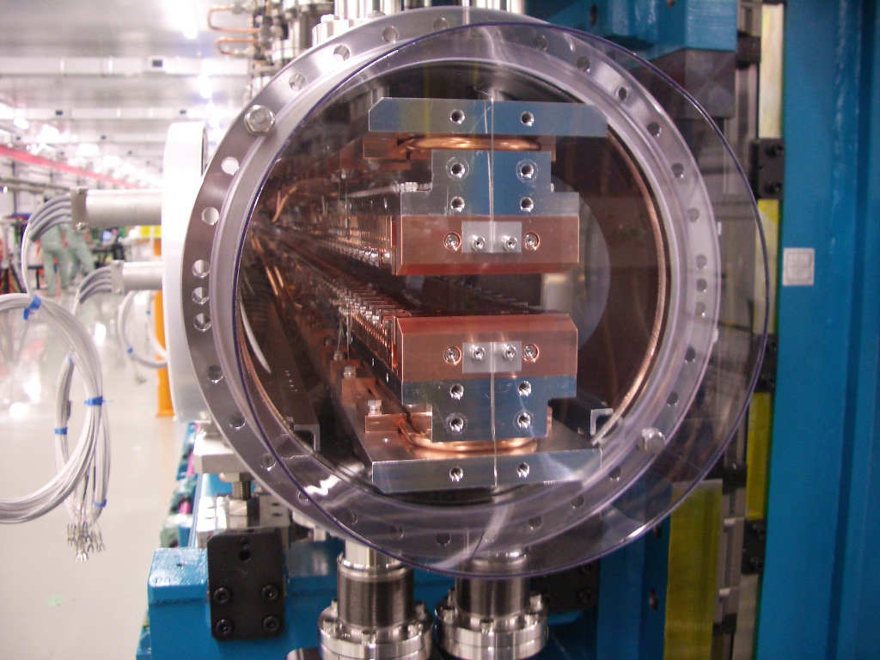

XFEL facility “SACLA”
0.8 GeV max.
~0.1 keV Soft XFEL
8 GeV max.
~10 keV XFEL
500 kV thermionic gun
C-band high-gradient accelerators
In-vacuum undulators
βγε ~ 1 mm mrad
> 35 MV/m
$$λ_{u}:18 mm$$
BL2: 6.85 GeV, 5.5 keV
BL3: 7.8 GeV, 12.7 keV
XFEL
XFEL

Slide 4
Current problems
Bunch compression condition is hard to be reproduced after the replacement of the gun cathode.
  We had only one transverse deflector cavity (TCAV) to monitor a longitudinal bunch profile after BC3.
    C-band TCAV after BC3 is essential to the tuning of BC2 and BC3.
    A new TCAV was needed for tuning of velocity bunching and BC1.
  We installed a L-band TCAV (1428 MHz) to the velocity bunching section.
Transverse profile monitors did not work properly due to coherent OTR (optical transition radiation).
  Transvers profile monitors are necessary for the emittance measurement and the envelop matching in the undulator section.
  A short-bunch beam ( < ~ 100 fs) generates intense coherent OTR.
  We tried several mitigation schemes of COTR.

Slide 5
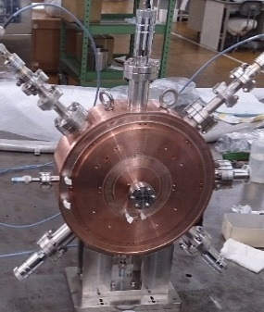
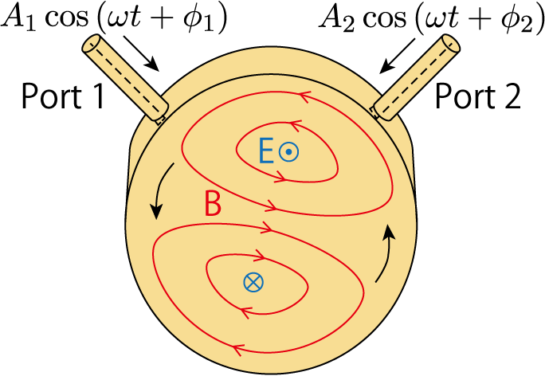
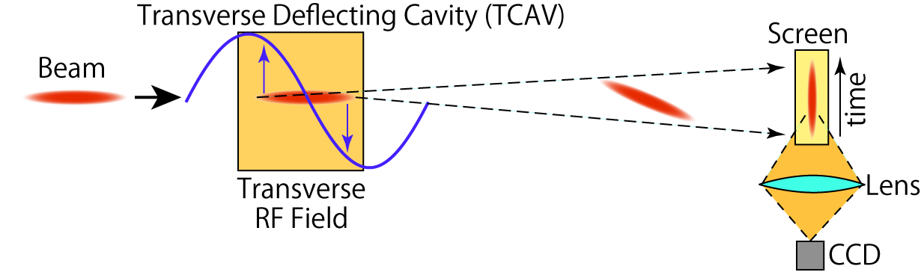
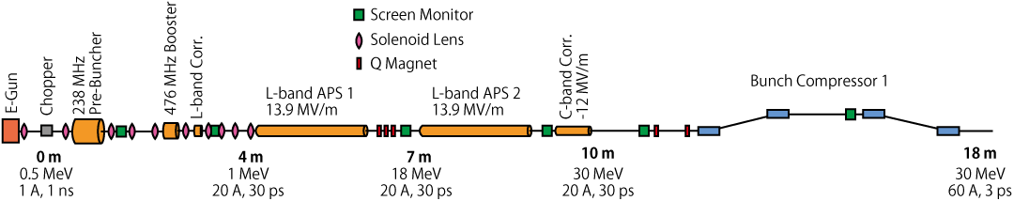
L-band transverse deflector
Polarization control is need.
  Longitudinal magnetic field in a solenoid lens rotates the stretched image.
Two input ports intersecting with a right angle can generate arbitrary polarization.
Port 1
Port 2
Place for L-band
TCAV
Velocity
bunching

Slide 6
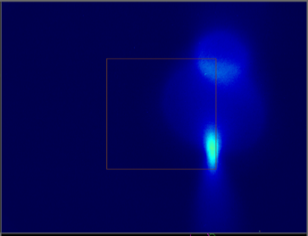
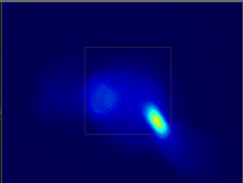
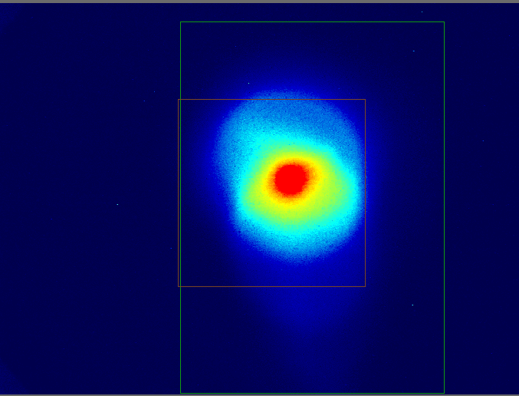
Temporal Profiles (linear polarization)
Vertical sweep
Horizontal sweep
Lasing part
No sweep
Over focus
Lasing part
100 ps
Over focus
100 ps
Polarization was adjusted to obtain vertical or horizontal sweep on the screen.
Position-to-time coefficient: 0.07 mm/ps
Temporal resolution: ~ 10 ps
Large chromatic aberration exists due to a large energy chirp.
These images are still useful to reproduce the longitudinal profile in the velocity bunching section.

Slide 7
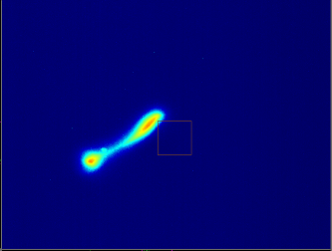
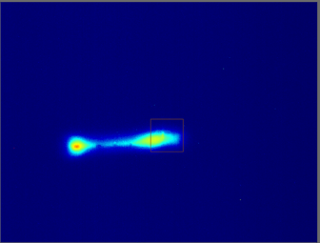
Energy v.s. time phase-space (BC1)
Vertical sweep
No sweep
Head
High E
Low E
High E
Low E
Tail
E-T phase-space profile was appropriately obtained at the dispersive section of BC1.
L-band TCAV
Screen

Slide 8
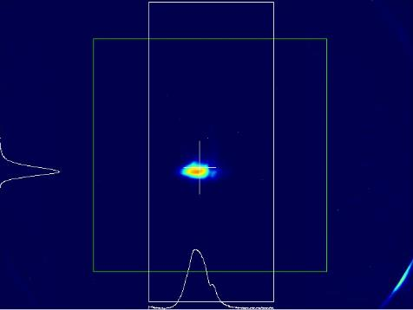
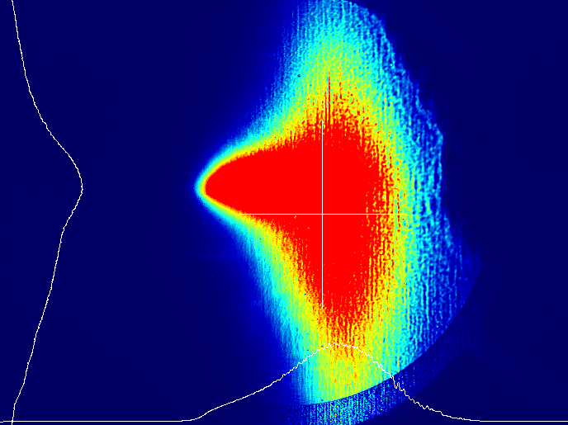
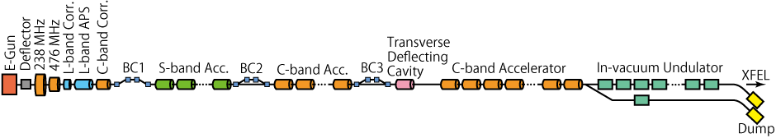
Coherent OTR problem
OTR (optical transition radiation) profile monitors after BC3 did not work due to coherent OTR (COTR) problem.
Short-bunch (<100fs) beam produced intense COTR.
OTR
Target: stainless-steel mirror
Intense COTR

Slide 9
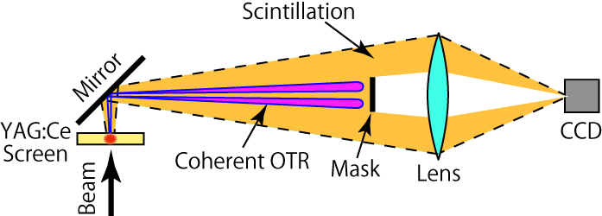
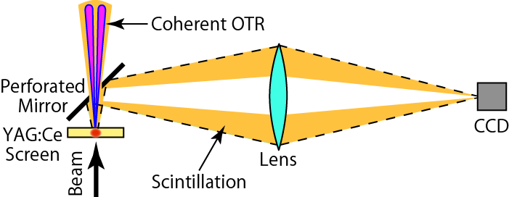
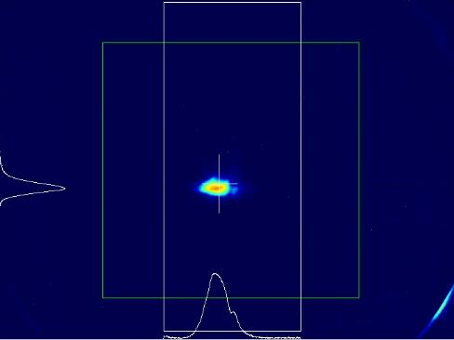
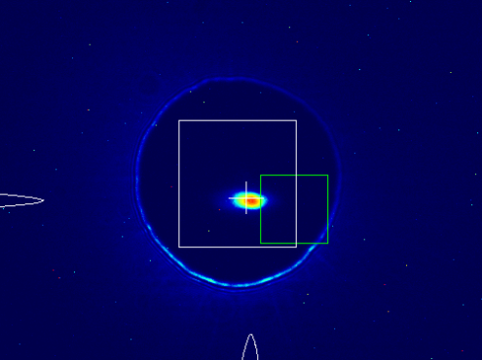
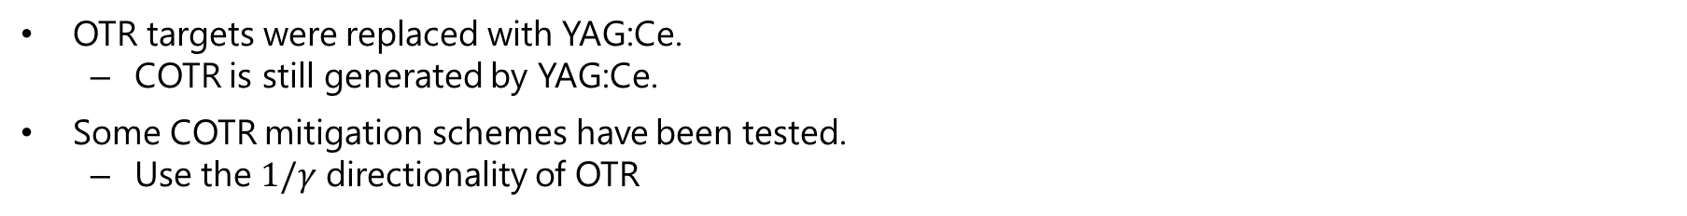
COTR mitigation schemes
OTR targets were replaced with YAG:Ce.
  COTR is still generated by YAG:Ce.
Some COTR mitigation schemes have been tested.
  Use the $1/γ$ directionality of OTR
H. Maesaka et al., IBIC’12, MOIC02.
S. Matsubara et al., IBIC’12, MOCC04.
Y. Otake et al., PRAB 16, 042802 (2013).
Mask scheme
Perforated mirror scheme
φ3mm
^{t}0.1mm
^{t}0.1mm
YAG:Ce with COTR mask
YAG:Ce with Perforated Mirror
5 mm
Scattered light from hole edge
5 mm
3 mm

Slide 10
PSI scheme
R. Ischebeck et al., PRAB 18, 082802 (2015).
Some profile monitors based on PSI scheme were installed in 2017.
Shaft φ 62mm
Mirror
Ce:YAG
COTR axis
Scintillation light axis

Slide 11
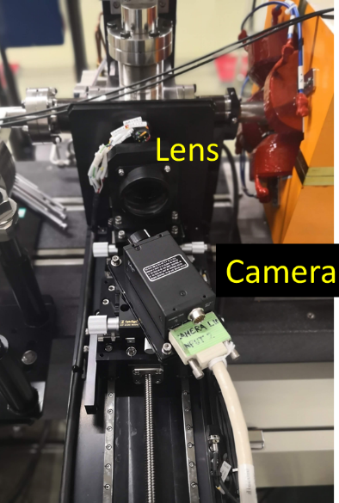
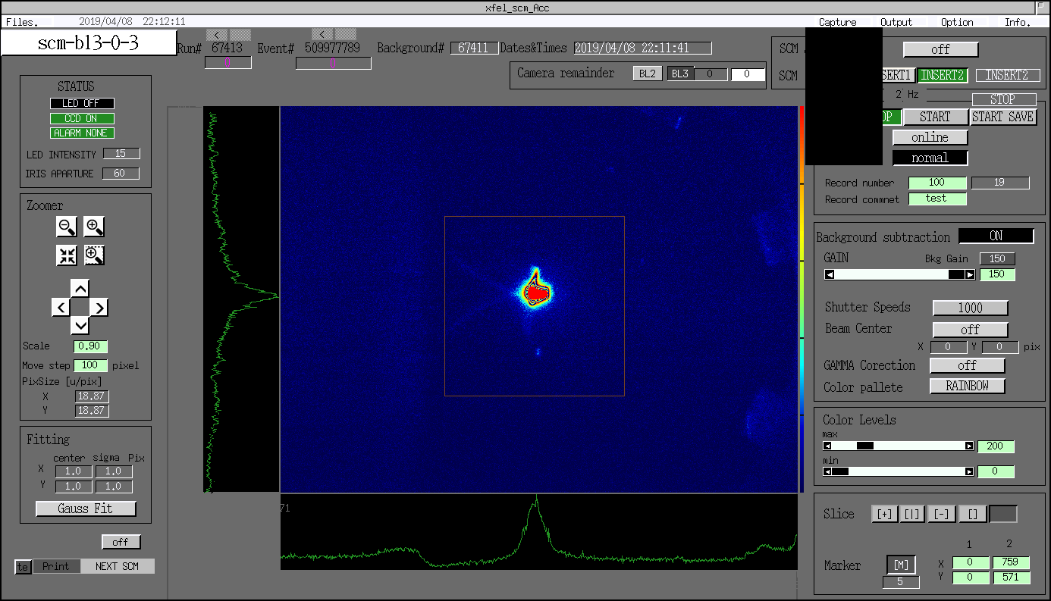
Imaging system for PSI scheme
Horizontal linear stage
Rotation stage
Rotation stage
Lens
Camera
・ Rotation stages for the lens and camera are necessary to correct aberration.

Slide 12
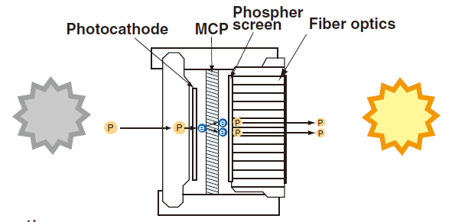
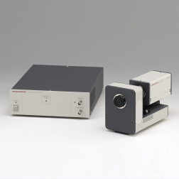
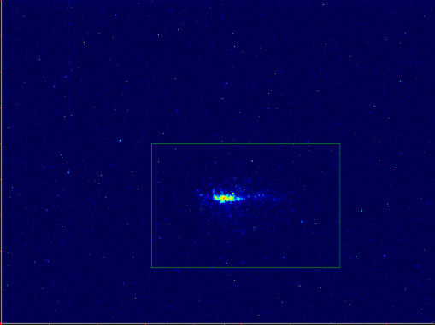
Fast gate scheme
Fluorescence of YAG:Ce
Fluorescence lifetime of YAG:Ce is about 50 ns.
COTR is prompt radiation.
COTR can be temporally discriminated from YAG scintillation.
We installed a fast gate camera to one of the profile monitors.
Fast gate camera
Hamamatsu C11370
Gate time: 5 ns –

Slide 13
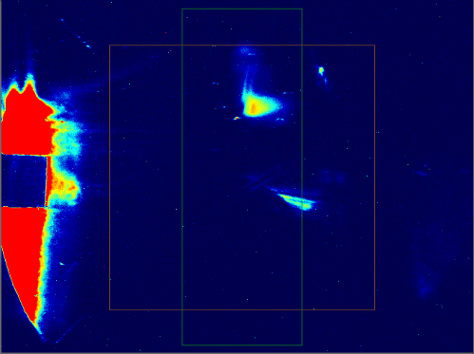
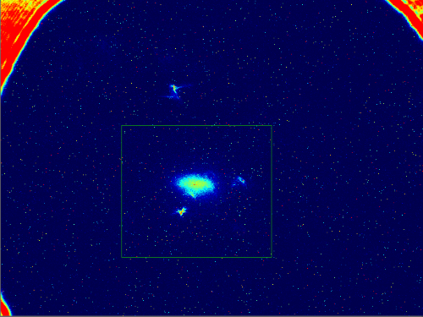
Profile monitor images
Mask scheme
Perforated mirror scheme
COTR
Hot spots due to imperfections
COTR
Beam
Beam
PSI scheme
Fast gate scheme
COTR
COTR

Slide 14
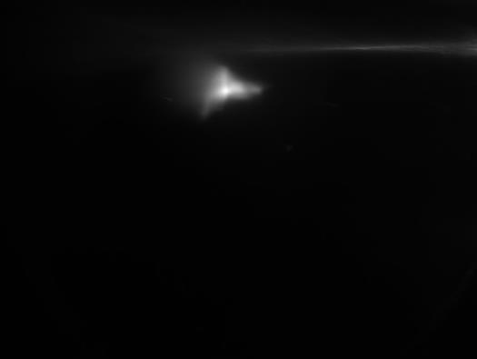
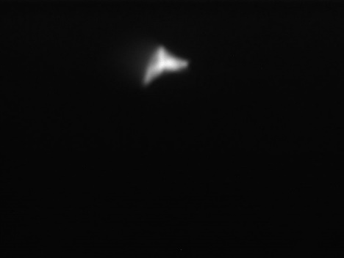
Timing shift of normal cameras
Timing jitter of the camera system is about 100 ns.
We can get beam profiles without COTR by adjusting the camera trigger timing just after COTR.
Geometrical COTR mitigation scheme is still needed.
  General imaging device may be damaged by intense COTR.
Since the image intensity changes shot-to-shot due to the timing jitter, software normalization is necessary.
PSI scheme
Timing Adjustment
COTR
Beam
COTR disappeared

Slide 15
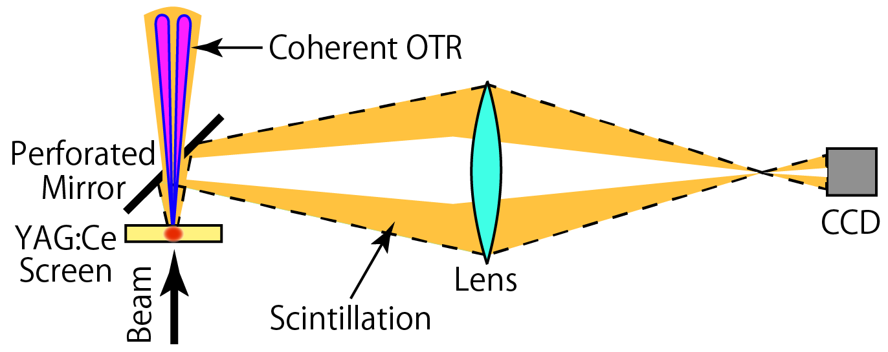
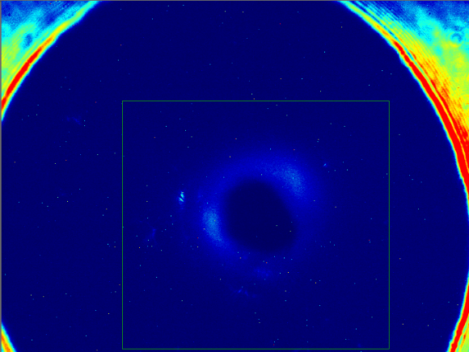
Known problems
Mask scheme
  Intense stray COTR light is observed around the beam image.
  Bothersome mask adjustments are needed.
Perforated mirror scheme
  Shadow of the mirror hole can appear if the image is out of focus.
  Stray COTR light still exists.
PSI scheme
  Stray COTR light still exists.
Fast gate scheme
  Expensive.
  Image intensifier has poor resolution.
    a few 10 µm
Timing shift of the normal camera
  Software normalization is needed.
Out of focus

Slide 16
Comparison of COTR mitigation schemes
Geometrical COTR mitigation schemes
 | COTR separation | Tuning | Cost
COTR mask | Acceptable | Difficult | Reasonable
Perforated mirror | Good | Easy | Reasonable
PSI scheme | Very good | Moderate | Expensive a little
Temporal COTR mitigation schemes
 | COTR separation | Resolution | Tuning | Jitter | Cost
Fast gate camera | Very good | Bad | Easy | Good | Expensive
Timing shift of a normal camera* | Good | Good | Easy | Moderate | Free
*: Geometrical COTR mitigation scheme must be used together to protect the camera from the intense COTR.
We employed the timing shift of normal camera combined with geometrical schemes (perforated mirror and PSI scheme) for most of our profile monitors.

Slide 17
Summary
Transverse and longitudinal profile monitors are important for the XFEL facility SACLA.
L-band TCAV
  We designed a L-band TCAV and installed it to the velocity bunching section.
  Temporal profile and energy v.s. time phase-space distribution were successfully obtained.
Transverse profile monitors suffered COTR problems.
  We tried several geometrical COTR reduction methods.
  Mask, perforated mirrors and PSI scheme
  Timing shift of the camera trigger worked well.
Now, the COTR problem was almost solved by the combination of the geometrical COTR reduction and the timing shift of the camera trigger.

