Slide 2
SR Simulation Software
The Synchrotron Radiation (SR) is strongly used by the be beam
diagnostics community to perform deferent type of measurements
(emittance, position, energy, power load...)
It is useful to simulate SR generation,
propagation, and absorption.
X-ray Oriented Program (XOP)
SHADOW/SHADOWOUI
Synchrotron Radiation Workshop (SRW)
...
Several type of software, not
compatible, difficult
languages, almost no
documentation...
A nightmare!

Slide 3

Oasys
“The implemented software architecture allows to obtain not only an intuitive and very-easy-to-use graphical interface, but also provides high flexibility and rapidity for interactive simulations, allowing to make quick configuration changes to compare multiple beamline configurations” *
Manuel Sanchez del Rio (ESRF) and
Luca Rebuffi (APS)
Graphical environment for optical (and more) simulation:
Python based
Module adds-on
Communicating packages
* https://www.aps.anl.gov/Science/Scientific-Software/OASYS

Slide 4
oasys
Graphical User Interface available for Windows, Linux, macOs
Worfry: Simple optical wavefront (plane, spherical, Gaussian) propagation tool
Shadow: Ray tracing simulations + Hybrid: to introduce diffraction (quick and dirty)
SRW: Generation and optical propagation of SR wavefront
XOPY: Generation and transmission/absorption of SR spectra
Use Python library →
Possibility to obtain the
code and run scripts!

Slide 5
Example - Common Source Generation
Possibility to create and save different source, common for all the different software, by defining lattice characteristics and beam parameters

Slide 6
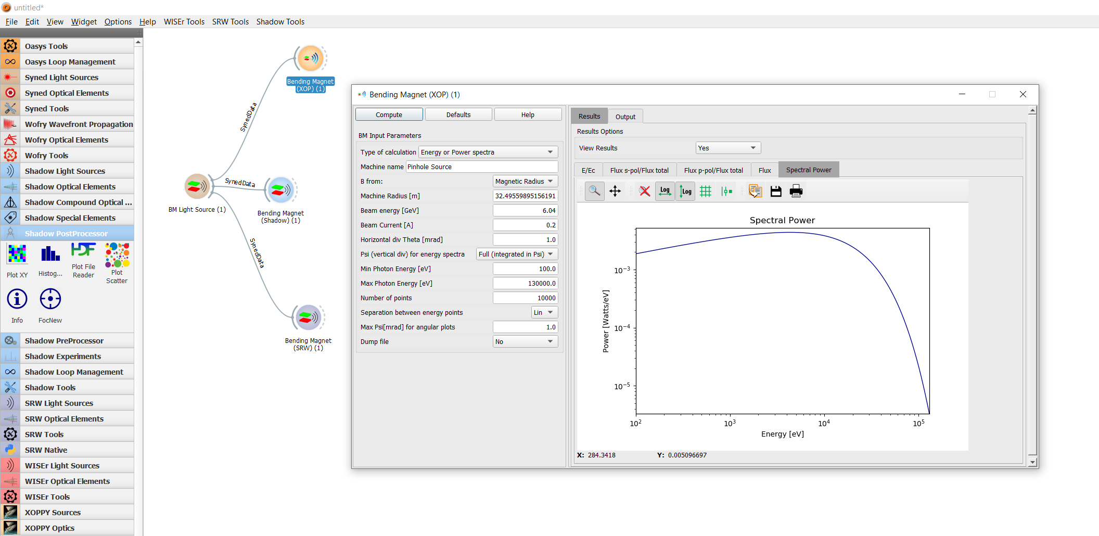
Example - Source Generation - XOP
XOP → Generation of the SR spectra

Slide 7
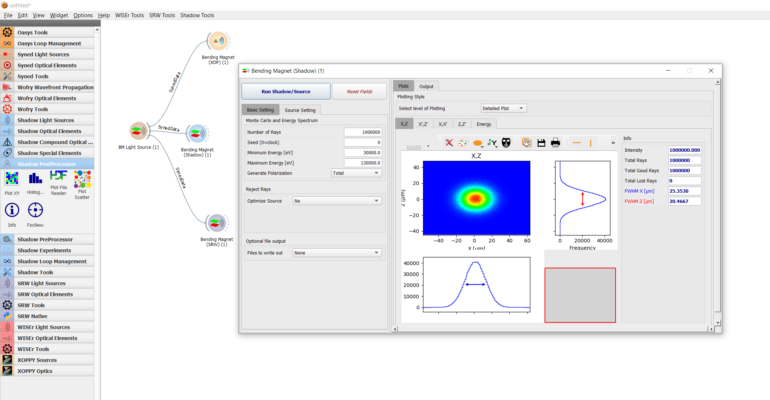
Example - Source Generation - shadow
SHADOW → Random generation of a given number of rays with an energy distributed according to the SR spectra

Slide 8
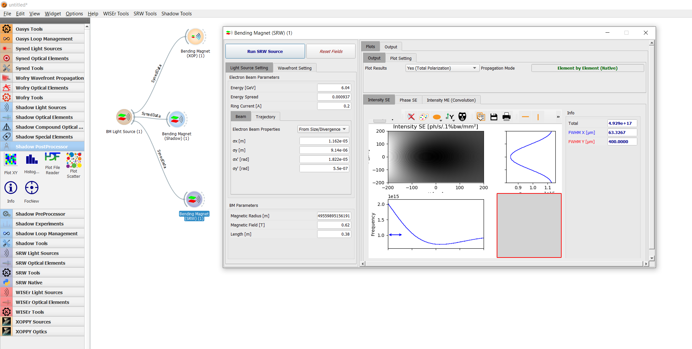
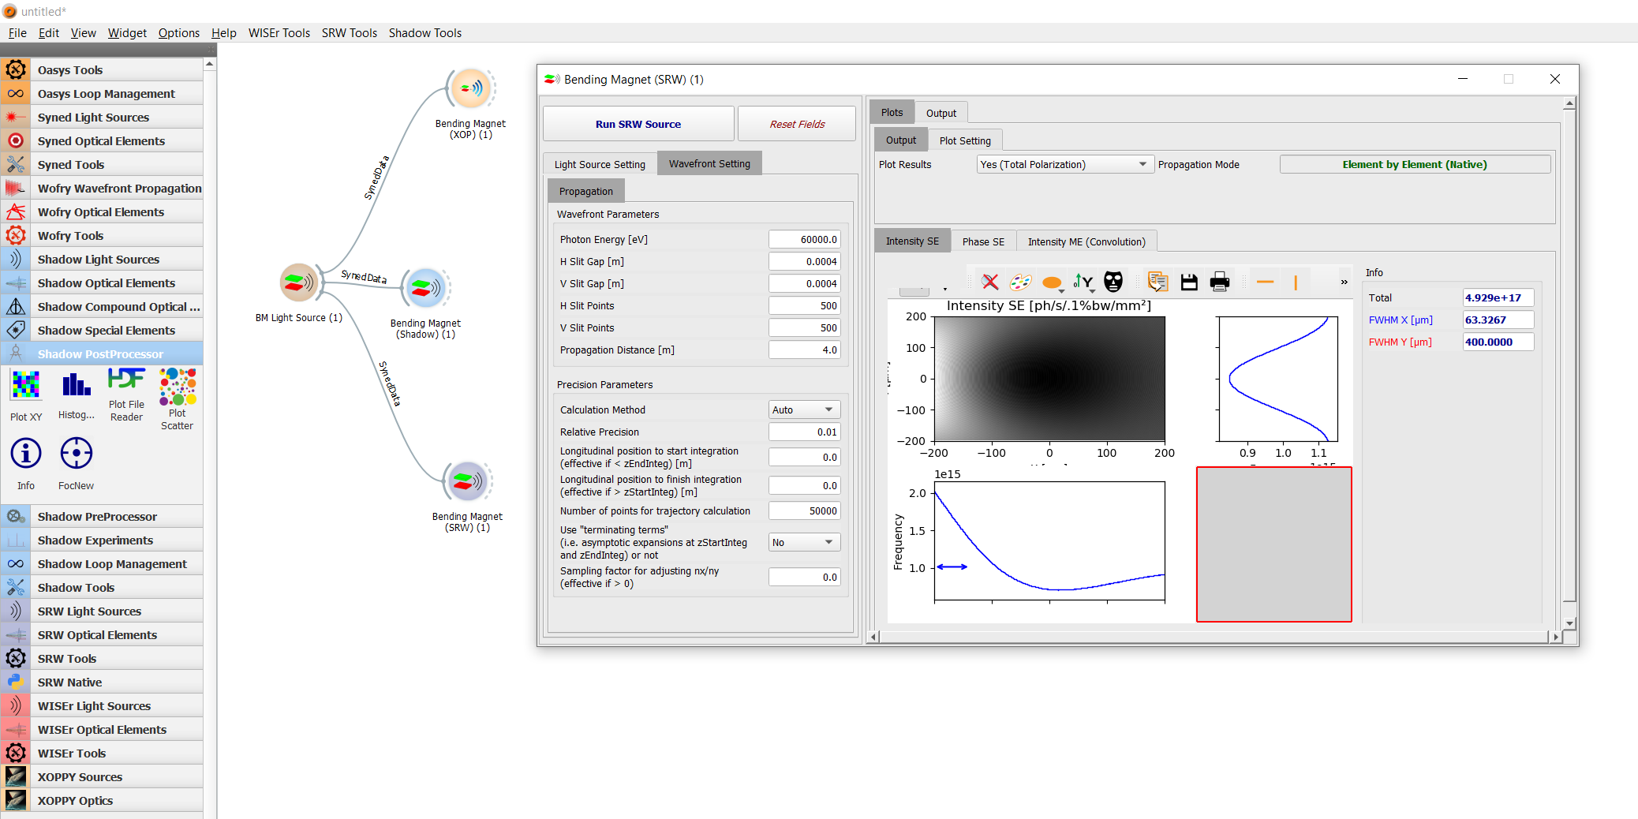
Example - Source Generation - SRW
SRW → Generation of the SR wavefront at a given energy and a given position

Slide 9
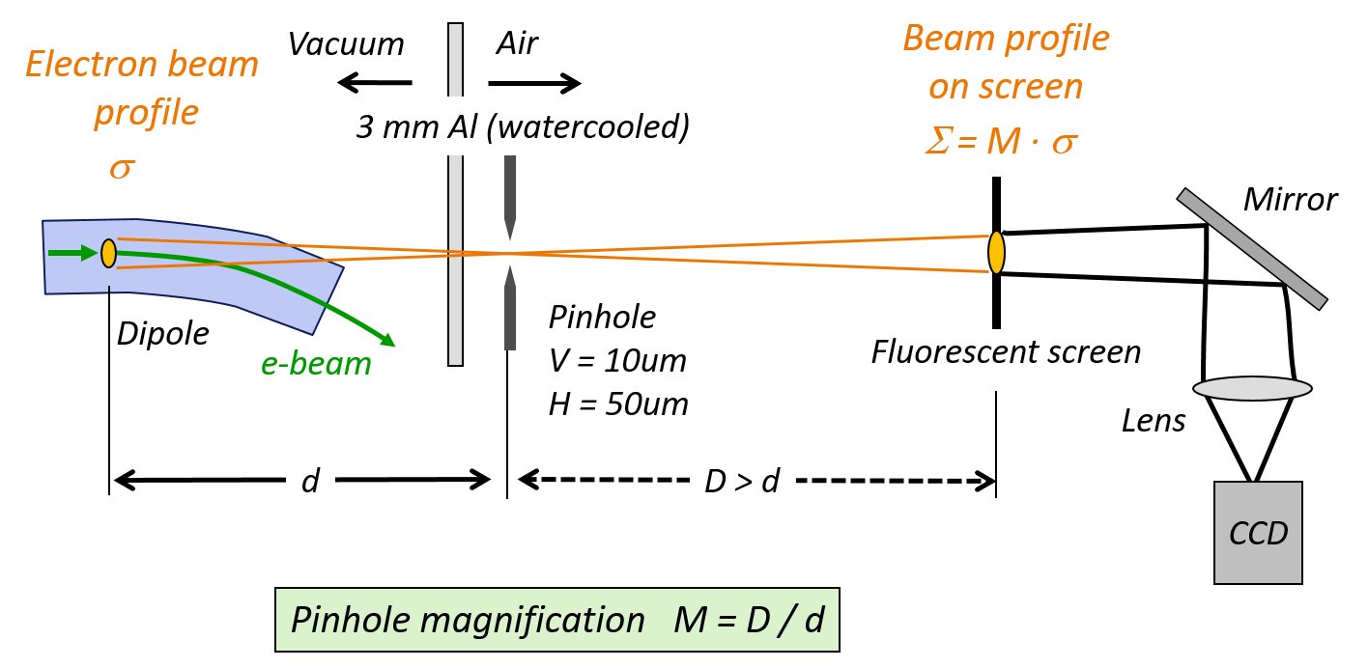
The pinhole
F. Ewald, "Beam Size Monitoring at the ESRF: Comparison of different
X-ray based techniques"
Topical Workshop on Emittance Measurements for Light Sources and
FELs, Barcelona, 29-30 Jenuary 2018

Slide 10
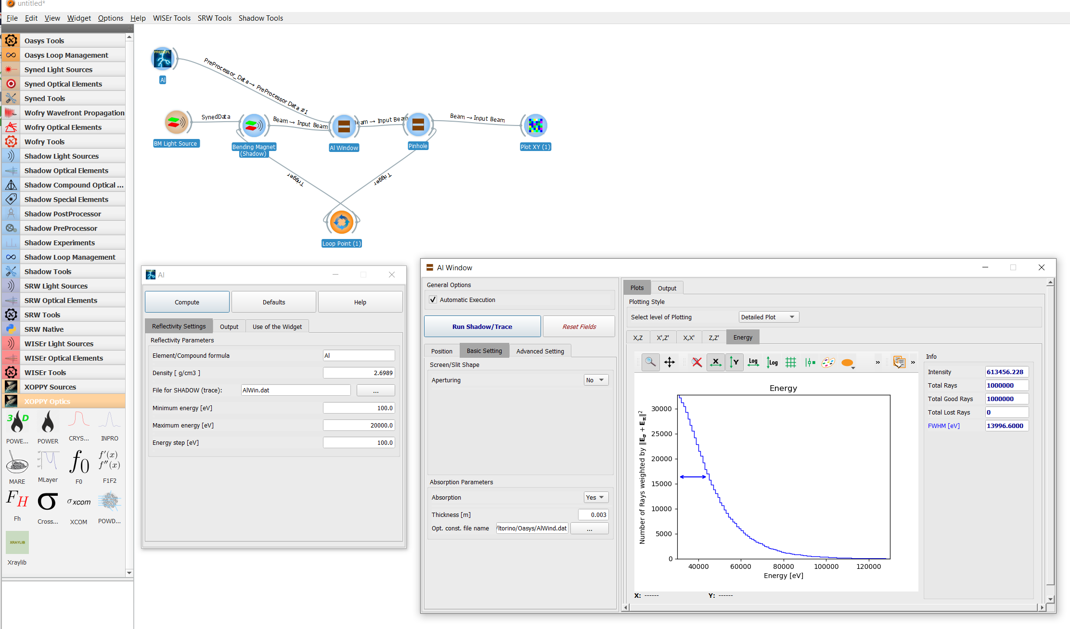
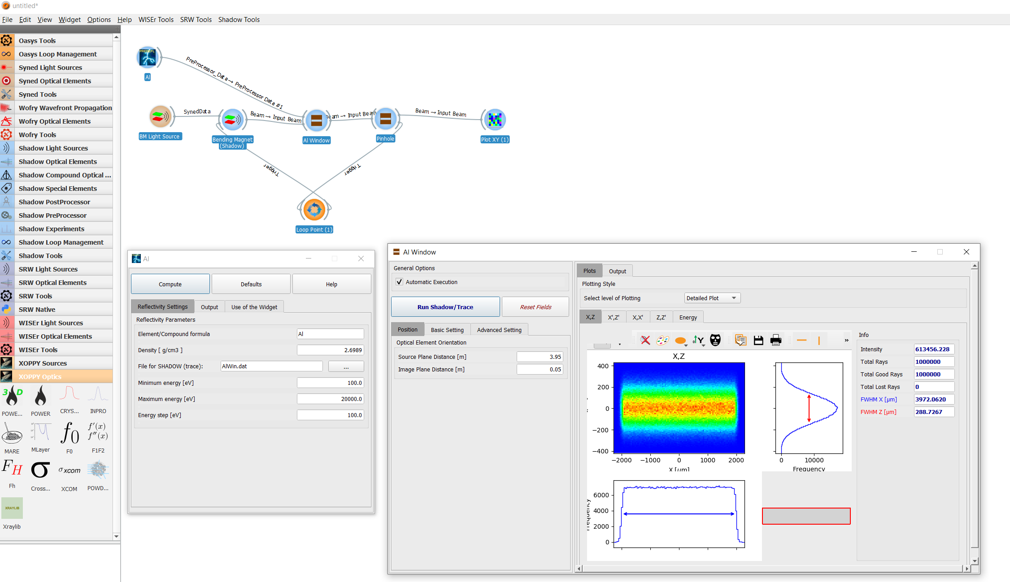
Example - Pinhole - Shadow
Beam after the Al window.
→ Possibility to study the path of the survived x-rays by adding filters

Slide 11
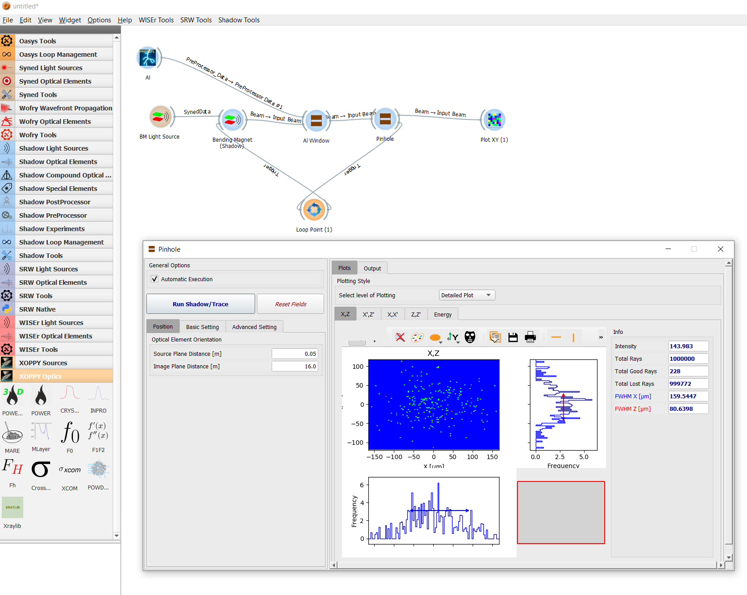
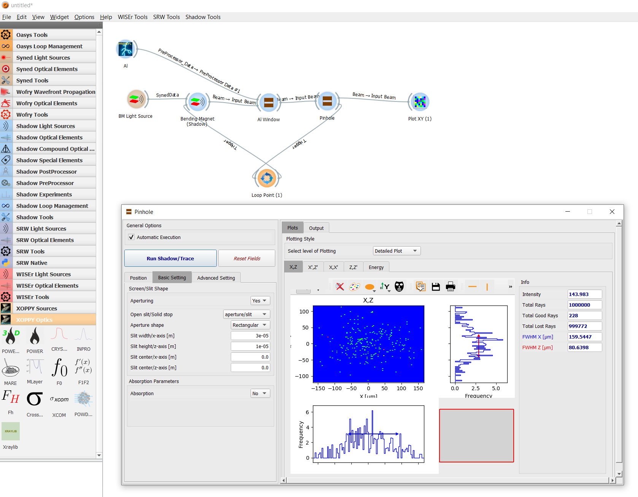
Example - Pinhole - Shadow
Possibility of defining slits or obstacles and to propagate the x-rays
Computation might be heavy depending on the number of rays
→ Possibility to define a loop and iterate the source generation

Slide 12
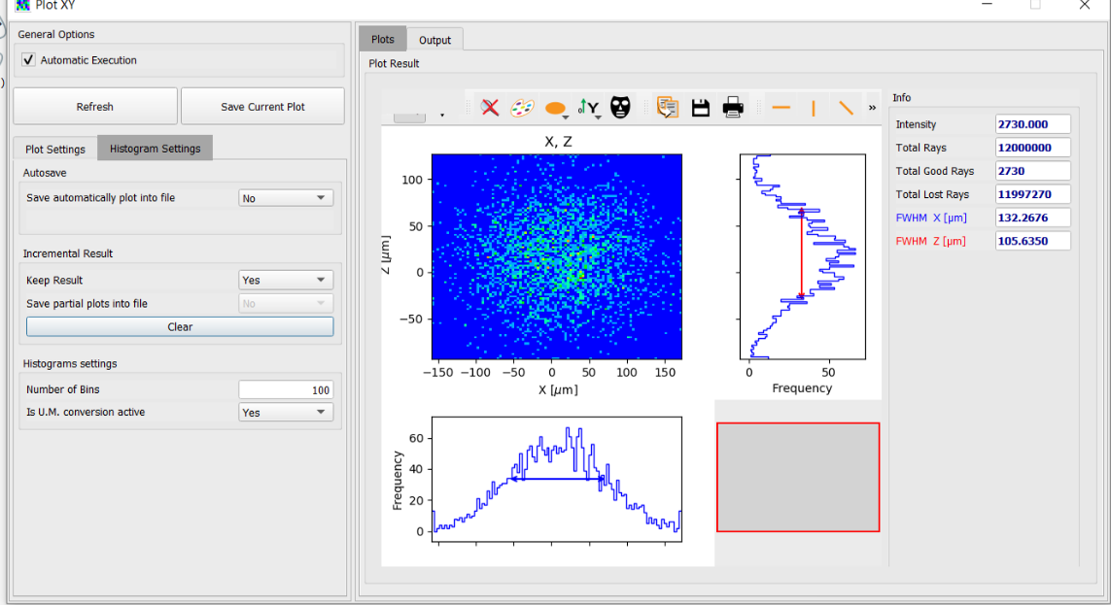
Example - Pinhole - Shadow
Possibility to retrieve the python script and run it into a cluster!
NOTE: Very heavy for the computer!

Slide 13
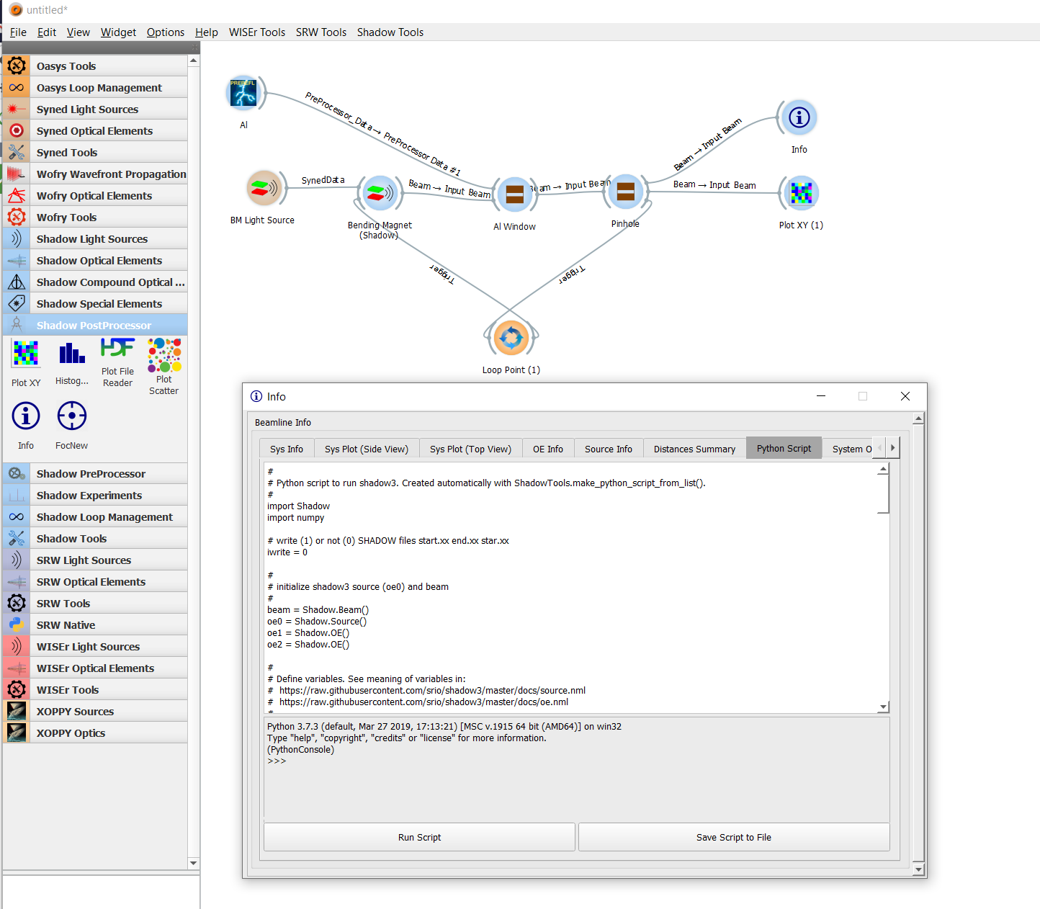
Example - Pinhole - Shadow
On the “Info” buttons it is possible to find several info on the simulation and the Python script!

Slide 14
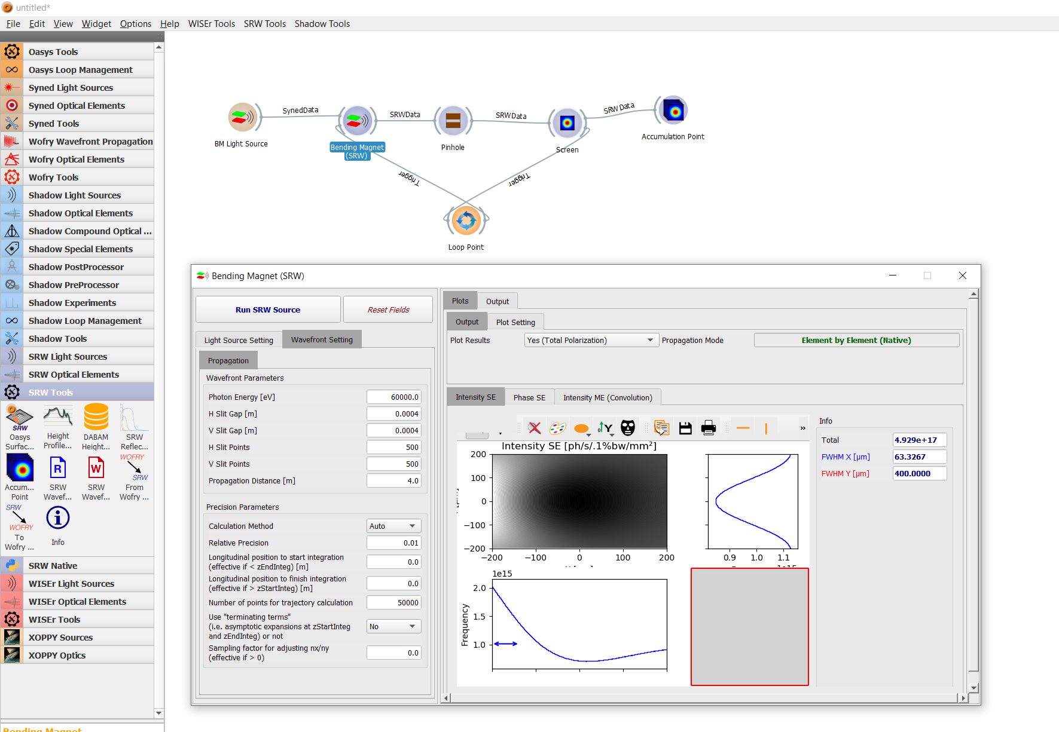
Example - Pinhole - srw
Generation of the source until the first slit (just before the pinhole)

Slide 15
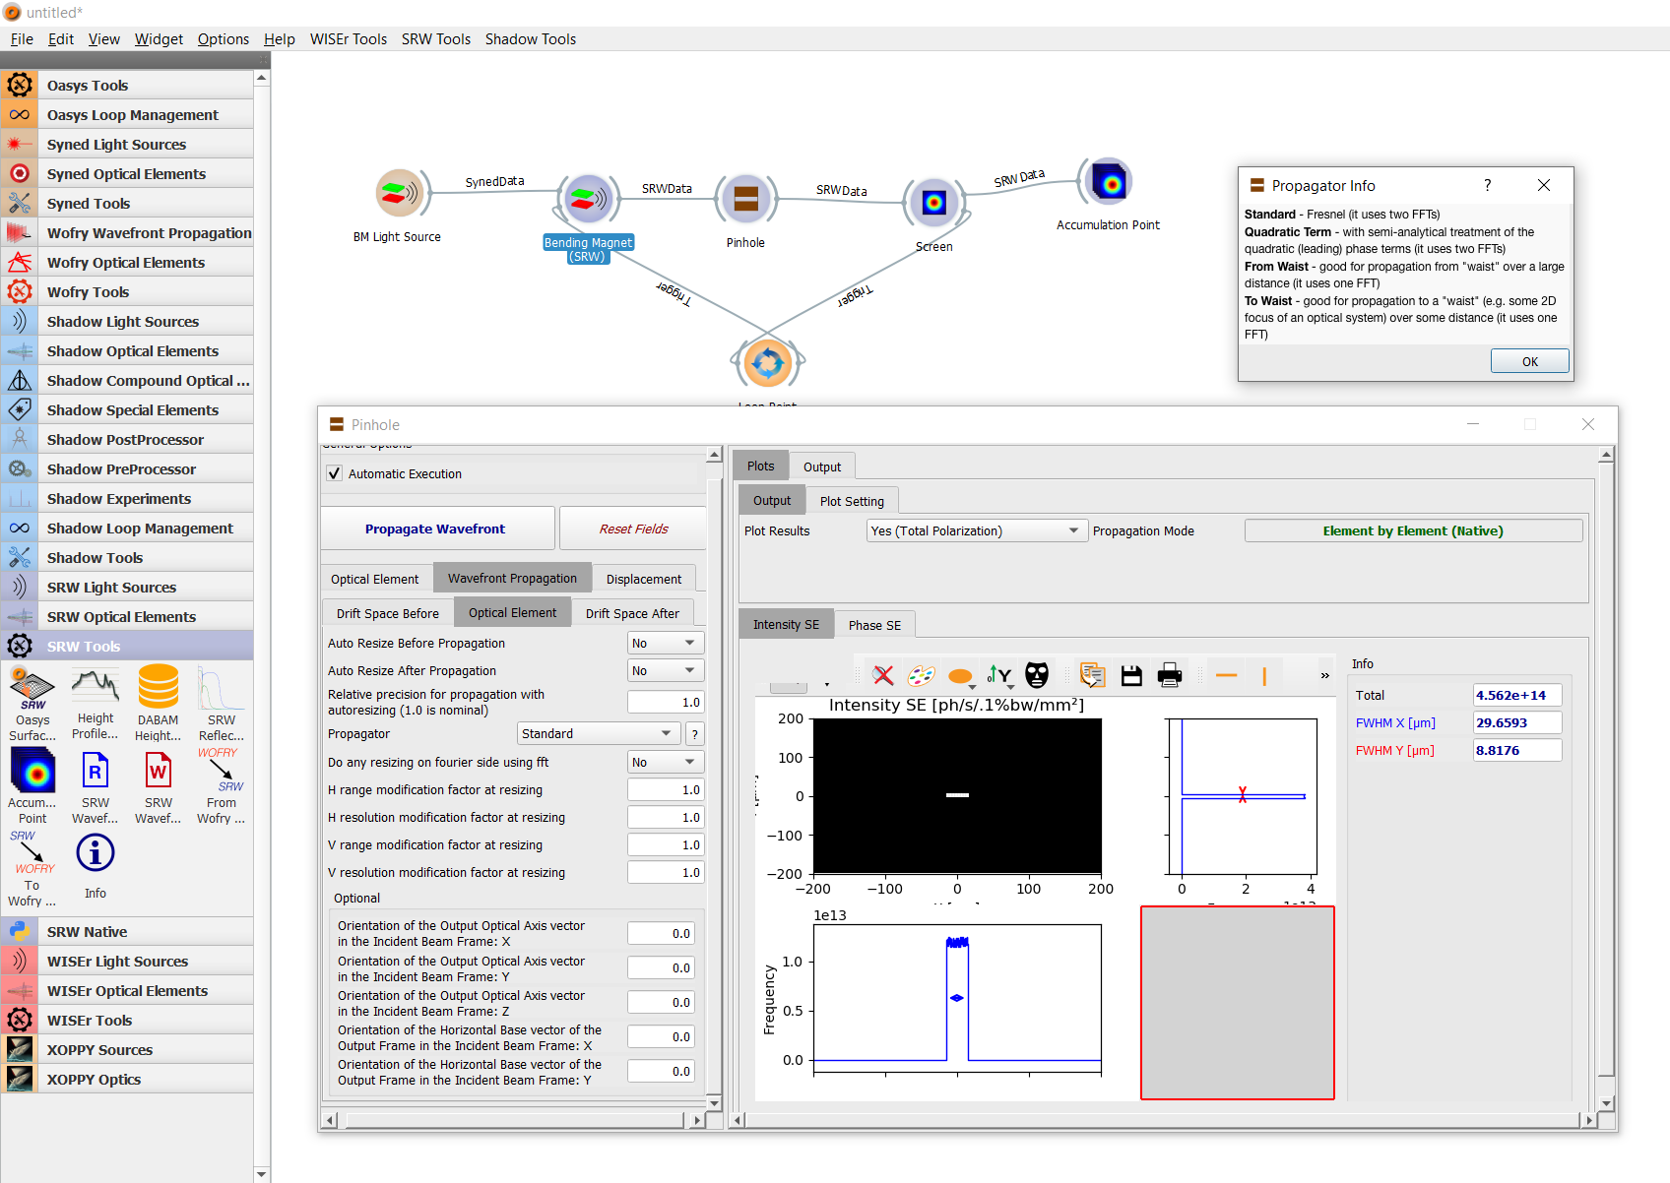
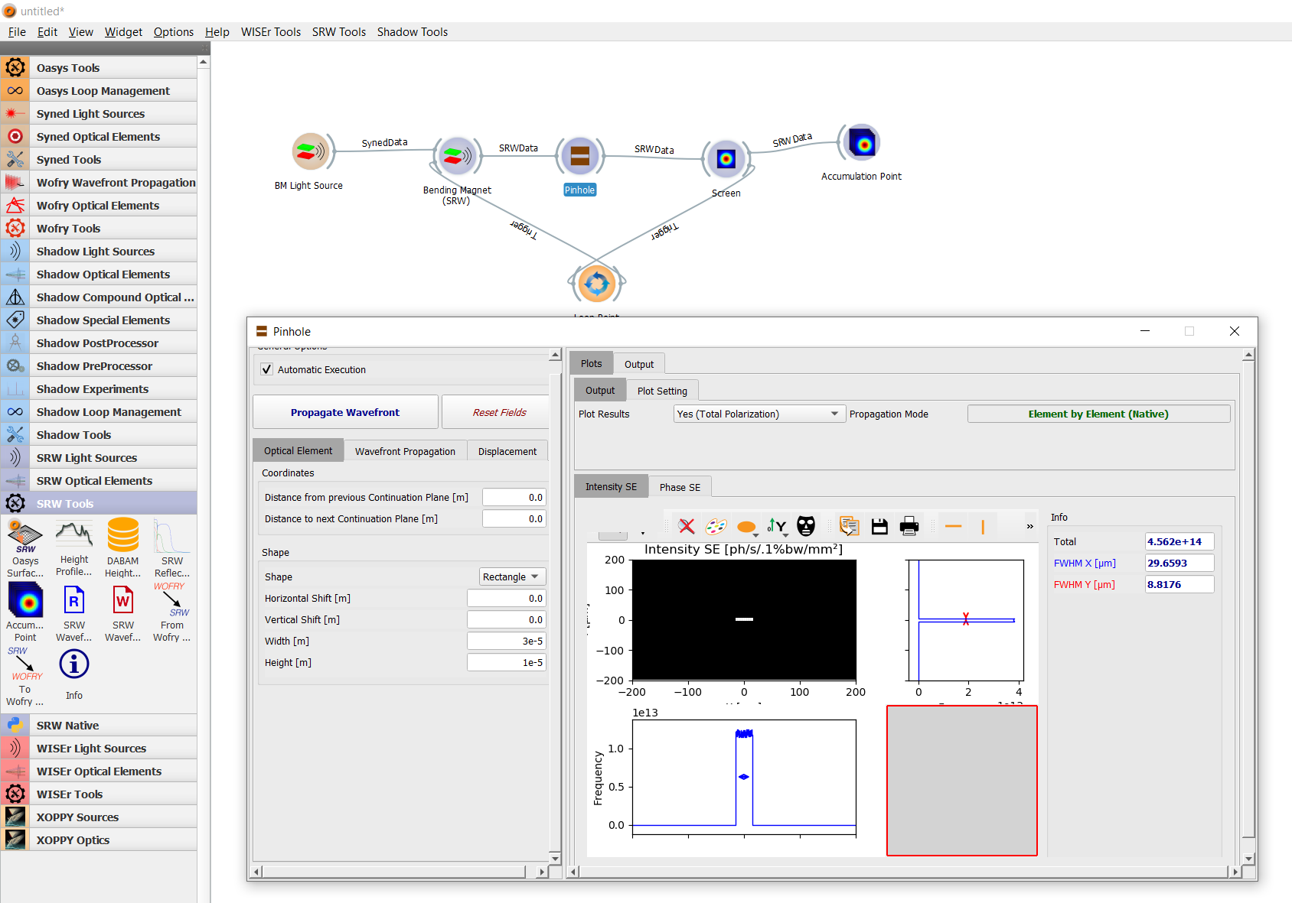
Example - Pinhole - srw
Slit (pinhole)
No needs of definition of “containers”!

Slide 16
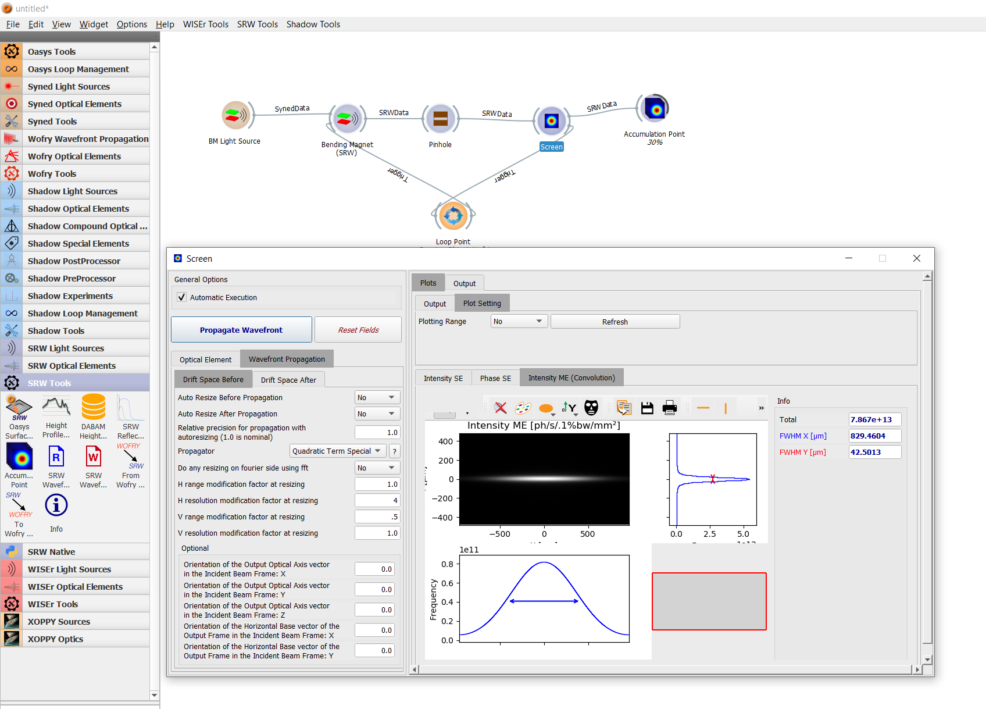
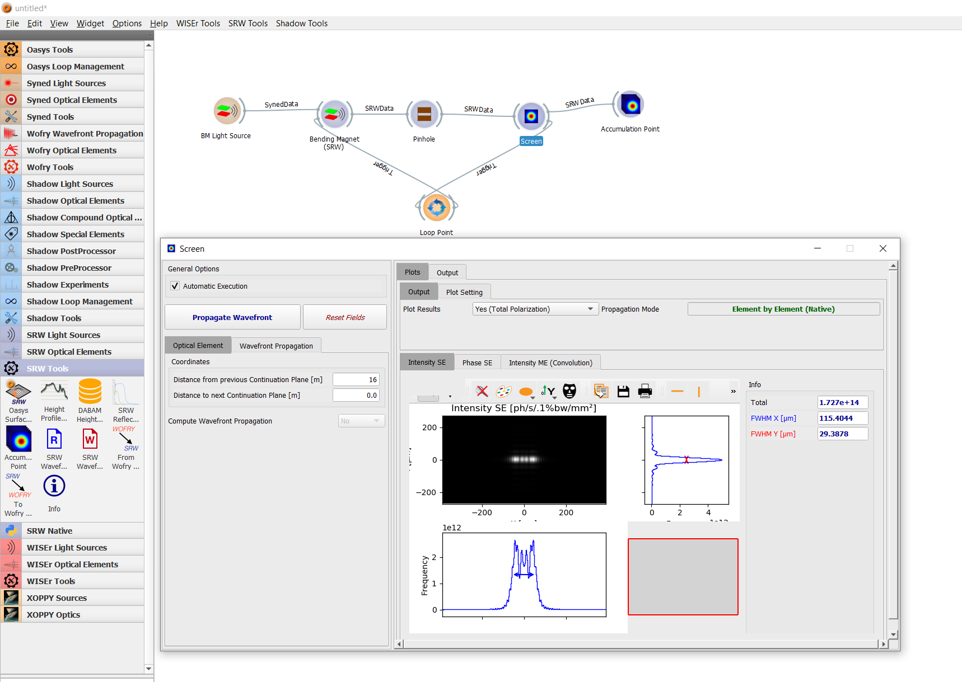
Example - Pinhole - srw
Multi-Electron with convolution → Not correct, just to an idea!
Single electron
Possibility of loops sampling the single electron starting position from the phase space (slow)…

Slide 17
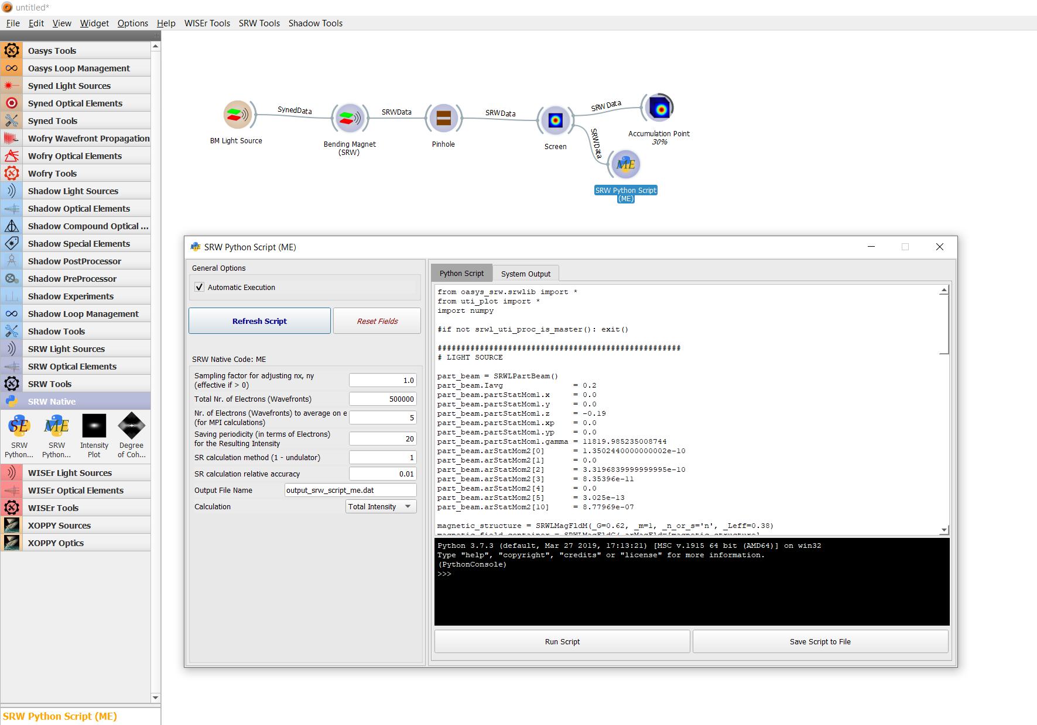
Example - Pinhole - srw
Provides python script for native Multi-Electron simulation → Can be manipulated and launched on a cluster!

Slide 18
Overview and references
OASYS is an intuitive SR generation and propagation software:
Allows to perform quick simulations step by step
Useful to “align” and optimize the main parameter
Computationally heavy but provides Python scripts which might be modified and run in a cluster (after all the optimization has been done!)
You can find the software and the installation how-to in:
https://github.com/oasys-kit
The material for the First OASYS School, with some extremely useful slides and several examples can be found in:
https://github.com/oasys-kit/oasys_school
A second OASYS school is foreseen soon (in the US…)
Many thanks to M. Sanchez del Rio, R. Celestre, J. Reyes (ESRF),
L. Rebuffi (APS)

