Slide 1
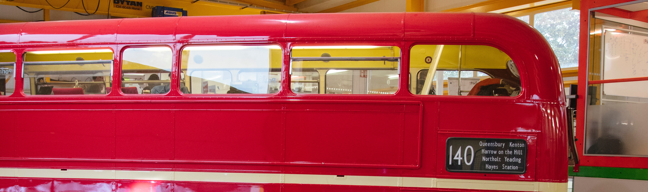
Hackathons, workshops and other events
Jani Kalasniemi
Prototyping Viking @ Ideasquare, CERN

Slide 2
Activities in total @ Ideasquare
Year Total
2017 100
2018 154
2019 109

Slide 3
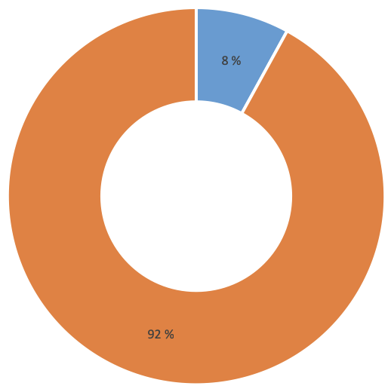
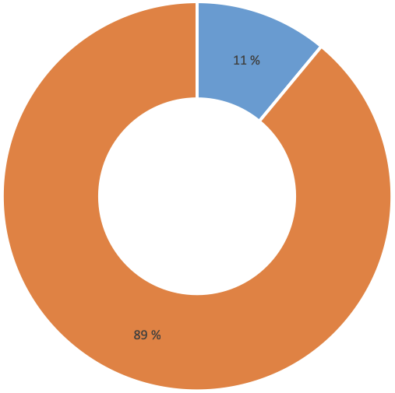
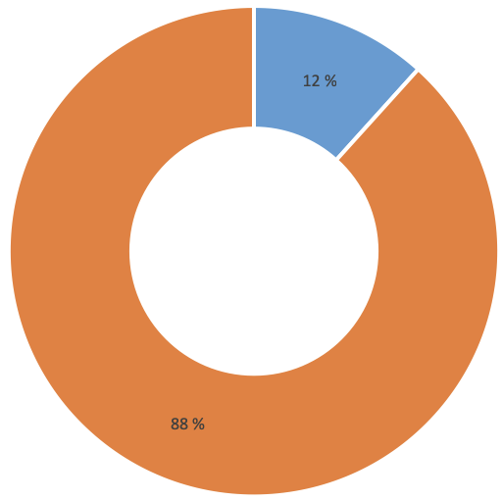
Open vs. CERN internal
2017
2019
2018

Slide 4
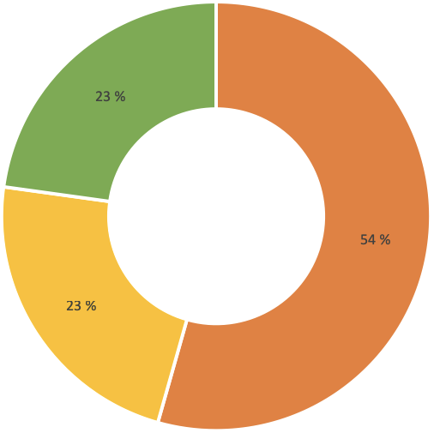
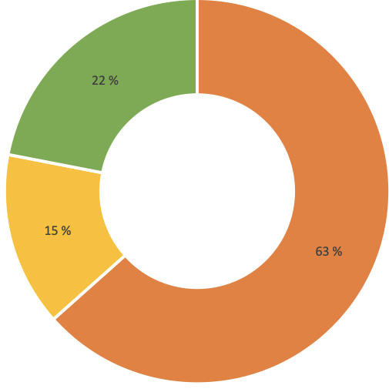
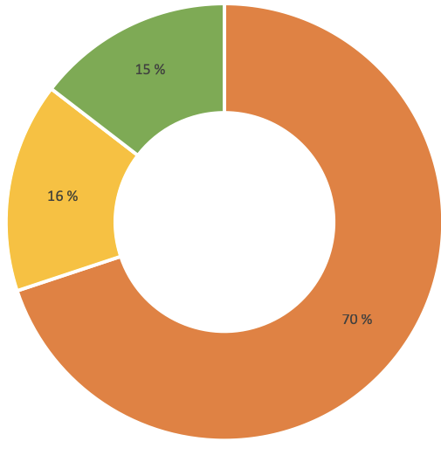
1-2 days, 3-4 days or 5+ days
2017
2019
2018

Slide 5
Hackathons @ Ideasquare
Ideasquare is helping the hackathon organizers but usually not responsible for the event. This means that the hackathons have a lot of variety in the topics and themes. This also increases serendipity. CERN internal hackathons are usually project related hackathons (for example LCHb hackathon). The Port is the oldest hackathon organizer at Ideasquare.
An average hackathon is 3 days long (2017 & 2018: 3 days, 2019: 4 days)

Slide 6
Hackathons @ Ideasquare
Year Total
2017 13
2018 14
2019 12

Slide 7
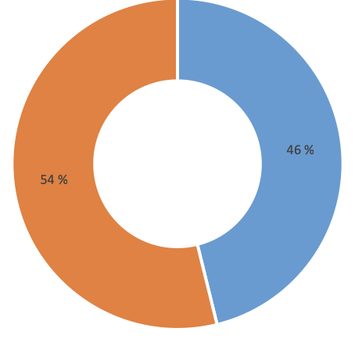
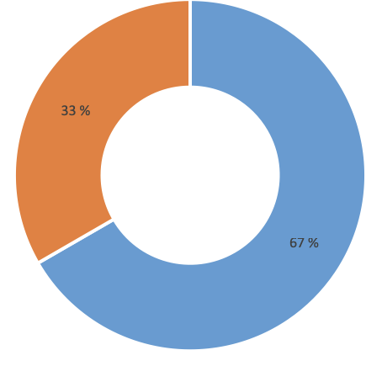
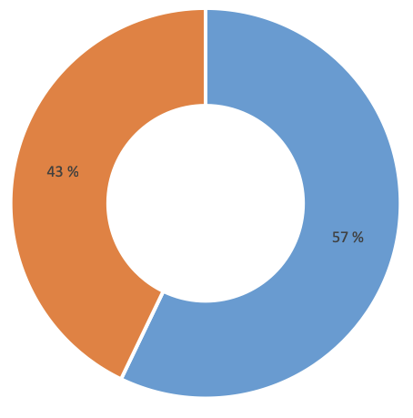
Open vs. CERN internal
2017
2019
2018

Slide 8
Workshops and Events @ Ideasquare
Workshops and events held at Ideasquare differ greatly and are everything from few hours to 3 days long. Topics and themes vary from programming to building and from cooking to finding new solutions to everyday problems. Most of the topics are somehow related to sharing experiences.
No need for advertising: normally 3 requests per week to use Ideasquare spaces.

Slide 10
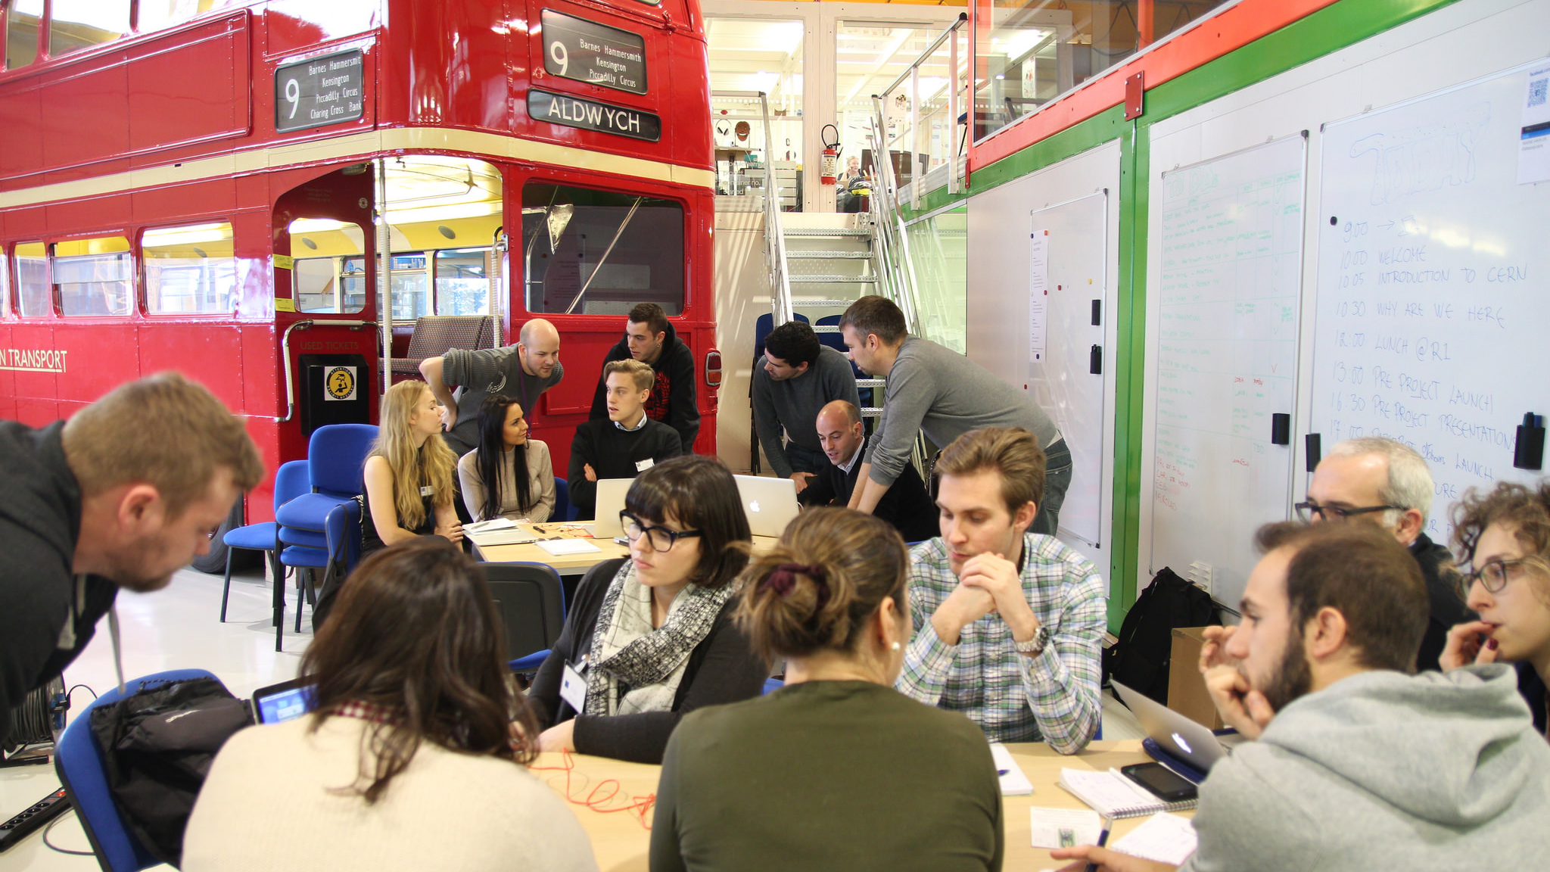
Ideasquare hands-on workshops
Mechatronics
One day workshop teaching the basics on how to use Arduino IDE together with Teensy microcontroller. After the basic introduction each group will design and build their own tangible game with LEDs and buttons as the user interface.

Slide 11
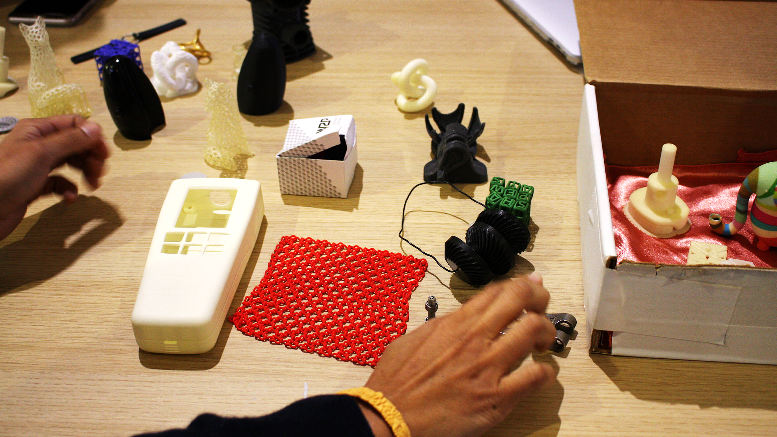
Ideasquare hands-on workshops
3D printing
Two day workshop to teach participants basics of 3D modeling and 3D printing. Introduction to different 3D printing methods and techniques with tangible examples. During the course participants model their own 3D printable part and see it transform from virtual to reality. This year planning to have also shorter one day workshops with the focus on teaching only how to use a 3D printer.

Slide 12


Questions? Comments? Ideas?
Contact information:
jani.kalasniemi@cern.ch
+41 75 411 41 01

