Slide 1
Location of the electrical substation at P5: Noise impacts
Laurent Tavian, ATS-DO
16 January 2019

Slide 2
Content
Location proposals
Study cases with different noise protection system
Results and impact on ZERs
Conclusion
Based on DbVib Consulting report
CVI06718_AINDU_CMI_RA03

Slide 3
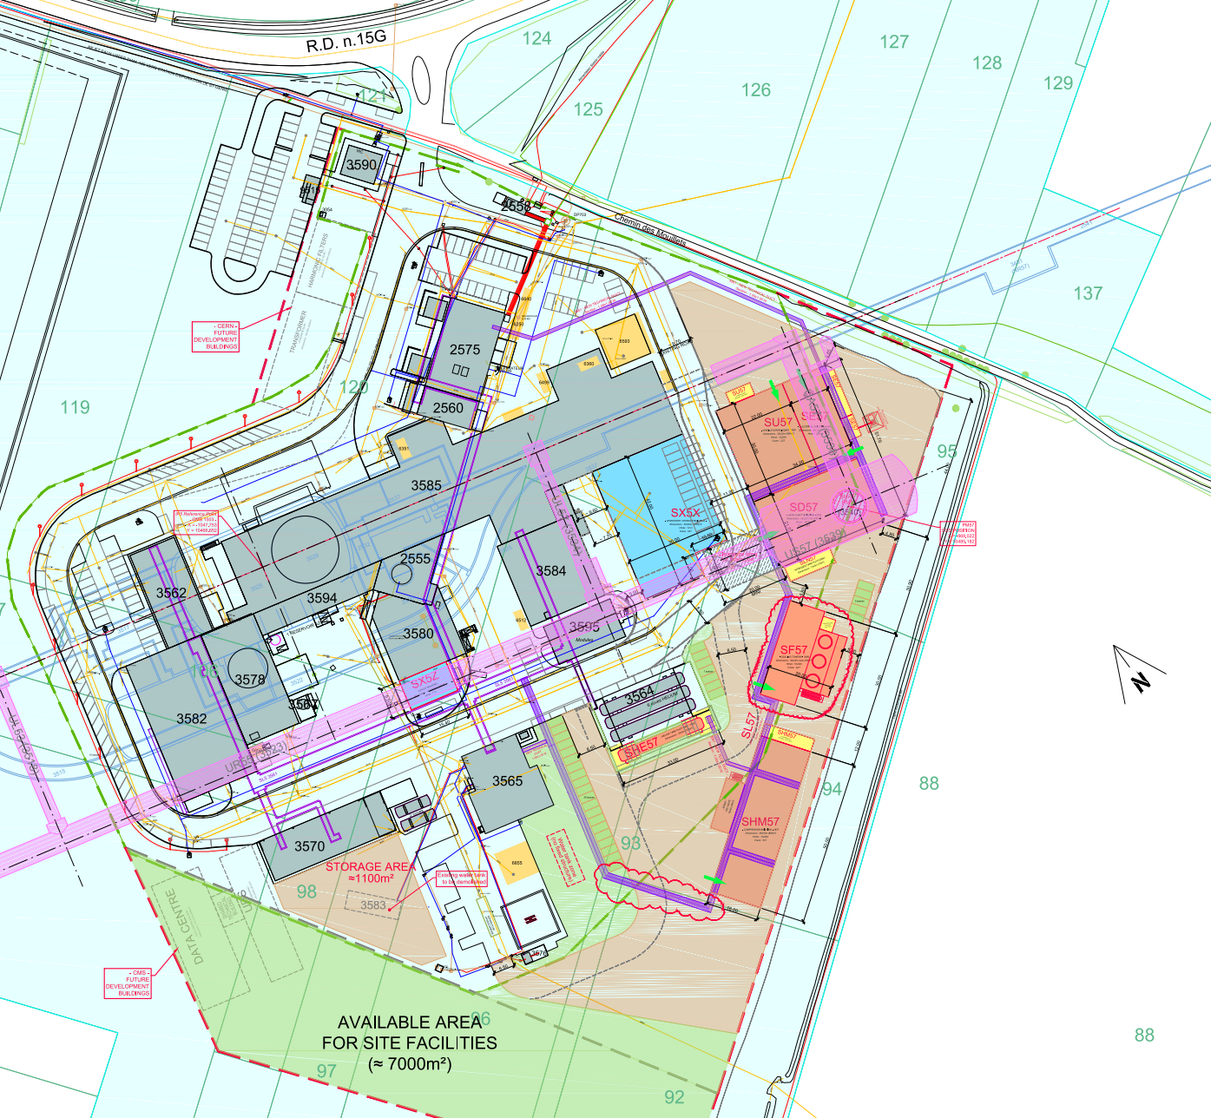
Location of the electrical sub-station
Present location (North)
(Identified as future works in the HL building permit)
Cessy
New proposed location (South):
Minor impact on the 66-kV line but longer 18-kV line to reach the B2575 (existing P5 SE building)

Slide 4
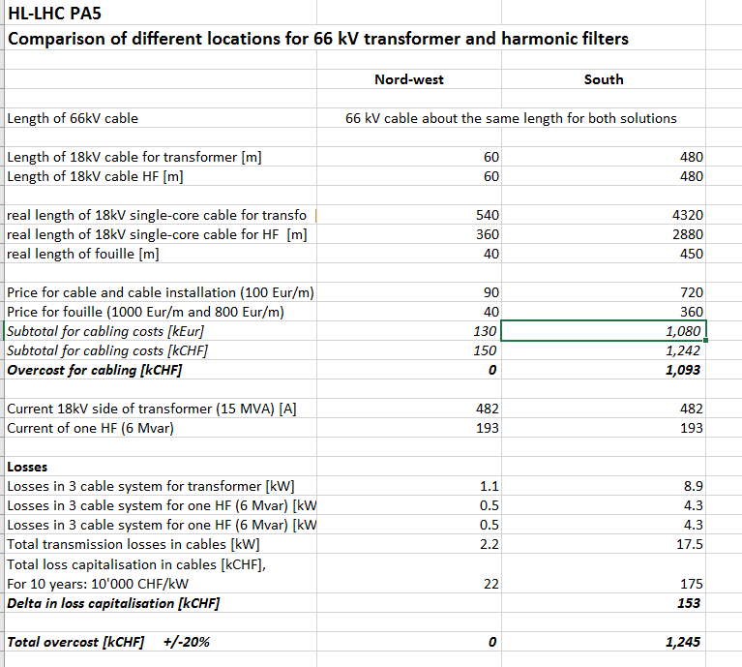
Financial Aspects

Slide 5
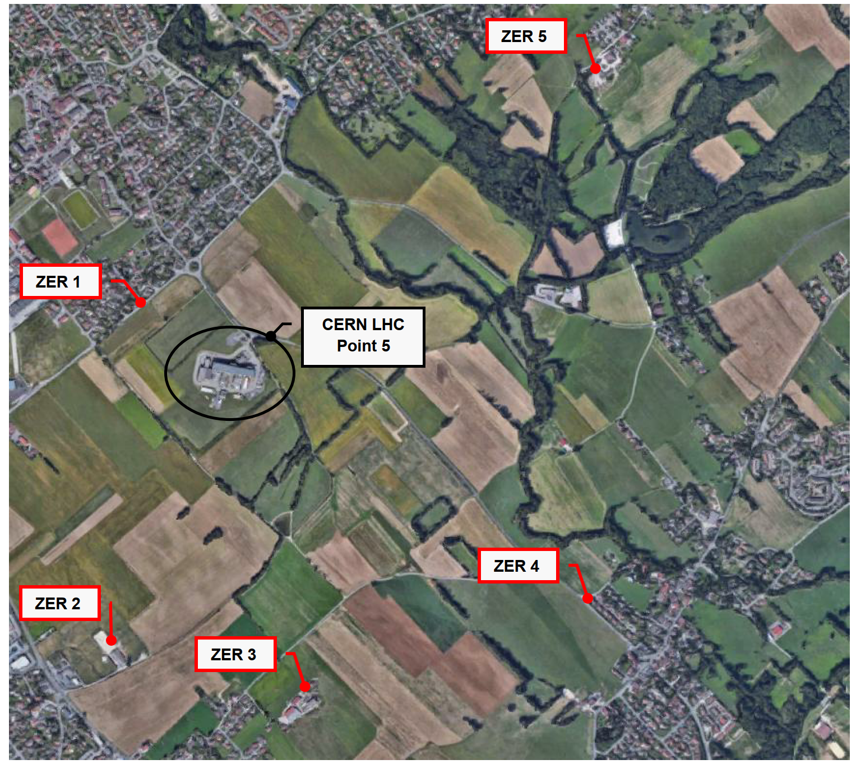
ZER location
North
South

Slide 6
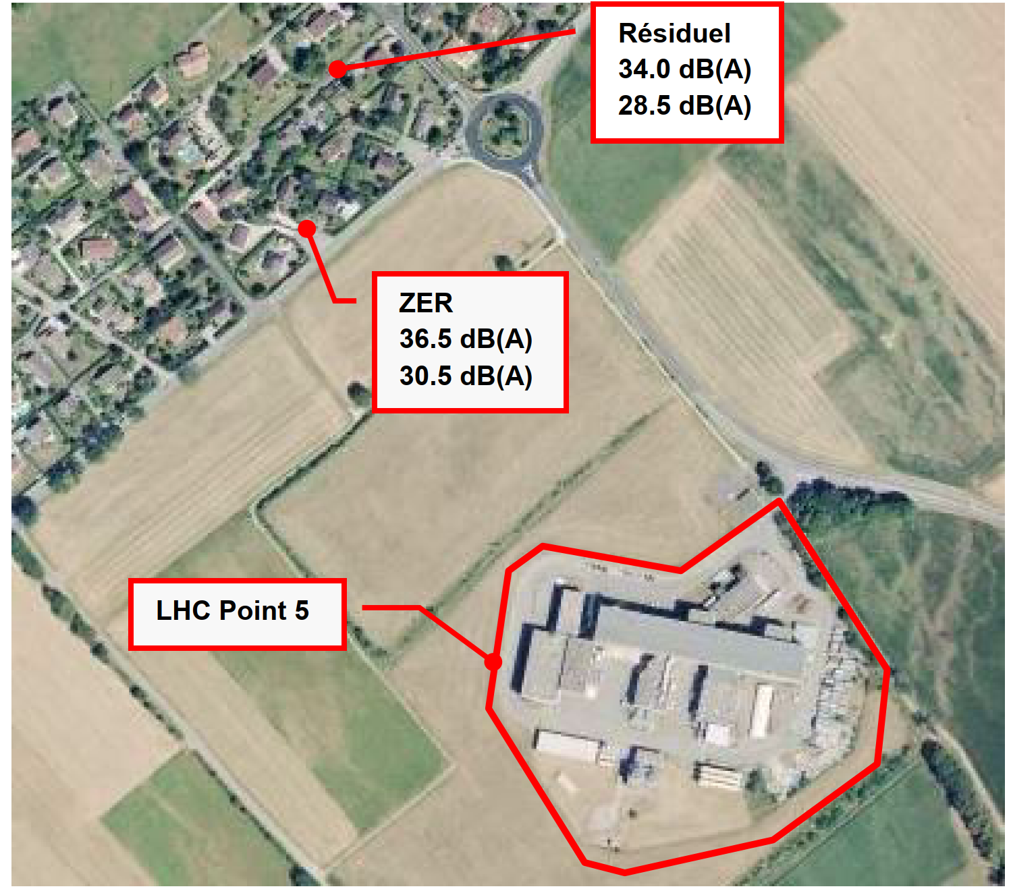
Study inputs: ZER maximum noise level requirement
Noise level to be respected (according to the regulation)
  During day period:
  34 dB(A) (residual) + 6 dB(A) (authorized emergence) = 40 dB(A)
  During night period:
  28.5 dB(A) (residual) + 4 dB(A) (authorized emergence) = 32.5 dB(A)
Noise level to be respected (according the CERN management commitment)
  No additional noise w/r to the existing one i.e.:
  36.5 dB(A) during day and 30.5 dB(A) during night

Slide 7
Study inputs: Noise level of equipment
Electrical sub-station:
  Noise level of electrical transformer alone: 78 dB(A)
  Noise level of refrigeration system alone: 84 dB(A)
  Total noise level (transformer + refrigeration): 85 dB(A)
Harmonic filters:
  Noise level of filter coils: 52 dB(A) per unit (3 units in total)
  Noise level of resistors: 52 dB(A) per unit (3 units in total)
  Noise level of capacitor banks: 48 dB(A) per unit (3 units in total)

Slide 8
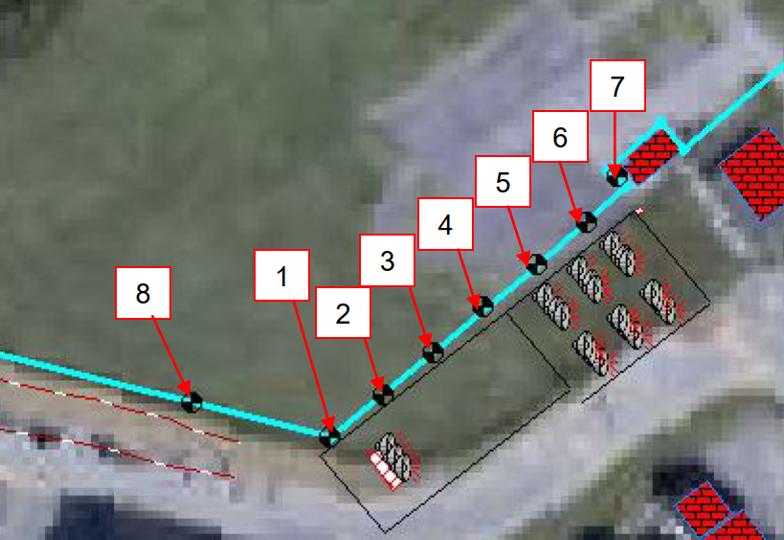
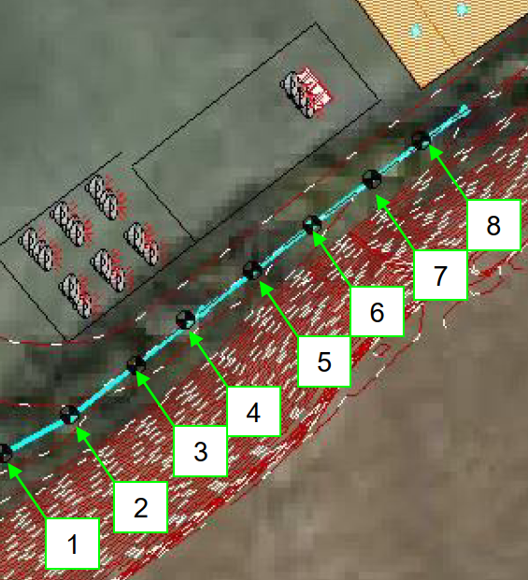
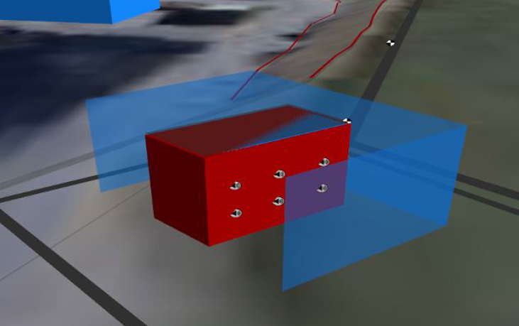
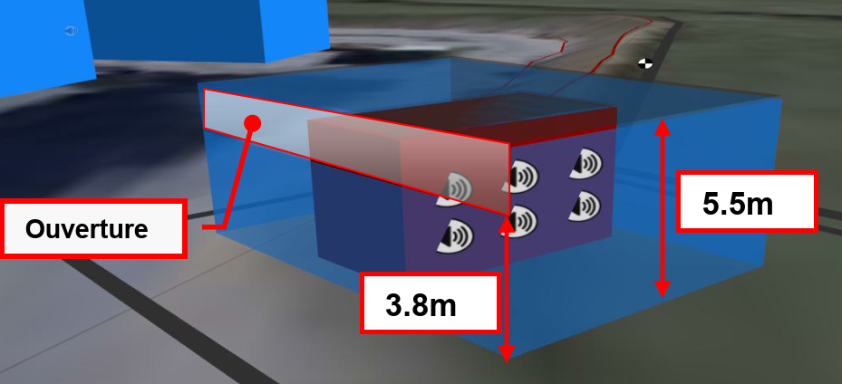
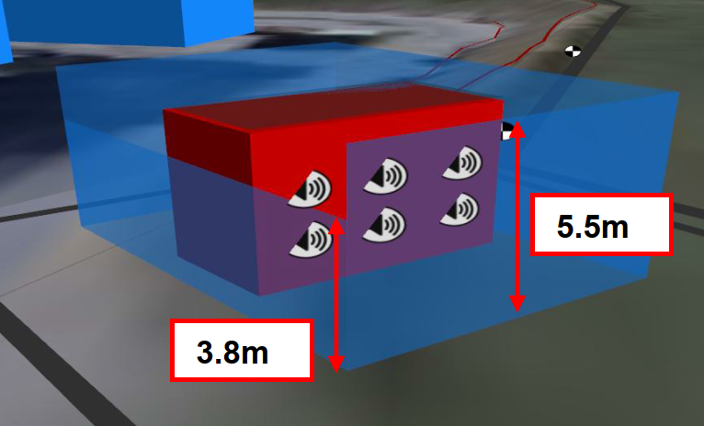
Study cases
8 points per location
Location |  | North | South
Case 1: w/o protection | w/o refrigeration | X | X
 | with refrigeration | X | X
Case 2: with U-wall protection | w/o refrigeration | X | X
 | with refrigeration | X | X
Case 3: with 4-wall protection + roof | w/o refrigeration | X | X
 | with refrigeration | X | X
Case 4: with 4-wall protection | w/o refrigeration | X | X
 | with refrigeration | X | X

Slide 9
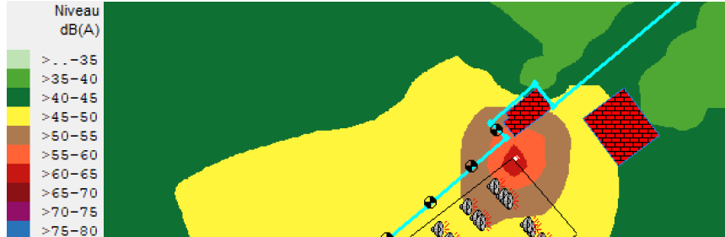
Study cases : Noise levels [dB(A)]
Existing + HL-LHC buildings
Location | North |  |  |  |  |  |  |  | South
Point | 1 | 2 | 3 | 4 | 5 | 6 | 7 | 8 | 1 | 2 | 3 | 4 | 5 | 6 | 7 | 8
Existing | 44.6 | 43.4 | 42.6 | 43.3 | 46.1 | 53.1 | 54.9 | 48.9 | 35.8 | 36.4 | 37.3 | 38.8 | 39.0 | 36.3 | 32.7 | 29.3
HL-LHC | 21.3 | 21.3 | 21.2 | 21.3 | 21.5 | 22.4 | 23.5 | 21.0 | 38.1 | 38.7 | 39.0 | 39.2 | 39.4 | 39.9 | 40.5 | 40.9
Total | 44.6 | 43.4 | 42.6 | 43.3 | 46.1 | 53.1 | 54.9 | 48.9 | 40.1 | 40.7 | 41.3 | 42.2 | 42.4 | 41.4 | 41.1 | 41.2
Already an existing equipment (RP monitoring) is generating noise at the limit of the north location

Slide 10
Additional noise [dB(A)] with sub-station in North location
Negative impact of the roof and of the addition wall
→ better to retain Case 2 (U-shape protection)
Negligible impact on the south limit

Slide 11
Additional noise [dB(A)] with sub-station in South location
Negligible impact on the north limit
Positive impact of the additional wall (Case 4). No additional gain with a roof (Case 3)
→ better to retain Case 4 (4-wall protection)

Slide 12
Total noise level at the site limit [dB(A)]
With the sub-station in north location
the maximum noise level identical between the two locations (54.9 dB(A)) mainly due to existing equipment.
With the sub-station in south location

Slide 13
What about noise level [dB(A)] in ZER1?
South location is more impacting the ZER1 than the North location! why?
- Total noise fulfils the regulation thresholds,
- W/r to the CERN commitment, a maximum increase of 0.1 dB(A) is calculated (but probably within the measurement accuracy)

Slide 14
Conclusion
Noise level consideration of the new electrical sub-station at P5 does not allow:
  to choose between North and South location,
  to justify the additional cost of 1.2 MCHF.
Other considerations:
  Engineering value? → North location better
  Efficiency of the filters? → North location definitely better
  Cohabitation with CMS? → South location better
  Visual impact? → South location better
  Politics: relations with French Authorities?

Slide 15
Thank you !

