Slide 2
Analysis Electron Motion Within the Beam
22nd February 2019 E-Cloud Meeting 65
L. Sabato, G. Iadarola
luca.sabato@cern.ch

Slide 3
Outline
Theoretical Oscillation
Uniform Longitudinal Profile
Gaussian Longitudinal Profile
Conclusions

Slide 4
Outline
Theoretical Oscillation
  Frequency
  Amplitude and Phase
  Linear Region
  Invariant
Uniform Longitudinal Profile
Gaussian Longitudinal Profile
Conclusions

Slide 5
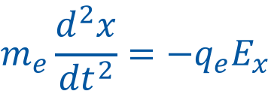
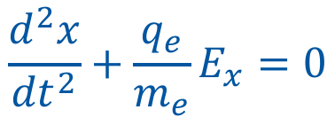
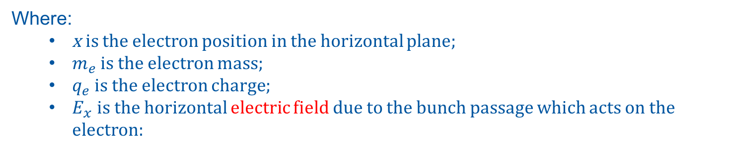
Theoretical Oscillation
From the Newton law:
$$m_{e}\frac{d^{2}x}{{dt}^{2}}=\text{−}q_{e}E_{x}$$
$$\frac{d^{2}x}{{dt}^{2}}+\frac{q_{e}}{m_{e}}E_{x}=0$$
(1)
Where:
  x is the electron position in the horizontal plane;
  $m_{e}$ is the electron mass;
  $q_{e}$ is the electron charge;
  $E_{x}$ is the horizontal electric field due to the bunch passage which acts on the electron:

Slide 6
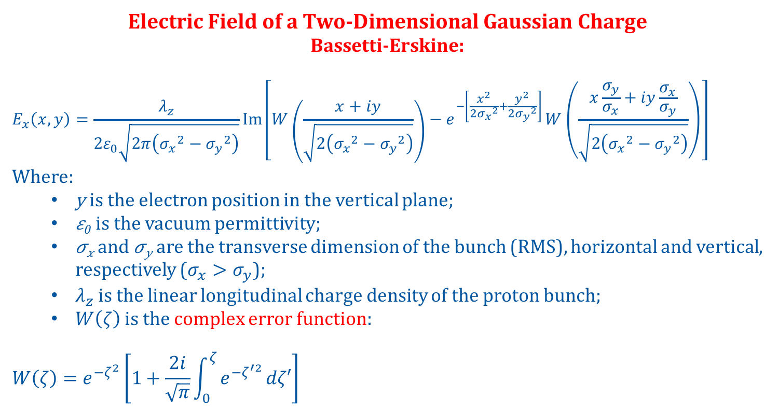
Theoretical Oscillation
Electric Field of a Two-Dimensional Gaussian Charge
Bassetti-Erskine:
$$E_{x}\left(x,y\right)=\frac{λ_{z}}{2ε_{0}\sqrt{2π\left({σ_{x}}^{2}−{σ_{y}}^{2}\right)}}Im\left[W\left(\frac{x+iy}{\sqrt{2\left({σ_{x}}^{2}−{σ_{y}}^{2}\right)}}\right)−e^{−\left[\frac{x^{2}}{2{σ_{x}}^{2}}+\frac{y^{2}}{2{σ_{y}}^{2}}\right] }W\left(\frac{x\frac{σ_{y}}{σ_{x}}+iy\frac{σ_{x}}{σ_{y}}}{\sqrt{2\left({σ_{x}}^{2}−{σ_{y}}^{2}\right)}}\right)\right]$$
Where:
  y is the electron position in the vertical plane;
  𝜀₀ is the vacuum permittivity;
  𝜎_{𝑥} and 𝜎_{𝑦} are the transverse dimension of the bunch (RMS), horizontal and vertical, respectively ($σ_{x}>σ_{y}$);
  $λ_{z}$ is the linear longitudinal charge density of the proton bunch;
  $W\left(ζ\right)$ is the complex error function:
$$W\left(ζ\right)=e^{−ζ^{2}}\left[1+\frac{2i}{\sqrt{π}}\int_{0}^{ζ}{e^{−ζ^{′2}}}dζ′\right]$$

Slide 7
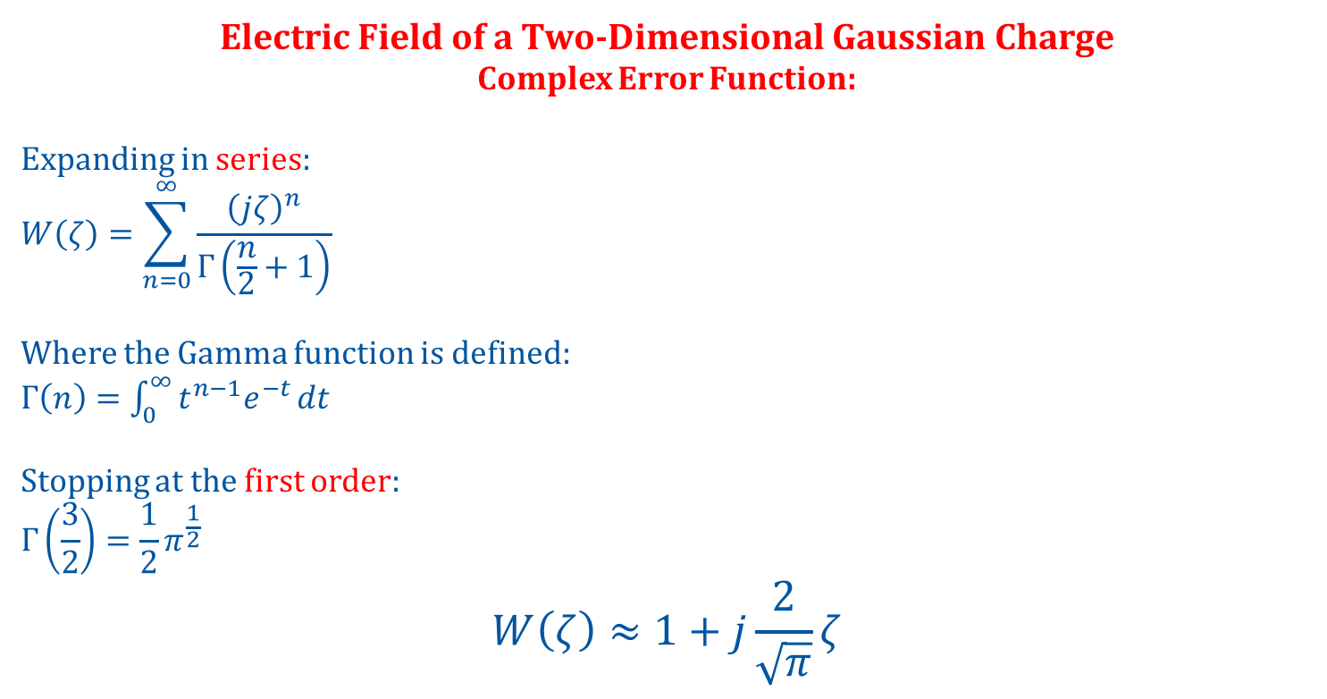
Theoretical Oscillation
Electric Field of a Two-Dimensional Gaussian Charge
Complex Error Function:
Expanding in series:
$$W\left(ζ\right)=\sum_{n=0}^{∞}{\frac{{\left(jζ\right)}^{n}}{Γ\left(\frac{n}{2}+1\right)}}$$
Where the Gamma function is defined:
$Γ\left(n\right)=$ $\int_{0}^{∞}{t^{n−1}e^{−t}}dt$
Stopping at the first order:
$$Γ\left(\frac{3}{2}\right)=\frac{1}{2}π^{\frac{1}{2}}$$
$$W\left(ζ\right)≈1+j\frac{2}{\sqrt{π}}ζ$$

Slide 8
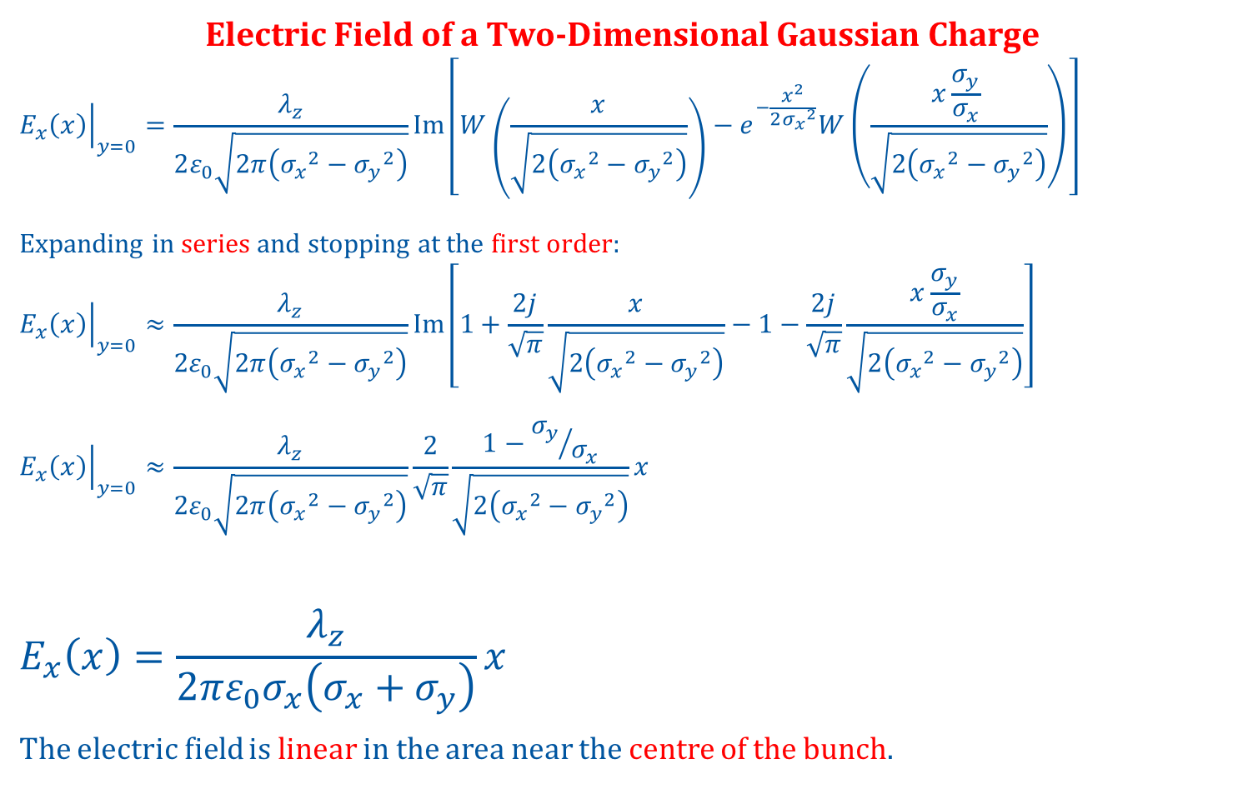
Theoretical Oscillation
Electric Field of a Two-Dimensional Gaussian Charge
$${\left.E_{x}\left(x\right)\right|}_{y=0}=\frac{λ_{z}}{2ε_{0}\sqrt{2π\left({σ_{x}}^{2}−{σ_{y}}^{2}\right)}}Im\left[W\left(\frac{x}{\sqrt{2\left({σ_{x}}^{2}−{σ_{y}}^{2}\right)}}\right)−e^{−\frac{x^{2}}{2{σ_{x}}^{2}}}W\left(\frac{x\frac{σ_{y}}{σ_{x}} }{\sqrt{2\left({σ_{x}}^{2}−{σ_{y}}^{2}\right)}}\right)\right]$$
Expanding in series and stopping at the first order:
$${\left.E_{x}\left(x\right)\right|}_{y=0}≈\frac{λ_{z}}{2ε_{0}\sqrt{2π\left({σ_{x}}^{2}−{σ_{y}}^{2}\right)}}Im\left[1+\frac{2j}{\sqrt{π}}\frac{x}{\sqrt{2\left({σ_{x}}^{2}−{σ_{y}}^{2}\right)}}−1−\frac{2j}{\sqrt{π}}\frac{x\frac{σ_{y}}{σ_{x}}}{\sqrt{2\left({σ_{x}}^{2}−{σ_{y}}^{2}\right)}}\right]$$
$${\left.E_{x}\left(x\right)\right|}_{y=0}≈\frac{λ_{z}}{2ε_{0}\sqrt{2π\left({σ_{x}}^{2}−{σ_{y}}^{2}\right)}}\frac{2}{\sqrt{π}}\frac{1−{σ_{y}}/{σ_{x}}}{\sqrt{2\left({σ_{x}}^{2}−{σ_{y}}^{2}\right)}}x$$
$$E_{x}\left(x\right)=\frac{λ_{z}}{2πε_{0}σ_{x}\left(σ_{x}+σ_{y}\right)}x$$
The electric field is linear in the area near the centre of the bunch.
(2)

Slide 9
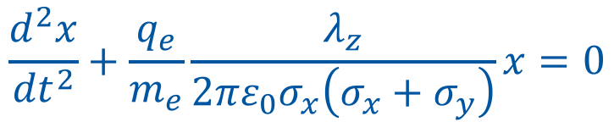
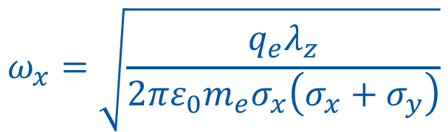

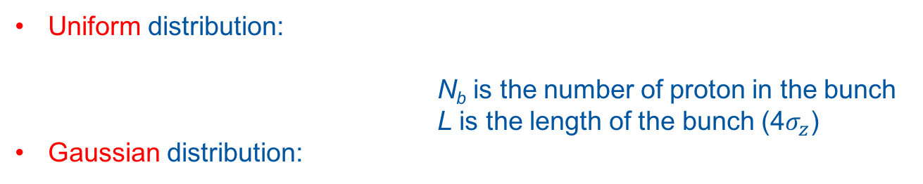

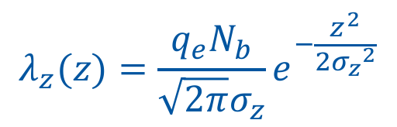
Theoretical Oscillation
Substituting (2) in (1):
$$\frac{d^{2}x}{{dt}^{2}}+\frac{q_{e}}{m_{e}}\frac{λ_{z}}{2πε_{0}σ_{x}\left(σ_{x}+σ_{y}\right)}x=0$$
$$\ddot{x}+{ω_{x}}^{2}x=0$$
$$ω_{x}=\sqrt{\frac{q_{e}λ_{z}}{2πε_{0}m_{e}σ_{x}\left(σ_{x}+σ_{y}\right)}}$$
(3)
The linear longitudinal charge density of the proton bunch:
Uniform distribution:
N_{b} is the number of proton in the bunch
L is the length of the bunch (4$σ_{z}$)
Gaussian distribution:
$$λ_{z}=\frac{q_{e}N_{b}}{L}$$
(4)
$$λ_{z}(z)=\frac{q_{e}N_{b}}{\sqrt{2π}σ_{z}}e^{−\frac{z^{2}}{2{σ_{z}}^{2}}}$$
(5)

Slide 10

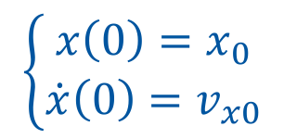
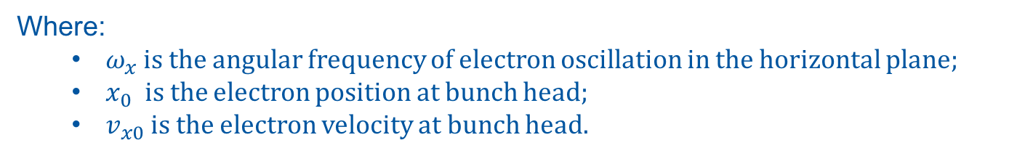
Theoretical Oscillation
Equation of the Electron Transverse Motion: Harmonic Oscillator
Symmetry between Horizontal and Vertical plane
$$\ddot{x}+{ω_{x}}^{2}x=0$$
(6)
$$\left\{\begin{matrix}x\left(0\right)=x_{0} \\ \dot{x}\left(0\right)=v_{x0}\end{matrix}\right.$$
(7.1)
(7.2)
Where:
  $ω_{x}$ is the angular frequency of electron oscillation in the horizontal plane;
  $x_{0}$ is the electron position at bunch head;
  $v_{x0}$ is the electron velocity at bunch head.

Slide 11
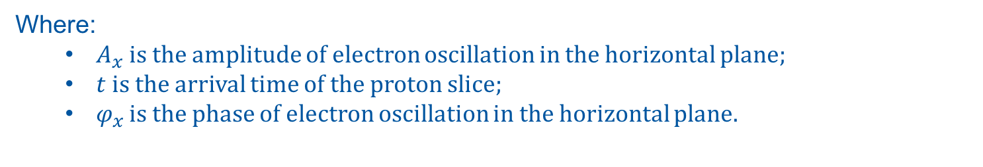

Theoretical Oscillation
Solution of the harmonic oscillator:
$$x\left(t\right)=A_{x}\cos\left(ω_{x}t+φ_{x}\right)$$
(8)
Where:
  $A_{x}$ is the amplitude of electron oscillation in the horizontal plane;
  $t$ is the arrival time of the proton slice;
  $φ_{x}$ is the phase of electron oscillation in the horizontal plane.

Slide 12
Theoretical Oscillation
Solution of the harmonic oscillator:
$$x\left(t\right)=A_{x}\cos\left(ω_{x}t+φ_{x}\right)$$
(8)
Oscillation Amplitude
Oscillation Phase
Oscillation Angular Frequency

Slide 13

Theoretical Oscillation: Frequency
Solution of the harmonic oscillator:
$$x\left(t\right)=A_{x}\cos\left(ω_{x}t+φ_{x}\right)$$
(8)
Oscillation Angular Frequency
$$ω_{x}=\sqrt{\frac{q_{e}λ_{z}}{2πε_{0}m_{e}σ_{x}\left(σ_{x}+σ_{y}\right)}}$$
(3)

Slide 14
Theoretical Oscillation
Solution of the harmonic oscillator:
$$x\left(t\right)=A_{x}\cos\left(ω_{x}t+φ_{x}\right)$$
(8)
Oscillation Amplitude
Oscillation Phase

Slide 15
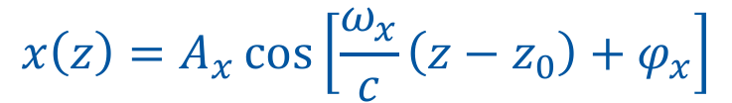
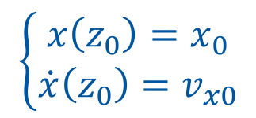
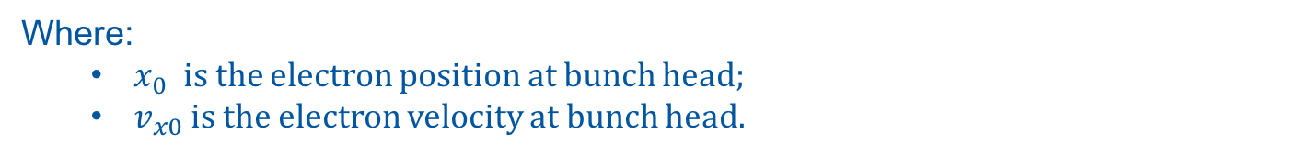
Theoretical Oscillation: Amplitude - Phase
Solution of the harmonic oscillator (ultra-relativistic regime t = z/c):
$$x\left(z\right)=A_{x}\cos\left[\frac{ω_{x}}{c}\left(z−z_{0}\right)+φ_{x}\right]$$
(9)
Oscillation Amplitude
Traslation in z axis:
z₀ = 2𝜎_{z}
Oscillation Phase
$$\left\{\begin{matrix}x\left(z_{0}\right)=x_{0} \\ \dot{x}\left(z_{0}\right)=v_{x0}\end{matrix}\right.$$
(9.1)
(9.2)
Where:
  $x_{0}$ is the electron position at bunch head;
  $v_{x0}$ is the electron velocity at bunch head.

Slide 16
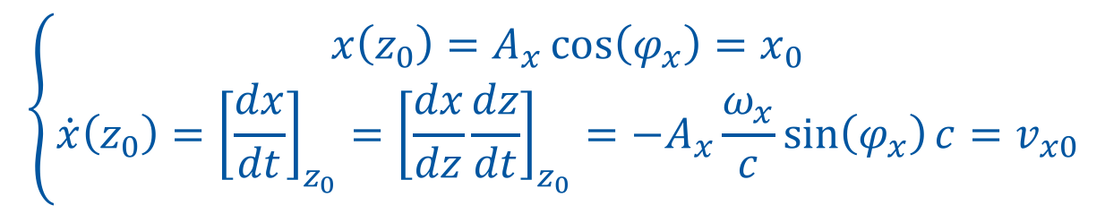
Theoretical Oscillation: Amplitude - Phase
Solution of the harmonic oscillator (ultra-relativistic regime t = z/c):
$$x\left(z\right)=A_{x}\cos\left[\frac{ω_{x}}{c}\left(z−z_{0}\right)+φ_{x}\right]$$
(9)
Oscillation Amplitude
Traslation in z axis:
z₀ = 2𝜎_{z}
Oscillation Phase
$$\left\{\begin{matrix}x\left(z_{0}\right)=A_{x}\cos\left(φ_{x}\right)=x_{0} \\ \dot{x}\left(z_{0}\right)={{\left[\frac{dx}{dt}\right]}_{z_{0}}={\left[\frac{dx}{dz}\frac{dz}{dt}\right]}_{z_{0}}=−A}_{x}\frac{ω_{x}}{c}\sin\left(φ_{x}\right)c=v_{x0}\end{matrix}\right.$$
(10)
(11)

Slide 17
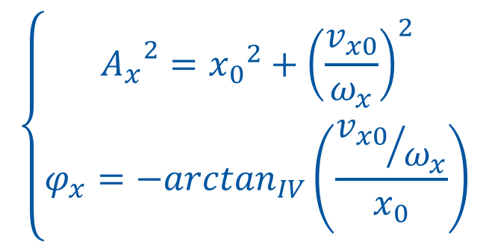
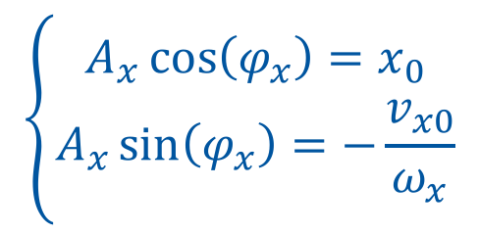
Theoretical Oscillation: Amplitude - Phase
$$\left\{\begin{matrix}A_{x}\cos\left(φ_{x}\right)=x_{0} \\ A_{x}\sin\left(φ_{x}\right)=−\frac{v_{x0}}{ω_{x}}\end{matrix}\right.$$
(10)
(11)
$$\left\{\begin{matrix}{A_{x}}^{2}={x_{0}}^{2}+{\left(\frac{v_{x0}}{ω_{x}}\right)}^{2} \\ φ_{x}=−\arctan_{IV}\left(\frac{{v_{x0}}/{ω_{x}}}{x_{0}}\right)\end{matrix}\right.$$
(12)
(10)² + (11)²
(13)
(11) / (10)

Slide 18
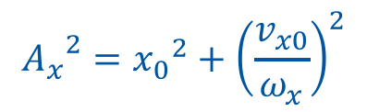
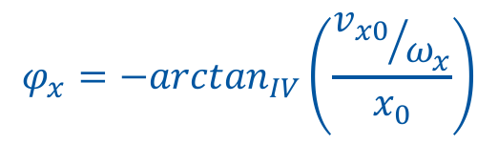
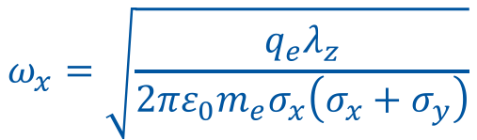
Theoretical Oscillation: Amplitude - Phase
Solution of the harmonic oscillator (ultra-relativistic regime t = z/c):
$$x\left(z\right)=A_{x}\cos\left[\frac{ω_{x}}{c}\left(z−z_{0}\right)+φ_{x}\right]$$
(9)
Oscillation Amplitude:
Traslation in z axis:
z₀ = 2𝜎_{z}
Oscillation Phase:
$${A_{x}}^{2}={x_{0}}^{2}+{\left(\frac{v_{x0}}{ω_{x}}\right)}^{2}$$
$$φ_{x}=−\arctan_{IV}\left(\frac{{v_{x0}}/{ω_{x}}}{x_{0}}\right)$$
(12)
(13)
Oscillation Angular Frequency:
$$ω_{x}=\sqrt{\frac{q_{e}λ_{z}}{2πε_{0}m_{e}σ_{x}\left(σ_{x}+σ_{y}\right)}}$$
(3)

Slide 19
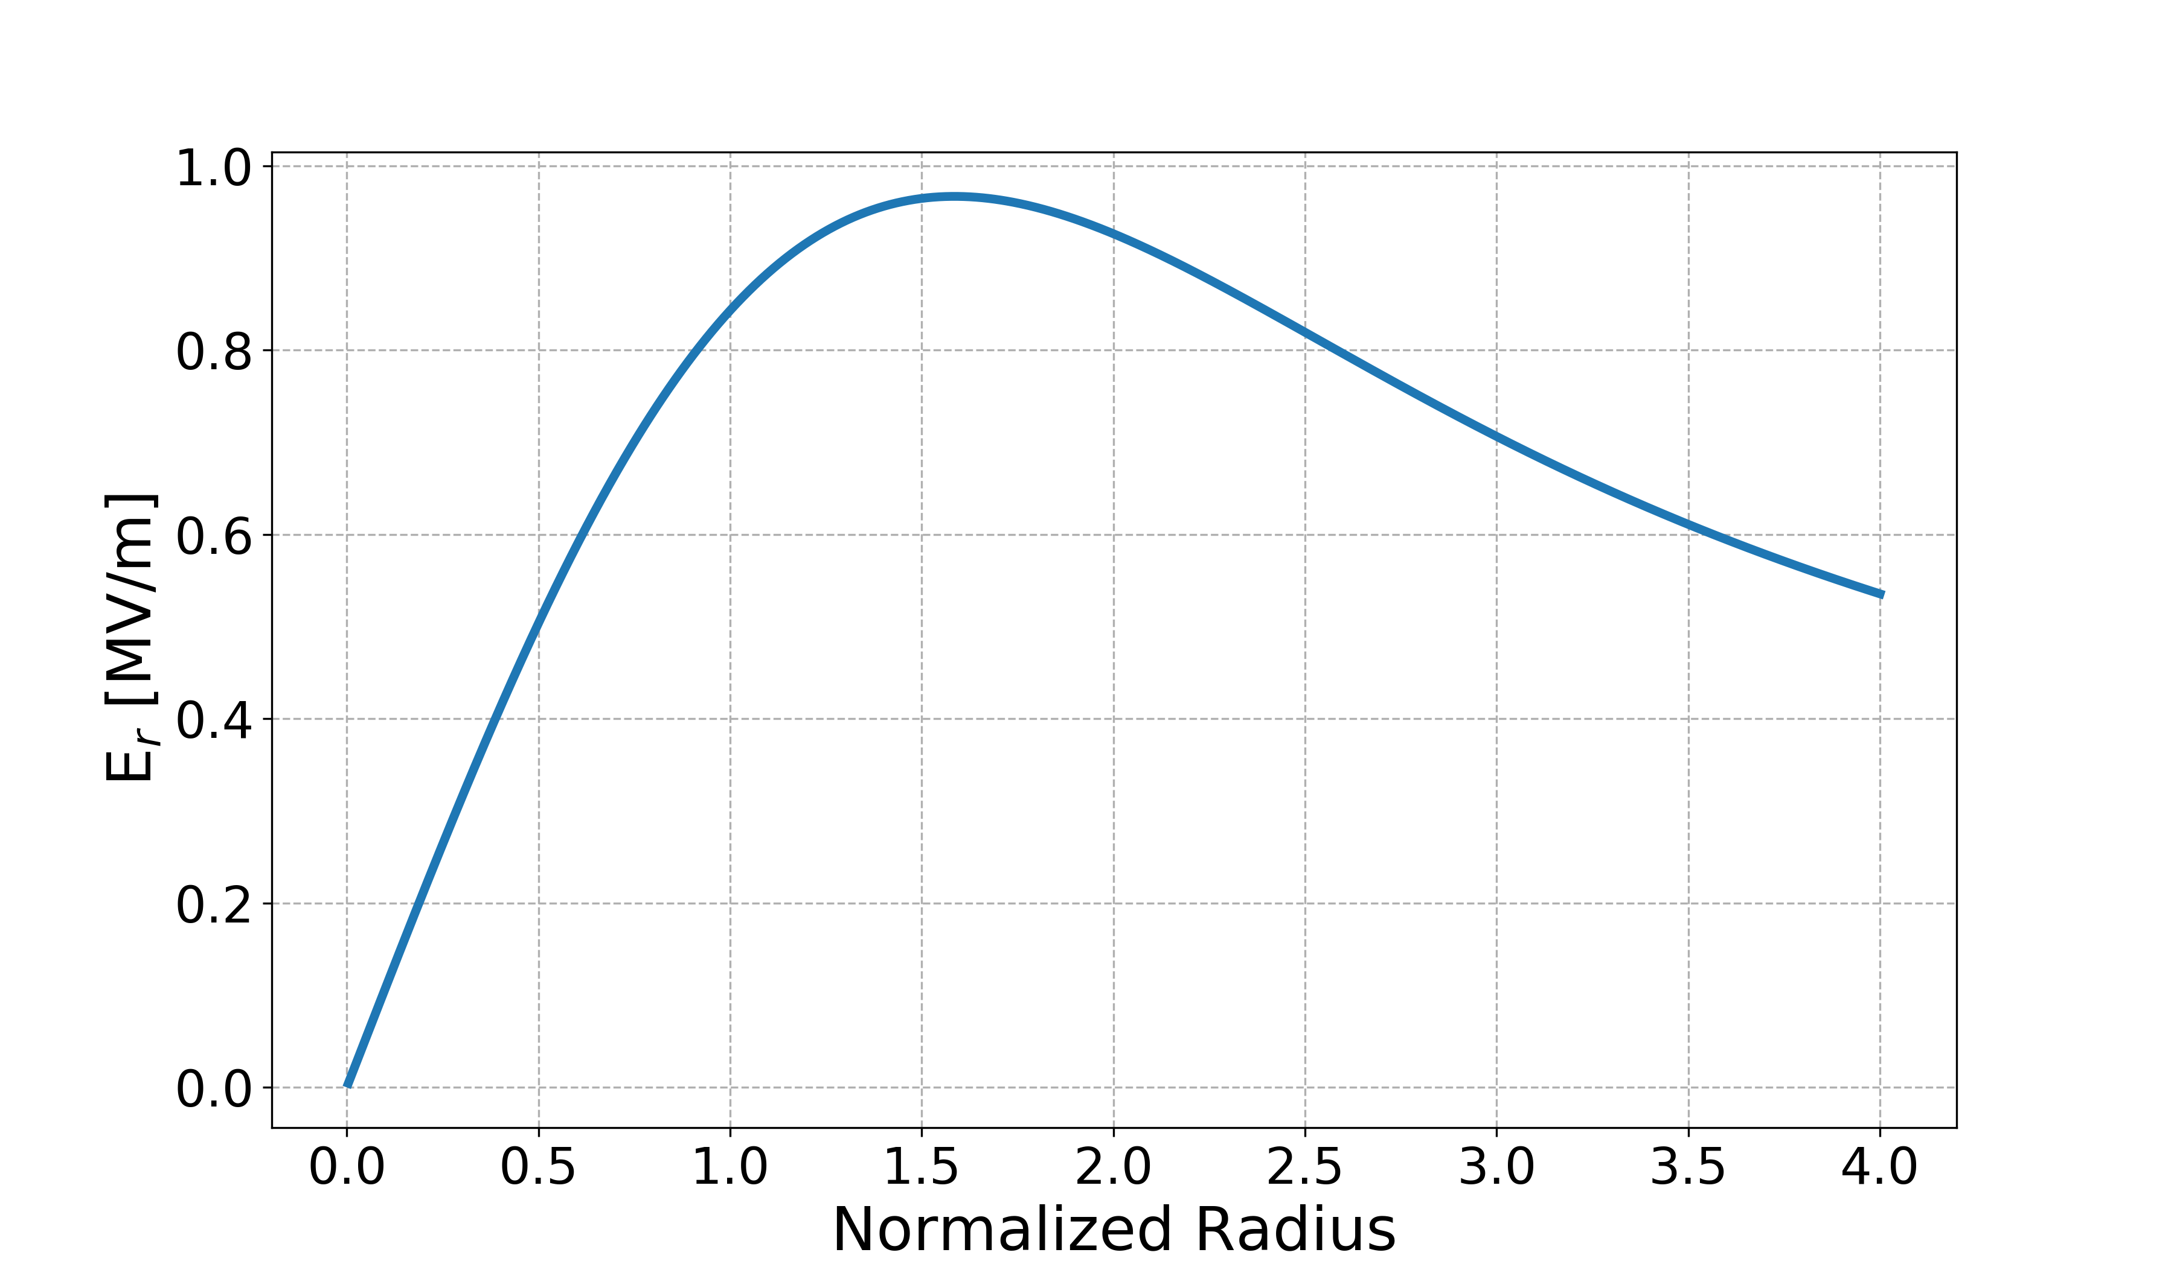
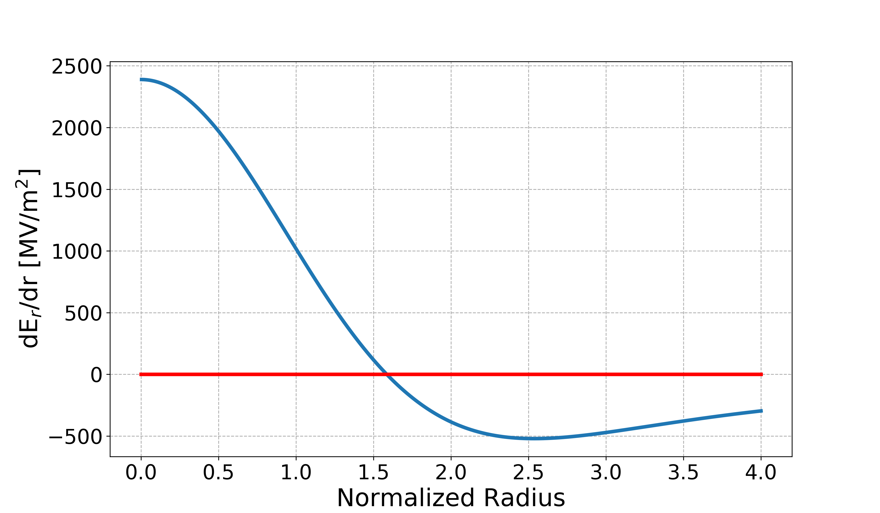
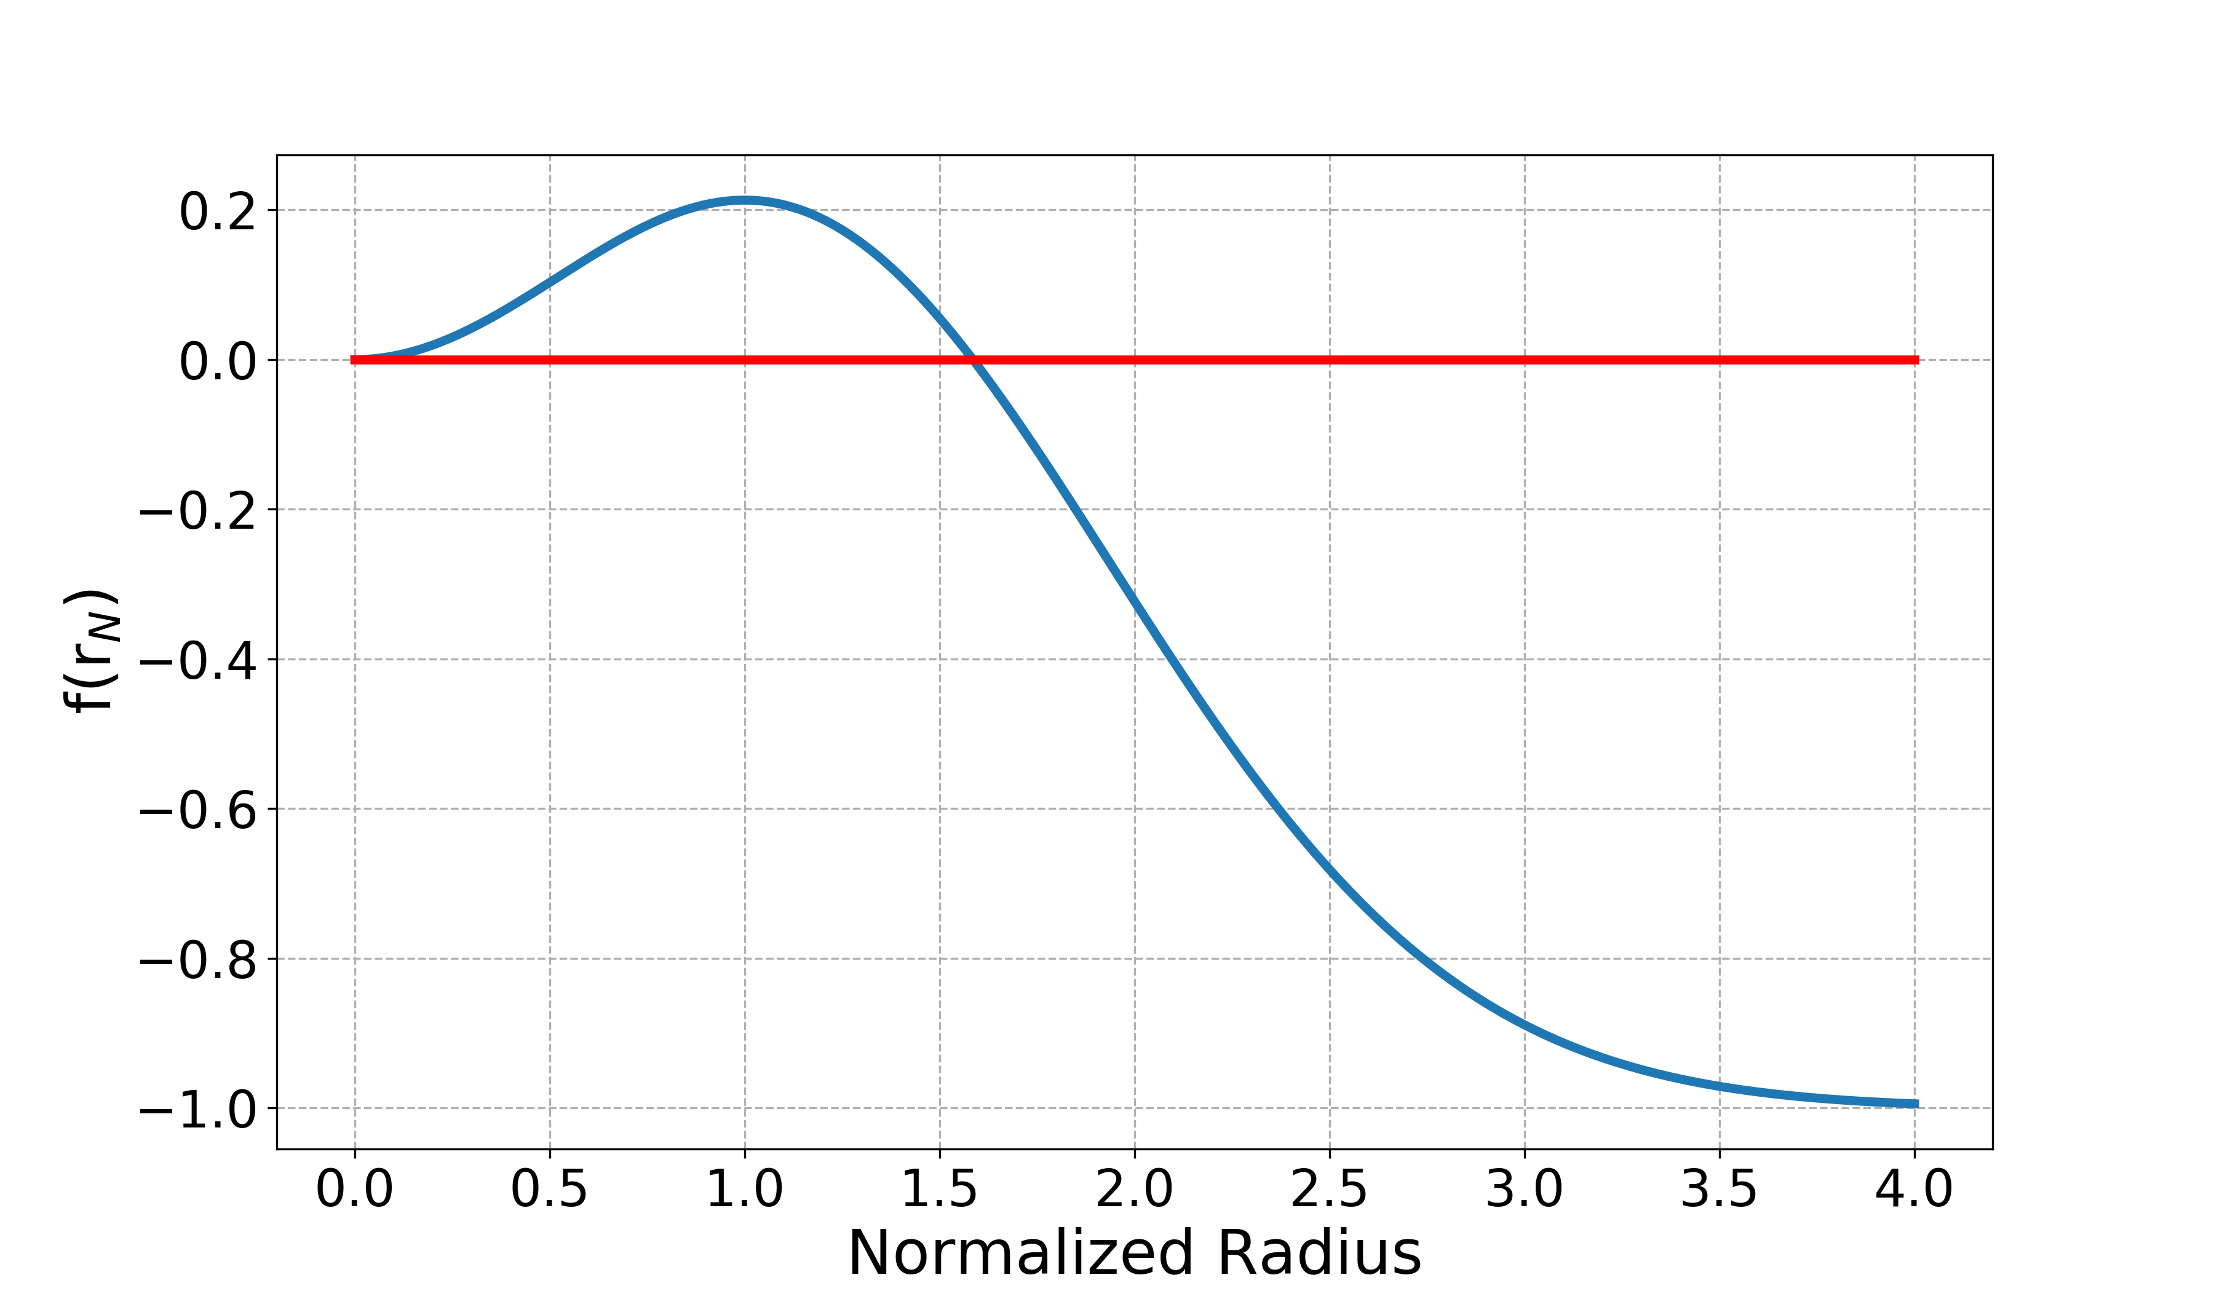
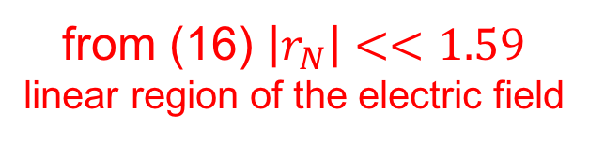

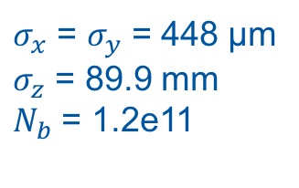
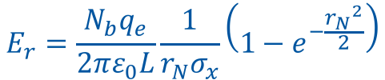




Theoretical Oscillation:
Linear Region
Normalized
radius
(1)
$$E_{r}=\frac{N_{b}q_{e}}{2πε_{0}L}\frac{1}{r_{N}σ_{x}}\left(1−e^{−\frac{{r_{N}}^{2}}{2}}\right)$$
$$r_{N}=\frac{r}{σ_{x}}$$
(14)
(15)
(16)
$$L=4σ_{z}$$
(2)
$$\frac{dE_{r}}{dr}=\frac{N_{b}q_{e}}{2πε_{0}L{r_{N}}^{2}{σ_{x}}^{2}}\left({r_{N}}^{2}e^{−\frac{{r_{N}}^{2}}{2}}+e^{−\frac{{r_{N}}^{2}}{2}}−1\right)$$
                $σ_{x}$ = $σ_{y}$ = 448 μm
                $σ_{z}$ = 89.9 mm
                $N_{b}$ = 1.2e11
$$\frac{dE_{r}}{dr}=0$$
(3)
$${{f\left(r_{N}\right)=r}_{N}}^{2}e^{−\frac{{r_{N}}^{2}}{2}}+e^{−\frac{{r_{N}}^{2}}{2}}−1=0$$
from (16) $\left|r_{N}\right|<<1.59$
linear region of the electric field

Slide 20
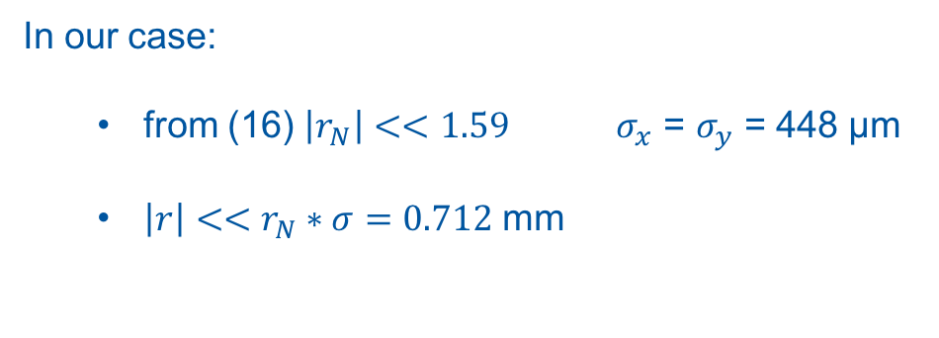
Theoretical Oscillation:
Linear Region
(1)
In our case:
  from (16) $\left|r_{N}\right|<<1.59$ $σ_{x}$ = $σ_{y}$ = 448 μm
  $\left|r\right|<<r_{N}∗σ=0.712$ mm
(2)
(3)

Slide 21
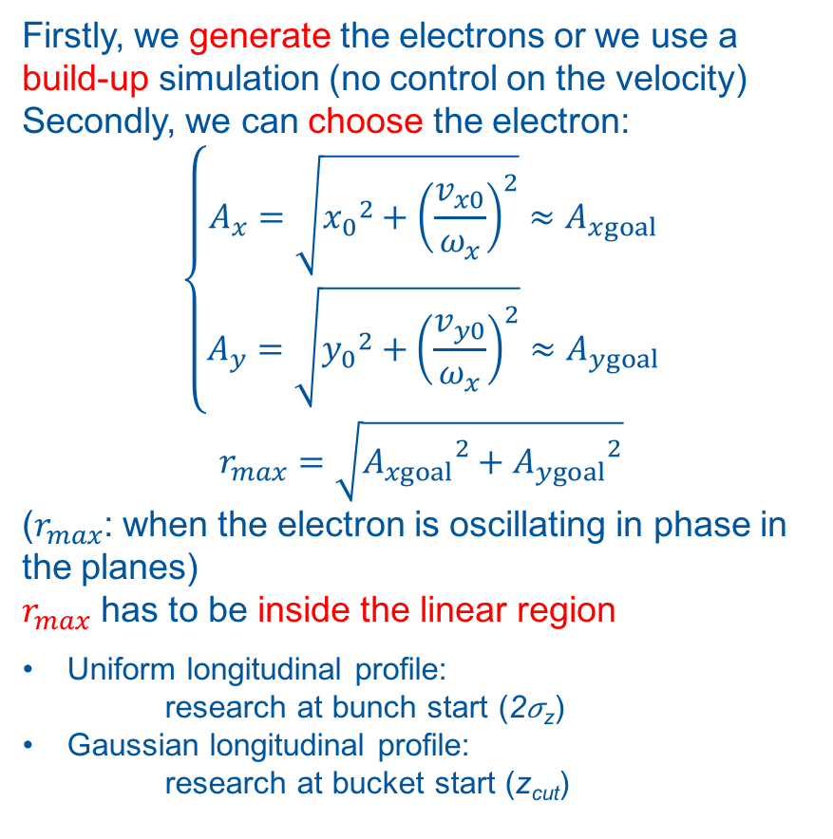
Theoretical Oscillation:
Linear Region
(1)
Firstly, we generate the electrons or we use a build-up simulation (no control on the velocity)
Secondly, we can choose the electron:
$$\left\{\begin{matrix}A_{x}=\sqrt{{x_{0}}^{2}+{\left(\frac{v_{x0}}{ω_{x}}\right)}^{2}}≈A_{xgoal} \\ A_{y}=\sqrt{{y_{0}}^{2}+{\left(\frac{v_{y0}}{ω_{x}}\right)}^{2}}≈A_{ygoal}\end{matrix}\right.$$
$$r_{max}=\sqrt{{A_{xgoal}}^{2}+{A_{ygoal}}^{2}}$$
($r_{max}$: when the electron is oscillating in phase in the planes)
$r_{max}$ has to be inside the linear region
Uniform longitudinal profile:
research at bunch start (2𝜎_{z})
Gaussian longitudinal profile:
research at bucket start (z_{cut})
(2)
(3)

Slide 22
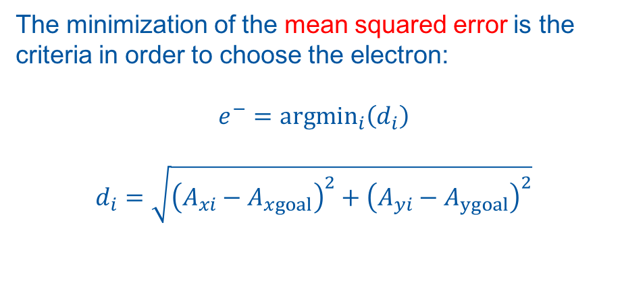
Theoretical Oscillation:
Linear Region
(1)
The minimization of the mean squared error is the criteria in order to choose the electron:
$$e^{−}={argmin}_{i}\left(d_{i}\right)$$
$$d_{i}=\sqrt{{\left(A_{xi}−A_{xgoal}\right)}^{2}+{\left(A_{yi}−A_{ygoal}\right)}^{2}}$$
(2)
(3)

Slide 23


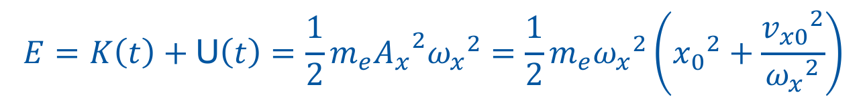
Theoretical Oscillation: Invariant
$$x\left(t\right)=A_{x}\cos\left(ω_{x}t+φ_{x}\right)$$
(8)
$$v_{x}\left(t\right)={−A}_{x}ω_{x}\sin\left(ω_{x}t+φ_{x}\right)$$
(17)
The kinetic energy of the system is:
The potential energy of the system is:
The total energy of the system is:
(it does not depend on time: invariant)
$K\left(t\right)=\frac{1}{2}m_{e}{v_{x}}^{2}\left(t\right)=\frac{1}{2}m_{e}$ ${A_{x}}^{2}{ω_{x}}^{2}\sin^{2}\left(ω_{x}t+φ_{x}\right)$
(18)
U$\left(t\right)=\frac{1}{2}m_{e}{ω_{x}}^{2}x^{2}\left(t\right)=\frac{1}{2}m_{e}$ ${A_{x}}^{2}{ω_{x}}^{2}\cos^{2}\left(ω_{x}t+φ_{x}\right)$
(19)
$$E=K\left(t\right)+\text{U}\left(t\right)=\frac{1}{2}m_{e}{A_{x}}^{2}{ω_{x}}^{2}=\frac{1}{2}m_{e}{ω_{x}}^{2}\left({x_{0}}^{2}+\frac{{v_{x0}}^{2}}{{ω_{x}}^{2}}\right)$$
(20)

Slide 24
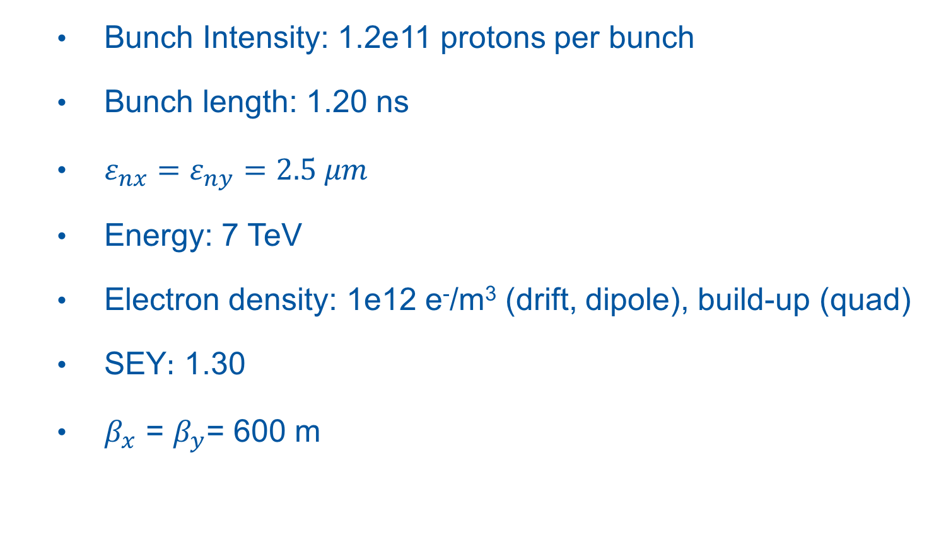
Simulation Parameters
  Bunch Intensity: 1.2e11 protons per bunch
  Bunch length: 1.20 ns
  $ε_{nx}=ε_{ny}=2.5 μm$
  Energy: 7 TeV
  Electron density: 1e12 e⁻/m³ (drift, dipole), build-up (quad)
  SEY$:$ 1.30
  $β_{x}$ = $β_{y}$= 600 m

Slide 25
Numerical Parameters
  Slices = 500
  MPs/slice = 5,000
  Segments = 16
  Max Electron MPs = 900,000

Slide 26
Outline
Theoretical Oscillation
Uniform Longitudinal Profile
  Drift Space
  Dipole
  Arc Quadrupole
Gaussian Longitudinal Profile
Conclusions

Slide 27
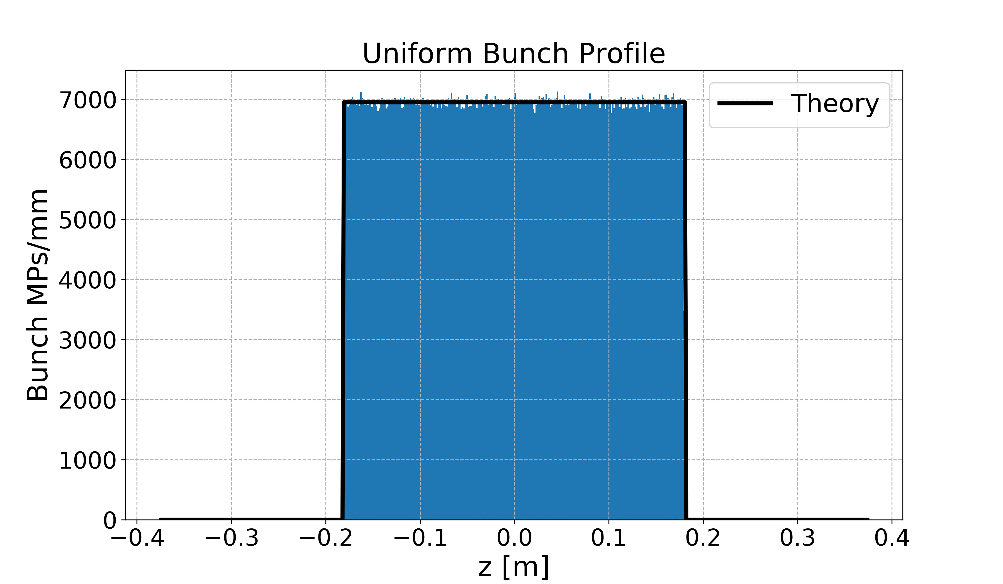



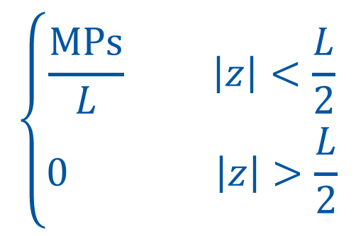
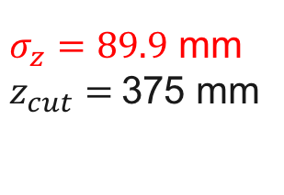


Uniform Longitudinal Profile
$σ_{z}=89.9$ mm
$z_{cut}=$375 mm
500 slices
$$\left\{\begin{aligned}\frac{MPs}{L} \left|z\right|<\frac{L}{2} \\ 0 \left|z\right|>\frac{L}{2}\end{aligned}\right.$$
$${−z}_{cut}$$
$${−2σ}_{z}$$
$${2σ}_{z}$$
$$z_{cut}$$
$${L=4σ}_{z}$$

Slide 28
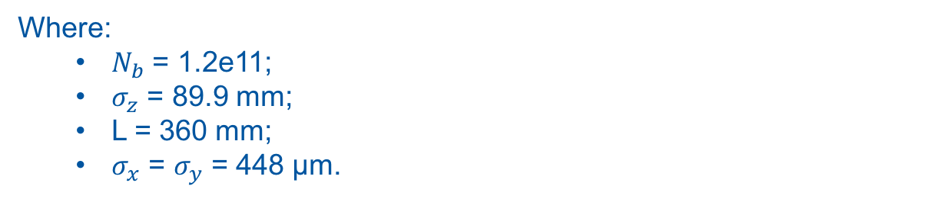

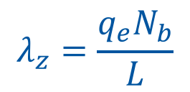
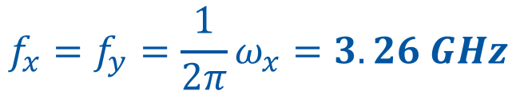
Uniform Longitudinal Profile
Theoretical Oscillation: Frequency
In the case study: uniform distribution and round bunch
$$ω_{x}=\sqrt{\frac{q_{e}λ_{z}}{2πε_{0}m_{e}σ_{x}\left(σ_{x}+σ_{y}\right)}}$$
(3)
$$λ_{z}=\frac{q_{e}N_{b}}{L}$$
(4)
$$f_{x}=f_{y}=\frac{1}{2π}ω_{x}=3.26 GHz$$
Where:
  $N_{b}$ = 1.2e11;
  $σ_{z}$ = 89.9 mm;
  L = 360 mm;
  $σ_{x}$ = $σ_{y}$ = 448 μm.

Slide 29
Outline
Theoretical Oscillation
Uniform Longitudinal Profile
  Drift Space
  Dipole
  Arc Quadrupole
Gaussian Longitudinal Profile
Comparisons

Slide 30
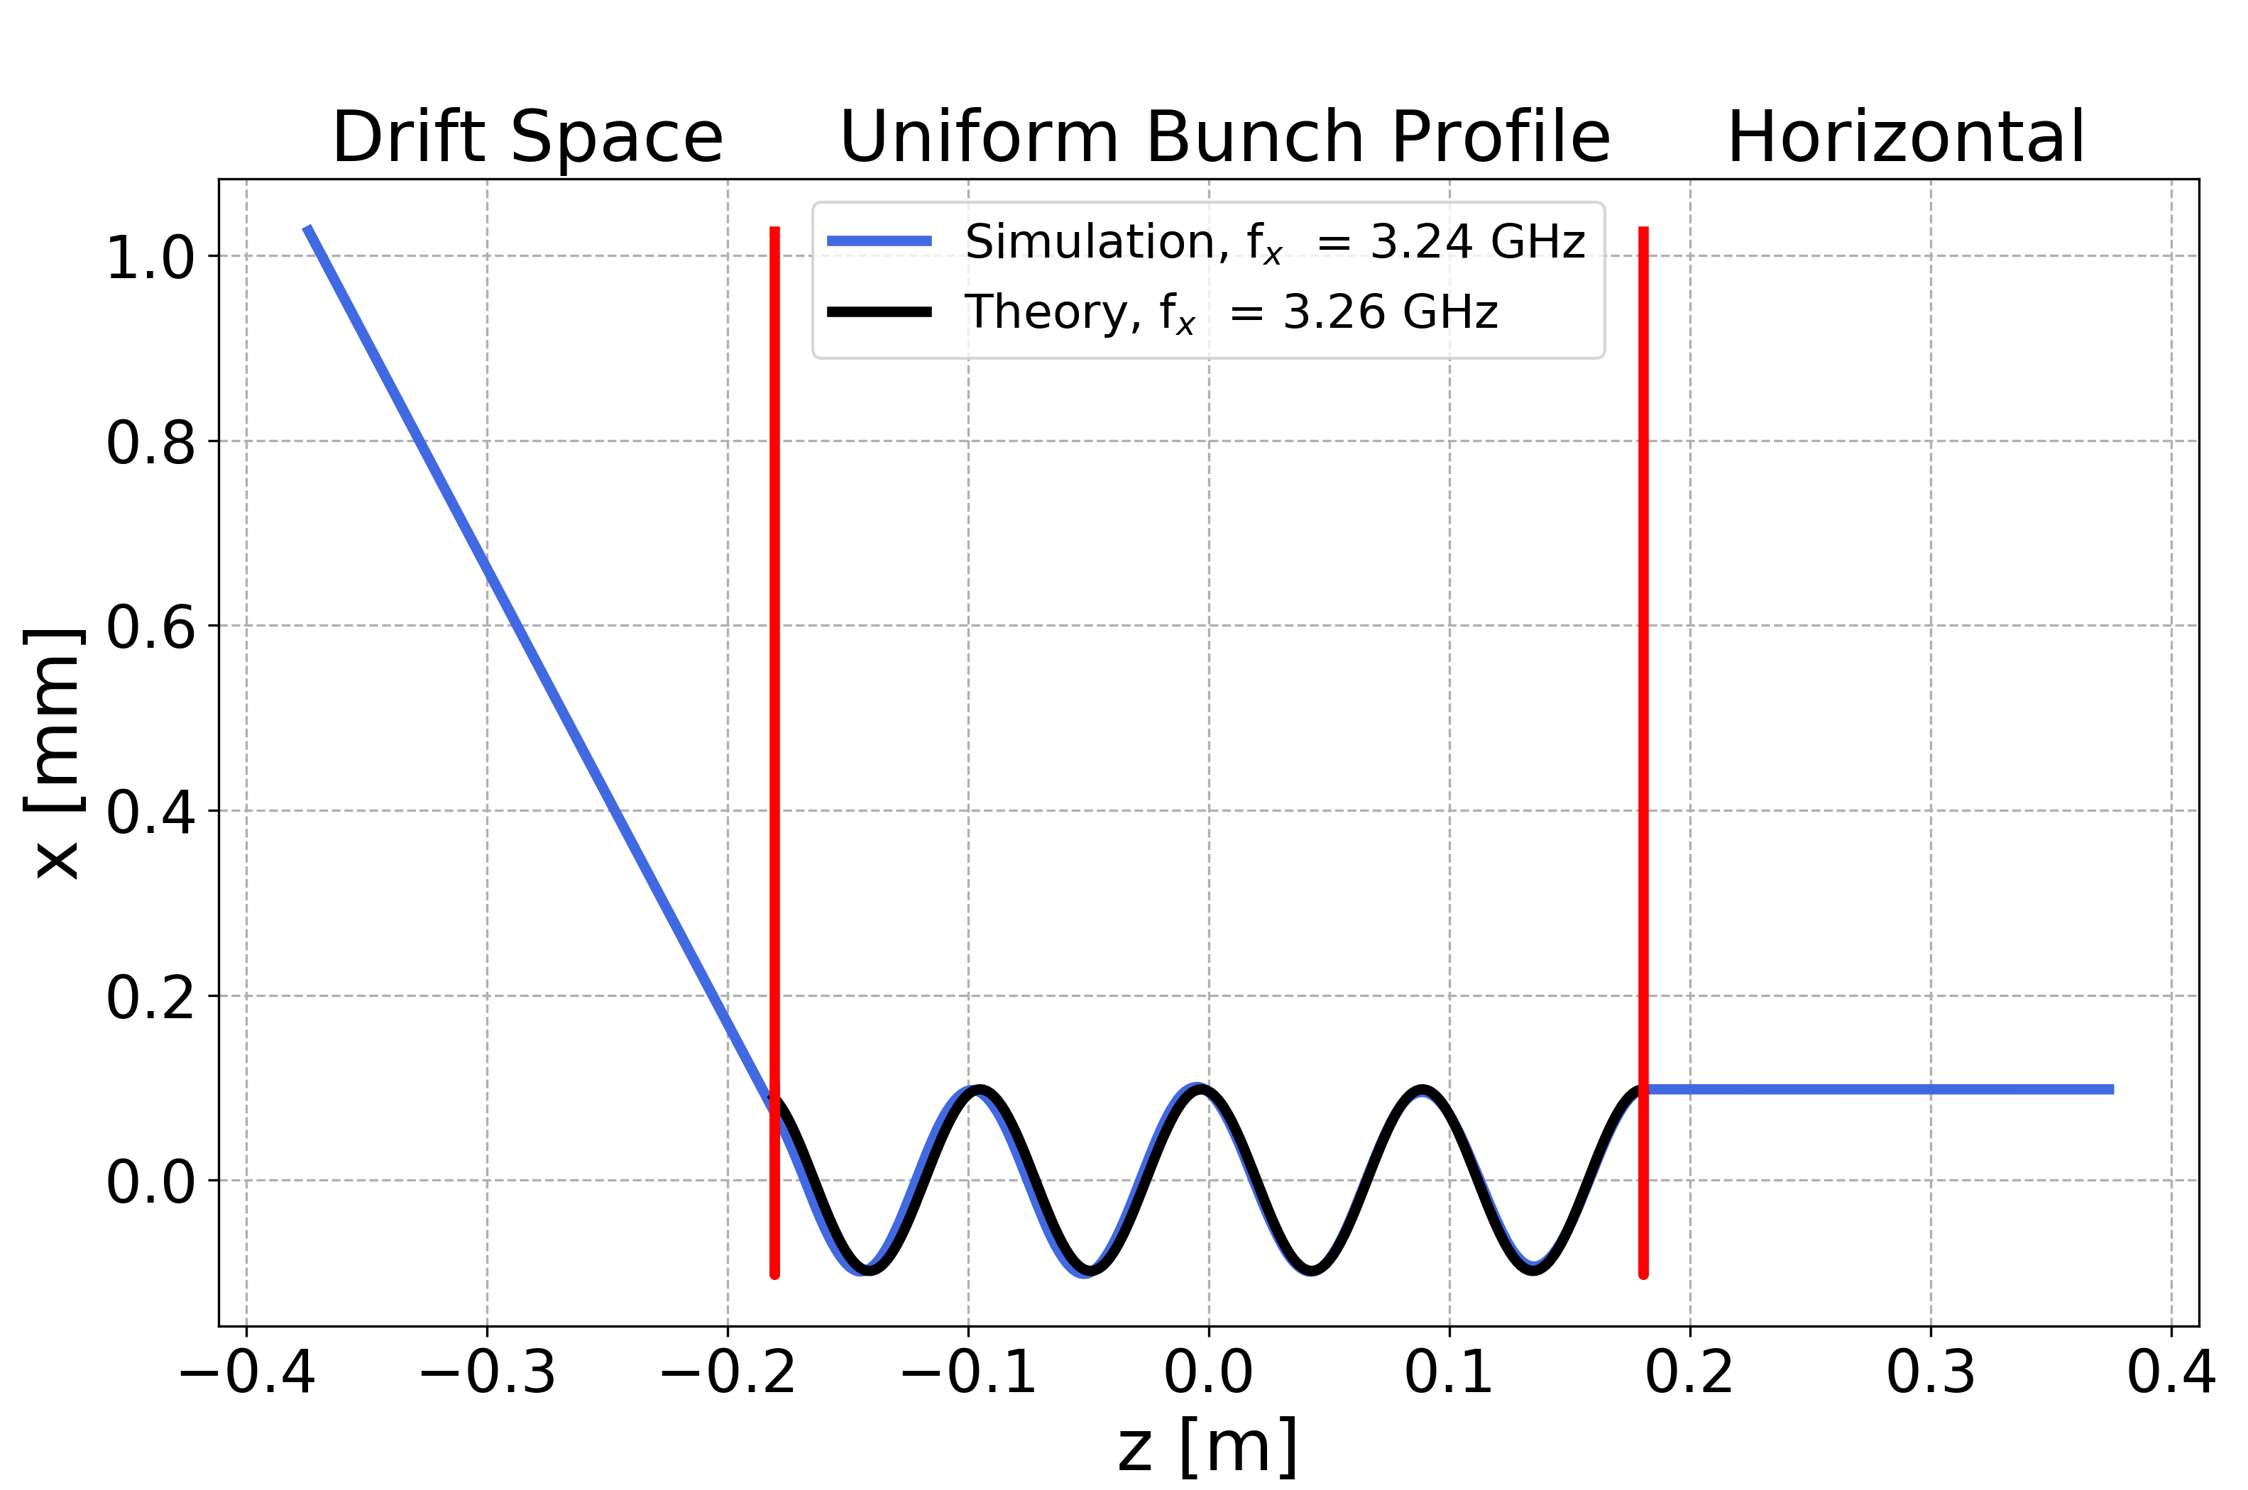
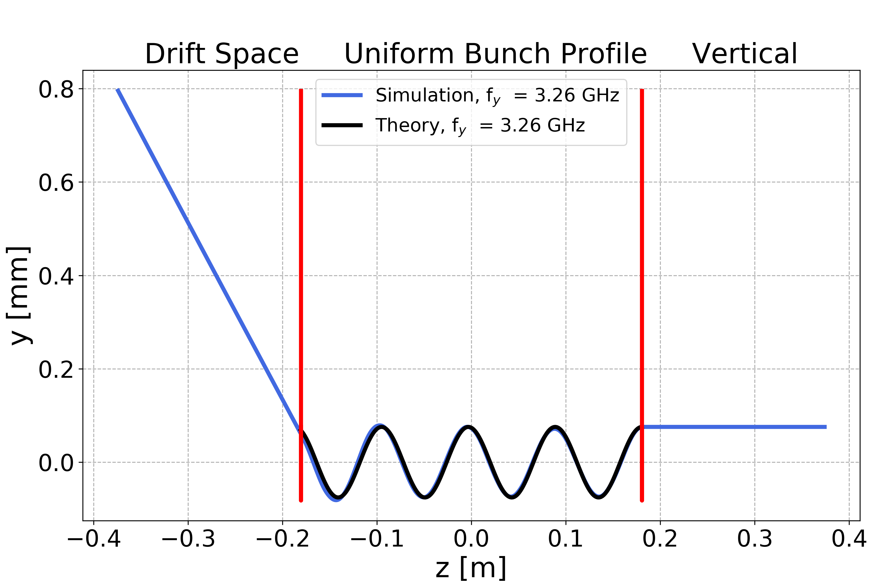
Uniform Longitudinal Profile: Drift Space
$A_{xgoal}=0.1$ mm $A_{ygoal}=0.1$ mm at bunch start
Good agreement between simulation and theoretical prediction

Slide 31
Outline
Theoretical Oscillation
Uniform Longitudinal Profile
  Drift Space
  Dipole
  Arc Quadrupole
Gaussian Longitudinal Profile
Conclusions

Slide 32
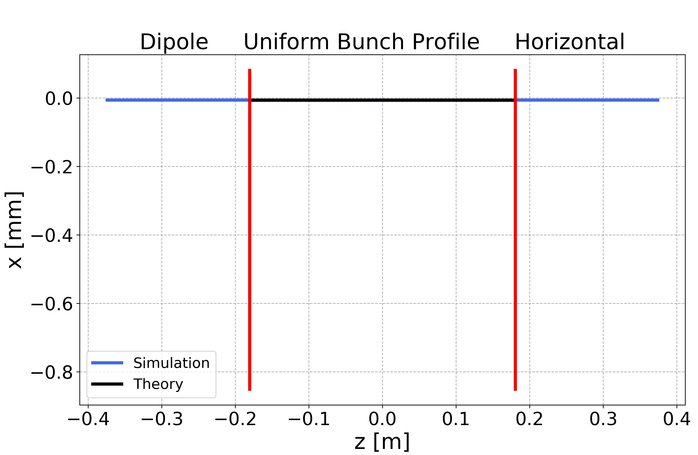
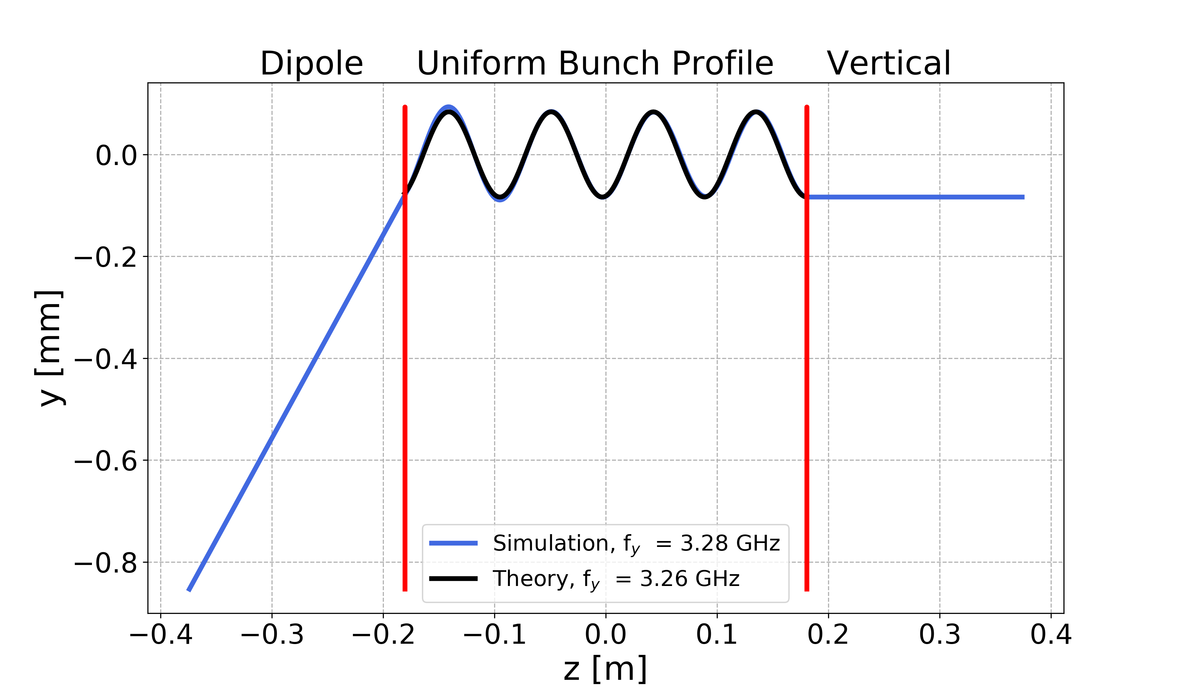
Uniform Longitudinal Profile: Dipole
$A_{xgoal}=0.0$ mm $A_{ygoal}=0.1$ mm at bunch start
Good agreement between simulation and theoretical prediction
In horizontal plane, the electrons cannot move due to the presence of the dipolar magnetic field

Slide 33
Outline
Theoretical Oscillation
Uniform Longitudinal Profile
  Drift Space
  Dipole
  Arc Quadrupole
Gaussian Longitudinal Profile
Conclusions

Slide 34
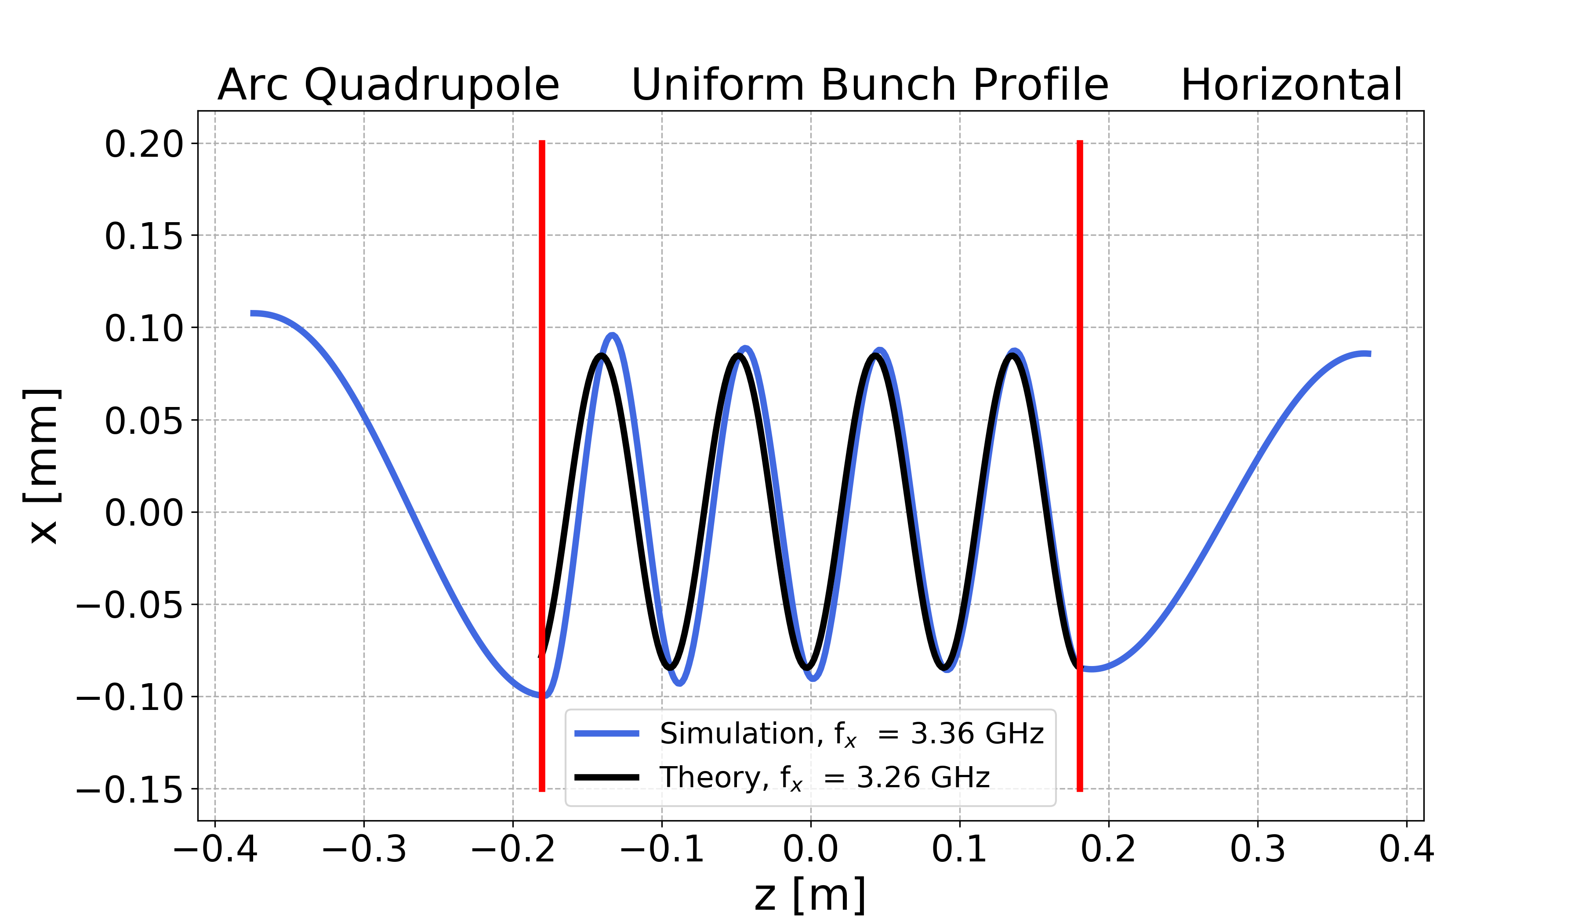
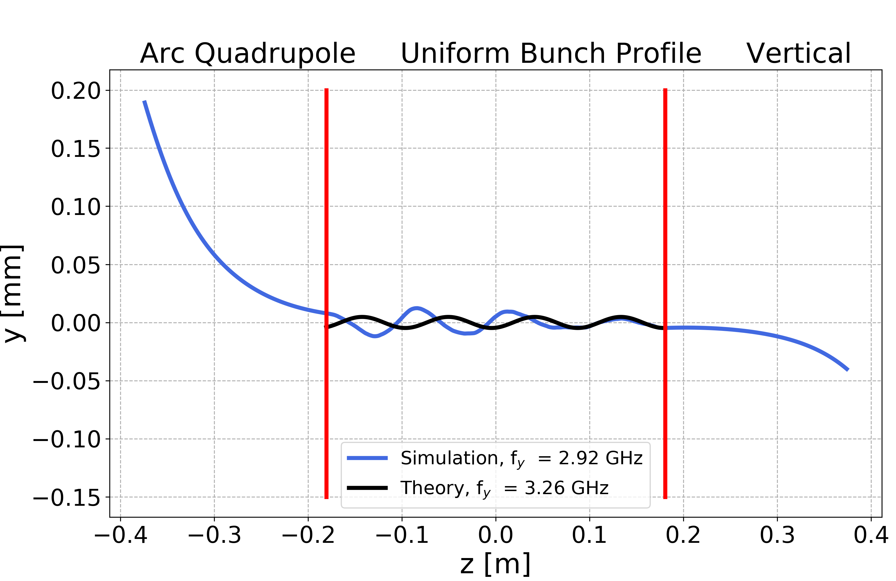
Uniform Longitudinal Profile: Quadrupole
$A_{xgoal}=0$.1 mm $A_{ygoal}=0.0$ mm at bunch start
Good agreement between simulation and theoretical prediction

Slide 35
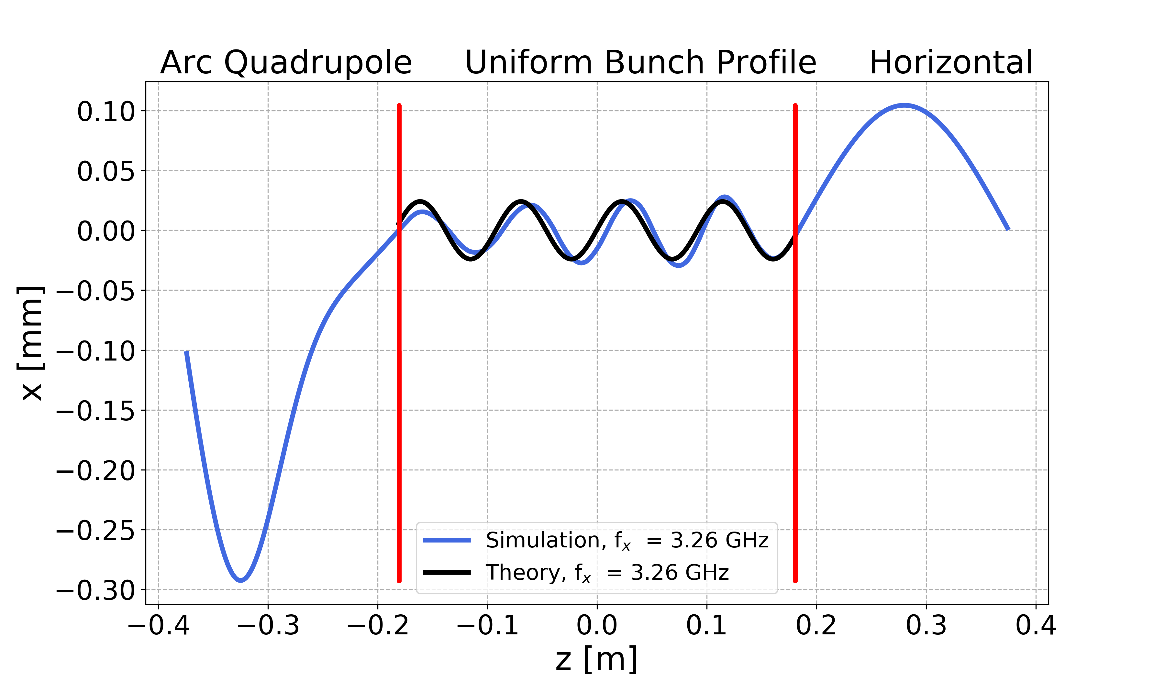
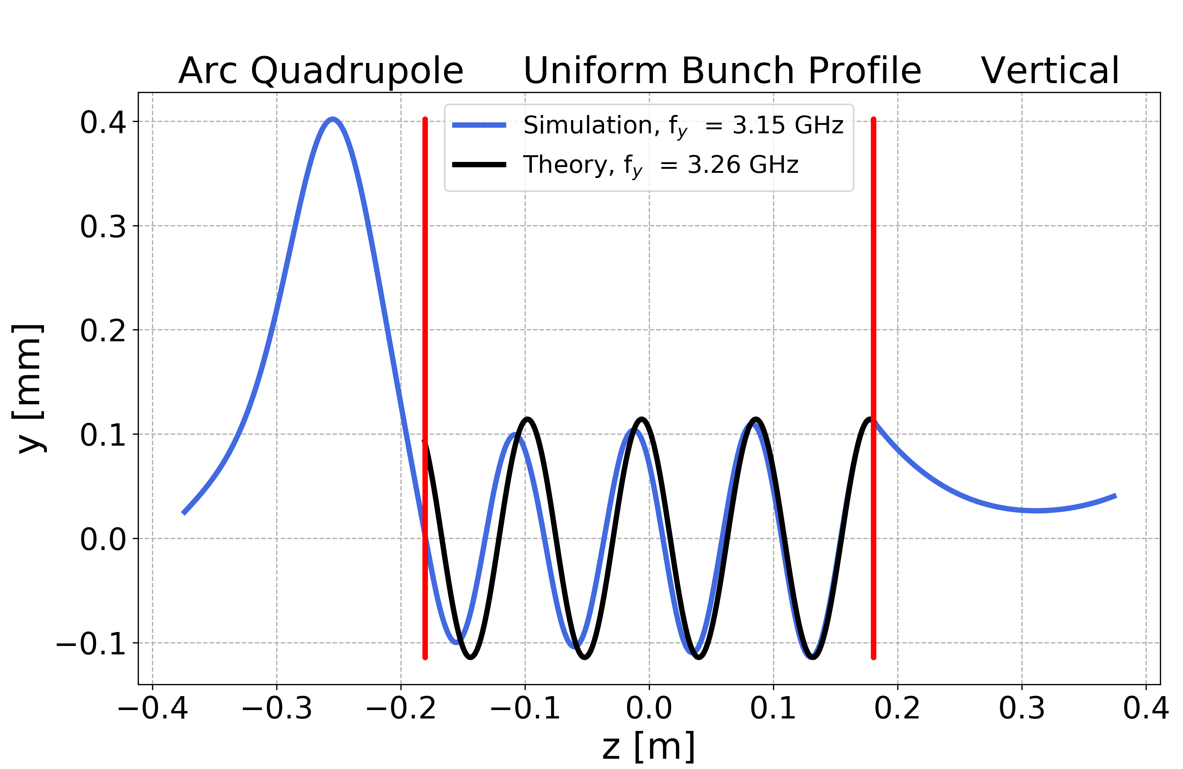
Uniform Longitudinal Profile: Quadrupole
$A_{xgoal}=0.0$ mm $A_{ygoal}=0.1$ mm at bunch start
Good agreement between simulation and theoretical prediction

Slide 36
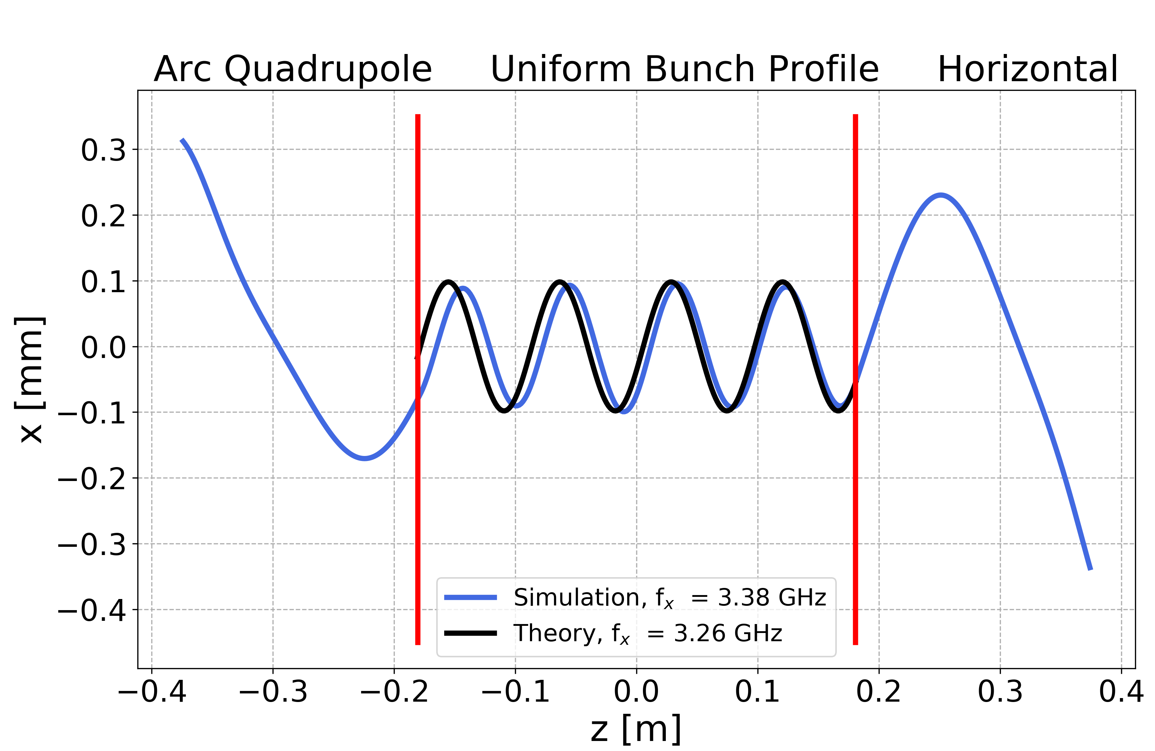
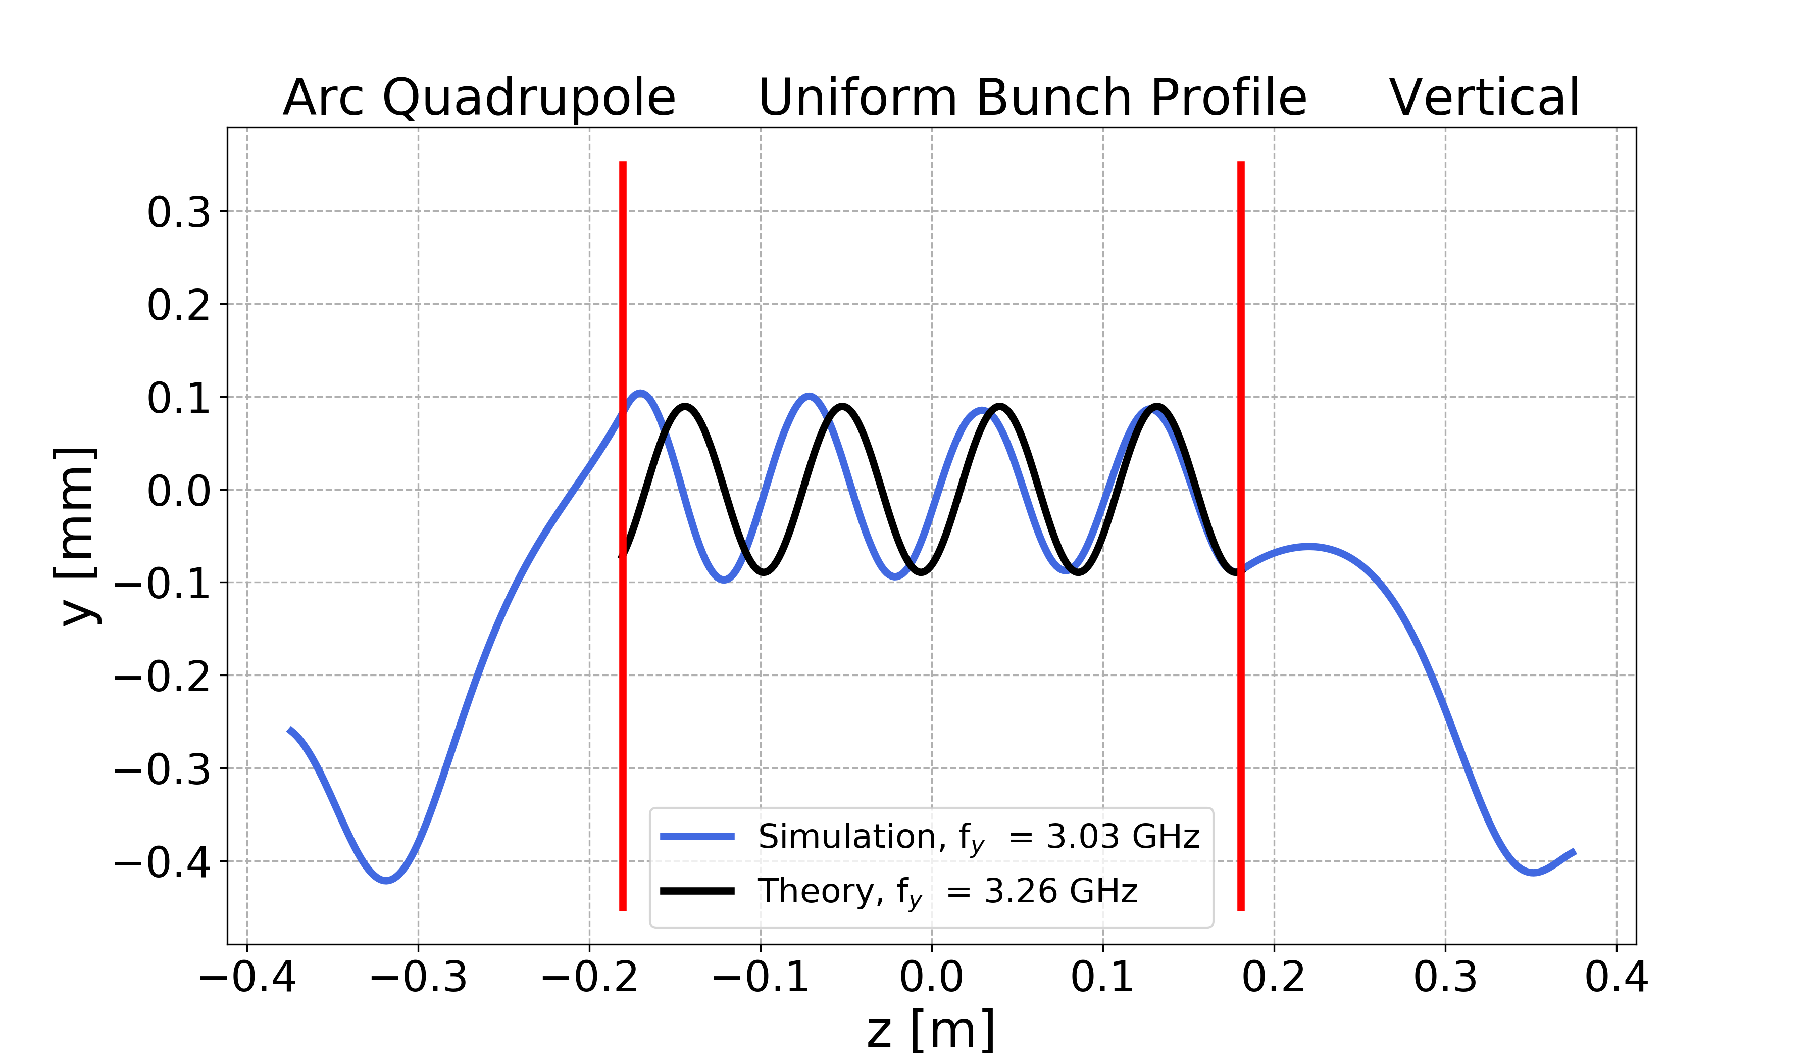
Uniform Longitudinal Profile: Quadrupole
$A_{xgoal}=0.1$ mm $A_{ygoal}=0.1$ mm at bunch start
The equations work well also when the electron oscillates in both the planes

Slide 37
Outline
Theoretical Oscillation
Uniform Longitudinal Profile
Gaussian Longitudinal Profile
  Drift Space
  Dipole
  Arc Quadrupole
Conclusions

Slide 38


Gaussian Longitudinal Profile
$σ_{z}=89.9$ mm
$z_{cut}=$375 mm
500 slices
$$\frac{\text{MPs} }{\sqrt{2π}σ_{z}}e^{−\frac{z^{2}}{2{σ_{z}}^{2}}}$$
$${−z}_{cut}$$
$${−2σ}_{z}$$
$${2σ}_{z}$$
$$z_{cut}$$
$${L=4σ}_{z}$$

Slide 39
Outline
Theoretical Oscillation
Uniform Longitudinal Profile
Gaussian Longitudinal Profile
  Drift Space
  Dipole
  Arc Quadrupole
Conclusions

Slide 40


Gaussian Longitudinal Profile: Drift Space
$A_{xgoal}=0.1$ mm $A_{ygoal}=0.1$ mm at bunch start
Using the equations of the case of uniform longitudinal profile

Slide 41



Gaussian Longitudinal Profile: Drift Space
$A_{xgoal}=0.1$ mm $A_{ygoal}=0.1$ mm at bunch start
The frequency increases in the centre of the proton bunch (more protons):
The amplitude decreases in the centre of the proton bunch (more protons):
$$ω_{x}=\sqrt{\frac{q_{e}λ_{z}}{2πε_{0}m_{e}σ_{x}\left(σ_{x}+σ_{y}\right)}}$$
$$λ_{z}=\frac{q_{e}N_{b}}{L}$$
(3)
(4)
$${A_{x}}^{2}={x_{0}}^{2}+{\left(\frac{v_{x0}}{ω_{x}}\right)}^{2}$$
(12)

Slide 42




Gaussian Longitudinal Profile
$$λ_{z}(z)=\frac{q_{e}N_{b}}{\sqrt{2π}σ_{z}}e^{−\frac{z^{2}}{2{σ_{z}}^{2}}}$$
(5)
The local frequency increases in the centre of the proton bunch
$$f_{x}(z)=2π\sqrt{\frac{q_{e}λ_{z}(z)}{2πε_{0}m_{e}σ_{x}\left(σ_{x}+σ_{y}\right)}}$$
(3)

Slide 43


Gaussian Longitudinal Profile
In the case of Gaussian longitudinal profile the frequency depends on the time:
Therefore, (8) is only a local approximated solution (not a global solution) of our problem.
We can use an iterative method
$$\ddot{x}+{ω_{x}}^{2}(t)x=0$$
(6)
$$x\left(t\right)=A_{x}\cos\left(ω_{x}(t)t+φ_{x}\right)$$
(8)

Slide 44


Gaussian Longitudinal Profile
Step 0
$$x\left(z_{0}\right)=x_{0}$$
(9.1)
The initial position of the electron is given by the initial conditions

Slide 45





Gaussian Longitudinal Profile
Step 1
$$x\left(z\right)=A_{x0}\cos\left[\frac{ω_{x}(z_{0})}{c}\left(z−z_{0}\right)+φ_{x0}\right]$$
(21)
$$A_{x0}=A_{x}(z_{0})=\sqrt{{x_{0}}^{2}+{\left(\frac{v_{x0}}{ω_{x}(z_{0})}\right)}^{2}}$$
(12)
$$φ_{x0}=φ_{x}(z_{0})=−\arctan_{IV}\left(\frac{{v_{x0}}/{ω_{x}(z_{0})}}{x_{0}}\right)$$
(13)
The local solution at z₀ is given by (21).
In order to simplify the mathematical notation:
$$x_{k}=x\left(z_{k}\right)$$
$$ω_{xk}=ω_{x}\left(z_{k}\right)$$
$$A_{xk}=A_{x}(z_{k})$$
$$φ_{xk}=φ_{x}(z_{k})$$

Slide 46






Gaussian Longitudinal Profile
Step 1
$$x_{1}=A_{x0}\cos\left[\frac{ω_{x0}}{c}\left(z_{1}−z_{0}\right)+φ_{x0}\right]$$
$$∆z_{1}=z_{1}−z_{0}$$
Uniform sampling:
$∆z_{k}=∆z$
$$x_{1}=A_{x0}\cos\left[\frac{ω_{x0}}{c}∆z+φ_{x0}\right]$$
(22)
The electron position at z₁ is given by (22).
The initial conditions of the next step are:
$$\left\{\begin{matrix}x_{1} \\ v_{x1}={−A}_{x0}ω_{x0}\sin\left(\frac{ω_{x0}}{c}∆z+φ_{x0}\right)\end{matrix}\right.$$

Slide 47




Gaussian Longitudinal Profile
Step 2
$$x\left(z\right)=A_{x1}\cos\left[\frac{ω_{x1}}{c}\left(z−z_{1}\right)+φ_{x1}\right]$$
(23)
$$A_{x1}=\sqrt{{x_{1}}^{2}+{\left(\frac{v_{x1}}{ω_{x1}}\right)}^{2}}$$
(12)
$$φ_{x1}=−\arctan_{IV}\left(\frac{{v_{x1}}/{ω_{x1}}}{x_{1}}\right)$$
(13)
The solution at z₁ is given by (23)

Slide 48



Gaussian Longitudinal Profile
Step 2
$$x_{2}=A_{x1}\cos\left[\frac{ω_{x1}}{c}∆z+φ_{x1}\right]$$
(24)
The electron position at z₂ is given by (24).
The initial conditions of the next step are:
$$\left\{\begin{matrix}x_{2} \\ v_{x2}={−A}_{x1}ω_{x1}\sin\left(\frac{ω_{x1}}{c}∆z+φ_{x1}\right)\end{matrix}\right.$$
And so on…

Slide 49




Gaussian Longitudinal Profile
Step k
Summary:
(25)
(26)
(27)
(28)
$$A_{xk}=\sqrt{{x_{k}}^{2}+{\left(\frac{v_{xk}}{ω_{xk}}\right)}^{2}}$$
$$φ_{xk}=−\arctan_{IV}\left(\frac{{v_{xk}}/{ω_{xk}}}{x_{k}}\right)$$
$$x_{k+1}=A_{xk}\cos\left[\frac{ω_{xk}}{c}∆z+φ_{xk}\right]$$
$$\begin{matrix} \\ v_{xk+1}={−A}_{xk}ω_{xk}\sin\left(\frac{ω_{xk}}{c}∆z+φ_{xk}\right)\end{matrix}$$

Slide 50


Gaussian Longitudinal Profile: Drift Space
$A_{xgoal}=0.1$ mm $A_{ygoal}=0.0$ mm at bucket start
Good agreement between simulation and theoretical prediction

Slide 51


Gaussian Longitudinal Profile: Drift Space
$A_{xgoal}=0.0$ mm $A_{ygoal}=0.1$ mm at bucket start
Good agreement between simulation and theoretical prediction

Slide 52


Gaussian Longitudinal Profile: Drift Space
$A_{xgoal}=0.1$ mm $A_{ygoal}=0.1$ mm at bucket start
The equations work well also when the electron oscillates in both the planes

Slide 53
Outline
Theoretical Oscillation
Uniform Longitudinal Profile
Gaussian Longitudinal Profile
  Drift Space
  Dipole
  Arc Quadrupole
Conclusions

Slide 54


Gaussian Longitudinal Profile: Dipole
$A_{xgoal}=0.0$ mm $A_{ygoal}=0.1$ mm at bucket start
Good agreement between simulation and theoretical prediction
In horizontal plane, the electrons cannot move due to the presence of the dipolar magnetic field

Slide 55
Outline
Theoretical Oscillation
Uniform Longitudinal Profile
Gaussian Longitudinal Profile
  Drift Space
  Dipole
  Arc Quadrupole
Conclusions

Slide 56


Gaussian Longitudinal Profile: Quadrupole
$A_{xgoal}=0$.1 mm $A_{ygoal}=0.0$ mm at bucket start
The magnetic field force on the electrons is not negligible compared to the electric field outside the range ±2𝜎_{z}
Good agreement between simulation and theoretical prediction inside the range ±2𝜎_{z}

Slide 57


Gaussian Longitudinal Profile: Quadrupole
$A_{xgoal}=0.0$ mm $A_{ygoal}=0.1$ mm at bucket start
Good agreement between simulation and theoretical prediction inside the range ±2𝜎_{z}

Slide 58


Gaussian Longitudinal Profile: Quadrupole
$A_{xgoal}=0.1$ mm $A_{ygoal}=0.1$ mm at bucket start
Good agreement between simulation and theoretical prediction inside the range ±2𝜎_{z}
The equations work well also when the electron oscillates in both the planes

Slide 59
Outline
Theoretical Oscillation
Uniform Longitudinal Profile
Gaussian Longitudinal Profile
Conclusions

Slide 60

Conclusions
  No bugs in the code: we find the frequency we expect (when $λ_{z}$ is uniform);
  When $λ_{z}$ is Gaussian we can compute local frequencies (for estimating $∆z$);
  This is also valid in the presence of a magnetic field
  Study the oscillation of all electrons
Future Developments

Slide 61
Thanks for your attention

Slide 63
Extended Presentation
/eos/user/l/lusabato/e_cloud_studies/milestones/2019-02-13_electron_oscillation_8.pptx

Slide 64





Appendix: Amplitude - Phase
$$\left\{\begin{matrix}{A_{x}}^{2}={x_{0}}^{2}+{\left(\frac{v_{x0}}{ω_{x}}\right)}^{2} \\ φ_{x}=−\arctan_{IV}\left(\frac{{v_{x0}}/{ω_{x}}}{x_{0}}\right)=\left\{\begin{matrix}−arctan\left(\frac{{v_{x0}}/{ω_{x}}}{x_{0}}\right) & x_{0}>0 \\ ±π−arctan\left(\frac{{v_{x0}}/{ω_{x}}}{x_{0}}\right) & x_{0}<0\end{matrix}\right.\end{matrix}\right.$$
(12)
(13)
$$−{v_{x0}}/{ω_{x}}$$
$$\left\{\begin{matrix}A_{x}\cos\left(φ_{x}\right)=x_{0} \\ A_{x}\sin\left(φ_{x}\right)=−\frac{v_{x0}}{ω_{x}}\end{matrix}\right.$$
(10)
\A_{x}\
$$φ_{x}$$
(11)
$$x_{0}$$

Slide 65







Appendix: Invariant (2.1)
An Ordinary Differential Equation (ODE) of the second order can be written as a system of two ODE of the first order:
$$\left\{\begin{matrix}\frac{dx}{dt}=v_{x} \\ \frac{dv_{x}}{dt}=−{ω_{x}}^{2}x\end{matrix}\right.$$
(6.1)
$$\ddot{x}+{ω_{x}}^{2}x=0$$
(6)
(6.2)
$$α\frac{dx}{dt}+β\frac{dv_{x}}{dt}={αv}_{x}−{βω_{x}}^{2}x$$
𝛂*(6.1) + 𝛃*(6.2):
$$\frac{d}{dt}\left(αx+βv_{x}\right)={αv}_{x}−{βω_{x}}^{2}x$$
In order to have this quantity $\left(αx+βv_{x}\right)$ constant with the time:
$${αv}_{x}−{βω_{x}}^{2}x=0$$
$$β=α\frac{v_{x}}{{ω_{x}}^{2}x}$$
(21)
Substituting (14) in the invariant:
$$\left(αx+βv_{x}\right)=\frac{α}{x}\left(x^{2}+\frac{{v_{x}}^{2}}{{ω_{x}}^{2}}\right)$$
(22)

Slide 66




Appendix: Invariant (2.2)
In order to have the same invariant (13), we can choose 𝛂:
$$α=\frac{1}{2}m_{e}{ω_{x}}^{2}x$$
$$β=\frac{1}{2}m_{e}v_{x}$$
(24)
(23)
$$\left(αx+βv_{x}\right)=\frac{1}{2}m_{e}{ω_{x}}^{2}\left(x^{2}+\frac{{v_{x}}^{2}}{{ω_{x}}^{2}}\right)$$
(25)

Slide 67





Gaussian Longitudinal Bunch Profile: Drift Space
$A_{xgoal}=0.1$ mm $A_{ygoal}=0.1$ mm at bunch start
$$x\left(z\right)=A_{x}\cos\left[\frac{ω_{x}}{c}\left(z−z_{0}\right)+φ_{x}\right]$$
(9)
Oscillation Amplitude:
Traslation in z axis:
z₀ = 2𝜎_{z}
Oscillation phase:
$${A_{x}}^{2}={x_{0}}^{2}+{\left(\frac{v_{x0}}{ω_{x}}\right)}^{2}$$
$$φ_{x}=−\arctan_{IV}\left(\frac{{v_{x0}}/{ω_{x}}}{x_{0}}\right)$$
(12)
(13)
Oscillation Angular Frequency:
$$ω_{x}=\sqrt{\frac{q_{e}λ_{z}}{2πε_{0}m_{e}σ_{x}\left(σ_{x}+σ_{y}\right)}}$$
$$λ_{z}=\frac{q_{e}N_{b}}{L}$$
(3)
(4)

Slide 68


Gaussian Longitudinal Bunch Profile: Quadrupole
$A_{xgoal}=0.1$ mm $A_{ygoal}=0.1$ mm at bucket start
Discrepancy between the theoretical predictions and the simulations
The magnetic field force on the electrons might be non-negligible compared to the electric field:
  considering only the part of the bunch where there are more protons (in the longitudinal centre, for example in the range ±2𝜎_{z})
  coupling between the planes

