Slide 2
Asset Management within ML (BI)
Benjamin Moser BI-ML

Slide 3
MTF Code = Asset Code

Slide 4
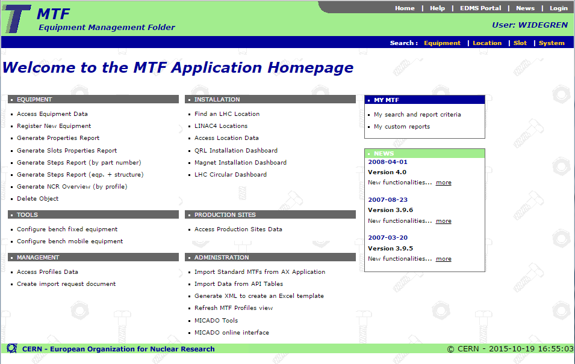
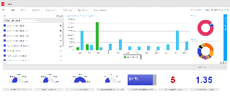
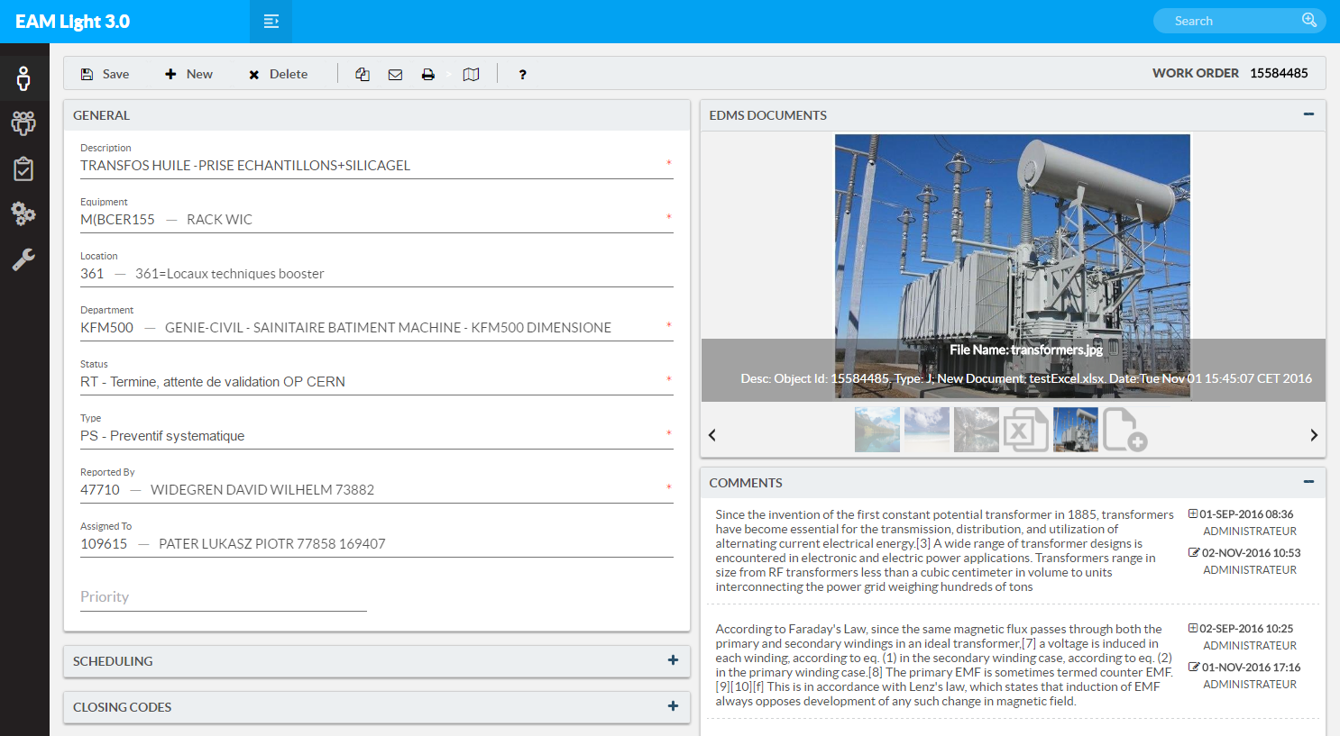


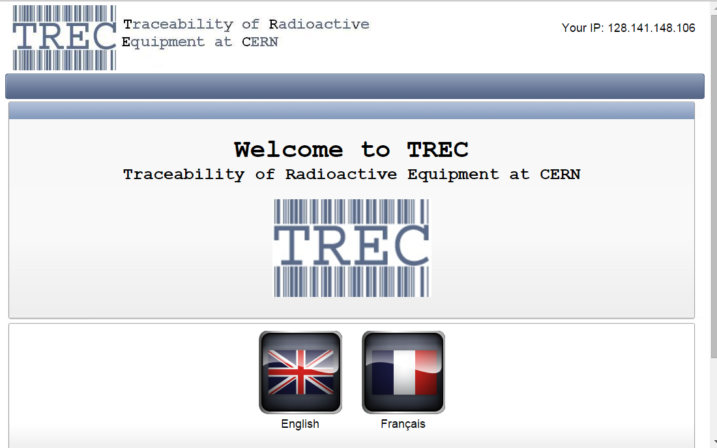
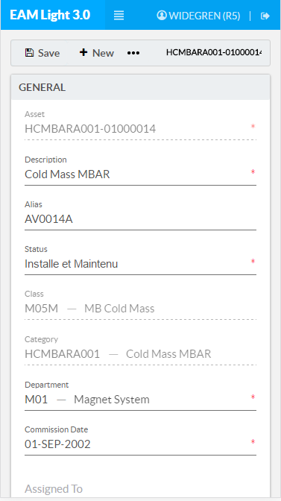
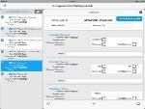

Our Asset Management Platform
Manufacturing
Operation &
Maintenance
Disposal & Waste
Management
MTF
Manufacturing & Test Folder
EAM-Light
Enterprise Asset Management
TREC
Radioactive Traceability

Slide 5
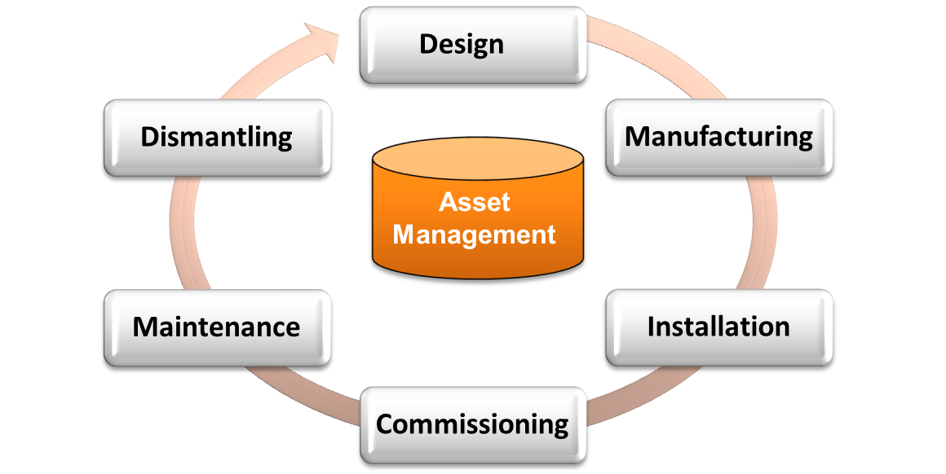

Asset Management at CERN
Assets at CERN have often a lifecycle exceeding 50 years.
The long lifecycles combined with turnover of personnel make documentation of both assets and interventions an absolute must.
An inventory of all assets with detailed technical characteristics is essential.

Slide 6
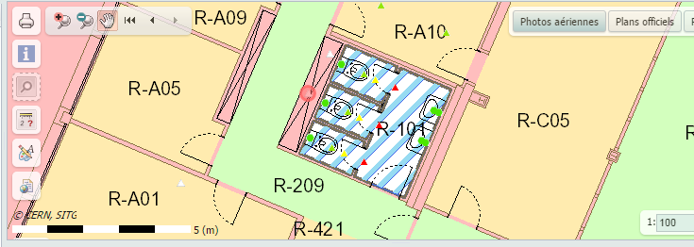

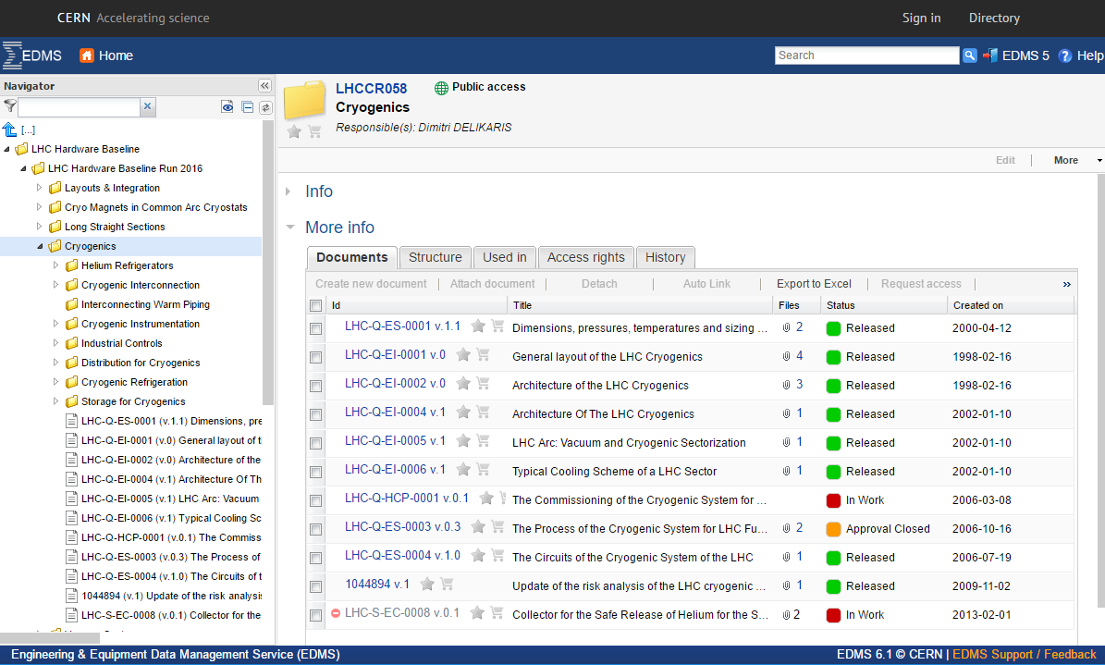
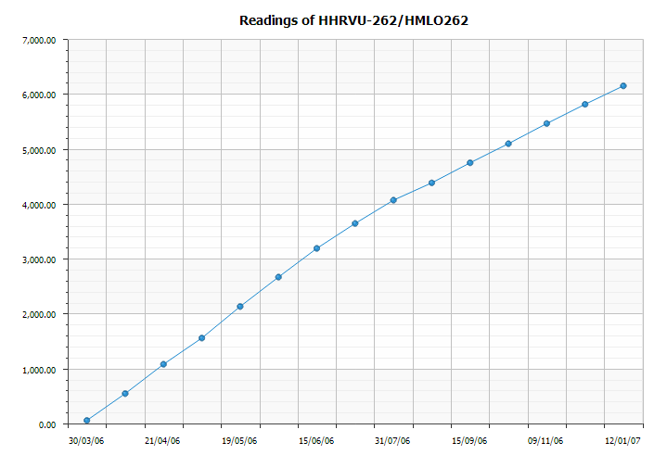
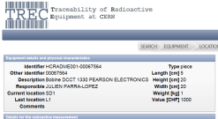

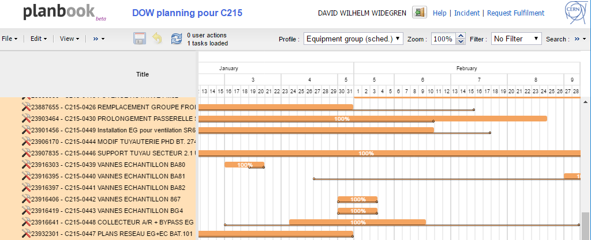
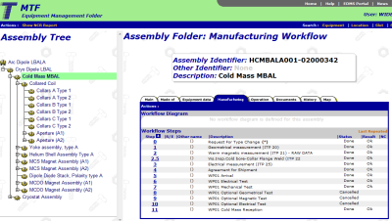
Integrating tools and processes
GIS
Control Room & Service Desk
EDMS
Reporting tools
Tracing radioactive equip.
Planning tools
EAM
Accelerator Layout DB
Manufacturing & Tests
Contractor’s CMMS
SCADA
ERP(s)
Access Control

Slide 7
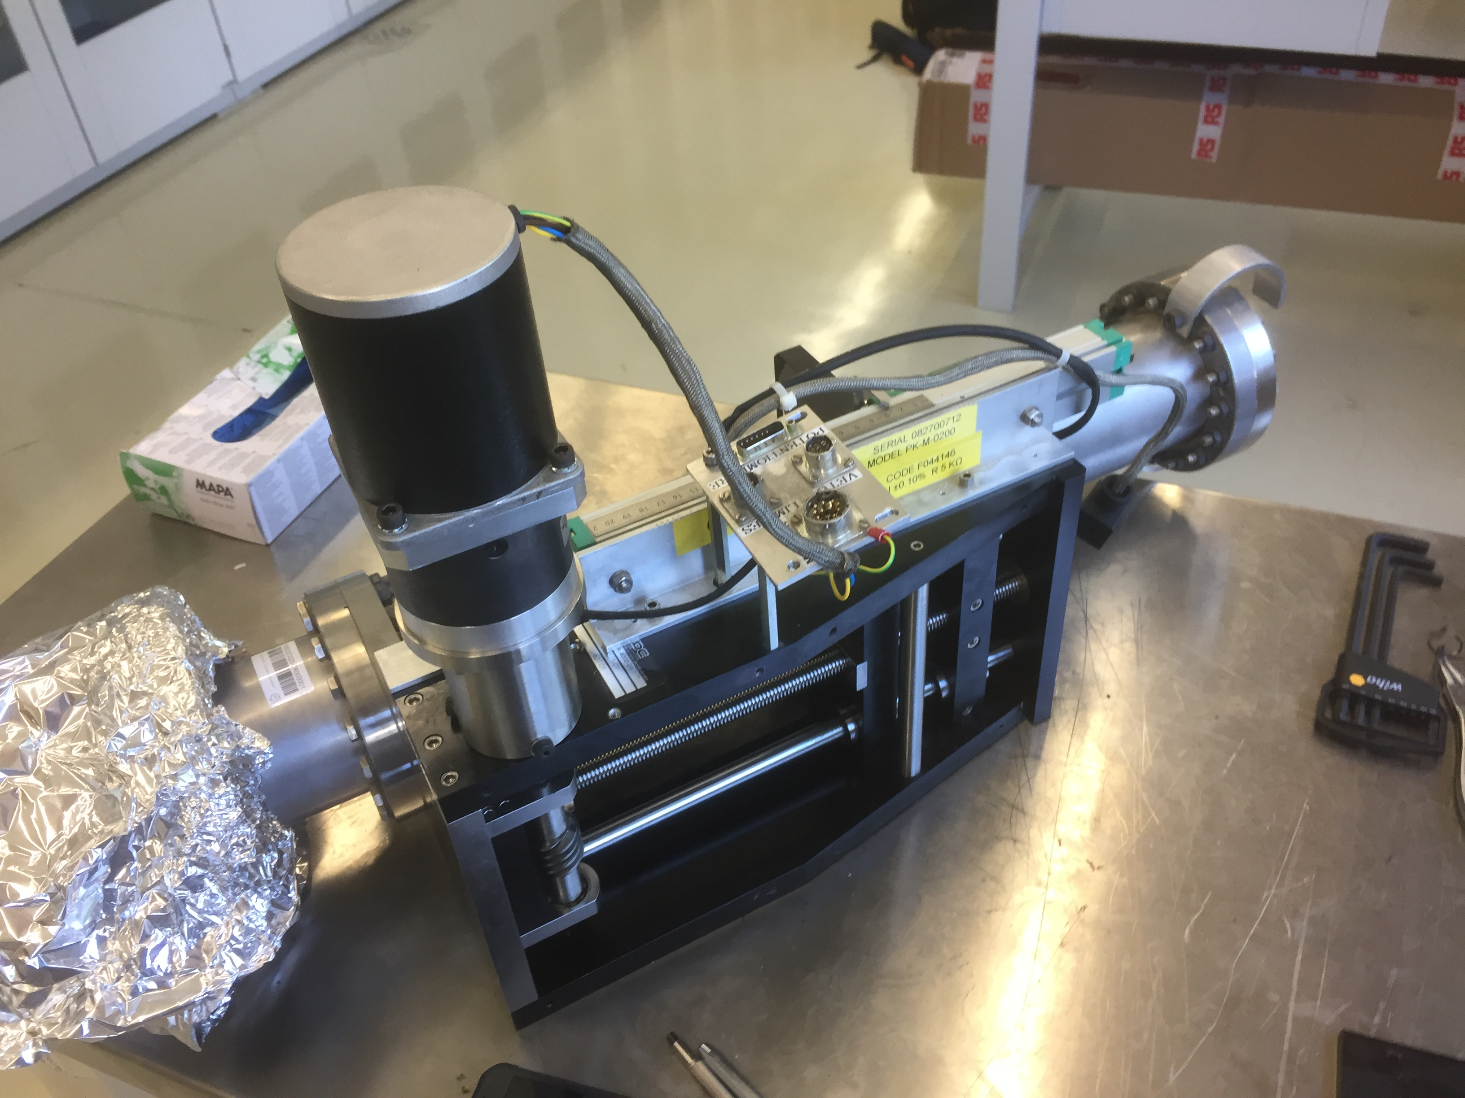
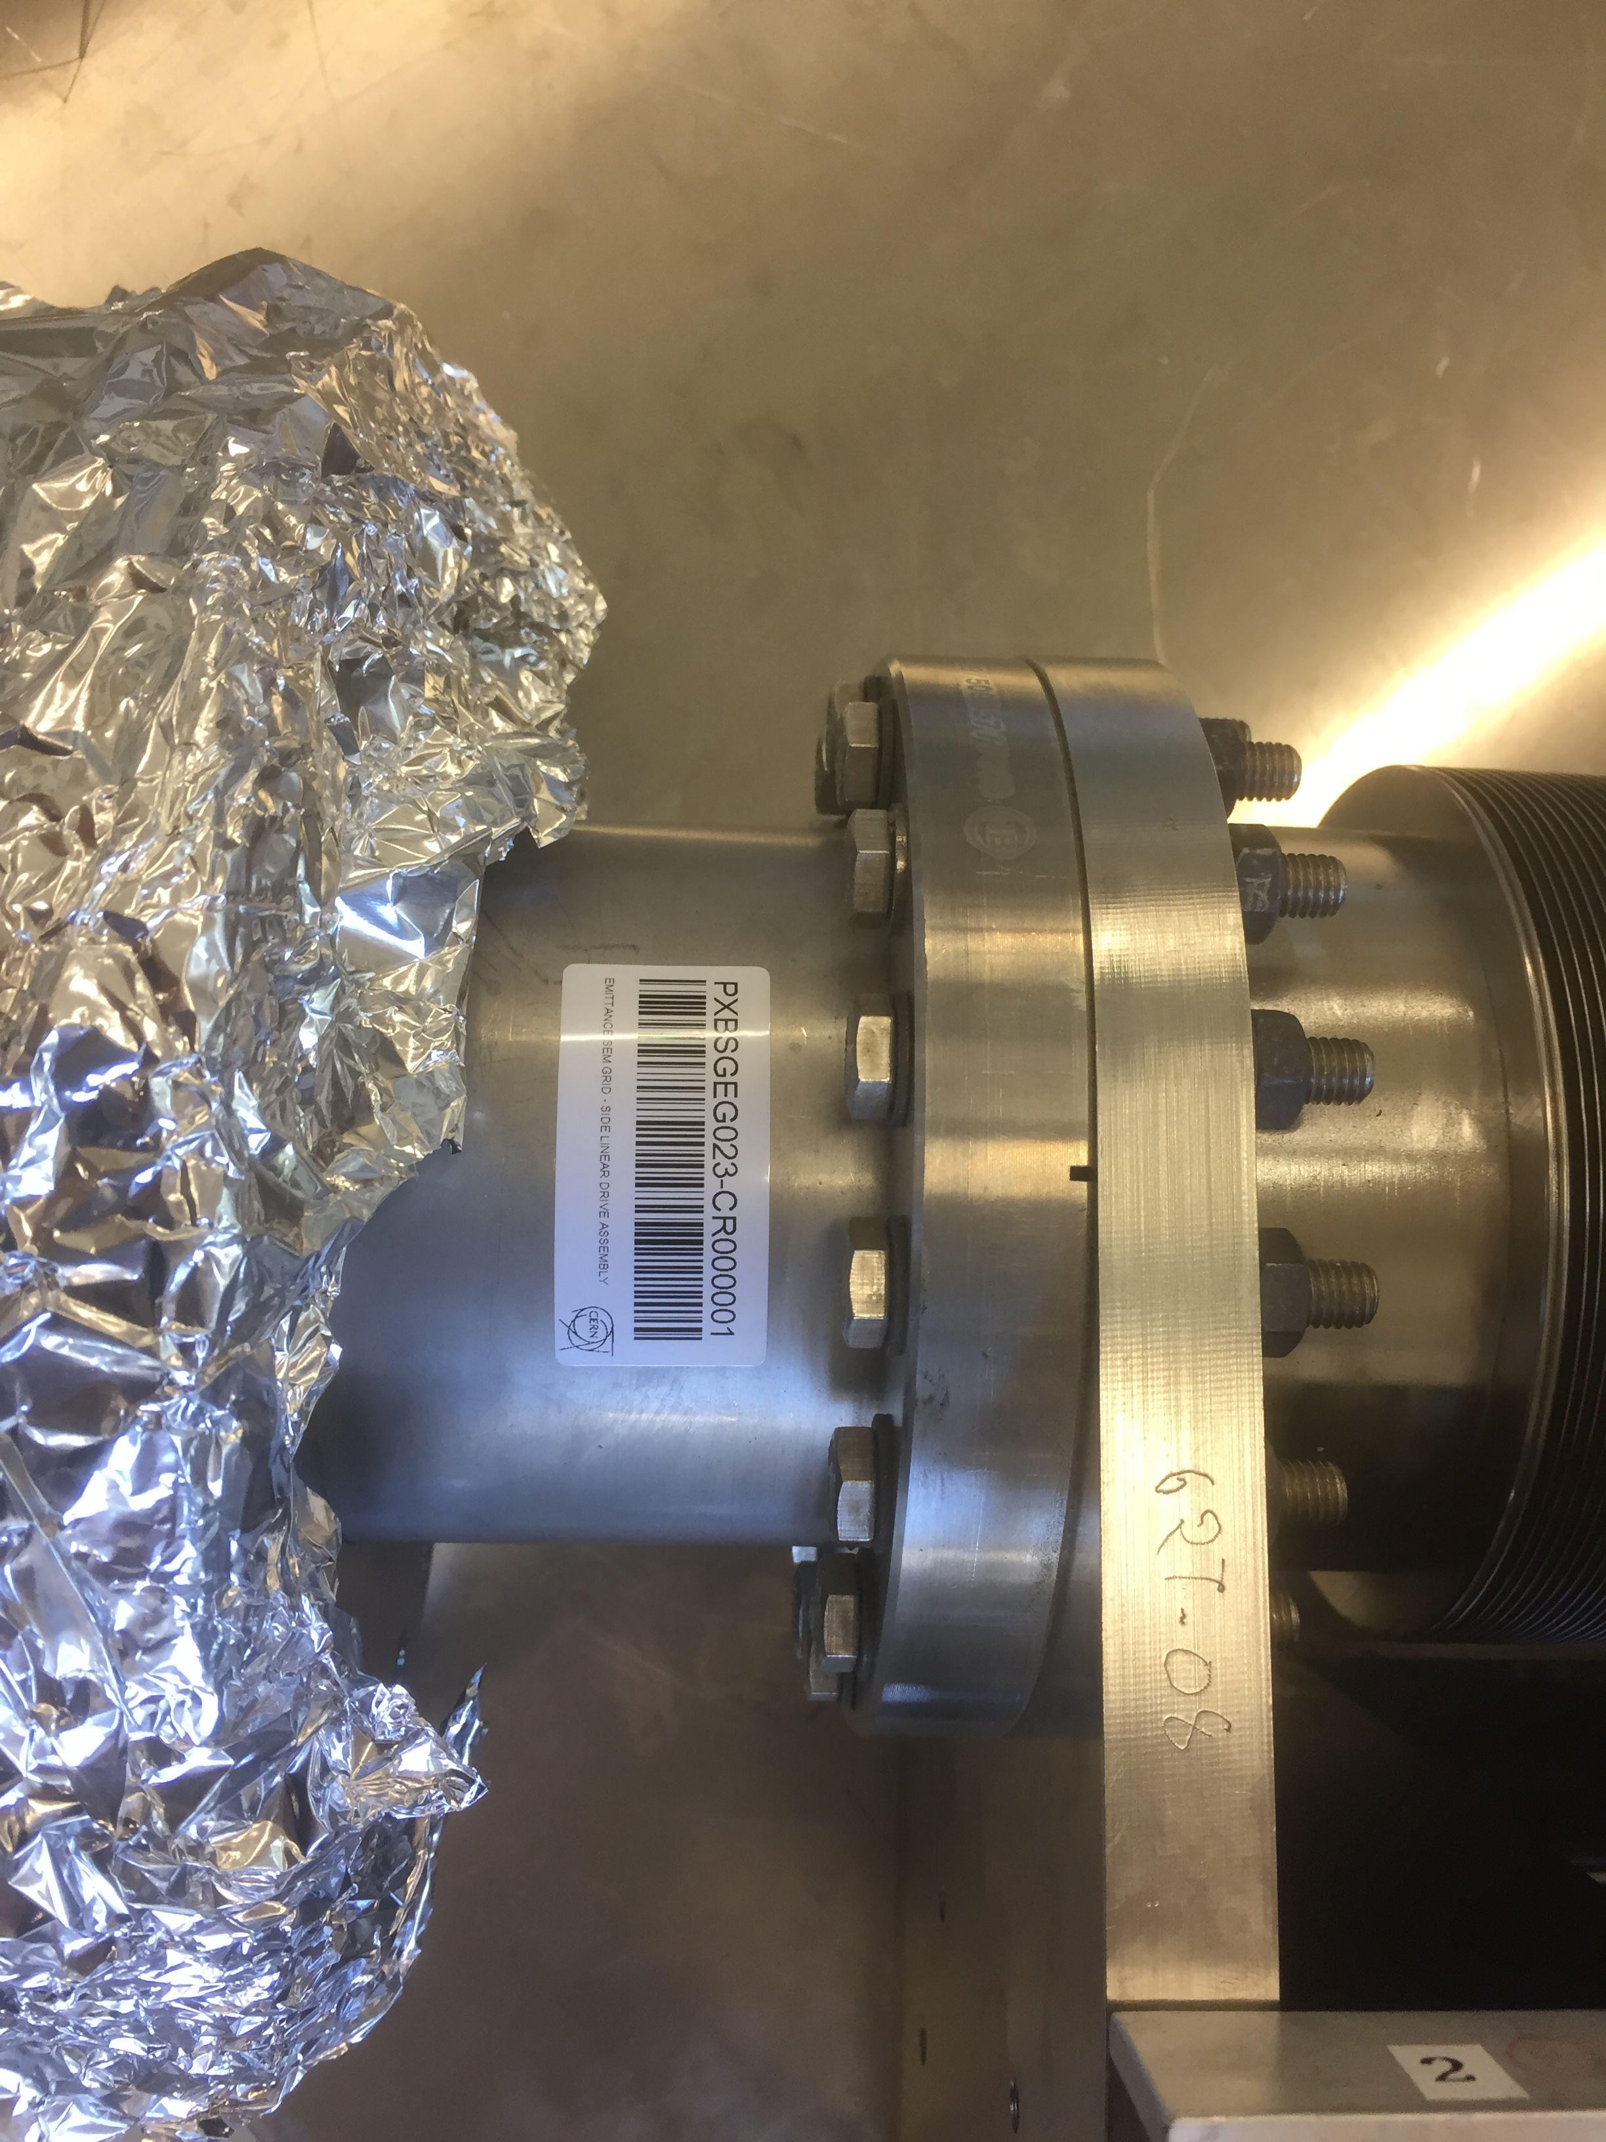
Our Asset Codes
A code which identifies one specific equipment / assembly

Slide 8
Our Asset Codes
PXBSGEG023-CR000001
Asset identification,
Naming is based on the CDD naming

Slide 9
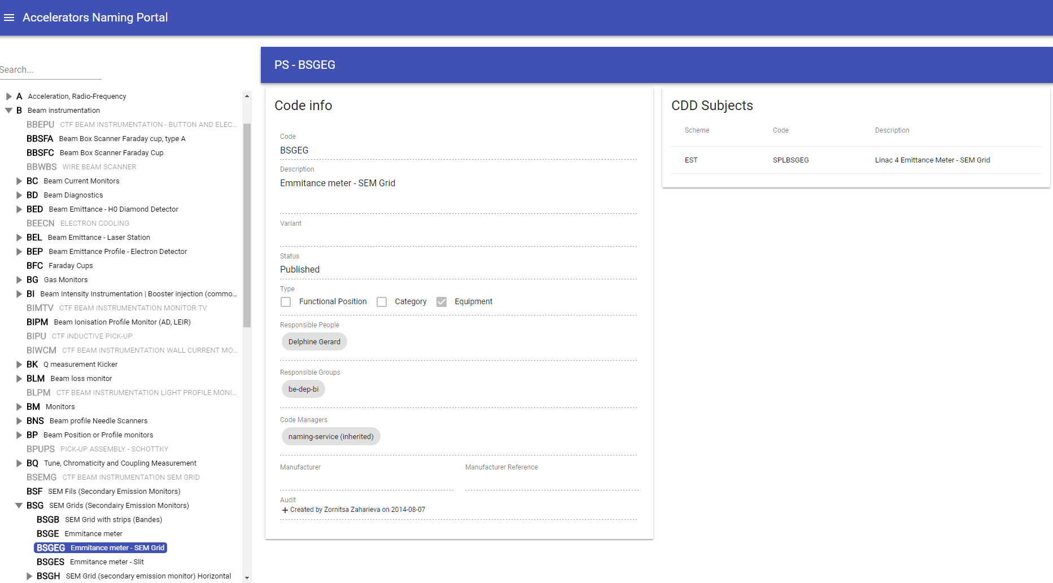
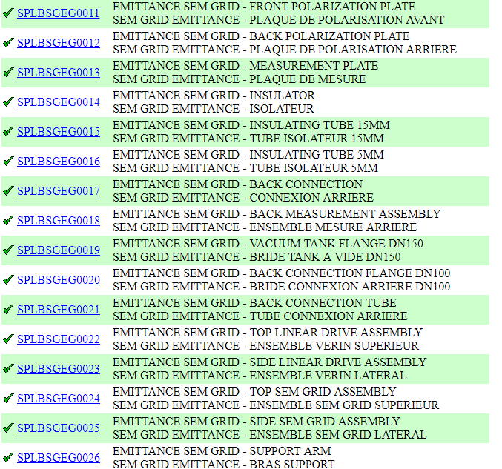
Our Asset Codes
PXBSGEG023-CR000001
Asset identification,
Naming is based on the CDD naming

Slide 10
Our Asset Codes
PXBSGEG023-CR000001
Asset identification,
Naming is based on the CDD naming
Serial number,
This number is what gives an equipment
his own identity

Slide 11
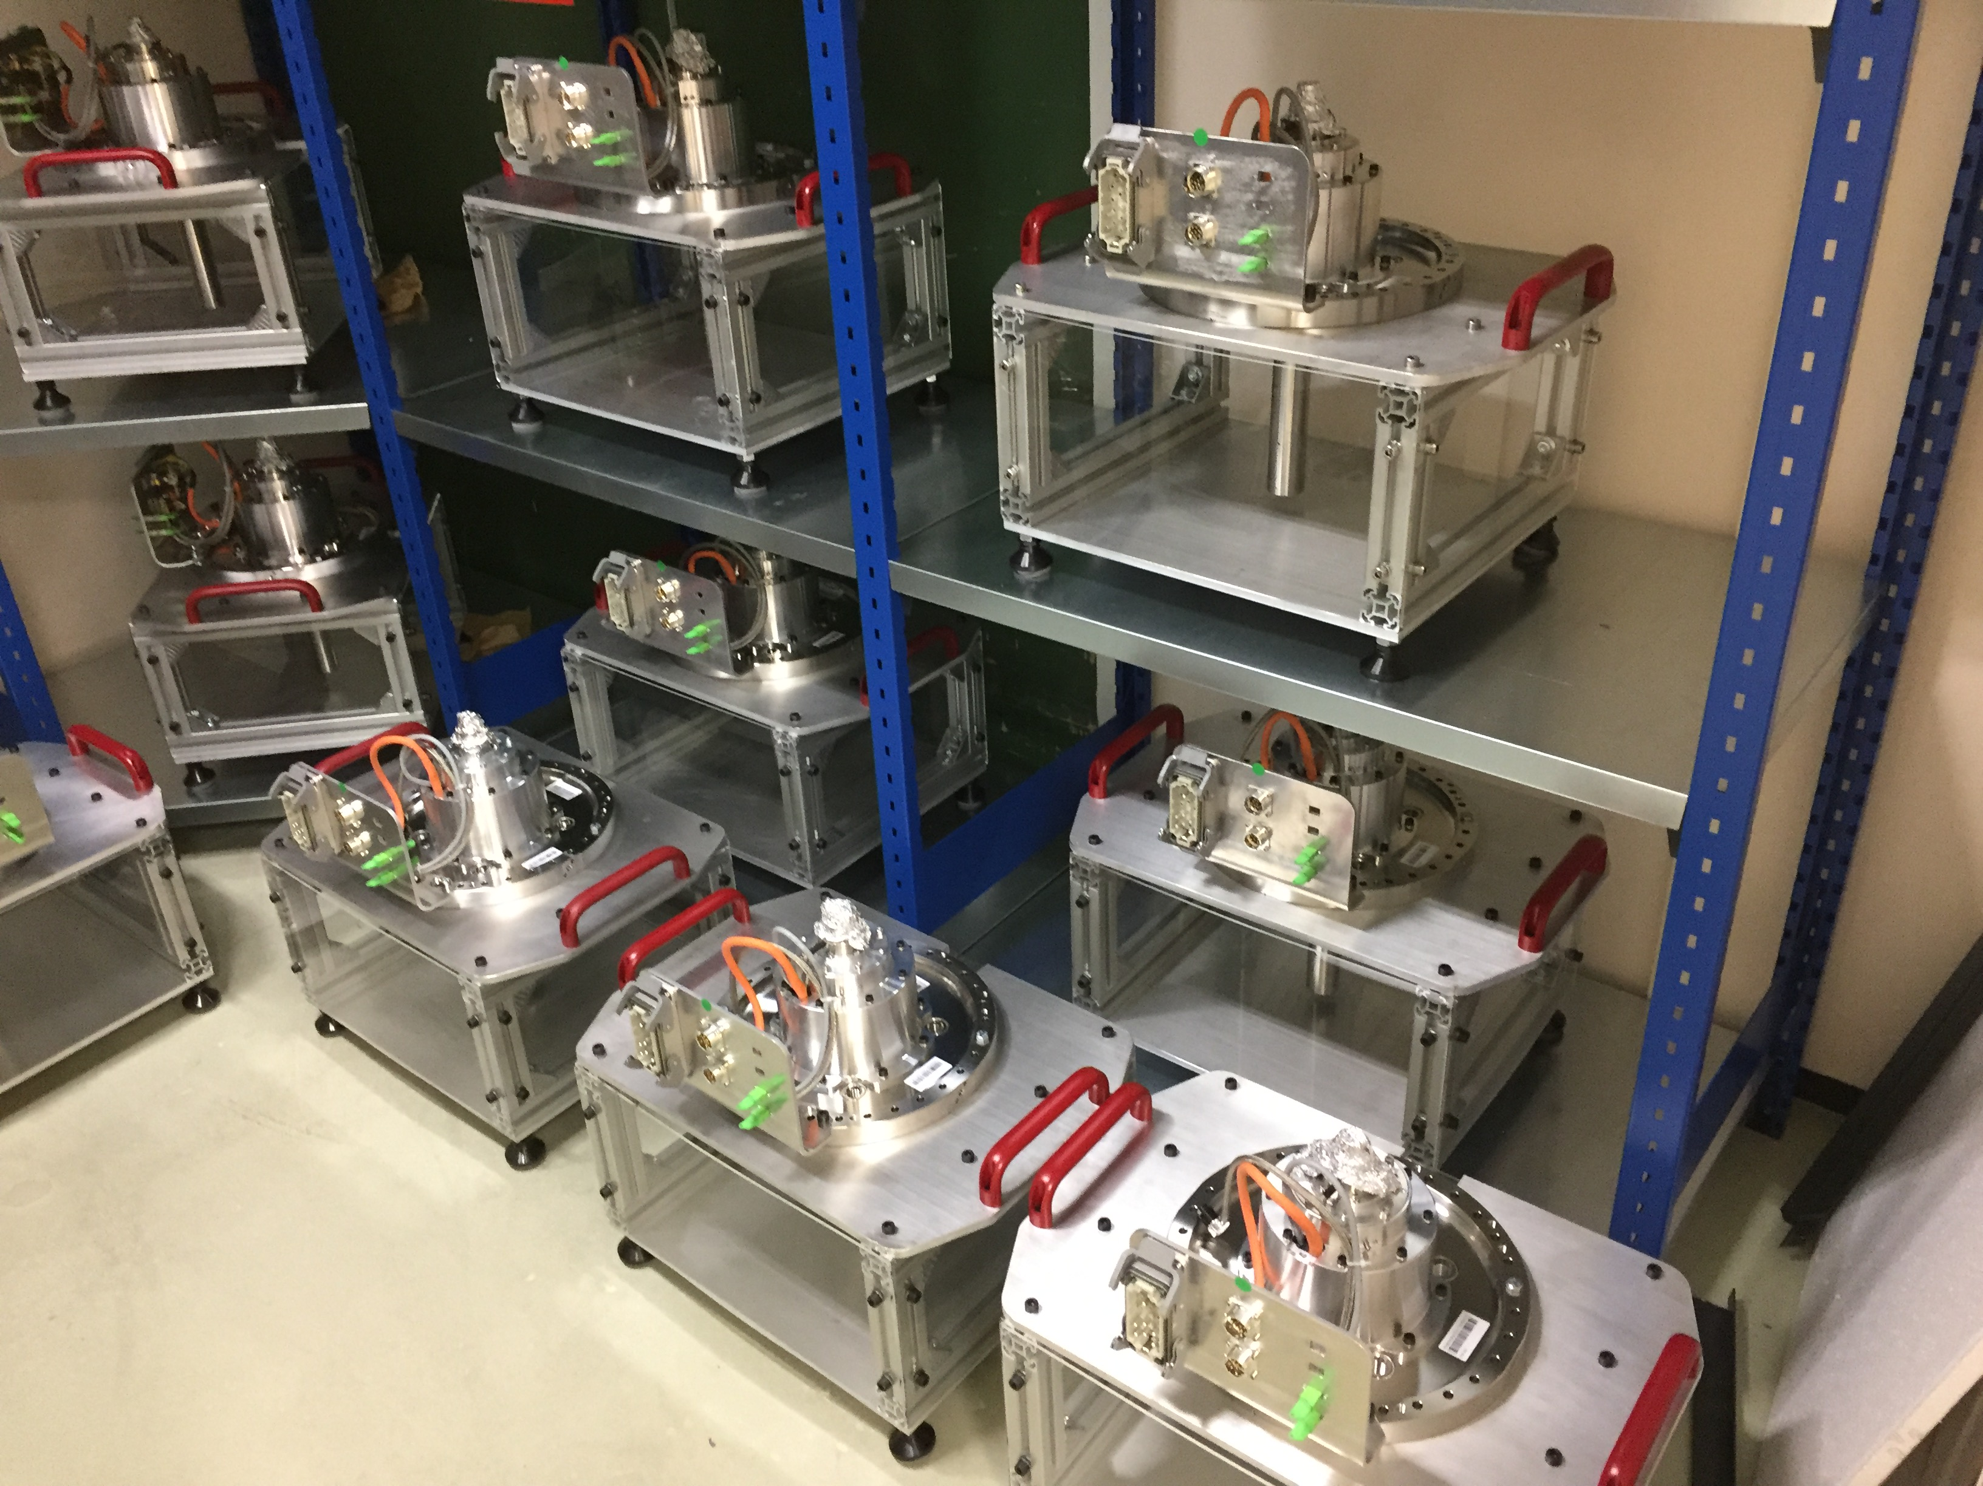
Our Asset Codes
PXBSGEG023-CR000001
Asset identification,
Naming is based on the CDD naming
Serial number,
This number is what gives an equipment
their own identity

Slide 12
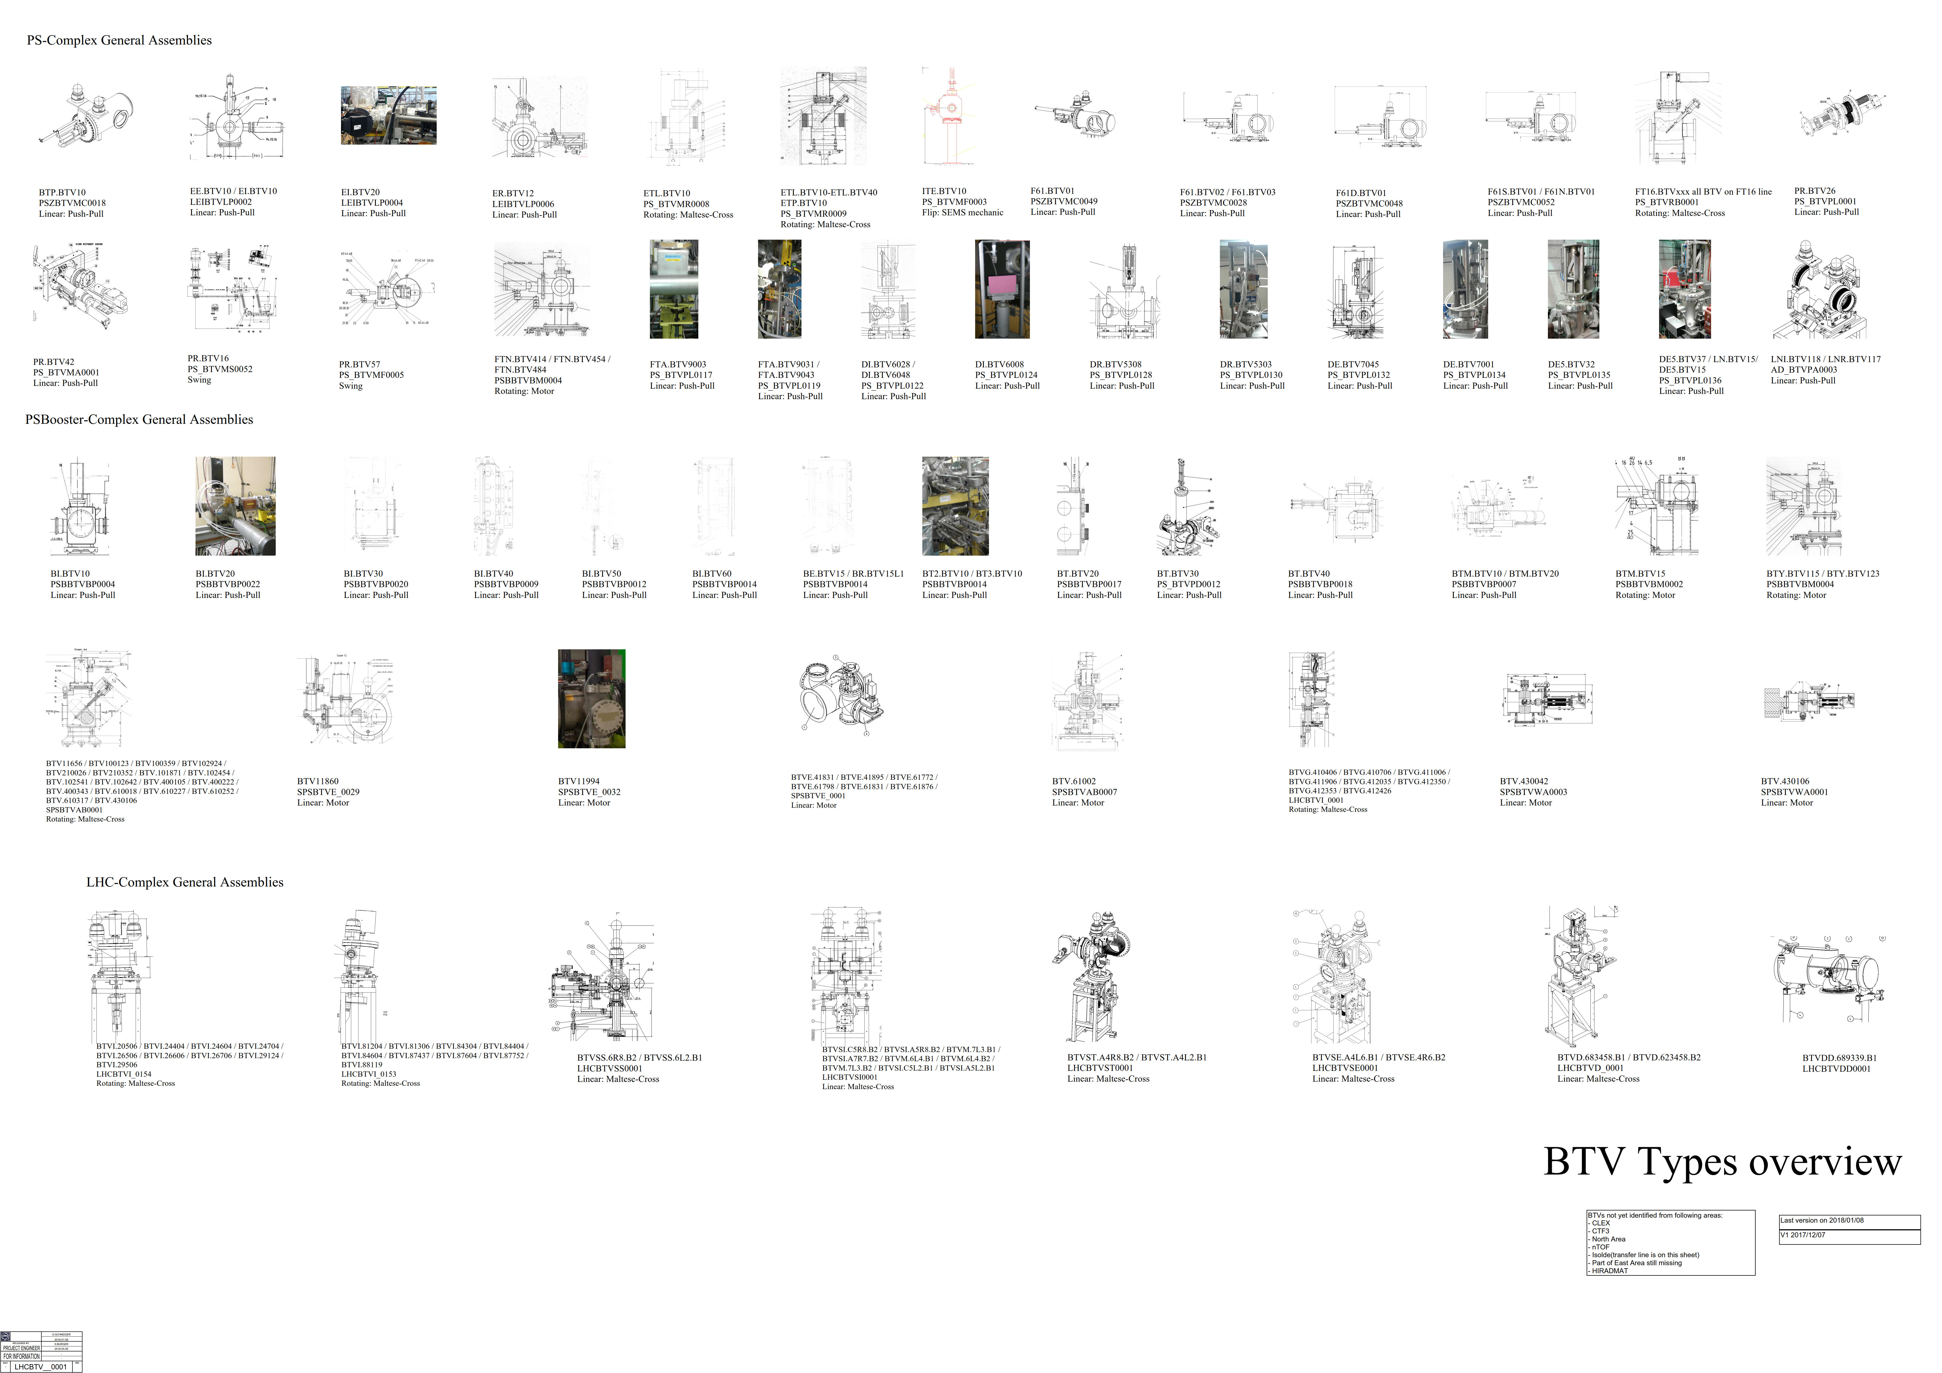
Comment nous suivons l'équipement
Nombreux types d'instruments différents
For example, BTVs

Slide 13
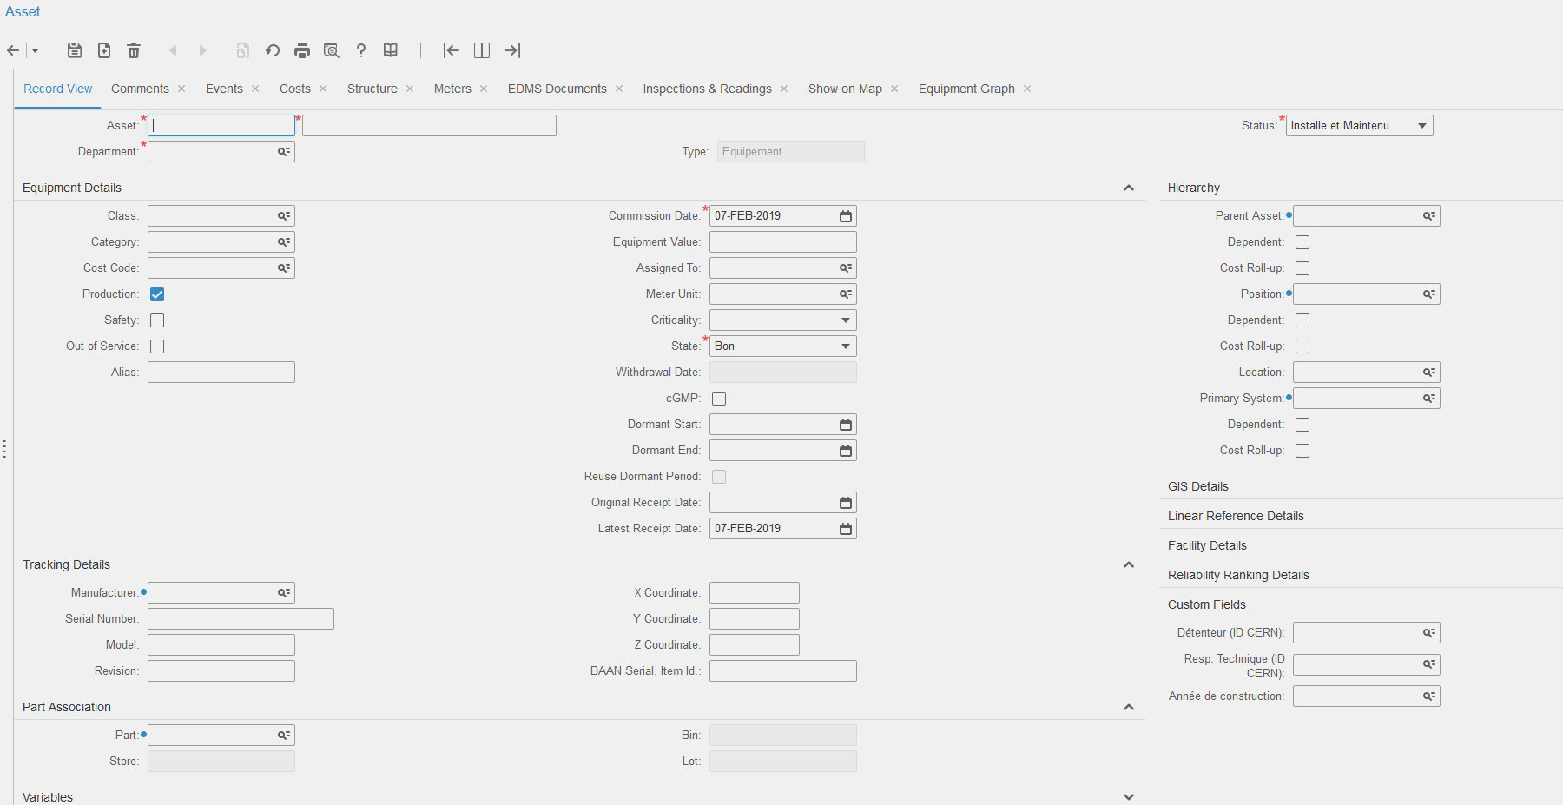
What is needed to create an Asset

Slide 14

What is needed to create an Asset
Asset Code
Description
Department (B01)
Commission Date
Status:
State

Slide 15
What ML needs to create a new Asset
Asset Code
Description
Department (B01)
Commission Datte
Status:
State
Class
Part

Slide 16
Other useful information to add while creating the Asset
Location / Position
Dimensions
Equipment Value
Test Reports on EDMS

Slide 17
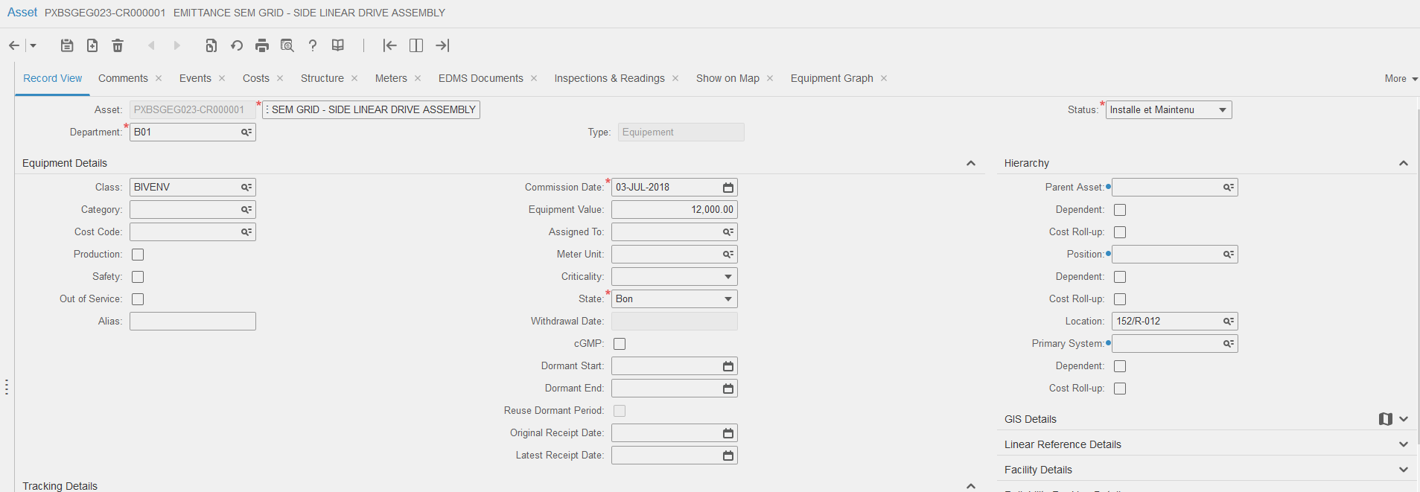
Example

Slide 18
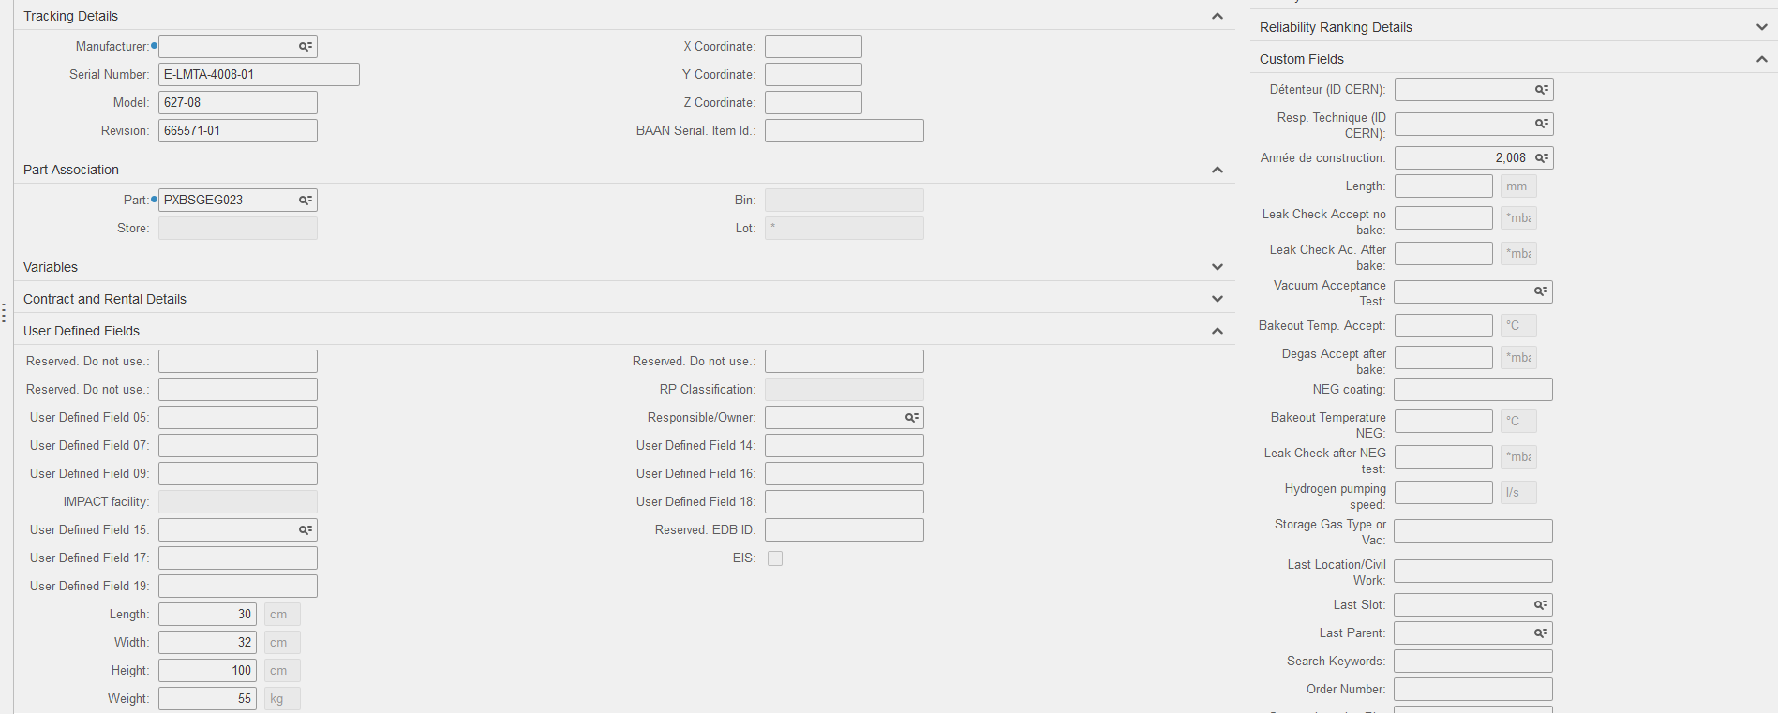
Example

Slide 19
Our classes
BIVENV – anything that contains a vacuum
BIVINS – anything that is within a vacuum
BIVNON – anything that is outside of a vacuum

Slide 20
Parts
Parts for Assets using the same code as the Asset identification
Has to be linked to the Asset
Parts for consumable and off the shelf products
Code always starts with BI
BIBF202 – Blank Flange 202

Slide 21
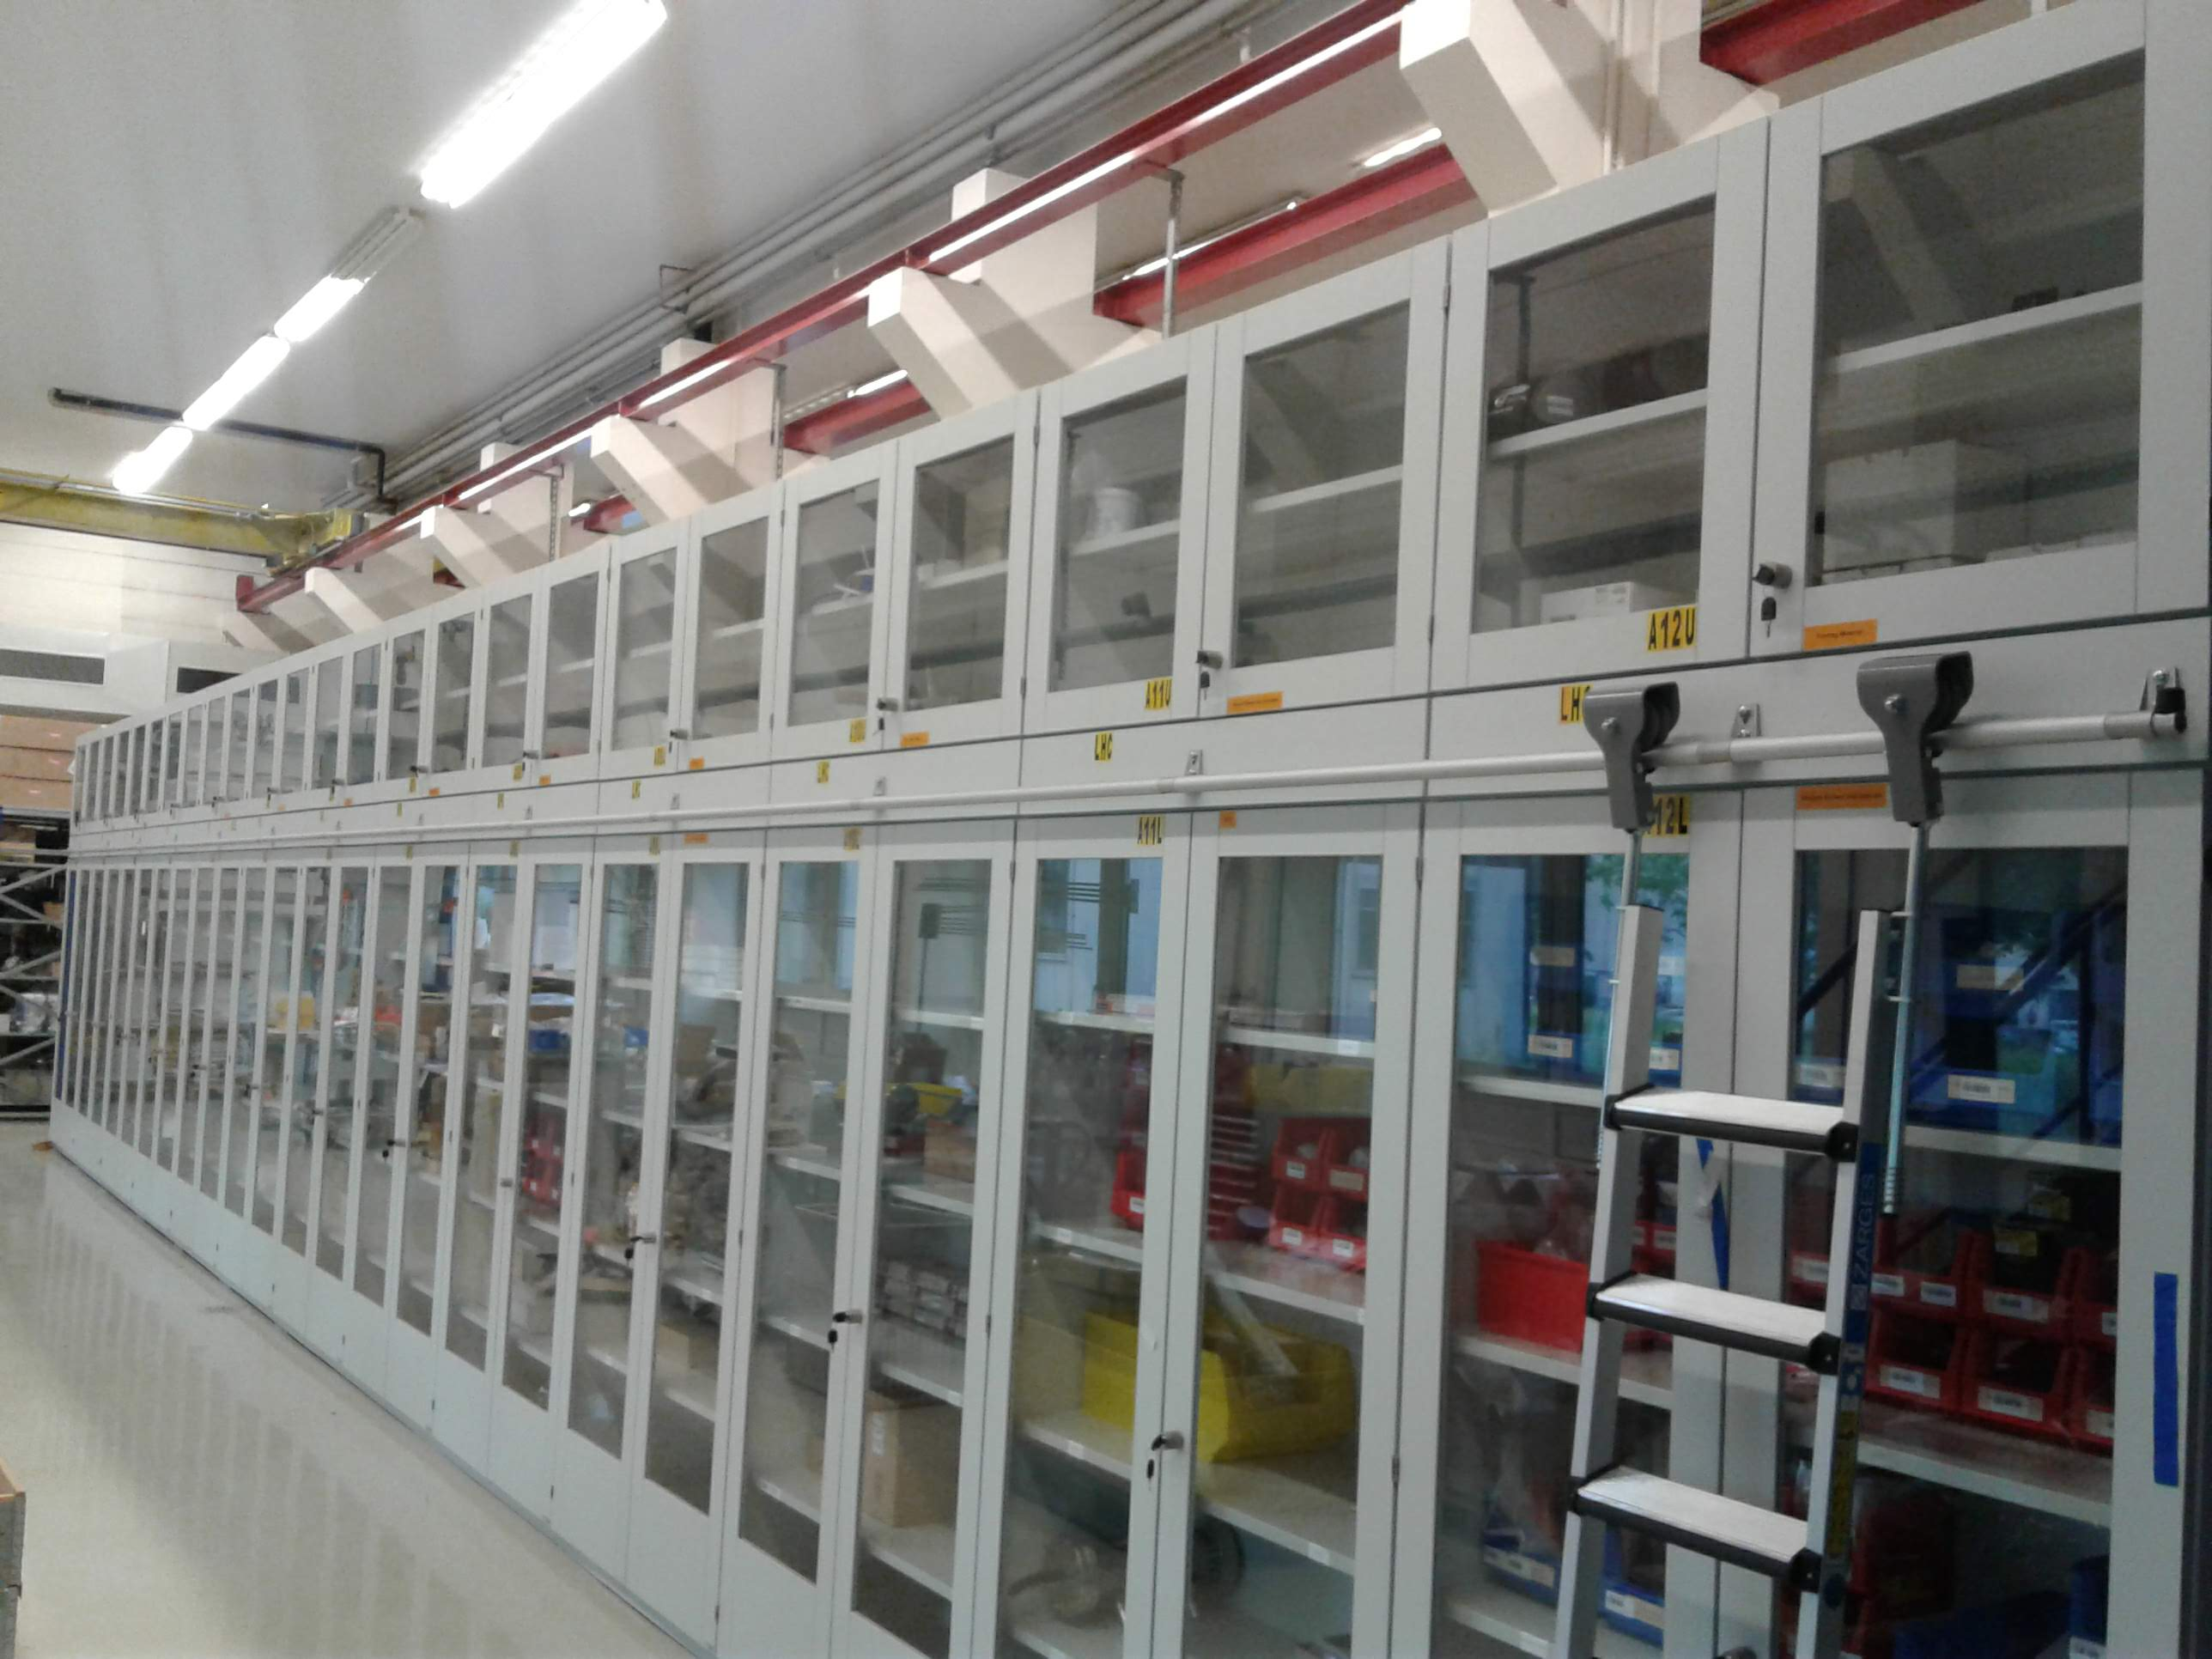
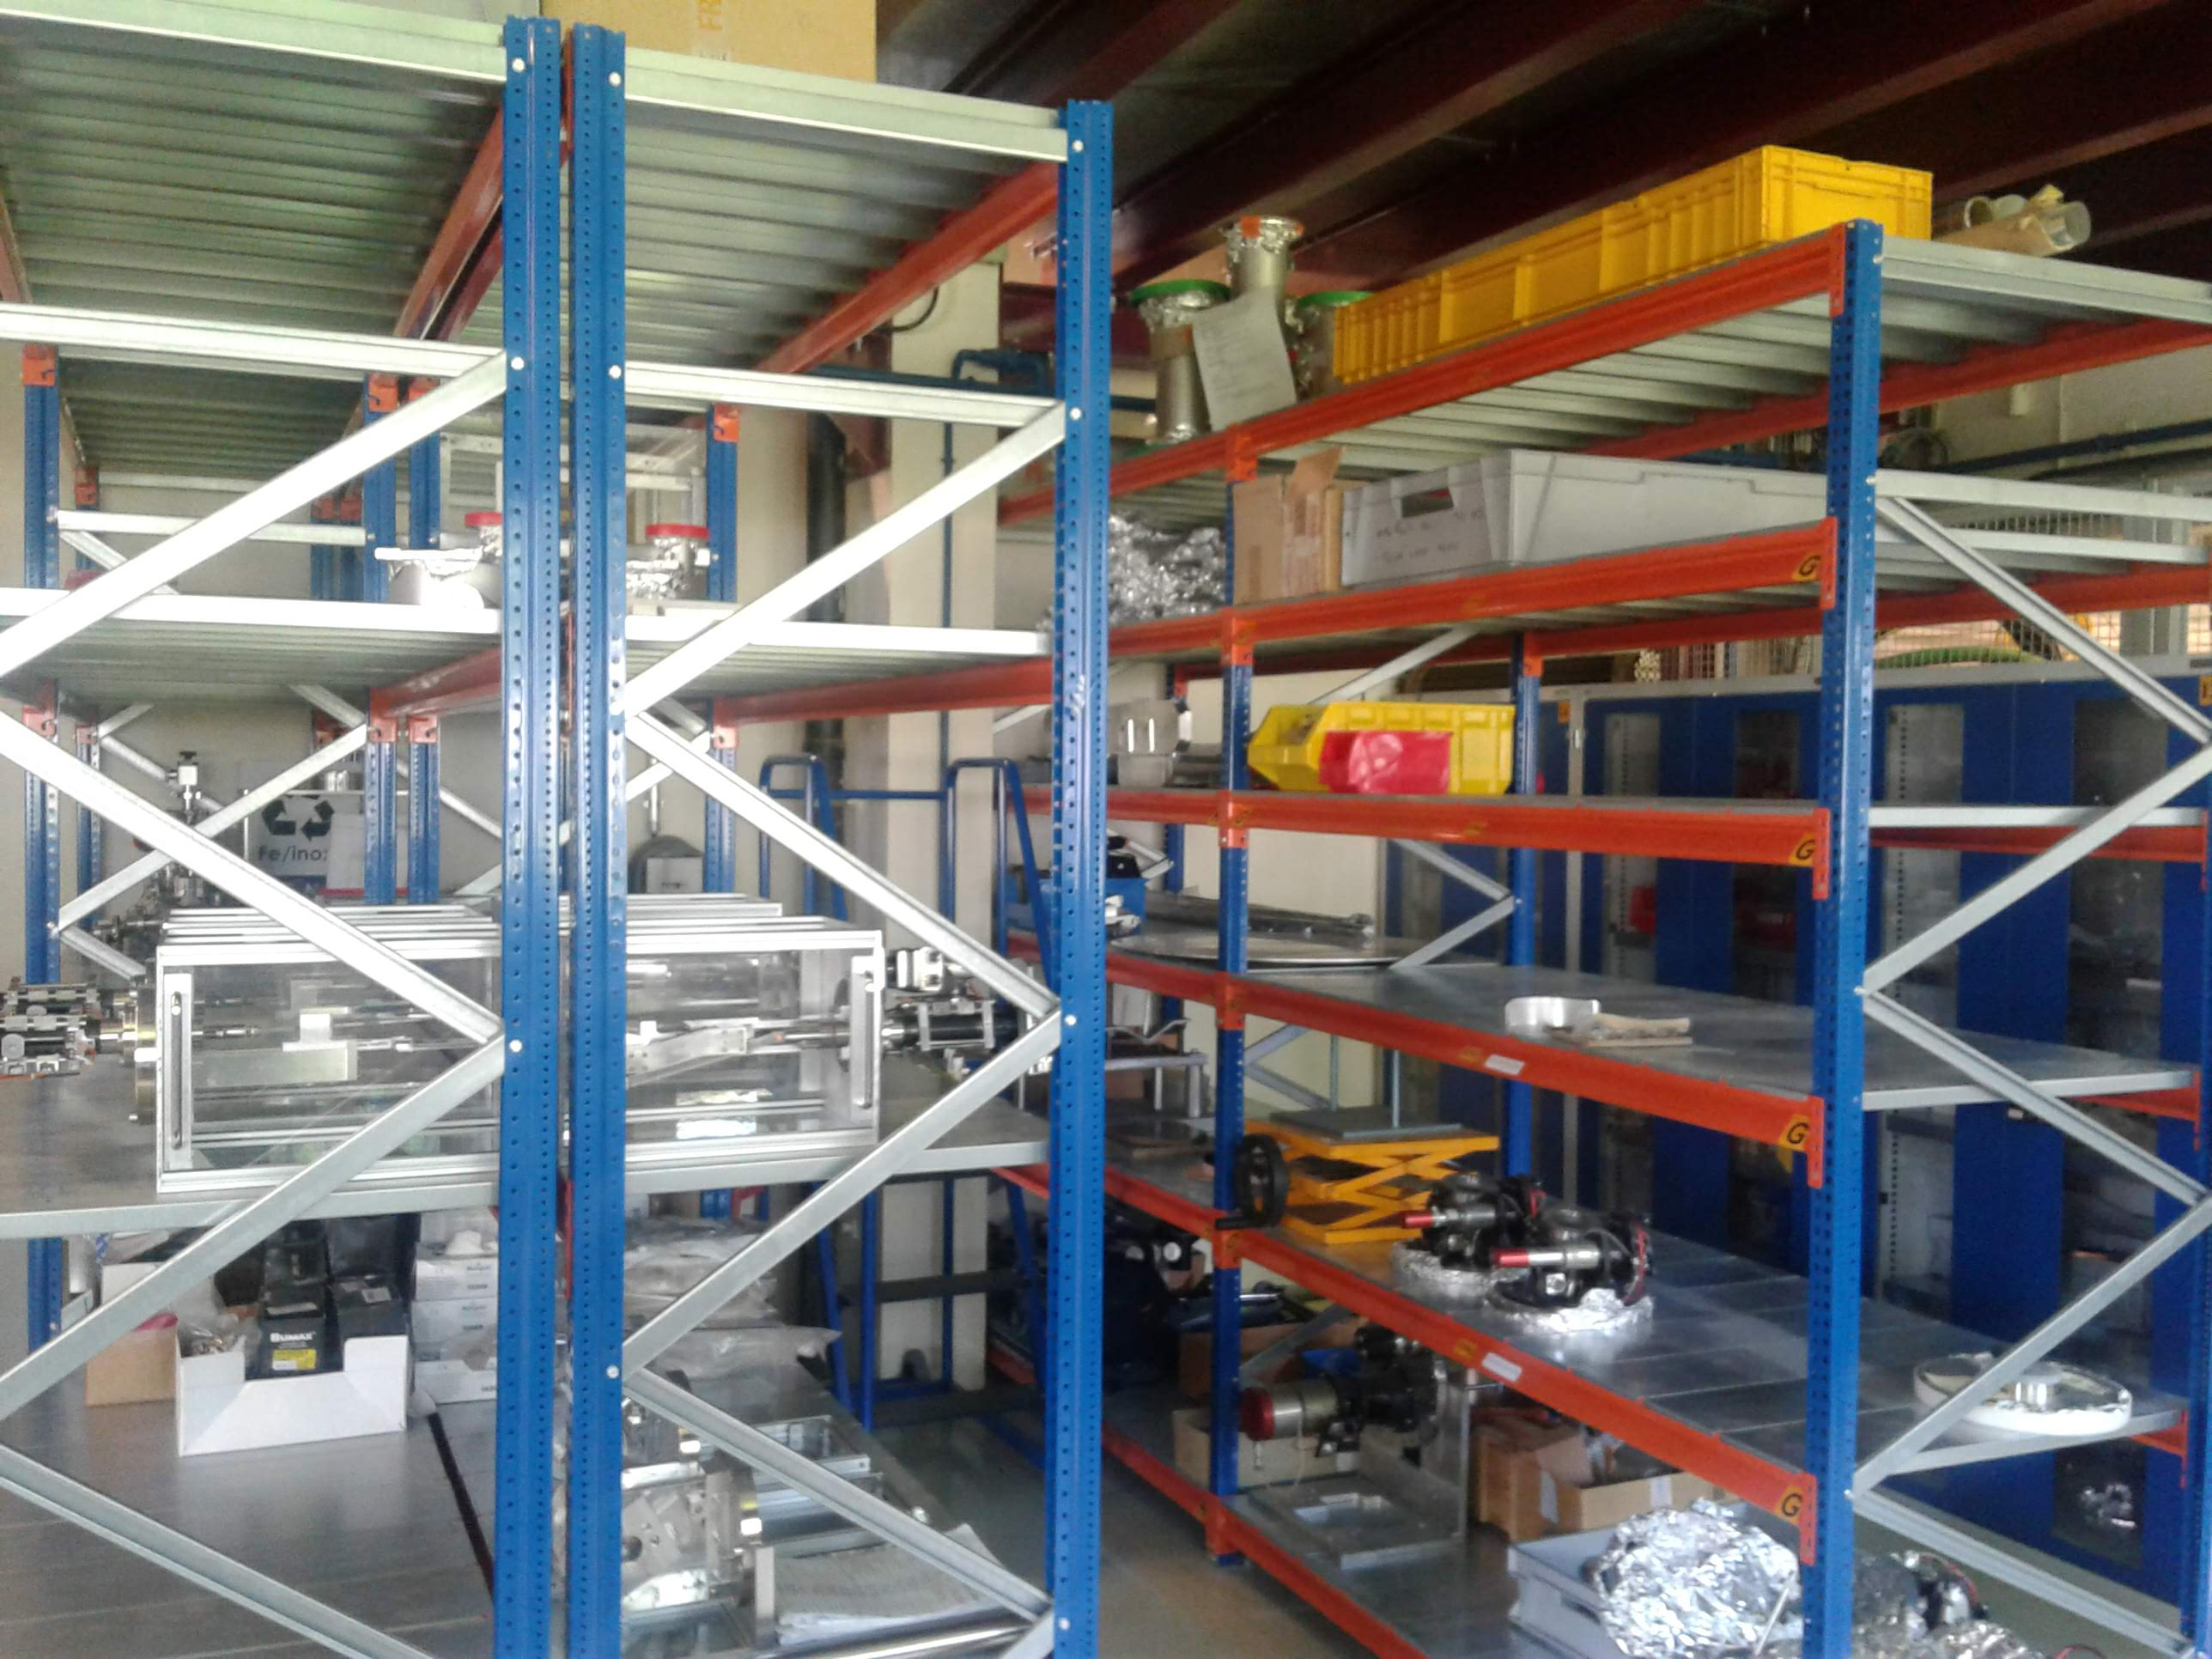
BI-ML Kiosk

Slide 22
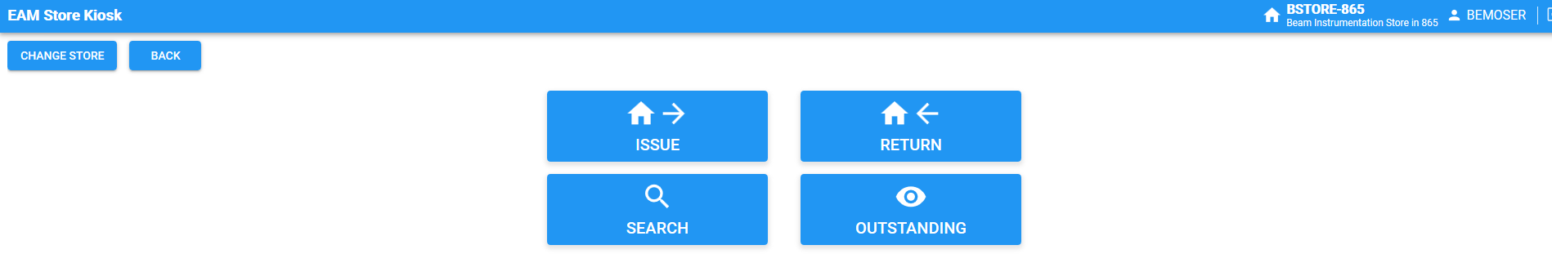
BI-ML Kiosk
BI STORE
InforEAM
Bin A012U
Bin A012L

Slide 23
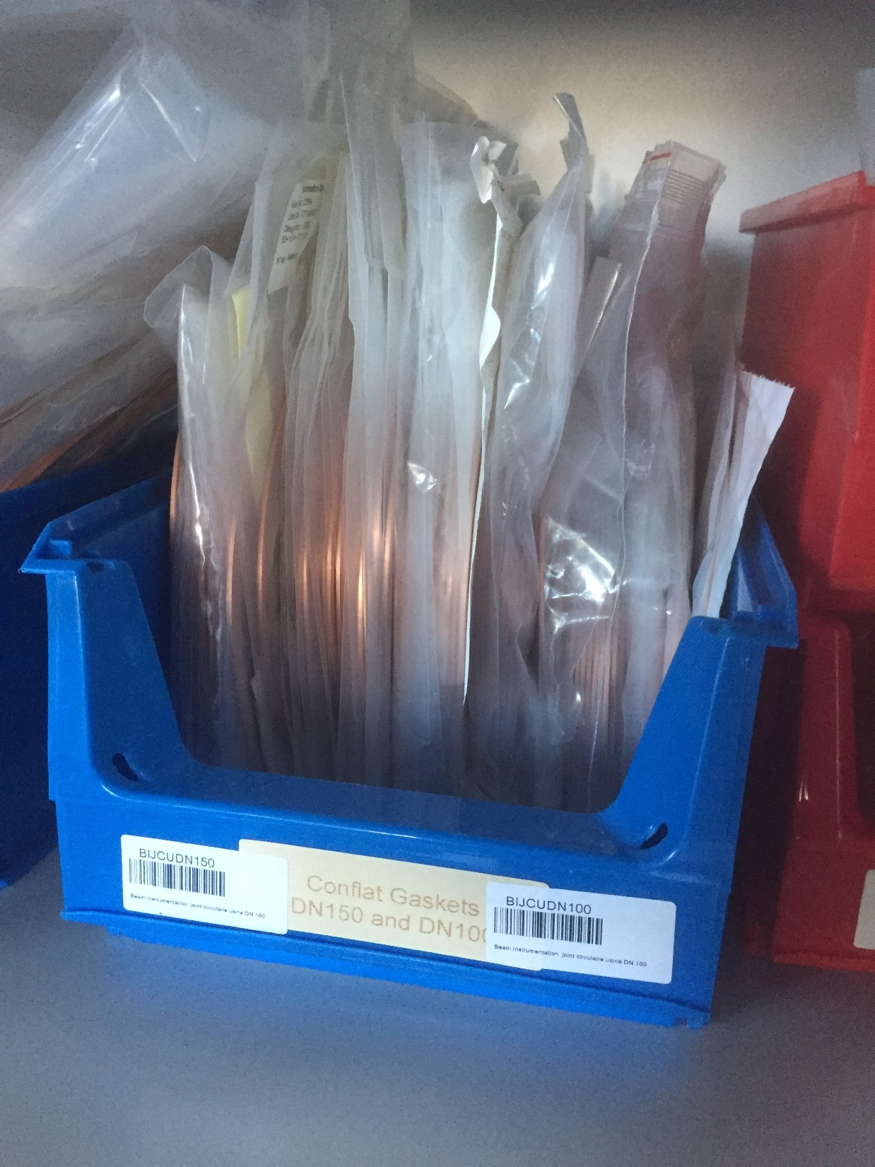
How to use the Kiosk

Slide 24

How to use the Kiosk

Slide 25
BI-ML Kiosk
We now have an inventory list
We know where things are
Easier to maintain then before
Working on setting minimum stock levels

Slide 26
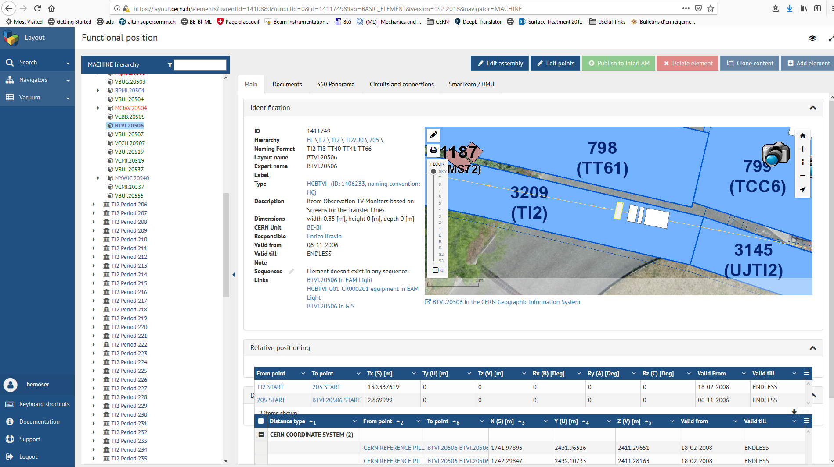
Functional Positions

Slide 27
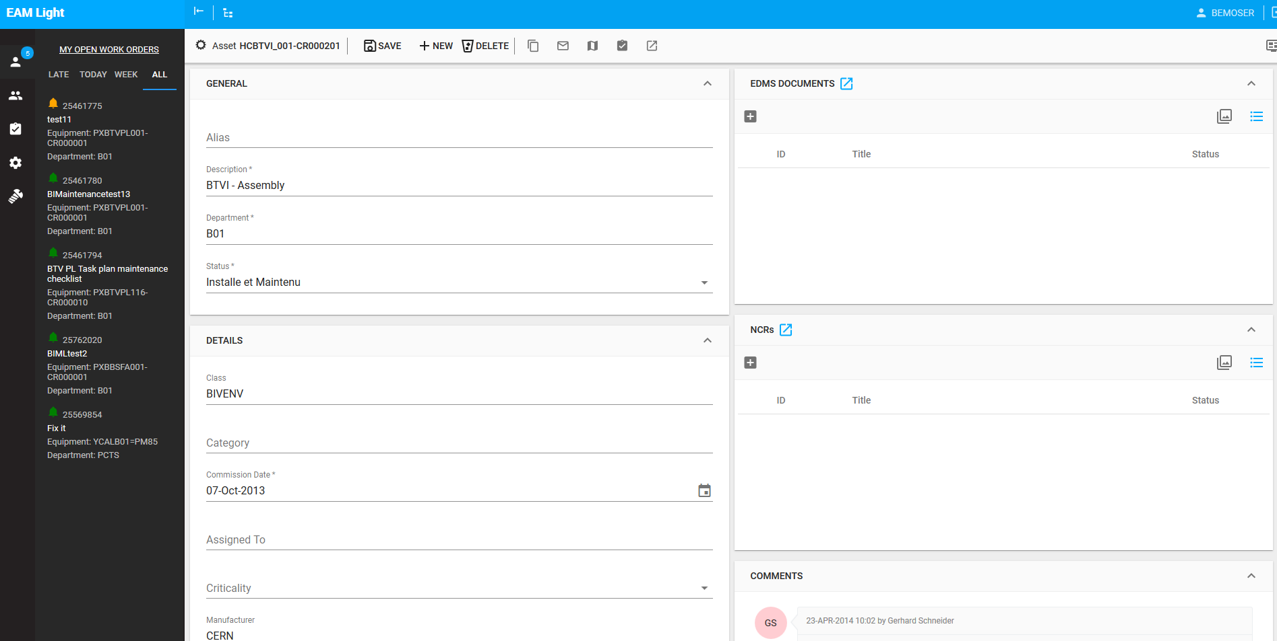
Functional Position

Slide 28
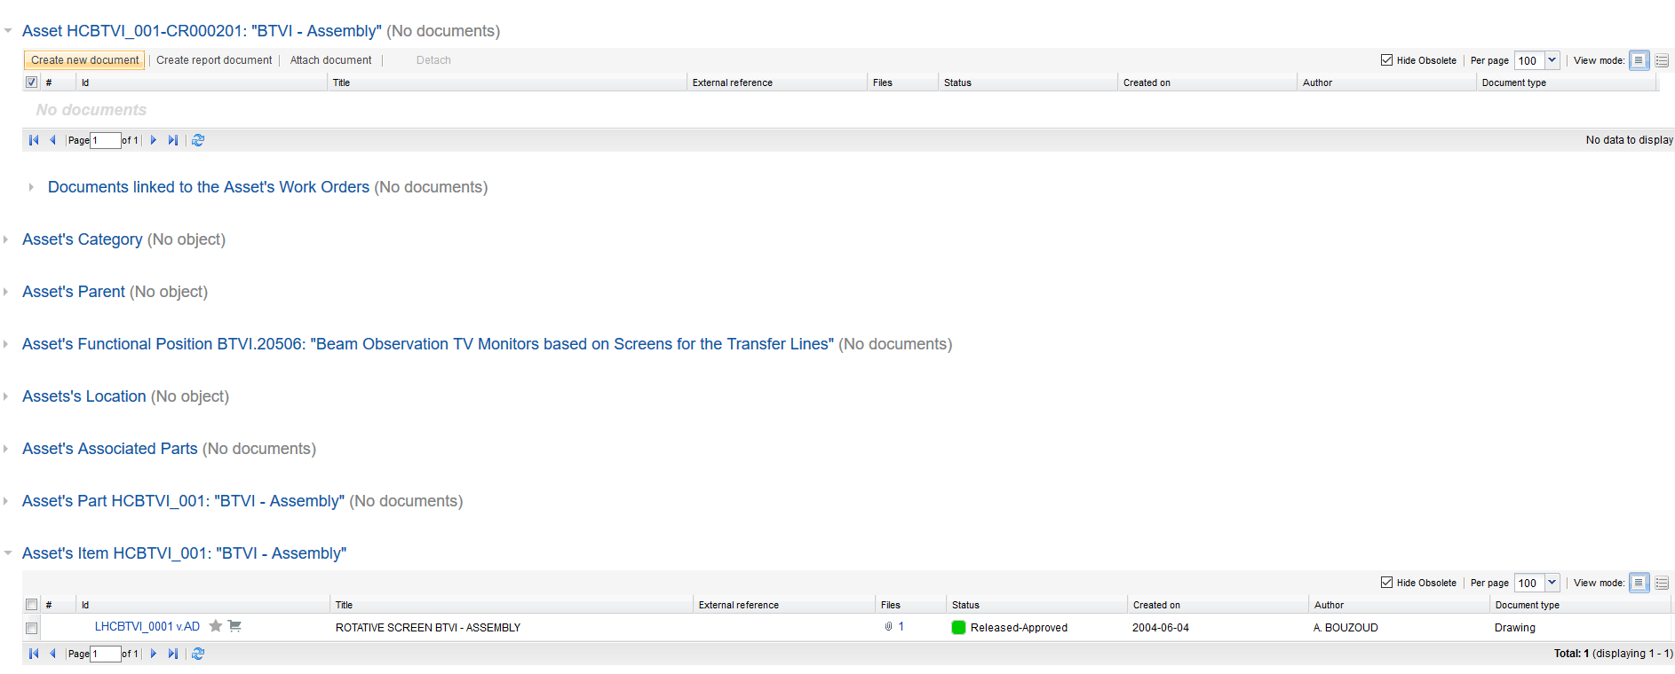
EDMS Links

Slide 29
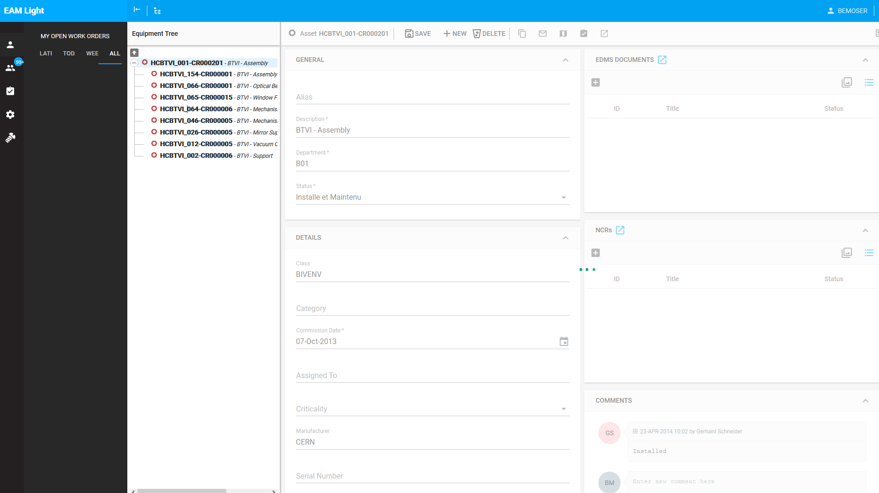
Equipnment Tree

Slide 30
Other Projects we are currently working on
Some Instruments are still missing Assets
Linking Kiosk with EDH store
Meter reading, each time CCC uses an Instrument
Checklist – Preventive Maintenance

Slide 31
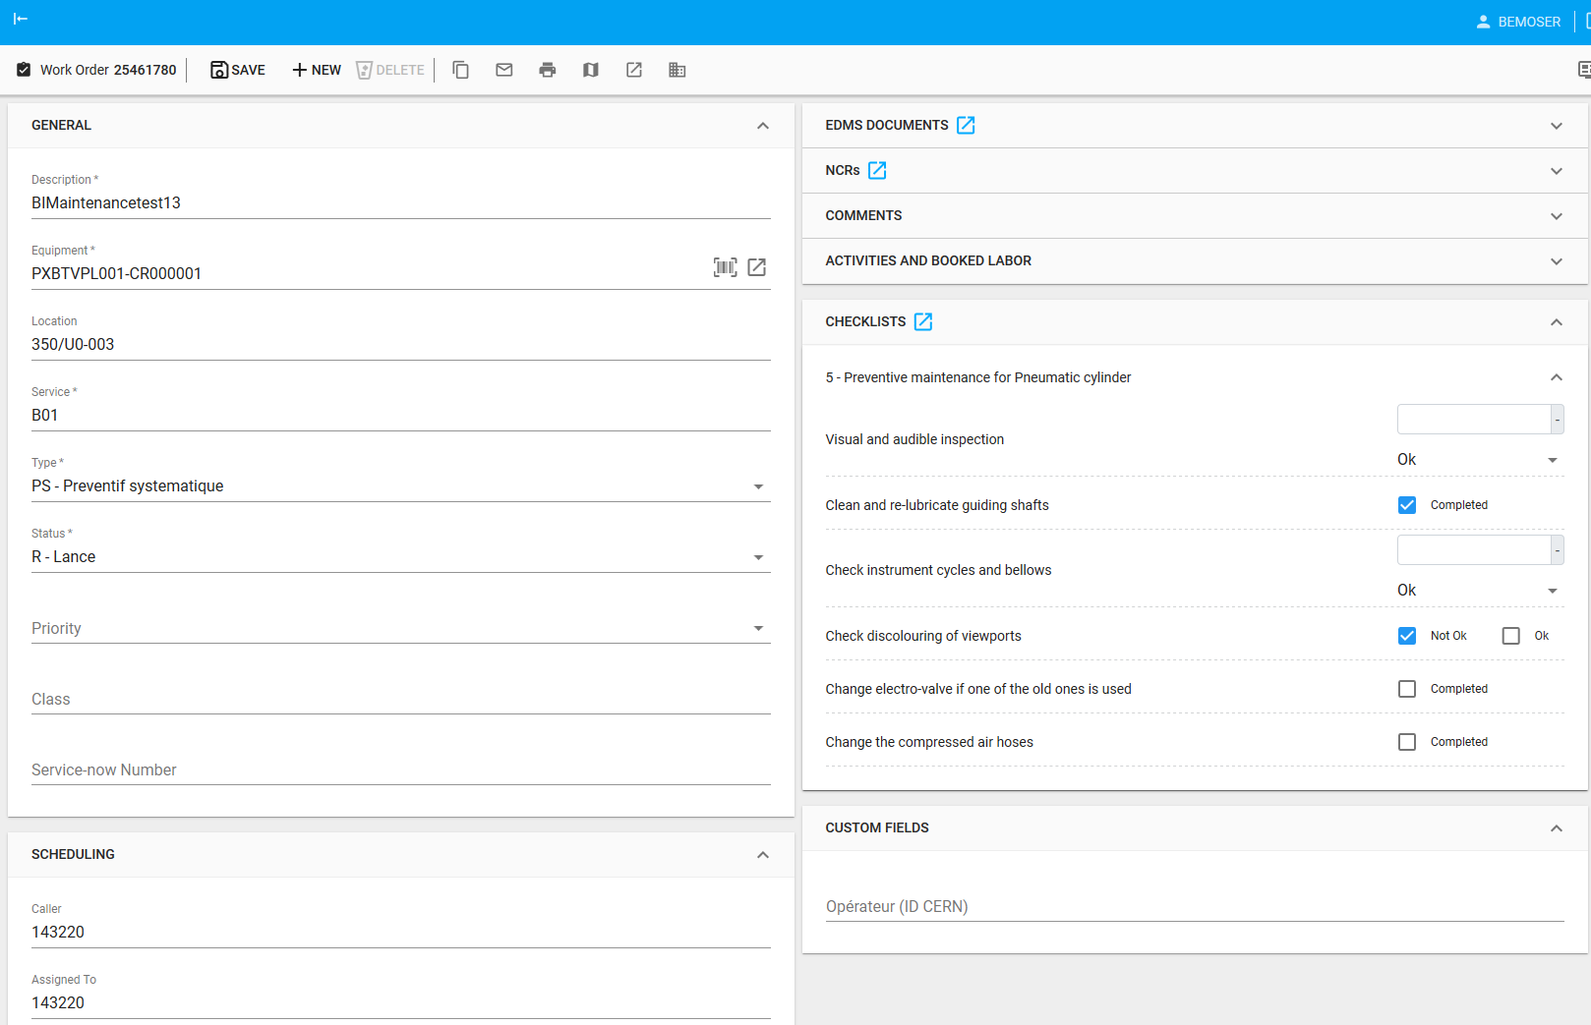
Checklists – Preventive Maintenance

Slide 32
Conclusion
Having all our equipment equipped with Asset codes makes it easier to keep track of their history
Linking EDMS documents to Asset is a good way of keeping documentation with the instrument
Kiosk allows a DIY store
Not everything is straight forward and there are a lot of specifics which have to be taken into account
There is still more to get out INFOR EAM

Slide 33
Questions?

