Slide 1


D2 requirements
E. Todesco, A. Foussat (CERN)
P. Fabbricatore, S. Farinon (INFN)
www.cern.ch/hilumi/wp3
11 March 2019 – D1 and D2 review

Slide 2
SUMMARY
Lay out and function
Requirements
Selection of design
Structure

Slide 3
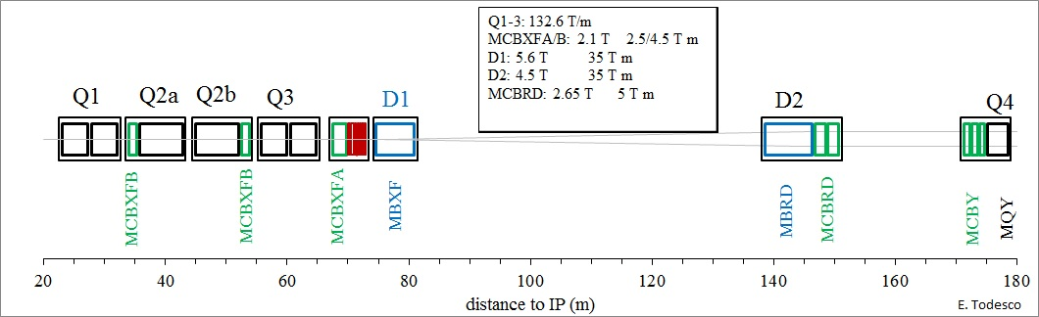
HL-LHC LAYOUT
Replacement of Q1-Q3, D1 and D2 plus correctors in IP1 and IP5 with larger aperture magnets (from 70 mm to 150 mm)
HL-LHC 2026-2035
LHC 2008-2023

Slide 4
D2 LAYOUT
Here we talk about the D2 (aka MBRD)
HL-LHC 2026-2035
LHC 2008-2023

Slide 5
D2 LAYOUT AND FUNCTION
Detail of the layout: one magnet per IP side, 8 m long, in the cold mass including also two orbit correctors (MCBRD) (A. Foussat talk)
Which magnet and why?
  Horizontal dipole, same field direction in both apertures, apertures in series
  35 T m integrated field at 7 TeV
    Used to bring beams to collision
  37.5 T m integrated field at 7.5 TeV (ultimate field)
HL-LHC 2026-2035

Slide 6
SUMMARY OF MAIN REQUIREMENTS
Ultimate field of 37.5 T m has to be reached
  Apertures in series
  Virgin training: no requirement
  Training after thermal cycle: 1 quench to nominal
Size:
  Magnet length has to fit within the 8.3 m (D2 cold mass)
  Magnet diameter has to fit within the 614 mm diameter (D2 cold mass)
Field quality
  Low order systematic field harmonics have to be smaller than 3 units at R_{ref}=35 mm at nominal field in any aperture, the others smaller than 1 unit – requirement only at 7 TeV
  Saturation pattern should be limited to avoid a major change of field quality in the range 6.5-7.5 TeV
Cooling: heat exchanger on one side of the cold mass, not going through the 8 m length
  Free X-sectional area of 225 cm² and stacking factor lower than 98.5%

Slide 7
REQUIREMENTS: QUANTITIES
6 series magnets
  We have 1 magnet per IP side, 4 needed
  Plus two spare IP sides, 2 needed (both assembled in D2 cold masses)
Plus one prototype for the prototype D2 cold mass
  Note: The D2 prototype cold mass could be an additional spare if everything goes for the best (i.e. no major iterations needed in design and requirements, no major non conformities) (P. Fabbricatore talk)

Slide 8
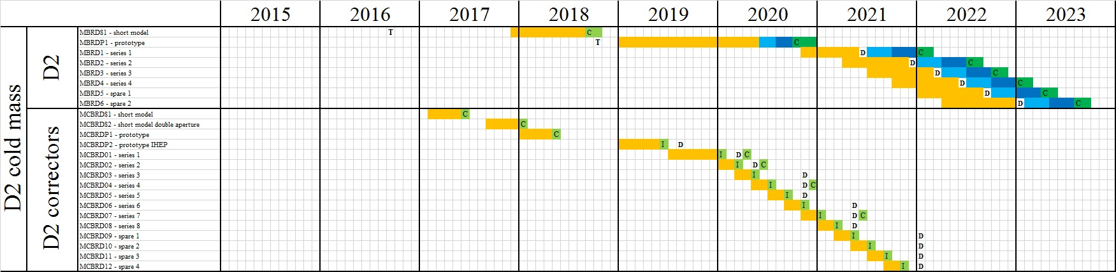
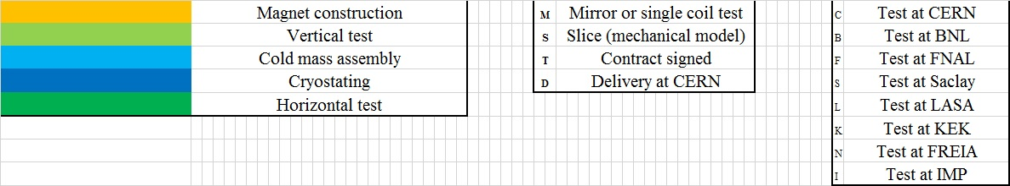
REQUIREMENTS: SCHEDULE
Prototype tested before the end of 2020
  No requirements from string
Fourth magnet of the series should be tested by July 2023
  6 months contingency in the present schedule

Slide 9
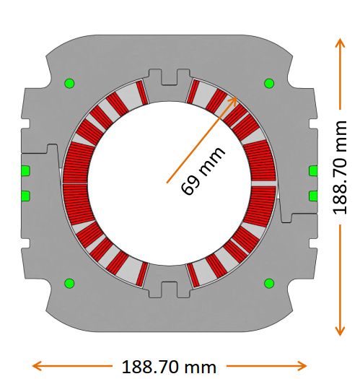
SELECTION OF THE DESIGN - 1
Initial decision to reuse the LHC dipole cable, outer layer
  To reduce time related to development of new cable, and cost (reusing LHC spare)
Decision to place the loadline fraction below 70%
  Loadline fraction = current at nominal field/short sample current
Main constraint is the field quality: cross talk between apertures
  Aperture is 105 mm, beam separation is 188 mm, little space to place iron to magnetically separate the apertures
  This limits field at 4.5 T, length of 7.8 m
Decision to have an asymmetric coil to compensate the cross talk, and not to have iron between the apertures
  Single coil has b₂ and b₃ of order of 200 units – compensation required within 98% (S. Farinon talk)

Slide 10
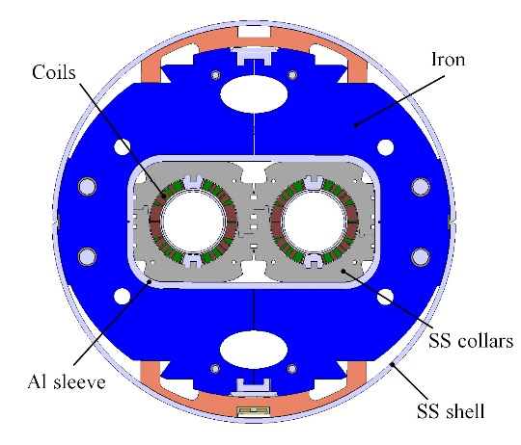
SELECTION OF THE DESIGN - 2
Decision to have self supporting collars
  Decouple the iron from the mechanical part
Decision to have separate collars
  More flexibility in a short production
  Smaller collaring press
Decision to have no energy extraction
  Cost reduction, use standard LHC quench heaters
New feature of the Al sleeve (see S. Farinon talk)
D2 cross-section (P. Fabbricatore, S. Farinon)

Slide 11
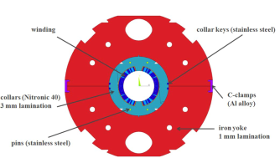
SELECTION OF THE DESIGN - 3
D2 also relies on the experience of SIS 300
  INFN-Ge built in ASG, in 2014-a full length prototype magnet for GSI (SIS 300) whose parameters are quite smilar
    Same cable size and number of strands
    Same one layer, five block coil
    Same operational field 4.5 T
    Similar aperture (100 mm versus 105 mm)
    Same collared structure
SIS 300 magnet (P. Fabbricatore,
S. Farinon, et al. IEEE TAS 24 (2014)

Slide 12
SELECTION OF THE DESIGN - 3
  Additional complexities for SIS 300
    Curved magnet
    Fast ramping (smaller filament, cored cable, much attention devoted to reduce losses)
  Additional complexities of MBRD
    Double aperture
    Asymmetric coil

Slide 13
STRUCTURE
HL-LHC project leader: L. Rossi (CERN)
  WP3 leader: E. Todesco (CERN)
    D2 magnet: P. Fabbricatore (INFN), A. Foussat (CERN project engineer)
    D2 cold mass: A. Foussat (CERN)
    D2 cryostat: D. Duarte Ramos (CERN)
INFN deliverable
  Magnet
  No SS shell, no end covers, no cold bore, no test

Slide 14
STRUCTURE: COLLABORATION WITH INFN-Ge
First engineering design starts in INFN in April 2014
  Collaboration agreement 2291, with engineering design as deliverable
  Completed in advance (mid 2016)
Construction of the short model steered by INFN starts in 2017
  Second collaboration agreement 3084
  Initial target of short model test: March 2018 – tested in February 2019
Construction of the prototype steered by INFN to start in 2019
  This is also included in the second collaboration agreement 3084
  Initial date for the prototype test October 2019, shifted to October 2020
  Call for tender has been completed in January 2019
Construction of the series steered by INFN to start in 2020
  Collaboration agreement XXXX
  Series included as an option in the call for tender of the prototype

Slide 15
STRUCTURE OF REVIEW
General framework and requirements (E. Todesco)
Design and results of the model program (S. Farinon)
Plans for the prototype and series (P. Fabbricatore)
Integration in the cold mass (A. Foussat)
Documentation and QA/QC (A. Foussat)
Integration in the cryostat (A. Vande Craen)

Slide 16
APPENDIX
Acceptance criteria draft: EDMS 2051868

