Slide 1

D2 cryostat
Design and interface with cold mass
Arnaud Vande Craen
CERN
International review on D1 and D2 superconducting magnets for HL-LHC
12th of March 2019

Slide 2
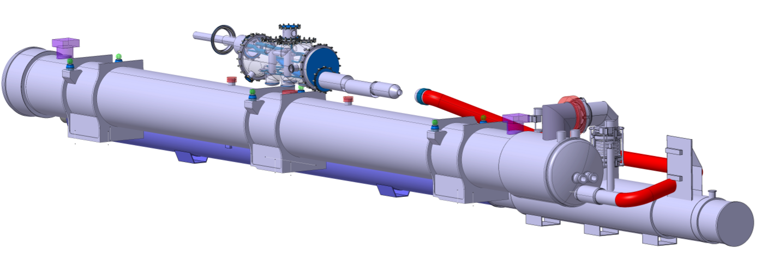


D2 specificity
Standalone magnet
  Cryostat closed on both ends
  Cold/warm transition (beam line) on both ends
Powering through DFM
Jumper for cryogenic services
Domed end (cryostat closure)
DSHm
DFM
D2-DFM link
D2 jumper
Domed end (cryostat closure)
D2
QXL

Slide 3
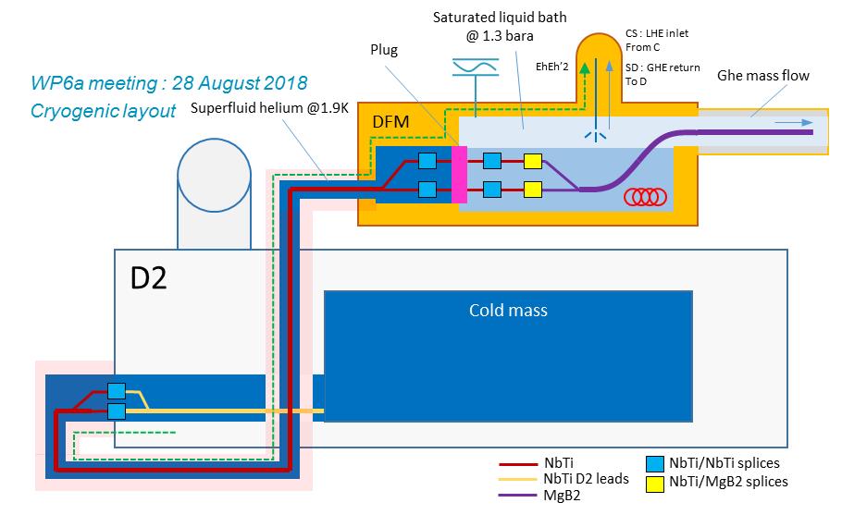
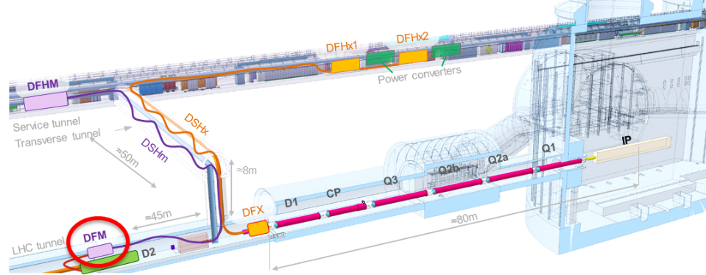
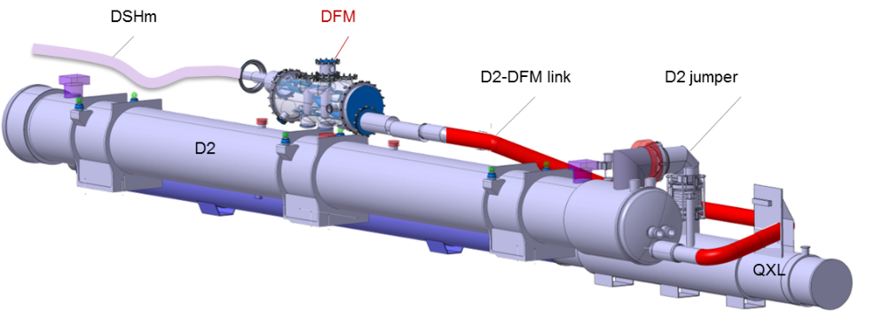
DFM (WP06a)
Functions
  Electrical interface between SC (MgB2) and D2 (NbTi)
  Supply cryogenics to the DSHm SCLink (Ghe mass flow)
Integration
  Installed on top of magnet
  Fixed to tunnel wall
  Vacuum insulated link to D2 routed behind cryogenic jumper
Link to D2
  NbTi round cable (MBRD – 13 kA + 4 correctors MCBRD)
  Superfluid helium cooled by D2
  Actively cooled thermal shield (Ghe)
Courtesy Y Leclercq

Slide 4
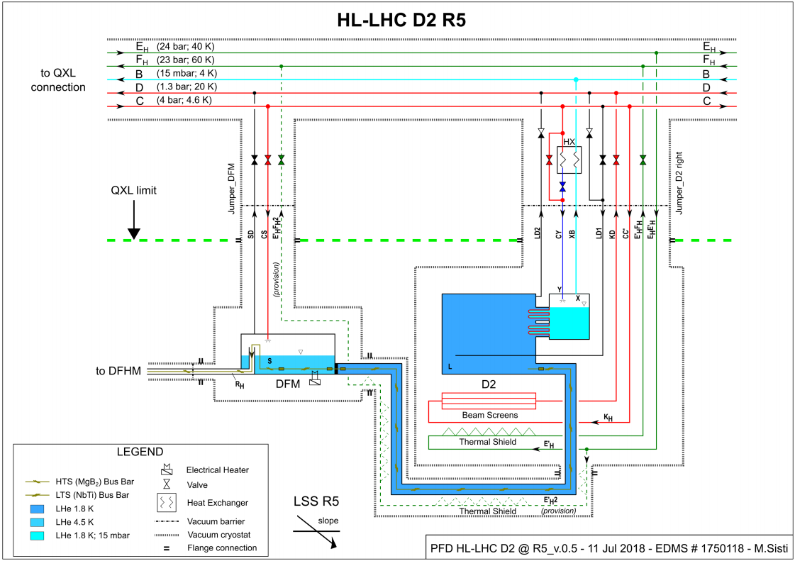
Cryogenic scheme
QXL
D2 cryostat
DFM
D2 – DFM Link

Slide 5
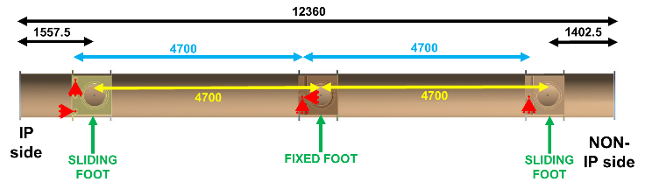
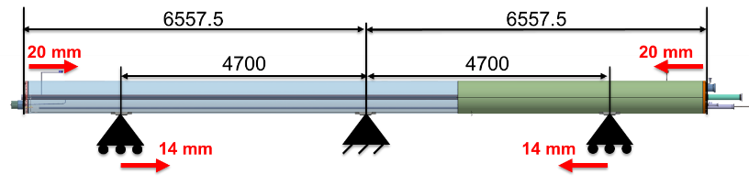
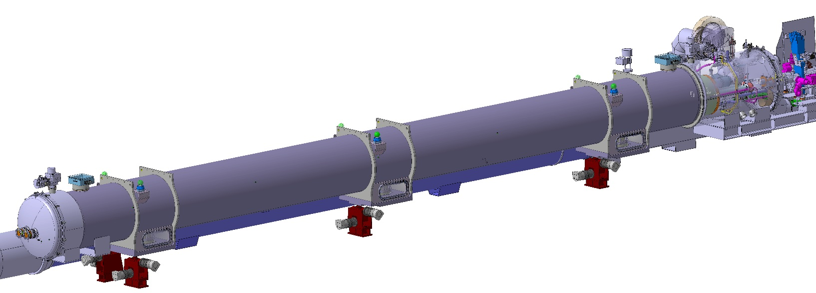
Supporting scheme
Cold mass and vacuum vessel supported on 3 points
  Central support
    Centre of cold mass (not centre of cryo-assembly)
    Fixed support, for symmetry of beam line cold/warm transition
  Side supports
    4700 mm from centre (from optimization of cold mass deformation)
    Sliding supports (movement due to thermal contraction = 14 mm)
Cold mass vertical deflection = 0.3 mm
Thermal contraction of cold mass extremity = 20 mm (symmetric)
Vacuum vessel supported on 4 jacks with remote alignment (from CCC)
Vacuum vessel on its jacks
Vertical deflection of cold mass

Slide 6
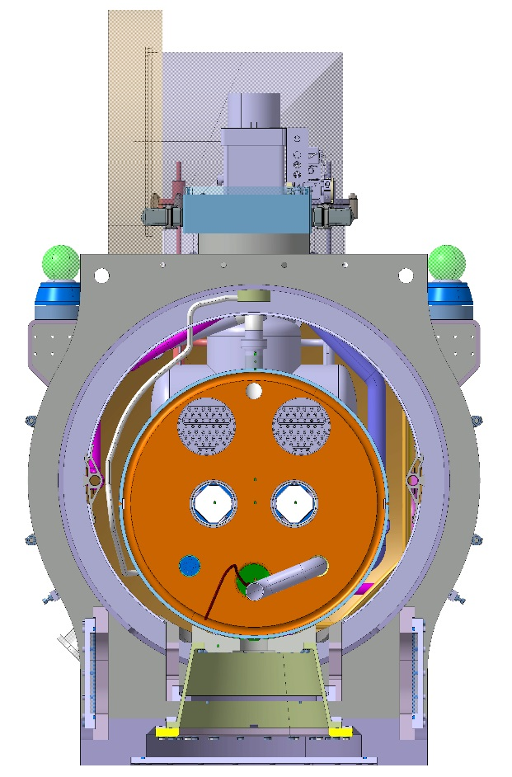
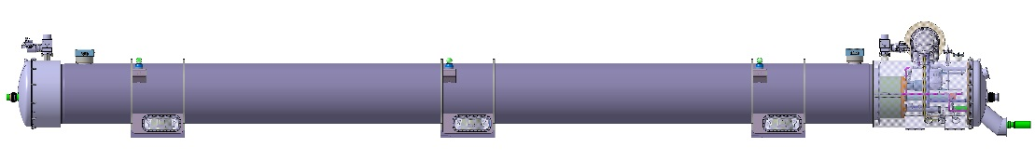

Cryostat breakdown
“Standard section” (Construction principle common to all triplets)
  Conical GFRE columns
  Cryostat designed for larger cold mass with LHC vacuum vessel diameter
  New assembly tooling
Service module IP-side
  Closes cryostat (vacuum vessel, thermal shield)
  Beam lines cold/warm transitions
Service module Non-IP side:
  Closes cryostat
  Beam lines components
  Cryogenic circuit to QXL
  Cryogenic equipment
  Magnet powering (link to DFM)
D2
cold mass
Cross section as seen from IP
service module IP Side
Standard section
service module Non-IP Side

Slide 7
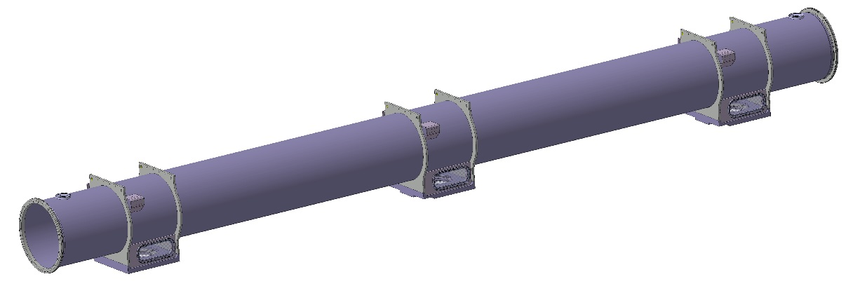
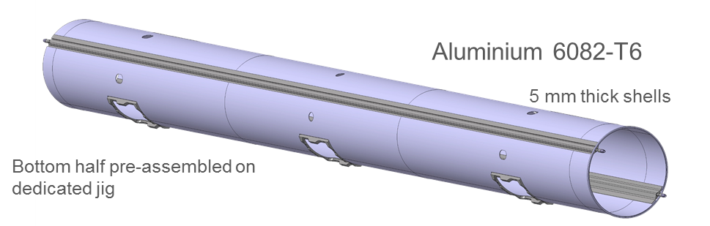
Standard section
Vacuum vessel (in procurement)
  Share WP11 features (see D Ramos presentation)
    Support posts interface
    Extremity flanges
    Cradles for vacuum vessel supporting
  Two types
    Proto (3 IFS)
    Series (2 IFS)
Thermal shield (detailed design on-going)
  Common principal features for WP11 (see D Ramos presentation)
D2 series vacuum vessel

Slide 8
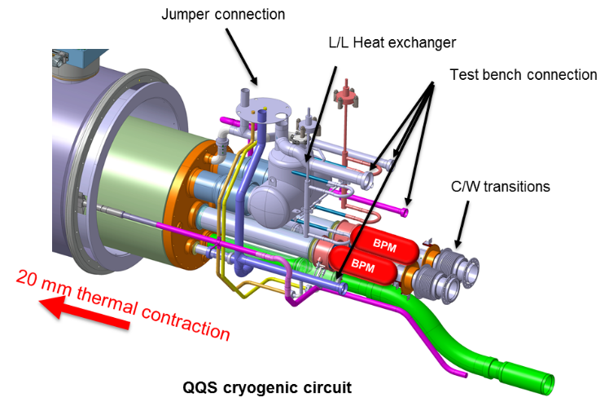
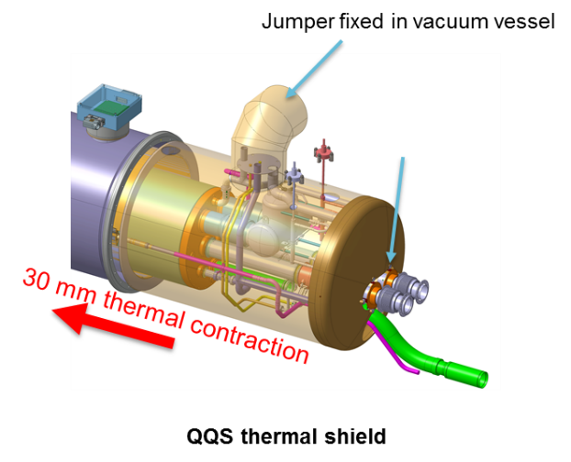
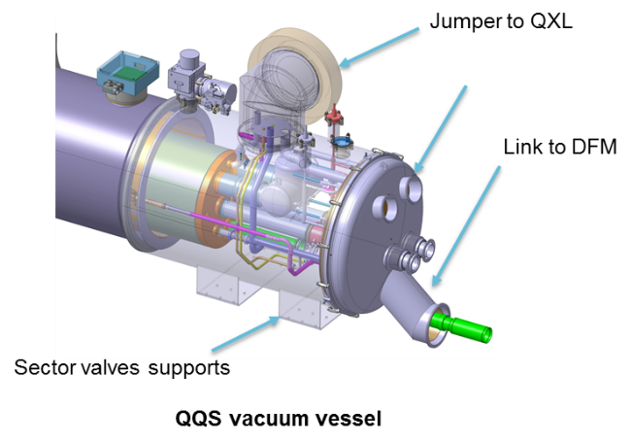
Service module
Jumper layout complete
  Thermal shield fixed inside jumper, independent of service module TS
  10 mm offset of cryogenic pipes for 20 mm thermal contractions
Integration of all large elements is complete (HX, BPM, C/W transition)
Conceptual cryogenic piping routing is complete according to PFD (detailed design on-going)
  Pipes flexibility requirement defined
  Routing to be completed for test bench connection in parallel to jumper
Thermal shield (detailed design on-going)
  Fixed to standard section
  Independent domed end
  IFS routing on-going, passage through thermal shield agreed
Vacuum vessel (detailed design on-going)
  Ports position defined
  Support for sector valves under study
Assembly sequence being defined

Slide 9
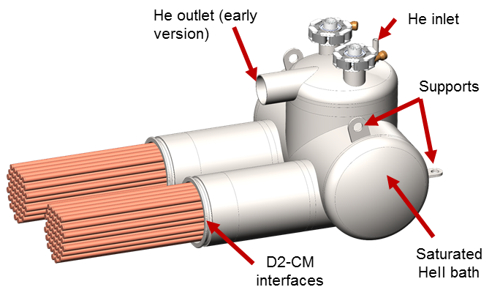
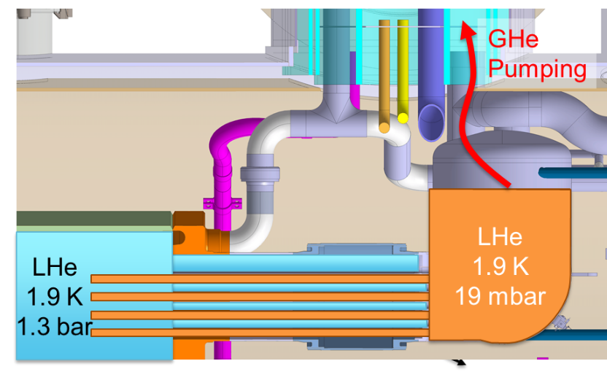
Service module - 1.9 K L/L heat exchanger
Collaboration agreement with CEA INAC-SBT (Grenoble) for design, fabrication and testing
Operation in pressurized superfluid helium
  Pumping on saturated helium bath
  Heat exchange through copper heat exchanger
Configuration chosen (2x 52) cylindrical HX channels protruding into the D2 cold mass
Sleeve connection to cold mass
  Installation after pressure test due to space constraint in the test facility
  Add flexibility during welding to relax manufacturing tolerances
Integrated instrumentation
  Level sensors (2x)
  Temperature sensor (Cernox)
Responsibility of CERN TE-CRG

Slide 10
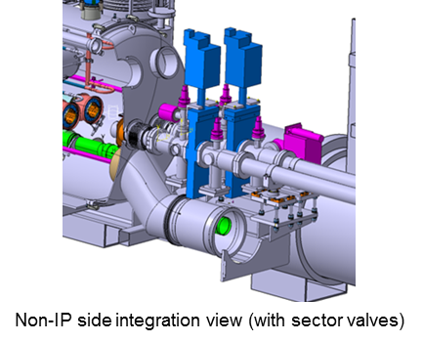
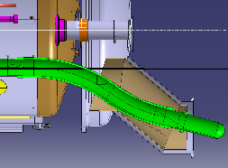
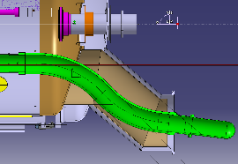
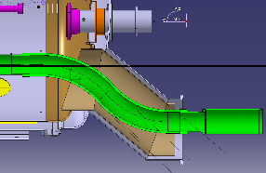
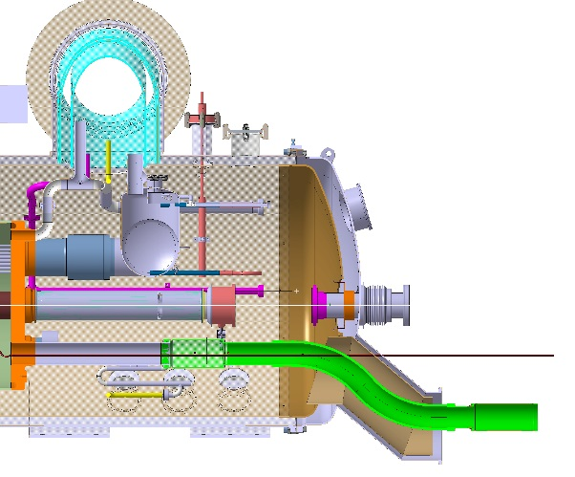
Service module - Connection to DFM
Due to sector valves, link to DFM must be lower than cryostat (offset of 320 mm )
  Rigid vacuum vessel and thermal shield outside of cryostat
  Flexible cryogenic hose and busbar (pre-formed) for assembly, to be checked on mock-up
Flexible S-bend is used for compensation of thermal contraction (20 mm)
Flexible cannot be used for cold test
  Risk to damage the busbar insulation if too large movement
  Flexible too long for connection to test bench
  ➔ Splice to be done inside the service module after cold test
Interconnection box to DFM link at D2 extremity of S-bend (design on-going)
Domed-end assembly sequence
Busbar for cold test
Additional splice inside service module
Interconnection to DFM link

Slide 11
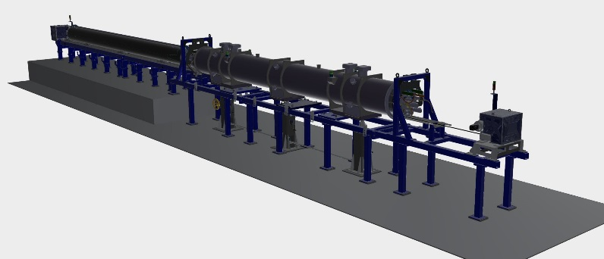
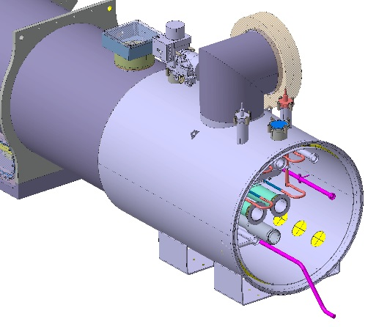
Cryostat assembly and cold test sequence
Cryostating - Phase 1 + 2
  Cold mass insertion inside standard section (with supports posts, thermal shield and MLI)
  Cold mass instrumentation (IFS)
  Service module welding
    Heat exchanger
    Piping (open to extremity for connection to test bench)
    Vacuum vessel, thermal shield and MLI
    Jumper (closed for cold test)
Cold test
  Connection to test bench with temporary interfaces and cryostat end cover
Cryostating - Phase 3
  Beam screen, BPM and CWT welding
  Link to DFM (splice, flexible)
  Close temporary interface for cold test
  Open jumper interface
  End covers
D2 on cryostating tooling
D2 service module extremity ready for cold test

Slide 12
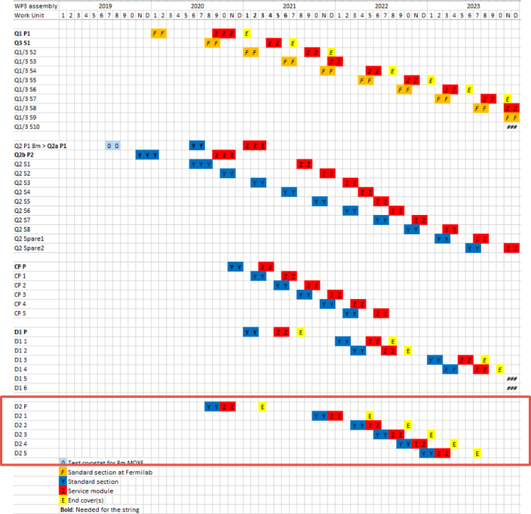
Schedule
Vacuum vessel (see D Ramos presentation)
  Invitation for tender is on-going
  Purchase order to be issued in July 2019
Heat exchanger
  Prototype assembly on-going
  Delivery at CERN in August 2019
Cryostating tooling (see D Ramos presentation)
  Contract running
  Contractual installation schedule: July 2019 at CERN
All components for prototype order to be issued before end 2019
Prototype assembly to start in August 2020
Series assembly to start in October 2021

Slide 13
Summary
Cryostat conceptual design is complete
  Based on WP3 standard section
  Cryogenic component integration completed
  Assembly sequence defined
Detailed design is on-going work
Long lead items (vacuum vessels and cryostating tooling) are under procurement
Prototype components drawings to be issued for procurement before end 2019

Slide 14
Thank you !

