Slide 1
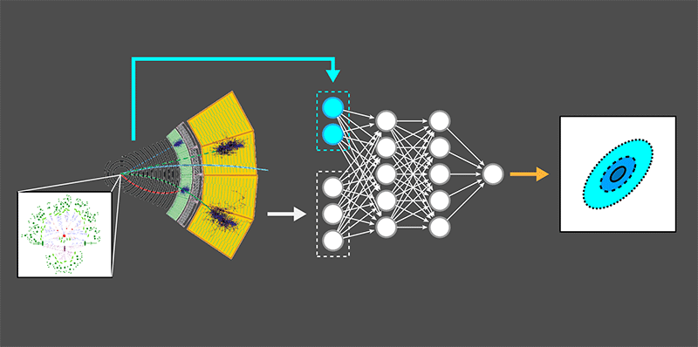

Machine Learning for Likelihood-Free Inference
J. Brehmer et al. ; adapted by APS/Alan Stonebraker
Luc Le Pottier
University of Michigan, CERN ATLAS Group

Slide 2
Outline
Project Intro
Project Update (issues, previous work)
Goals for the stay
Culture

Slide 3




Brief Intro
Working under Dr. Tancredi Carli on ATLAS data analysis
Trying to measure Effective Field Theory
(EFT) parameters and constrain possible
models of physics BSM
Do this by training deep neural networks to approximate the likelihood function, using the joint likelihood ratio and joint score as added parameters to our loss functions.
Scales well to high dimensional observable/parameter spaces, unlike many previous methods
ALICE Method Cross-Entropy
Estimator-based loss function

Slide 4
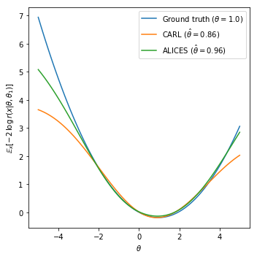
Progress thus far
Using the MadMiner machine learning toolkit ^{(1, 2, 3)} , with an implementation of the ALICE algorithm, claimed to be one of the more ‘sample-efficient’ algorithms (good for testing and debugging).⁽²⁾
Problem Introduction (January)
  Finished with a python module for testing ML
  algorithms on arbitrary-dimensional ‘toy’
  processes
  Validated precision results of various algorithm
  using the tractable likelihoods of these toy
  processes
  Made clear that ALICES is a good algorithm
  to start with
w

Slide 5
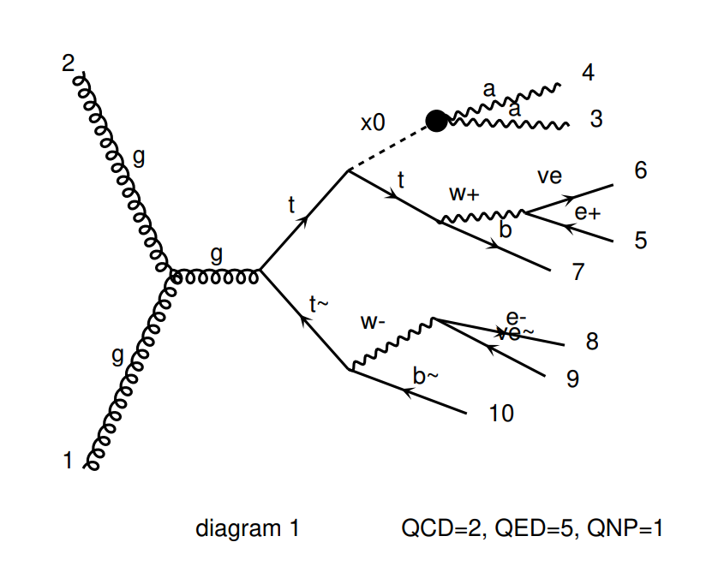
Progress thus far
ttH Process joint-likelihood ratio estimation (February – present)
  Measuring whether process has Charge conjugation-Parity (CP) symmetry (antiparticles + flipped coordinates)
  2 observables, one parameter in this case
    x_0, pseudo-scalar observable, Higgs boson in SM
    Delta_t_tbar observable, the angle between the t
    and tbar jets
    Cos(alpha), parameter, parameterization of CP sym.
  Small scale => good interaction to start with
  Promising interaction wrt discovery; mass of
  constituent particles / ttH coupling strength
  could give interesting hints for new physics.
/ 17
Leading order Feynman

Slide 6
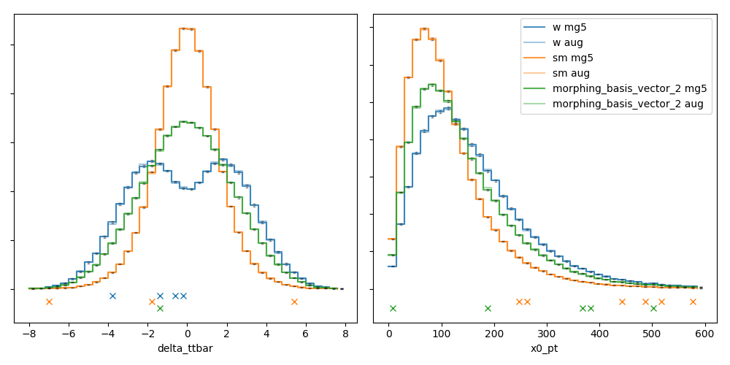
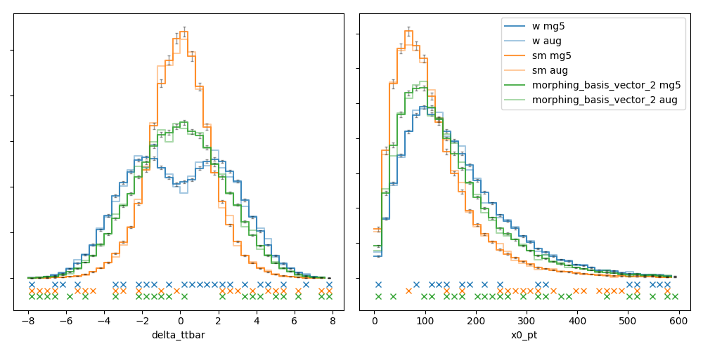
Progress thus far
ttH Process joint-likelihood ratio estimation
  Almost finished with another python module
  for MadMiner scripting
    Python object/scripting utility which wraps ML
    functions and centralizes process differences in
    a single set of backend files
    Allows quick scripting and safe setup of large
    batch jobs (full control of logging/exception
    handling => quicker debug)
  Running many batch jobs to determine ideal
  sample augmentation ratios
  (generated : augmented events)
  Working on lxplus7 (condor) and flashy (UBC servers)
Good sample augmentation
/ 17
Poor sample augmentation

Slide 7
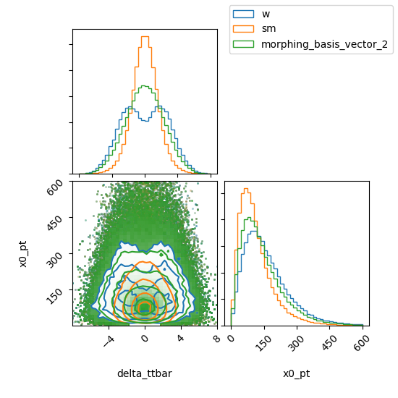
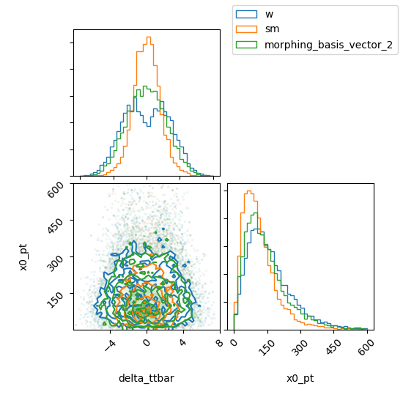
Progress thus far
/ 17
Good sample augmentation
Poor sample augmentation

Slide 8
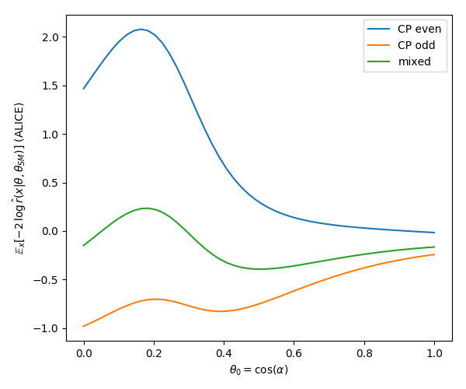
Problems
ttH CP parity parameterization is limited to the range [0, 1], with simulation benchmarks at the boundary points
This results in strange likelihood functions; correct predictions, but very poor variances
Extrapolated variances from log-likelihood ratio are both nonlinear and terrible
Generating more samples, augmented samples, and training models to further investigate this problem
/ 17

Slide 9
Future Work
Successfully model ttH interaction likelihood function, with believable variances
  Verify result precision with Fisher information
Extend methodology to higher dimensional EFT interactions
  Streamline setup and predict theory parameters for a wide variety of models and interactions
Eventually hope to develop a reliable procedure for constraining new EFT theories using these machine learning algorithms
/ 17

Slide 10


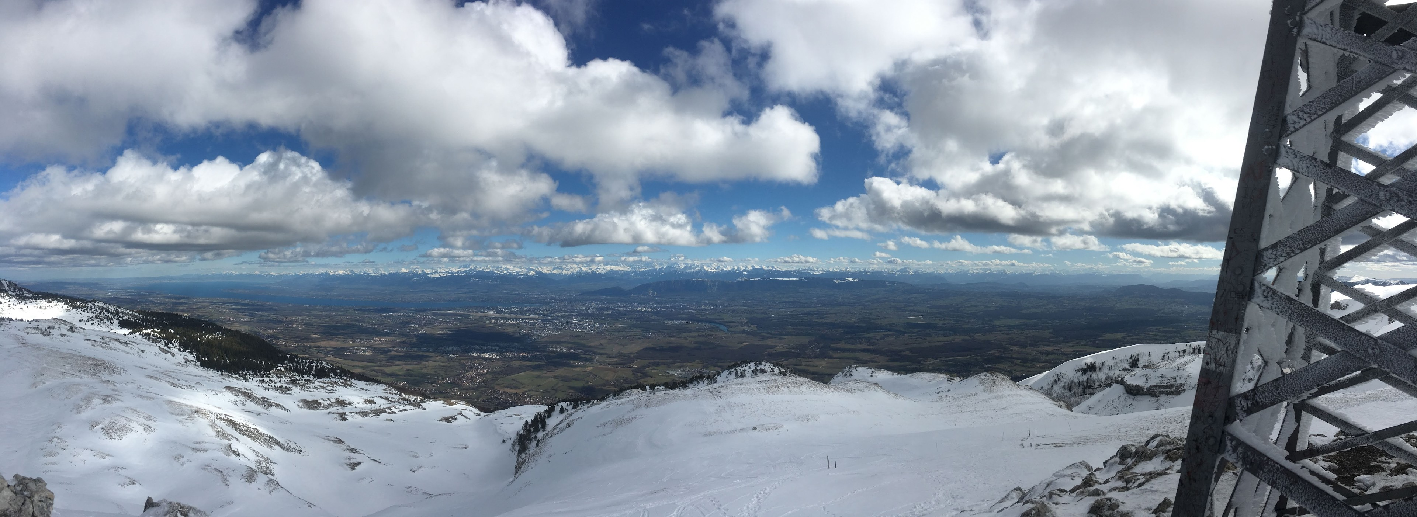
culture stuff

Slide 11

culture stuff 2.0

Slide 12
Questions?

Slide 13
References
Brehmer, Johann, et al. “A Guide to Constraining Effective Field Theories with Machine Learning.” Physical Review D, vol. 98, no. 5, 2018, doi:10.1103/physrevd.98.052004.
Brehmer, Johann, et al. “Likelihood-free inference with an improved cross-entropy estimator,” arXiv:1808.00973v1 [stat.ML], 2 Aug 2018.
Brehmer, J., Louppe, G., Pavez, J., & Cranmer, K. (2018). Mining gold from implicit models to improve likelihood-free inference. CoRR, abs/1805.12244.

