Slide 1


CSC Hardware & Four-Top Analysis
Sergio Garcia
Associated with the UCR CMS Group and the CMS CSC Group.
Mentored by Nick Manganelli, UC Riverside
$$t\overline{t}t\overline{t}$$
1

Slide 2
Projects
I am working a combination of hardware work for the CMS system and analysis work on a search for Four-Top Production.
Hardware Side:
  Test stands are being set up for replacement electronics that will be installed during LS2.
  I am assisting in the set up and the operation of the test stands.
Analysis Side:
  The UC Riverside CMS Group is developing a run-2 search for Four-Top production.
  The analysis is migrating to a new format called “NanoAOD” which is more compact and easier to use.
  I am assisting this migration by plotting signal and background distributions in Monte Carlo, control, and other distributions in Data.
2

Slide 3

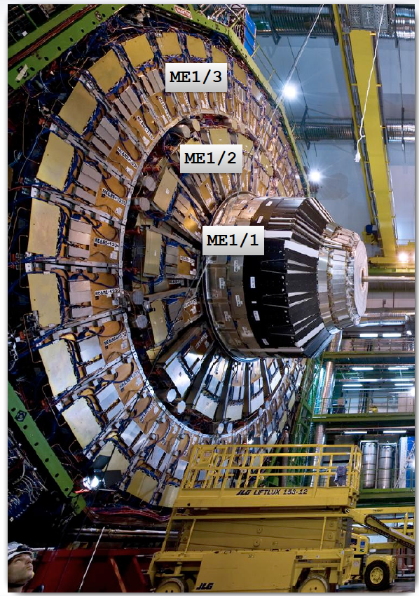
Cathode Strip Chambers (CSCs)
I am part of the CSC group of CMS.
  CSCs are cathode strip chambers which are located at the endcap disks where the magnetic field is uneven and the particle rates are high .
Credit: Manuel Franco Sevilla
3

Slide 4
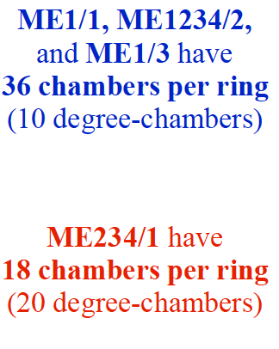
In Continuation
Credit: Manuel Franco Sevilla
4

Slide 5
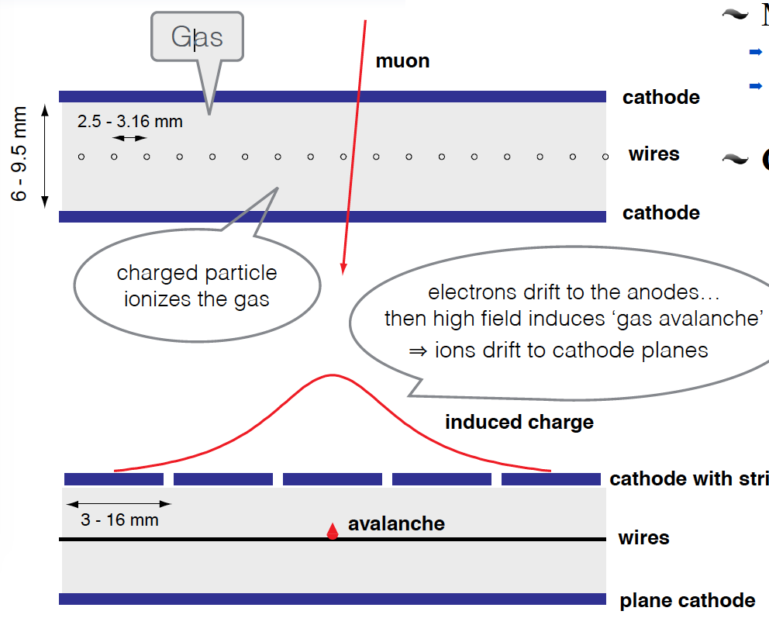
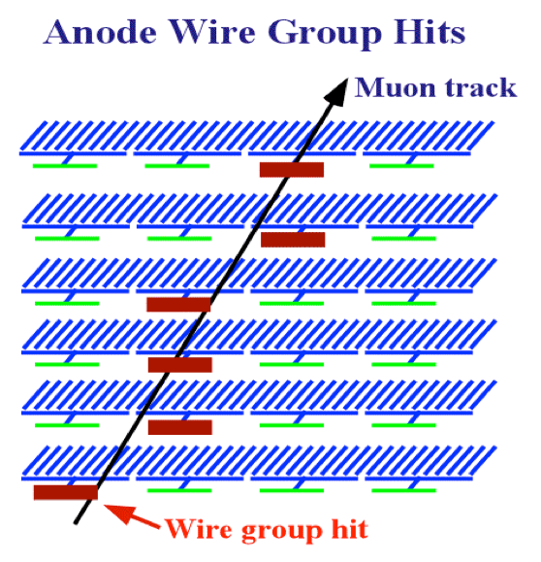
In Continuation
CSCs use perpendicular arrangements of these cathodes and anodes inside an ionizable gas, which detects the passage of muons, and measures their momentum.
Credit: Manuel Franco Sevilla
5

Slide 6
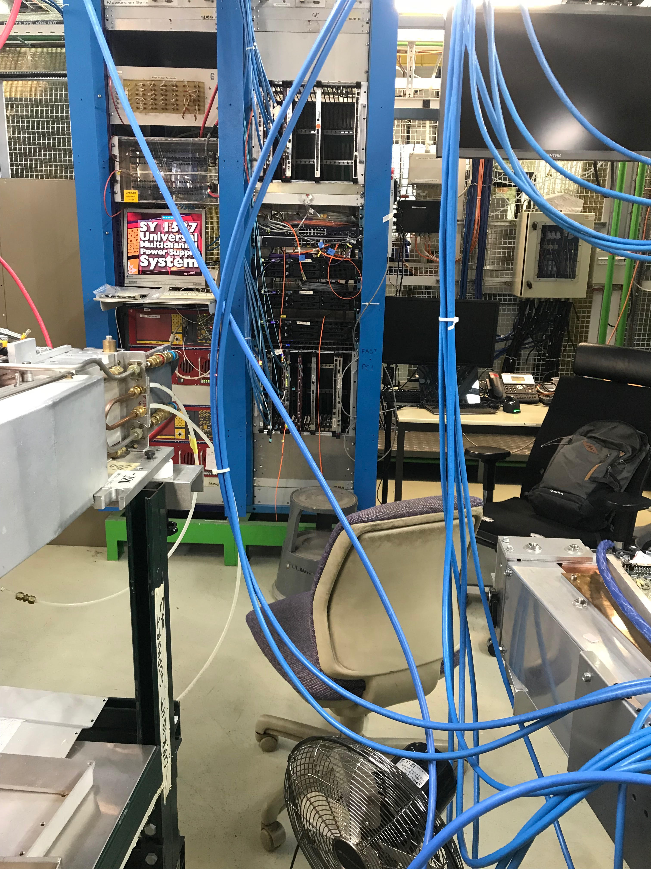
In Continuation
The on-chamber electronics that analyze the cathode/anode data are the Digital Cathode Front-End Boards (DCFEBS)/ Anode Local Charged Track board (ALCT).
  DCFEBS and the ALCT send trigger and detailed data-stream information to the Trigger Mother Board and the DAQ Mother board which are on a peripheral crate.
6

Slide 7
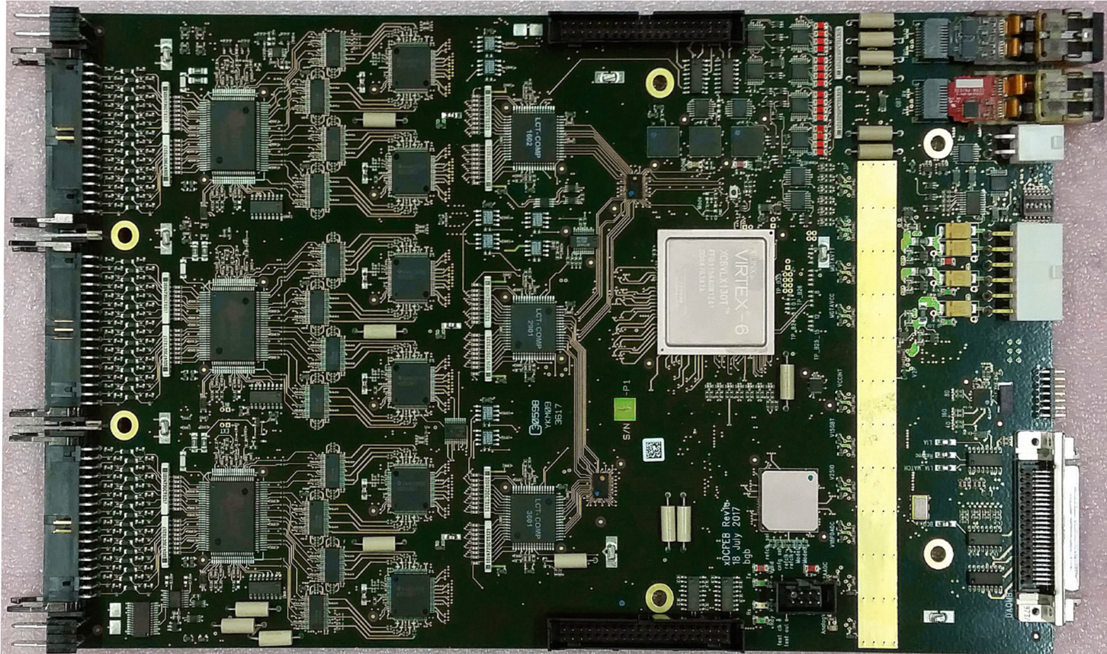
In Continuation
During LS2, we are upgrading DCFEBS to xDCFEBS in ME1/1
xDCFEBS are similar to DCFEBS, but they have an increased in radiation hardness.
Credit: Manuel Franco Sevilla
7

Slide 8
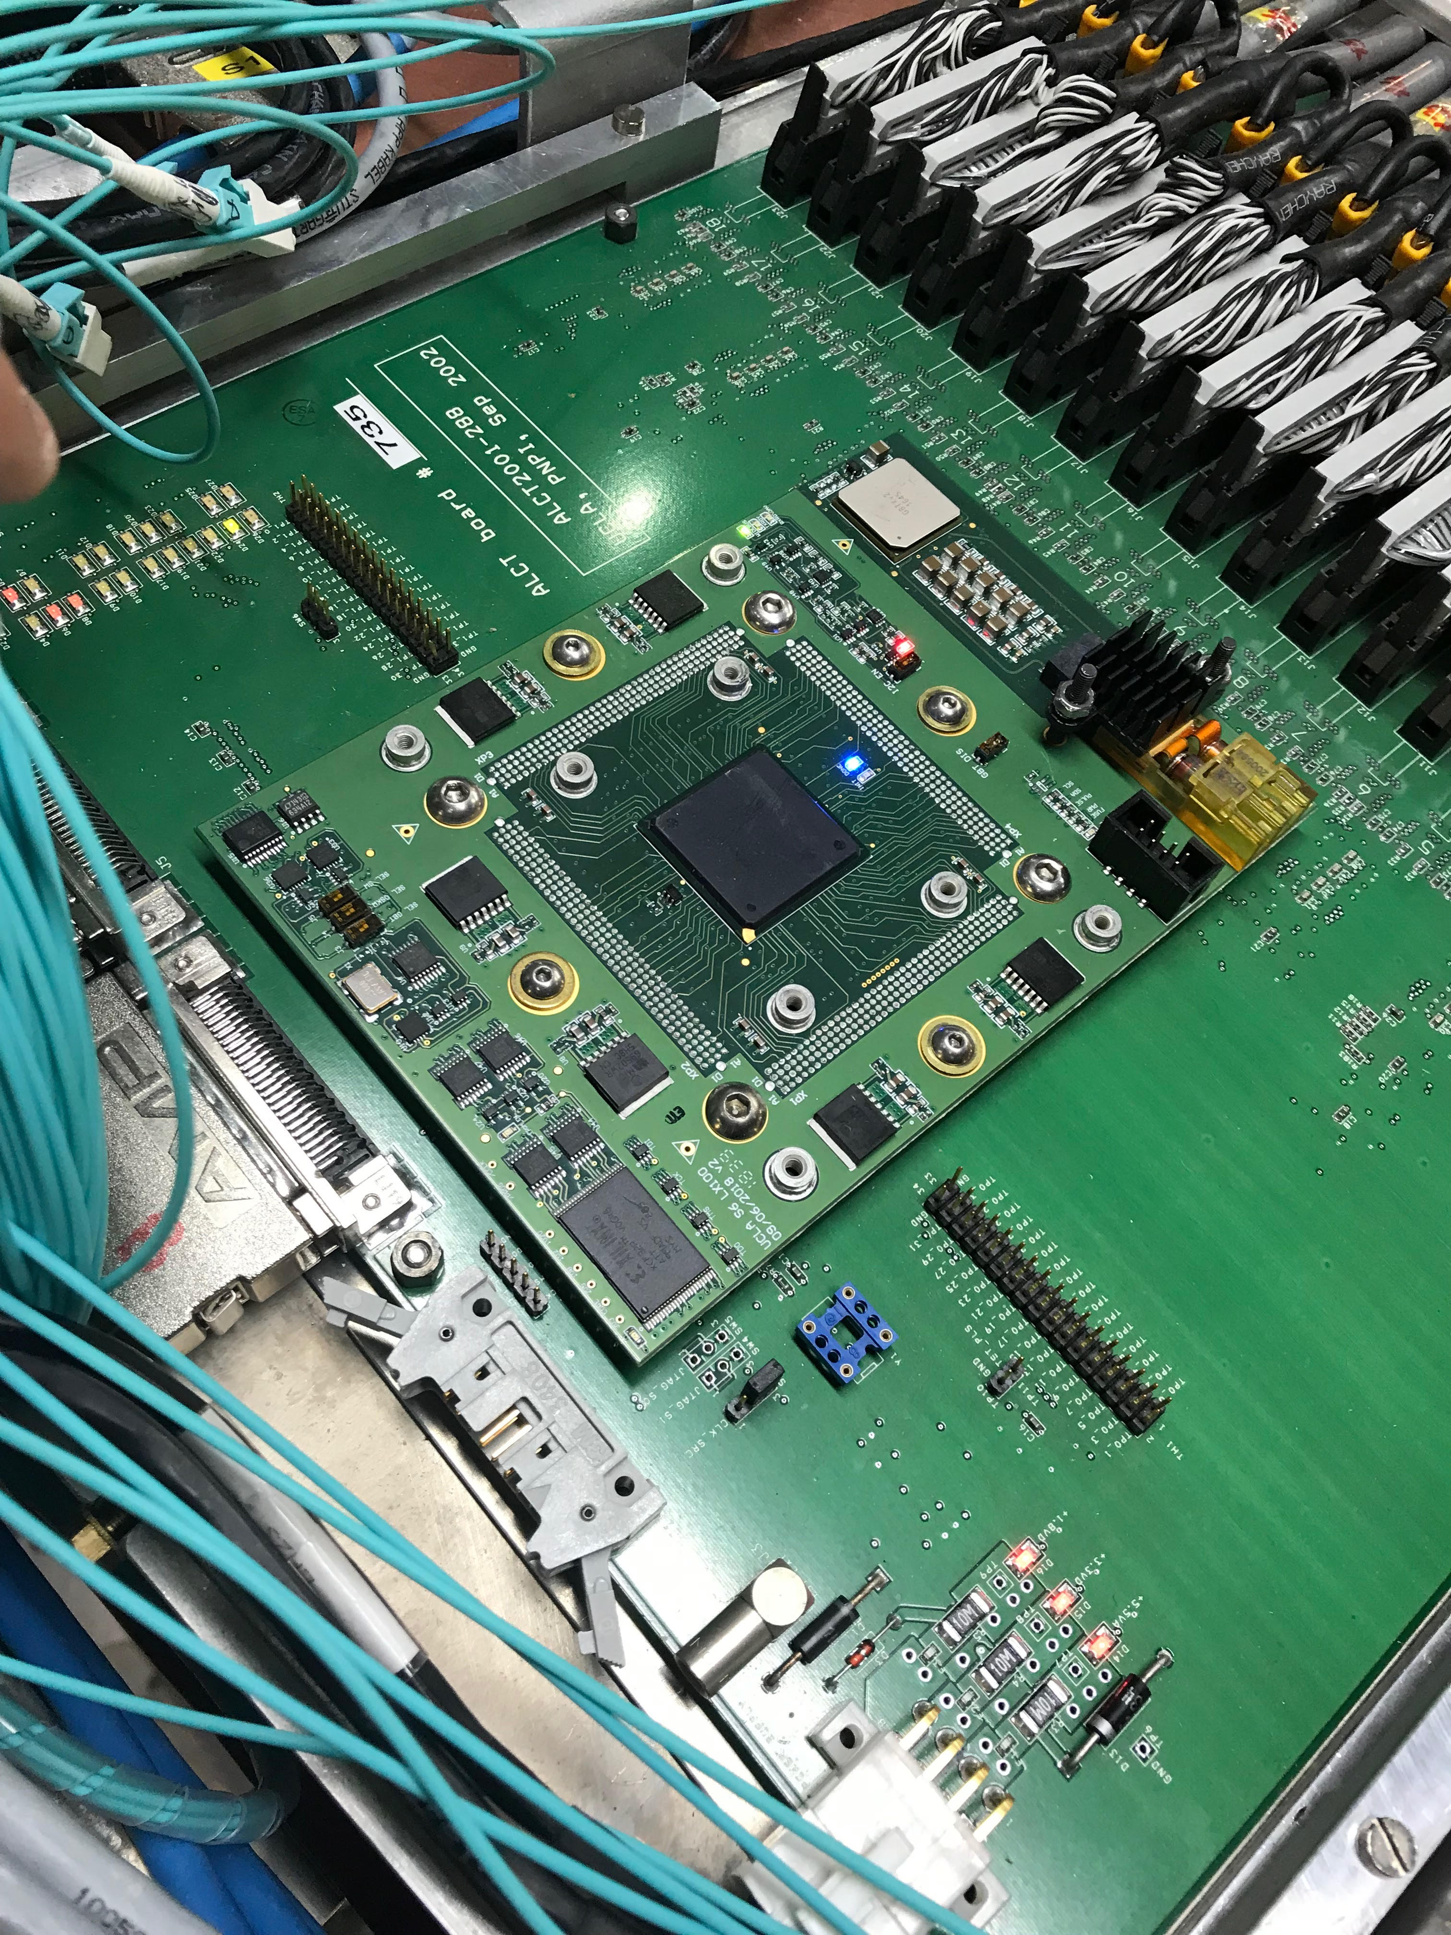
In Continuation
One chamber has been extracted from CMS system, its DCFEBS have been removed and moved to the Radioactive Protection at the Prevessin site to be modified and installed to ME 2,3,4/1 chambers.
There is a spare chamber set up at SX5 (P5).
I worked with a few members of the CSC group to replace the DCFEBS and install the xDCFEBs.
The older ALCT was removed, modified, and a new version of the ALCT mezzanine replaced the older version.
8

Slide 9
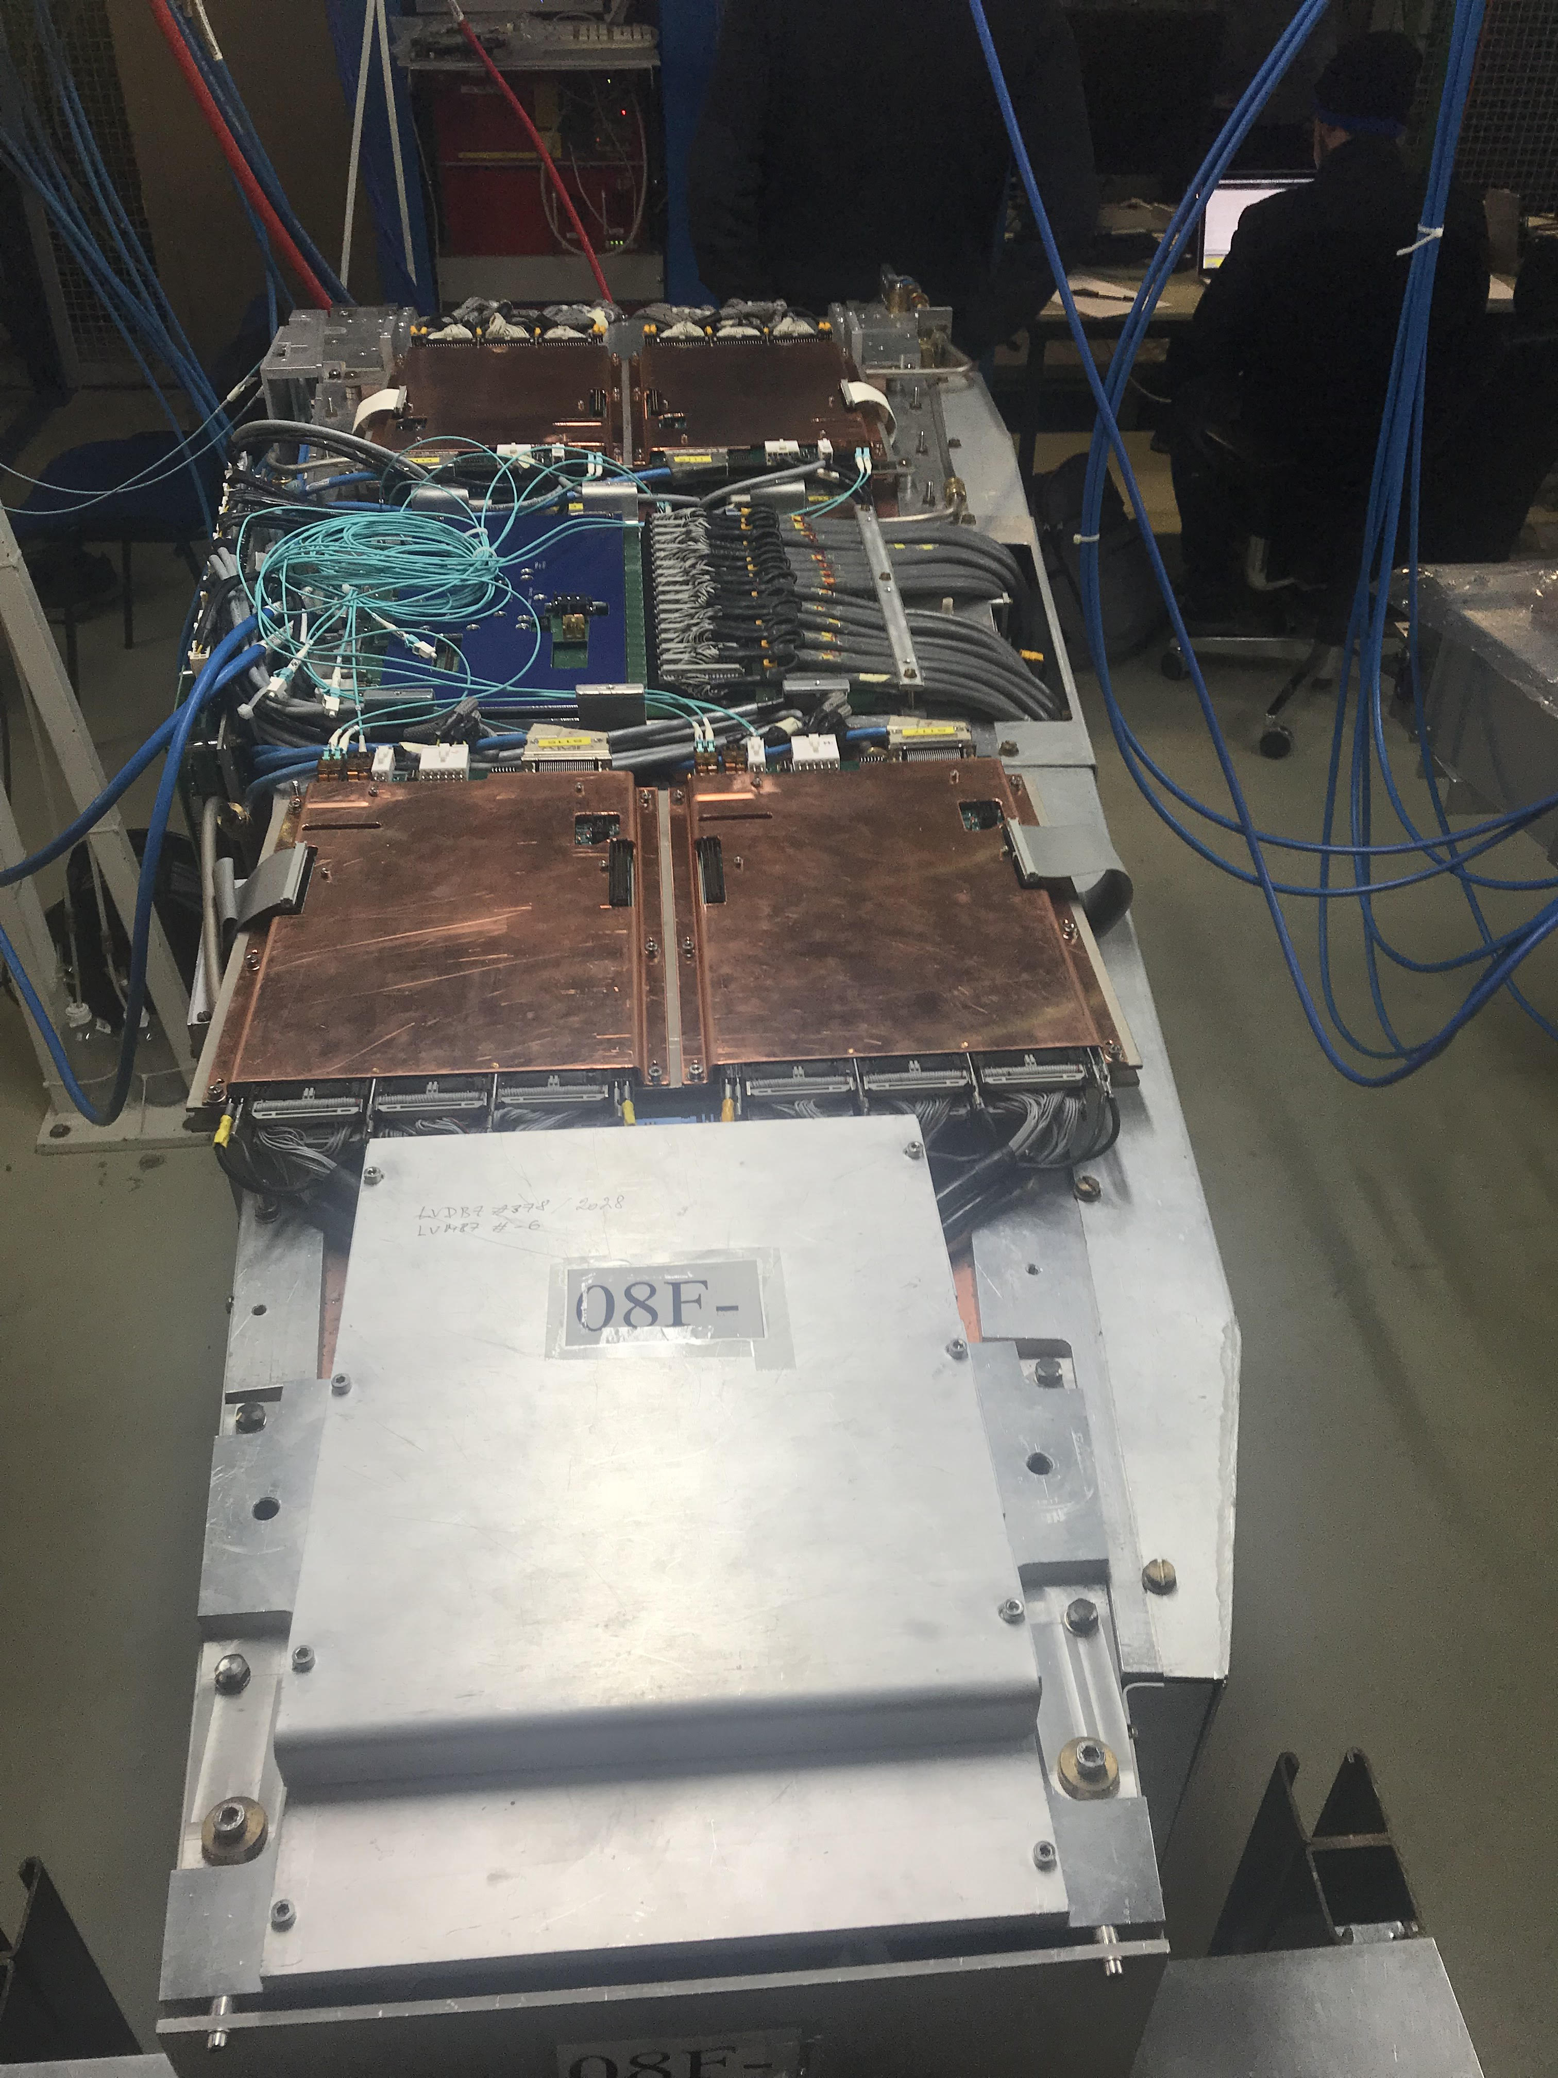
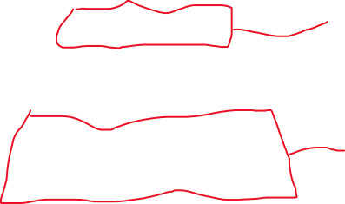
There are four (x)DCFEBS, two visibly shown and two beneath them
There are there two (x)DCFEBS visibly show and one beneath those two.
7 total xDCFEBS
9

Slide 10
In Continuation
We must use various tests for electronics such as “cosmics”
”Cosmics” is useful for testing for real muons, and this is the closest we can get to collision data without the beam.
Another test will be the burn-in test where the chambers are powered on 48 hours continuously.
Afterwards, they go back underground and get reinstalled.
The first set of xDCFEBS installed were a mix of prototype and early production boards that needed to be modified.
They are now replaced with final production boards.
The spare ME chamber is on a test stand waiting for testing.
10

Slide 11
End of part 1
The purpose of using this spare chamber is to test the software and firmware that has to be used, and validate the test stands themselves.
When CSCs from underground are extracted, we have a foundation already laid out for test stands .
11

Slide 12
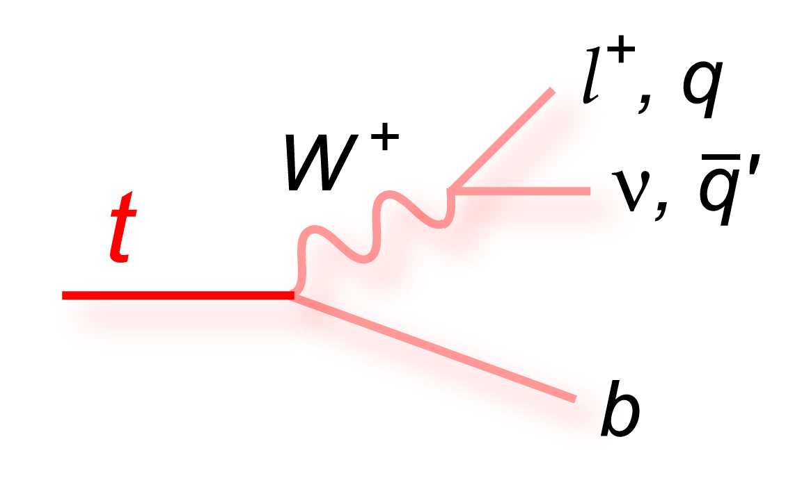
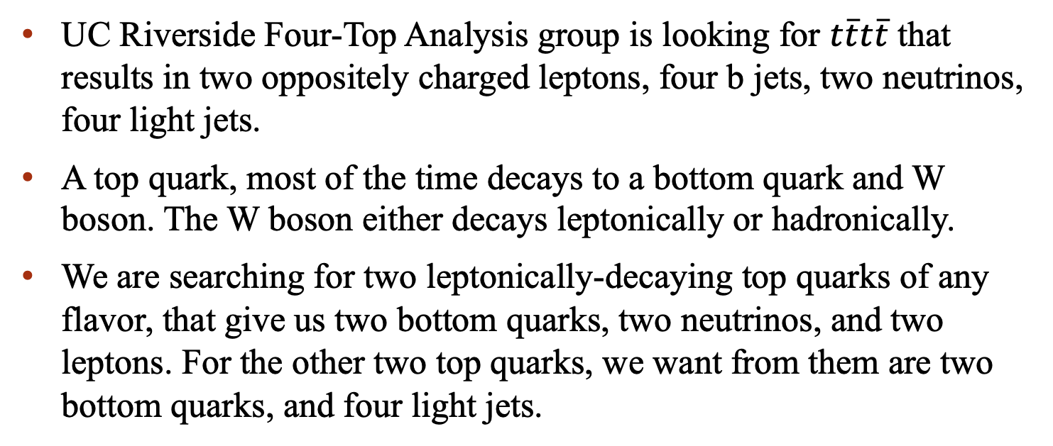
Four-Top Analysis
UC Riverside Four-Top Analysis group is looking for $t\overline{t}t\overline{t}$ that results in two oppositely charged leptons, four b jets, two neutrinos, four light jets.
A top quark, most of the time decays to a bottom quark and W boson. The W boson either decays leptonically or hadronically.
We are searching for two leptonically-decaying top quarks of any flavor, that give us two bottom quarks, two neutrinos, and two leptons. For the other two top quarks, we want from them are two bottom quarks, and four light jets.
Credit:https://www-d0.fnal.gov/Run2Physics/top/top_public_web_pages/top_feynman_diagrams.html
12

Slide 13
In Continuation
This Four-Top Analysis is a continuation of previous work; however the analysis has migrated to a new “NanoAOD” format.
  Old formats were Reco, AOD (Analysis On Demand), & miniAOD.
NanoAOD is a much faster and smaller data format to accommodate the large increase in the amount of data.
We pulled three streams of data: double e, e mu, and double mu from the 2017 data.
Using nanoAOD, I was able to gather information of the events collected and plot histograms of the missing energy, transverse momentum of each muon, electron, b-tagged jet, untagged jet, etc.
  Main point is about making control plots, which might reveal detector issues that affect the data for us. We're searching for an extremely rare process (over 800,000 ttbar events for every 12 tttt events!)
13

Slide 14
In Conclusion
What’s next?
Now, I will start with Monte Carlo Simulations to look at both signal and background distributions.
  Hypothesis testing (e.g. SM)
  How does this fare with the actual data
I will continue to work and contribute to the operation of the test stands.
  I will follow the grad students, postdocs, and supervisors’ lead and DO NOT cause trouble to the CSC group.
14

Slide 15
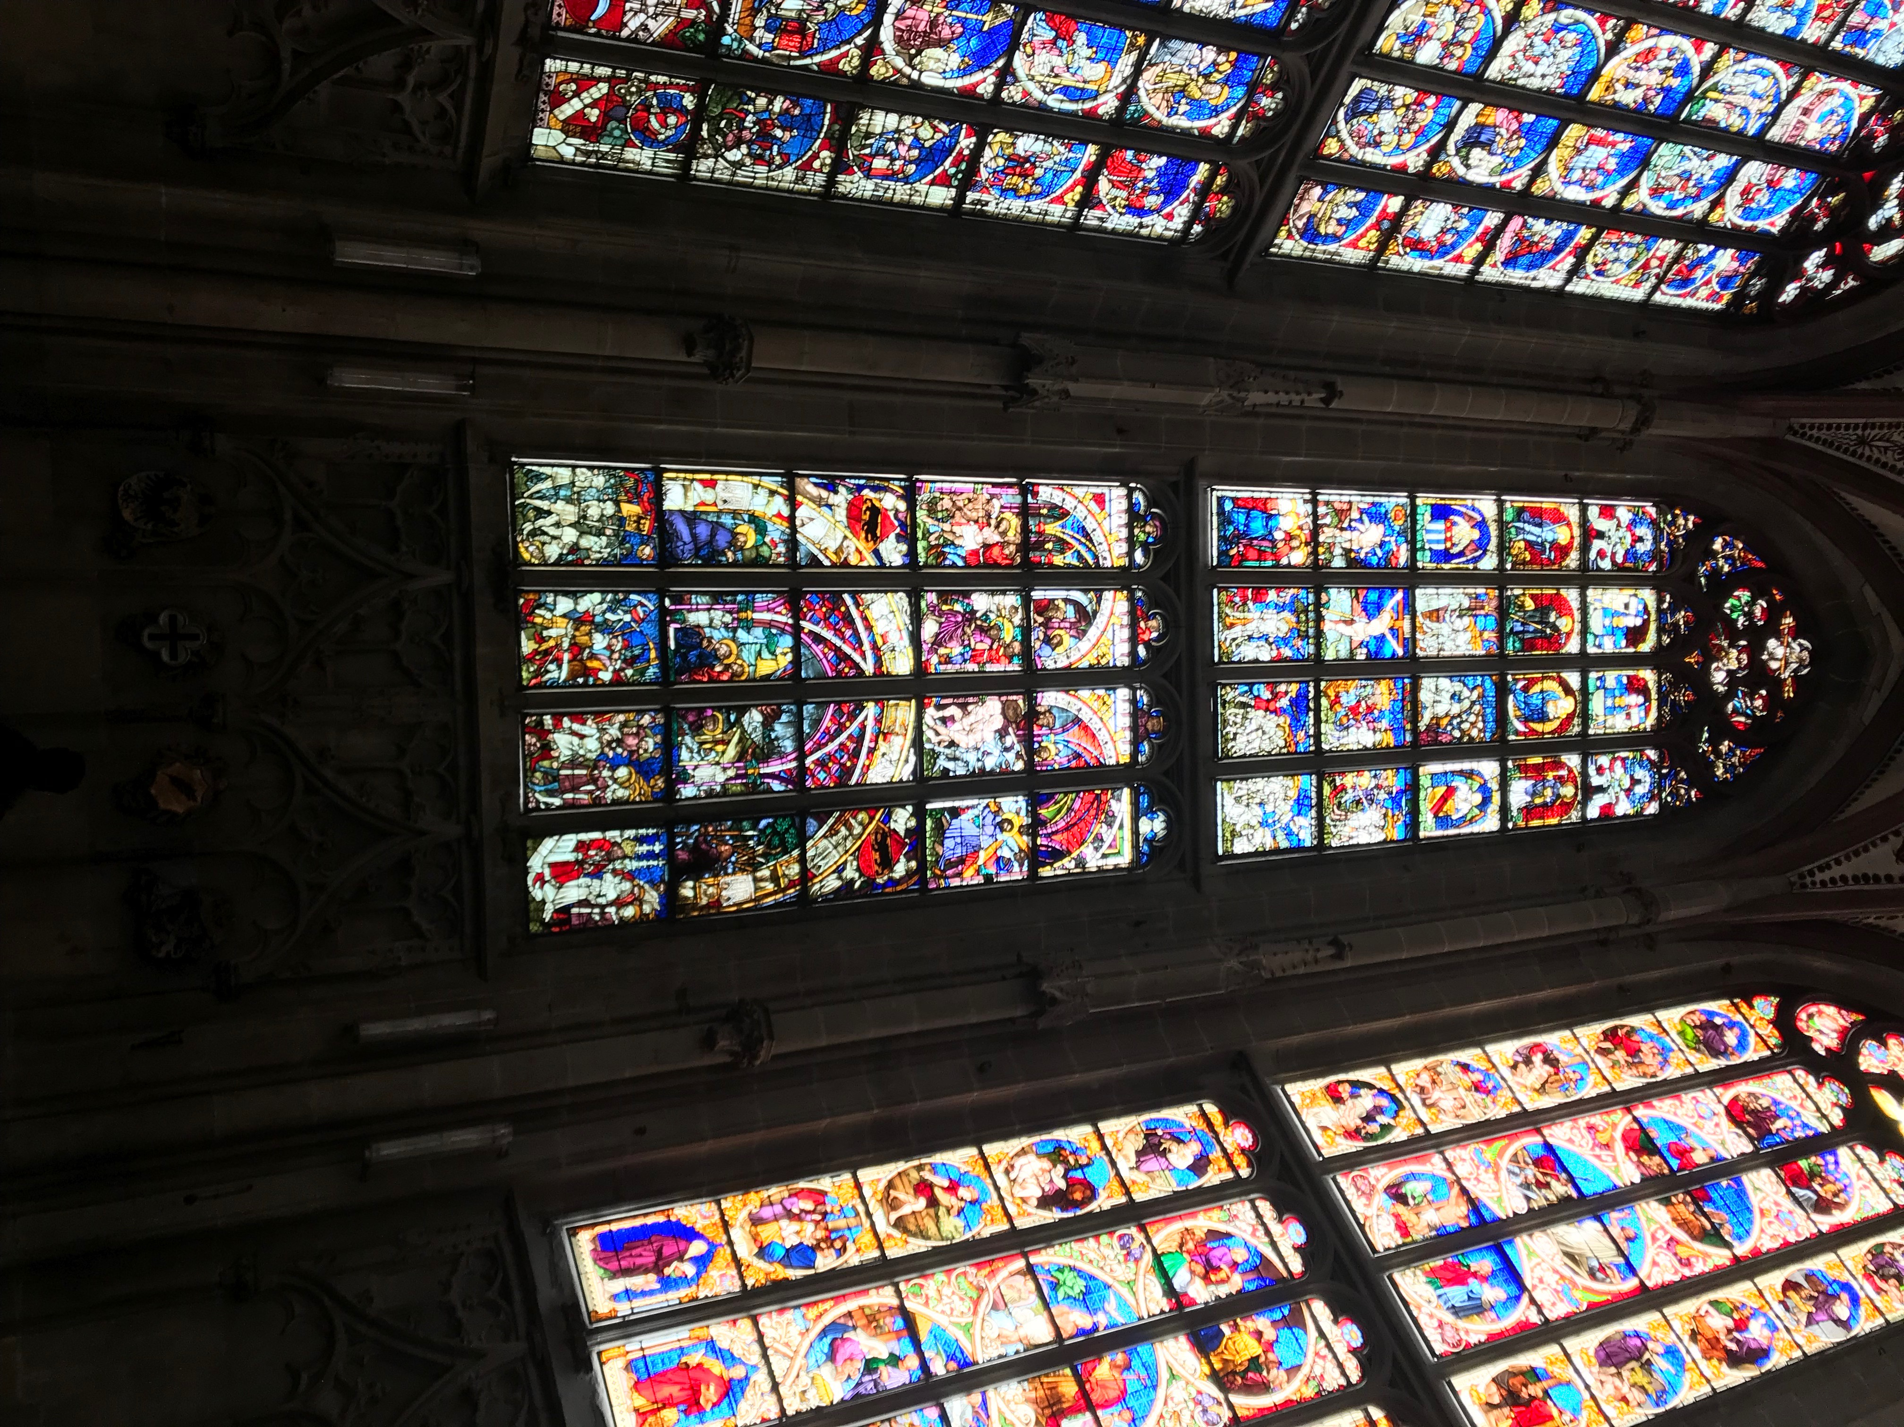
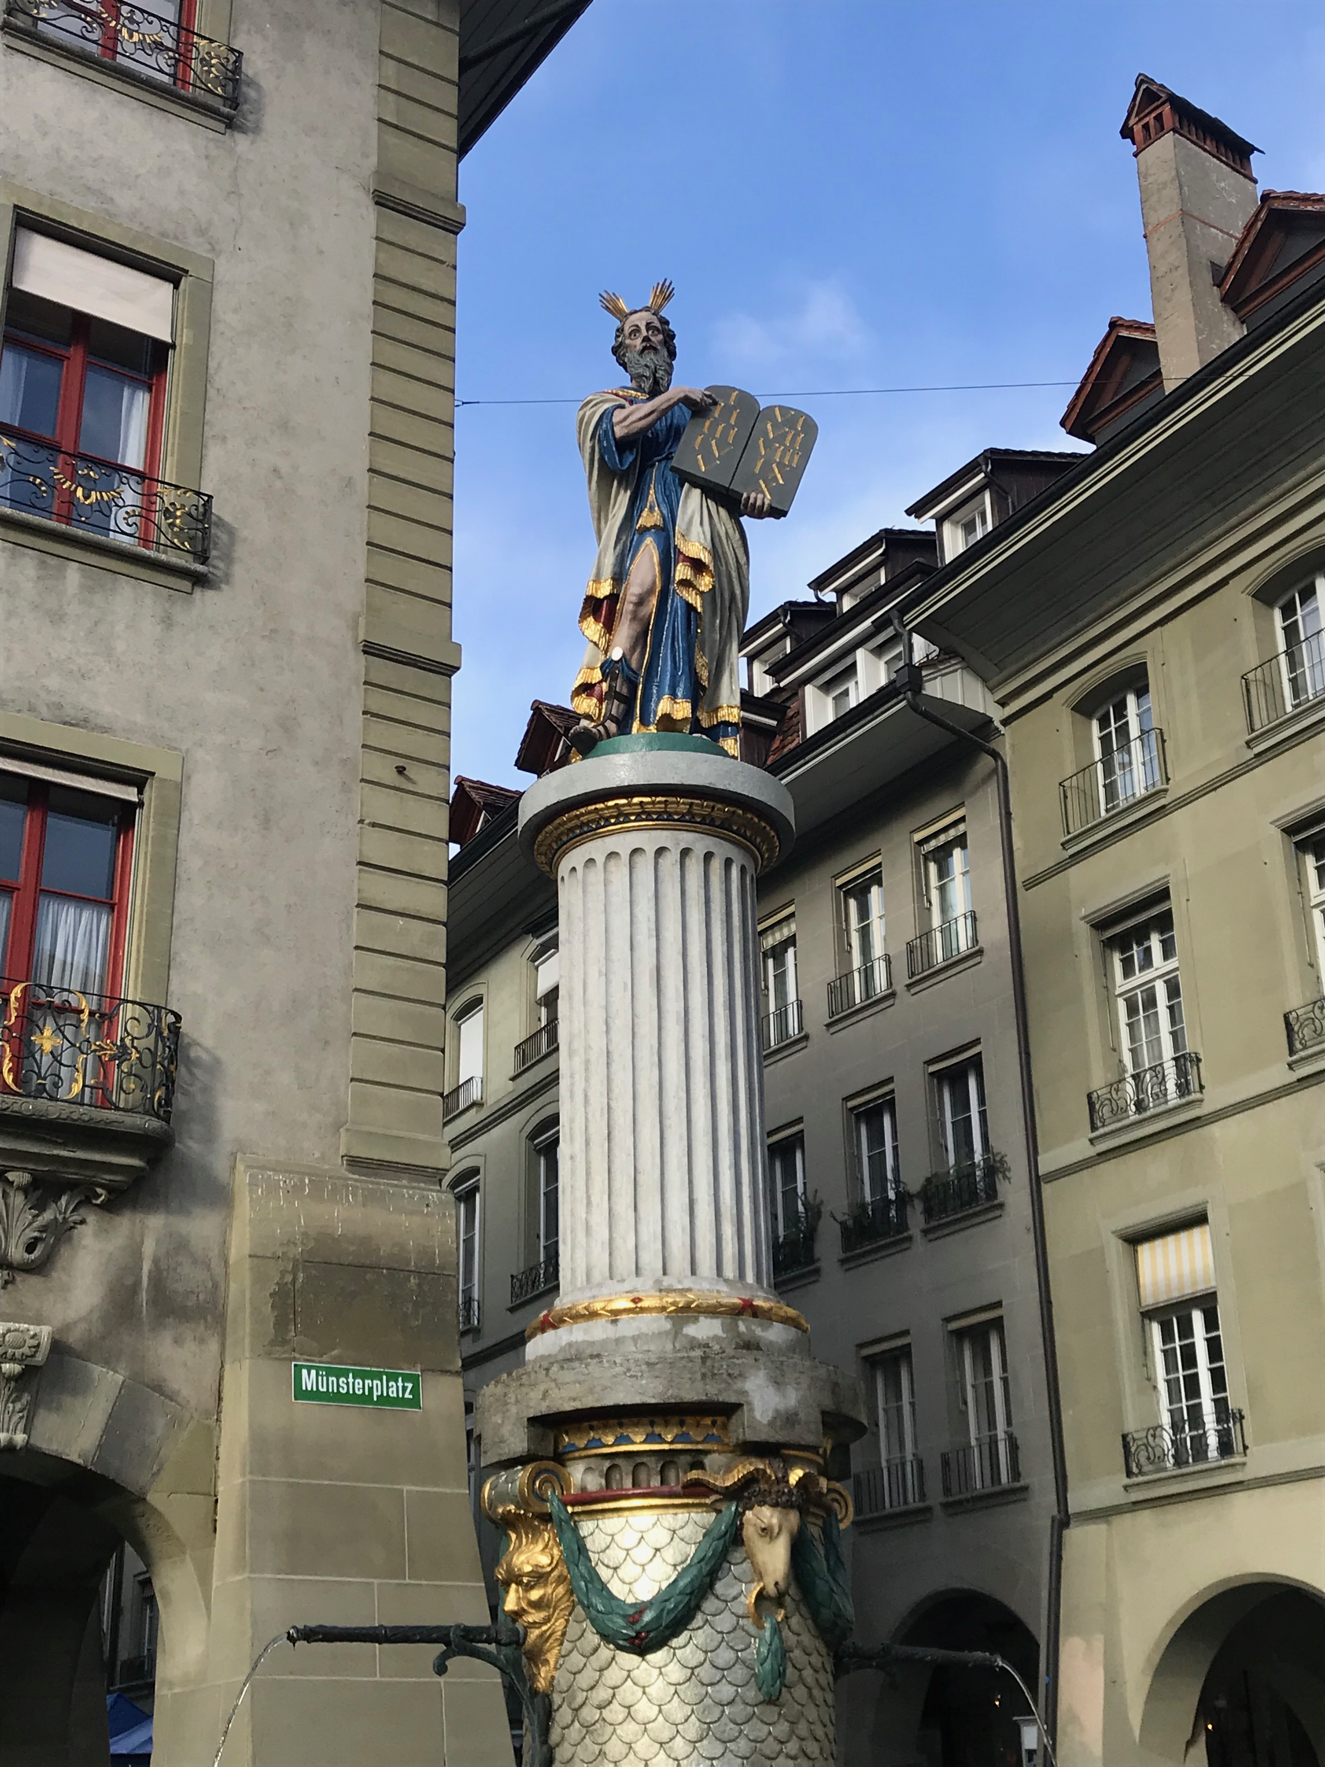
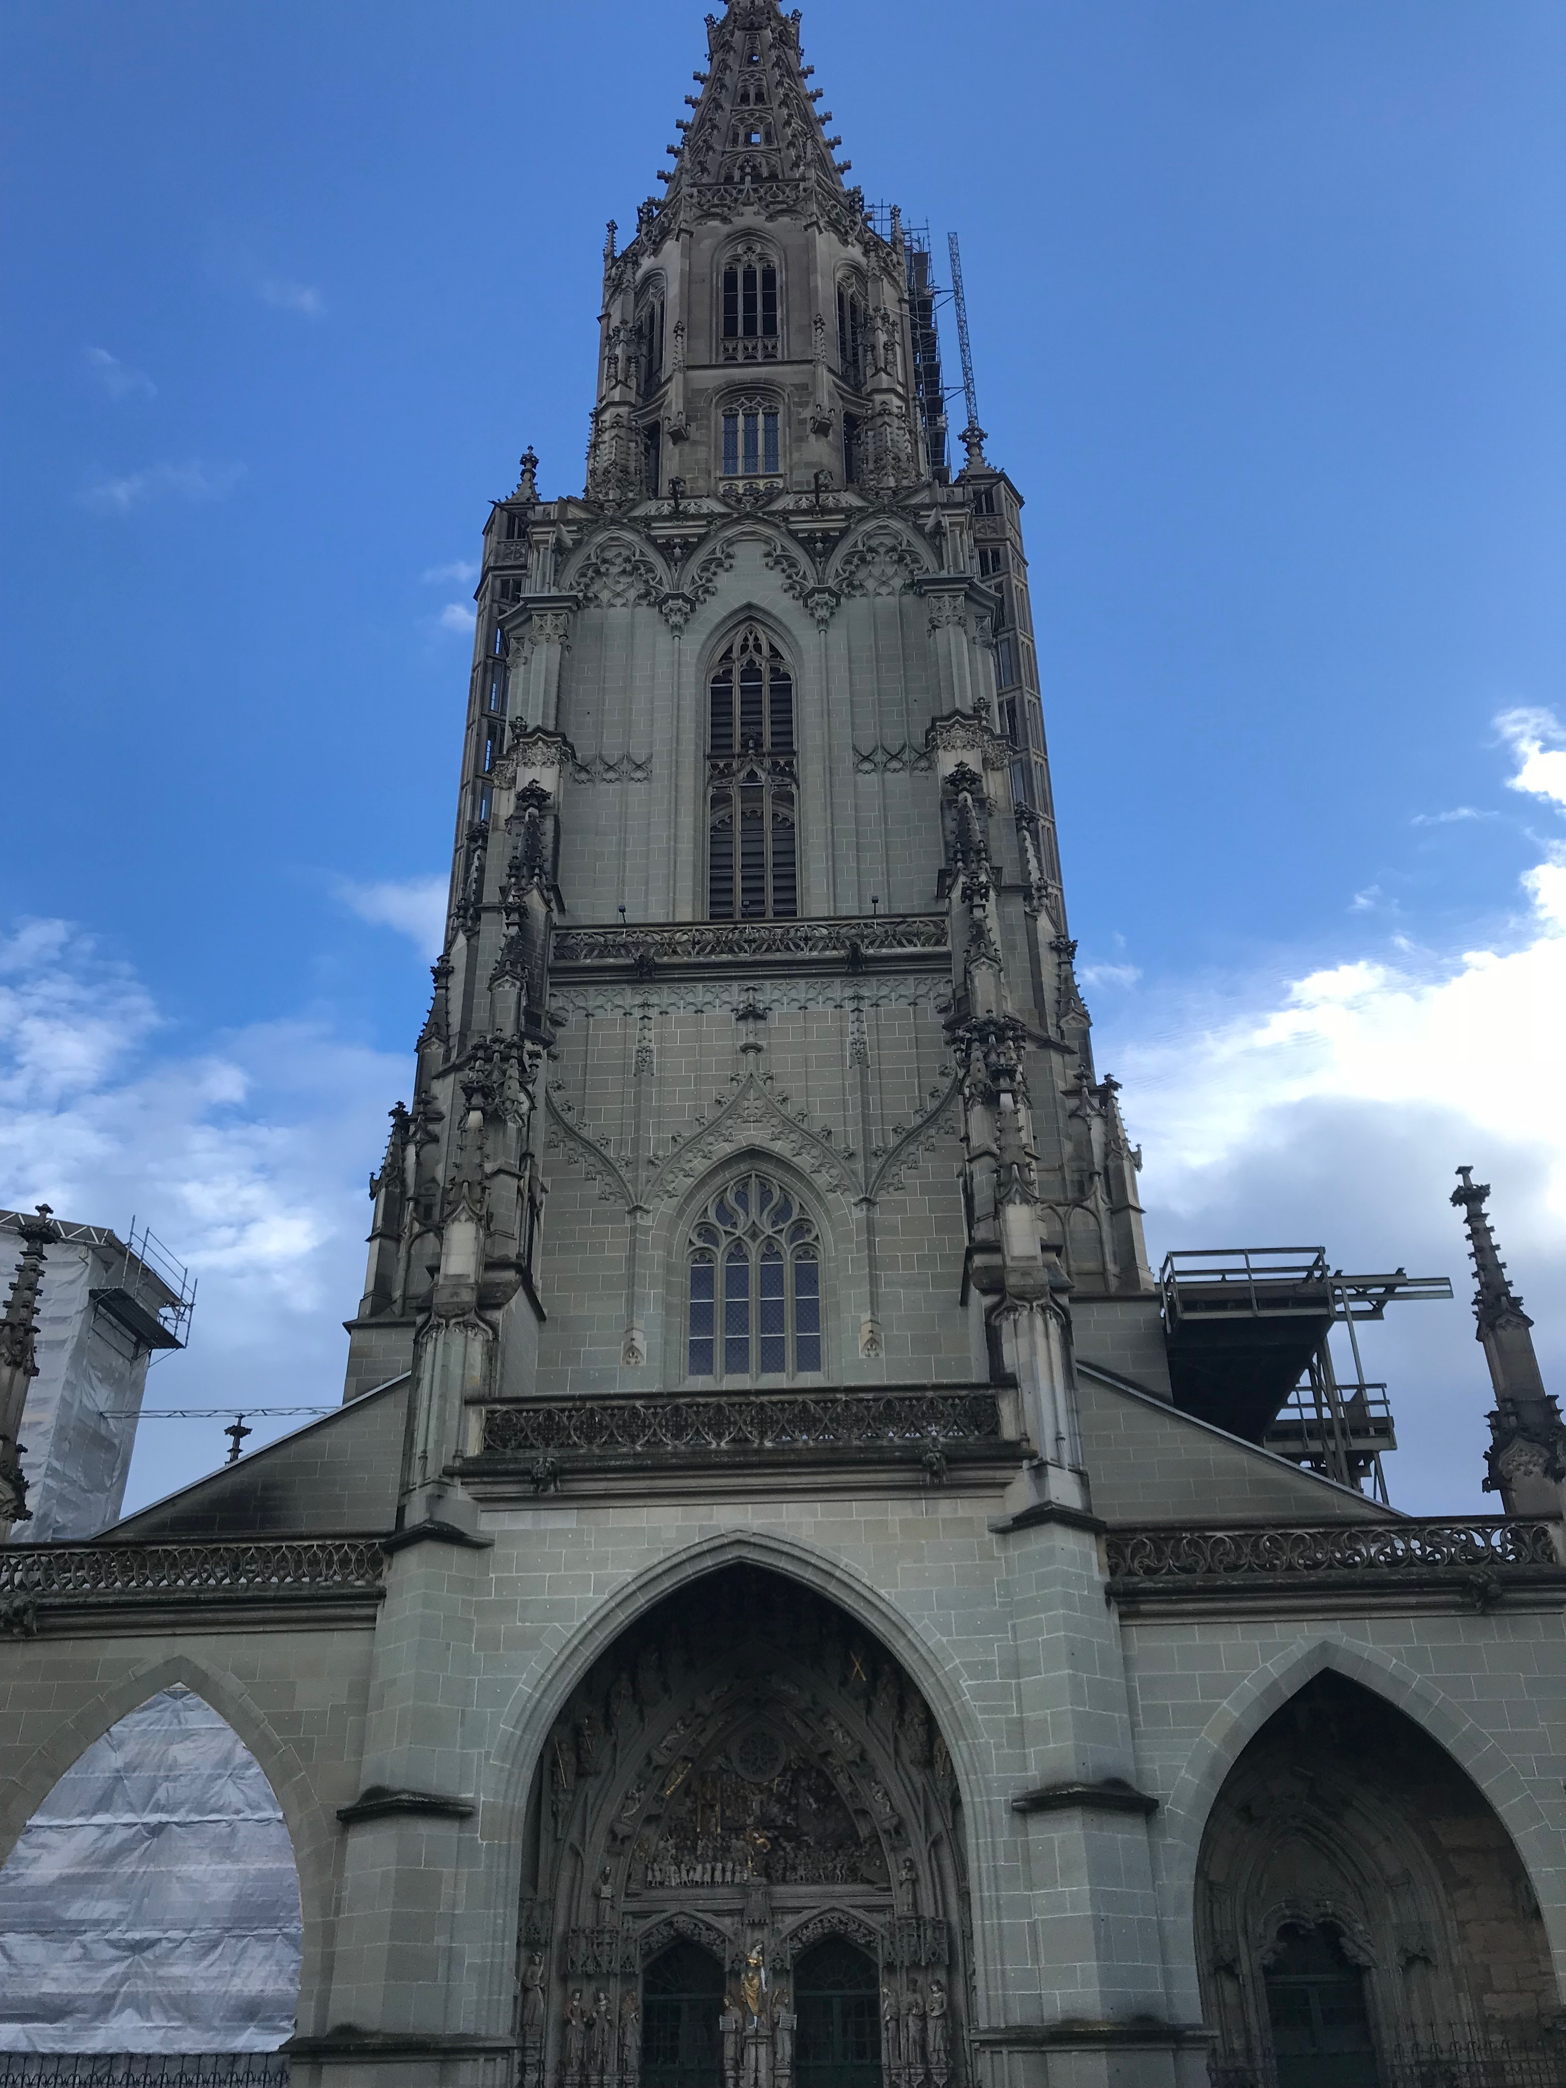
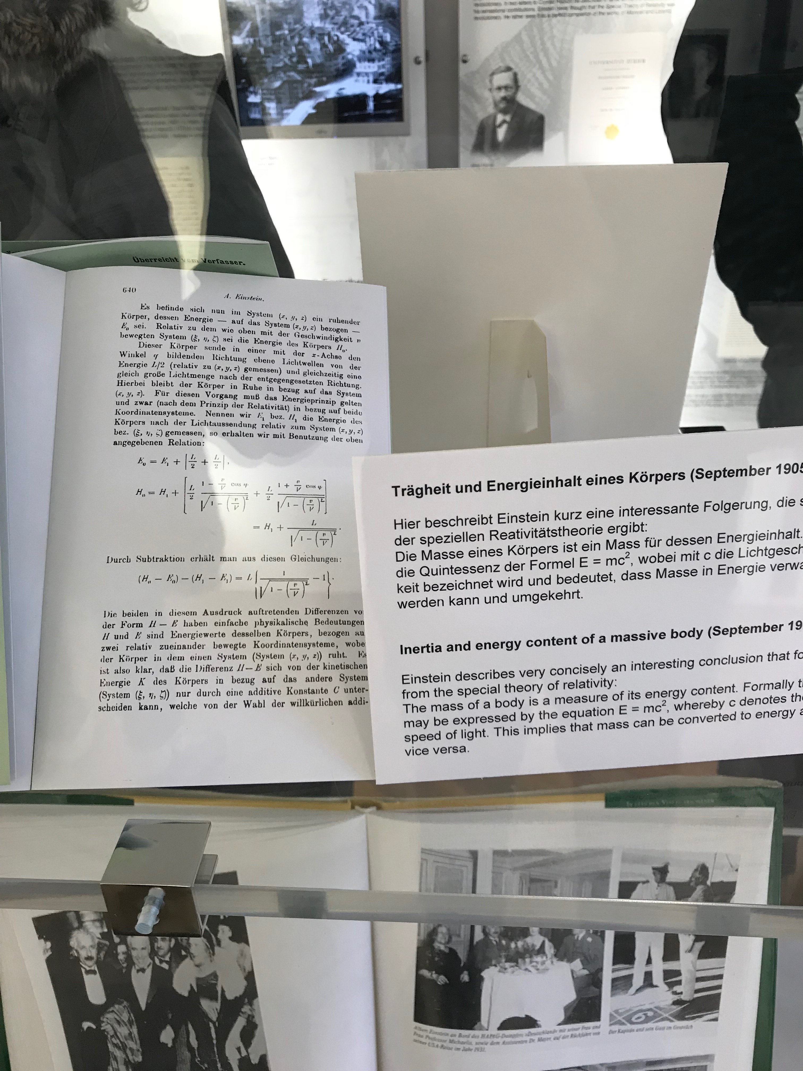
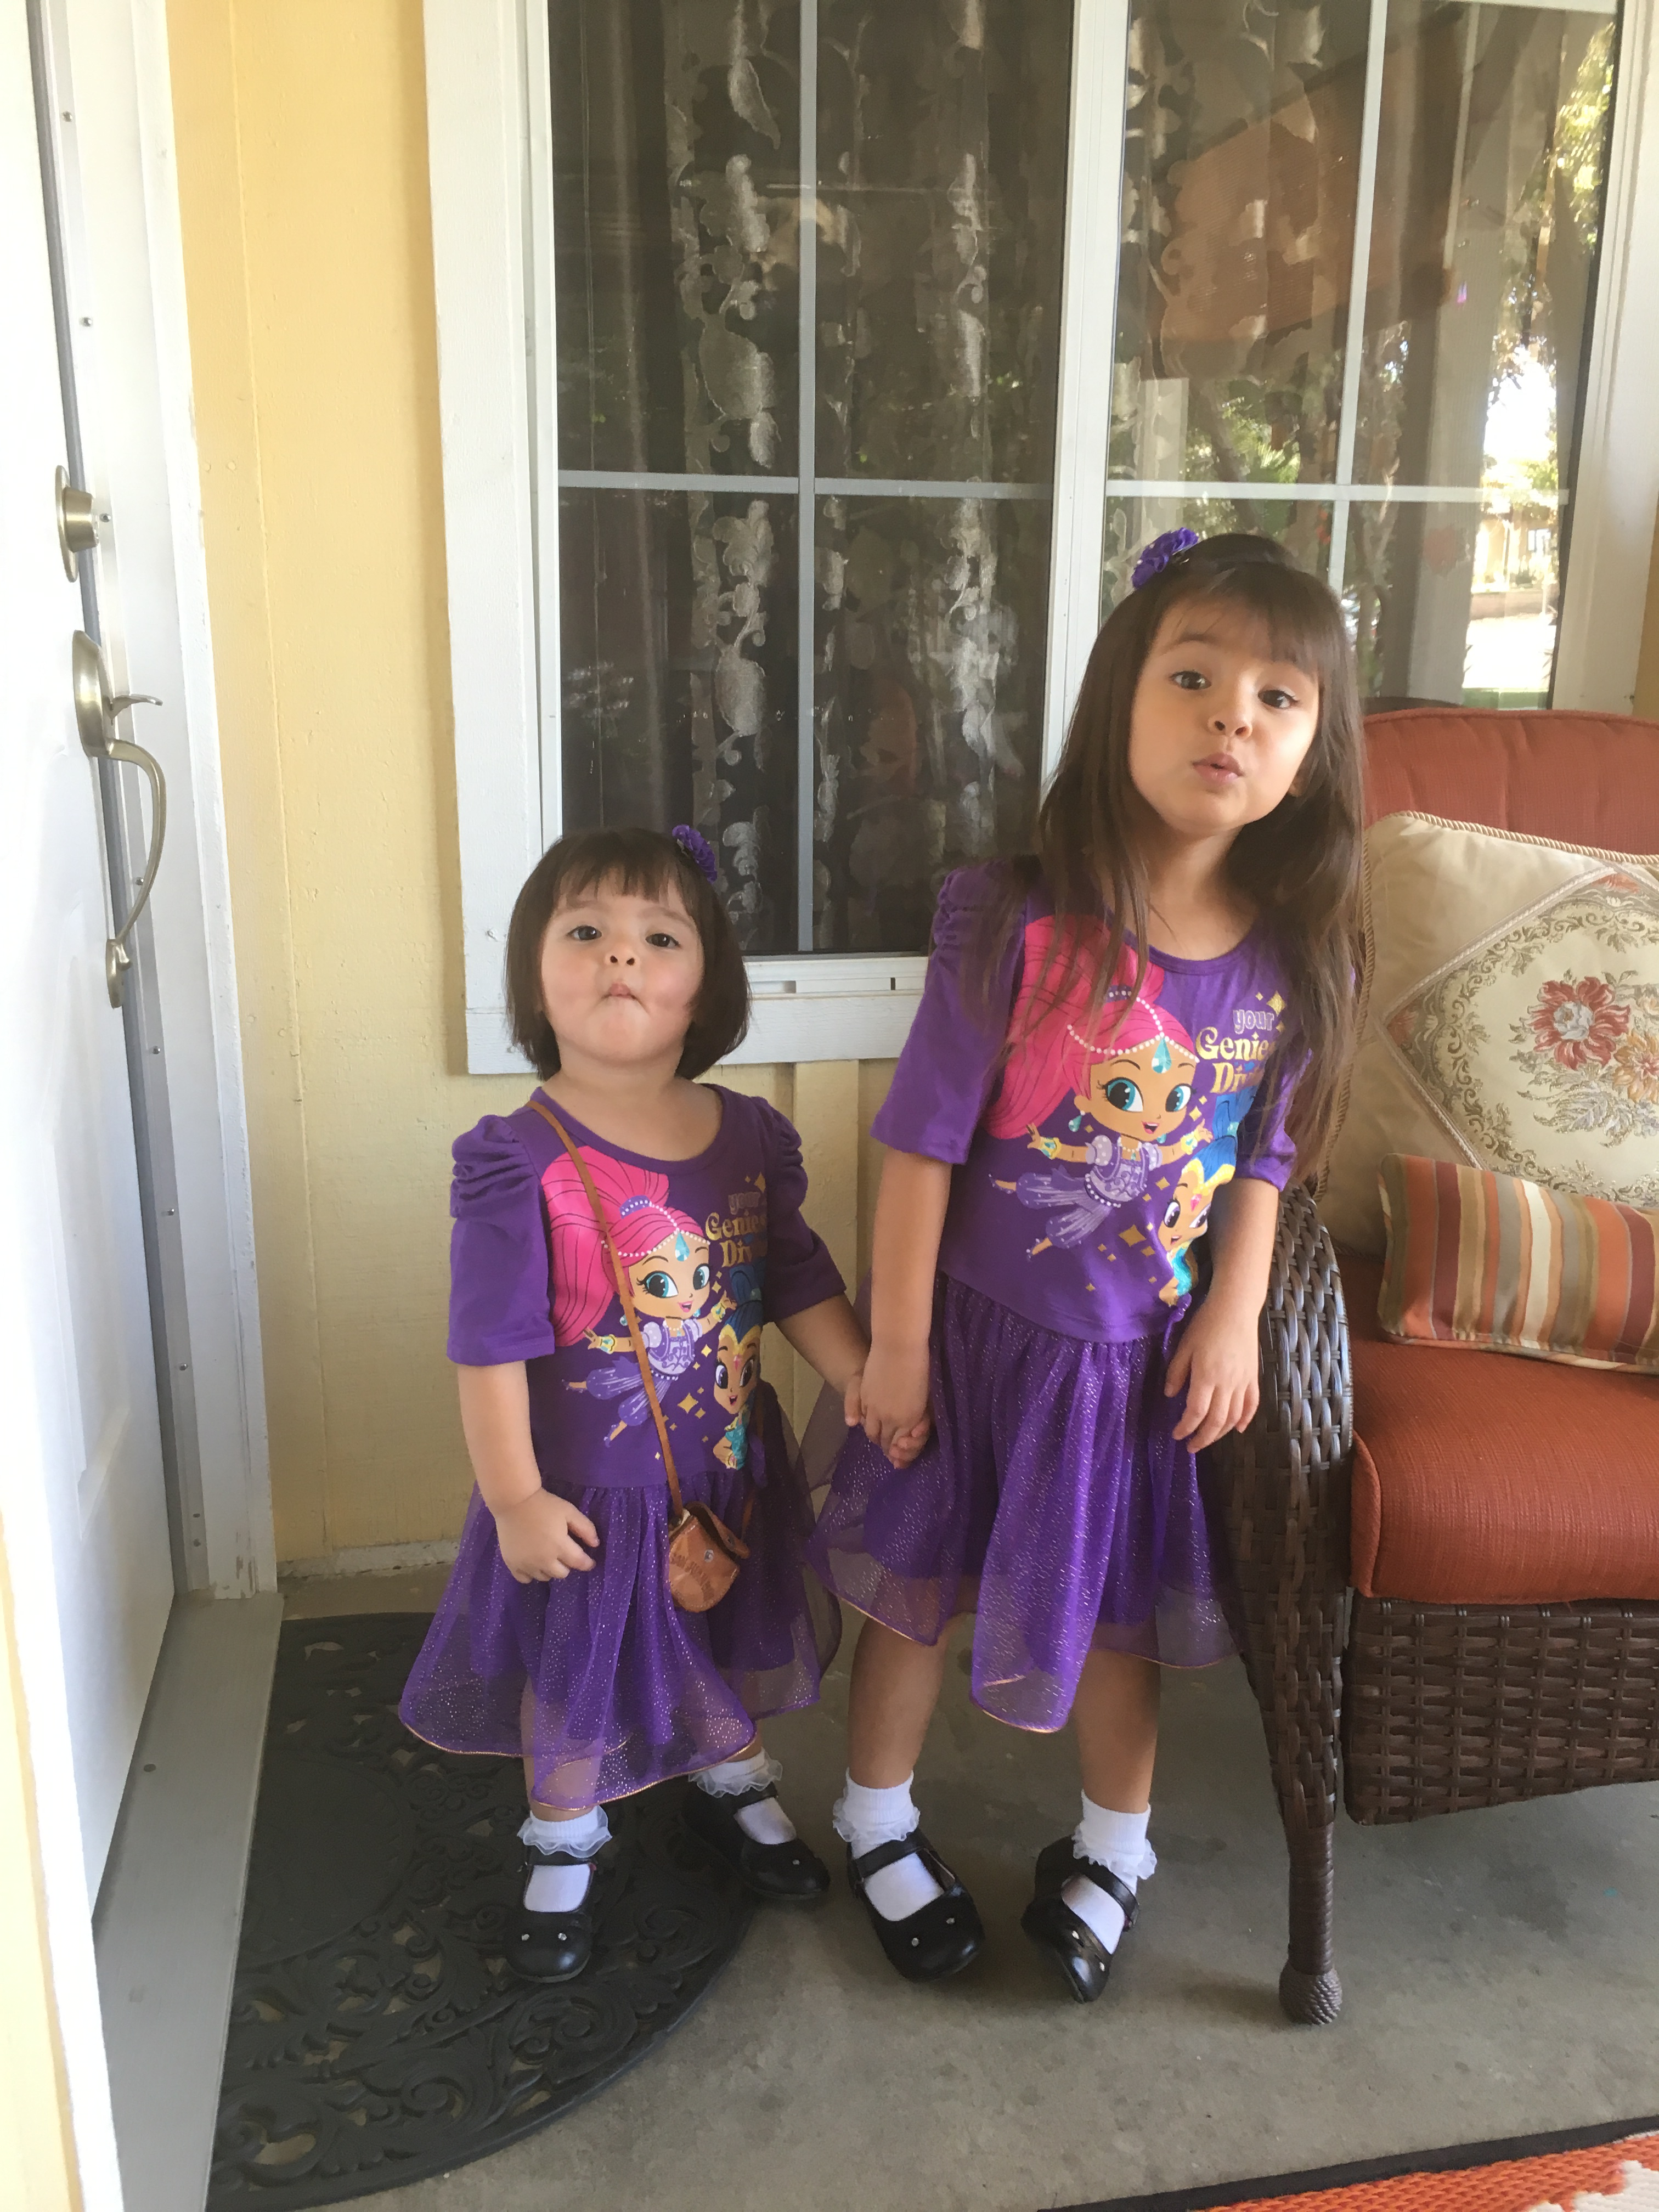
Pictures

Slide 17
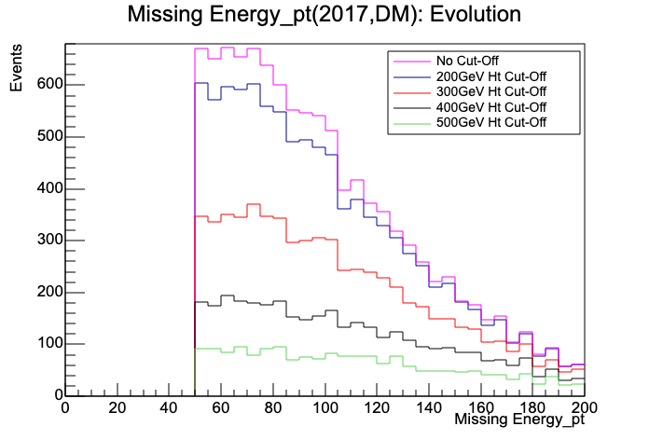
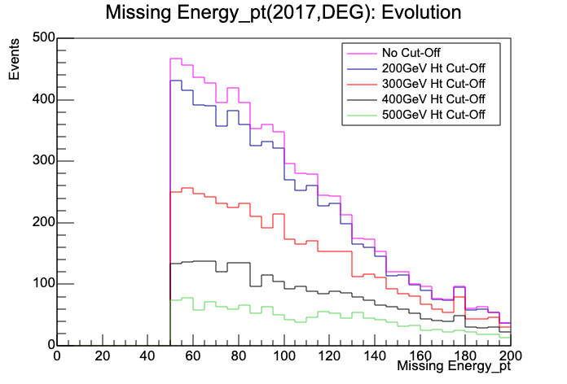
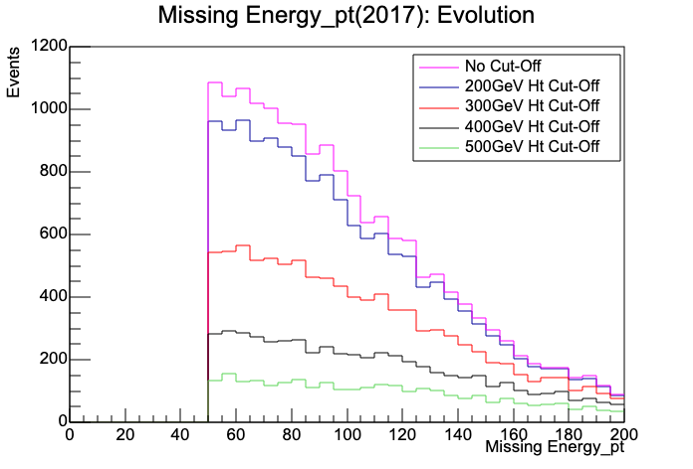
Plots
Double mu
Double e
e mu

Slide 18
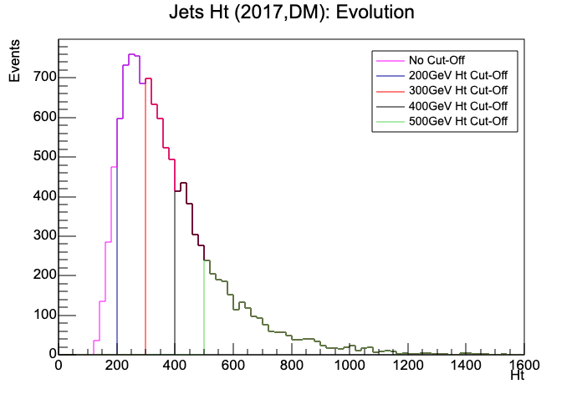
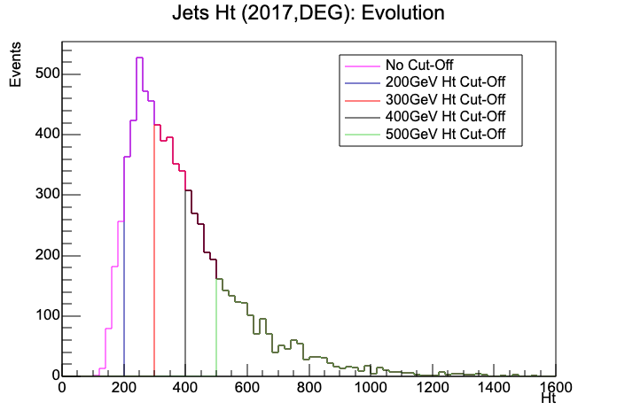
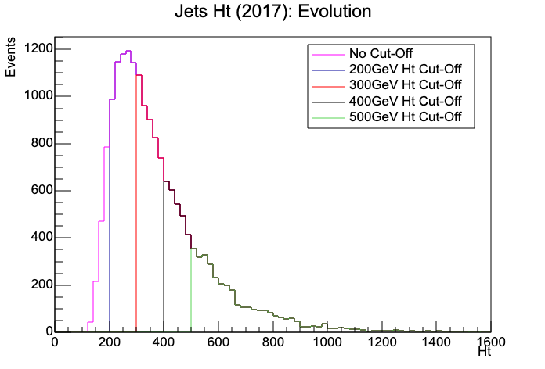

Slide 19
Four-Tops and CSC Progress
Welcome Back!
1

Slide 20
The Ongoing LS2
CSCs from ME1/1 (Cathode Strip Chambers) are being extracted from underground.
  The process of extraction began on February 25th.
  The extracted chambers are held at a workstation in SX5 (Point 5).
Now, the CSC group and I have to remove the old DCFEBS from the extracted chambers, and replace them with the new xDCFEBS.
2

Slide 21
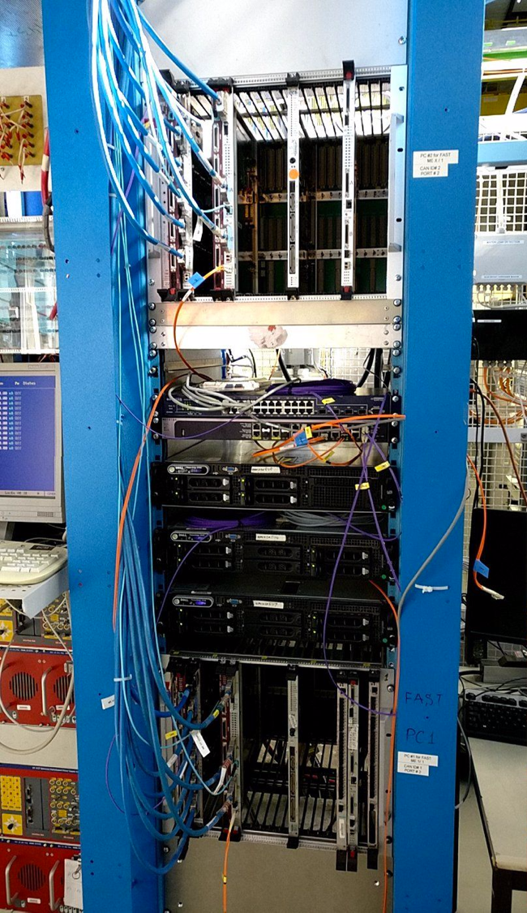
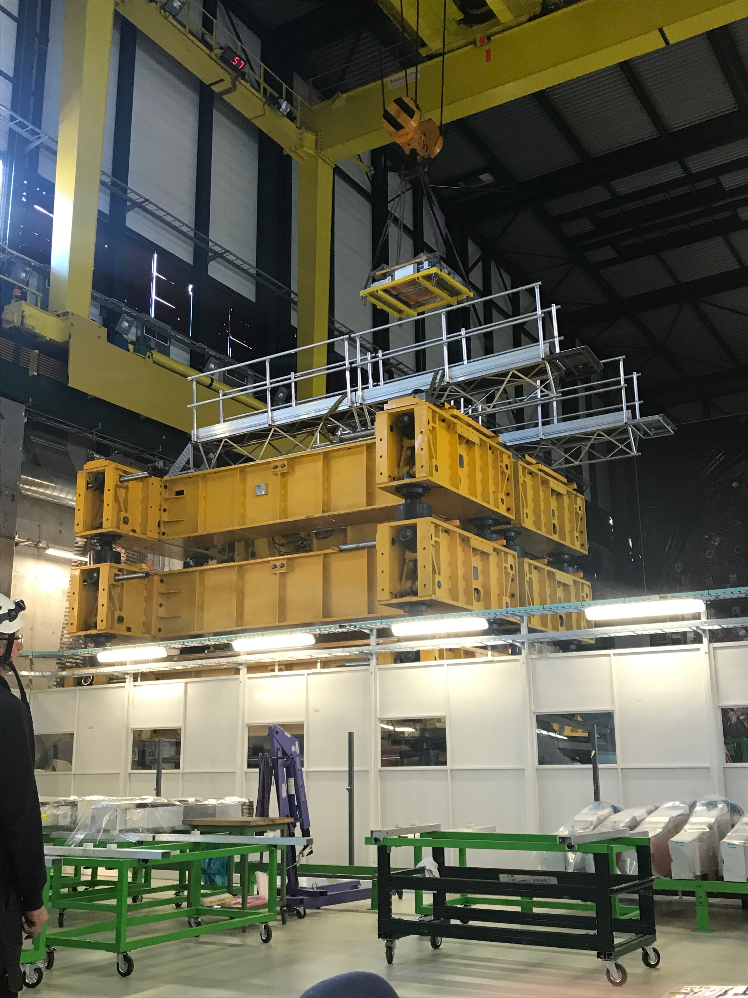
3

Slide 22
A Running Joke
To replace the DCFEBS with the xDCFEBS, first we had to cut thermal pads and stick them to specific places on copper covers.
  The thermal pads are to provide thermal conductivity on the electronics present in the xDCFEBS.
  This is a tedious task because we have to cut these thermal pads to some precise measurements.
In ME1/1 there are 36 chambers and each chamber holds 7 xDCFEBS.
  252 covers w/ thermal pads must be completed. So far we have done a slight fraction of that number.
  ”So who wants to cut thermal pads?”
4

Slide 23
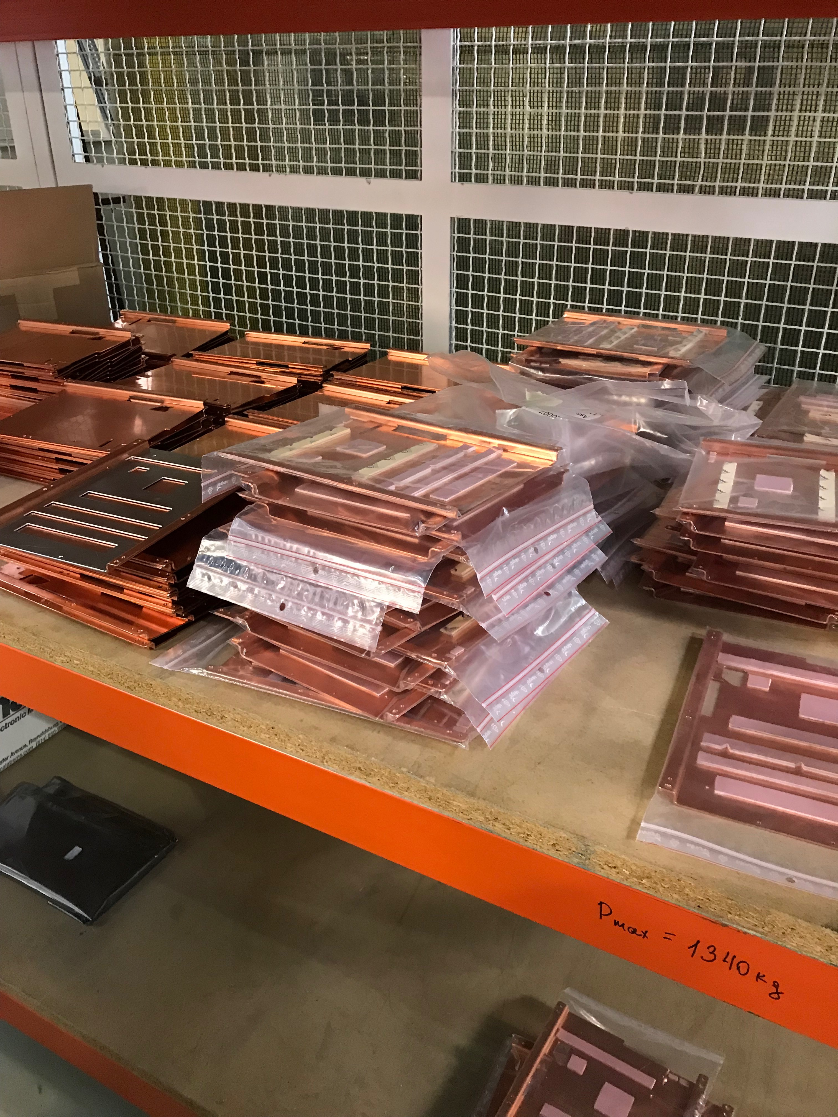
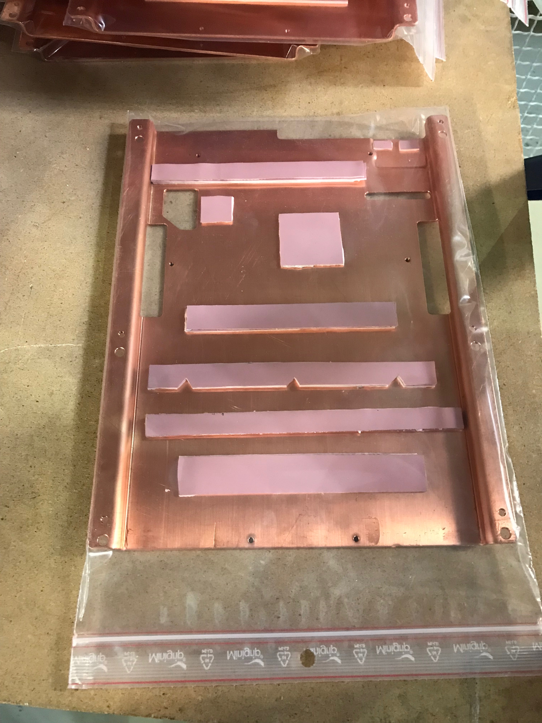
5

Slide 24
More Info on the “Cosmics”Tests
How exactly are “cosmics” tests performed?
Cosmic Muons are hitting the chamber
The Muon causes one gas atom to be ionized
  However, this is not enough to ionize other gas atoms.
  In addition, the ionize gas and the knocked electron will later recombine.
Applying a high voltage will create a separation of the electron and the ionized gas atom.
  With a high voltage there’s an electric field which drifts the electrons to the anode wire in which induces a charge on the cathode strips.
6

Slide 25
Testing
The CSCs with the new xDCFEBS installed are then later placed at stations in the working area.
Testing the xDCFEBS using software.
The Step Test Manager allows for control of testing.
  We can verify that the xDCFEBS and ALCT mezzanines are functional and see if other electronics installed on the chambers are working fine.
I will start working in testing CSCs in my final few weeks
7

Slide 26
Four-Top Analysis Continuation
The significance of four top production, but first, some facts about top quarks:
  The mass of a top quark is close to the scale of the electroweak symmetry breaking.
  Top quarks have large couplings the Standard Model (SM) Higgs Boson.
  Top quarks are not found in nature, but instead produced in high-energy experiments (LHC) and are produced in pairs.
Four-Top Production:
  Even though this process is predicted by the SM, it is rare and has yet to be measured.
  Models in new physics predict final sates that contain the four top quarks.
    Supersymmetry, extra dimensions
  SM production of four top quarks is an important background to the new models.
8

Slide 27
In Continuation
I was given 2017 data of runs of events that included dilepton final states.
  These dilepton states included double muon, double electron, and electron-muon.
  With the 2017 data, I ran a code that extracts information such as the transverse momentum, eta, phi of the leptons and jets. Missing energy: Pt & phi of the data sets.
  I did evolution plots which to say is adding Ht cuts.
    Ht is the sum of all the jets’ transverse momentum in one event.
    The higher the Ht cut, the less events will occur.
  Recently I was given more data sets like above except these data sets included a high level trigger (HLT)
    Filter; reduce rate
9

Slide 28
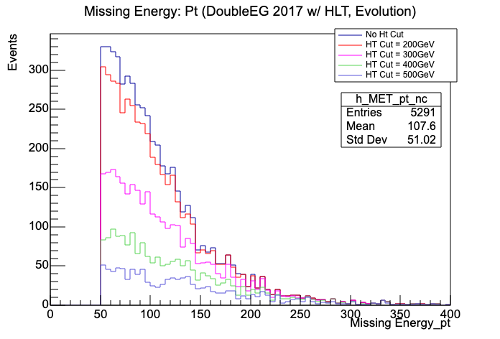
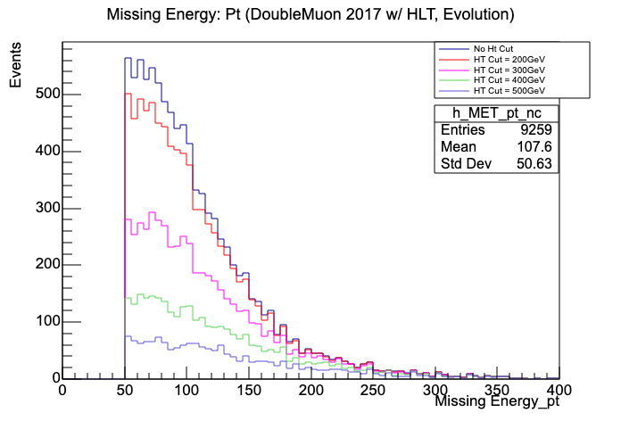

Some Cool Plots
10

Slide 29
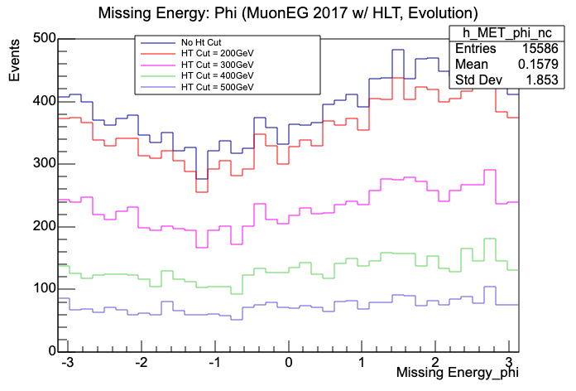
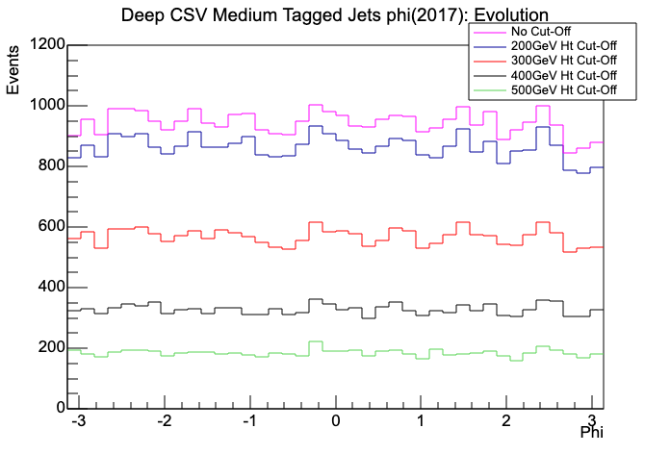
Typically the shape of the phi distribution is like the one on the right.
On the left, we some sinusoidal shape going on.
11

Slide 30
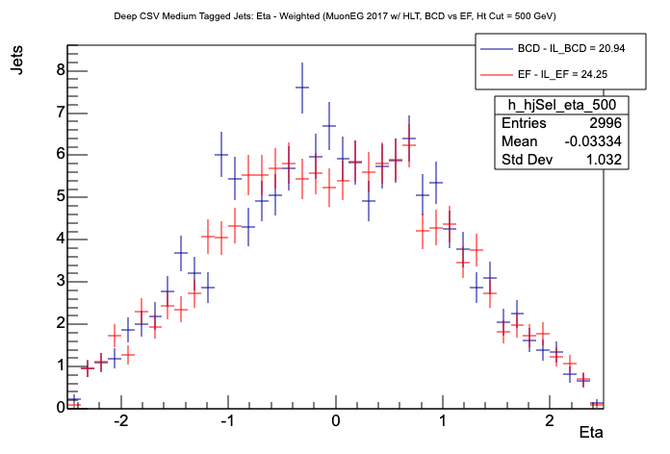
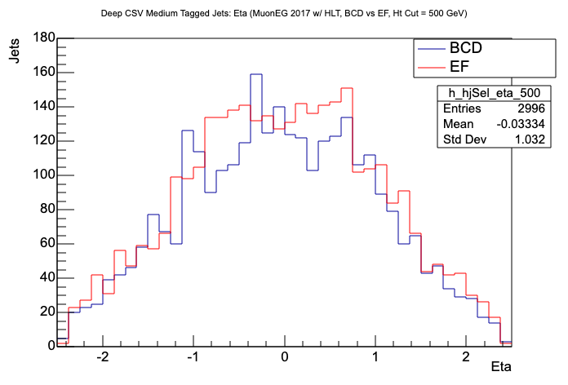
More Plots
Looking for any error-dependent effects that might have impacted the data quality.

Slide 31
Monte Carlo Simulations
  Test Backgrounds – TTWJets, TTJets, TTTo2L2Nu
    TTTo2L2Nu: Two tops whose W bosons decay into leptons and neutrinos
  Potential Backgrounds – TTToSemiLeptonic, TTW, TTH, TTZ, TTbb
    TTToSemiLeptonic: Only one top decays Leptonically and the other decays hadronically
  Proper Signal - TTTT
I’ve been working with the samples, the test backgrounds, and one of the potential backgrounds which is TTToSemiLeptonic.
12

Slide 32
Challenges
For the CSCs:
  Many people working together, complex electronics working with each other, new firmware, and new data paths for the ME 234/1
For the Analysis:
  Working with Root
  Time
13

Slide 33
Goals for the end
On the analysis side:
  I want to get as much as the analysis done before leaving early.
  Be really confident or comfortable with Root
On the CSC side:
  Testing goes well
  I don’t break anything
Personal:
  Have a clear understanding on what it means to be a physicist.

Slide 34
Back up slides

