Slide 1


sTGC FEB Hardware Integration
Sabrina Corsetti
Mentored by Siyuan Sun
UM Semester at CERN
April 16th, 2019

Slide 2
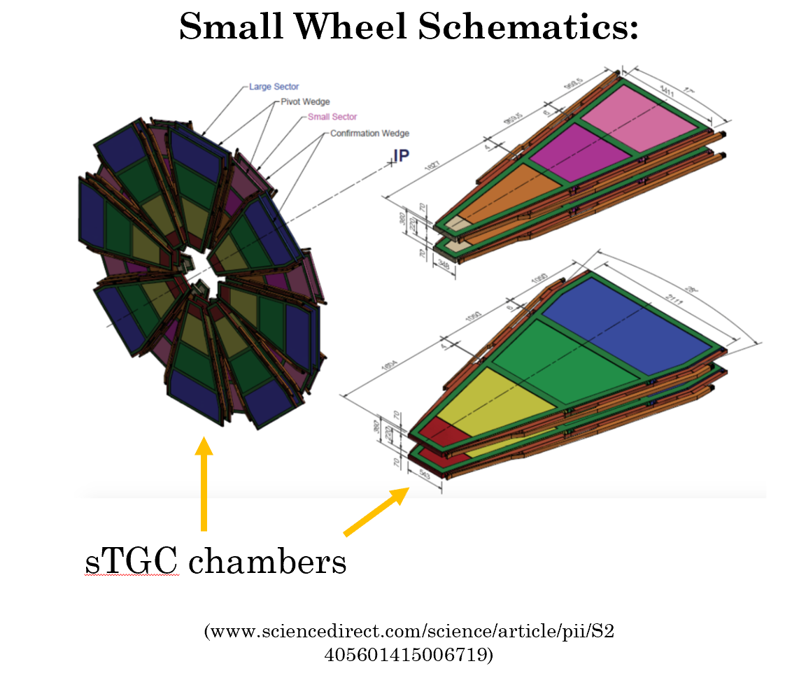
Recalling sTGCs and VMMs
sTGCs = NSW trigger detectors
  Wedges coupled into sectors with MicroMegas for precision tracking
Each sTGC wedge = 3 chambers
  QS1, QS2, QS3 for small wedges
  QL1, QL2, QL3 for large wedges
VMMs = signal amplifying ASICs on sTGC Front-End Boards (FEBs)

Slide 3
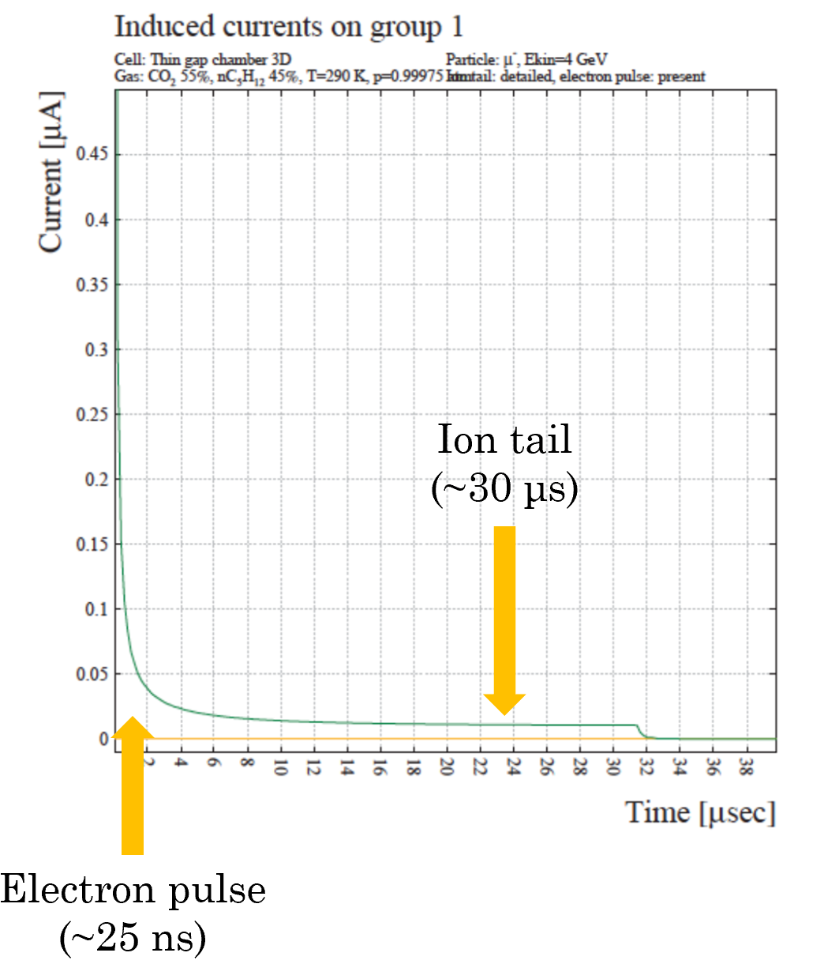
sTGC Signal Shape
Charged particles ionize the gases in the sTGC gaps
This produces a large, brief signal, trailed by a longer ion tail
Ion tail accumulation can cause VMMs to constantly trigger even in the absence of a signal

Slide 4
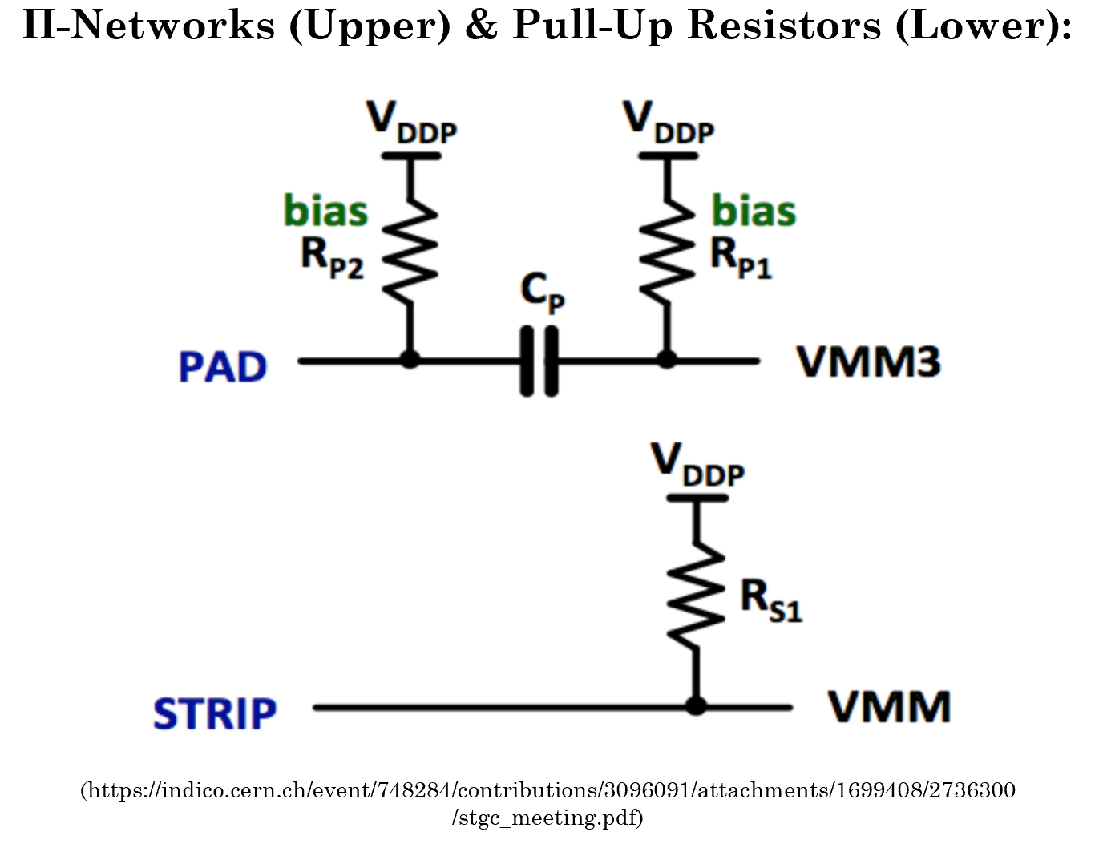
VMM Signal Recovery
Recall VMM dead-times
  Comes from VMM currents restoring below signal threshold after charge input
Pad Front-End Boards (pFEBs) → Π-networks
  High-pass filters that attenuate signal in conjunction with detector pads
Strip Front-End Boards (sFEBs) → pull-up resistors
  Introduce a bias current that decreases recovery time

Slide 5
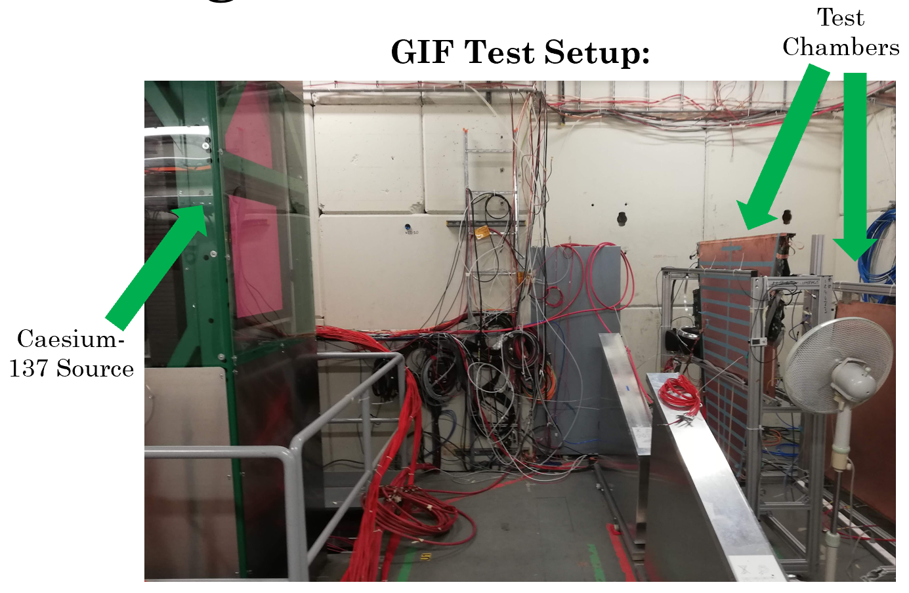
High Photon Rate Testing
sTGC QL1 & QS2 chambers tested in Gamma Irradiation Facility (GIF++)
Looking for effects of Π-network capacitances & sFEB pull-up resistances on VMM dead-time
  Capacitances of 100, 150, 200, 300, 470 pF
  Resistances of 200, 300, 500 kΩ, 1 MΩ

Slide 6
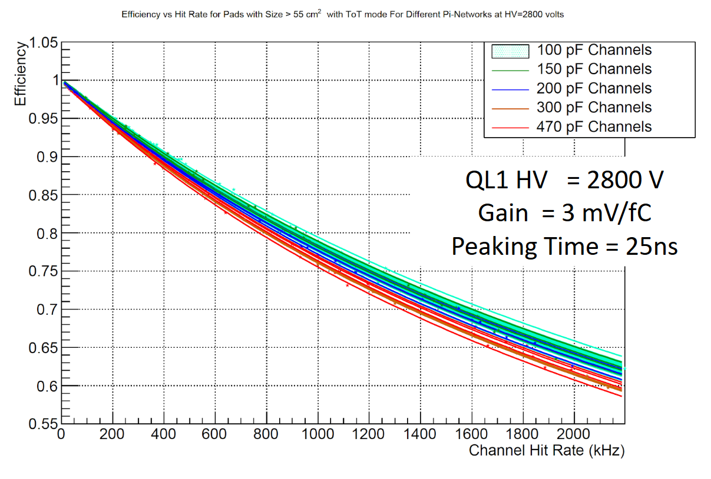
Finding Dead-Times
Detector exposed to Caesium source at rates ranging from 0 to 14 kHz/cm²
Efficiency curves fit to measured hit rates vs. original rates
  Dead-times used as a fit parameter
  Want to maximize efficiency & signal strength

Slide 7
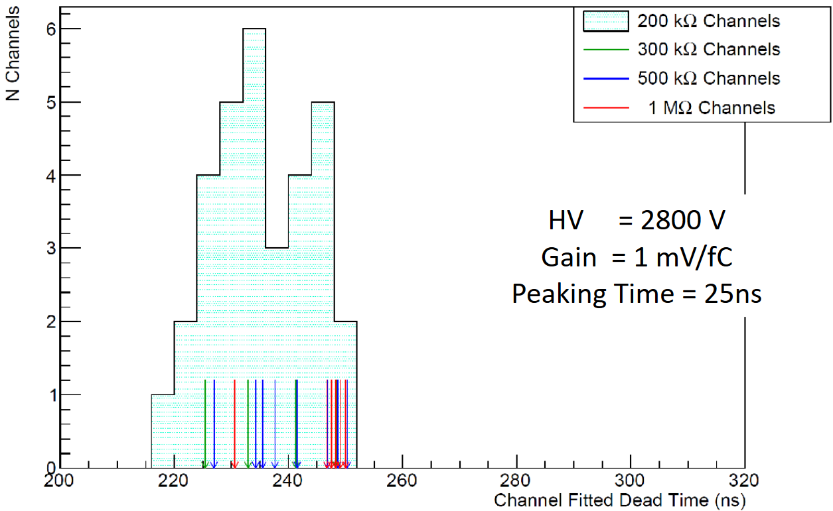
sFEB Dead-Time Results
sFEB pull-up resistances → no variations
QS2 sFEB Dead-Times by Resistance:

Slide 8
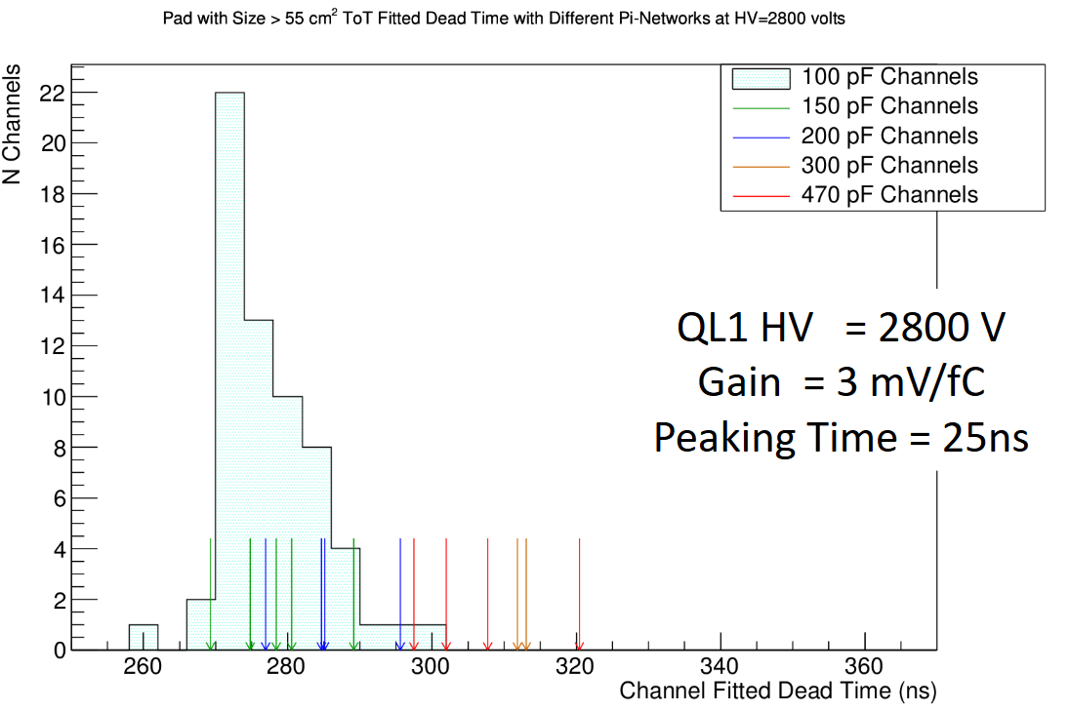
pFEB Dead-Time Results
pFEB Π-network capacitances → significant variations
pFEB Dead-Times by Capacitance:
300, 470 pF values outside 100 pF range

Slide 9
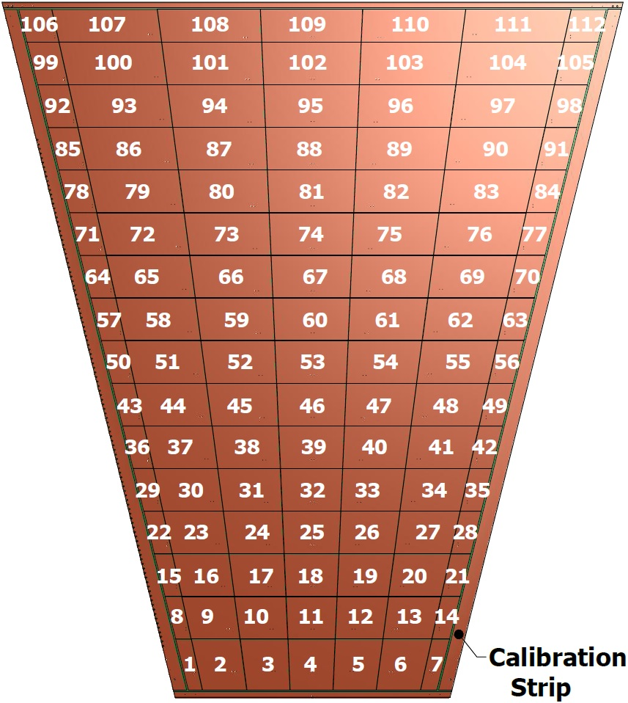
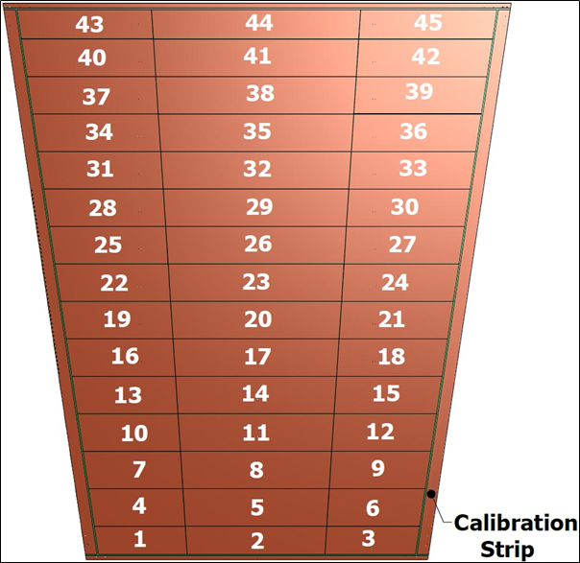
Why the Variation?
QL1 Pad Map:
As high pass filters, Π-networks attenuate signal and distort signal shape
QX1 → QX2 → QX3, pads increase in surface area and therefore capacitance
Higher detector C → lower signal fraction passes through Cpi and reaches VMM
  Increased C_{pi} restores the Q_{pi}/Q_{T} ratio, but this means Q_{pi} (and therefore dead-time) increase
QS2 Pad Map:

Slide 10
Conclusions
C_{pi} and pull-up resistance values chosen to minimize dead-time and maximize signal strength
C_{pi} values set to 200 pF (QX1), 350 pF (QX2), 470 pF (QX3)
Pull-up resistances set to 400 kΩ
  Above 300 kΩ to ensure baseline stability
  Below 1 MΩ to prevent changes in signal shape
VMM dead-time ~240 ns

Slide 11
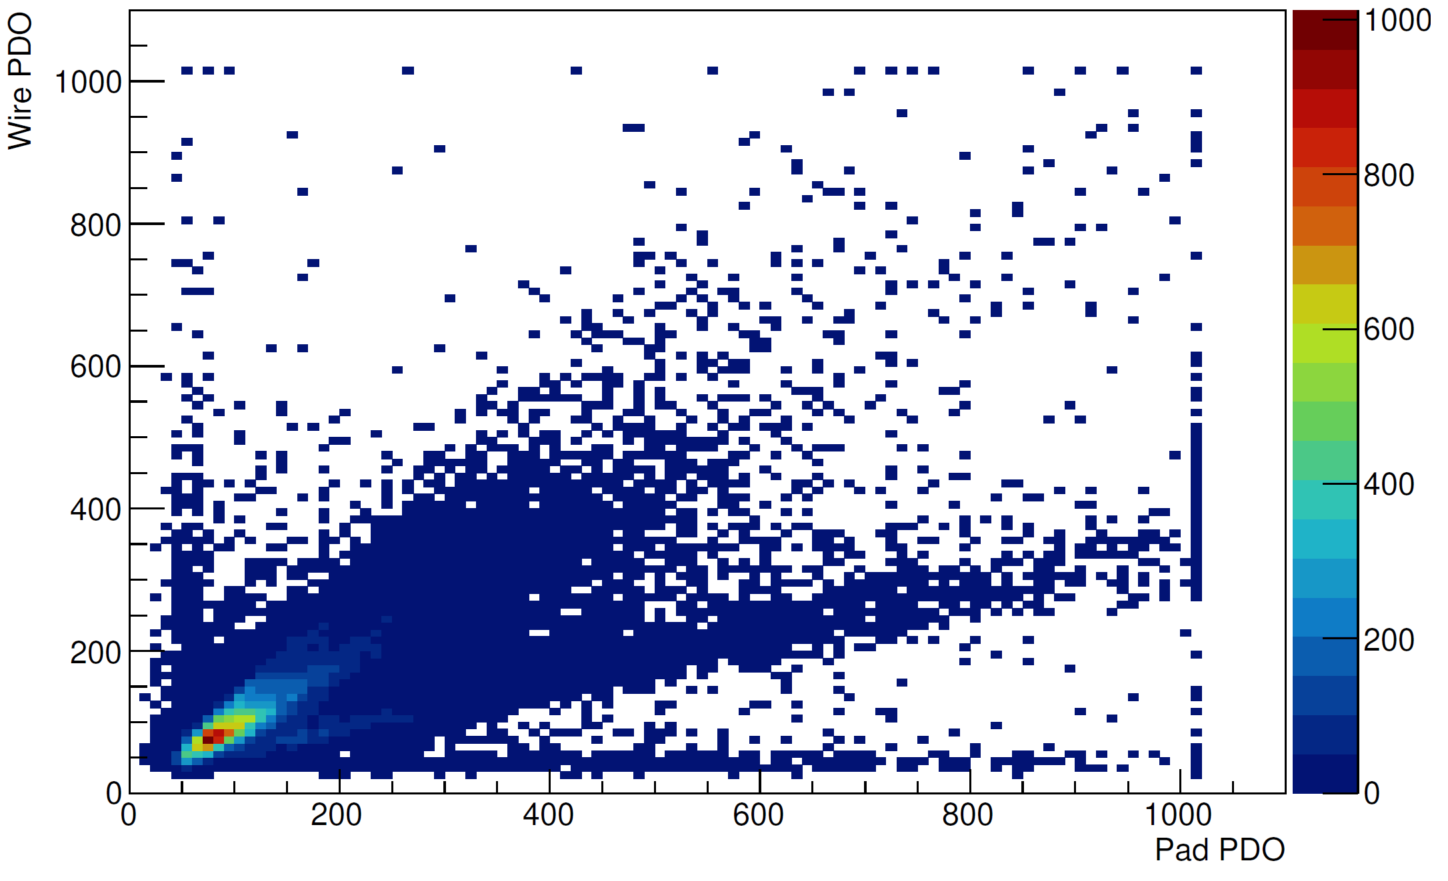
Personal Contributions & Accomplishments
Sample Wire vs. Pad Charge Plot:
GIF++ Analysis:
  Adding functionality to the analysis framework
  Producing additional checks outside the original framework
Hardware:
  Preparing QL1/QS2 for GIF++ installation, noise-testing FEBs, setting up pulser test in 180, etc.
ATLAS Upgrade Week plenary:
  NSW sTGC Wedge Assembly and Electronics Integration

Slide 12
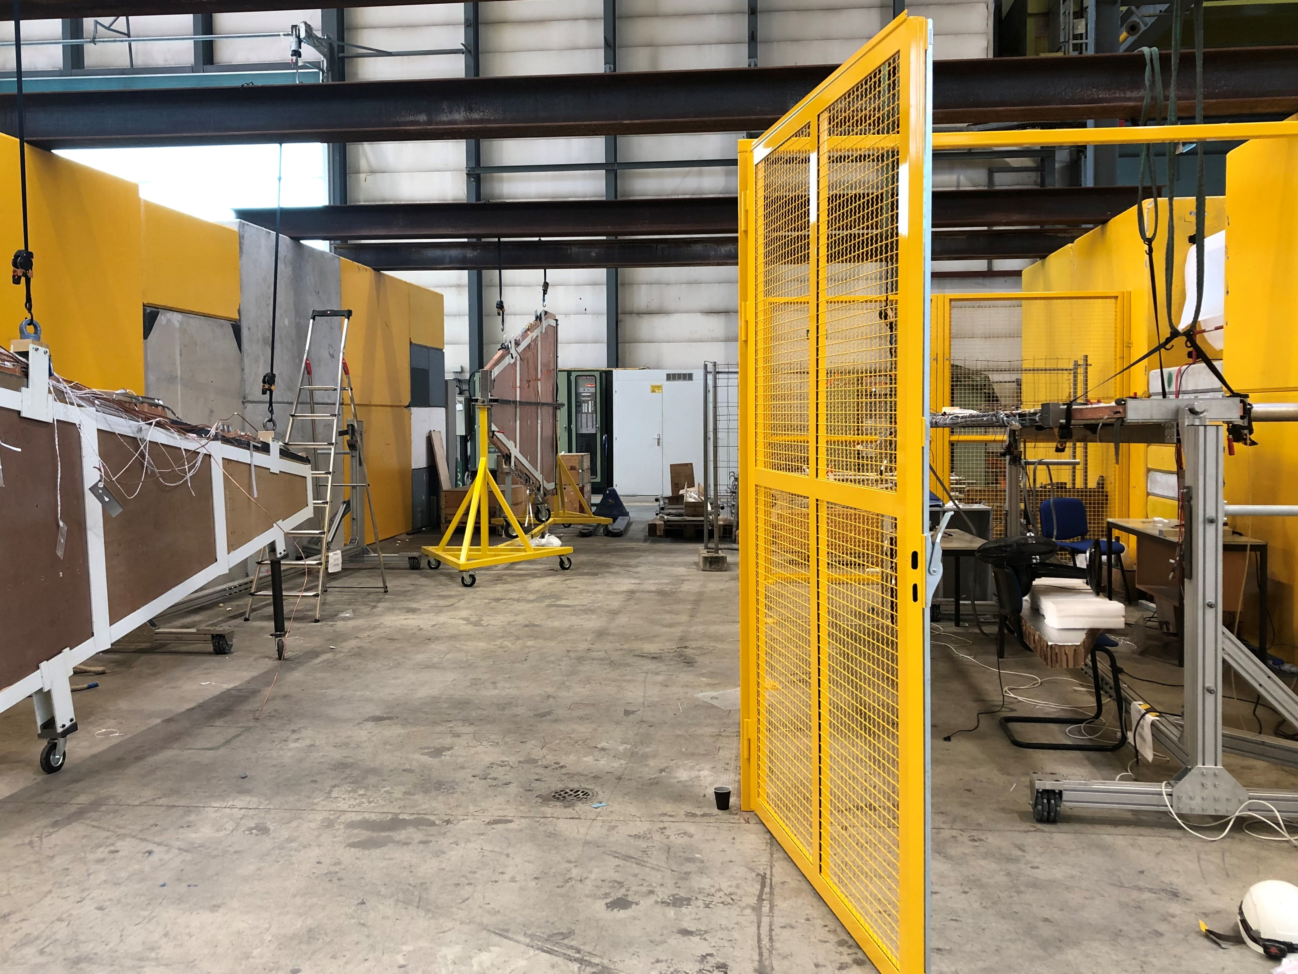
Remaining Work
sTGC Testing/Storage Area:
Mass production, wedge construction/testing, and sector assembly:
  New FEBs by June
  First sector by July
First NSW (16 sectors) by December
Further FELIX detector read-out development
Finding muon landau/setting thresholds accordingly

Slide 13
What I’ve Learned
My understanding of sTGCs and their FEBs can be generalized to other areas of particle physics - e.g. how proportional chambers work & how circuit components like operational amplifiers work
  I finally understand Geiger counters!
How to use C++ and Root
Operating systems other than Windows exist!
Never rush a project; you can work more hours in the same number of days to accomplish a task, but rushing inevitably leads to more work

Slide 14
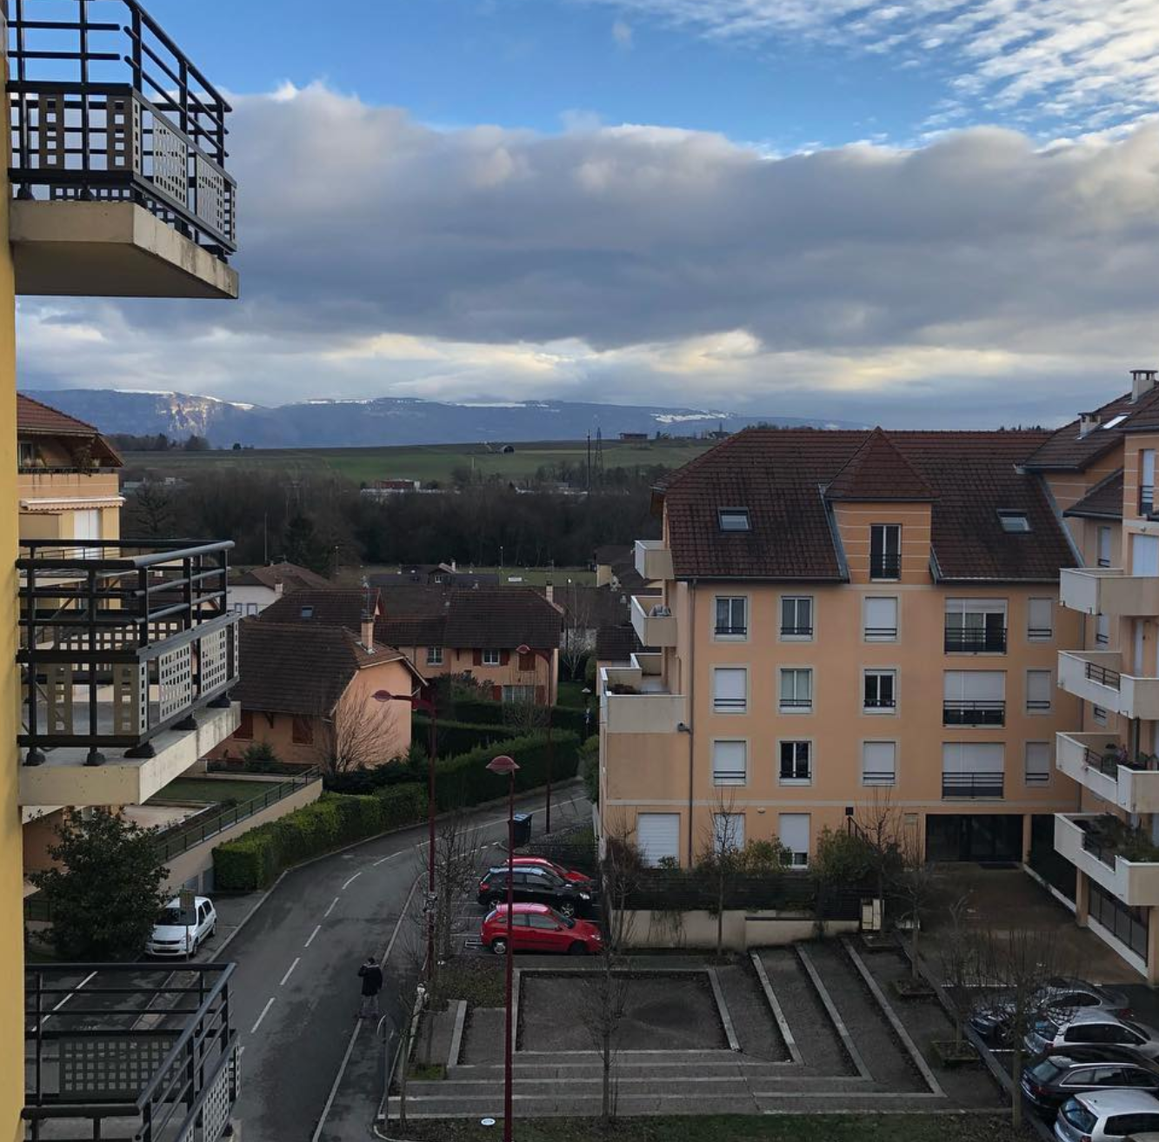
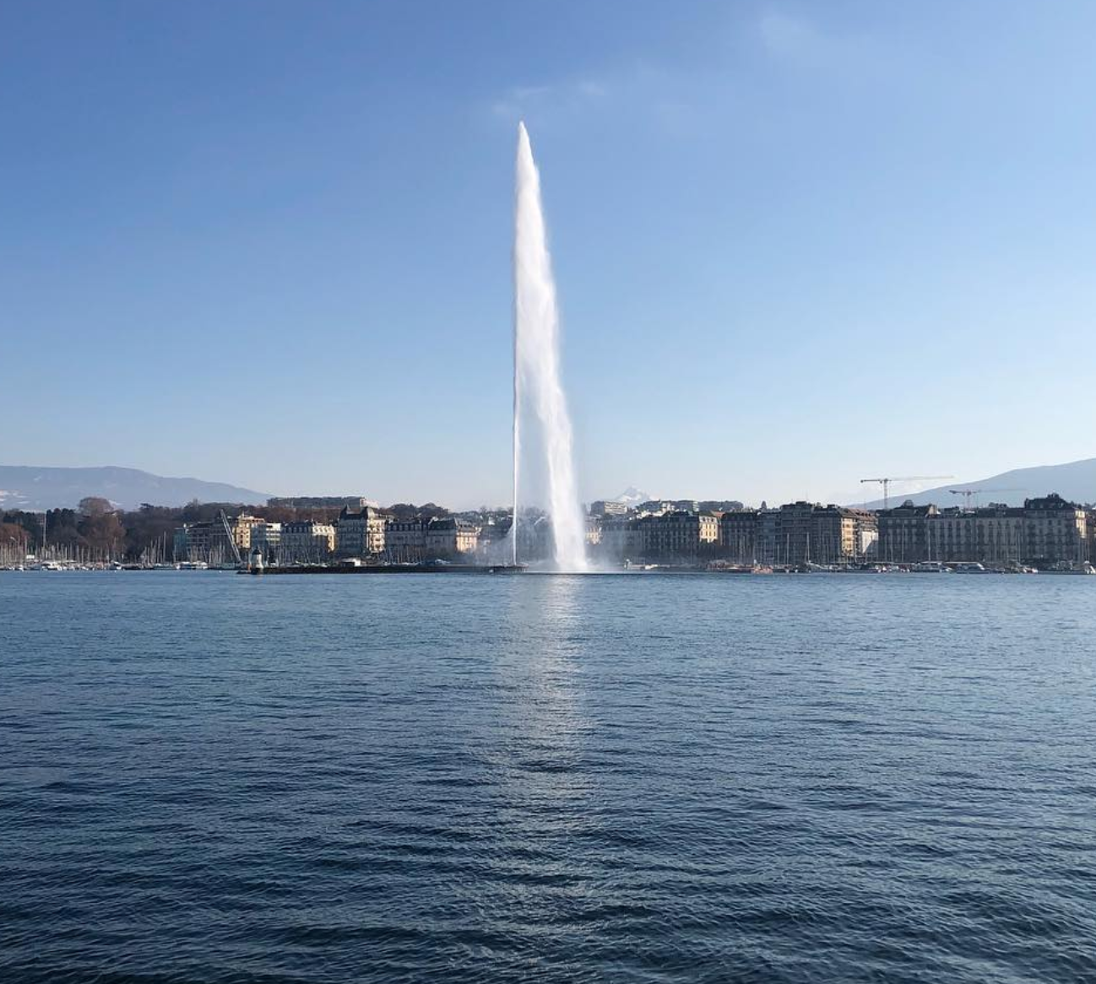
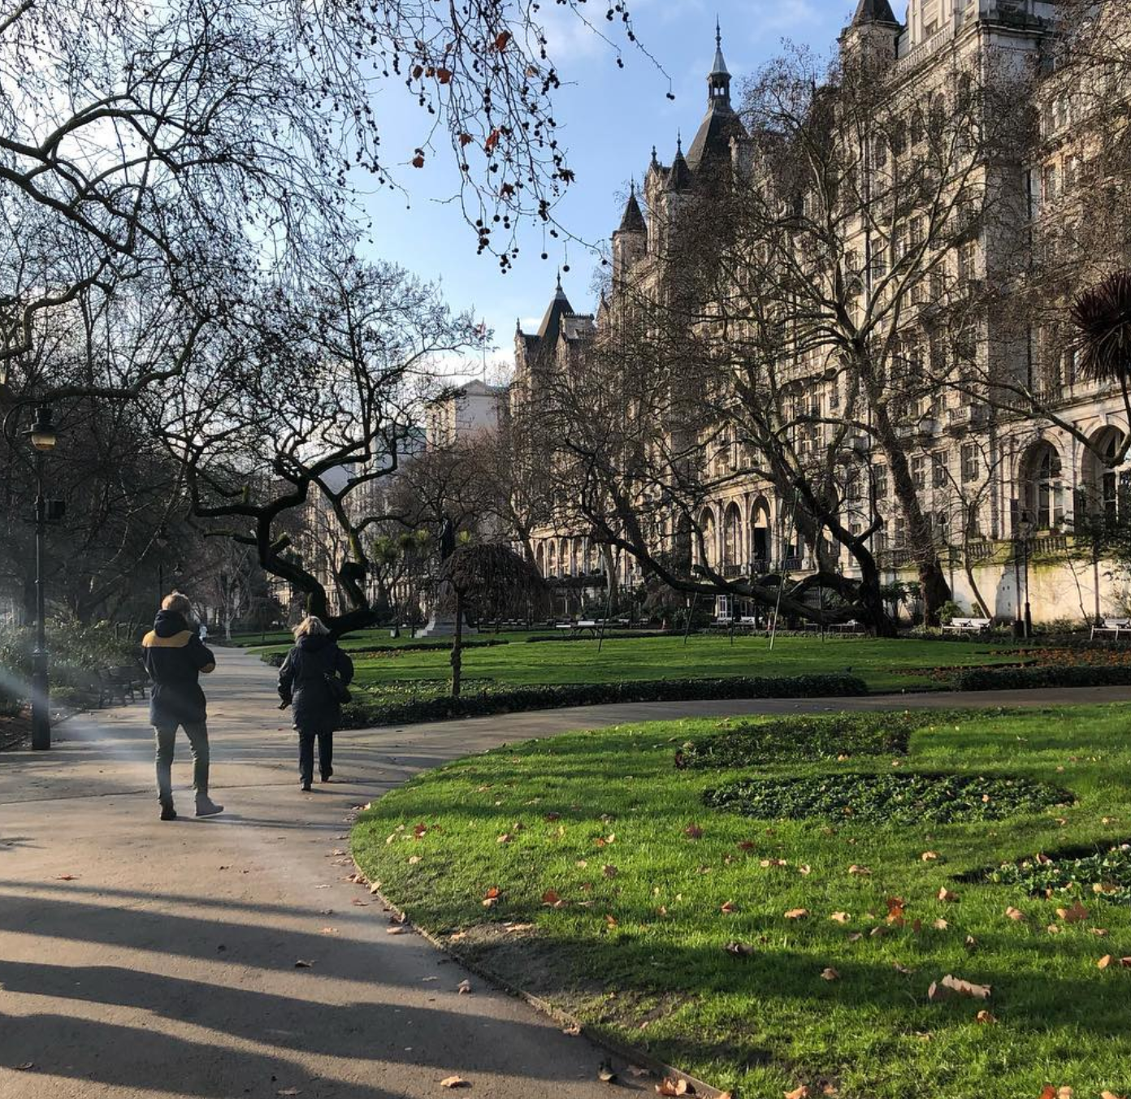
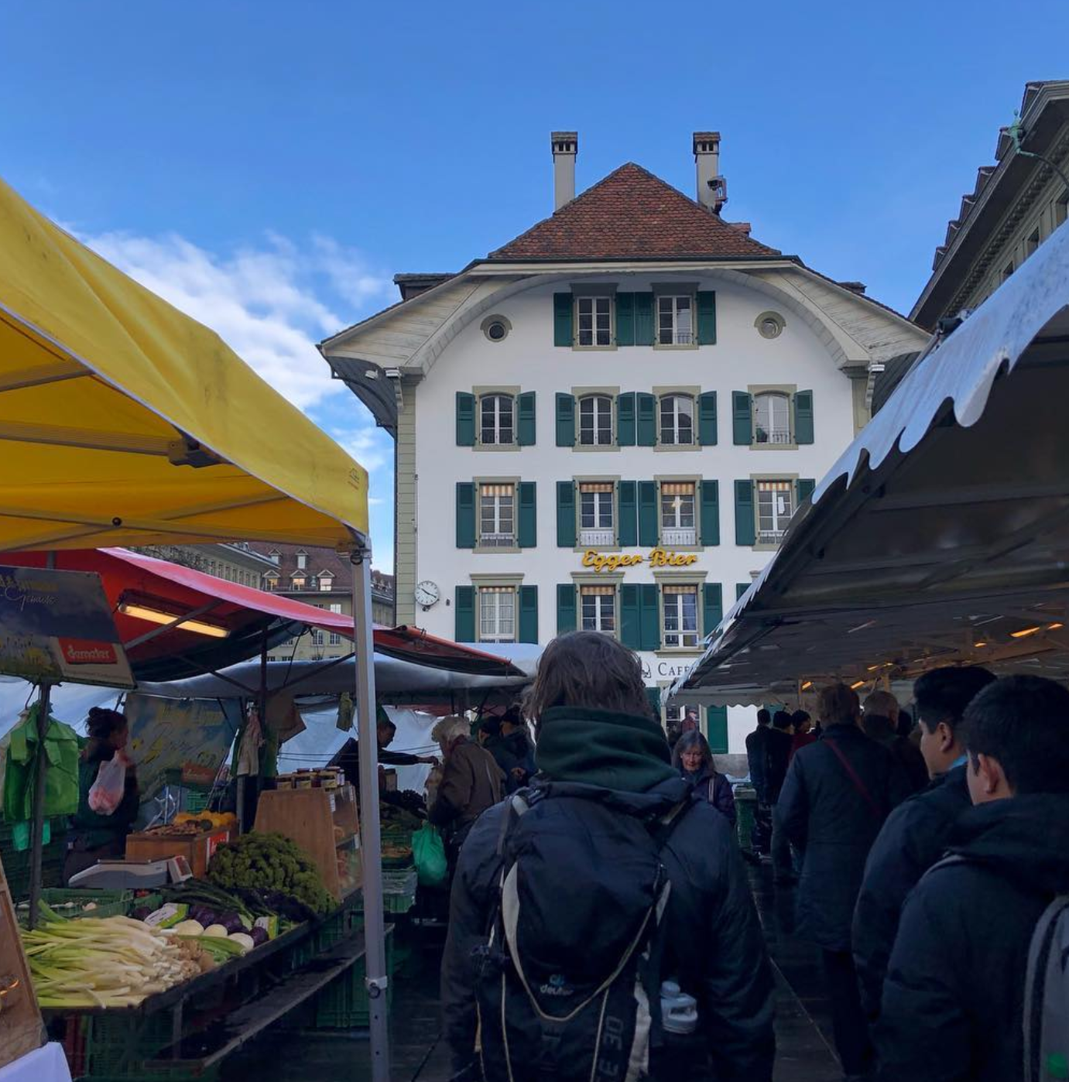

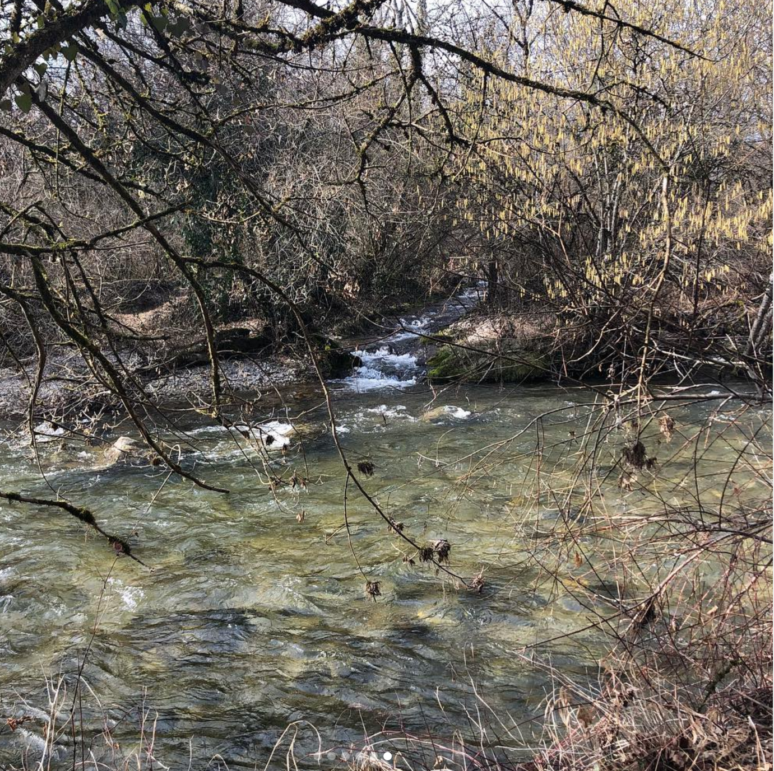
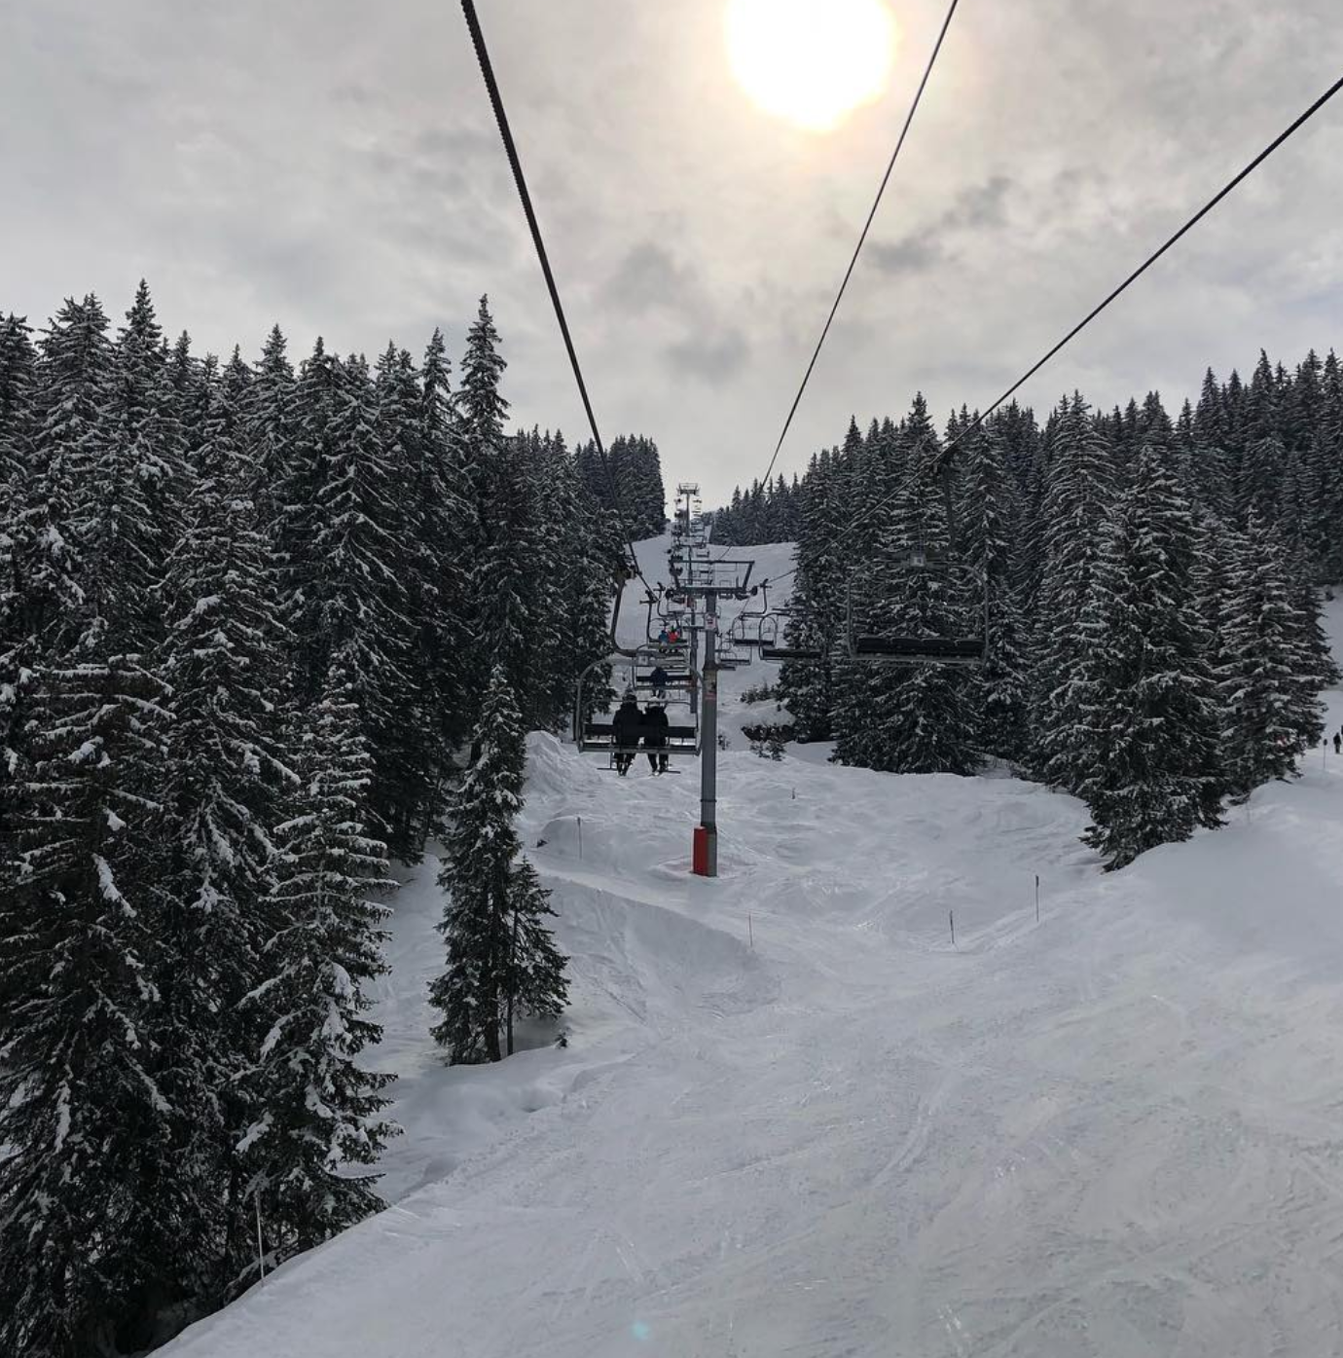
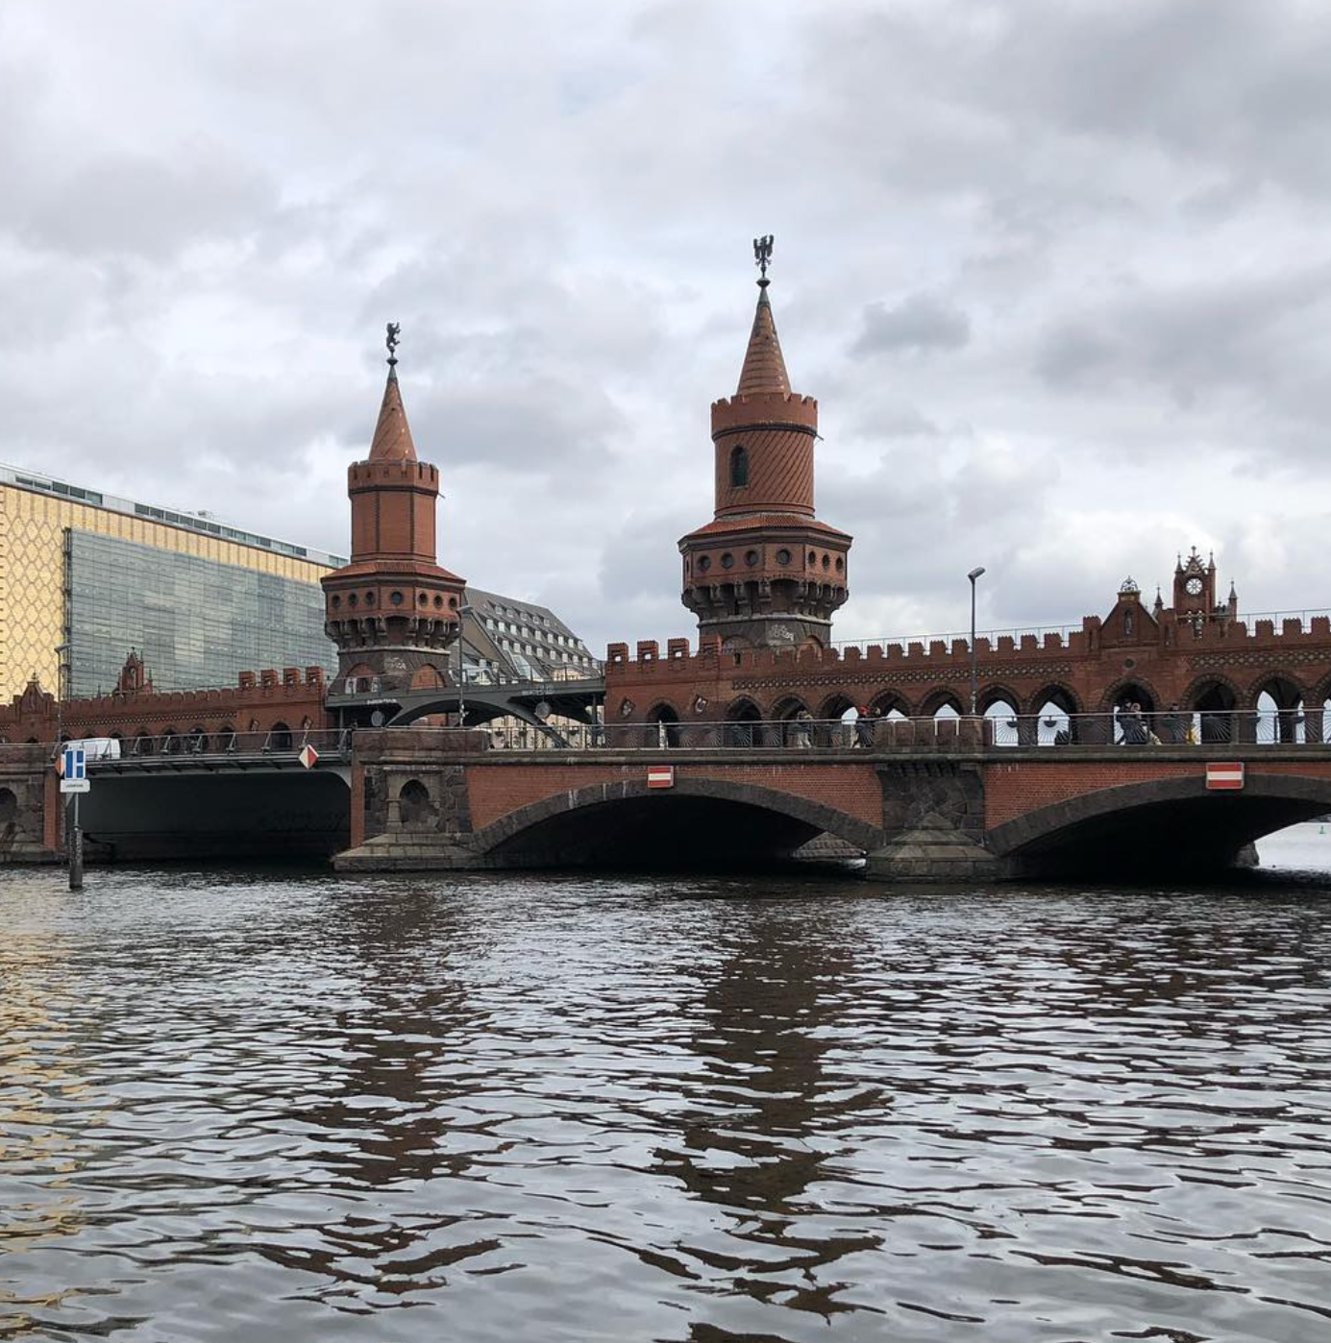

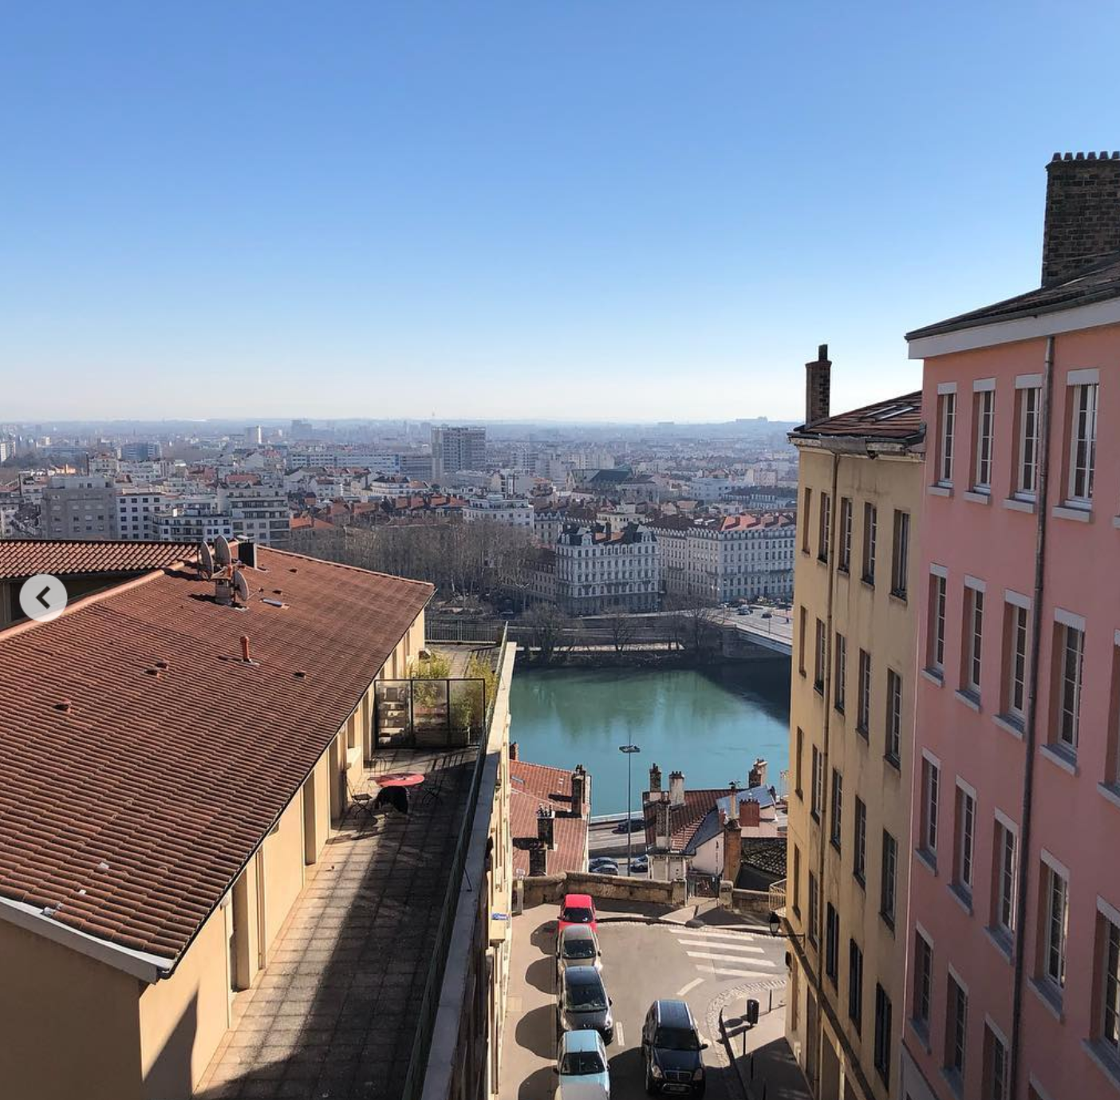
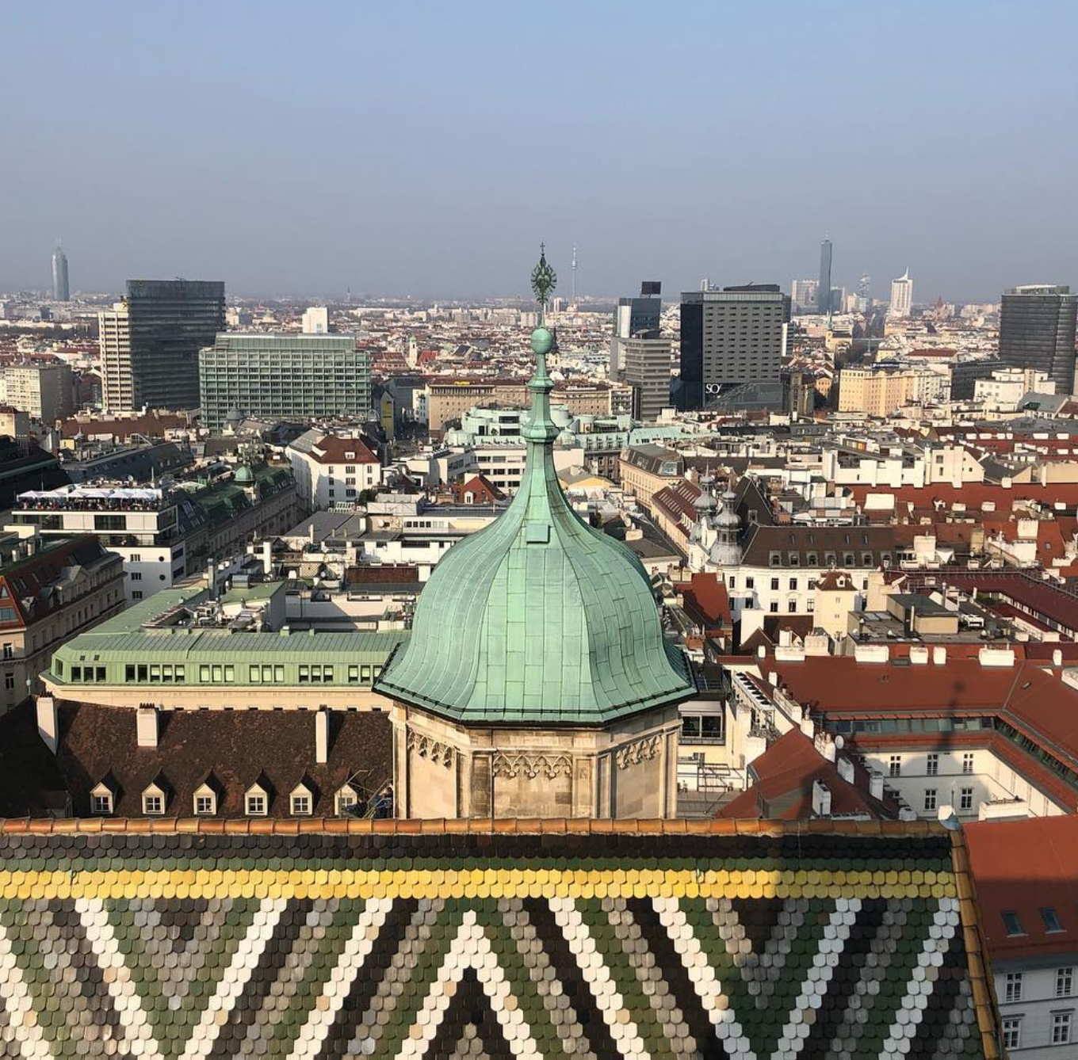
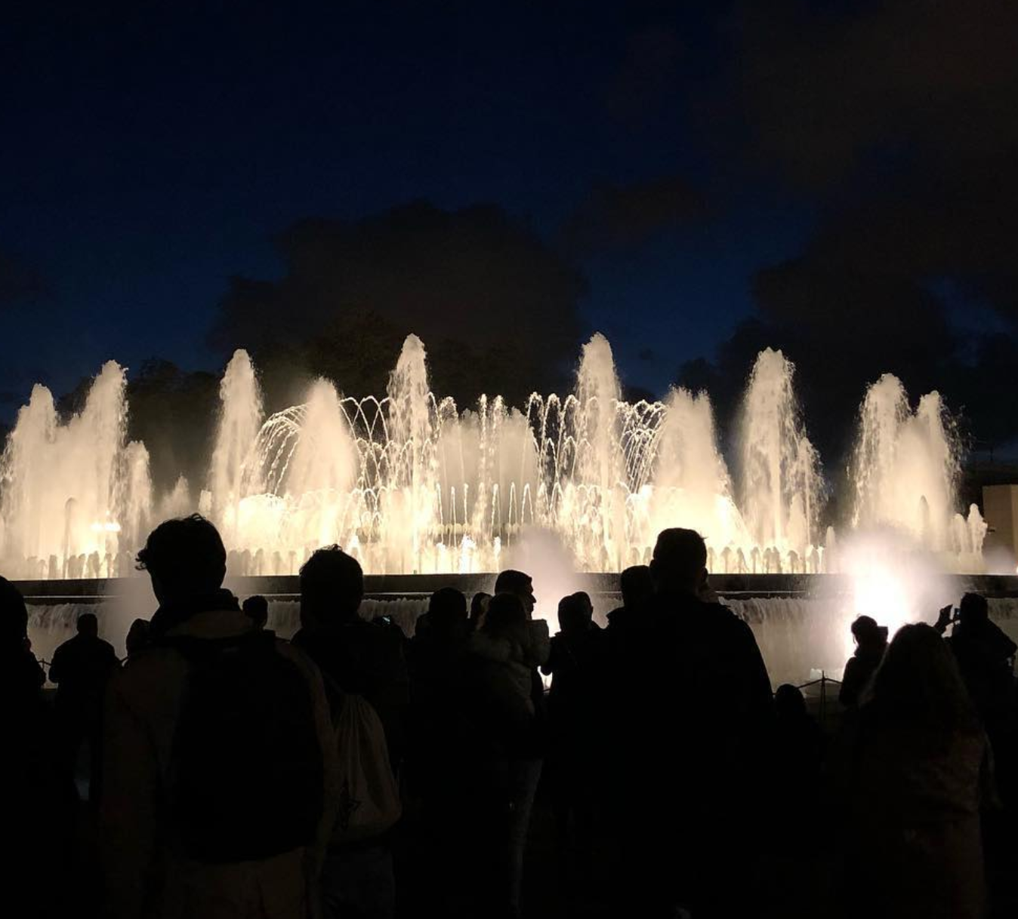

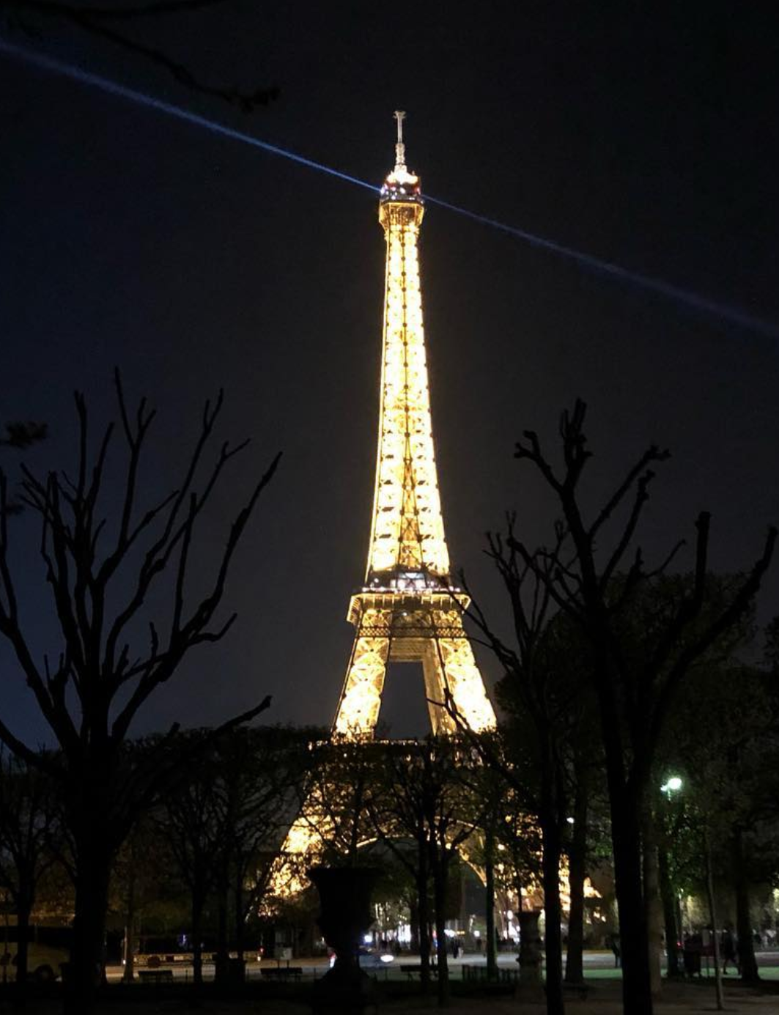

Slide 15
Back-Up Slides

Slide 16
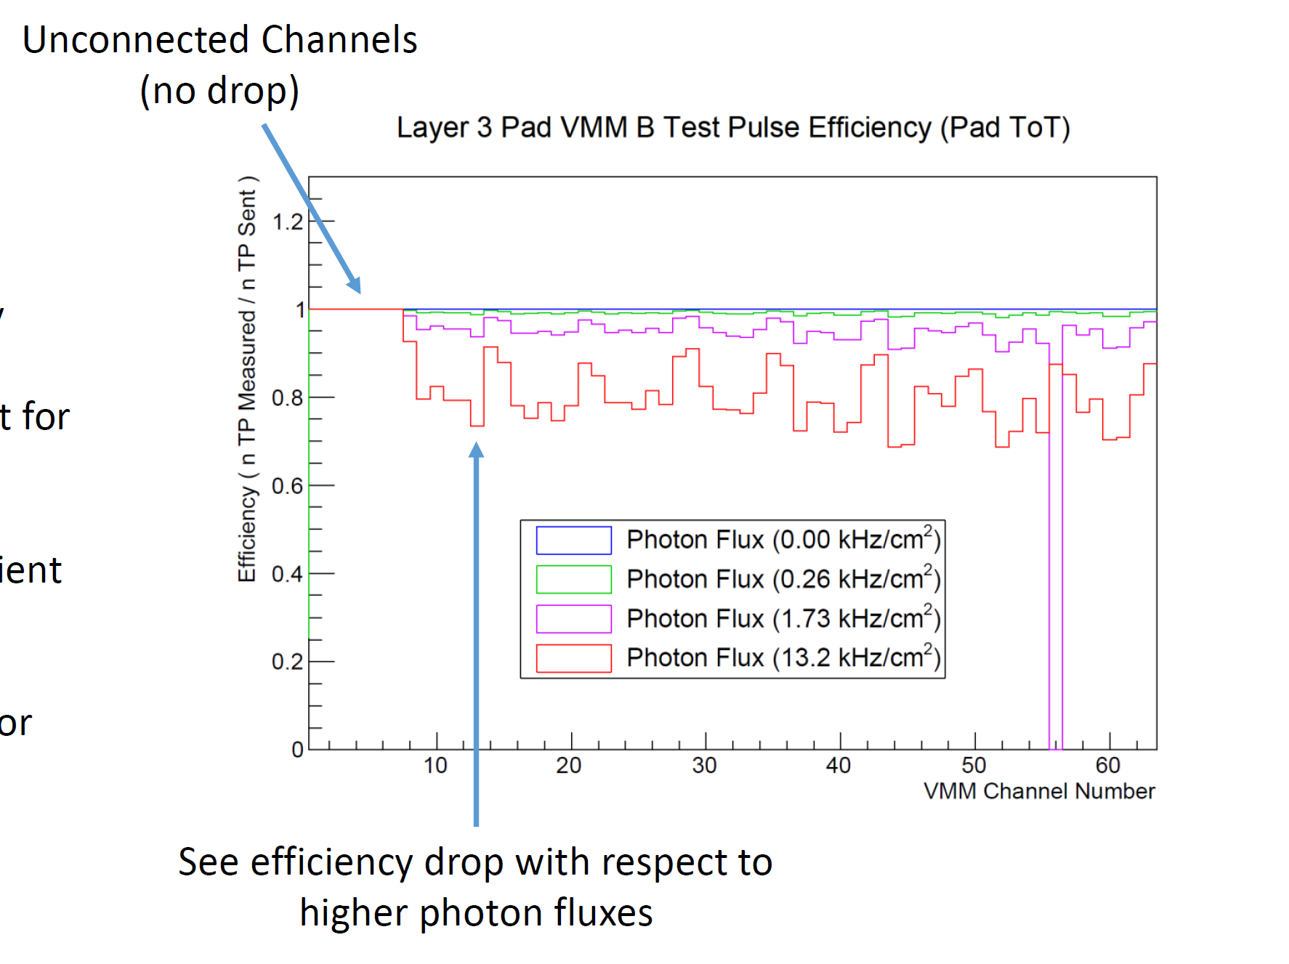
Efficiency Measurement:
Test pulses used to find electronics inefficiencies
Should see a 1:1 ratio of measured to sent pulses
Does not happen due to dead-time

Slide 17
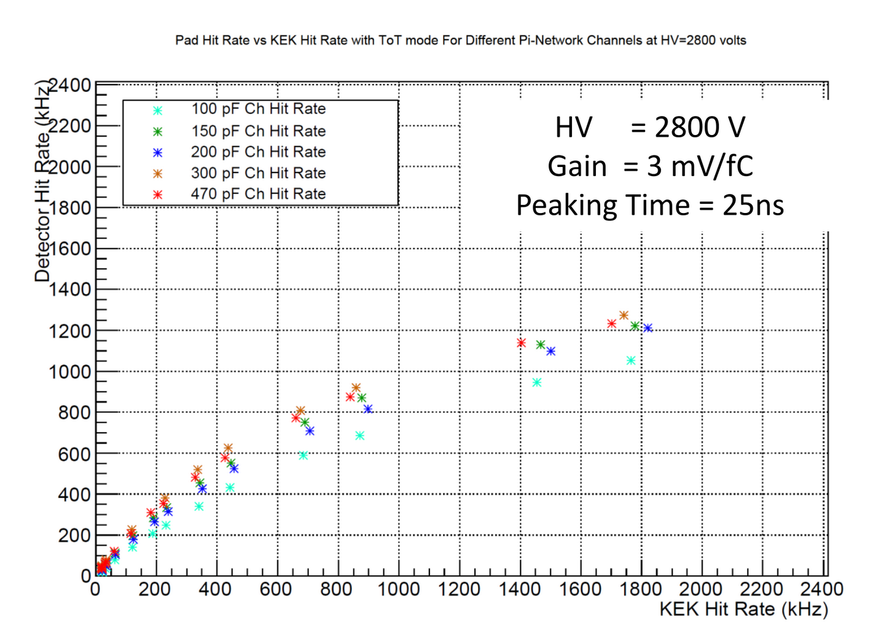
Photon Rate Measurement:
Plot shows measured photon rate vs. source photon rate
Different channels => different hit rates due to unique thresholds
Have to correct for inefficiency to find each channel’s rate before inefficiency

Slide 18
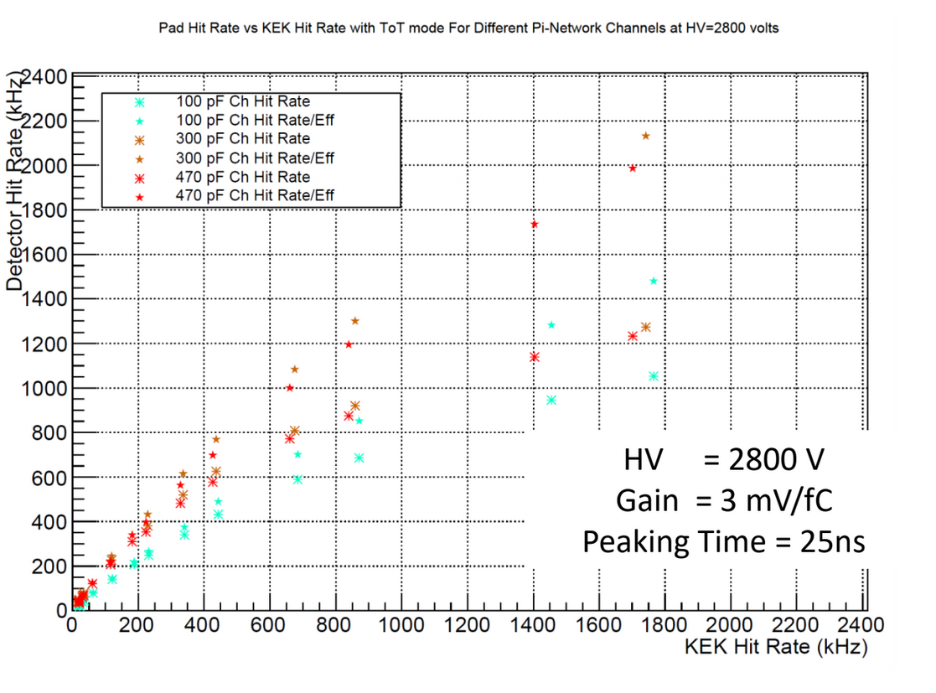
Correcting to Find Hit Rate:
Efficiency = Measured Hits/Expected Hits from test-pulses
Original Hit Rate = Measured Photon Hits/Efficiency for a channel
Increased capacitance => increased hit rate
Original Rates
Measured Rates

Slide 19
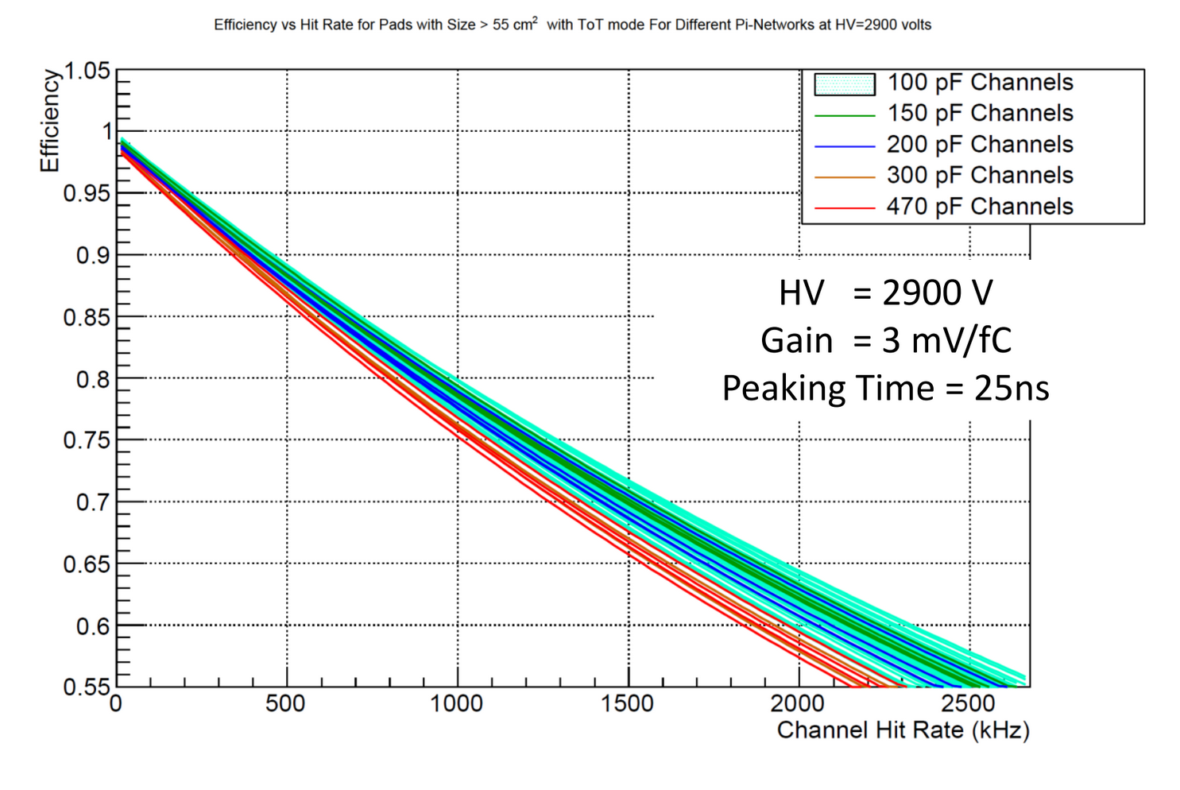
Comparative Π-Network Inefficiency:
150, 200 pF efficiencies fall w/in 100 pF efficiency band
300, 470 pF efficiencies separate from 100 pF band
Fall ~5% lower than band median
150, 200 pF viable; 150 safer

