Slide 1
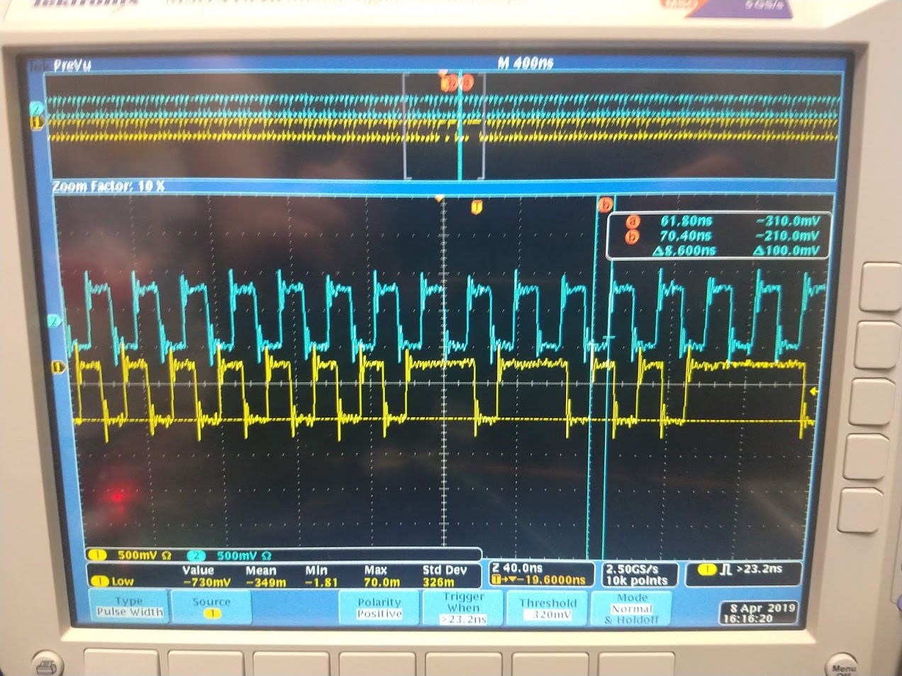
ITk Strip Demonstrator Readout
Olivier Arnaez¹, James Beacham², Thomas Calvet³, Benjamin Hunt⁴, Richard Teuscher¹
University of Toronto
Duke University
Stony Brook University
University of Illinois at Urbana Champaign through University of Michigan semester at CERN

Slide 2
Overview
HL-LHC
Inner Detector & Inner Tracker
TDAQ Phase I, II
My Work at CERN
My Progress
Remaining Work
What I’ve Learned

Slide 3
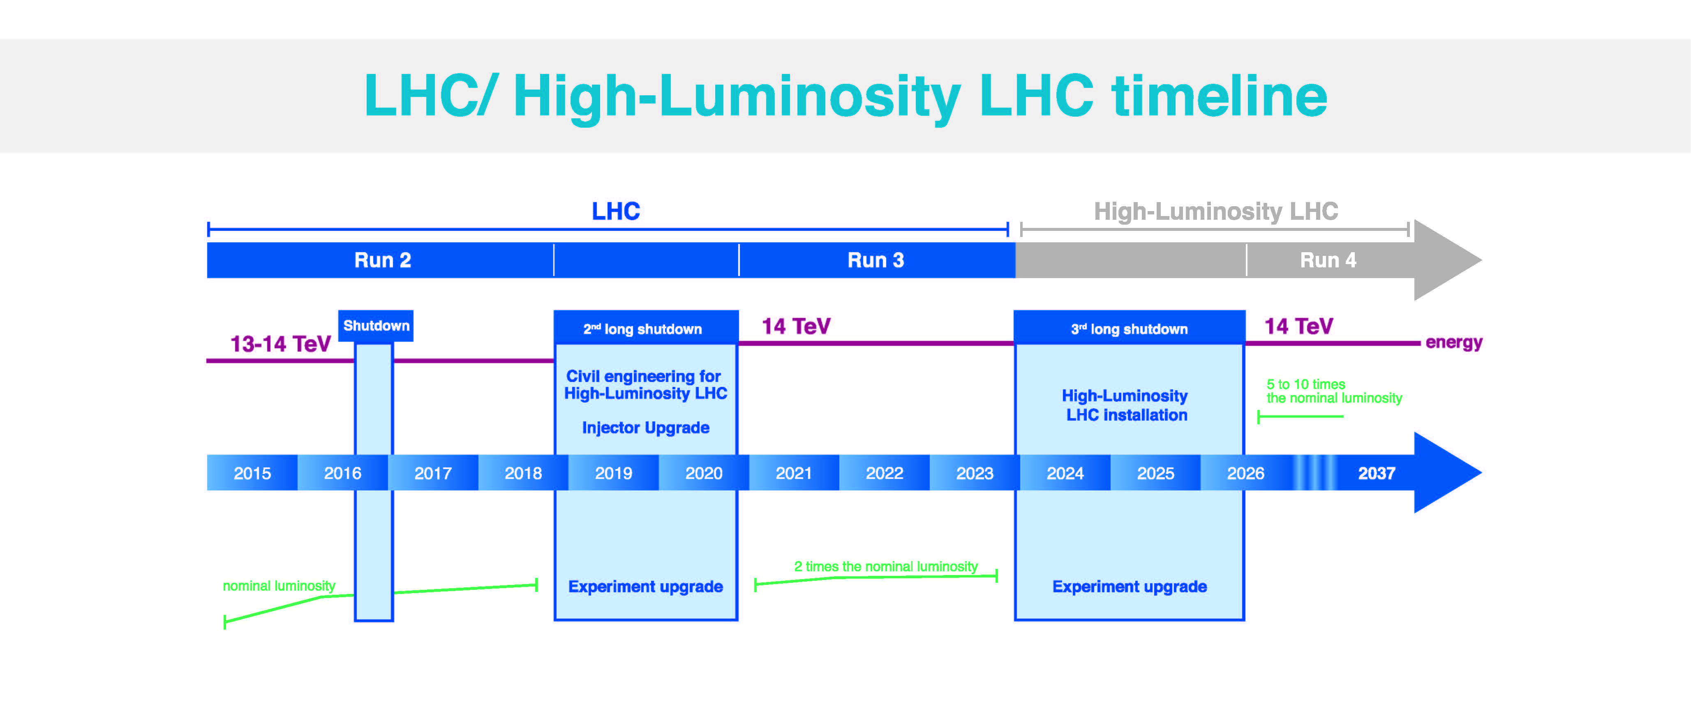
The High Luminosity LHC
Figure by HL Taus. (n.d.). HL-LHC Timeline

Slide 4
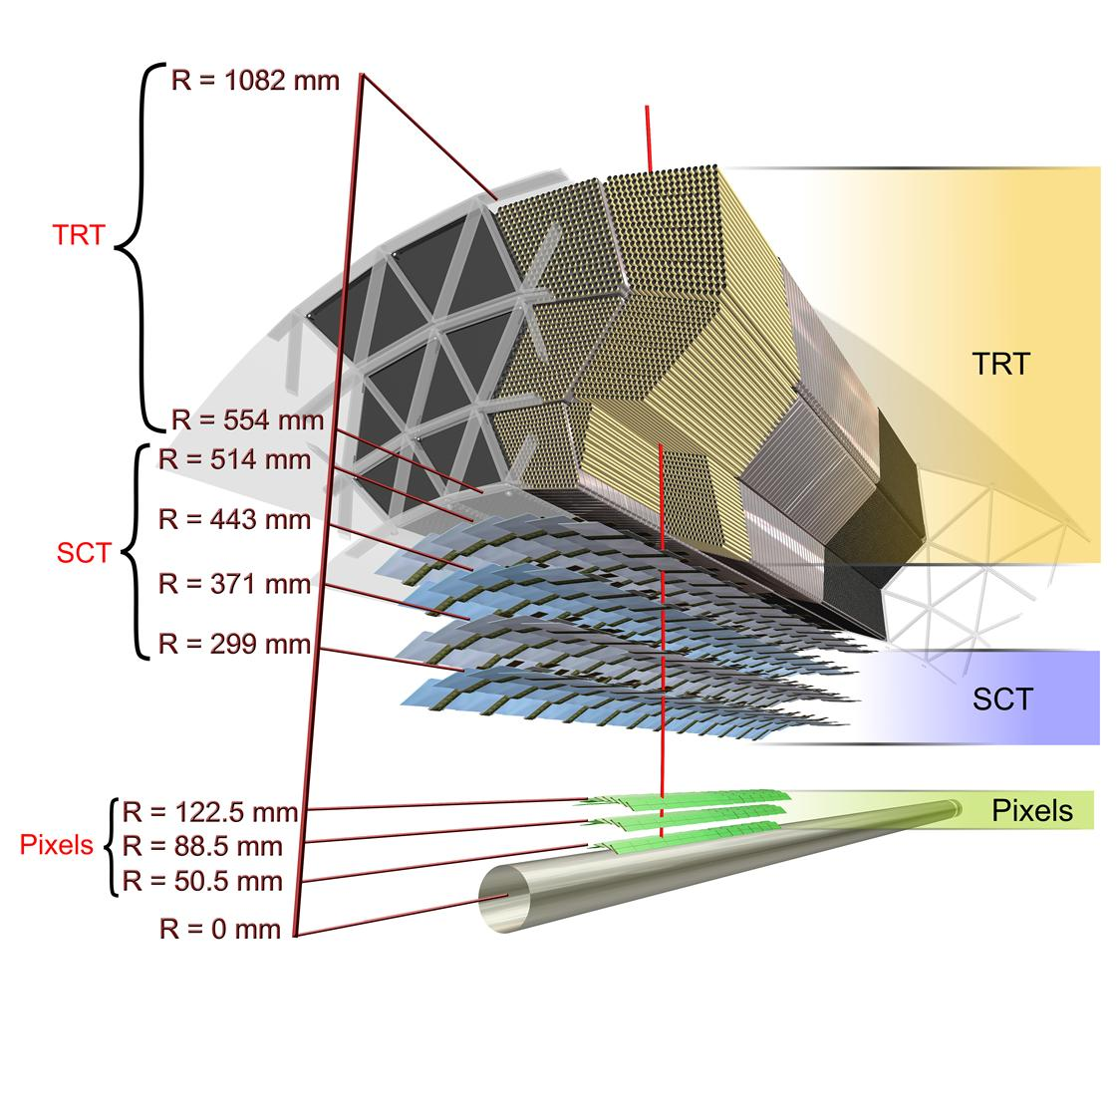
Inner Detector & Inner Tracker
The Inner Detector (ID) is the ‘heart’ of ATLAS
Identifies charged particles and helps with flavor tagging
After HL-LHC the ID will no longer be suitable for ATLAS
Figure from ATLAS Collaboration. (n.d.). Scheme of the ATLAS inner detector barrel being crossed by one high-energy particle, labeled and with dimensions.

Slide 5
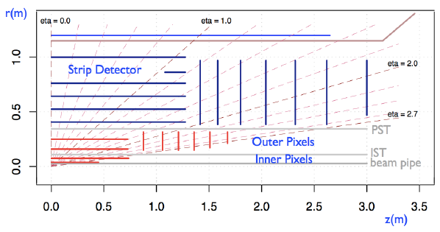
Inner Detector & Inner Tracker
Inner Tracker (ITk) is the replacement of ID
Must maintain same quality of physics data in new environment of HL-LHC
‘All silicon design’ composed of pixel and strip detectors
Figure by Nellist, C. (2014). Achievements of the ATLAS Upgrade Planar Pixel Sensors R&D Project. Journal of Instrumentation,10(01).

Slide 6
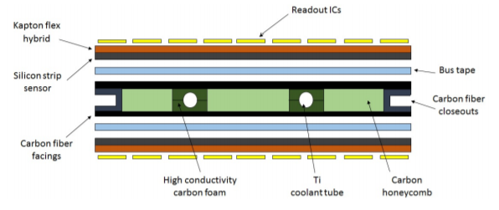
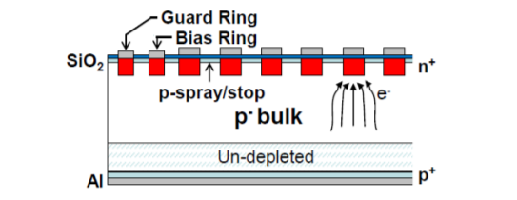
The Strip Module
Basic unit of strip detector is the strip module
Modules consist of hybrid control chips (HCC), ATLAS Binary Control Chip (ABC), and strip sensor
Must withstand 3000fb⁻¹ integrated luminosity
Figure by Kroll, J. (2017). ATLAS ITk Strip Detector for High-Luminosity LHC. In The 26th International Workshop on Vertex Detectors (pp. 1-8). Las Caldas, Spain: ATLAS Collaboration
Figure from Koutoulaki, A. (2017). The ITk Strip Tracker for the phase-II upgrade of the ATLAS detector of the HL-LHC. Journal of Instrumentation,12.

Slide 7
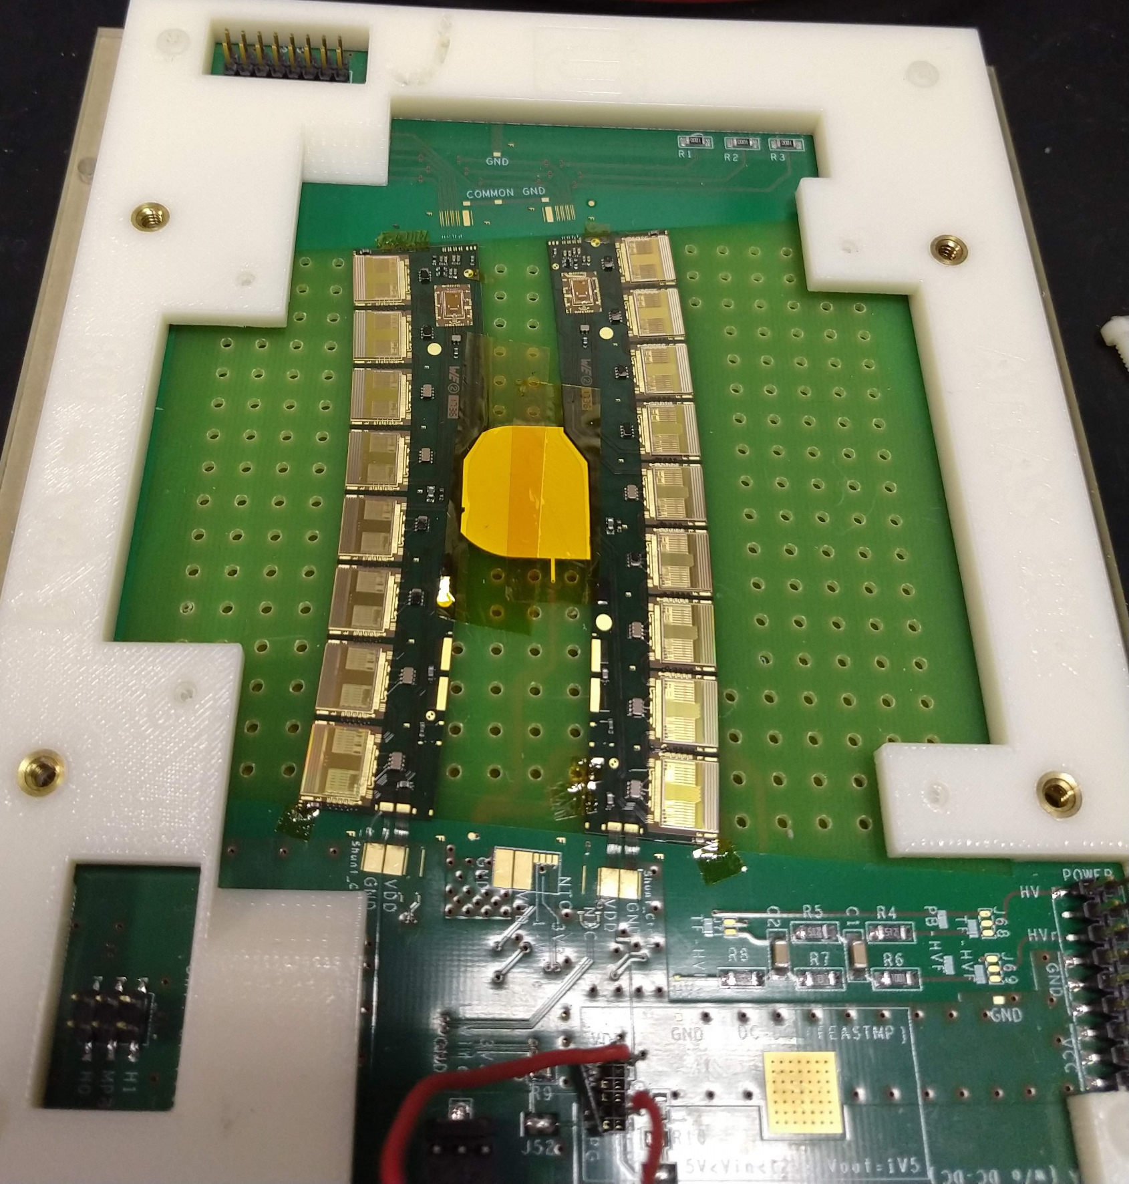
The Hybrid
1 HCC and numerous ABCs together are known as a hybrid
ABCs responsible for amplifying, shaping, and binary output
HCC responsible for building data packets, and sending events
HCC
Hybrid Module
ABC130

Slide 8
Overview
HL-LHC
Inner Detector & Inner Tracker
TDAQ Phase I, II
My Work at CERN
My Progress
Remaining Work
What I’ve Learned

Slide 9
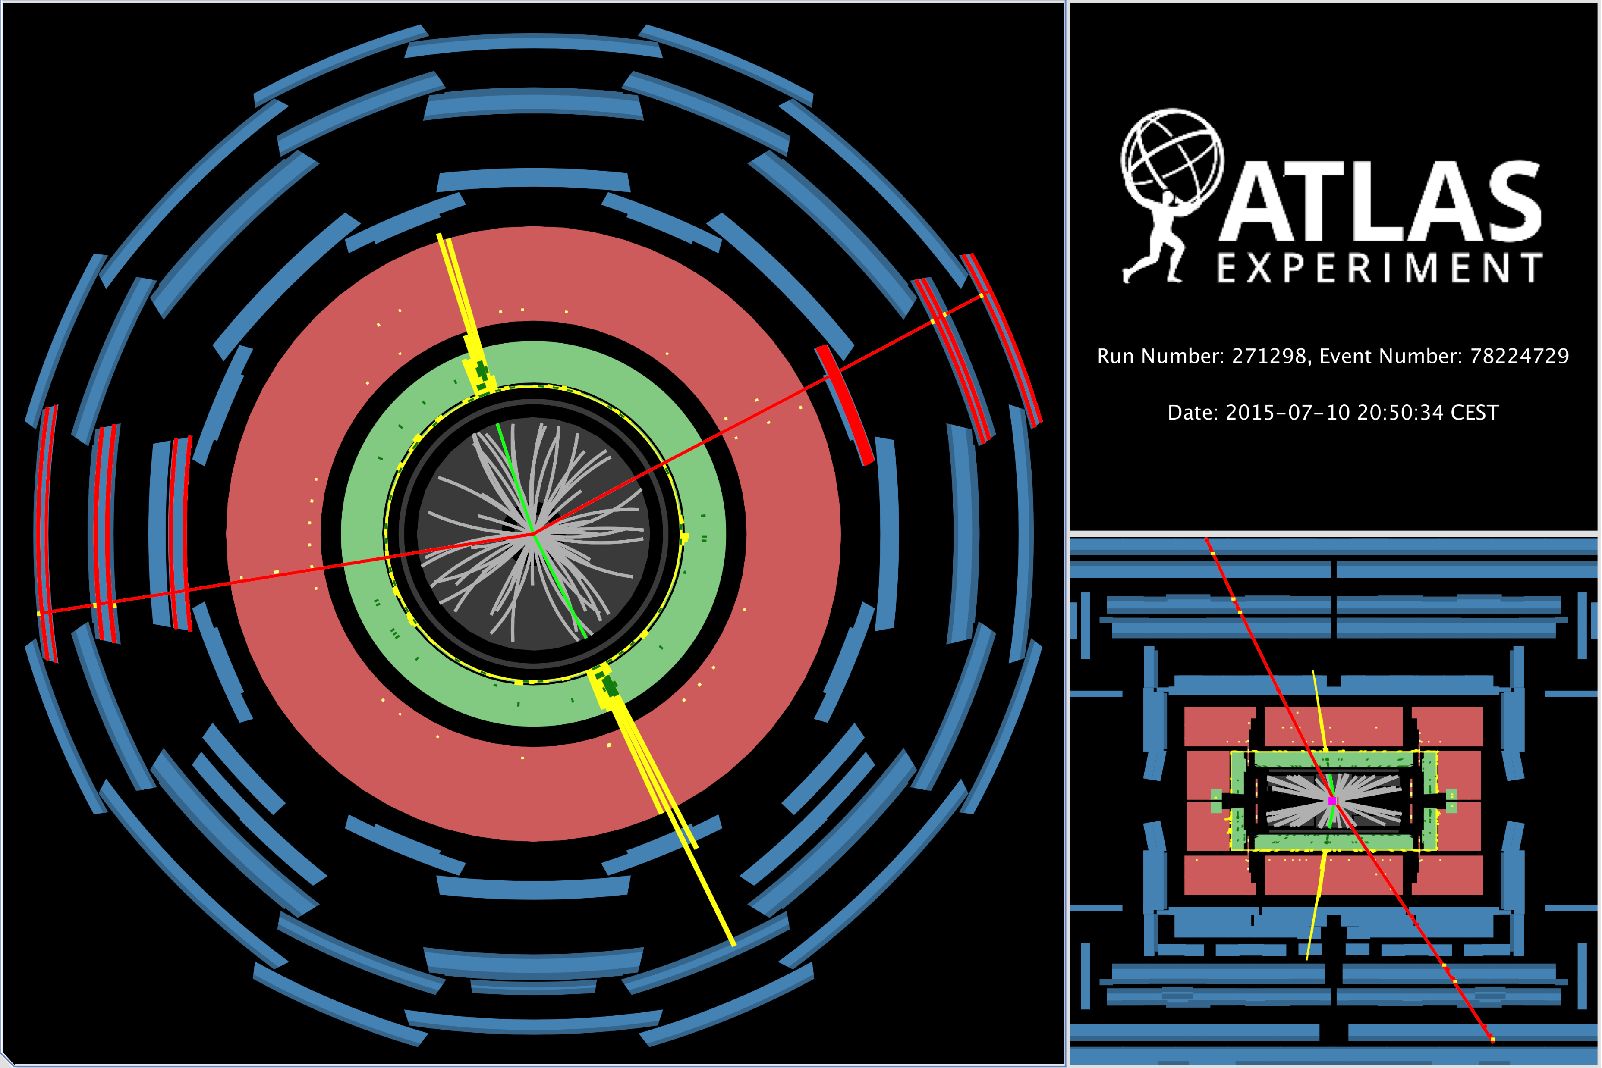
TDAQ
Trigger and Data Acquisition (TDAQ) is designed to filter and store ATLAS events
Separated into hardware -> LVL1 and software -> LVL2 triggers
DAQ undergoing upgrades as part of HL-LHC
ATLAS Collaboration (2015, July 10). Display of a ZZ candidate event from proton-proton collisions recorded by ATLAS, with LHC beams at a collision energy of 13 TeV

Slide 10
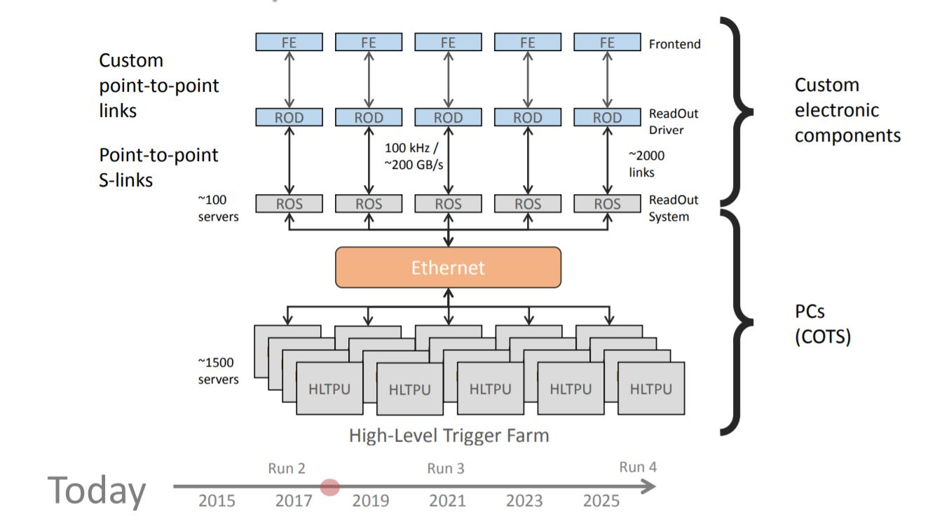
DAQ Today
Figure by ATLAS Collaboration. (2017, September 11-14). ATLAS DAQ.

Slide 11
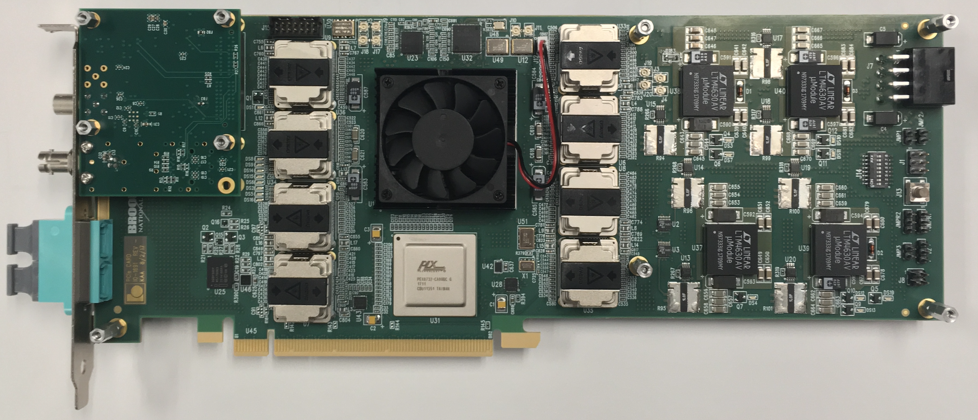
FELIX with the DAQ
Front-End LInk eXchange (FELIX) will be used to interphase commodity network and Front-Ends
Detector agnostic design will allow it to replace all custom point-to-point links
First implemented across NSW and LAr Calorimeter
Figure from Wu, W. (2018). FELIX: The New Detector Interface for the ATLAS Experiment. In 21st IEEE Real Time Conference(pp. 1-5). Williamsburg, Virginia.

Slide 12
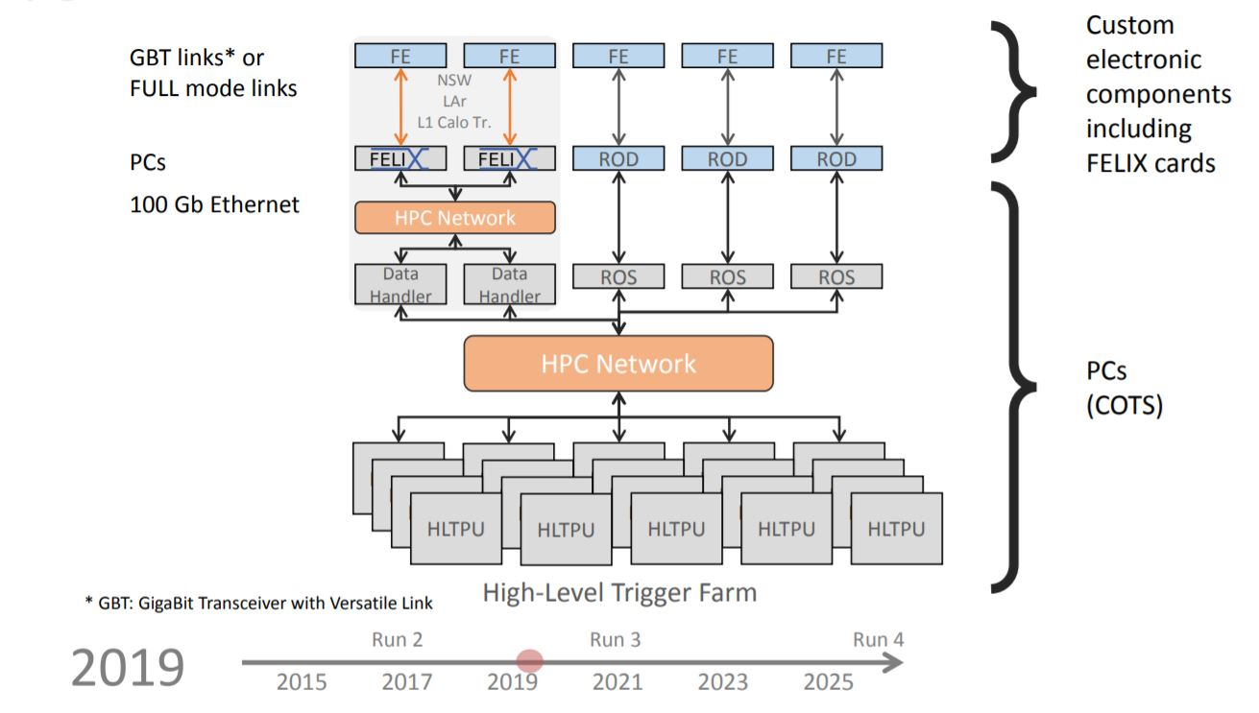
DAQ Phase I
Figure by ATLAS Collaboration. (2017, September 11-14). ATLAS DAQ.

Slide 13
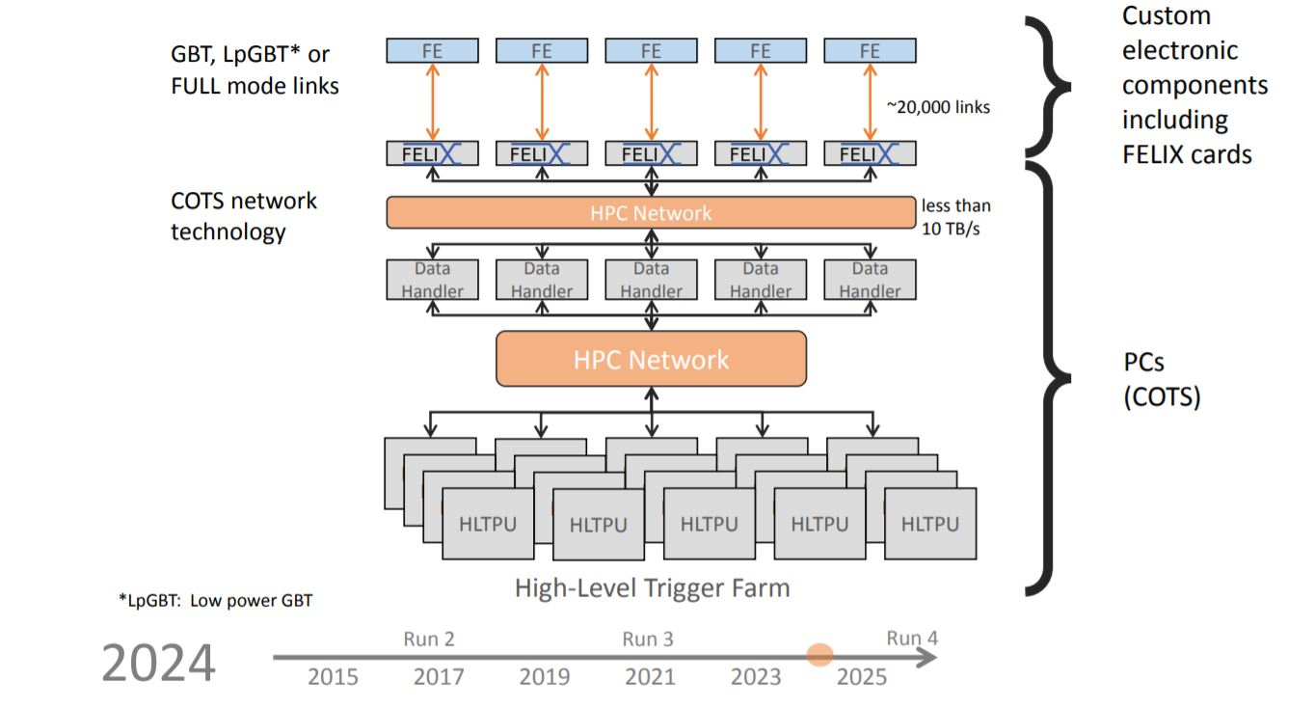
TDAQ Phase II
Figure by ATLAS Collaboration. (2017, September 11-14). ATLAS DAQ.

Slide 14
Overview
HL-LHC
Inner Detector & Inner Tracker
TDAQ Phase I, II
My Work at CERN
My Progress
Remaining Work
What I’ve Learned

Slide 15
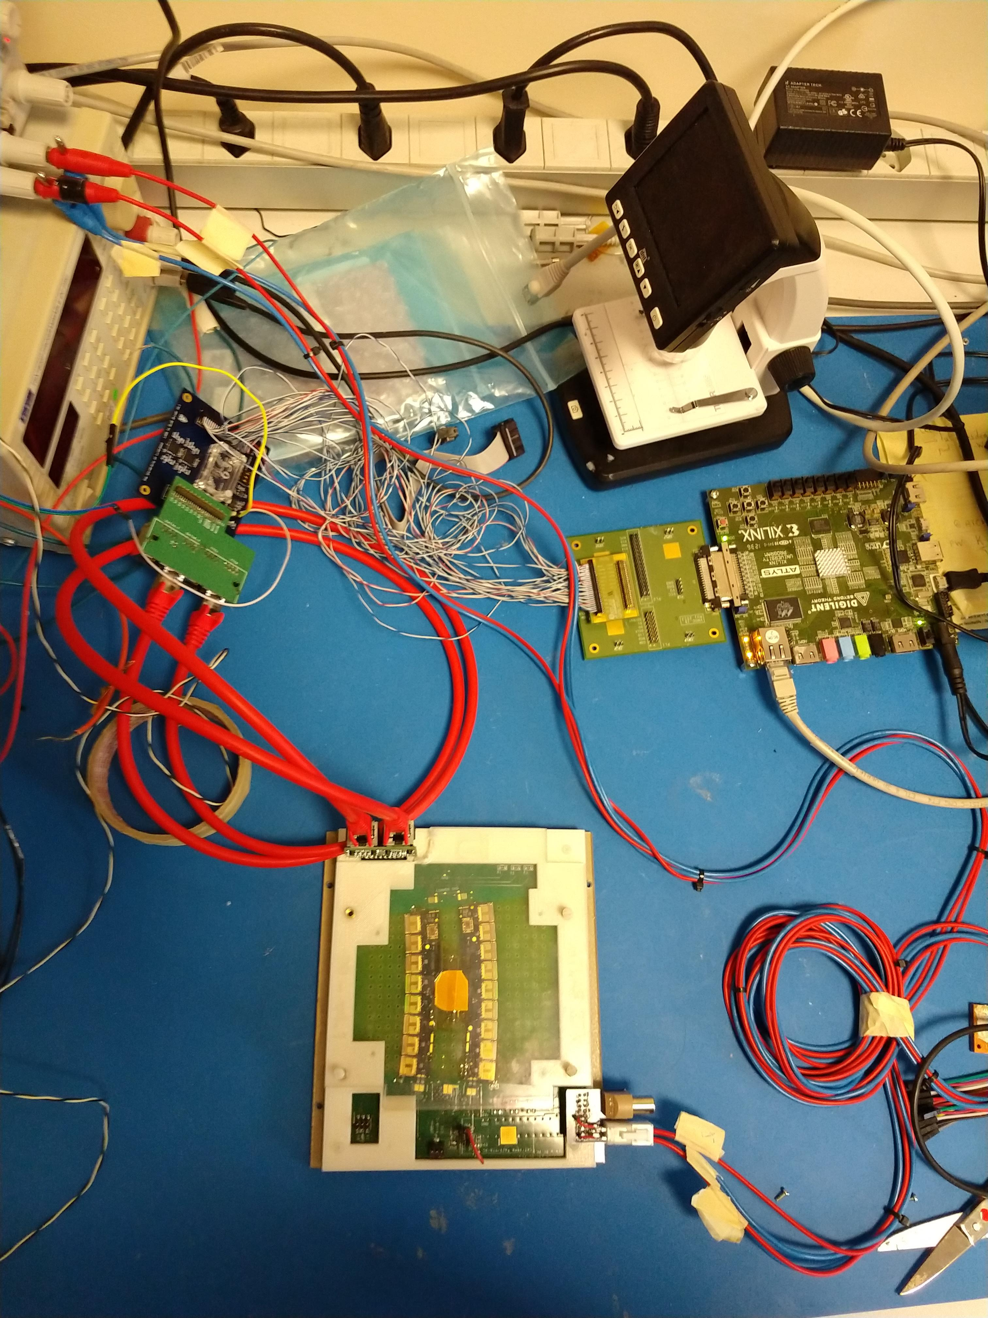
My Work on the ATLYS Setup
Diagnosed addressing issues
Reconfigured data streams to circumvent damaged chips
Developed technique to write and read back registers using a combination of the ITSDAQ software and Macros
Power Supply
SLVS Buffer Board
RJ45 Adaptor
ATLYS FPGA
VMOD Buffer Board
ROH0
ROH1
Hybrid Test Frame

Slide 16
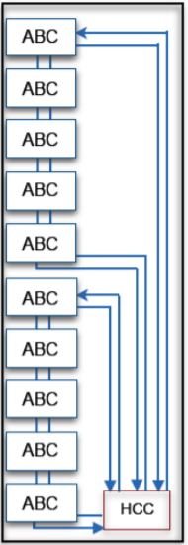
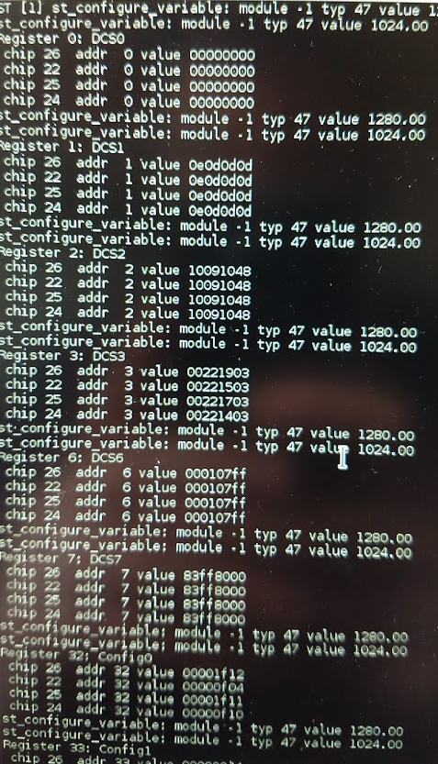
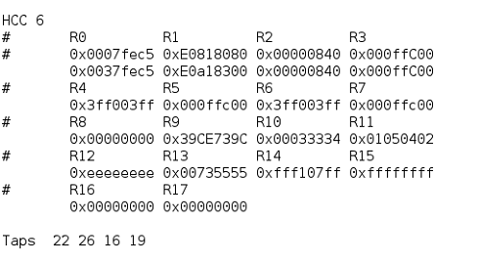
My Work on the ATLYS Setup
Hybrid Control Diagram. Adapted from “ATLAS Silicon Strip Detector Phase-2 Upgrade,” by Xin Shi on behalf of the IHEP/THU ATLAS ITk Group.

Slide 17
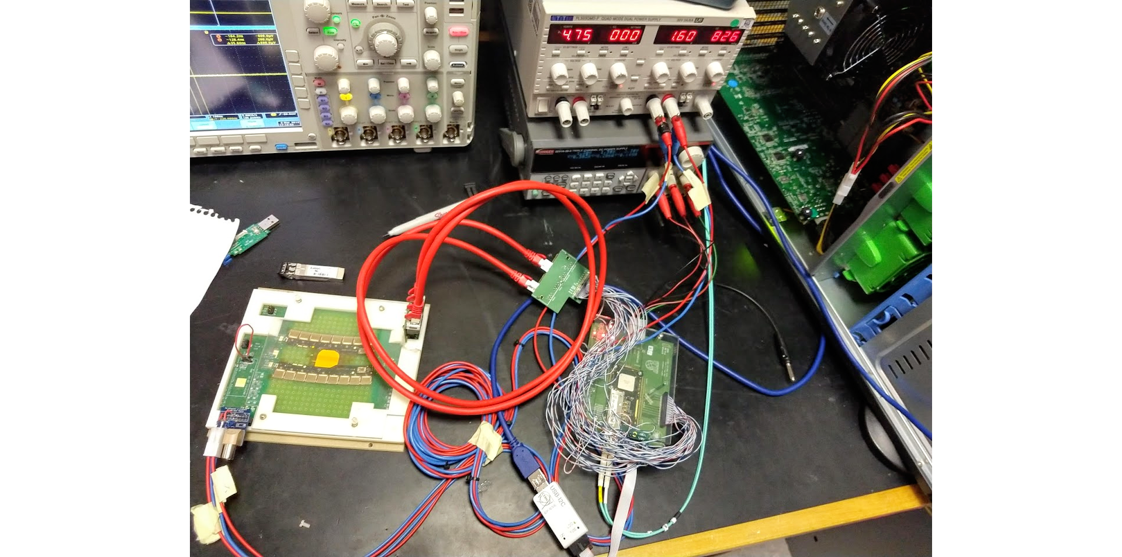
My Work on the FELIX Setup
Installation and configuration of FELIX and GBTx
A lot of debugging and diagnosing powering and communication issues
Laid foundation for configuration and basic communication between FELIX and Hybrids
Power Supplies
FELIX FPGA
RJ45 Adaptor
GBTx
Hybrid Test Frame

Slide 18
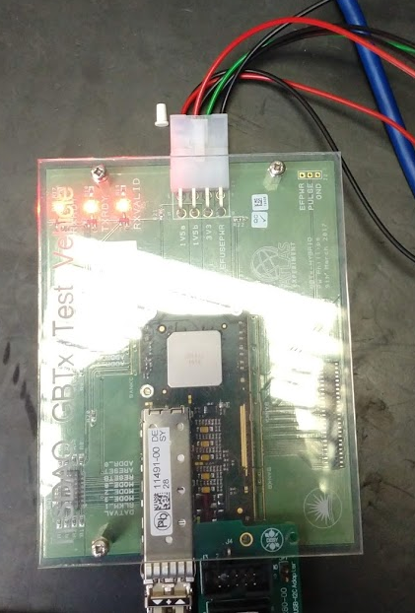
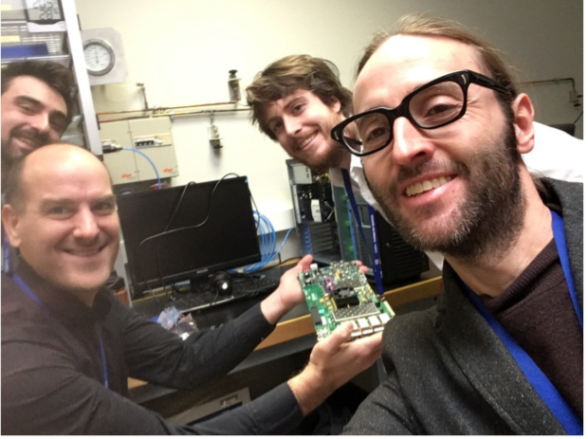
My Work on the FELIX Setup

Slide 19
Remaining Work
Have yet to configure hybrids and ability to read and write registers on FELIX setup
We should look into using Vivado as an internal probe for future debugging
With shipment of strip panel hopefully a full readout system can be finished in O(month)

