Slide 1
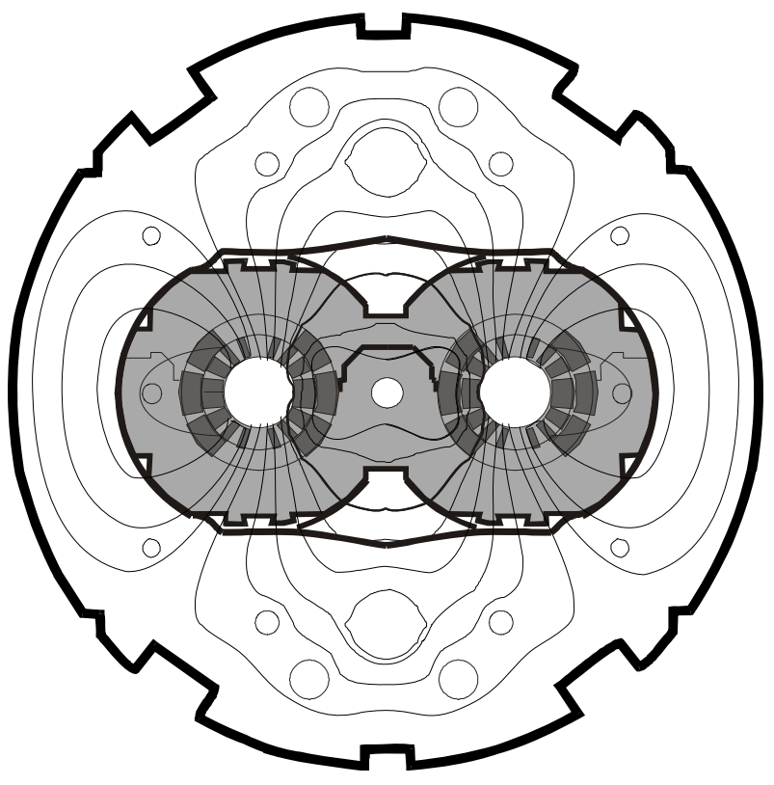
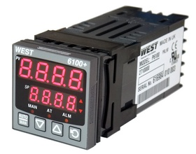


Current leads temperature regulators
Regular meeting #4
Szymon Michniuk
Edward Nowak
Grzegorz Seweryn
Krzysztof Stachon
(TE-MPE-EE)
18.01.2019

Slide 2
Review of decisions after previous meeting
3nd CL regulators meeting
Meeting on CL regulators strategy #3
20-12-18
Participants: A. Siemko, F. Rodriguez-Mateos, G. D’Angelo, E. Nowak, K. Stachon
Indico: https://indico.cern.ch/event/783036/
Key points from the meeting:
Decision taken: we upgrade currently used controllers to be radiation tolerant. That means that:
power supply weakness must be fixed (ultra low voltage power supply)
Automated controller watchdog must be added
Crates mechanical upgrade must be performed.
Steps to do:
Check controllers that failed in the past years, whether all of them have the same fault signs (bunt resistors and MOSFET).
Find components that would be a good replacement for power MOSFET and optocoupler. Possibly with the same footprint.
Contact WEST and ask for production of 10 units of controllers with selected components
Order 10 units of ultra low voltage power supply controllers (without modifications)
Test controllers in an external radiation facility.
In parallel, development of automated controller watchdog system
Notes:
- The controller system consists of heater

Slide 3
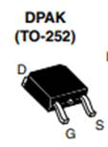
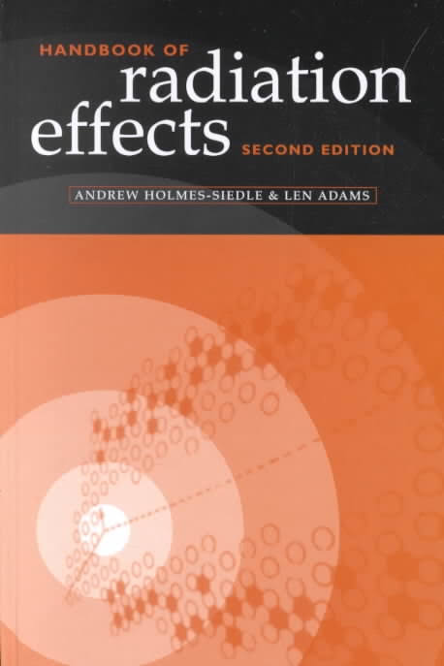
Replacement MOSFET research
Power MOSFET is in the form of TO-252 package (D-PACK) – the same footprint should be kept.
Literature says:
„The ion LET required for burn-out decreases as Vds increases and, in general, immunity from heavy-ion-induced ‚burn-out’ requires the use of a Vds of less than 50 per cent of the maximum rated value in a non-hardened device.”
CASE 1 – 230V AC
Expected Vds = 400V (peak value of 230V AC), the MOSFET should be rated Vds = 800V.
There are MOSFETs satisfying the requirements available on the market!
CASE 2 – 24V AC
Expected Vds = 40 V, then the mosfet should be rated at least 80Vds.
There are MOSFETs satisfying the requirements available in the CERN tested components database, they were proved to be radiation tollerant, however, they were tested in 2014. Therefore, a new batch of that components should be tested again!
Notes:
- The controller system consists of heater

Slide 4
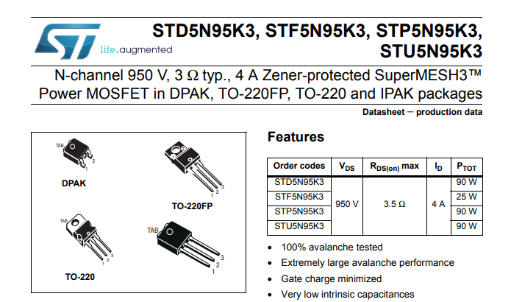
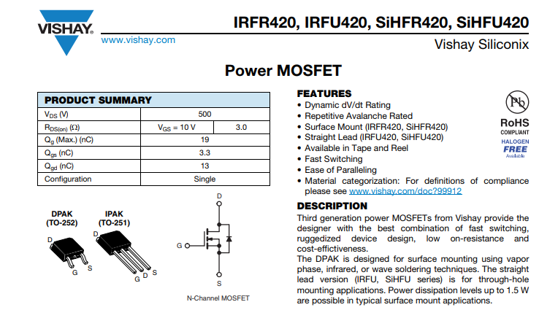
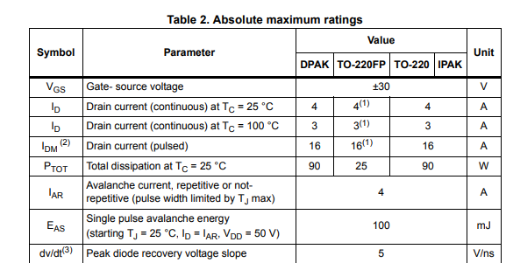
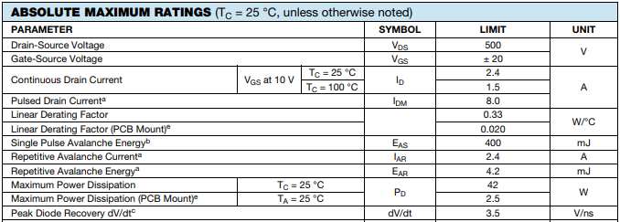
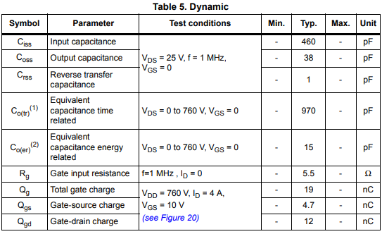
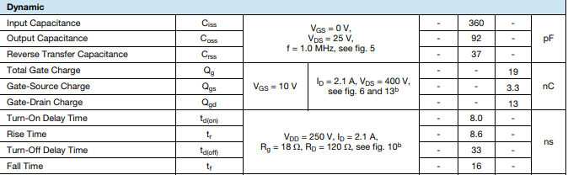
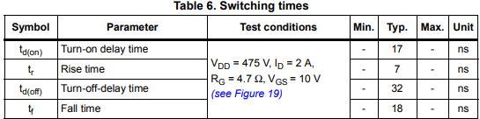
Replacement MOSFET research
IRFR420 – currently used MOSFET
STD5N95K3 – the most similar MOSFET found
Notes:
- The controller system consists of heater

Slide 5
Replacement MOSFET research
Selected components to be tested in PSI proton beam facility:
STD5N95K3 ( http://www.farnell.com/datasheets/1718566.pdf ) – Vds = 950V, Rds = 3Ohm [farnell: 2098176]
IPD80R3K3P7 ( http://www.farnell.com/datasheets/2327423.pdf ) - Vds = 800V, Rds = 2.7 Ohm [farnell: 2771323]
IRFR420 ( http://www.farnell.com/datasheets/2046027.pdf ) – Vds = 500V, Rds = 3 Ohm (currently used in controllers, could be tested as a reference) [farnel: 2335254] – to be unsoldered from controllers
STD10NFT4 ( http://www.farnell.com/datasheets/128836.pdf ) – tested in 2013 at PSI – to be verified again – Vds = 100V [farnell: 1175682]
IRLR120N ( http://www.farnell.com/datasheets/1884190.pdf ) - Vds = 100V (currently used in ultra lov voltage controllers) to be unsoldered from controllers
Tests of components selected by us may be done by EN-SMM-RME. They are testing components there roughly once per month.
For the test, there are 10 components of each kind needed.
We need to specify when we want the components to be tested
Notes:
- The controller system consists of heater

Slide 6
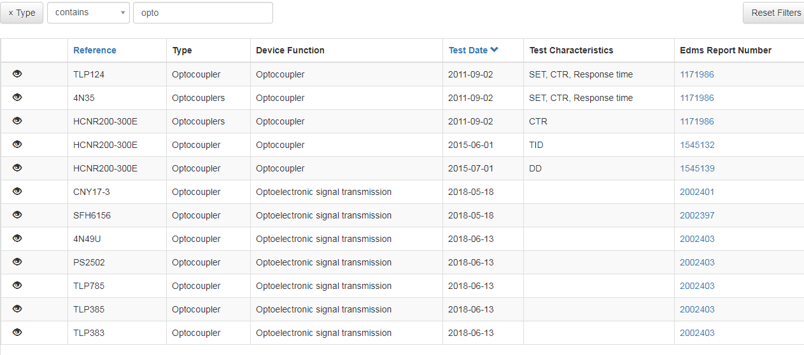
Replacement optocoupler research
There were many optocouplers tested in the 2018 at CHARM. Reports are available in components database ( https://radwg-table.web.cern.ch/ ).
To do final selection, we need to get data of 1MeV neutorn fluence eq. expected in RRs. – the major damage due to radiation in optocouplers is displacement damage.
Notes:
- The controller system consists of heater

Slide 7
Plan for the future
Order replacement MOSFETs and test if the power supply is functional with them
Find the best replacement at PSI
Select optocoupler (in case change is necessary)
Design test setup for the final test in a mixed field radiation facility
Design watchdog system
Notes:
- The controller system consists of heater

