Slide 1
Items supplied by CERN and procurement plan
Y.Leclercq on behalf of the DF development team WP6a
31 Jan. 2019
Conceptual design review of the DFX

Slide 2
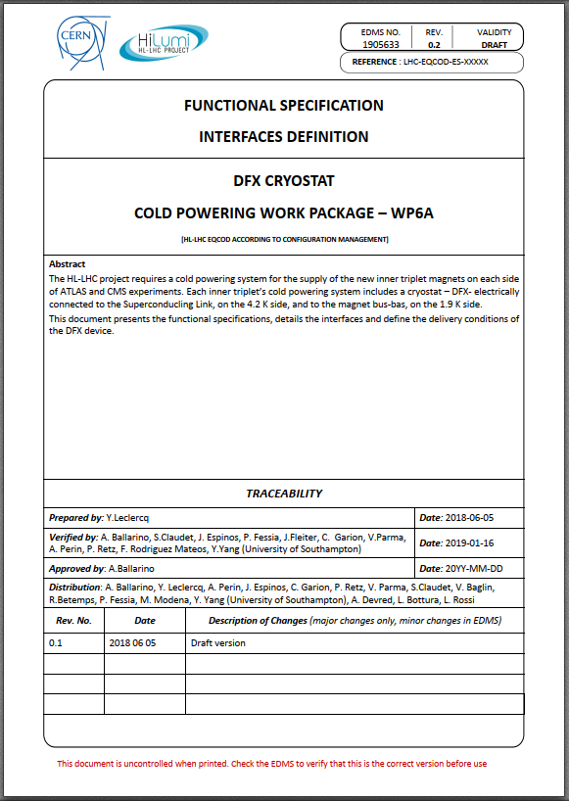
Items supplied by CERN
Defined in DFX functional specification EDMS 1905633 §4
Insulation vacuum:
  Elastomer seals (specific to the integrated dose)
  Pumps, valves and pressure transducers
Cryogenics:
  Wired instrumentation and electrical feedthroughs
  Electrical heaters
  Safety relief pressure devices
Survey:
  External survey targets for installation.
Circuit protection:
  V-taps feedthroughs.
Test in SM18:
  Supporting structure and installation tooling.

Slide 3
Procurement plan
Prototype Series 1st use 1st need
Insulation vacuum:
Elastomer seals (specific to the integrated dose) No Yes String test 2021
Hardware (installed @ CERN) No Yes String test 2021
Cryogenics instrumentation, hardware Yes Yes Assy proto Q3 2019
Circuit protection: V-taps feedthroughs. Yes Yes Assy proto Q3 2019
Test in SM18: Supporting structure and installation tooling. Yes No SM18 test Q1 2020
2019 |  |  |  | 2020 |  |  |  | 2021
Q1 | Q2 | Q3 | Q4 | Q1 | Q2 | Q3 | Q4
Conceptual design approved
Detailed design approved
Delivery DFX prototype
Cryogenics instru., hardware
Circuit protection hardware
SM18 test supports & tooling
DFX series manufacturing period ???
Common procurement CRG ?
Proc. proto
Proc. series
Proc. proto
Proc. series
Design
Proc.

