Slide 1

DFX safety aspects in the LHC tunnel
Vittorio Parma (vittorio.parma@cern.ch ),
CERN, Technology Department
Event, date

Slide 2
Contents
Safety at CERN
Pressure vessels
System description
Cryogenic safety
  Preliminary risk assessment and sizing of safety
Summary

Slide 3
Safety at CERN (https://hse.cern/content/safety-rules)
Electrical Safety Code C1 (EDMS 335725)
GENERAL SAFETY INSTRUCTION GSI-M-4 – Cryogenic Equipment (EDMS 1327191)
  “Cryogenic equipment liable to have major safety implications” because of “high-level hazard for people, the environment or other installations in the event of failure”
Safety Guideline SG-M-4-0-1
Requested compliance with European Directives:
  Pressure Equipment Directive 2014/68/EU where relevant

Slide 4
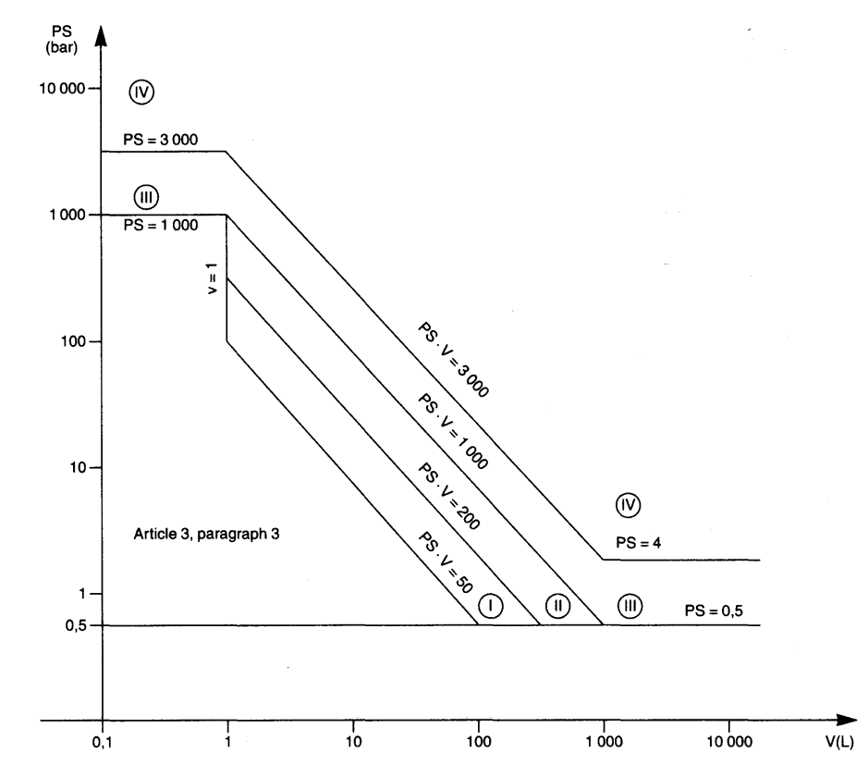
Pressure vessel codes regulations
Pressure European Directive 2014/68/EC (PED) is a legal obligation in the EU since 2002 and CERN’s Safety Unit (HSE) requests to comply with it:
  Applies to internal pressure ≥ 0.5 bar gauge
  Vessels must be designed, fabricated and tested according to the requirements defined
  Establishes the conformity assessment procedure depending on the vessel category, which depends on the stored energy, expressed as Pressure x Volume in bar.l
→ CE marking and notified body required from and above cat II
Category | Conf. assessment module | Comment
SEP | None | The equipment must be designed and manufactured in accordance with sound engineering practice. No CE marking and no involvement of notified body.
I | A | CE marking with no notified body involvement, self-certifying.
II | A1 | The notified body will perform unexpected visits and monitor final assessment.
III | B1+F | The notified body is required to approve the design, examine and test the vessel.
IV | G | Even further involvement of the notified body.
Pressure vessels
Article 4, paragraph 3
Vacuum vessels
For vessels with non-dangerous gases, Group 2, (cryogenic liquids are treated as gas)

Slide 5
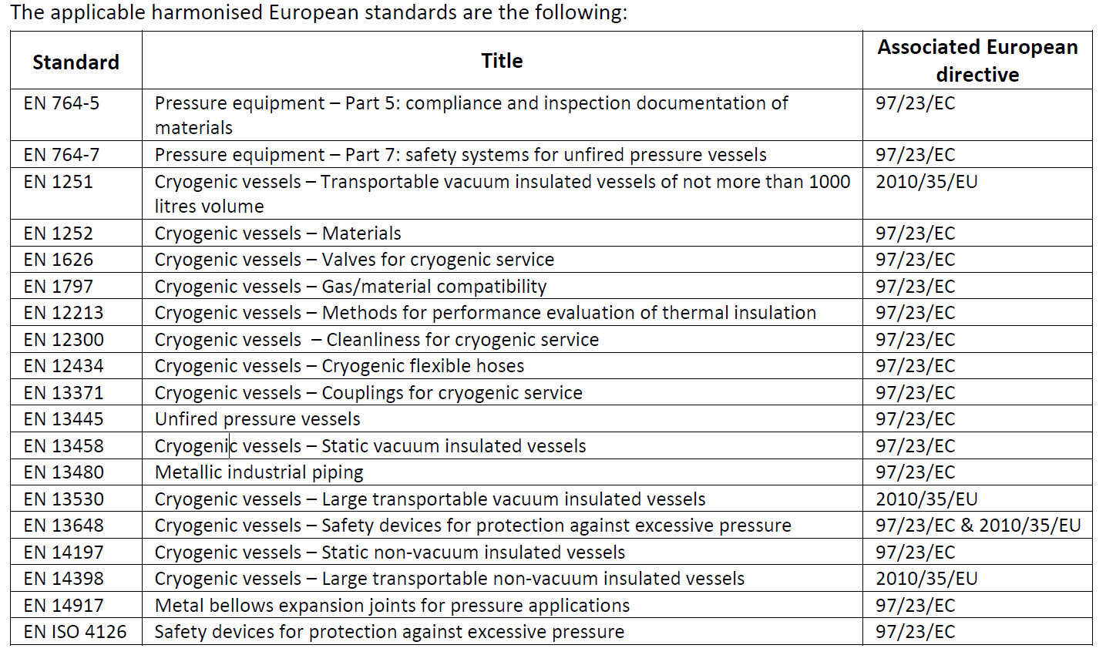
Harmonised codes and standards
Harmonised standards give presumption of conformity with the PED, within their scope. Useful codes for cryostat design and fabrication, including safety devices:
→ Now replaced by ISO 21013-3
Very useful guidelines and design rules to be used!

Slide 6
Insulation vacuum volumes
4 independent insulation vacuum per cold powering chain
Each equipped with pressure gauge, pumping port (static), pressure relief plate
3 x 7 kA
12 x 2 kA
Vac.barriers
PT
2 x 18 kA
2 x 13 kA
PT
DFHx1
DFHx2
DSHx
UR: Service tunnel
UL: Transverse tunnel
DSHx
LHC tunnel
PT
Superfluid @ 1.9K
Liquid He @ 4.5 K
Gaseous He @ 4.5 K
PT
Jumper DFX
DFX
Jumper D1
D1
MBXF
Item | Volume [m3] | Remark
DFX
DSHx
DFHx1
DFHx2
DFH flex.line

Slide 7
Helium volumes
4 independent insulation vacuum per cold powering chain
Each equipped with pressure gauge, pumping port (static), pressure relief plate
3 x 7 kA
12 x 2 kA
Vac.barriers
PT
2 x 18 kA
2 x 13 kA
PT
DFHx1
DFHx2
DSHx
UR: Service tunnel
UL: Transverse tunnel
DSHx
LHC tunnel
PT
Superfluid @ 1.9K
Liquid He @ 4.5 K
Gaseous He @ 4.5 K
PT
Jumper DFX
DFX
Jumper D1
D1
MBXF
Item | Volume [m3] | Remark
DFX
DSHx
DFHx1
DFHx2
DFH flex.line

Slide 8
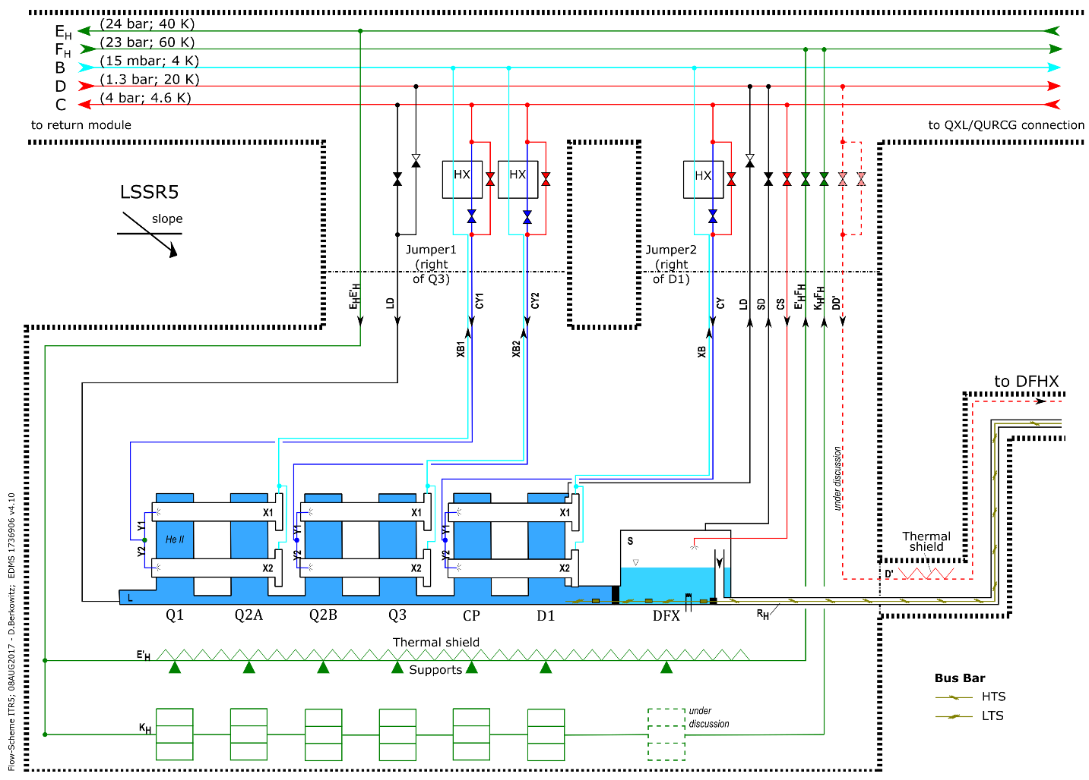
Cryogenic scheme (EDMS1736906)
Cryogenic boiler circuit not yet included (recently added)

Slide 9
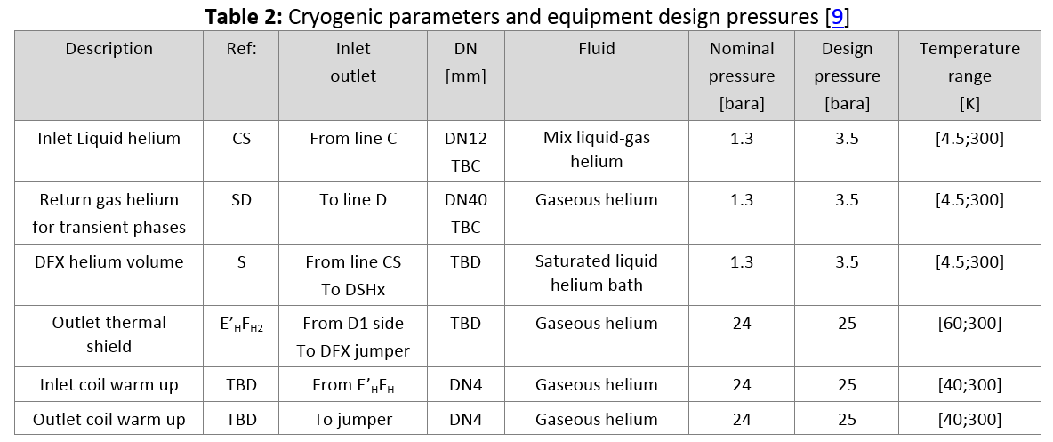
DFX specification
(EDMS1905633)

Slide 10
DFX Schematic

Slide 11
DFX volumes and cold surfaces
(W.Bailey, SOTON)

Slide 12
Scale of pressures
bar(a)
Ptest: Test pressure
6.43 bar(a) (1.43 x (Ps+1))
Ps: Design pressure
3.5 bar(a)
Pt: burst disk set press.
< 3.5 bar(a) (2.5 barg)
Pn Nominal pressure
1.3 bar(a)

Slide 13
PED category
Ps x V = 2800 bar.L
→ Cat.3 (~4)
3.5
Article 4, paragraph 3
800

Slide 14
The pressure safety design process
Identify all circuit/enclosed volume(s) for the cryostat to be protected (as a minimum vacuum and helium vessels)
Build the scale of pressures. As a minimum:
  Nominal operating pressure (Pn), related to the operation of the device
  Design Pressure (PS), related to mechanical limits (e.g. cavity plastic limits) or to operational scenarios (e.g. magnet quench)
  Set pressure (Pt) of the relief device < PS
  Test pressure (Ptest) depending on the norms
Make risk hazard analysis & mitigation measure:
  Risk matrix: risks, likelihood vs. severity
  Identify mitigation measures (e.g. protections of exposed bellows)
  Identify the credible worst-case scenario
Design the safety relief system according to the worst-case
  The safety relief system must be designed to keep pressure rise within the limits of the Design Pressure (PS)
  Sizing of devices according to EN 13648-3 and ISO412
Ptest Test pressure
PS: Design pressure
Pt: relief device set press.
Pn Nominal pressure

Slide 15
Risk assessment matrix

Slide 16
Retained pressure hazards
A) Heating/vaporization of cryogens from sudden release of stored energy in SC device from arcing
B) Accidental air venting of insulation vacuum with sudden condensation on cold surfaces, helium boil-off and pressure build-up
C) Accidental release of cryogenic fluid to higher T surfaces (thermal shield and vacuum vessel), and consequent pressure increase and increased of conduction/convection heat loads to cold surfaces
D) Brake of lambda plug(s)…
Cryogenics fluid
Cryogenics fluid
Cryogenics fluid
Vacuum
Air
Vacuum
Air
Vacuum
Air
A)
B)
C)

Slide 17
Safety devices: preliminary sizing
Bust disc for helium reservoir
  ~ DN ? burst disk + rated valve
Relief plates for vacuum vessel
  DN 150-200 (TBC)

Slide 18
Summary

Slide 19
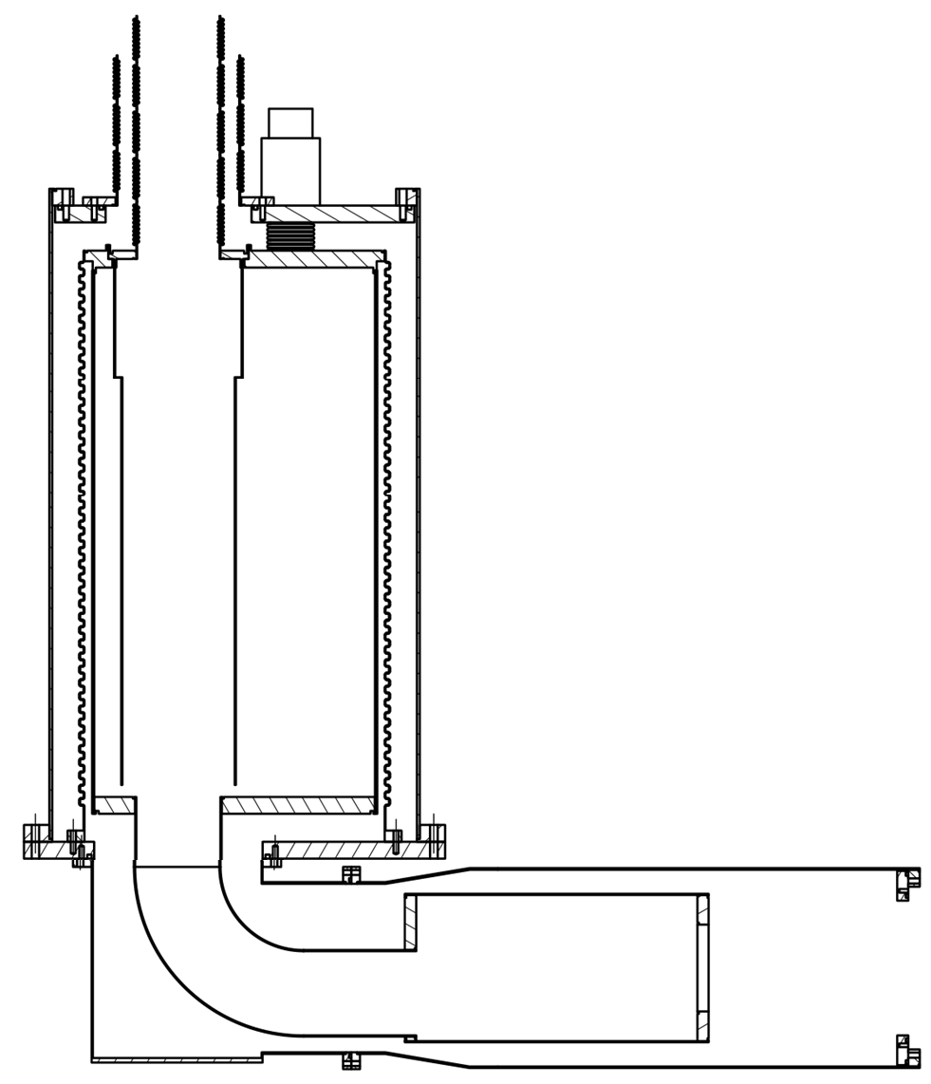
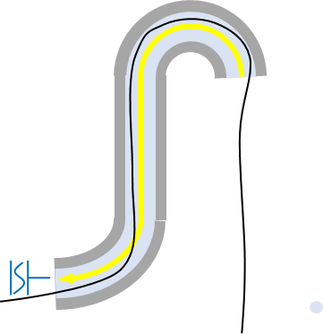
MgB2
Shaft
Concrete
Integration reservation
Liquid level
MgB2-NbTi splices
1.6 m
1.3 m
Plug to D1

Slide 20
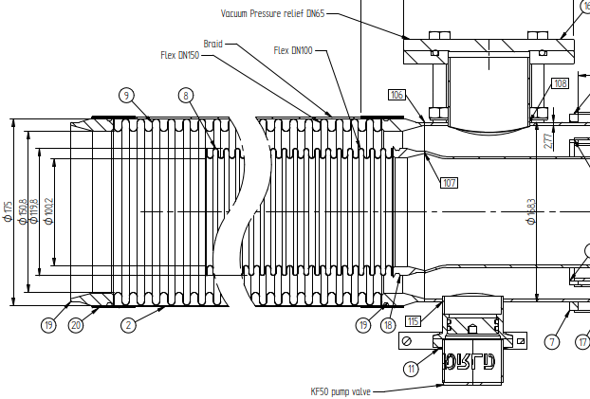
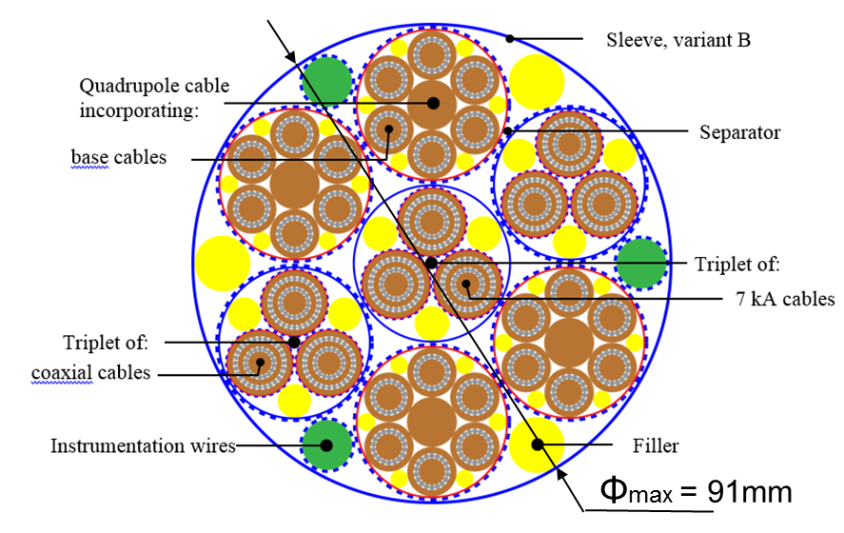
DSH cross section

Slide 21
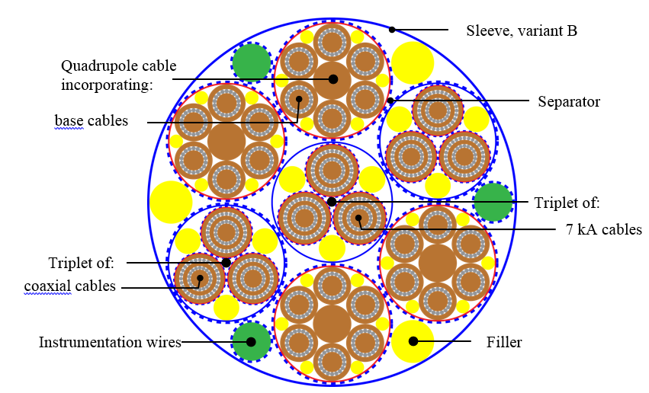
Φmax = 91mm

