Slide 1

DFX instrumentation requirements_DRY RUN
J. Fleiter
Conceptual design review of the DFX 31 Jan 2019

Slide 2
Outline
Functional requirements:
  Cryogenic
  Vacuum
  Protection of circuits
List of instrumentation
  Vtaps
  Cryo sensors
  Vaccum

Slide 3
Functional requirements
The DFX will host the MgB2/Nb-Ti splices and the Nb-Ti bus bars of the cold powering system of triplets:
  2x 18 kA
  2 x 13 kA
  3x 7 kA
  12 X 2 kA
Three types of functional requirements (others not part of this presentation)
  Cryogenic
  Vacuum
  Protection

Slide 4
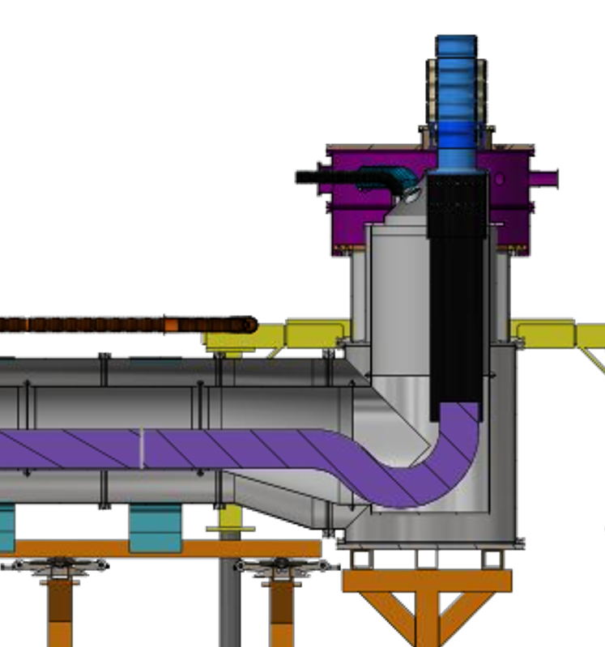
Cryogenic requirement
Immersion of Nb-Ti/MgB₂ splices and Nb-Ti bus bars in LHe bath => regulation of level.
Generate from the LHe bath, a He boil off mass flow (of up to 10 g/s) sufficient to:
  Maintain the MgB2 cable of the Sc Link below 25 K
  Maintain the MgB2 HTS splices below 25 K
  Thermalize to 50 K the bottom of the HeX of the leads

Slide 5
Cryogenic instrumentation of DFX
6 Thermal transducers (TT)
  Two in the He tank
  4 in the splice box
Two heaters
  1 Ghe/LHe Heat exchanger
  1 resistive Heater
1 He pressure gage
Two LHe level transducers
Elaborated in collaboration with S. Claudet
Additional instrumentation for transients not listed (CV, EH and TT)

Slide 6
Cryogenic instrumentation of Sc Link
Elaborated in collaboration with S. Claudet
Additional instrumentation for transients not listed (CV, EH and TT)

Slide 7
Protection requirements
Each of the circuit of the Sc Link shall be protected by a dedicated QPS system that:
  Detect any quench or detached Vtaps
  Triggers the removal of energy from the circuit (strategy depends on the circuit): fast abort, EE system, quench heater
Each circuit equipped with Vtaps to monitor voltage along Sc cables and across splices.

Slide 8
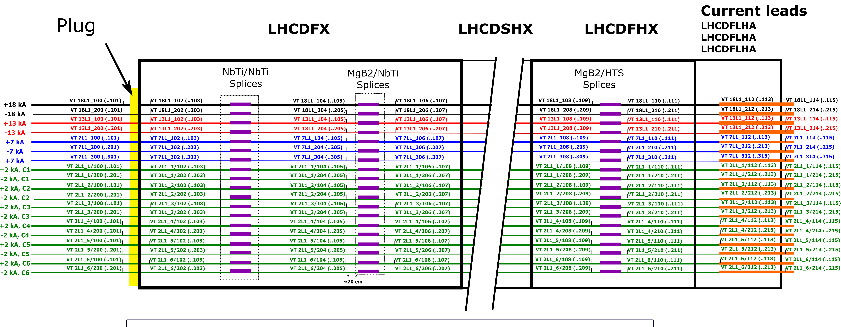
List of VTaps
Each VTap has a spare
Vtaps on the 1.9 K side required to monitor the plug
Local pairing (outside the DFX) of taps of the plug required

Slide 9
Vacuum requirements
The cold powering chain made of three vacuum volumes
Each of the volume equipped with pumps and instrumentation ( under definition with Germana, more advanced next week)……

