Slide 1
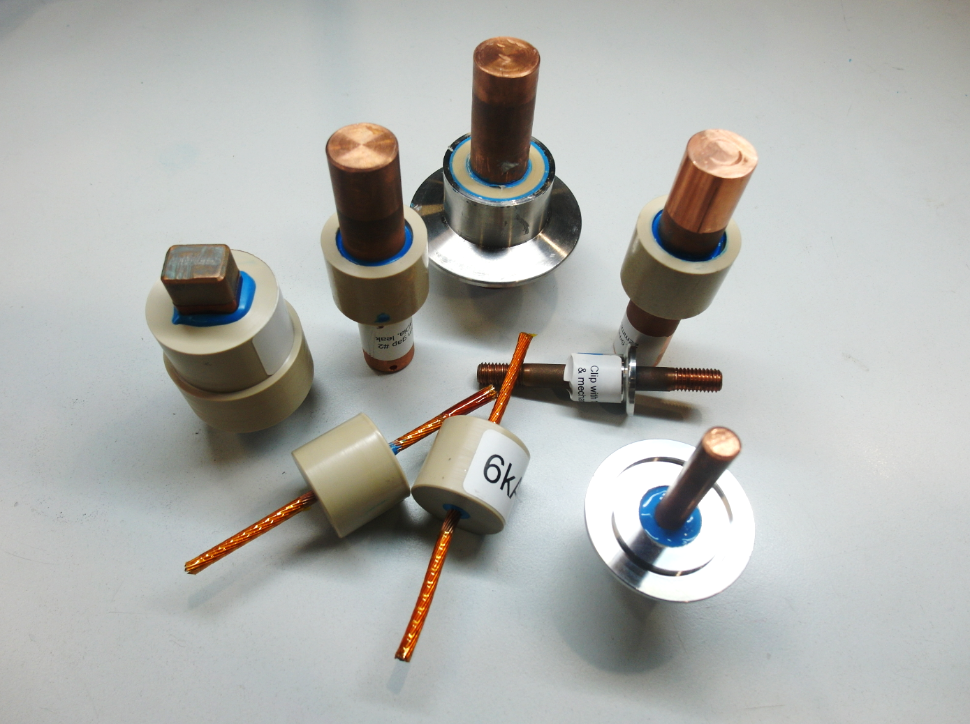
Plug development: status, plan and key milestones for intermediate validation, production plan
Y.Leclercq, JB. Deschamps on behalf of the Plug development team : 31 Jan. 2019
Conceptual design review of the DFX

Slide 2
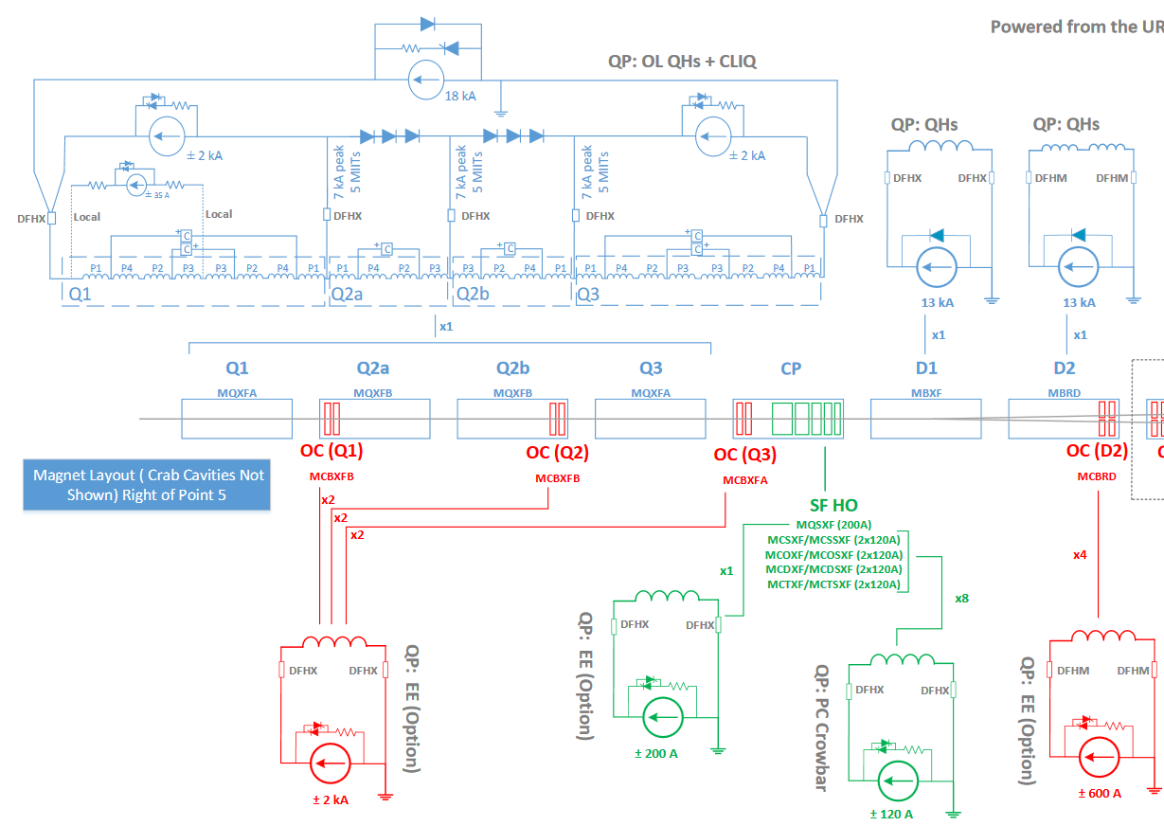
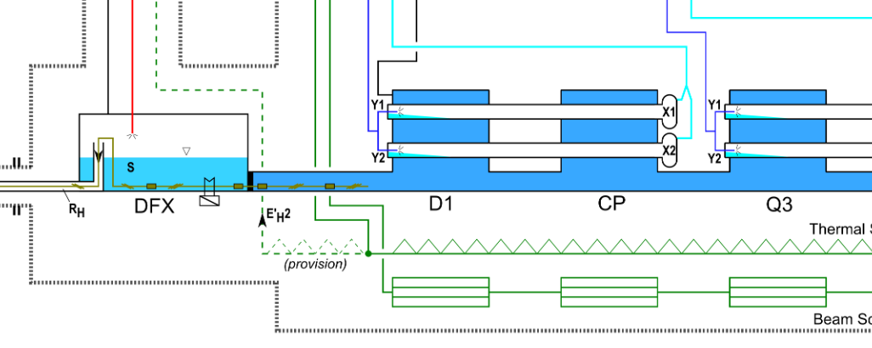
DFX-Triplet plug specifications
19 bus bars through the plug:
Separates 2 Cryogenic volumes:
Design requirements
 | I_{cable} [kA] | N_{cables}
MQXF | 18 | 2
Trim Q1/Q2a/Q2b/Q3 | 7 | 3
MCBXF% | 2 | 12
MBXF (D1) | 18 | 2
x6
x6
From MCF circuit layout
Courtesy S.Yammine
Helium volumes | Phase Nominal | T_{nom} [K] | P_{nom} [bara] | Design pressure PS [bar]
Triplet cold mass He enclosure | Superfluid | 1.8 | 1.3 | 20
DFX - SCLink | Sat. liquid | 4.5 | 1.3 | 3.5
Preliminary_naming_parameters_and_flow_diagrams_for_HL-LHC
Courtesy D. Berkovitz EDMS1573115
 |  | Specification
Overall leak rate (target) |  | 1.10⁻⁴ mbar.l.s⁻¹
Insulation to ground/cable @ RT |  | 4.6 kV
Thermal cycles |  | 200
Maintainability |  | Replaceable
Radiation levels (1.6m distance from beam) | Dose Neutron fluence | 100 kGy 2.10¹⁴ cm⁻²
From Process flow diagram of HL-LHC IT L5
Courtesy D. Berkowitz - M. Sisti – EDMS1963716
R.Garcia et al. “LHC and HL-LHC: Present and future radiation environment in the HL collision […]” CDS2310128

Slide 3
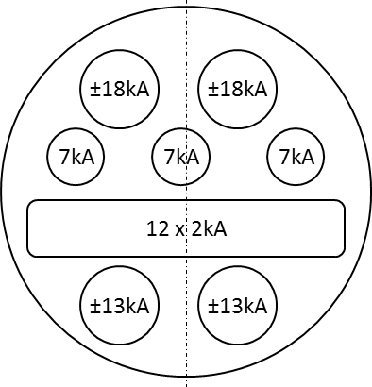
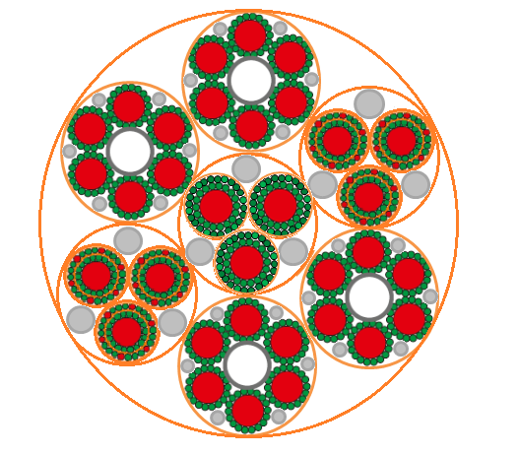
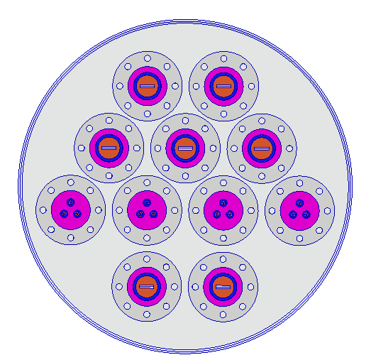
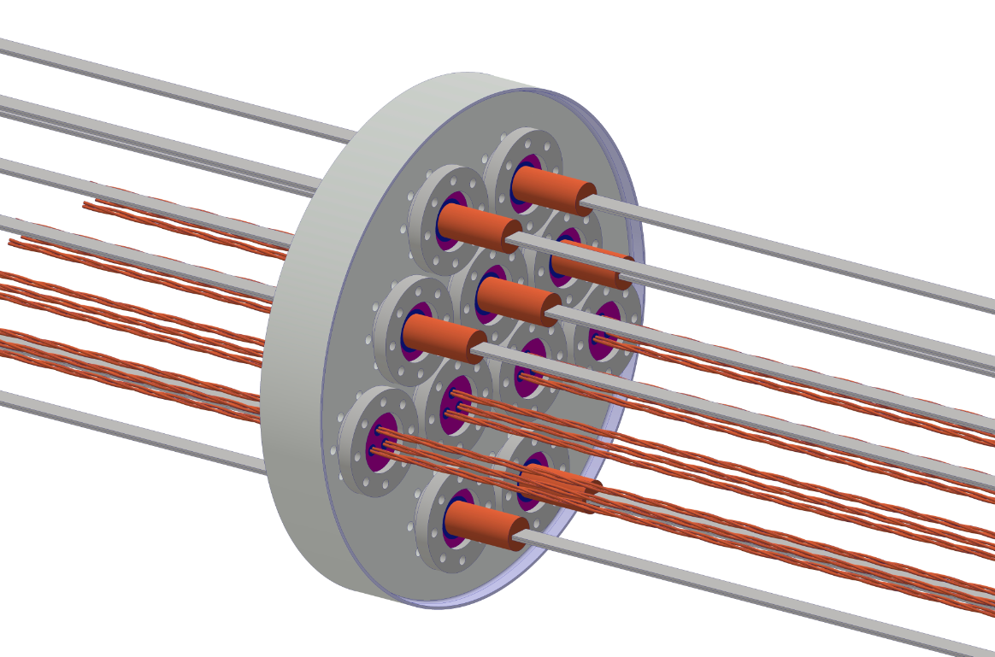
DFX-Triplet plug proposal
Bus bars configuration
➔ 2 different plugs 18 kA & 2 kA
Physical layout proposal
Plug LHC inspired design proposal:
  From 13 kA LHC plug
  From 3 x 6kA LHC plug
 |  |  | Cable type
 | I_{cable} [kA] | N_{cables} | Triplet side | Plug | DFX side
MQXF | 18 | 2 | 18 kA Nb-Ti round | 2 x MQXF leads | 2 x MQXF leads
MBXF (D1) | 18 | 2 | 13 kA Nb-Ti round
Trims | 7 | 3 | 18 kA Nb-Ti round |  | Not defined
MCBXF% | 2 | 12 | 2 kA Nb-Ti round | LHC 6 kA | MCBXF + Cu
D1 interface configuration
Plug proposal
SCLink configuration
Connected to cold diodes
+18kA
3x7kA
-18kA
+18kA
-18kA
Routed above D1
12 x 2 kA
6x2kA
3x7kA
6x2kA
Routed down to D1
-13kA
+13kA
-13kA
+13kA

Slide 4
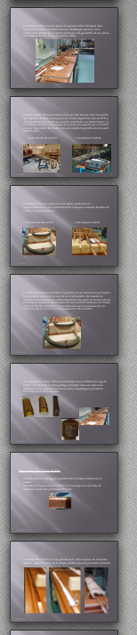
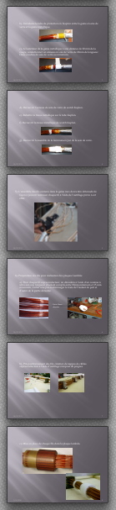
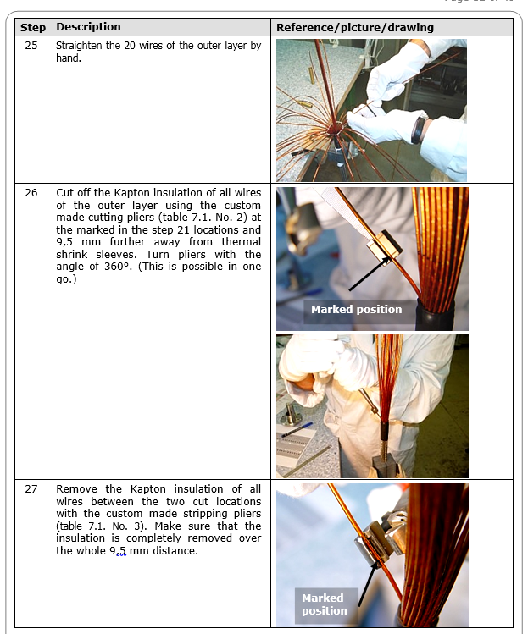
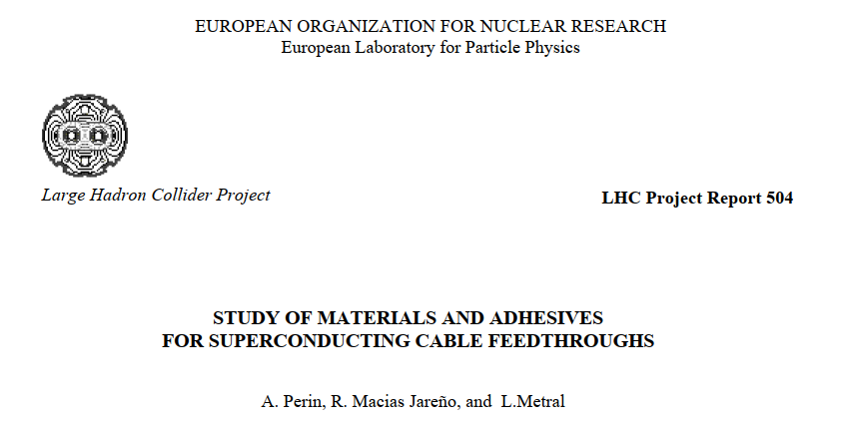
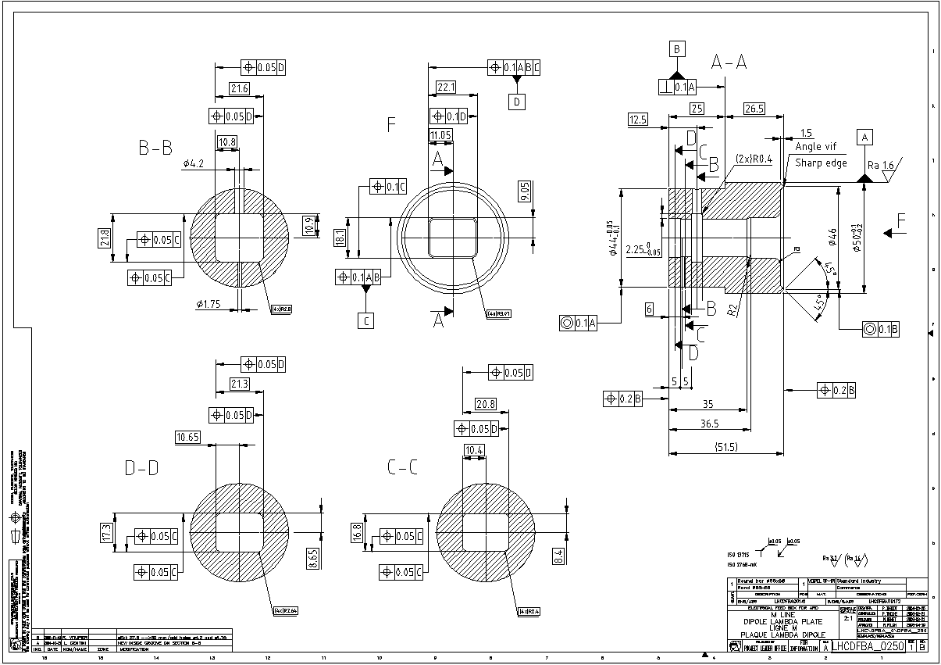
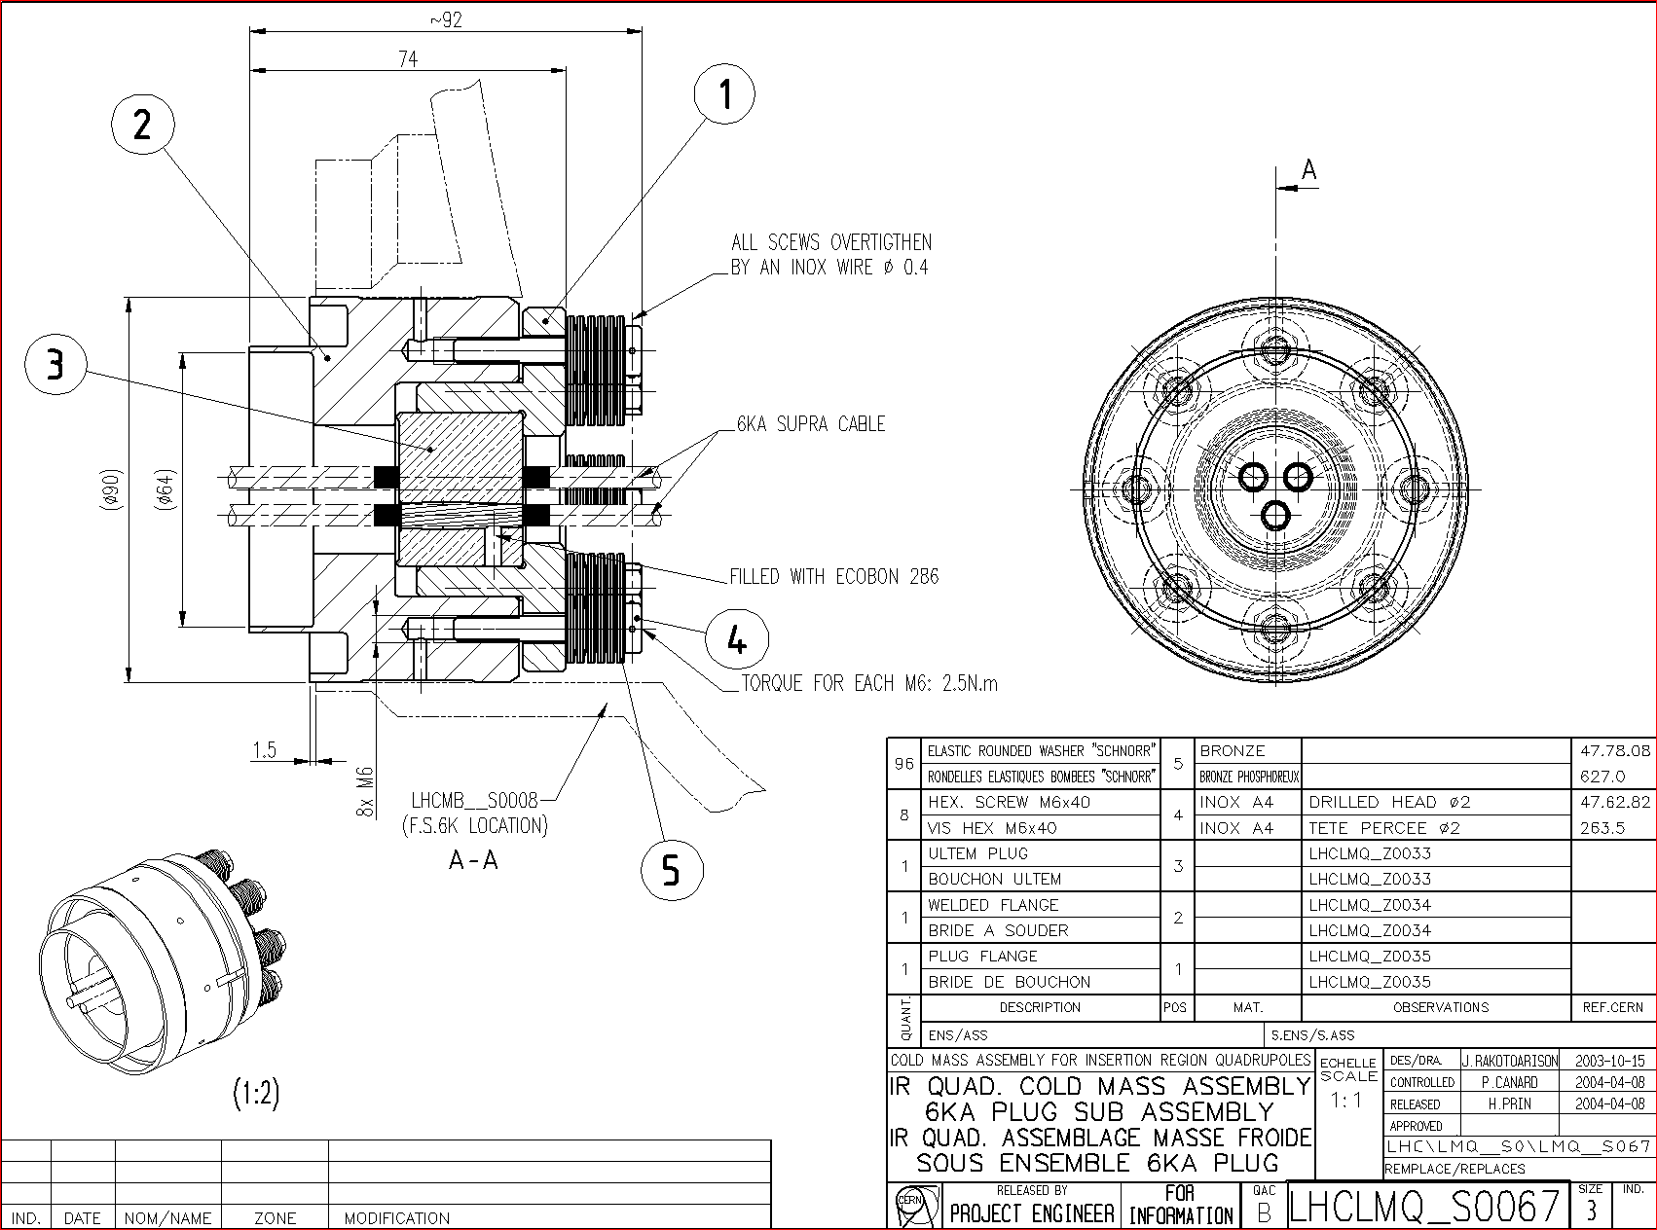
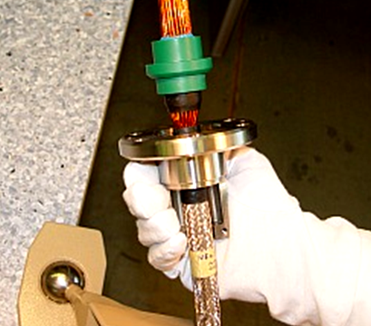
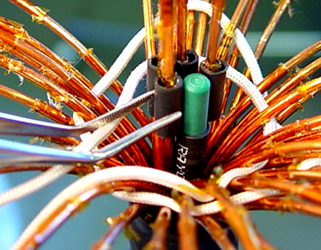
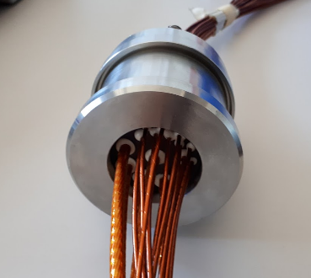
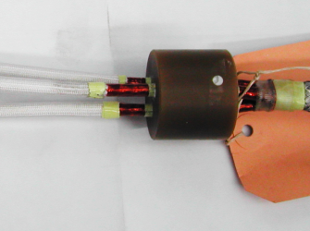
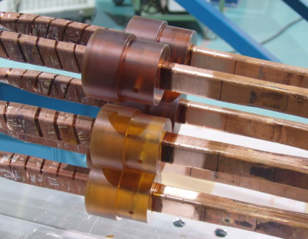
Infrastructure & Know-How
Procedures 6kA, 13kA & N line LHC plugs
Know-how from LHC experience
  Various plugs types and technologies
  Drawings, manufacturing procedure
  Qualification procedures
Drawings LHC plugs
Line N LHC plugs
6 kA LHC plugs
13 kA LHC plugs

Slide 5
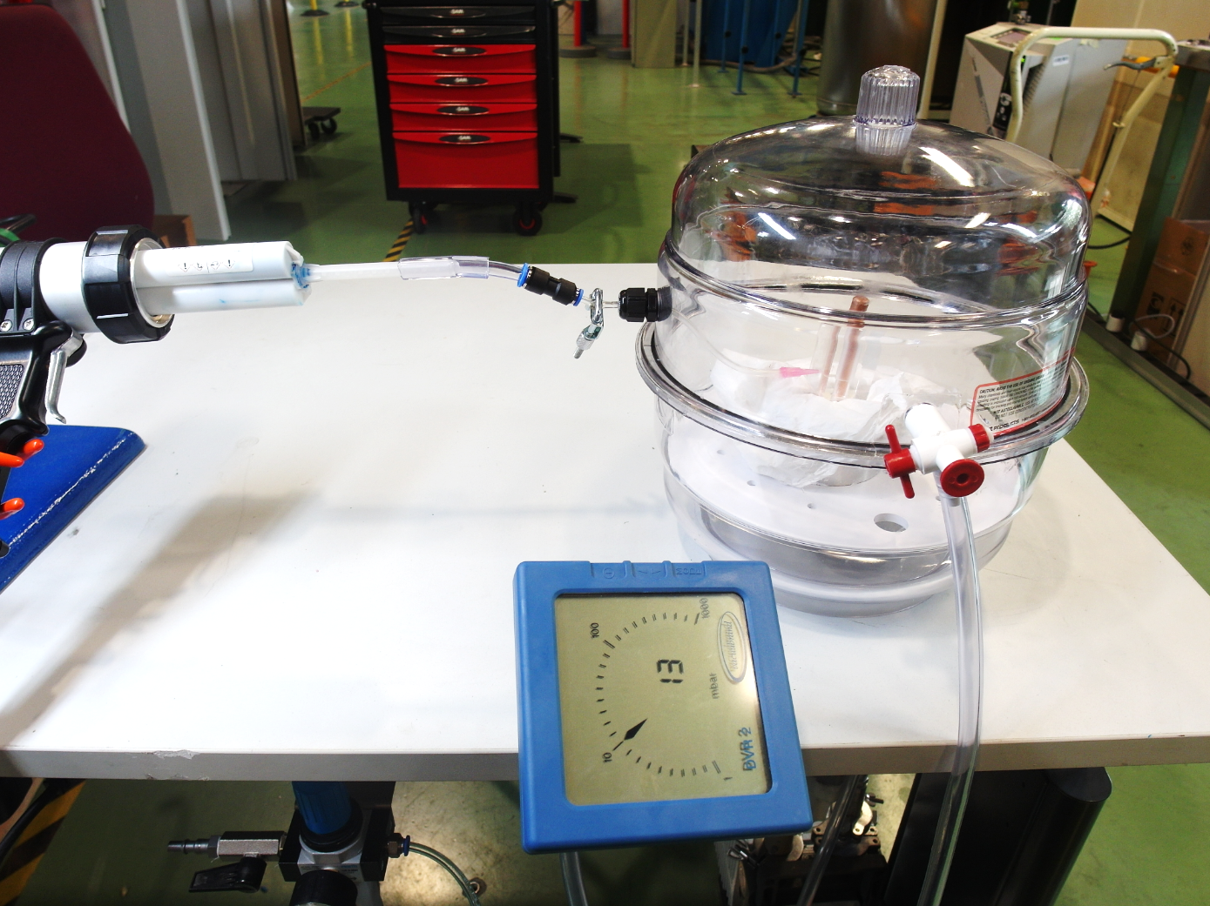
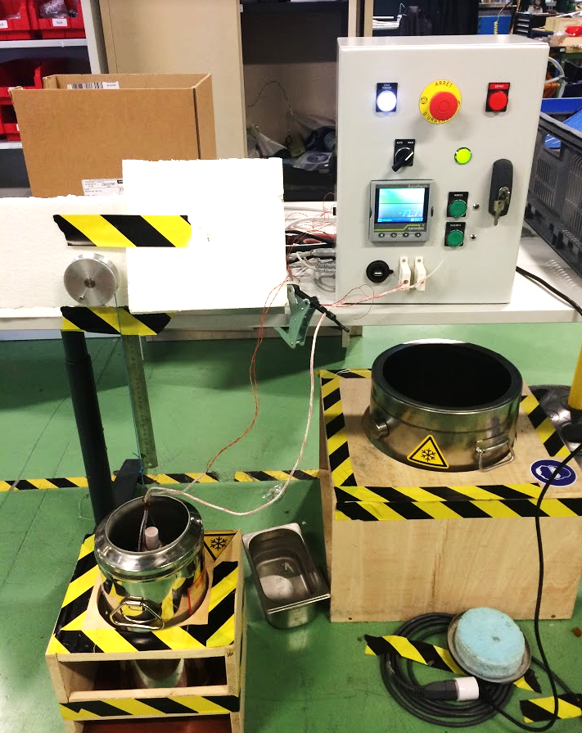
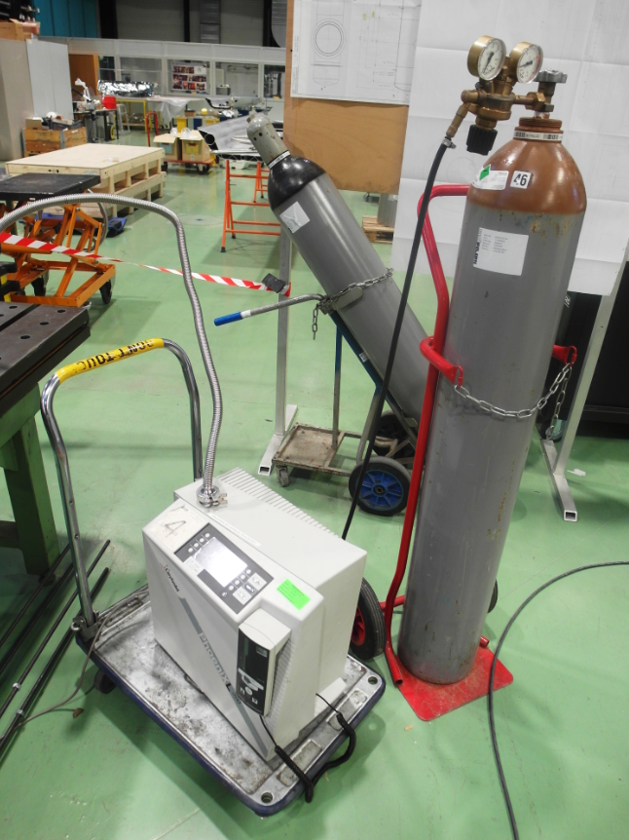
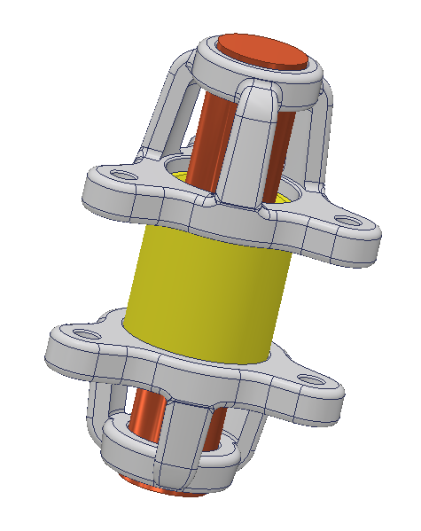
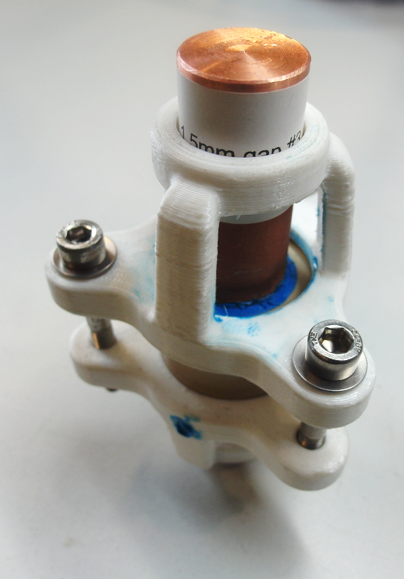
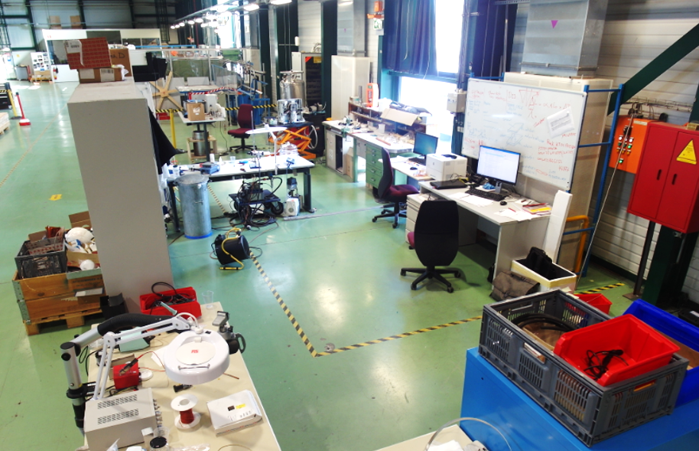
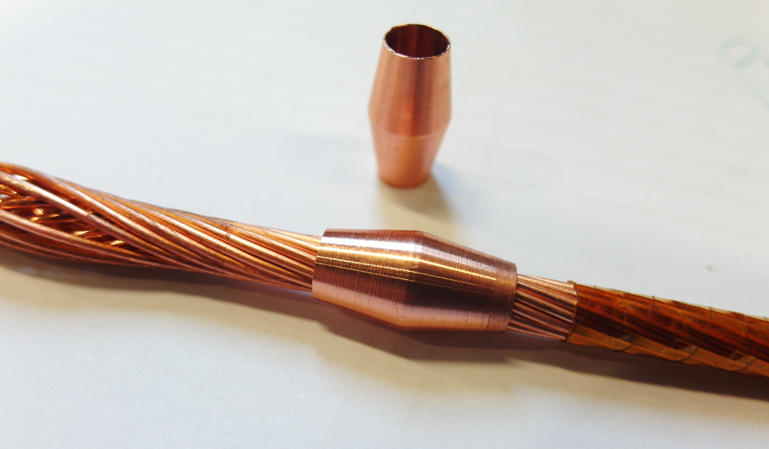
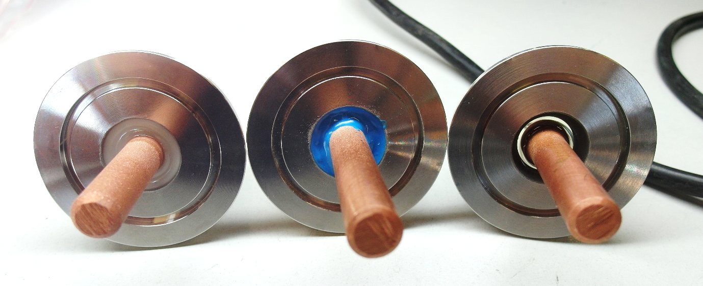
Infrastructure & know-how
Under vacuum glue injection
LN2 thermal cycling stand
Leak test equipment
Dedicated laboratory in SMI2
  Tooling & plug design area
  Preparation area
  Injection area
  Qualification area
Train staff on LHC type plugs
  Design & manufacturing of tooling/plug
  Optimisation of manufacturing & QA procedures
Some plugs developed at SMI2
Plug & tooling design
Interfaces optimisation samples
13kA LHC type plug
R&D on plug technology
SMI2 Plug lab
Cable preparation
Testing of various glues, polymers
6kA LHC type plug
MY750 Eccobond Araldite

Slide 6
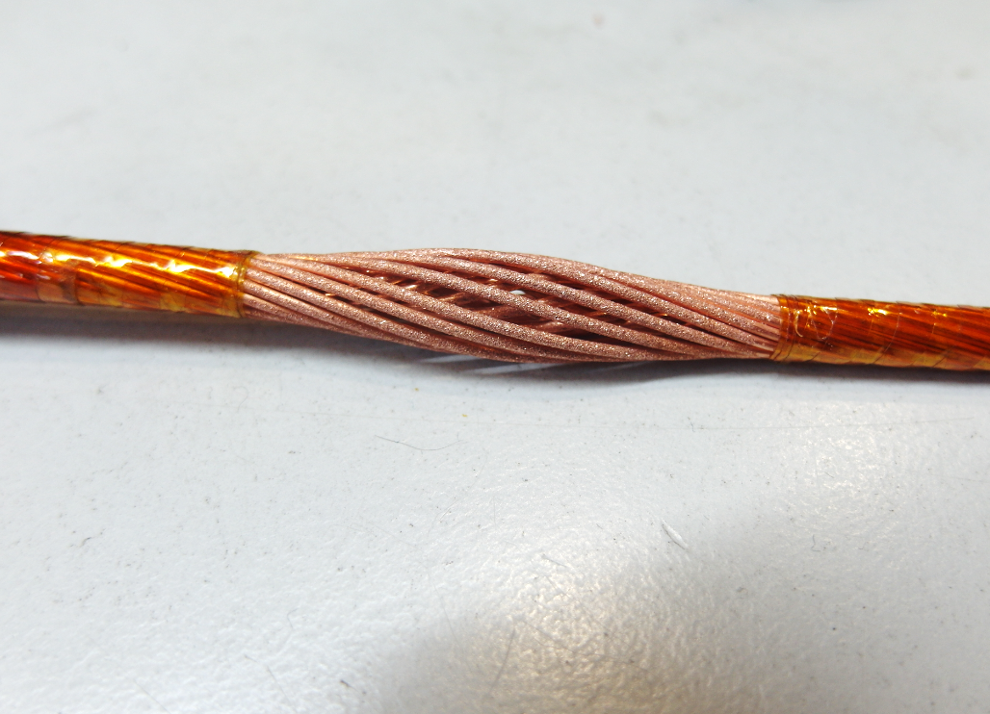
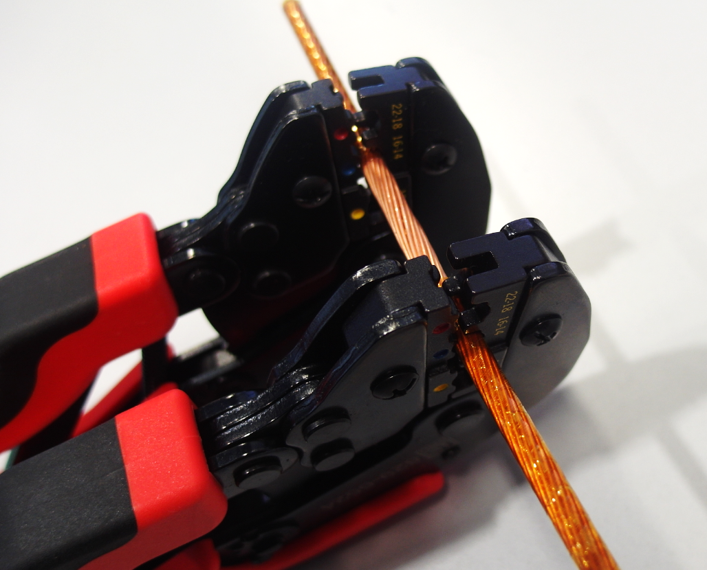
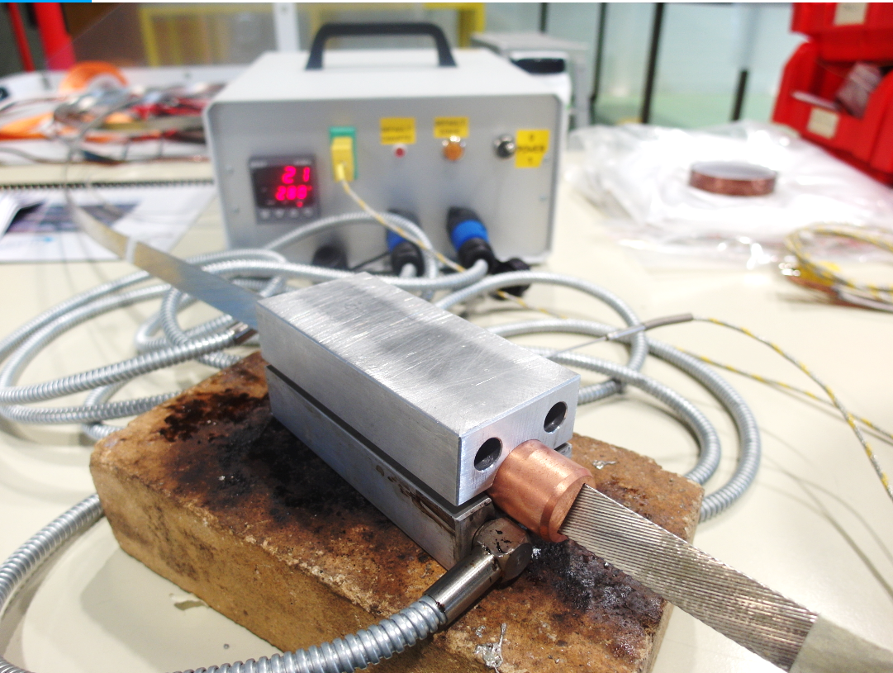
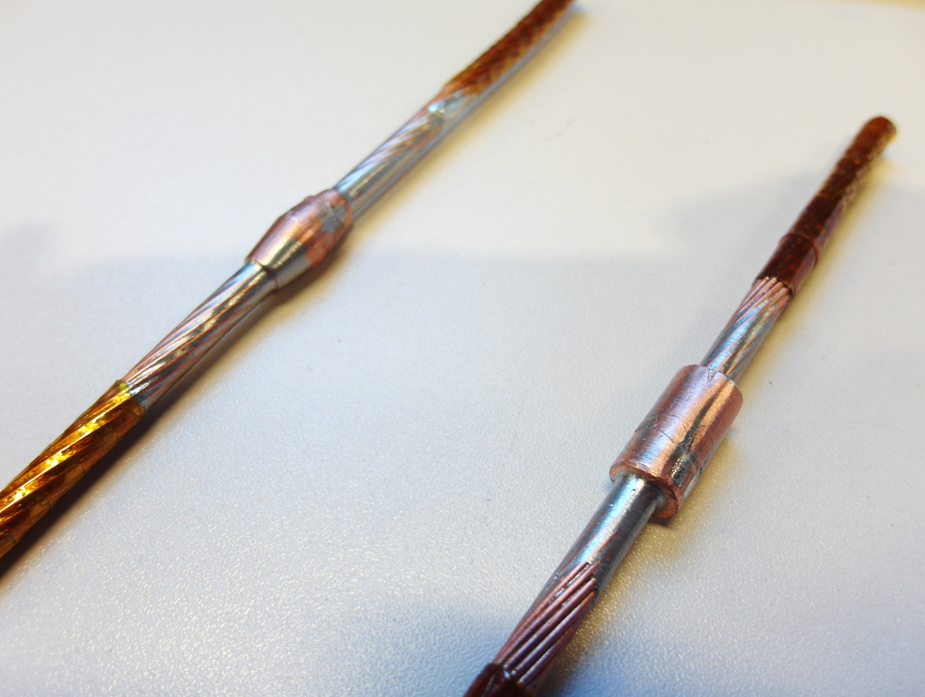
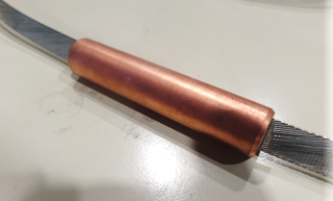
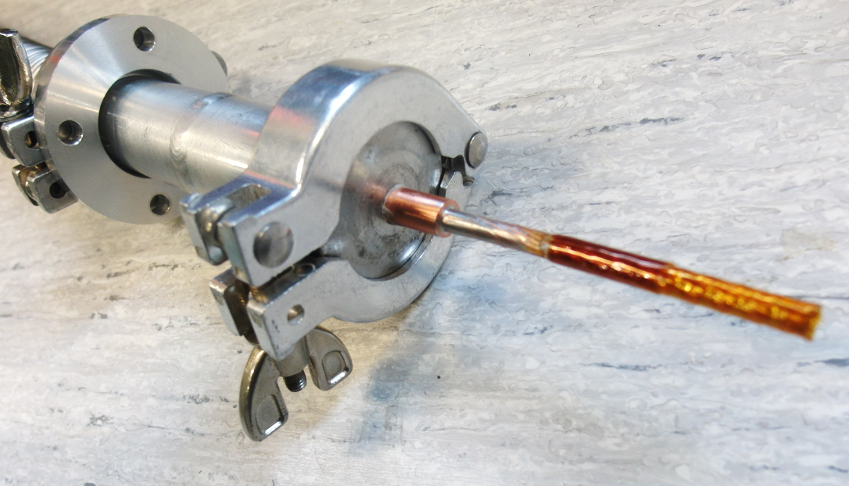
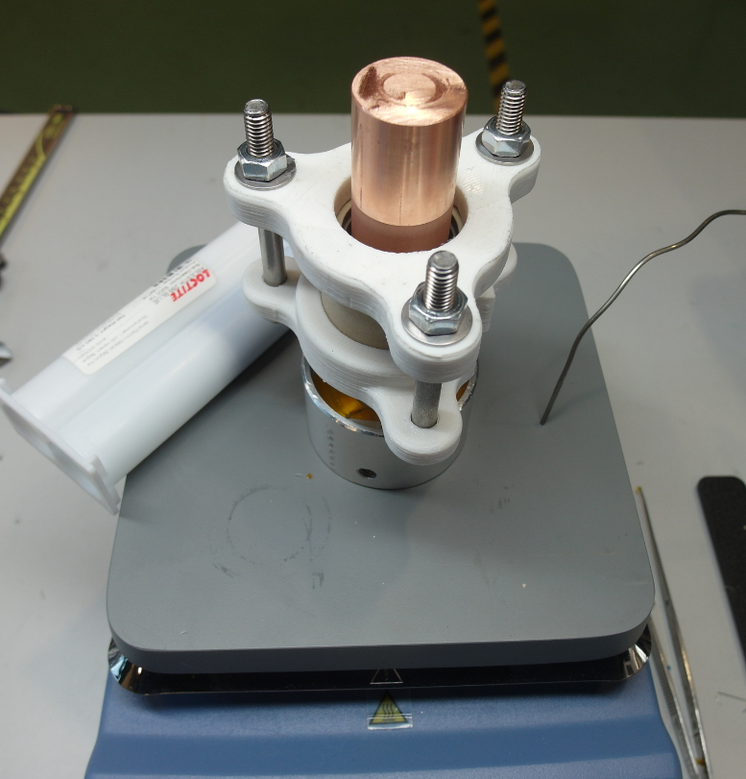
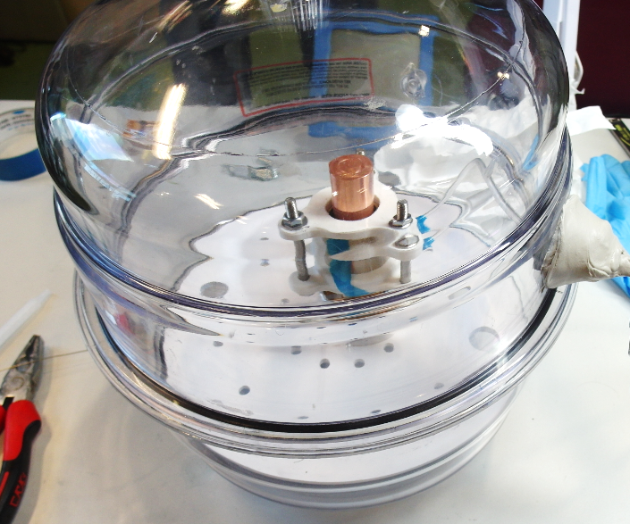
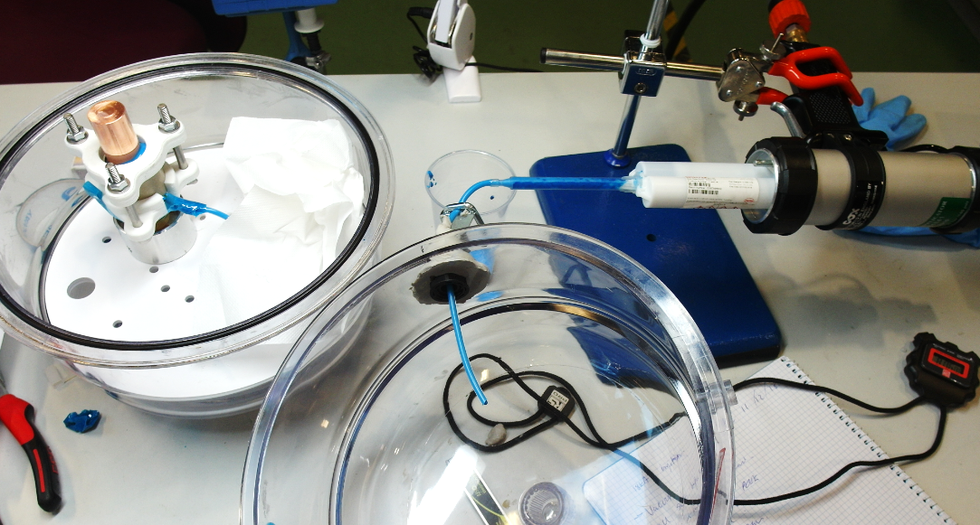
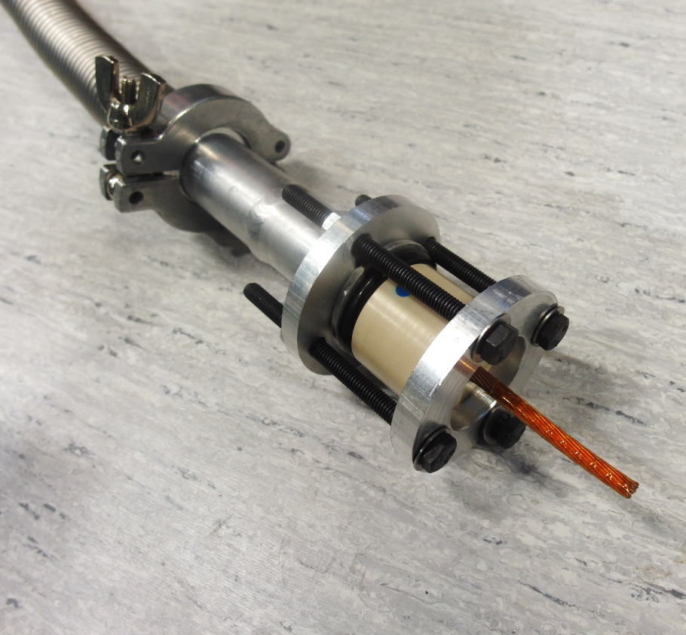
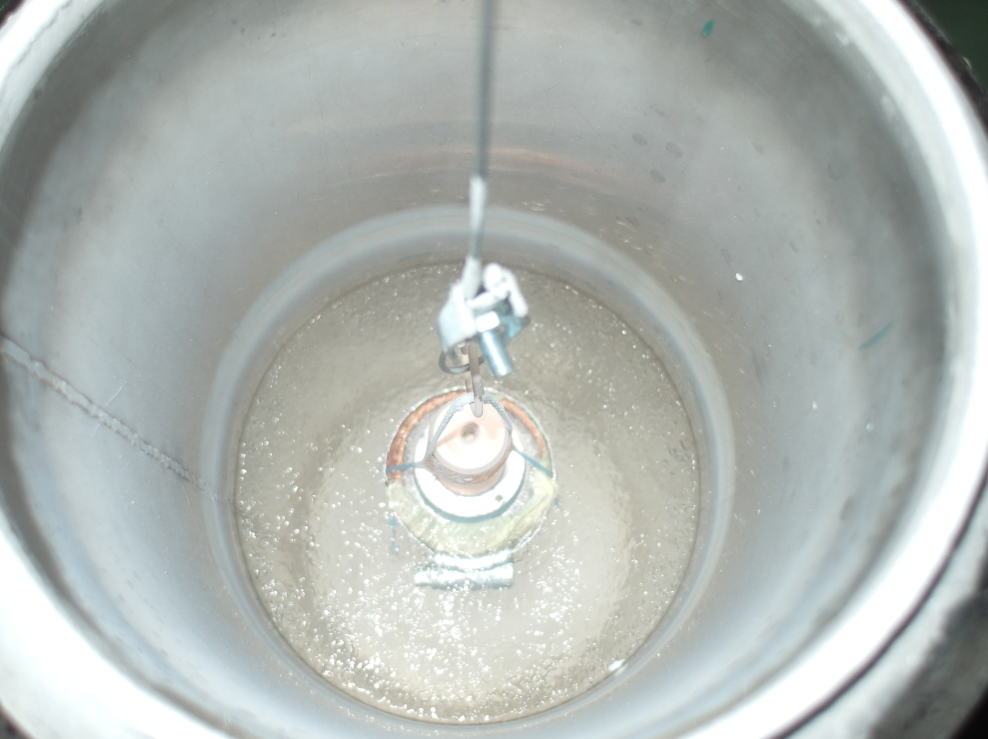
Plug general manufacturing & qualification procedure
Plug Cable preparation
Soldering into copper structure
  (if required)
QA: leak test of soldered cable
Surfaces preparation for gluing
  Sand blasting, plasma treatment
Parts preparation
  Warm up & degassing
Glue injection under vacuum
QA: leak test @ ambient temperature
QA: thermal cycling in LN2
QA: final pressure and leak test tests
Cable preparation
Soldering cable to copper
QA test for solder qualification
Parts warm up
Parts Degassing
Glue injection under vacuum
Glue tightness qualification
Thermal cycling in LN2

Slide 7
Schedule & plan
2018 |  |  |  | 2019 |  |  |  | 2020 | 2021
Q1 | Q2 | Q3 | Q4 | Q1 | Q2 | Q3 | Q4
Equip Laboratory, Know-How & define procedures
Bus bars definition
Plug layout proposal
Manufacture demonstrator
Plug Design Review
Prototype manufacturing & qualification
Available for assembly in prototype test
Series production (@ SMI2 ; 4 + 4 spares)

Slide 8
Spare slides

