Slide 1







Busbars for Q1 to D1 magnets
H. Prin, E. Todesco (CERN)
L. Bottura, Y. Leclercq, D. Duarte Ramos, M. Baldini, M. Methnik, R. Principe
31 January 2019 - Geneve

Slide 2
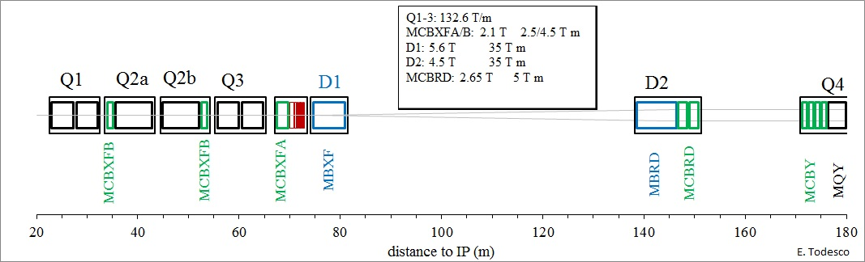
OVERVIEW
Busbar system for Q1 to D1 magnets linked to DFX
  Q1/Q2/Q3 18 kA (one) main circuit
  Q1/Q2/Q3 (three) trims
  D1 circuit (one)
  MCBXFA/B 2 kA circuit (six)
    Above quantities are per IP side
  Note that the so called « 2 kA » will never see more than 1.75 kA

Slide 3
PROTECTION STRATEGY
Energy extraction were removed long time ago (2015) with the exception of MCBXFA
18 kA
  In case of quench detection in a magnet, the whole string of magnets is quenched via CLIQ and outer layer heaters
  In case of quench detection in a busbar, the whole string of magnets is quenched via CLIQ and outer layer heaters
13 kA
  In case of quench detection in D1, the magnet is quenched via outer layer heaters
  In case of quench detection in D1 busbar, the magnet is quenched via outer layer heaters
2 kA
  In case of MCBXFB quench, the magnet is protected via energy extraction on the crowbar and via quench propagation in the magnet. We assume a 30 mΩ crowbar.
  In case of quench of the MCBXFB busbar or magnet lead, the busbar or magnet lead is protected via energy extraction on the crowbar.
  In case of MCBXFA quench, the magnet is protected via energy extraction on a 0.3 Ω external dump resistor.
  In case of quench of the MCBXFA busbar of magnet lead, the busbar or the magnet lead are protected via energy extraction on a 0.3 Ω external dump resistor.

Slide 4
SPECIFICATION
Most relevant numbers
  Quench load given by protection strategy (not including detection)
  Temperature margin : 5 K
  Hotspot: 150 K
Parameter | (units) | Triplet | D1 | MCBXFA/B
Design current | (kA) | 18.0 | 13.0 | 1.73
Operating temperature | (K) | 1.9 | 1.9 | 1.9
Quench integral | (MA² s) | 30 | 29 | 0.27/6.0
Equivalent time constant | (s) | 0.17 | 0.35 | 0.17/4.0
Minimum temperature margin | (K) | 5 | 5 | 5
Voltage test: RT at acceptance¹ | (V) | 4600 | 4000 | 4600
Voltage test: RT in the cold mass² | (V) | 3800 | 2800 | 3700
Test voltage at 1.9 K | (V) | 1900 | 1400 | 2300
Maximum leakage current | (mA) | 10 | 10 | 10
Joint resistance (per joint) | (nW) | 1 | 1 | 3
Maximum hot spot temperature | (K) | 150 | 150 | 150
Maximum dI/dt | (kA/s) | 90 | 36 | 15
Number of thermal cycles | (-) | 50 | 50 | 50
Number of triplet magnet quenches | (-) | 150 | 150 | 150
Maximum envelope internal busbars | (mm x mm) | 30×30³ 19×8.2⁴ | NA | NA
Maximum envelope round busbars (diameter) | (mm) | 45 Ø⁵ 15 Ø⁶ | 10 | 5
Minimum curvature radius magnet leads | (mm) | 50 | 50 | 50
Minimum curvature radius round busbars | (mm) | 70 | 70 | 50
Thermal shrinkage (from RT to operation) | (%) | 0.3 | 0.3 | 0.3

Slide 5
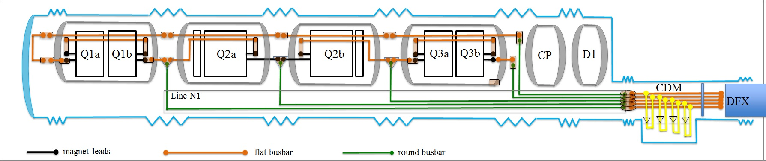
CONCEPTUAL DESIGN
Main circuit and 18 kA trims
  Magnet leads in Nb-Ti
  One internal busbar going through Q1 Q2 Q3 based on flat cable
  Round cable for trims
  Flat cable for CDM (Cold Diode Module) and passage through lambda plate
  Trims in the N1 line
  Passage through D1 and CP avoided through the N line also for the main
  End return module to avoid breaking symmetry between Q1 and Q3

Slide 6
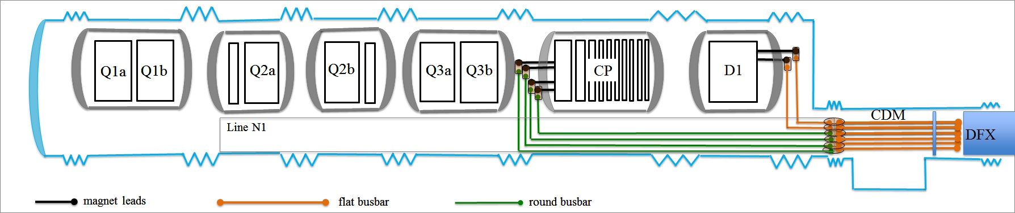
CONCEPTUAL DESIGN
12 kA circuit
  Magnet leads in Nb-Ti
  Same cable for magnet leads, busbars going out of the cold mass, and through CDM

Slide 7
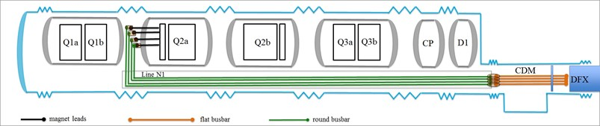
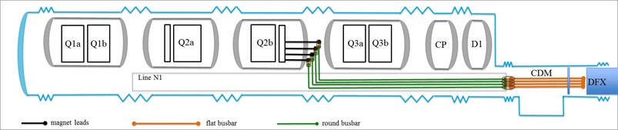
CONCEPTUAL DESIGN
2 kA circuit MCBXFB
  No need of internal busbar
  Magnet leads (flat cable)
  Round busbar in the N line

Slide 8
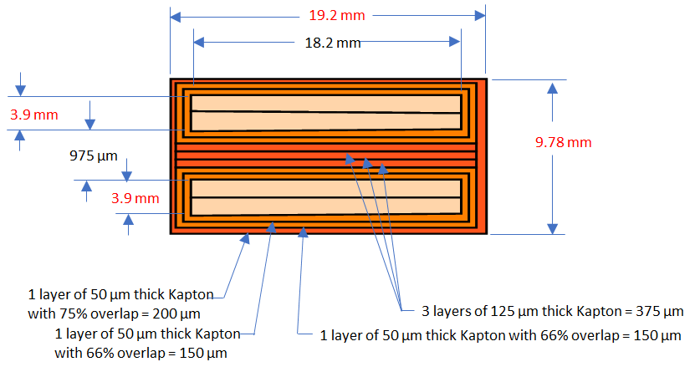
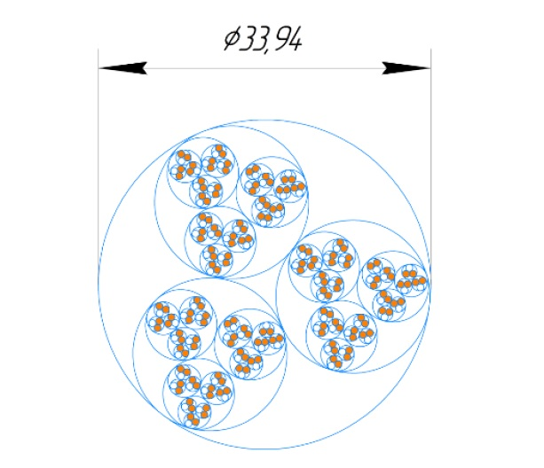
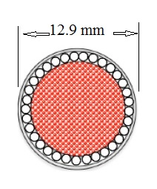
PROPOSAL
18 kA flat busbar
  Double cable of magnet lead
18 kA round busbar
  Under development in VKINP
  Two options
18 kA internal busbar (M. Baldini et al.)
Type | N. Strands | Strand dimension | Cu/no_Cu | Cu surf. | Sc surf.
 | (adim) | (mm) | (adim) | (mm²) | (mm²)
18 kA flat busbar | 17×2×2 | 1.065¹ | 1.65 | 22.8 | 37.7
Needed |  |  |  | 33 | 12
Option 1 (V. Vitaly et al.)
Option 2 (L. Bottura)
Type | N. Strands | Strand dimension | Cu/no_Cu | Cu surf. | Sc surf.
 | (adim) | (mm) | (adim) | (mm²) | (mm²)
18 kA round busbar option 1 | 36 72 | 1.065 1.065 | 1.65 ∞ | 20 64 | 12
18 kA round busbar option 2 | 34 1 | 1.065 10.37 | 1.65 ∞ | 19 83 | 11.5
Needed |  |  |  | 33 | 12

Slide 9
PROPOSAL
13 kA flat busbar
  Nb-Ti cable with 1.5 mm thick copper conductor, same width
2 kA flat busbar
  Nb-Ti cable with 1.5 mm thick copper conductor, same width
2 kA round busbar
  The 6 kA of the LHC is ok
Type | N. Strands | Strand dimension | Cu/no_Cu | Cu surf. | Sc surf.
 | (adim) | (mm) | (adim) | (mm²) | (mm²)
13 kA flat busbar - Double cable | 18×2×2 | 0.825 | 1.95 | 51 | 13
13 kA flat busbar – Single cable plus Cu | 18×2 Cu | 0.825 15.1×1.5 | 1.95 ∞ | 25.4 22 | 6.5 0
Needed |  |  |  | 28 | 7
Type | N. Strands | Strand dimension | Cu/no_Cu | Cu surf. | Sc surf.
 | (adim) | (mm) | (adim) | (mm²) | (mm²)
One 1.7 cable and one rectangular Cu cable | 9×2 (Nb-Ti) 1 (Cu) | 0.48¹ 4.35×1.5 | 1.75 ∞ | 2.08 6.5 | 1.18 0
Needed |  |  |  | 8 | 0.5
Type | N. Strands | Strand dimension | Cu/no_Cu | Cu surf. | Sc surf.
 | (adim) | (mm) | (adim) | (mm²) | (mm²)
LHC 6 kA round busbar | 11 (Nb-Ti) 9 (Cu) | 0.85¹ | 1.38 ∞ | 3.62 5.10 | 3.62 0
Needed |  |  |  | 8 | 0.5

Slide 10
CONCLUSIONS AND FUTURE ROADMAP
Specifications for the busbar are available
  Main parameters are 5 K temperature margin and 150 K maximum hotspot
Layout has been agreed
  Internal busbar only for the 18 kA
  18 kA trims will use the same busbar as the mains
Quantities and schedule are baselined
  The US AUP shall make the 18 kA internal busbar
Protection verified
  Three documents by M. Mentink on EDMS
    https://edms.cern.ch/document/2052319 (MQXF)
    https://edms.cern.ch/document/2052325 (MCBXF)
    https://edms.cern.ch/document/2061856/ (D1)
  Internal busbar for MQXF verified by M. Baldini
Next steps
  Cross-check of quench stopper in the full system
  Definition of splices between round and flat cables

