Slide 1
DFX Functional Specification
Y.Leclercq on behalf of the DF development team WP6a
31 Jan. 2019
Conceptual design review of the DFX

Slide 2
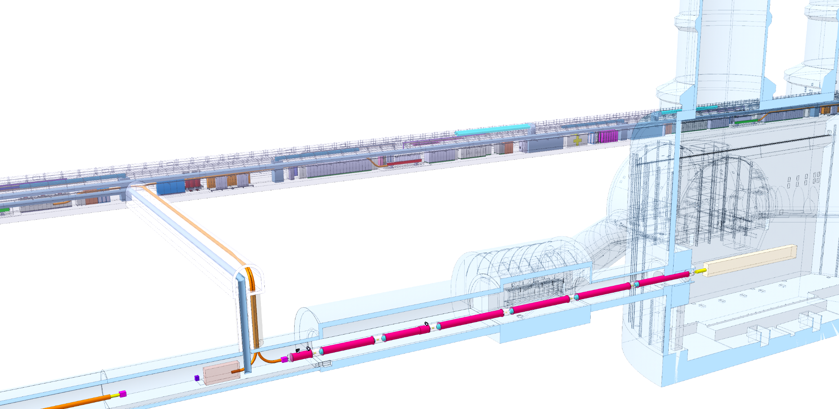
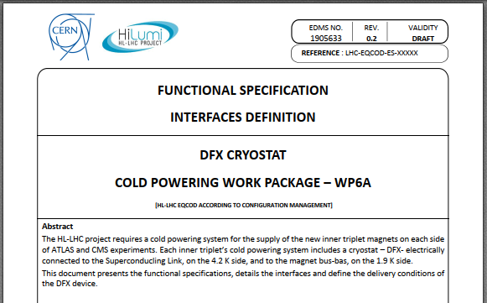
DFX in Cold Powering System
Each IP1 and IP5 sides equipped with a cold powering chains of cryostats
Triplet insertion : DFHx – SC Link (DSH) – DFX
DFX basic functions:
Electrical interface between SC Link and superconducting magnets
Supply cryogenics to the SCLink
System Interfaces
DFX functional specification and interface definition EDMS1905633
DFHx2
DFHx1
Power converters
Service tunnel
DSHx
Transverse tunnel
Q1
IP
≈50m
Q2b
Q2a
≈8m
Q3
D1
CP
≈45m
DFX
≈80m
LHC tunnel
DFX functional specification EDMS 1905633
DF system interfaces
Cryogenics
Triplet Magnet
Transport
Installation
Integration
DFX design
Maintenance
Insulation Vacuum
SCLink
Test

Slide 3
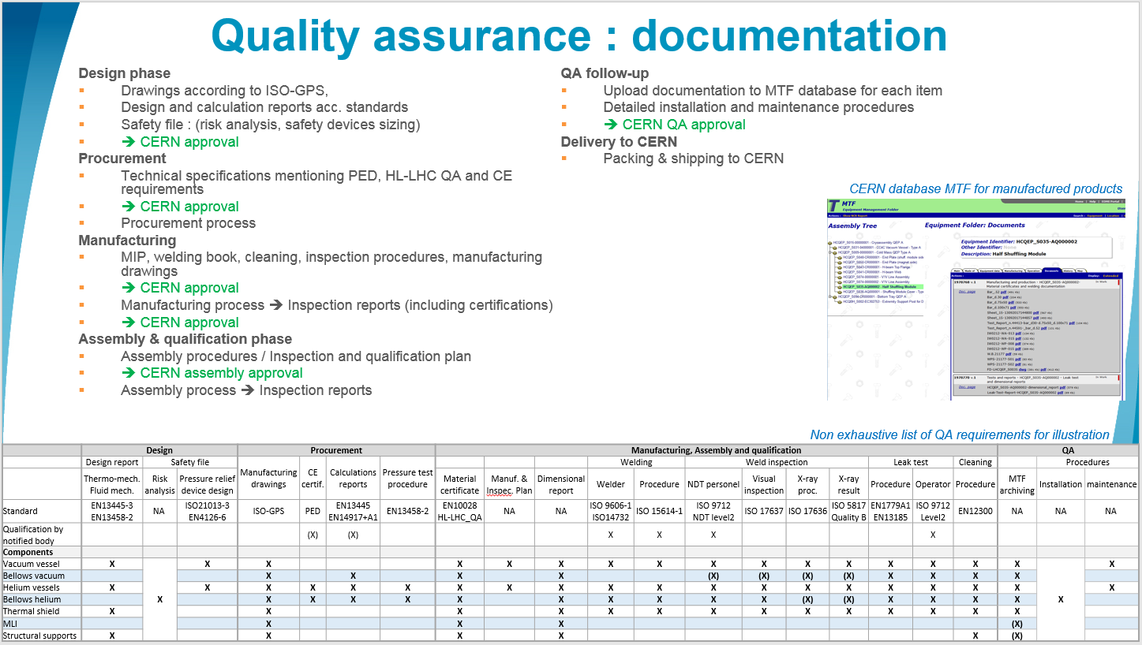
General requirements
DFX installed in LHC machine
  ➔ Comply with CERN rules
      CERN Safety Rules
      GSI-M-4 - Cryogenic equipment :
  ➔ European directives
      Pressure Equipment Directive 2014-68-EU
  ➔ HL-LHC QA requirements
      ALARA principle
      Material requirements
      Documentation & MTF
GSI-M4: “The manufacture […] by collaborating institutions, of all new cryogenic equipment shall comply with the applicable CERN Safety Rules, European directives and harmonised standards”.
HL-LHC documentation requirements
Details in spare slide

Slide 4
Electrical main specifications
DFX shall ensure the electrical connectivity between the SCLink and triplet cables
SCLink cables layout:
  MgB2 bus bars of the SCLink are pre-soldered to NbTi extentions
  MgB2-NbTi splices are protected
  Only NbTi extensions are accessible
Magnet cables layout:
  NbTi bus bars
Details on bus bars and layouts are presented in the “Bus bars” and “Plug” talks
The NbTi extensions shall be routed and connected to the NbTi bus coming out of from the plug (see dedicated talk for details)
Instrumentation shall be routed to feedthroughs on the vacuum vessel interface
Magnet
Rigid protection of MgB2-NbTi splices
DFX
SCLink
Splice
Plug
NbTi bus from Plug
NbTi bus from SCLink

Slide 5

Mechanical interfaces
SCLink mechanical interface
  Vacuum & helium jacket flanges fixed to DFX
  MgB2-NbTi splices contained in rigid protection
  Only NbTi extensions access the DFX He volume
Magnet mechanical interface
  Plug fixed to ground
  DFX fixed to He/vacuum interfaces with bellows
  Access to NbTi-NbTi splices granted during installation and maintenance
Cables thermal contractions
  NbTi-NbTi splices fixed to DFX He vessel
  DFX covers internal contractions
  DFX shall allow NbTi bus bars displacement
SCLink Vacuum Jacket flange
Bolted to DFX vacuum vessel
SCLink Helium Jacket flange
Welded to DFX He vessel
Ø 200
900 ?
MgB2-NbTi
rigid protection
NbTi
bus bars
Ø 180 ?
DFX
Magnet
SCLink
Plug

Slide 6
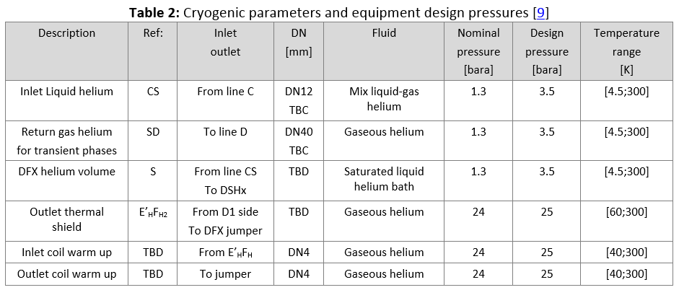
Cryogenics requirements
Dedicated presentations on:
  Cryogenic flow scheme
  Interface with Cryogenic equipment
  Operation boundaries
  Hardware & instrumentation
  Safety
DFX cryogenic principles
  NbTi cables & MgB2-NbTi splices shall be immersed in liquid helium
  The DFX shall produce up to 10 g.s⁻¹ gaseous helium mass flow to the SCLink helium volume
Cryogenic instrumentation shall be routed to the vacuum vessel interface
Access to valves and instrumentation shall be granted for inspection and maintenance
DFX
Magnet
SCLink
Plug
DFX functional specification

Slide 7
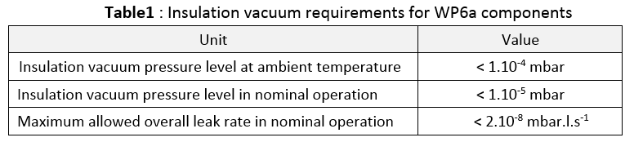
Insulation vacuum
The DFX insulation vacuum shall be compatible with the General WP6a insulation vacuum layout EDMS 2048016
The DFX insulation vacuum is independent to:
  Allow local maintenance & leak detection
  Minimise inter-dependence between helium volumes
DFX presents vacuum barriers with:
  The cryolines
  The SCLink
  The triplet cryostat
Interfaces:
  Standard type flanges with elastomer seal
  Ports for pumps and instrumentation
  Pressure relief plate
Unit | Value
Insulation vacuum pressure level at ambient temperature | < 1.10⁻⁴ mbar
Insulation vacuum pressure level in nominal operation | < 1.10⁻⁵ mbar
Maximum allowed overall leak rate in nominal operation | < 2.10⁻⁸ mbar.l.s⁻¹
Magnet
DFX
SCLink
Plug

Slide 8
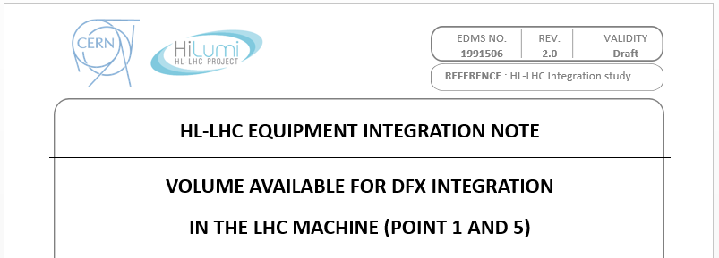
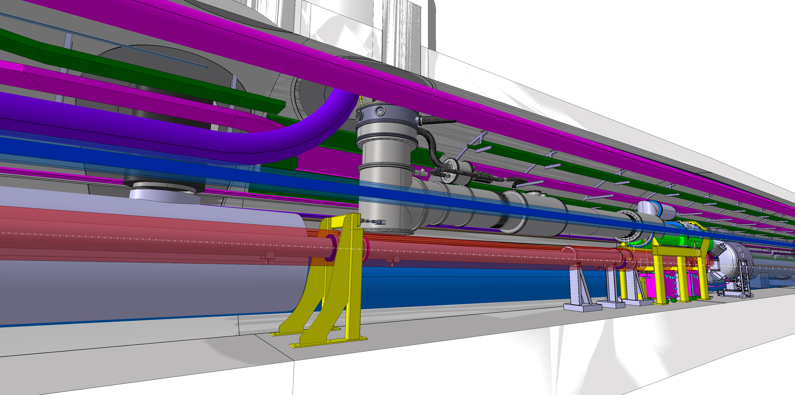
Integration specification
Dedicated talk from HL-LHC WP15
  Definition of volumes
  Environment
  Accessibility
EDMS 1991506
Conceptual DFX in integration model
Courtesy WP15 M.Gonzalez

Slide 9
Maintainability
Operations of maintenance shall be considered in the design from the ALARA point of view:
  Inspections of the instrumentation interfaces;
  Preventive maintenance of safety relief devices and vacuum equipment;
  Replacement of the plug, heater, instrumentation devices;
  Repair of Nb-Ti-Nb-Ti splices on the DFX side of the plug;
  Repair of the MgB2-Nb-Ti splices in situ.

Slide 10
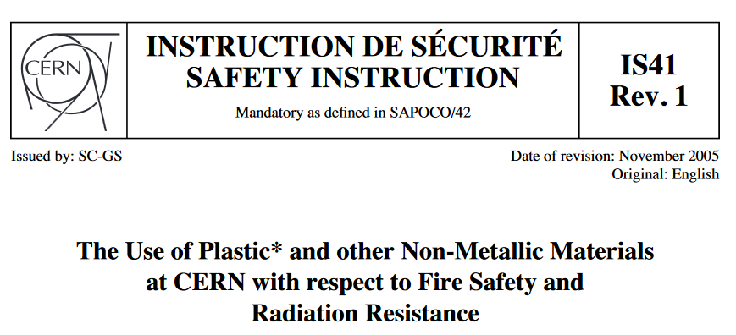
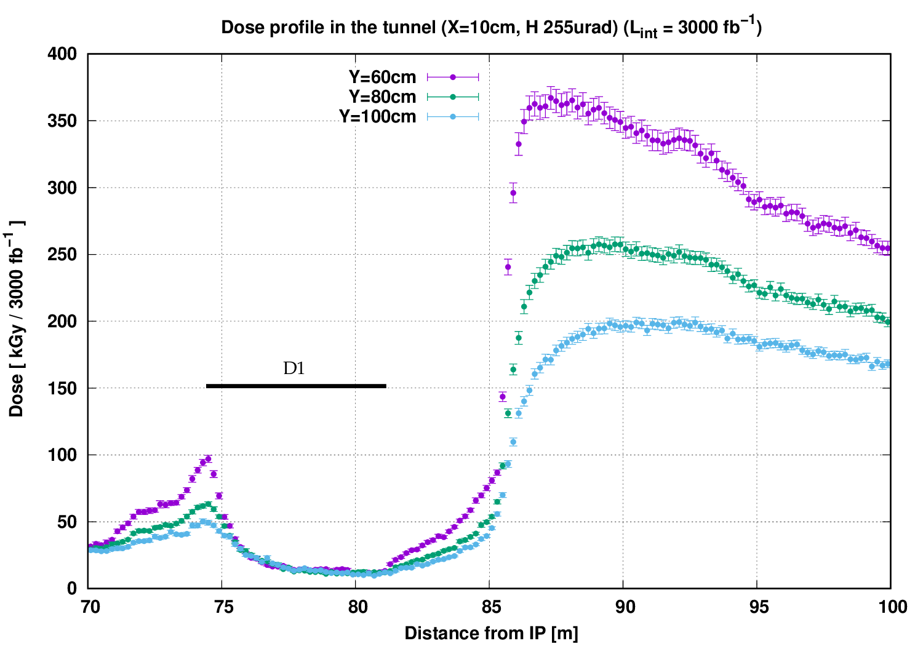
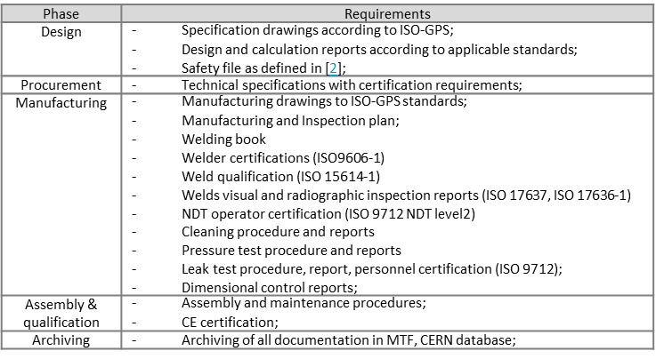
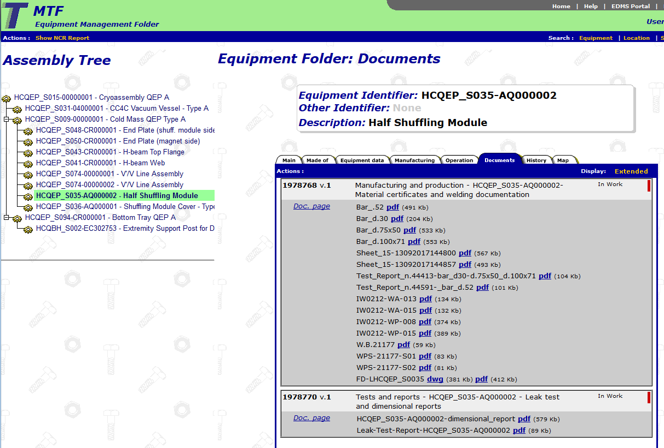
Manufacturing & Inspections
Manufacturing & Inspections according to
  Pressure Equipment Directive (PED)
  HL-LHC QA requirements (see spec)
Materials specific requirements:
  Compatible with Dose level over HL-LHC project period:
  Cobalt content for stainless steel < 0.1%
  Polymers according to IS41 EDMS335806
Inspections and certifications as for HL-LHC cryostat supplies
  Welding and welders
  Leak tightness level, procedure and operators
  Pressure testing according to PED
  COLD TEST ?
Documentation
  Manufacturing procedures & qualifications
  Inspection reports
  CE certification
  Upload into CERN database MTF
CERN database MTF for manufactured products

Slide 11
Spare slides

Slide 12
Quality assurance : documentation
Design phase
Drawings according to ISO-GPS,
Design and calculation reports acc. standards
Safety file : (risk analysis, safety devices sizing)
➔ CERN approval
Procurement
Technical specifications mentioning PED, HL-LHC QA and CE requirements
➔ CERN approval
Procurement process
Manufacturing
MIP, welding book, cleaning, inspection procedures, manufacturing drawings
➔ CERN approval
Manufacturing process ➔ Inspection reports (including certifications)
➔ CERN approval
Assembly & qualification phase
Assembly procedures / Inspection and qualification plan
➔ CERN assembly approval
Assembly process ➔ Inspection reports
QA follow-up
Upload documentation to MTF database for each item
Detailed installation and maintenance procedures
➔ CERN QA approval
Delivery to CERN
Packing & shipping to CERN
CERN database MTF for manufactured products
Non exhaustive list of QA requirements for illustration
 | Design |  |  | Procurement |  |  |  | Manufacturing, Assembly and qualification |  |  |  |  |  |  |  |  |  |  |  | QA
 | Design report | Safety file |  | Manufacturing drawings | CE certif. | Calculations reports | Pressure test procedure |  |  |  | Welding |  | Weld inspection |  |  |  | Leak test |  | Cleaning |  | Procedures
 | Thermo-mech. Fluid mech. | Risk analysis | Pressure relief device design |  |  |  |  | Material certificate | Manuf. & Inspec. Plan | Dimensional report | Welder | Procedure | NDT personel | Visual inspection | X-ray proc. | X-ray result | Procedure | Operator | Procedure | MTF archiving | Installation | maintenance
Standard | EN13445-3 EN13458-2 | NA | ISO21013-3 EN4126-6 | ISO-GPS | PED | EN13445 EN14917+A1 | EN13458-2 | EN10028 HL-LHC_QA | NA | NA | ISO 9606-1 ISO14732 | ISO 15614-1 | ISO 9712 NDT level2 | ISO 17637 | ISO 17636 | ISO 5817 Quality B | EN1779A1 EN13185 | ISO 9712 Level2 | EN12300 | NA | NA | NA
Qualification by notified body |  |  |  |  | (X) | (X) |  |  |  |  | X | X | X |  |  |  |  | X
Components
Vacuum vessel | X | X | X | X |  |  |  | X | X | X | X | X | X | X | X | X | X | X | X | X | X | X
Bellows vacuum |  |  |  | X |  | X |  | X |  | X |  |  | (X) | (X) | (X) | (X) | X | X | X | X
Helium vessels | X |  | X | X | X | X | X | X | X | X | X | X | X | X | X | X | X | X | X | X |  | X
Bellows helium |  |  |  | X | X | X | X | X |  | X | X | X | X | X | (X) | (X) | X | X | X | X
Thermal shield | X |  |  | X |  |  |  | X |  | X | X | X | X | X | X | X | X | X | X | X
MLI |  |  |  | X |  |  |  | X |  | X |  |  |  |  |  |  |  |  |  | (X)
Structural supports | X |  |  | X |  |  |  | X |  | X |  |  |  |  |  |  |  |  | X | (X)

Slide 13
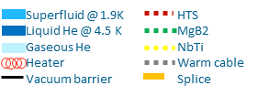
Cold powering system basic principle
CL
PC
DF
SCLink
DFH
Cryostat
LHC tunnel
UL
UR

