Slide 1

WP6a Master Plan, Key Milestones
Functional requirements
DFX Within WP6a System
DFX Conceptual Design Review, CERN, 31/01/2019

Slide 2
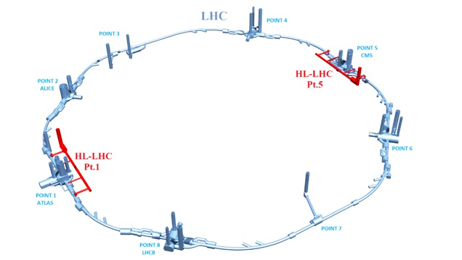
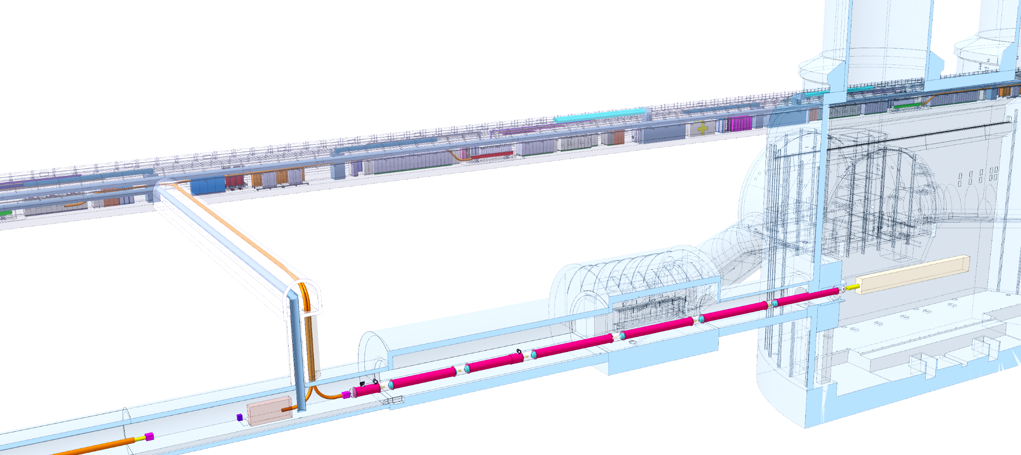
The HL-LHC Cold Powering (WP6a)
Four Cold Powering Systems
Two different types of Cold Powering Systems (one for the Triplets
and one for the Matching Sections
(D2 and its correctors)
Systems for ITs and MSs identical at P1 and P5
DFMI
DFXI
DFXJ
DFMJ
DFMJ
DFMI
DFXG
DFXF
Focus of this review is on the systems powering the Triplets

Slide 3
The HL-LHC Cold Powering (WP6a)
Cold powering system for HL-LHC Triplets:
One SC Link;
One DFX;
One DFHX;
- All current leads for Triplets;
- All required ancillary equipment.

Slide 4
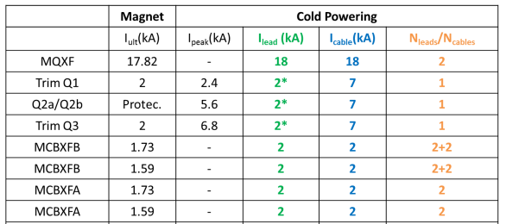
HL-LHC Triplets
EDMS 1821907
4× 18 kA
3× 7 kA
12 × 2 kA

Slide 5
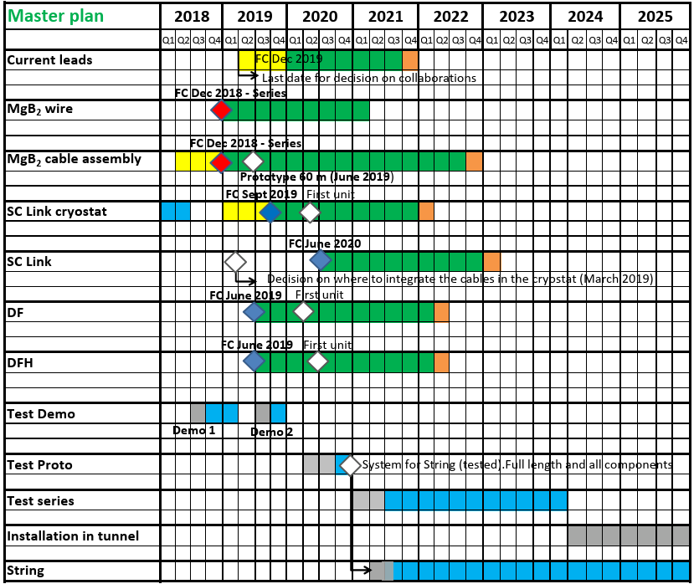


WP6a Master Plan
Series production: 2019-2021
System tests: 2018-2020
Series tests: 2021- 2023

Slide 6
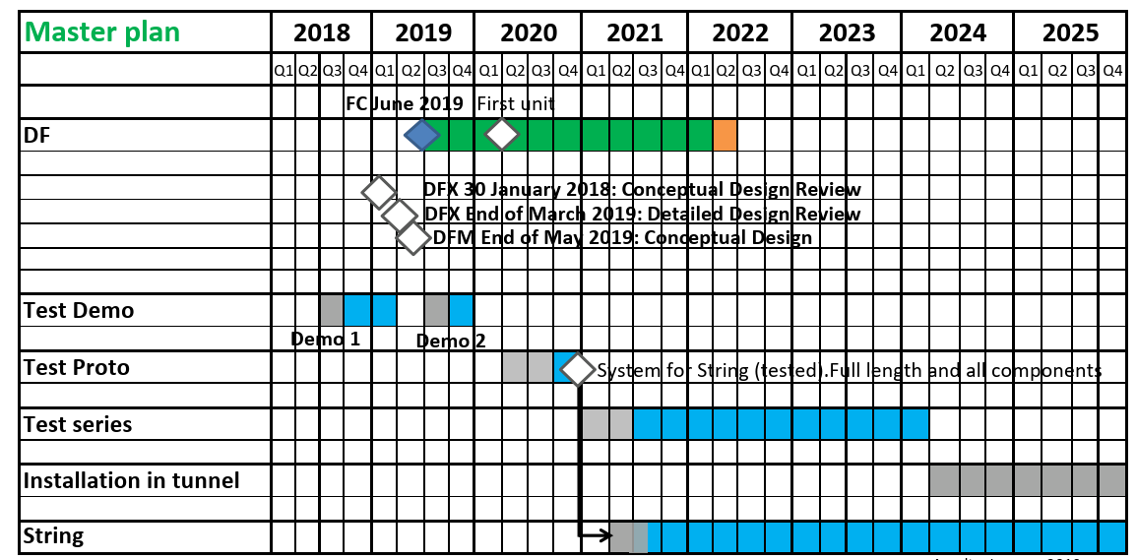
DFX in WP6a Master Plan

Slide 7
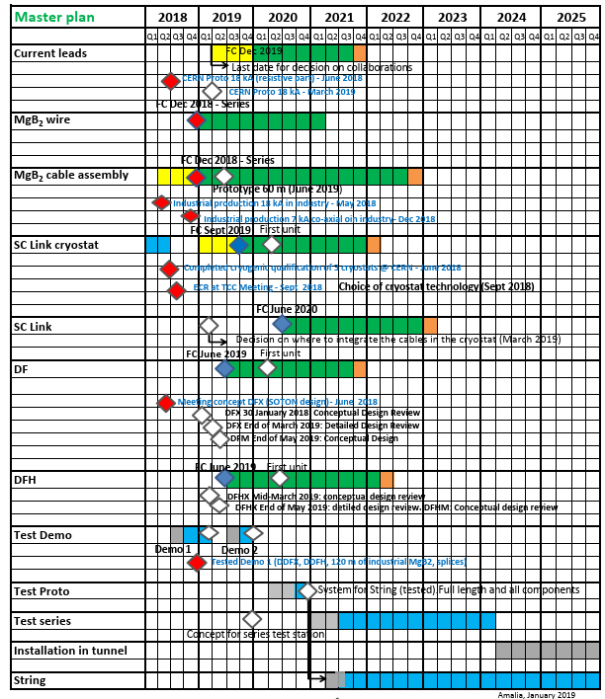
WP6a Key Milestones
Full-scale CERN proto 18 kA REBCO lead – March 2019
Series procurement MgB₂– FC Dec 2018
Series Cabling MgB₂ – FC Dec 2018
SC Link Cryostat technology (2-walls) – Sept 2018
Series SC Link Cryostat procurement – FC September 2019
Series SC Link assembly– FC Sept 2019
Prototype DFX – March 2019
Series DFX/DFM – FC June 2019
Prototype DFH – June 2020
Series DFH – FC June 2019
Demo 1 – Dec. 2018/ March 2019. Demo 2 – Dec. 2019
Prototype System – Dec. 2020
Series Test – June. 2021
String – June. 2021

Slide 8
DFX Functional Requirements
Interface to SC Link (mechanical, electrical)
Space requirements for SC Link
MgB₂ to Nb-Ti splices
Accessibility
Nb-Ti tail (attached to SC Link) feasibiliy

Slide 9
Thank you !

