Slide 1
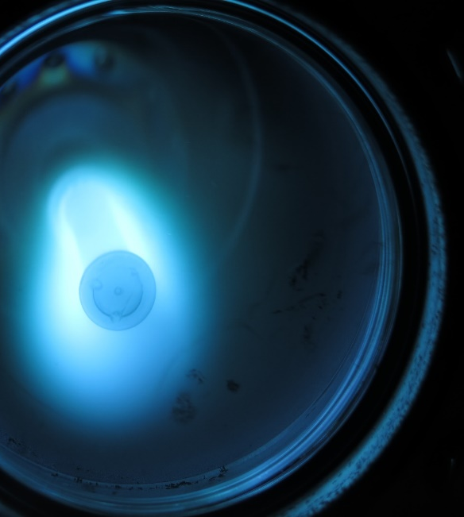


6 GHz cavities coating status
CERN-INFN-STFC Agreement N. KE2722/BE/FCC
Regular video meeting, 1st of February 2019

Slide 2
6 GHz cavities coating status
Very promising results → 4 Nb on Cu flat Q cavities coated

Slide 3
6 GHz cavities coating status
Very promising results → 4 Nb on Cu flat Q cavities coated
Reproducibility issue → Improvement of the surface quality is mandatory

Slide 4
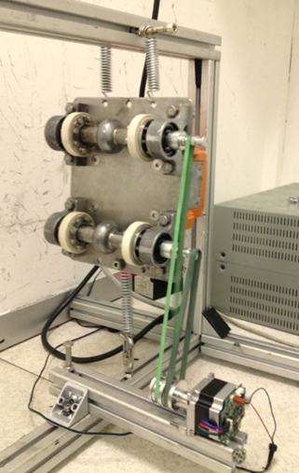
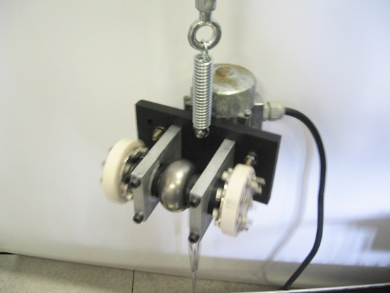
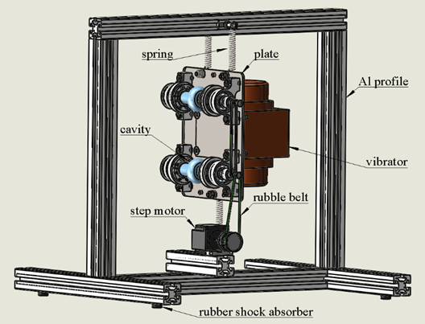
Vibro tumbling
Same concept of CBP, but vibration instead of rotation
Already explored at LNL in 2013
  High Removing Rate (around 6 µm/h)

Slide 5
Vibro tumbling
Same concept of CBP, but vibration instead of rotation
Already explored at LNL in 2013
  High Removing Rate (around 6 µm/h)
  Unstable system
  Low reproducibility
  Abbandoned technology

Slide 6
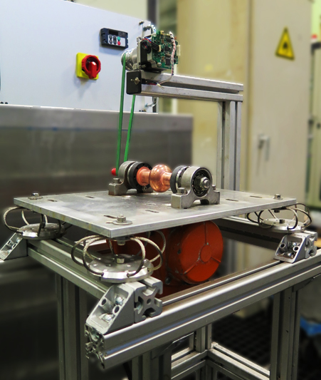
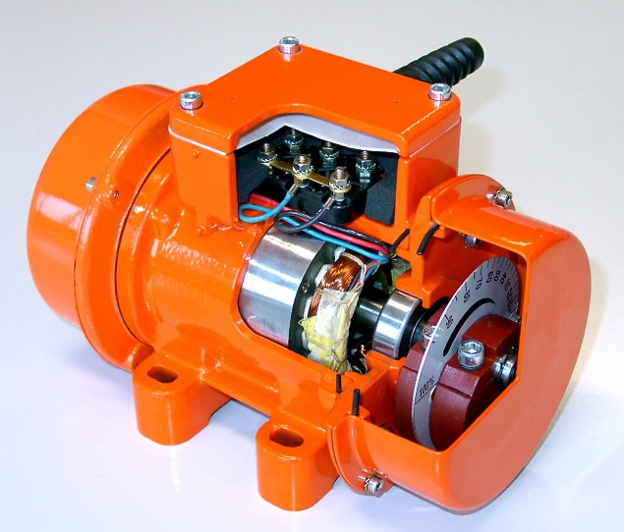
New LNL 6 GHz vibro tumbling
Unbalanced mass motor
Eccentric motor (vibration)

Slide 7
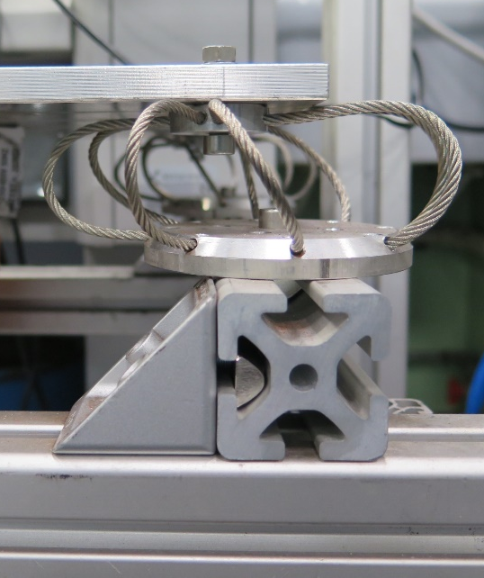
New LNL 6 GHz vibro tumbling
Steel wire rope shock absorber
Eccentric motor (vibration)

Slide 8
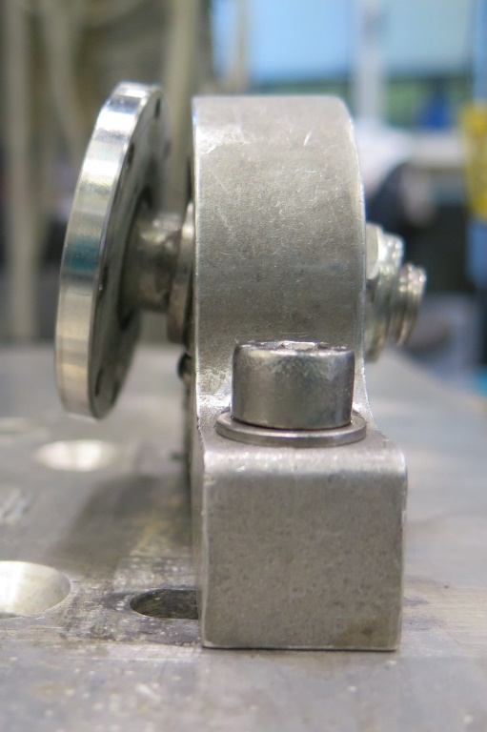
New LNL 6 GHz vibro tumbling
Self aligning bearing
Steel wire rope shock absorber
Eccentric motor (vibration)

Slide 9
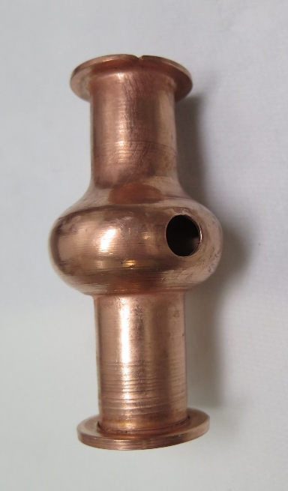
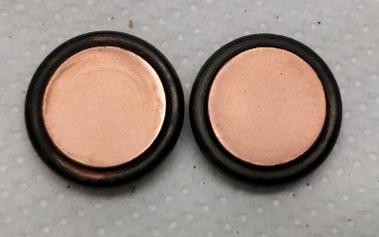
New LNL 6 GHz vibro tumbling
6 GHz cavity
Self aligning bearing
Test cavity
Steel wire rope shock absorber
Eccentric motor (vibration)
Coupons

Slide 10
New LNL 6 GHz vibro tumbling
Step motor (rotation)
6 GHz cavity
Self aligning bearing
Steel wire rope shock absorber
Eccentric motor (vibration)

Slide 11
New LNL 6 GHz vibro tumbling
Inverter
Step motor (rotation)
6 GHz cavity
Self aligning bearing
Steel wire rope shock absorber
Eccentric motor (vibration)

Slide 12
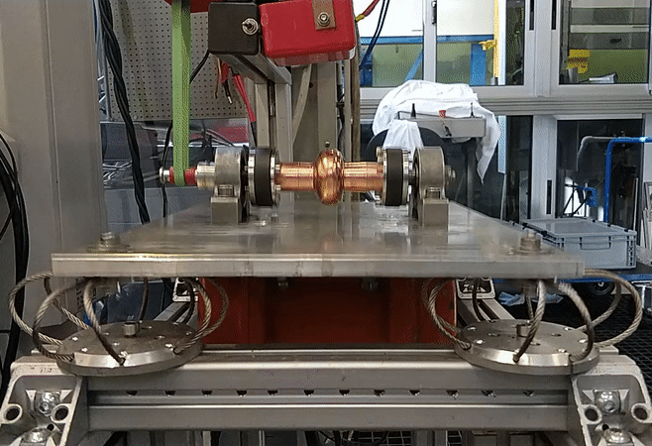
Vibro tumbling in action
Rotation
Vibration

Slide 13
Vibro tumbling parameters
Media
Volume
Frequency
Time
Temperature

Slide 14
Media explored on Cu cavities
BIG SIZE MEDIA
Allumina cones embedded in ureic resin → high RR
Stainless steel → high RR but contaminate and bend cavity
SiC → powder produced block the RR
ScotchBrite → low RR
Teflon balls → remove contaminants, but embedded in surface
POWDERS
Al₂O₃ → no effect
Si_{(am.)} and Si_{(crys.)} → no effect
Al → no effect
B₄C → no effect
ZrO₂ → no effect

Slide 15
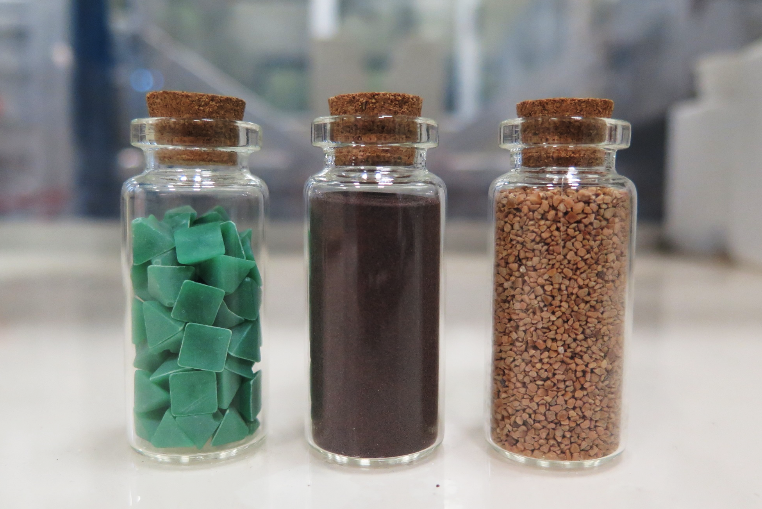
Cu working protocol (3 steps)
Al₂O₃ Piramids (Rosler RKG 6 PQ) + Rodastel30 (wet process)
Cu powder 200 mesh (dry process)
Coconut powder (dry process)

Slide 16
Cu working protocol (3 steps) – Removing Rates
Al₂O₃ Pyramids (Rosler RKG 6 PQ) + Rodastel30 (wet process)
High RR → ≈ 5 μm/h
Cu powder 200 mesh (dry process)
Polishing effect (remain powders on the surface) → ≈ 0,1 μm/h
Coconut powder (dry process)
Polishing effect (Cu powders removal effect) → ≈ 0,3 μm/h

Slide 17
Cu working protocol (3 steps) – Treatments time
Al₂O₃ Pyramids (Rosler RKG 6 PQ) + Rodastel30 (wet process)
> 2 h → foam production reduce RR and corrosion start (presence of H₃PO₄)
Cu powder 200 mesh (dry process)
> 2 hours → pitting starts (Why?)
Coconut powder (dry process)
2 hours

Slide 18
Volume of media
Influence surface quality and RR
Very important on Cu powders step

Slide 19
Temperature
overheating up to 90 ºC
~ 50 ºC
~ 30 ºC
Step 1 and 3 work at room temperature
Step 2 produce heating of the cavity → could be use to monitorize the polishing effect

Slide 20
Frequency effect
  Not fully explore yet
  Qualitative speaking, RR increase with frequency
  High and low frequency may damage the vibrotumbling system
  A good compromise is 200 Hz

Slide 21
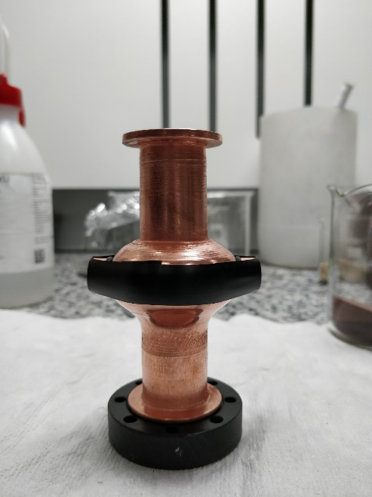

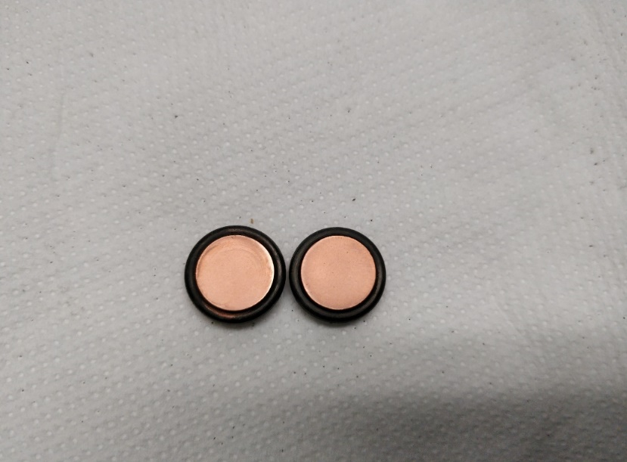
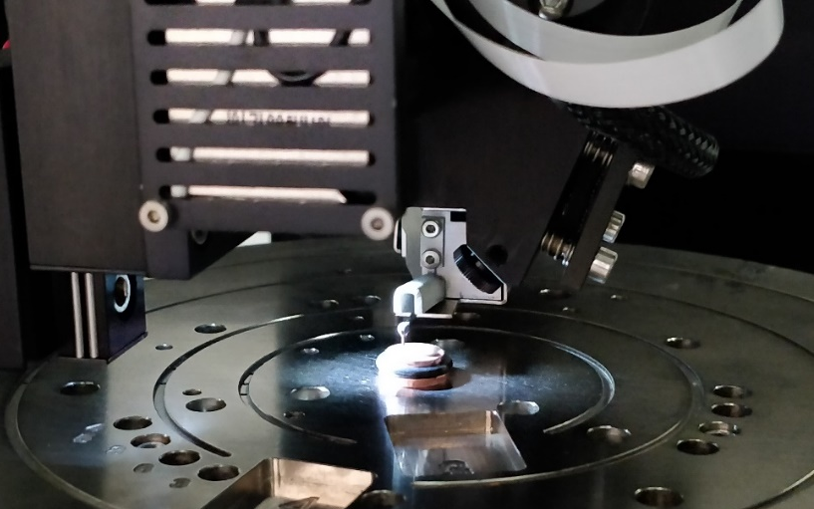
Results on Coupons
Test cavity with 2 coupons
Comparision with grinding polishing
Roughness characterizations

Slide 22
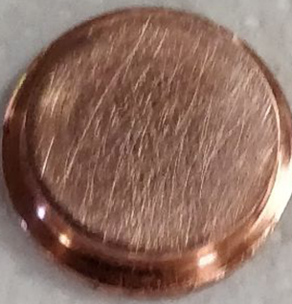
Vibro-Tumbling – Grinding comparision
Scratched
Ra
500 ± 60 nm

Slide 23
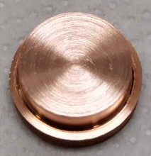
Vibro-Tumbling – Grinding comparision
Grinding
Scratched
550 ± 60 nm
Ra
500 ± 60 nm

Slide 24
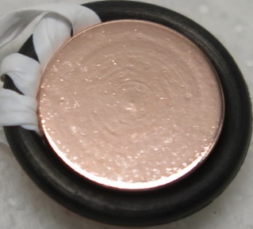
Vibro-Tumbling – Grinding comparision
SUBU5
Grinding
240 ± 60 nm
Scratched
550 ± 60 nm
Ra
500 ± 60 nm

Slide 25
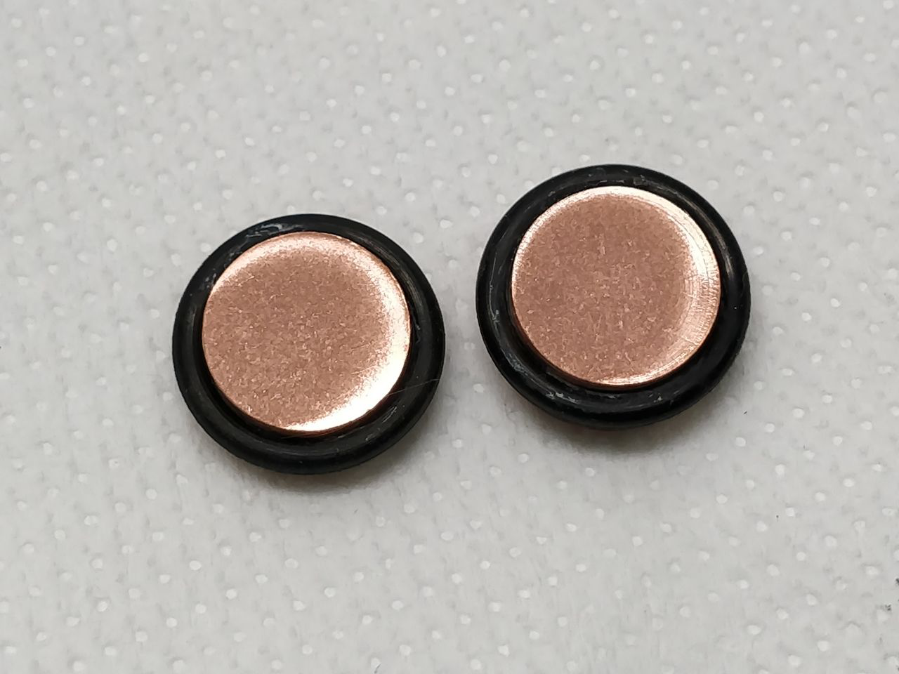
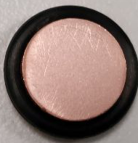
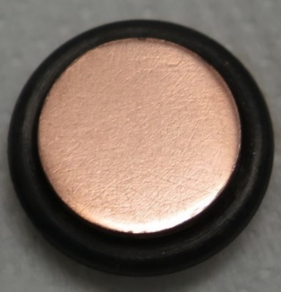
Vibro-Tumbling – Grinding comparision
SUBU5
Grinding
240 ± 60 nm
Scratched
550 ± 60 nm
Ra
500 ± 60 nm
VT Pyramids
VT Cu powders
VT Coconuts
520 ± 30 nm
380 ± 20 nm
290 ± 30 nm

Slide 26
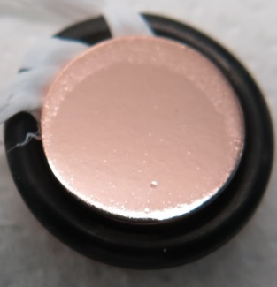
Vibro-Tumbling – Grinding comparision
SUBU5
Grinding
240 ± 60 nm
Scratched
550 ± 60 nm
Ra
500 ± 60 nm
VT Pyramids
VT Cu powders
VT Coconuts
SUBU5
520 ± 30 nm
380 ± 20 nm
290 ± 30 nm
100 ± 10 nm

Slide 27
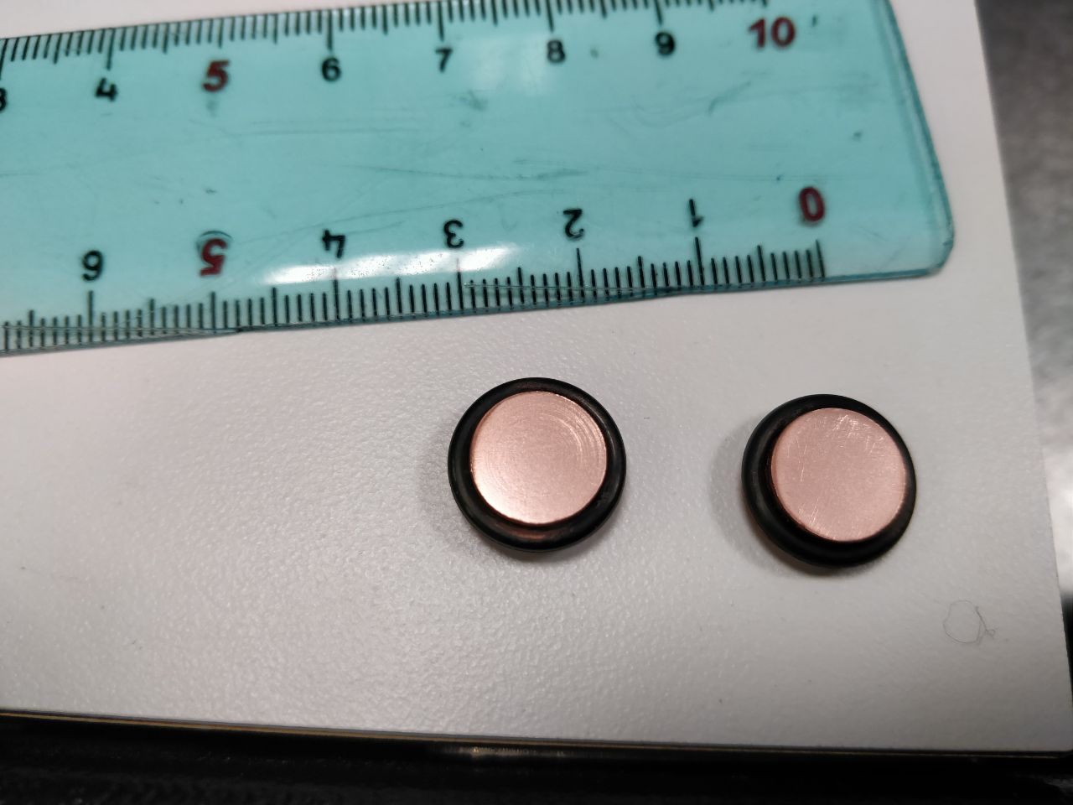
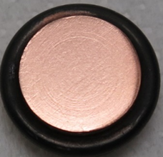
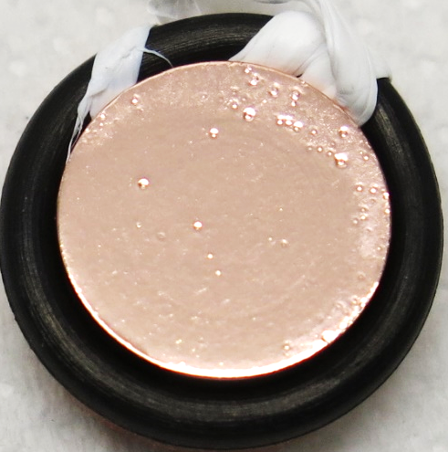
Vibro-Tumbling – Grinding comparision
SUBU5
Grinding
240 ± 60 nm
VT Pyramids
VT Cu powders
VT Coconuts
SUBU5
Scratched
550 ± 60 nm
510 ± 20 nm
400 ± 20 nm
330 ± 20 nm
220 ± 30 nm
Ra
500 ± 60 nm
VT Pyramids
VT Cu powders
VT Coconuts
SUBU5
520 ± 30 nm
380 ± 20 nm
290 ± 30 nm
100 ± 10 nm

Slide 28
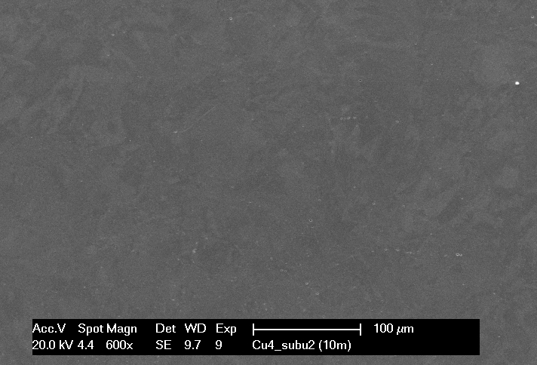
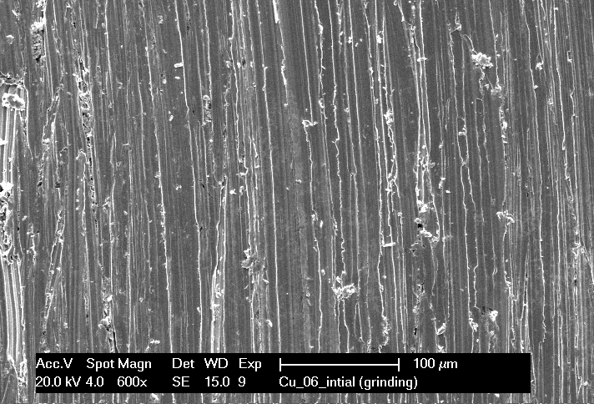
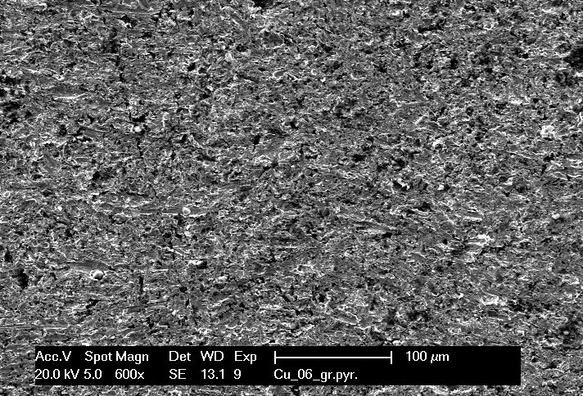
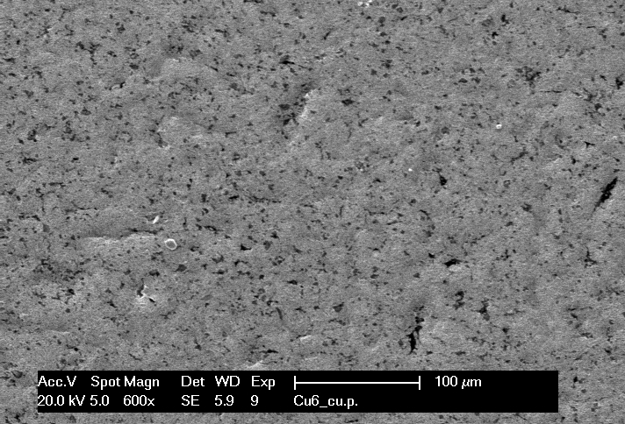
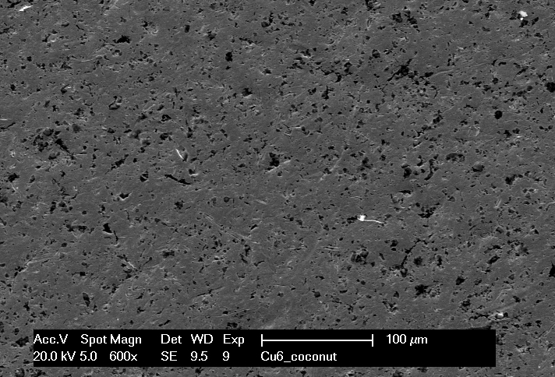
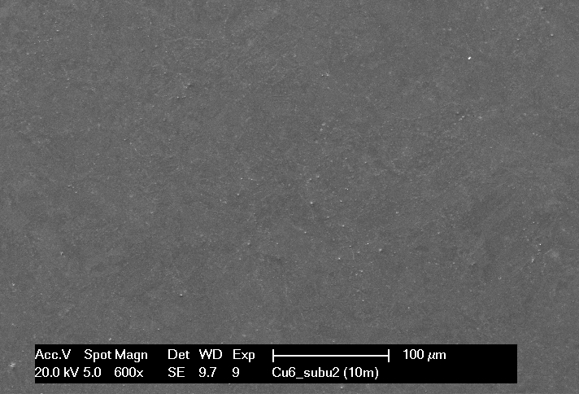
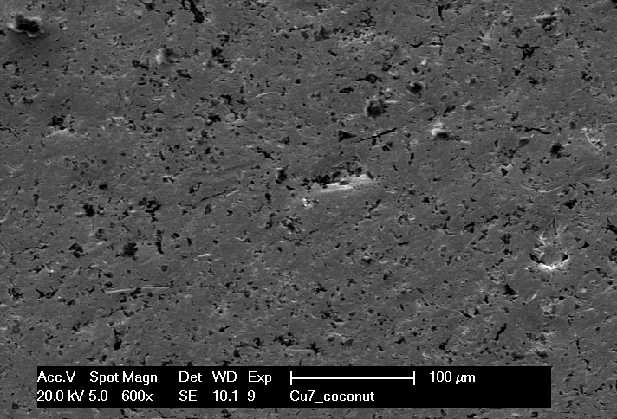
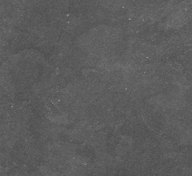
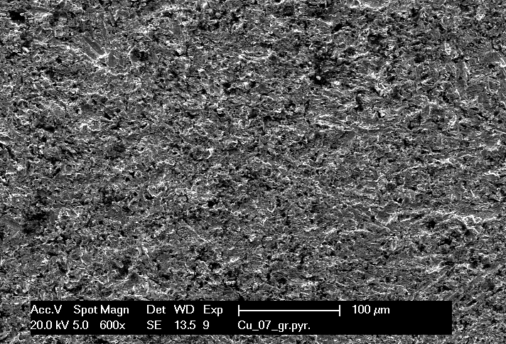
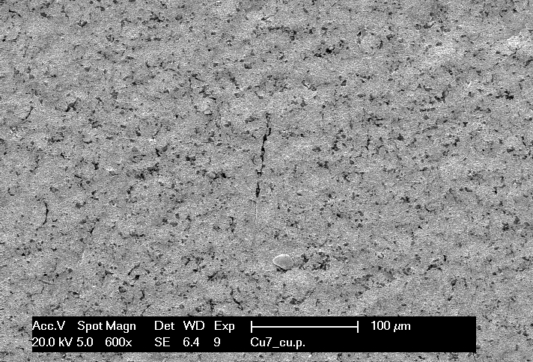
Vibro-Tumbling – Grinding comparision
SUBU5
Grinding
240 ± 60 nm
VT Pyramids
VT Cu powders
VT Coconuts
SUBU5
Scratched
550 ± 60 nm
510 ± 20 nm
400 ± 20 nm
330 ± 20 nm
220 ± 30 nm
Ra
500 ± 60 nm
VT Pyramids
VT Cu powders
VT Coconuts
SUBU5
520 ± 30 nm
380 ± 20 nm
290 ± 30 nm
100 ± 10 nm

Slide 29
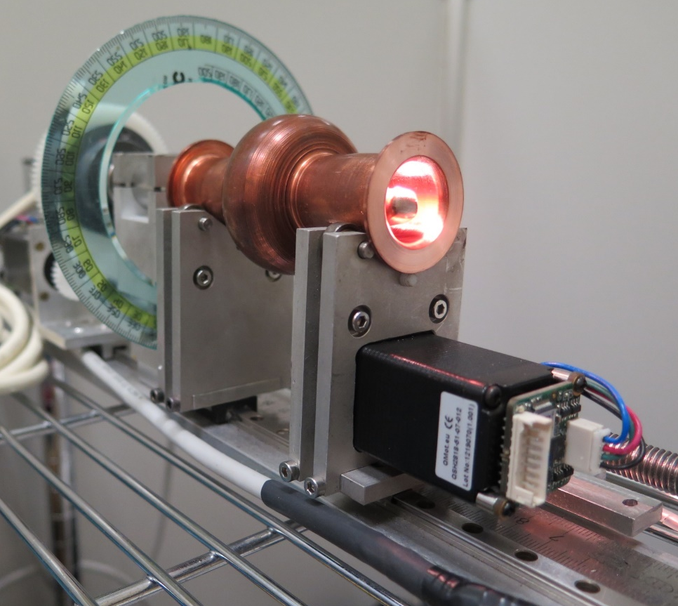
Results on cavities
Results on cavities
Comparision with grinding on cavities

Slide 30

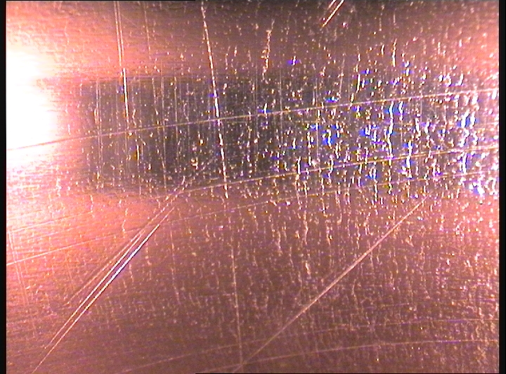
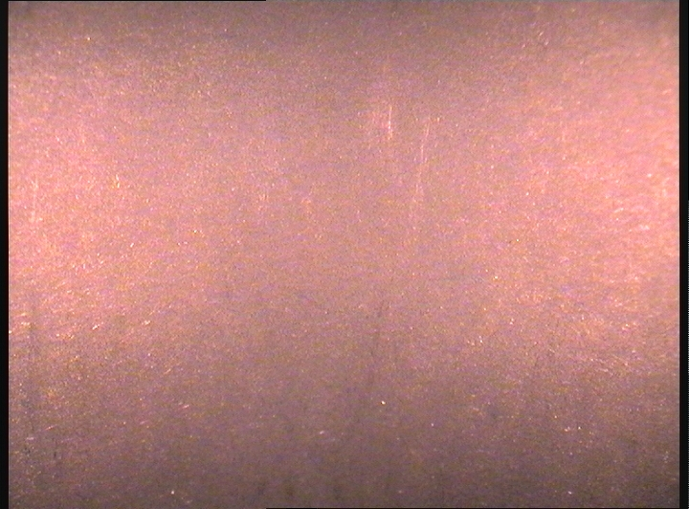
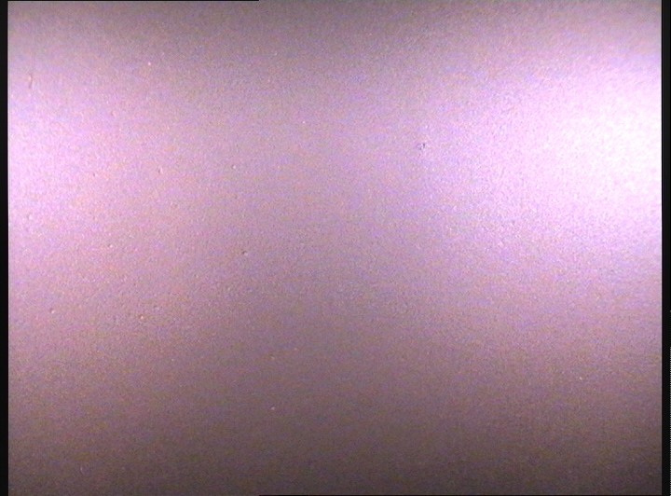
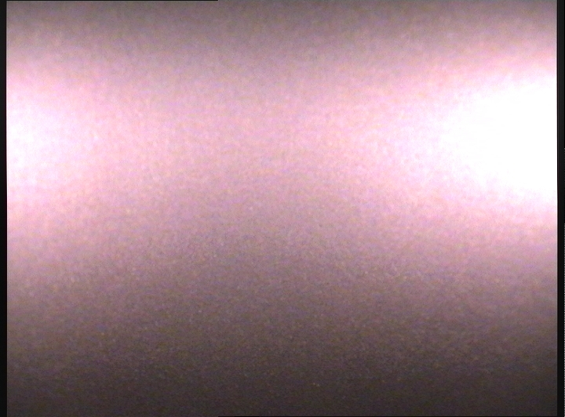
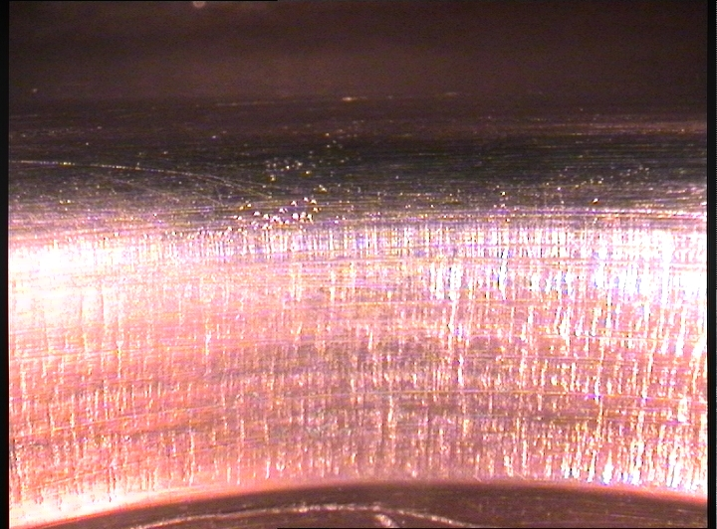
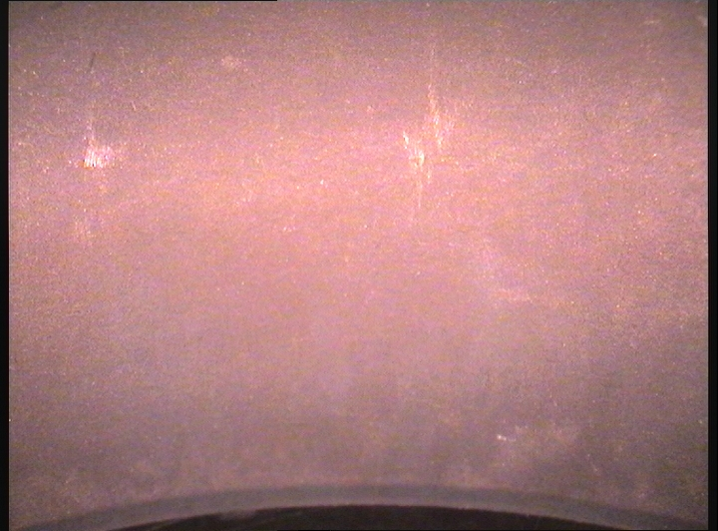
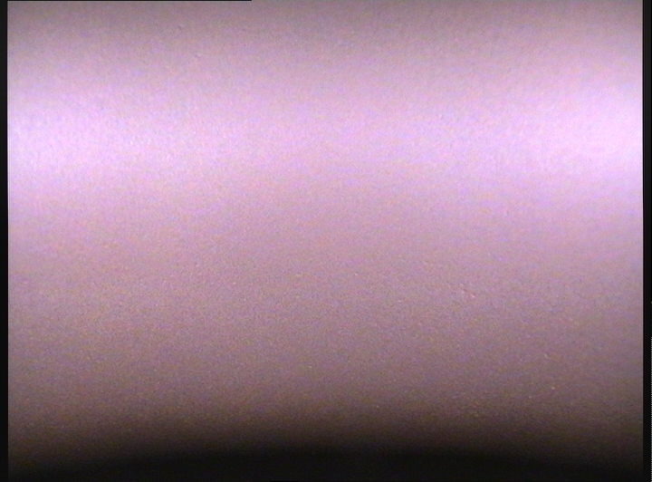
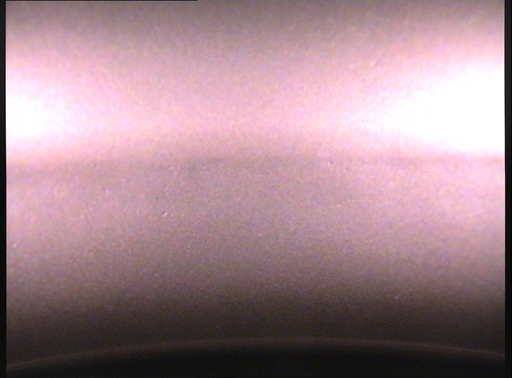
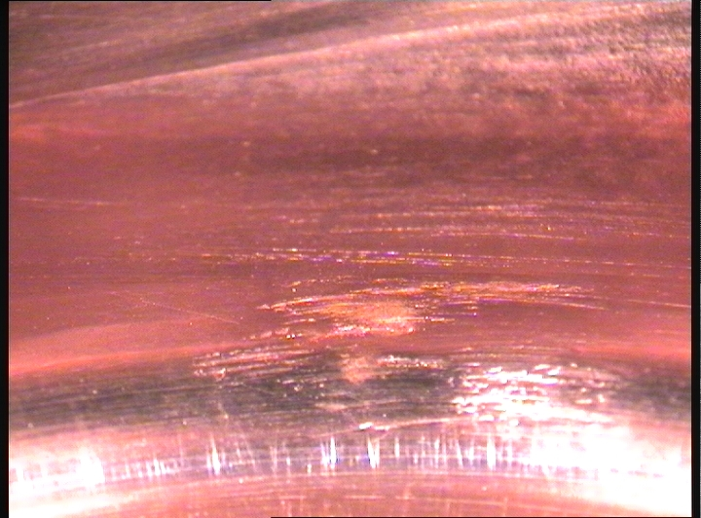
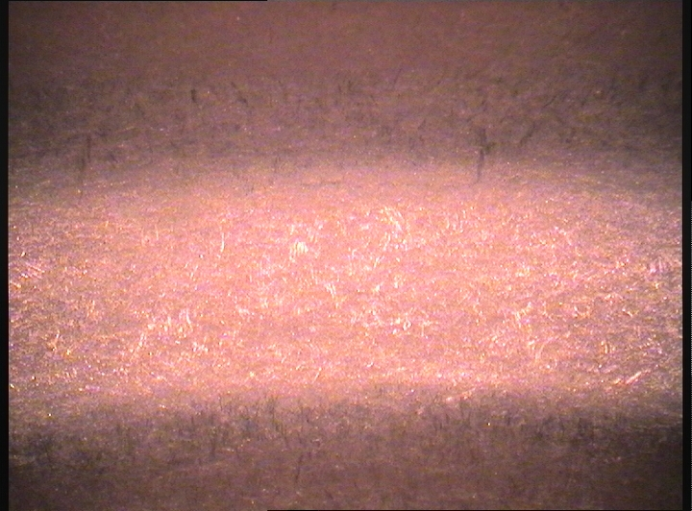
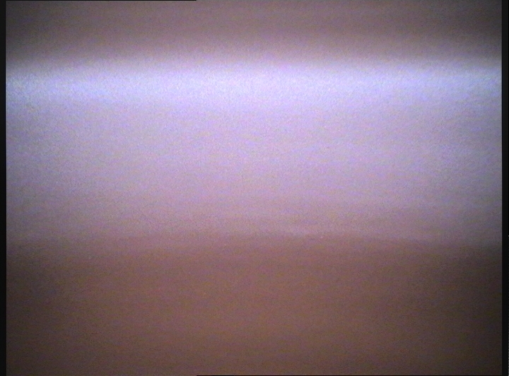
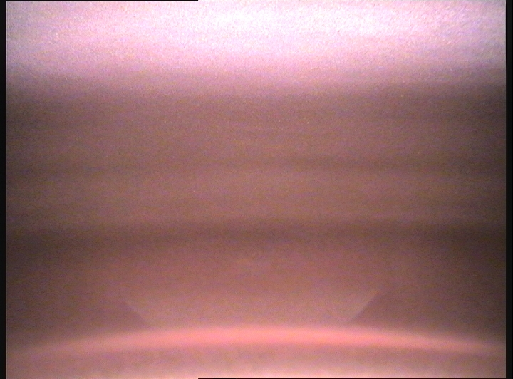
Cavity #31
GRINDING
VT – PYRAMIDS (4 h)
VT – Cu Powders (2 h)
VT – Coconut (2 h)
CUT OFF
IRIS
CELL

Slide 31
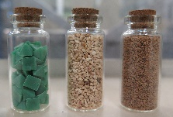
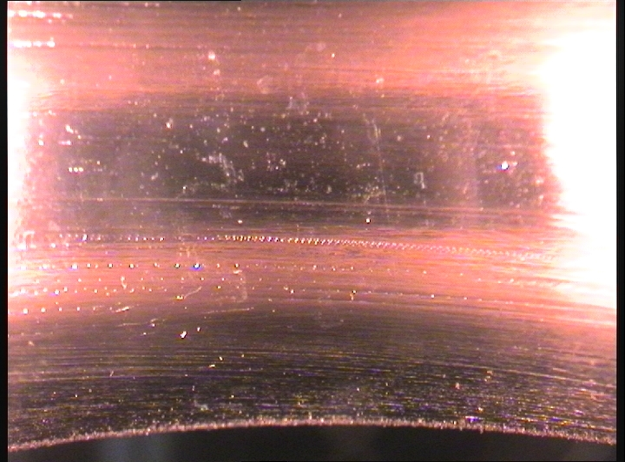











Cavity #28 Maize instead of Copper powders
GRINDING
VT – PYRAMIDS (4 h)
VT – Maise (2 h)
VT – Coconut (2 h)
CUT OFF
IRIS
CELL

Slide 32
Conclusions and next steps
Vibro-tumbling improve the surface finishing compare to grinding with Removing Rates comparable to CBP
RF tests to test improvement in performance reproducibility
Scalable to 1,5 – 1,3 GHz

Slide 33

Thank you for the attention!

