Slide 1
EBSD analysis of Nb layer, deposited on Cu substrate
Sample Preparation Techniques
Conventional metallurgical specimen preparation: Grinding (SiC papers), followed by 1 hour 40nm colloidal silica polish
Hitachi IM4000 Plus, Broad Argon Ion Beam: Cross-section milling under vacuum, 5kV Ar beam energy, 2 hour mill time

Slide 2
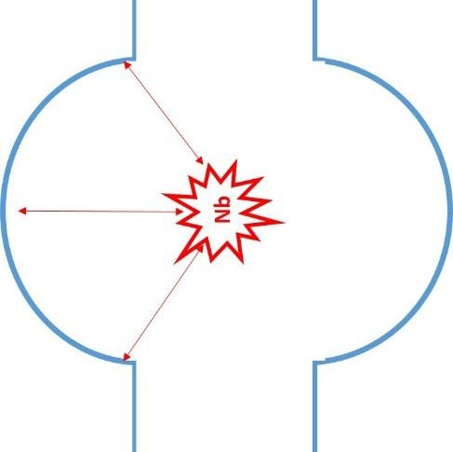
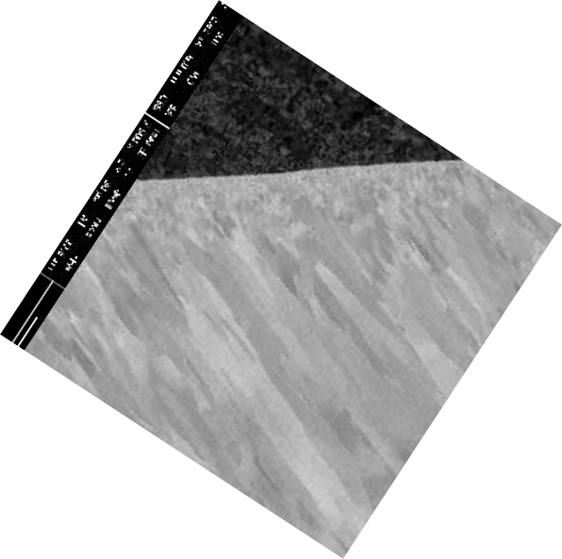
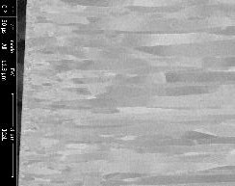
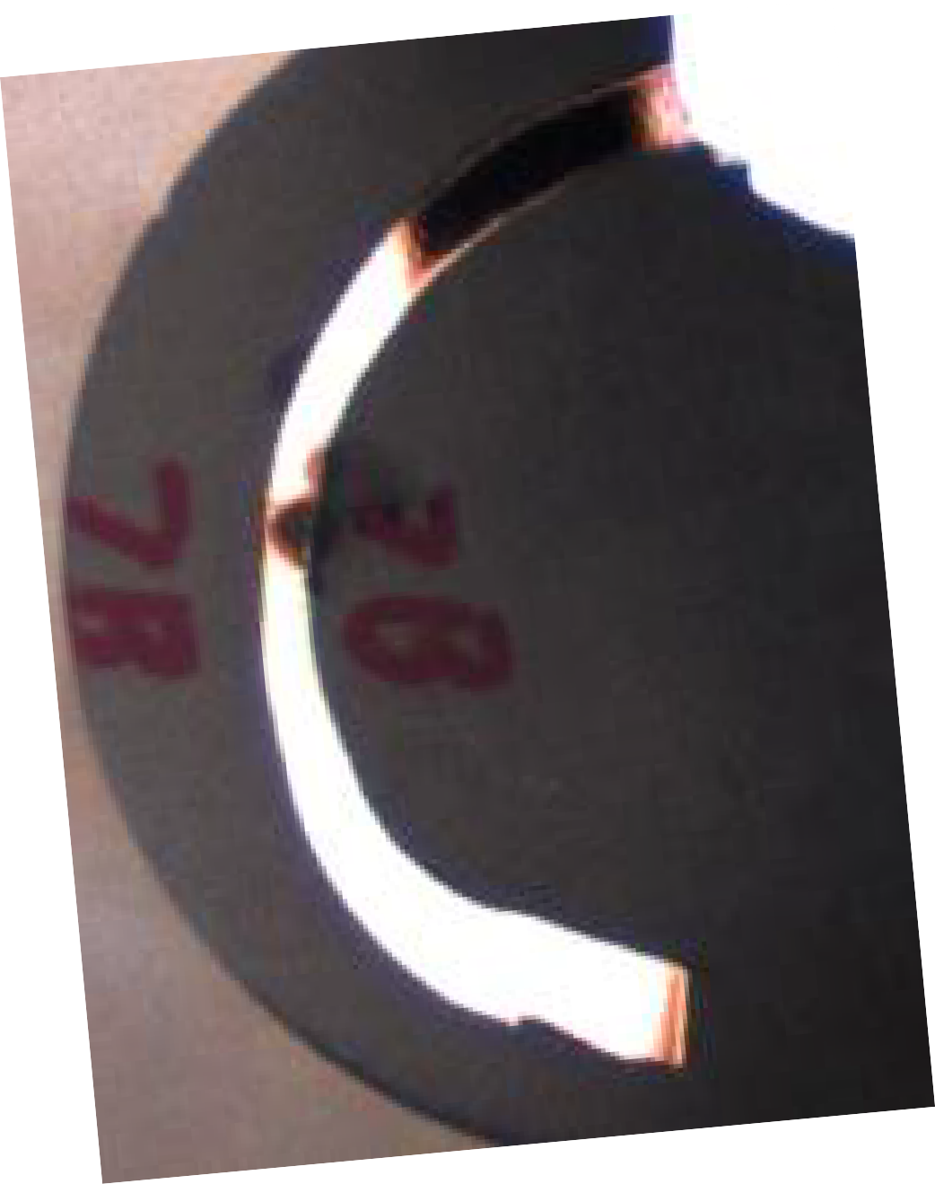
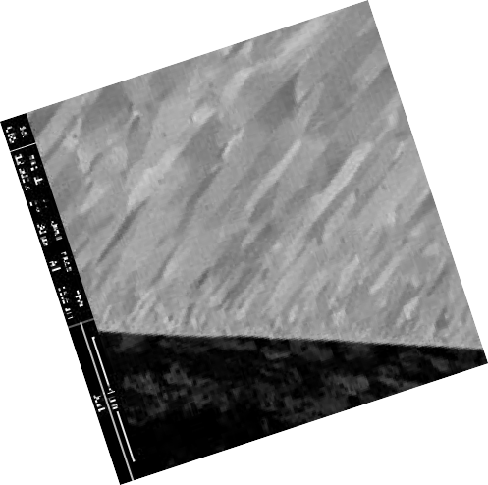
SEM – Layer morphology
Consistent with previous observations the growth of the columnar Nb grains is influenced by the positioning of the Nb source
Cu
Nb
Cu
Nb
Nb
Nb
Nb
Cu
In general, columnar grains grow toward the source. Therefore, grains located close to the curve midpoint tend to orient perpendicular to the substrate/Nb interface, whereas grains at either end of curve tilt toward the source.

Slide 3
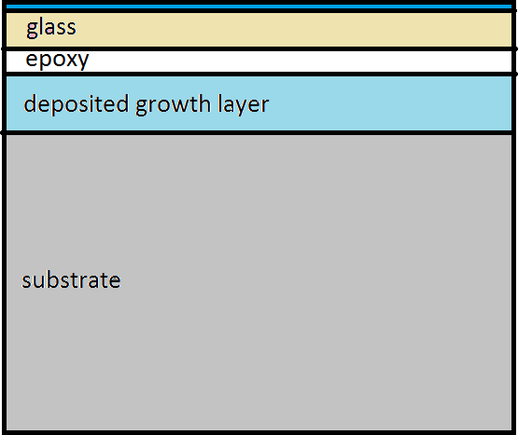
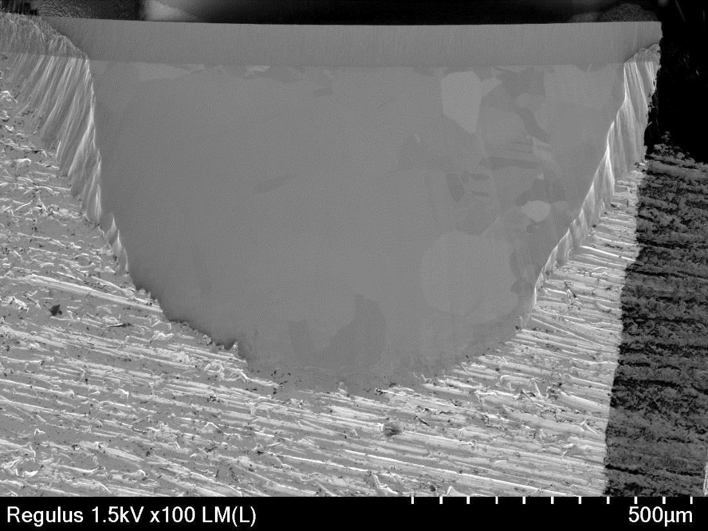
Hitachi IM4000 – Ar ion beam
Technique capable of preparing large area (1mm²) compared to Ga ion FIB (20 x 100 µm)
Low kV setting reduces surface damage (also available using FIB)
Inert species largely avoids problems associated with FIB Ga implantation
Liverpool’s Helios FIB has a maximum (realistic) cut depth of approx. 20 µm, hence would not be able
to prepare the full thickness of the Nb layer here.
FIB preparation is comparatively slow/expensive.
Hitachi Data

Slide 4
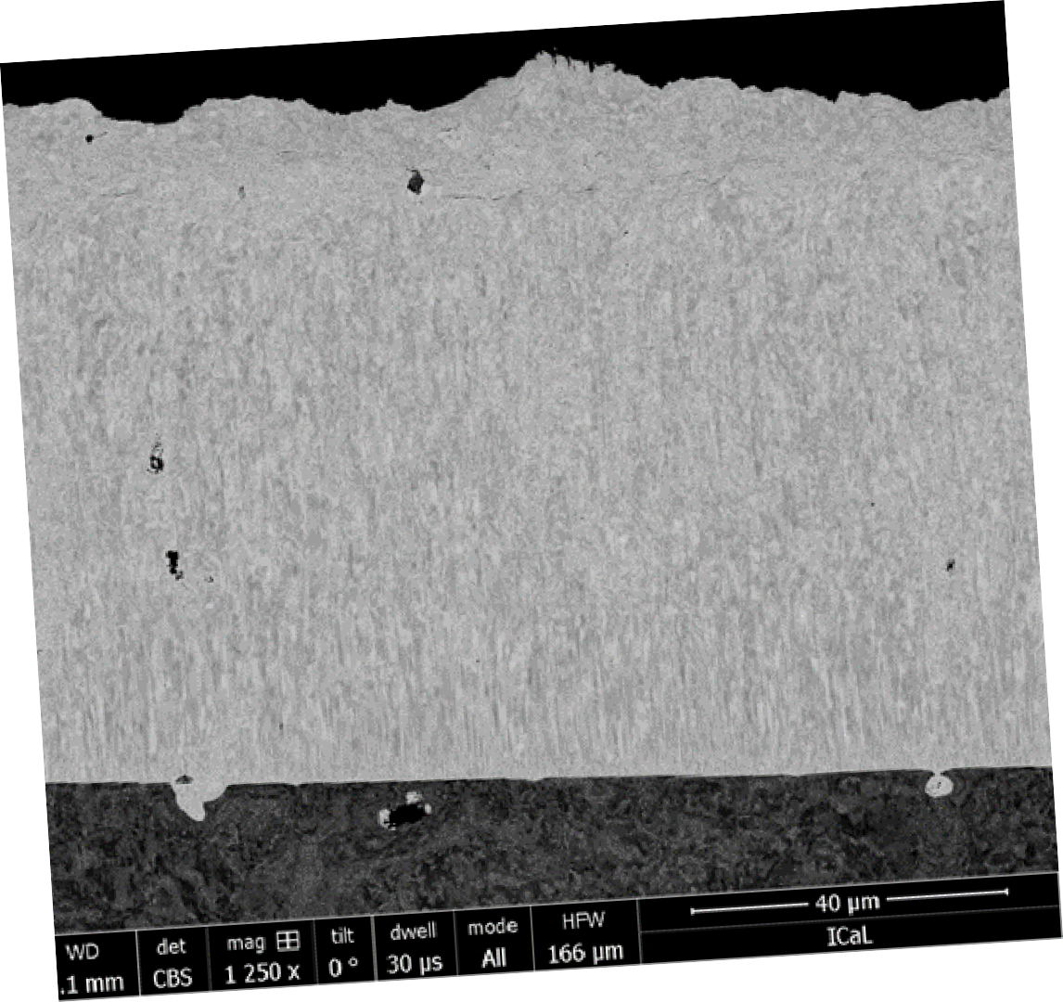
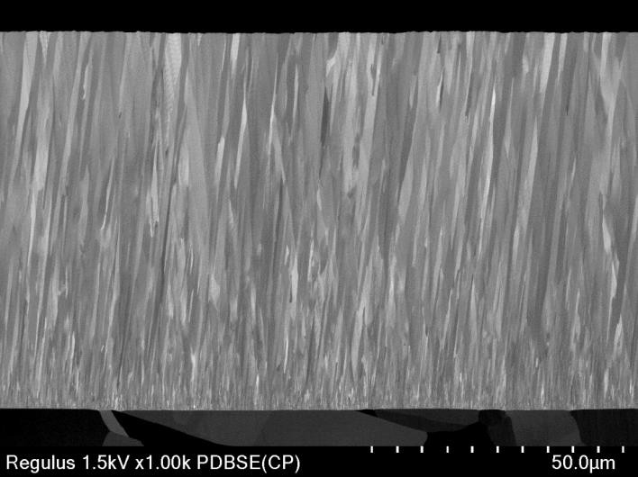
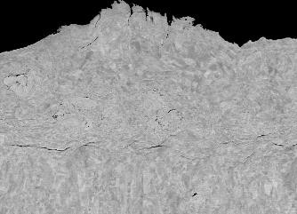
SEM – Preparation Artefacts
Polishing burr
True thickness
True thickness
Hitachi IM4000 Plus prepared
Colloidal silica (40nm) polished
Manual polishing can cause artefacts. Burrs induced by mechanical polishing will promote inaccuracies in the determination of layer thickness.
Clearly the columnar microstructure is also compromised by the effects of mechanical polishing. Material transfer was observed, including Nb to the Cu substrate and silicon carbide polishing aggregates engrained in both the Nb and substrate areas.
Polishing
burr

Slide 5
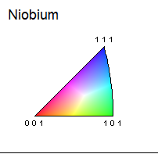
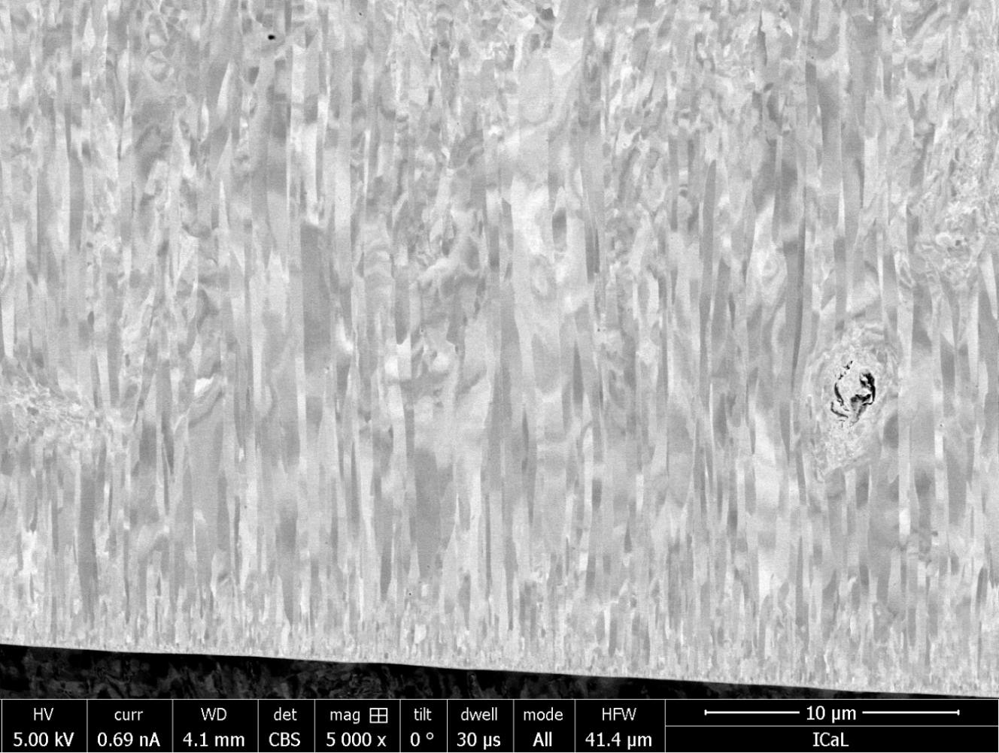
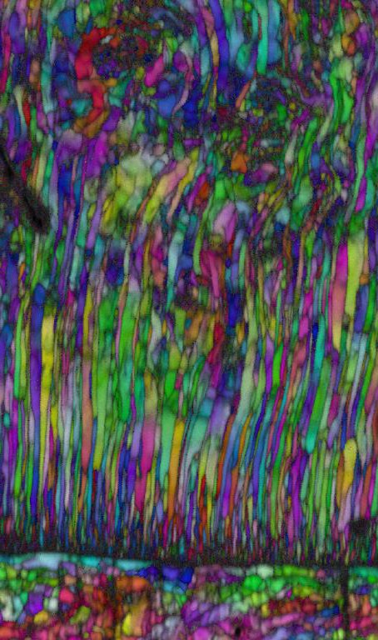
EBSD - Colloidal silica polished surface
Distortion of columnar crystal growth also evident in EBSD patterns. Crystallographic texture has been modified by the polishing process.
Initial fine grain Nb formation in the early stages of deposition gives way to the formation of columnar grains. However, distortion of the microstructure is evident at distances greater than 10 µm from the interface.
Nb
Cu
Inverse Pole Figure (IPF)
orientation map

Slide 6
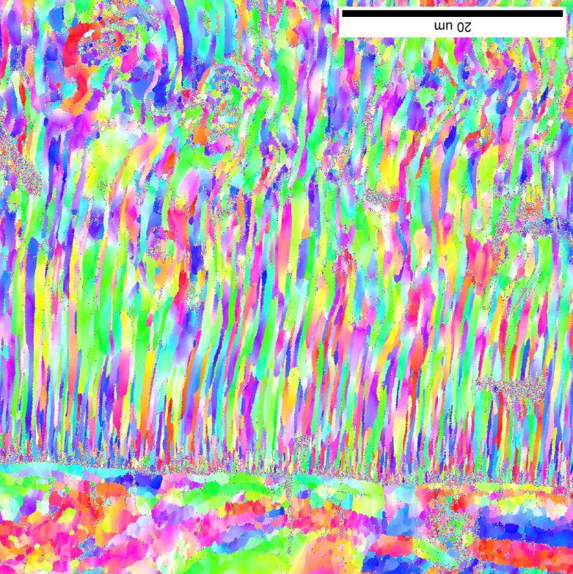
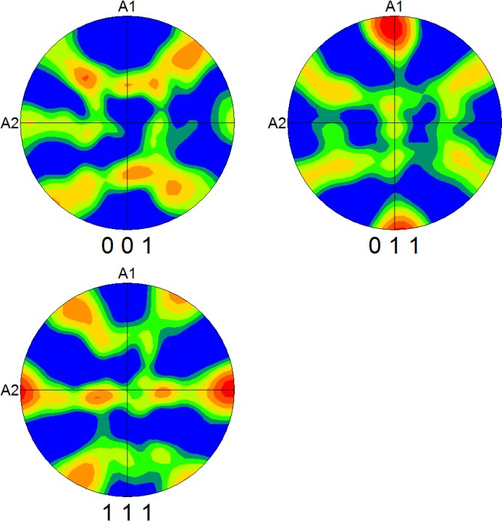
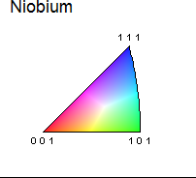
EBSD Texture
Niobium Texture plots indicate a preferred 011 crystal orientation parallel to the columnar grain growth direction.
IPF orientation map
direction
of growth
direction
of growth
Nb
Direction of growth
Cu

Slide 7
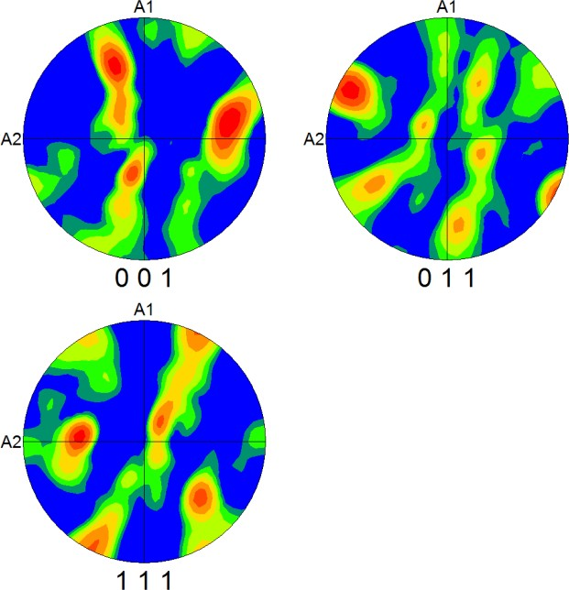
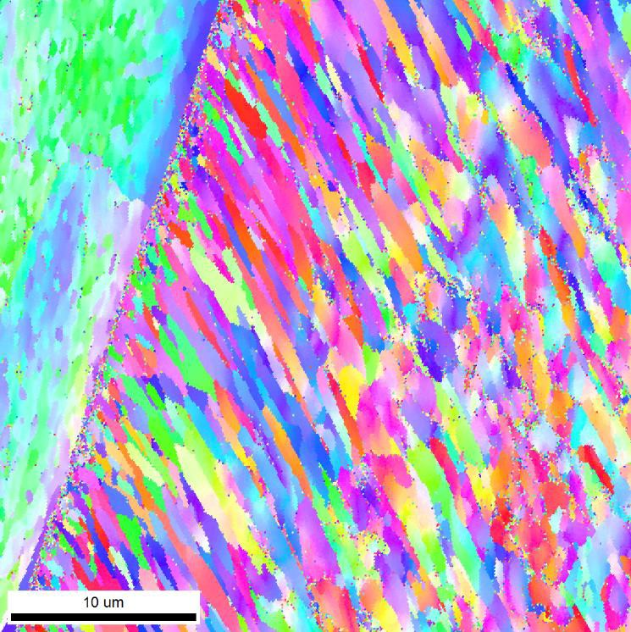
EBSD Texture
A preferred 011 crystallographic texture, parallel to the columnar grain long axis, is also observed where growth is not normal to the Cu surface.

Slide 8









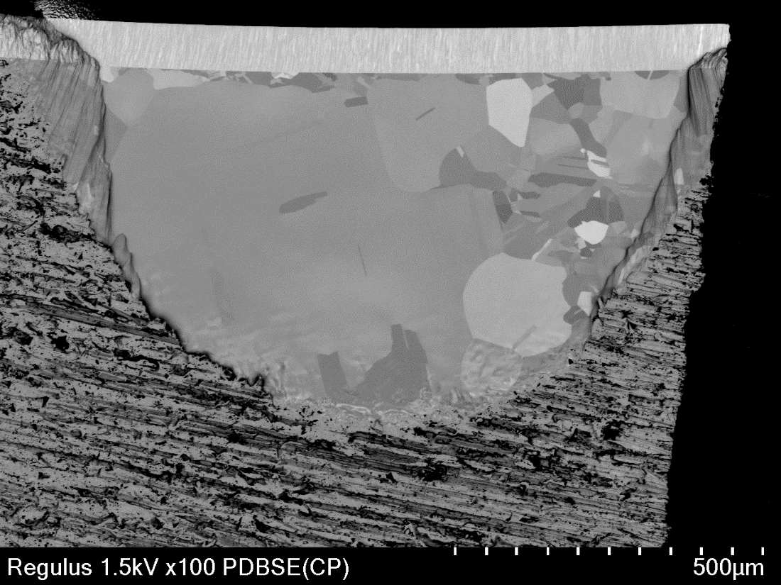
2. Nb layer on Cu substrate (Cross section)
Upper
SE BSE
Conversion Signal
PD BSED
Vacc. | 1.5 kV
Mag. | 100x
Signal | LM(L), PDBSE(CP)
Lower
Deceleration
OFF
LM(L)： Topographic information
PDBSE(CP)： Compositional contrast
10

Slide 9
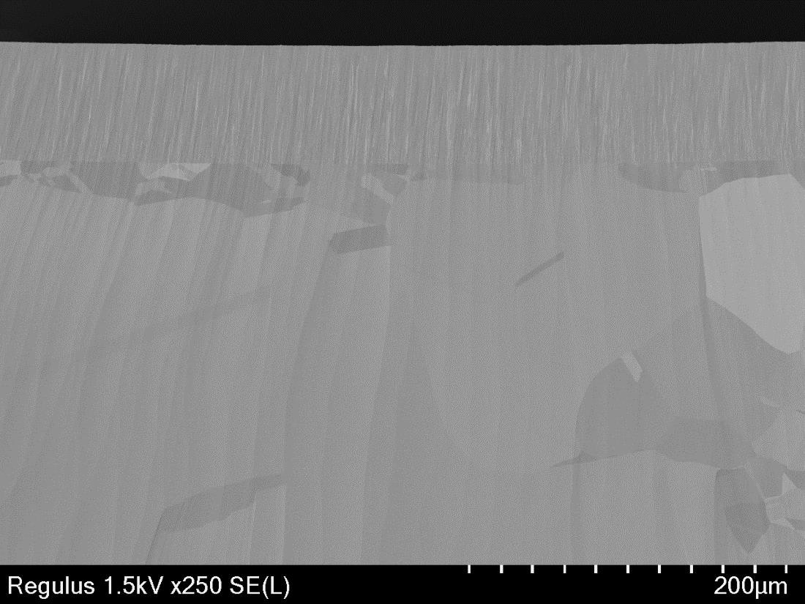
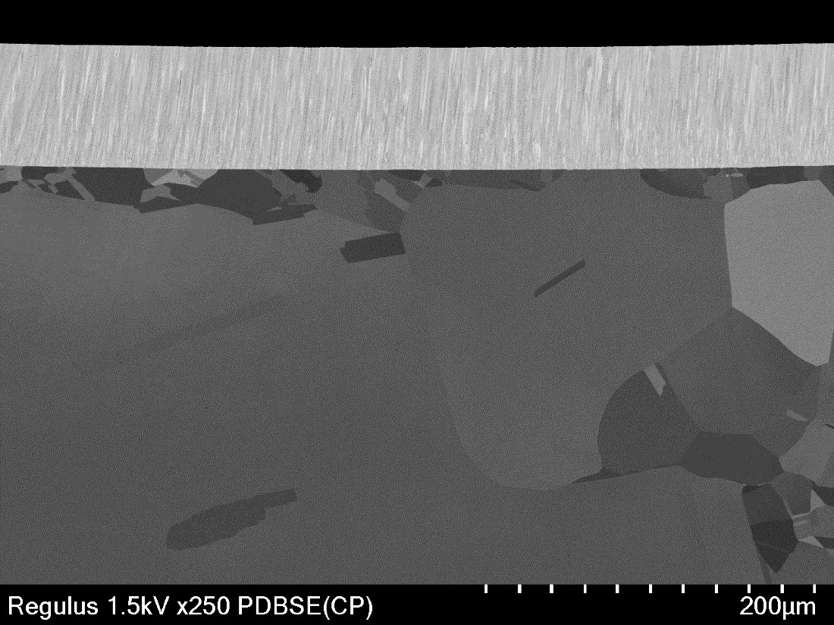
2. Nb layer on Cu substrate (Cross section)
Upper
SE BSE
Conversion Signal
PD BSED
Vacc. | 1.5 kV
Mag. | 250x
Signal | SE(L), PDBSE(CP)
Lower
Resin
Deceleration OFF
Nb
Cu
SE(L)： Topographic information
PDBSE(CP)： Compositional contrast

Slide 10
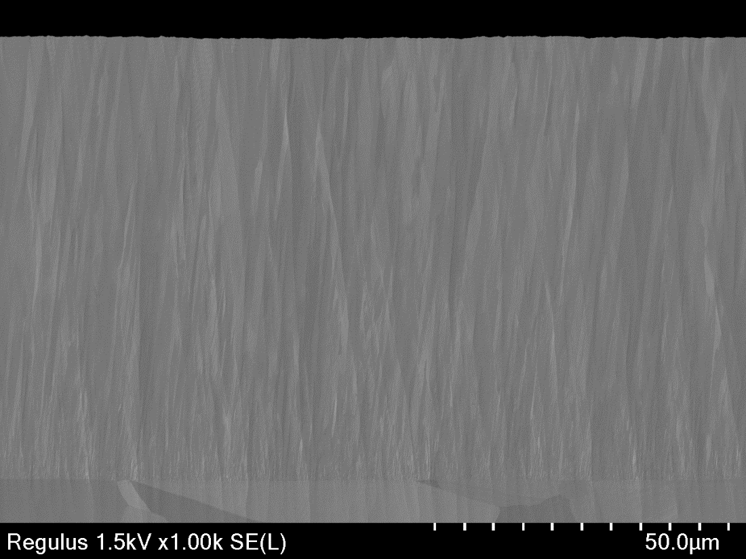

2. Nb layer on Cu substrate (Cross section)
Upper
SE BSE
Conversion Signal
PD BSED
Vacc. | 1.5 kV
Mag. | 700x
Signal | SE(L), PDBSE(CP)
Lower
Resin
Deceleration OFF
Nb
Cu
SE(L)： Topographic information
PDBSE(CP)： Compositional contrast

Slide 11

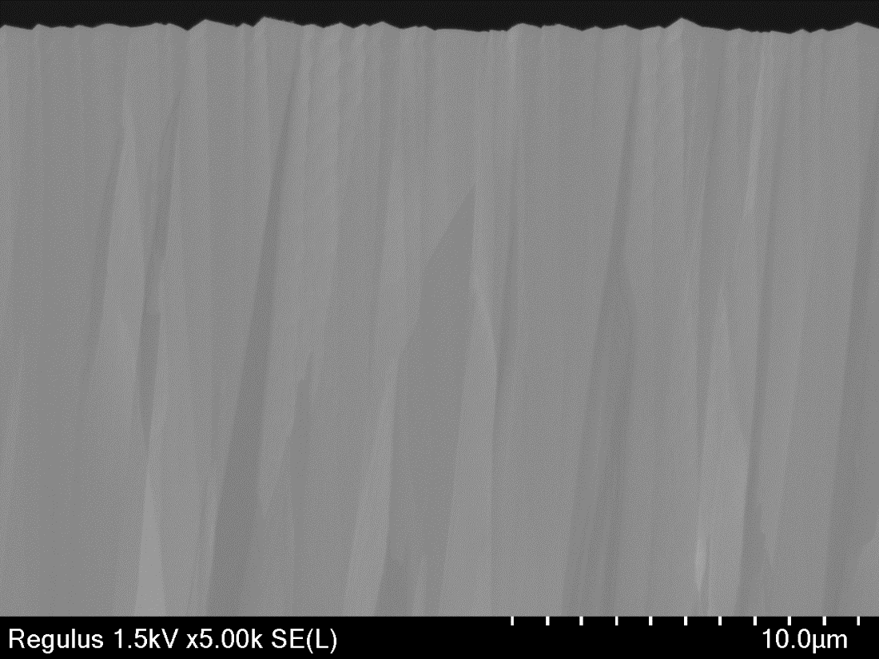
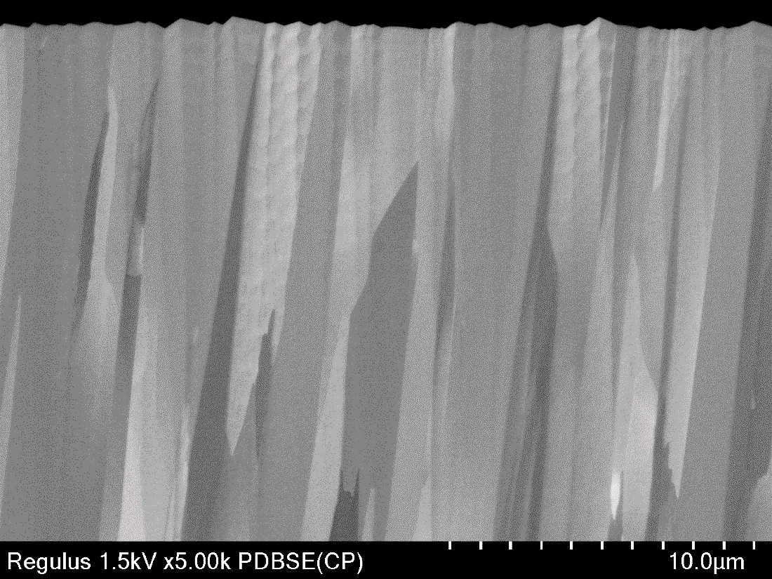
2. Nb layer on Cu substrate (Cross section)
Upper
SE BSE
Conversion Signal
PD BSED
Vacc. | 1.5 kV
Mag. | 5kx
Signal | SE(L), PDBSE(CP)
Lower
Deceleration
OFF
SE(L)： Topographic information
PDBSE(CP)： Compositional contrast

Slide 12
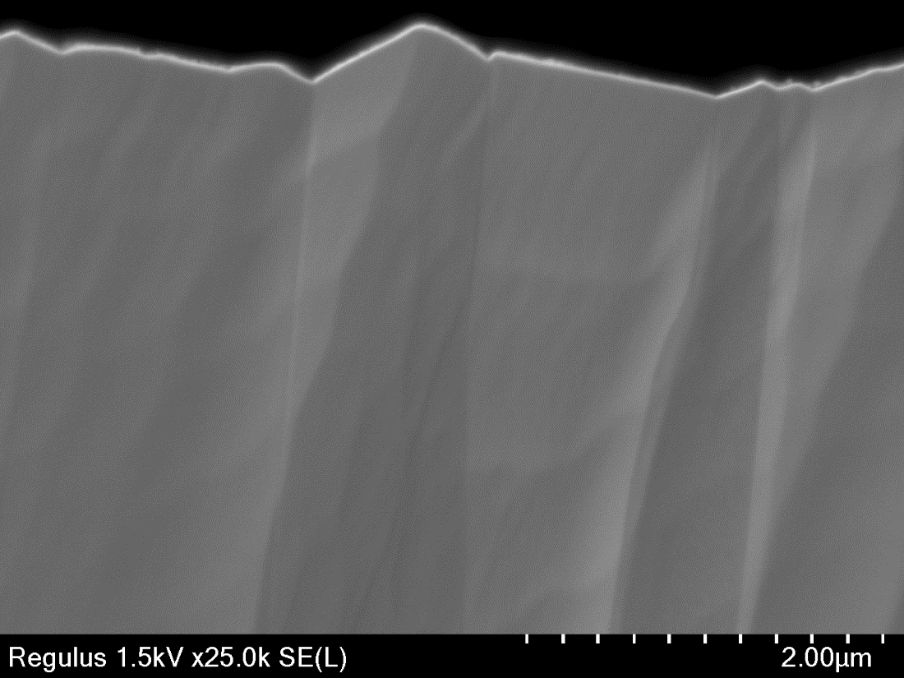
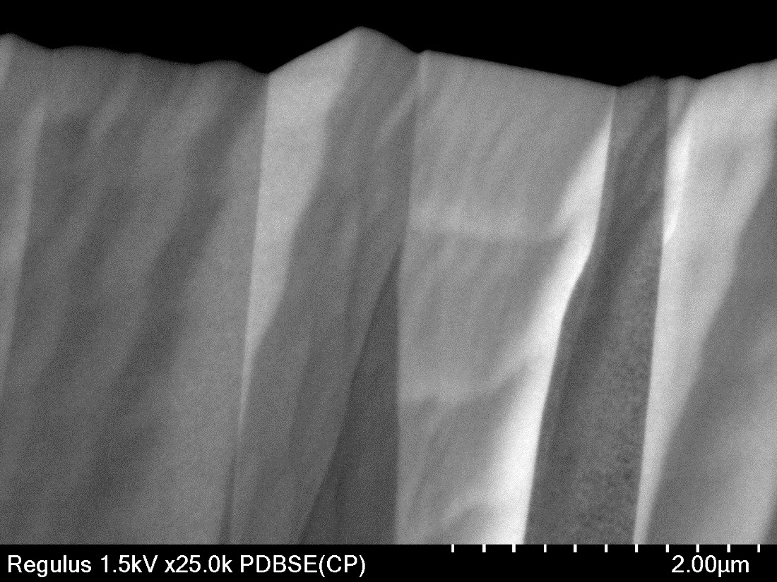
2. Nb layer on Cu substrate (Cross section)
Upper
SE BSE
Conversion Signal
PD BSED
Vacc. | 1.5 kV
Mag. | 25kx
Signal | SE(L), PDBSE(CP)
Lower
Deceleration
OFF
SE(L)： Topographic information
PDBSE(CP)： Compositional contrast

Slide 13
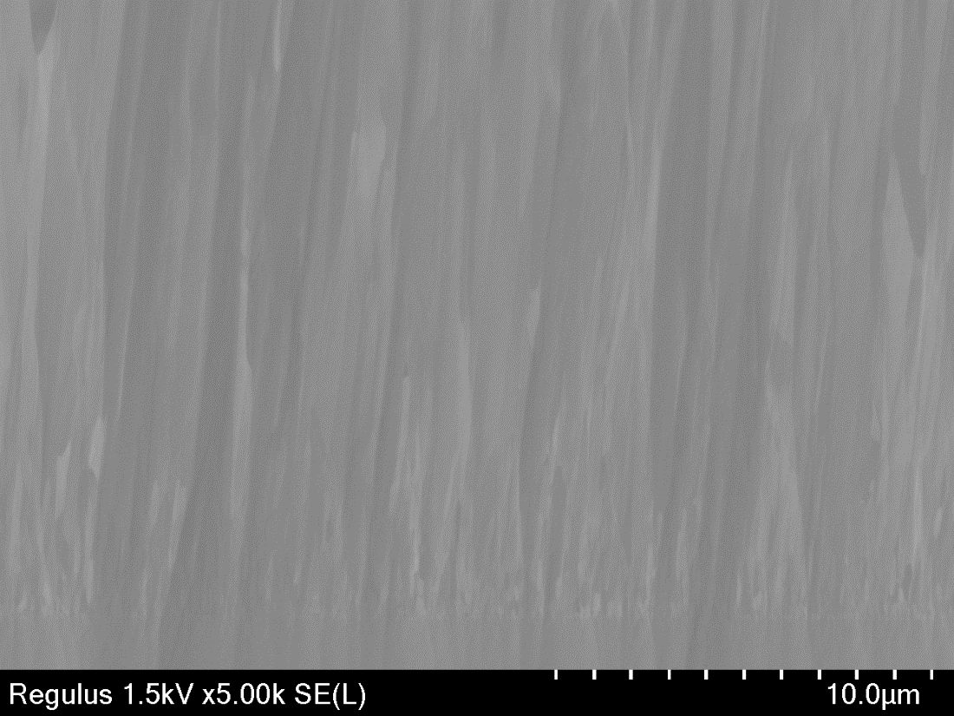
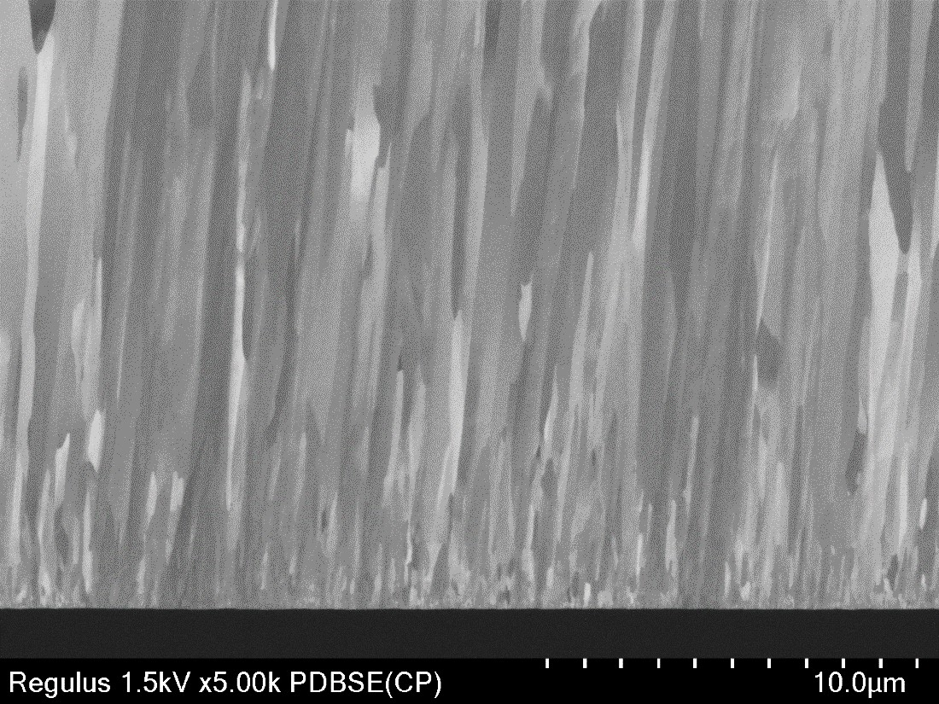
2. Nb layer on Cu substrate (Cross section)
Upper
SE BSE
Conversion Signal
PD BSED
Vacc. | 1.5 kV
Mag. | 5kx
Signal | SE(L), PDBSE(CP)
Lower
Deceleration
OFF
SE(L)： Topographic information
PDBSE(CP)： Compositional contrast

Slide 14
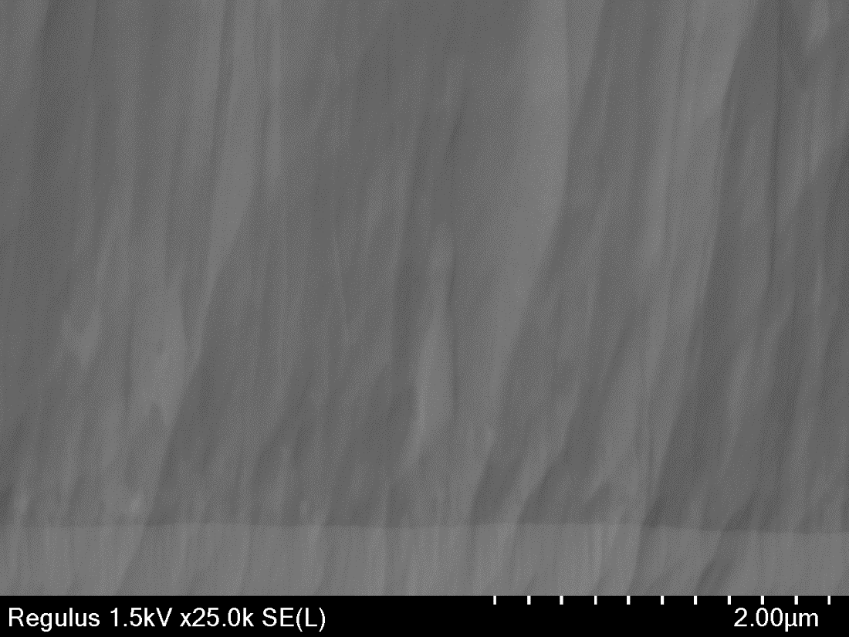
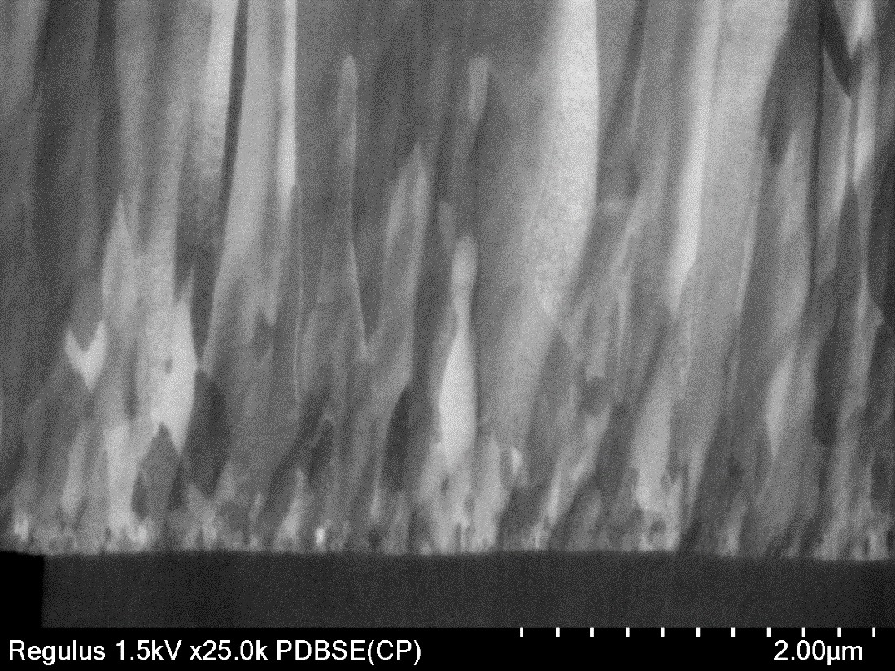
2. Nb layer on Cu substrate (Cross section)
Upper
SE BSE
Conversion Signal
PD BSED
Vacc. | 1.5 kV
Mag. | 25kx
Signal | SE(L), PDBSE(CP)
Lower
Deceleration
OFF
SE(L)： Topographic information
PDBSE(CP)： Compositional contrast

Slide 15
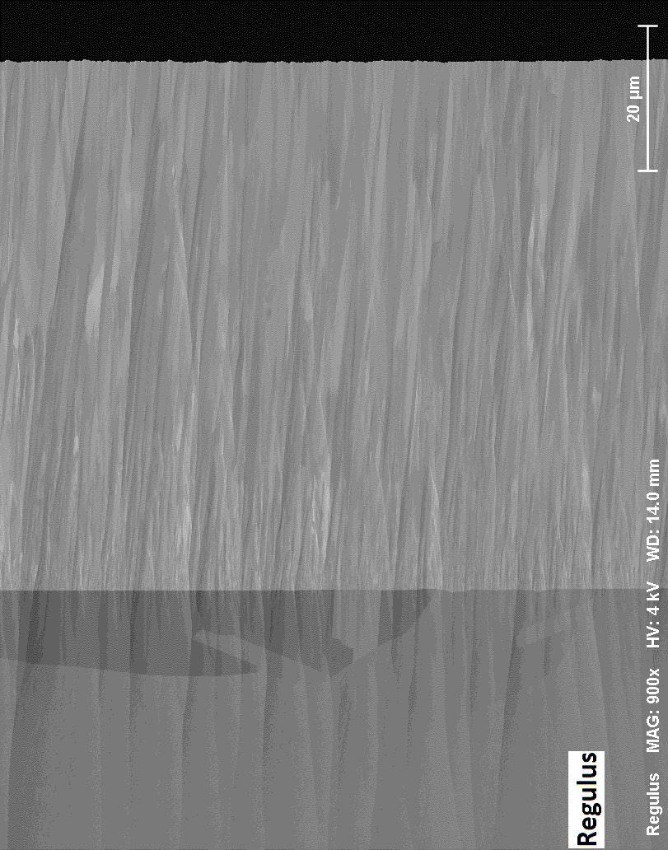
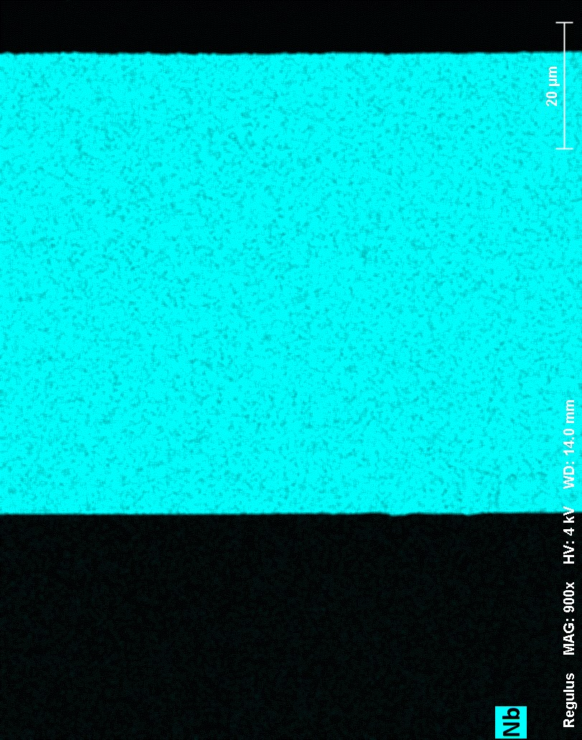
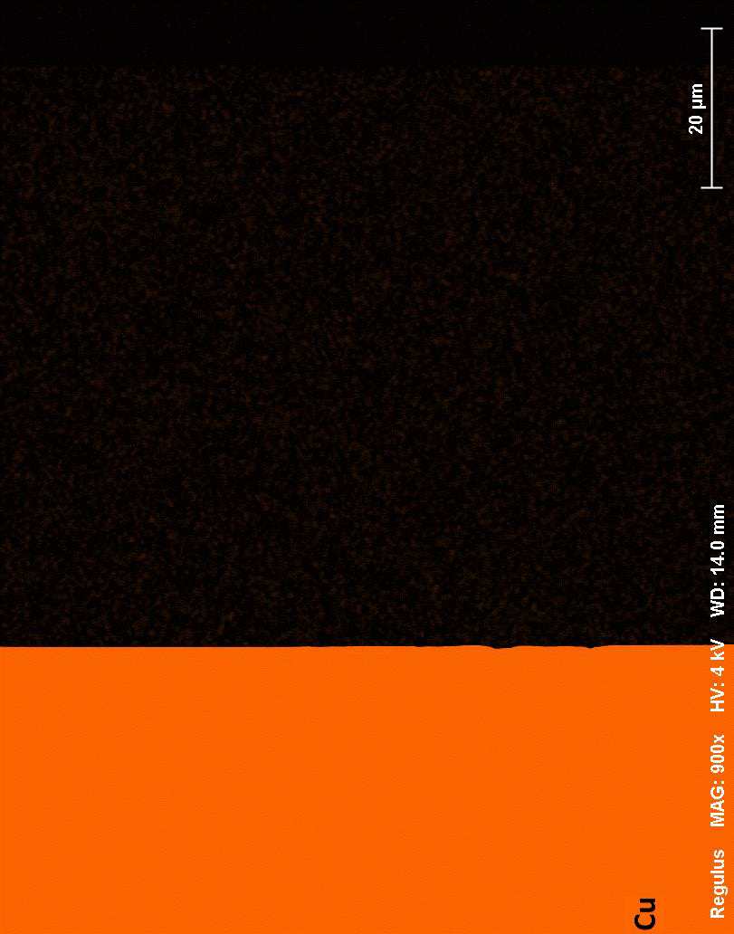
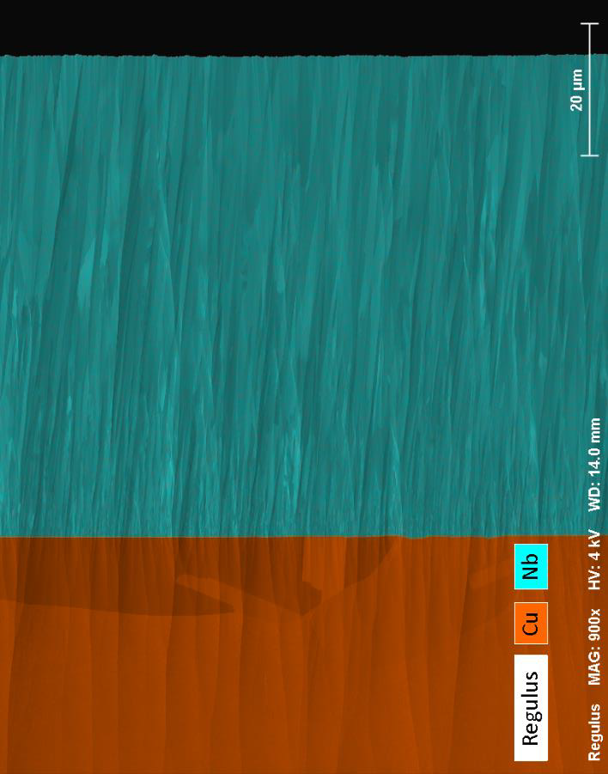
2. Nb layer on Cu substrate
(Cross section/EDX analysis)
4kV, 900x, 389sec
15

Slide 16

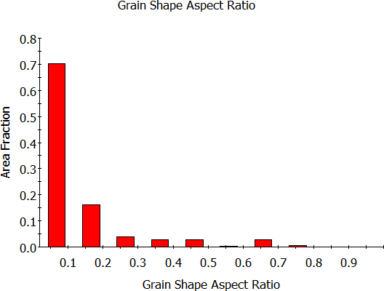
EBSD – Hitachi IB prepared specimen
EBSD Orientation maps of the Hitachi Ar ion beam prepared sample revealed high aspect ration columnar grains through the near complet thickness of the deposited film.
The fine equiaxed Nb grains, formed during the early stages of deposition are not easily resolved. Large twinned grains were observed in the Cu substrate.

Slide 17
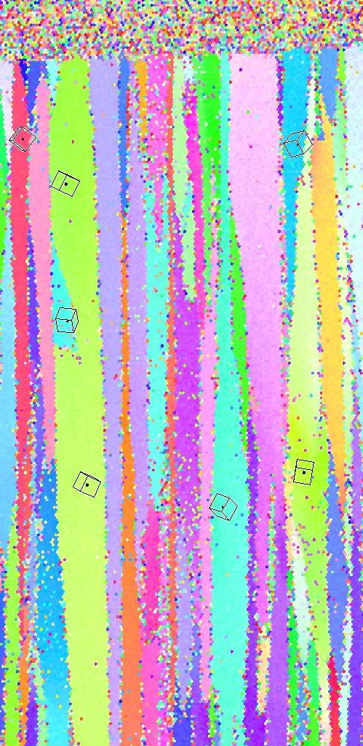
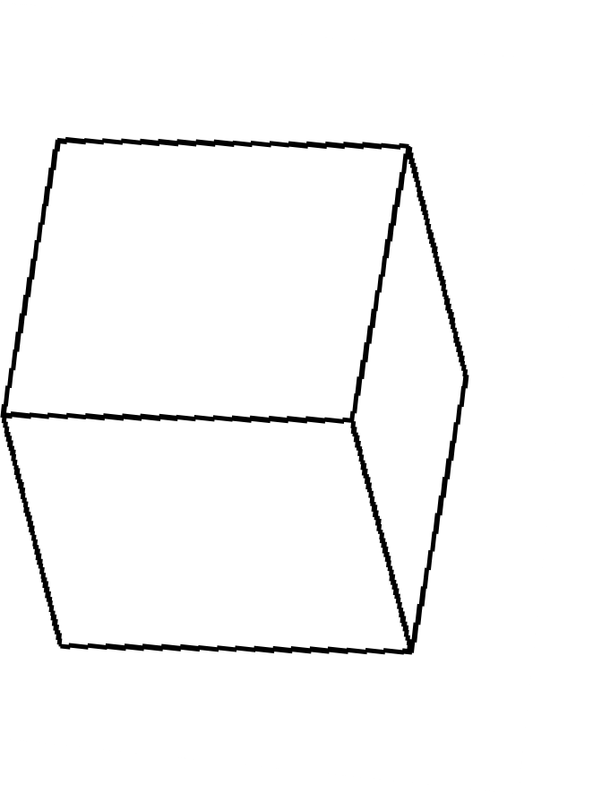

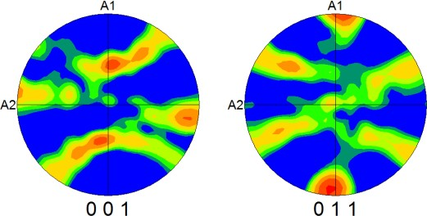
EBSD – Hitachi IB prepared specimen
EBSD texture measurements performed on the Ar ion beam prepared niobium layer were consistent with those recorded from the colloidal silica prepared materials. A strong
<011> texture was measured, parallel to the long axis of the columnar grains, which is approximately parallel to the growth direction.
<011>

