Slide 1

RT ^{(*)} cables terminations and routing to current leads according to baseline
D. De Luca, J-Cl. Guillaume
(*) RT = Room Temperature
Notes:
This presentation was already done in HL-MCF meeting February 2017
Is referenced to the BASELINE

Slide 2
Table of Contents
Electrical Circuit
Cable Requirements
Water Cooled Cables Specifications
Installation Constraints
Water Cooled Cable Layout
Documentation
Open Issues

Slide 3
Table of Contents
Electrical Circuit
Cable Requirements
Water Cooled Cables Specifications
Installation Constraints
Water Cooled Cable Layout
Documentation
Open Issues

Slide 4
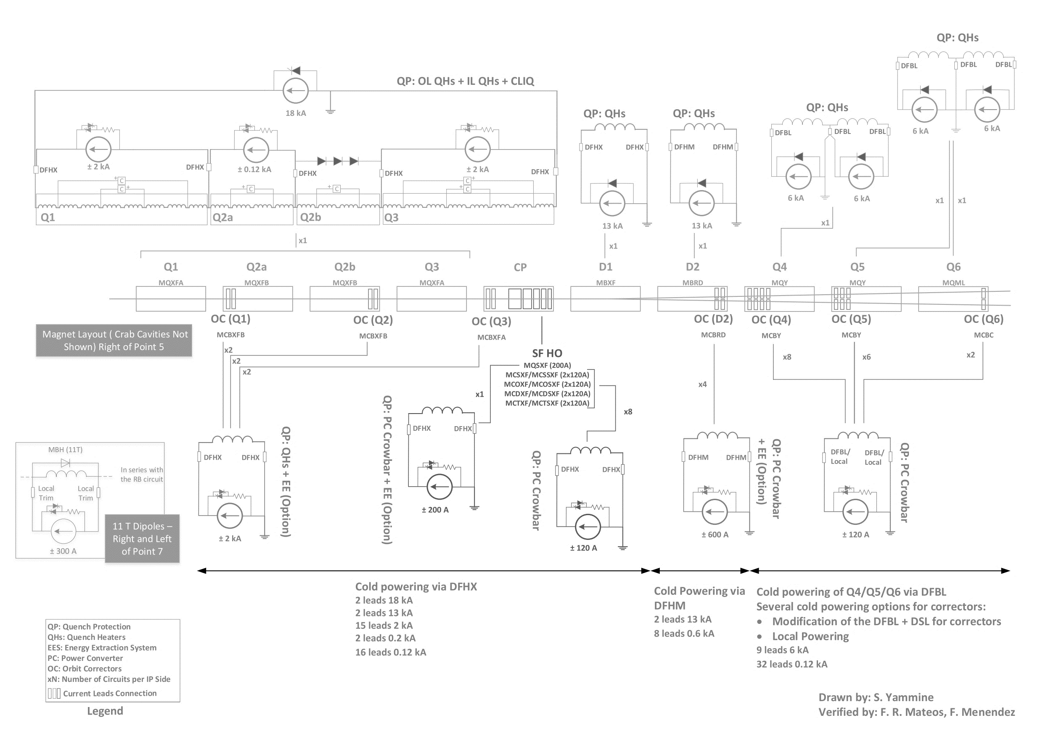
Electrical Circuit…as per Baseline
Warm cabling is located between current leads and power converters
RR Point 1, 5
UR Point 1, 5
mechanic (tunnel)
UR Point 1, 5
RR Point 7
RR Point 1, 5
Notes:
We focus the attention to the Converter in UR and specially for WCC 13kA ,18kA 2kA

Slide 5
Table of Contents
Electrical Circuit
Cable Requirements
Water Cooled Cables Specifications
Installation Constraints
Water Cooled Cable Layout
Documentation
Open Issues

Slide 6
Main Requirements…baseline
according to converter
and DFH layout
Notes:
In RED Details of electrical circuit of the converter shown in previous drawings

Slide 7
Cable Type Selection
Based on the requirements shown before
Taken into account the rated current of cables (I_{cable})
  Constraints: decrease power losses to minimise heat dissipation
  If I_{cable} ≤ 600 A → Standard air cooled cable (ACC)
  If I_{cable} > 600 A → Water cooled cable (WCC)
Intensity | Type
120 A | ACC
200 A | ACC
600 A | ACC
2 kA | WCC
13 kA | WCC
18 kA | WCC
Notes:
Selection proposed according and to follow constraint of the dynamic of the circuit

Slide 8
Cable Section Selection
ACC section selection: norm NF C 15-100 assuming
  three cable layers (0.73 of I_{cable r}*)
  > 9 cables touching on cable ladders (0.78 of I_{cable r}*)
  Resulting factor of 0.57 of I_{cable r}*
WCC section selection: technological constraints
→ LHC and other experiences at CERN
  500 mm² rated at 3.5 kA → 7 A/mm²
  1300 mm² rated at 8 kA → 6.2 A/mm²
  2000 mm² rated at 13 kA → 6.5 A/mm²
* I_{cable r}: rated current of a single cable without taking into account installation reduction factors
Notes:
Section have been chosen in accordance of NF C15-100 and for WCC selection based on experience on LHC and Test Areas SM18

Slide 9
Cable Proposal by EN-EL…baseline
Remarks
  Standard ACC are well known at CERN
  Further studies focused on WCC
Intensity | Section [mm²] | Type
120 A | 70 | ACC
200 A | 95 | ACC
600 A | 400 | ACC
2 kA | 500 | WCC
13 kA | 2000 | WCC
18 kA | 2x1300 | WCC
Notes:
Max length of WCC:
Hose: 40m max
Cable assembly: suppliers are not equipped to assemble cables >40m.
Just 3 European suppliers available that are able to meet CERN standards
ACC: Insulation test at 4xUo DC → 4x600V=2400V DC during 1min

Slide 10
Table of Contents
Electrical Circuit
Cable Requirements
Water Cooled Cables Specifications
Installation Constraints
Water Cooled Cable Layout
Documentation
Open Issues

Slide 11
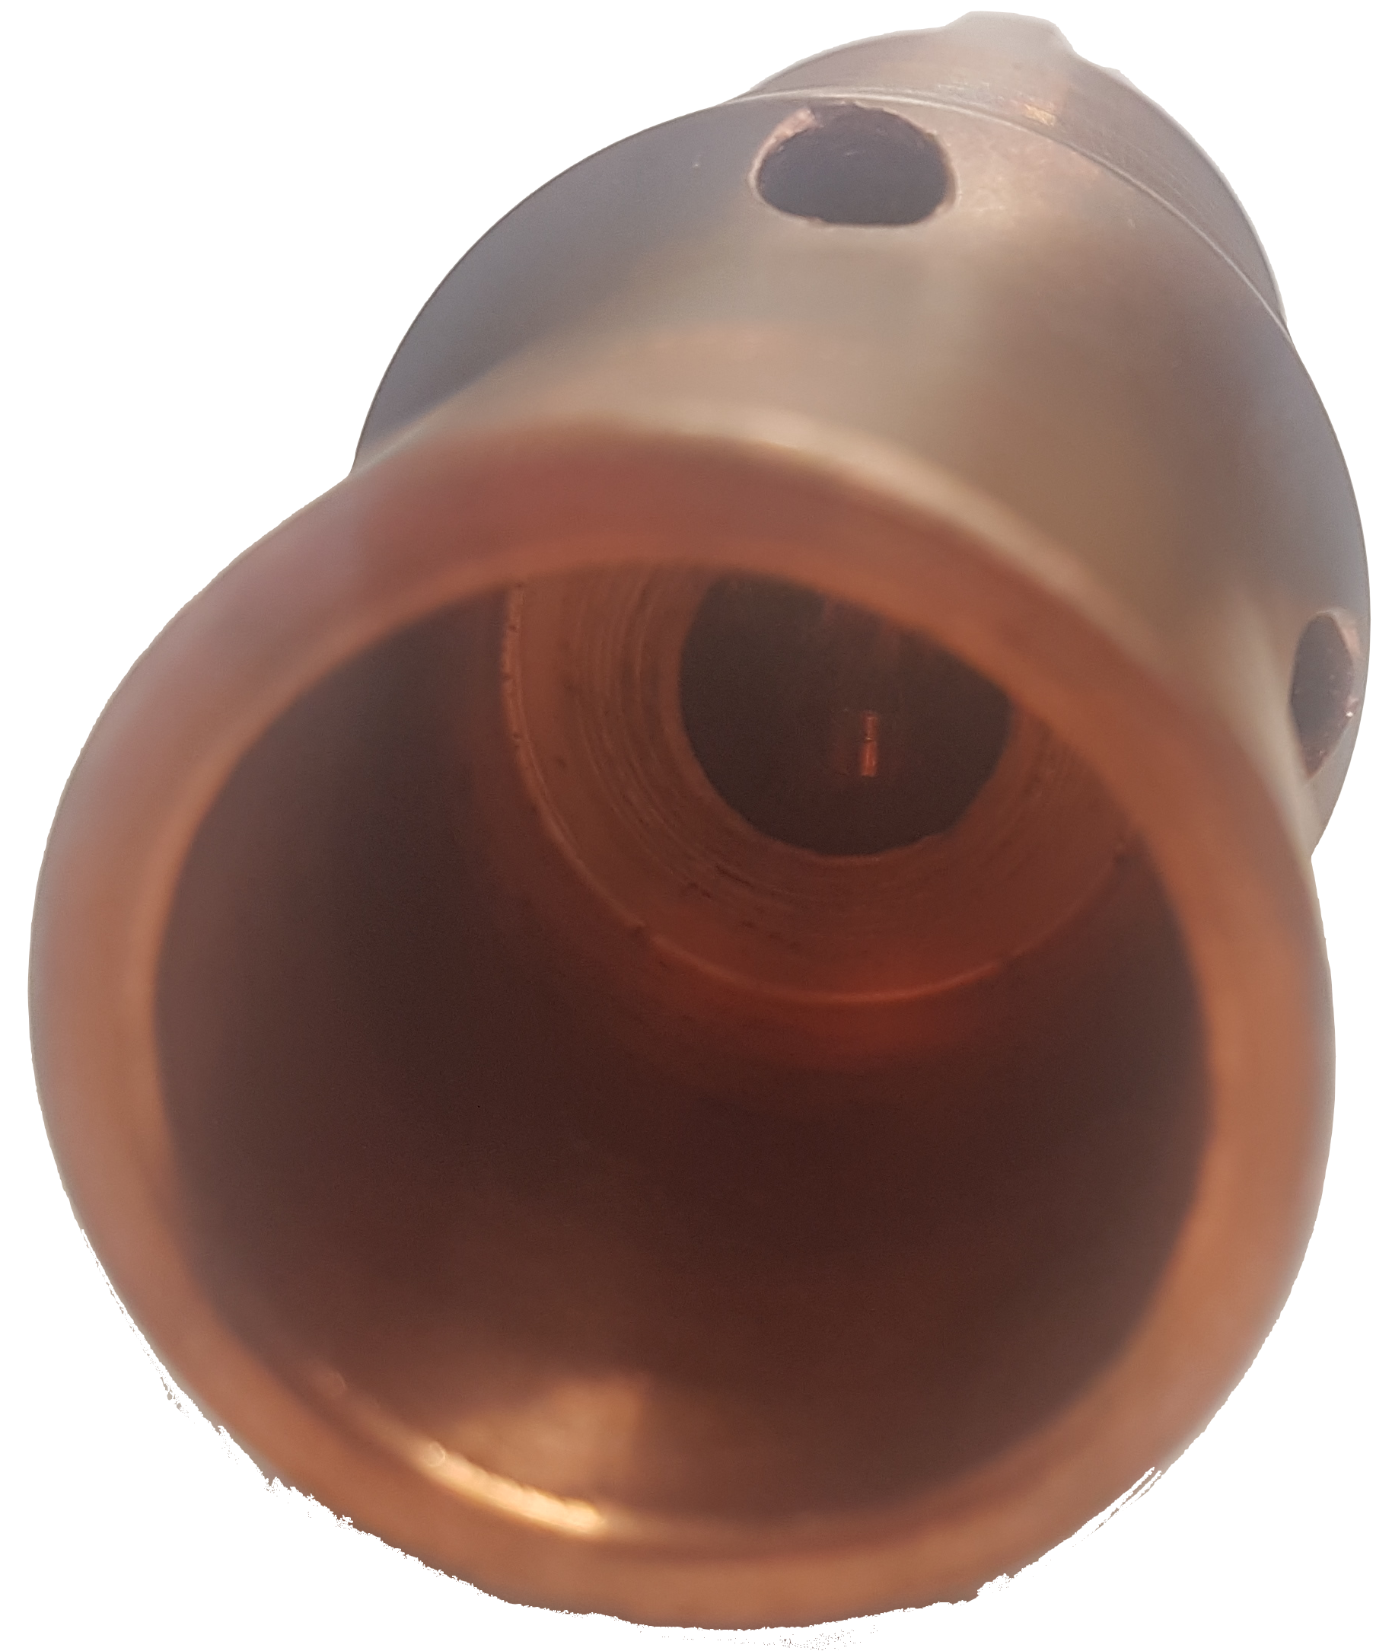
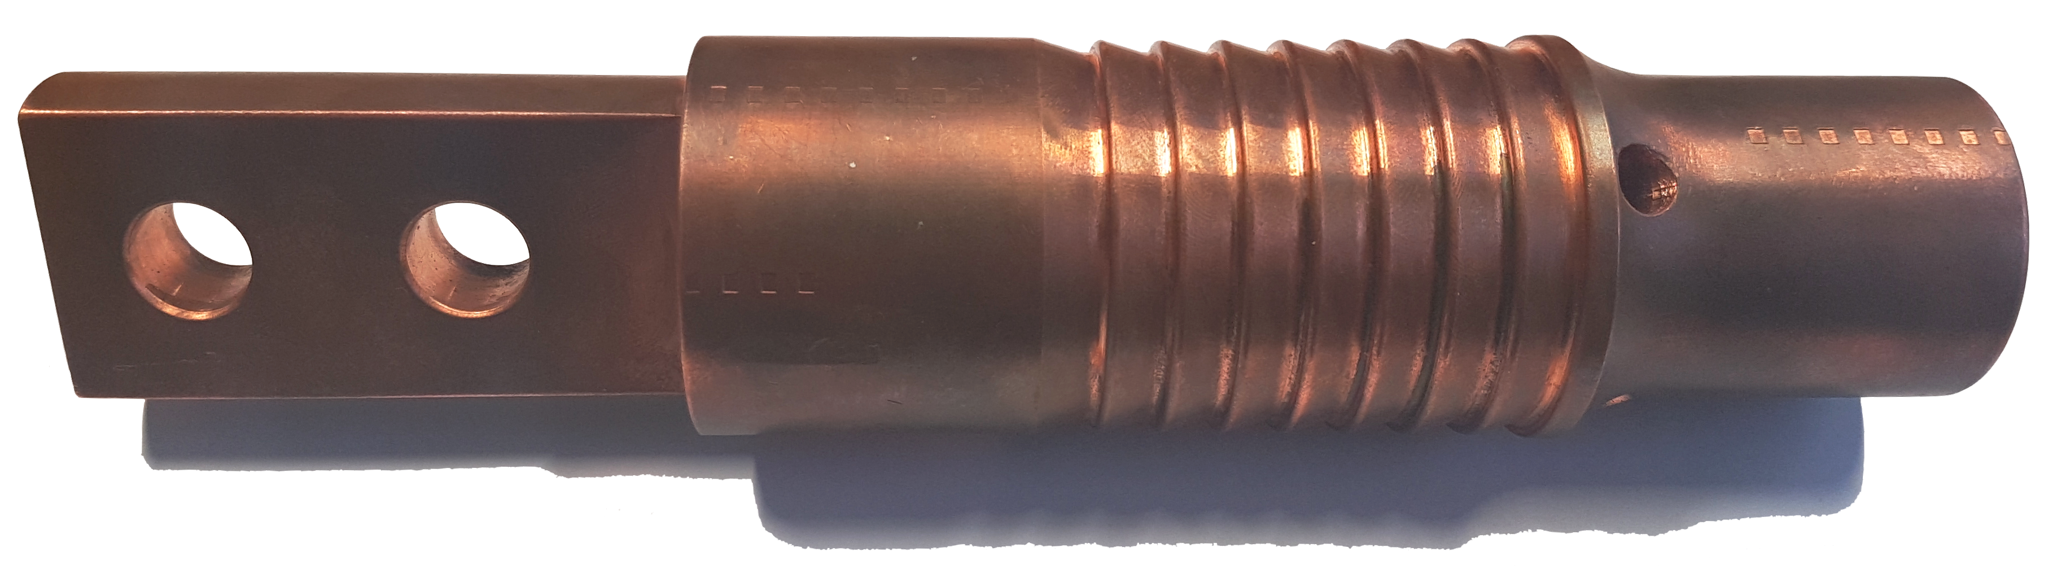
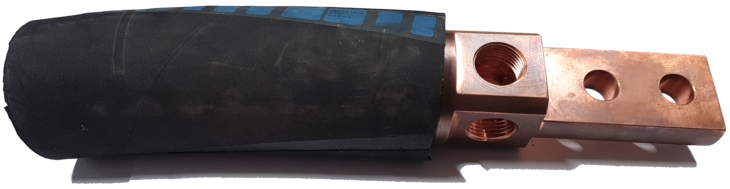
Introduction to WCC’s
Example: WCC lug, 500 mm² – FLOHE company
cable crimping zone
cable placed inside lug
water in/out flow mainly
through outside-holes
between lug and hose
screw fixations
hose crimping zone
water in/out
Notes:
Typical WCC lug 500mm2 where can be identified the hose Crimping zone and cable crimping zone
The cable is crimped inside the lug
The hose is crimped outside the lug

Slide 12
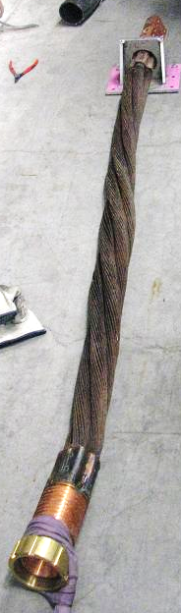
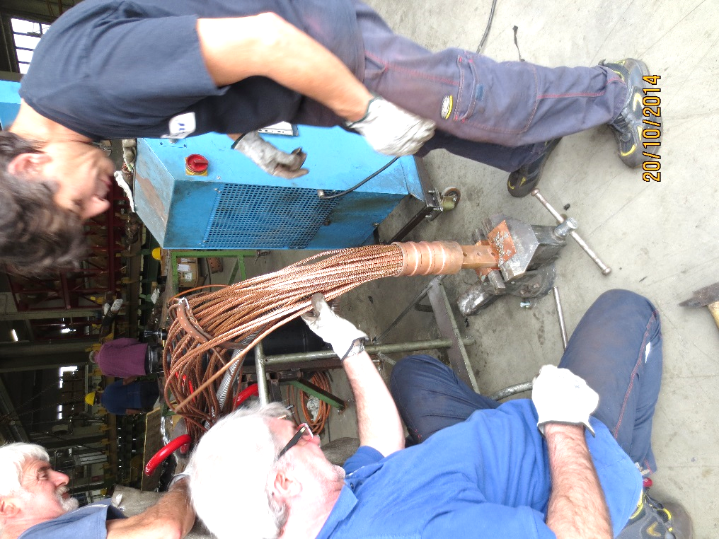
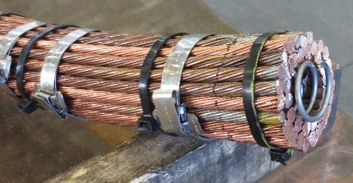
WCC Technologies
Cable bundle braised on the lug:
WCC with spring (BRAR, 2000mm²)
Cable bundle crimped on the lug:
WCC without spring (FLOHE, 2000mm²)
Notes:
Two different technologies and suppliers (FLOHE – BRAR) are shown
Cable bundle crimped on lugs and Copper Braid braised on the lug
The SPRING used by BRAR have an effect to increase the cable rigidity.

Slide 13
Main WCC Suppliers in Europe
Three main suppliers in Europe
Relevant information taken from suppliers catalogues
  Suppliers usually provide cables with non-standard sections
FLOHE | BRAR | GECSA
Standard Sections [mm²] | Standard Sections [mm²] | Standard Sections [mm²]
500 | 900 | 2500
800 | 1200 | No cables below 2500 mm²
1000 | 1500
1300 | 1800
2000 | 2100
WCC with cable bundle
crimped on lug
WCC with cable bundle
braised on lug

Slide 14
LHC WCC Specifications
Cross-section [mm²] | Nominal current [kA] | Leakage current [µA/m] | DC voltage test level [kV]
500 | 3.5 | 10 @ 3.0 kV | 3
800 | 6.0 | 20 @ 1.5 kV | 3
1000 | 8.0 | 20 @ 1.5 kV | 3
1300 | 8.0 | 30 @ 1.5 kV | 3
2000 | 13.0 | 40 @ 3.0 kV | 3
Normal usage
Voltage level | 500 V DC
Highest transitory voltage | 500 V
Operating temperature (hose) | 50 °C
Cooling water pressure in operation | 16 bar
Rated pressure | 24 bar
Water pressure drop | < 2 bar
Water speed | < 2.5 m/s
Maximum input water temperature | 28 °C
Maximum delta T (water in/out) | 15 K

Slide 15
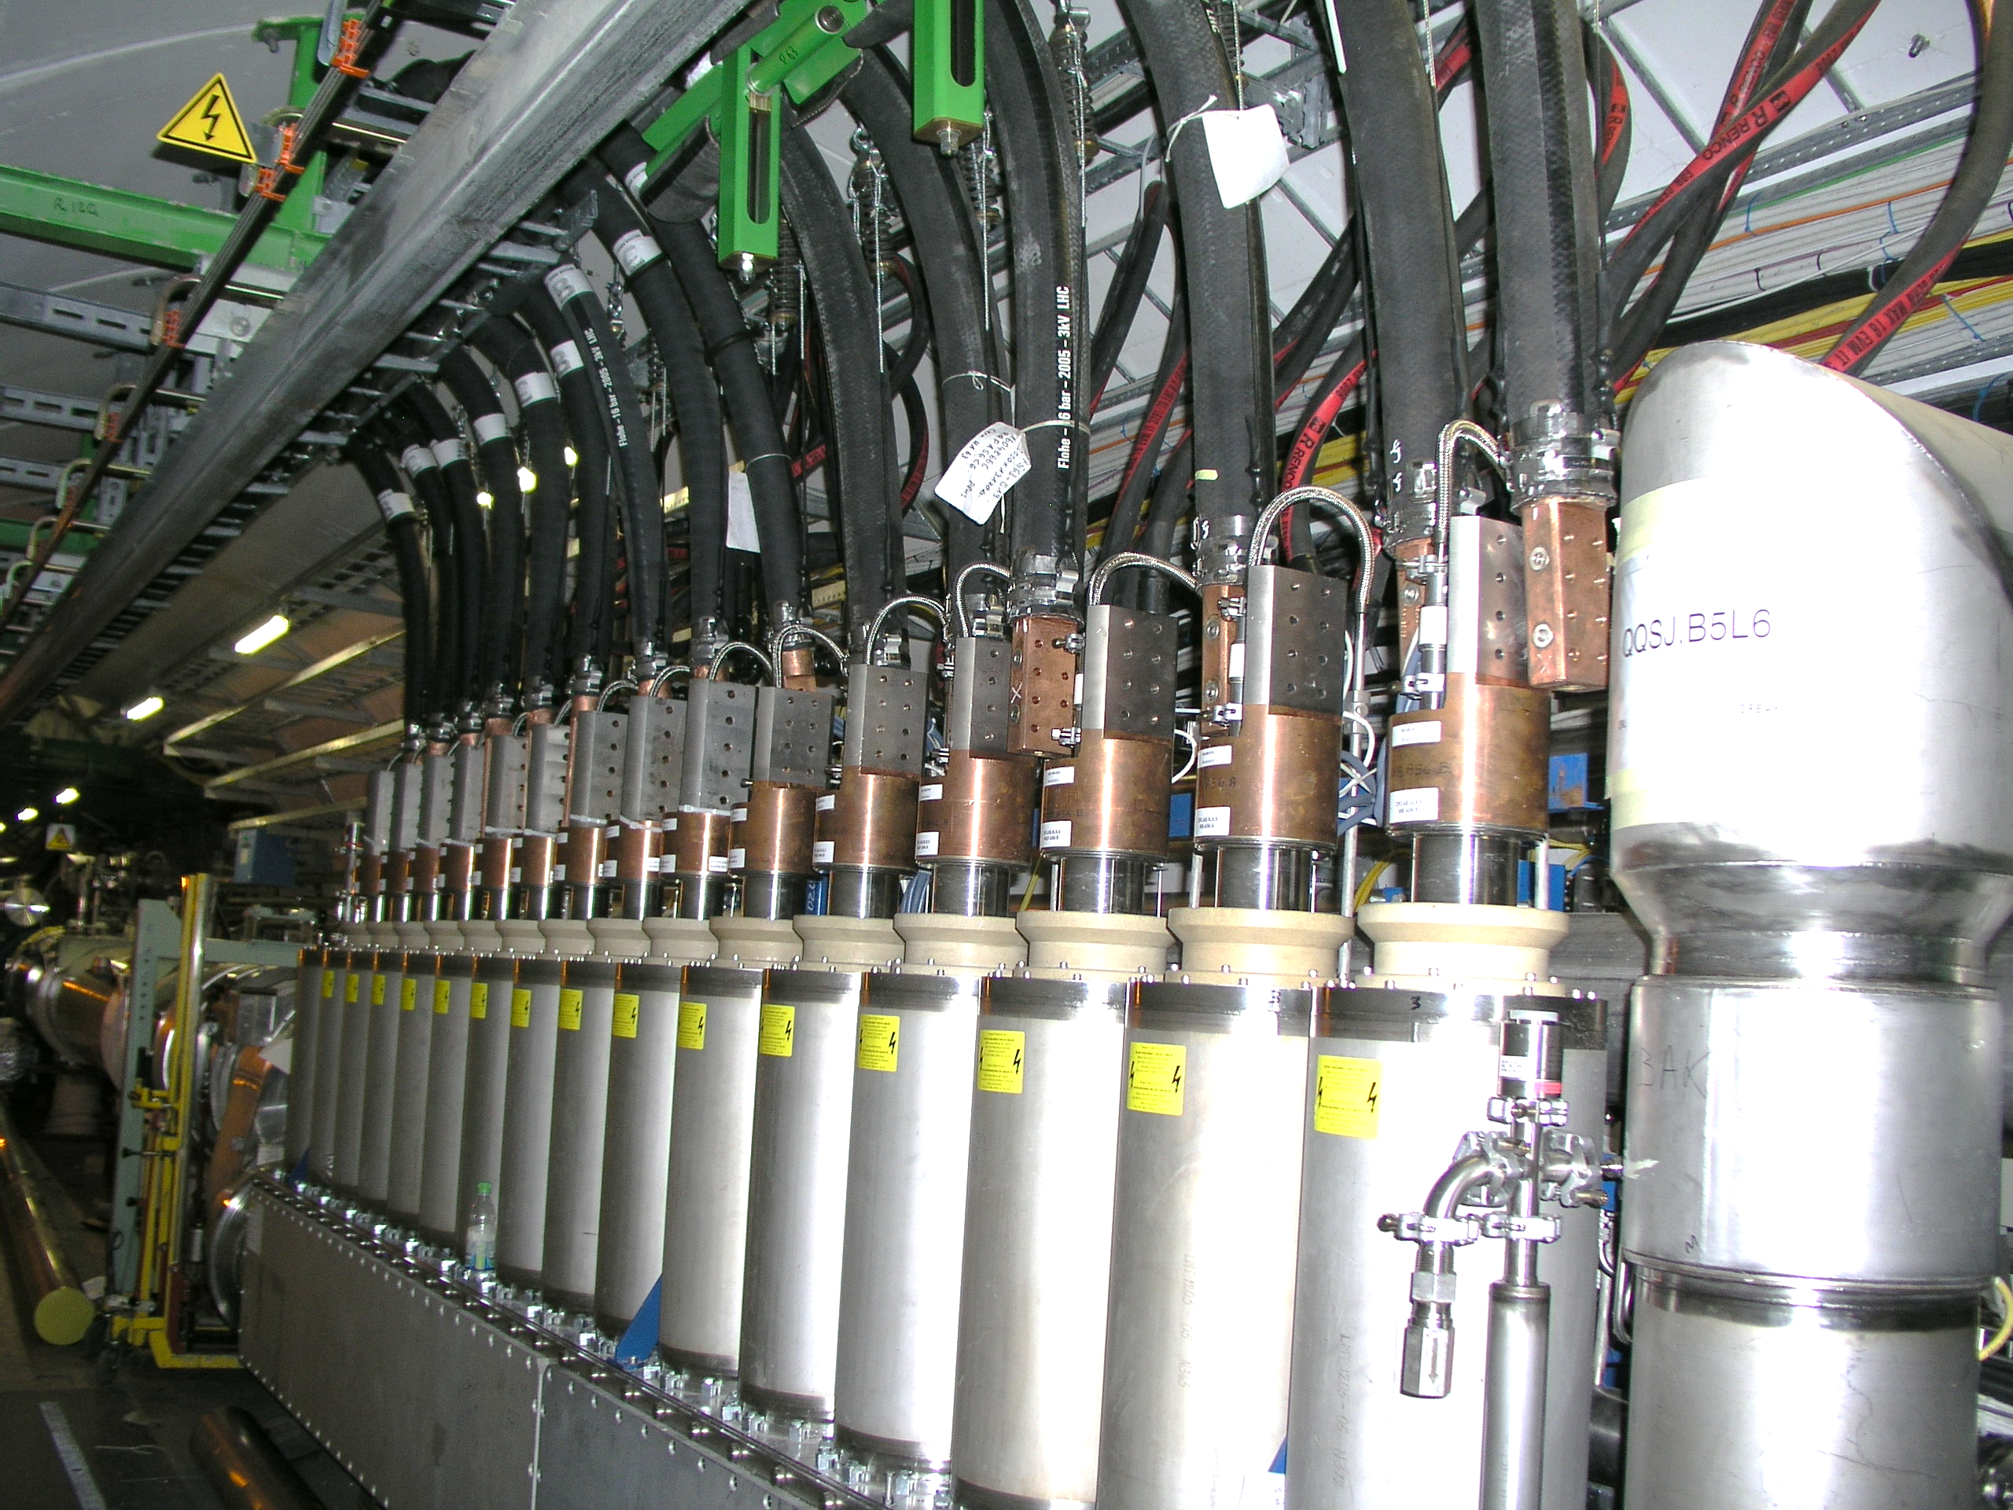
LHC WCC Installation Example: DFBAK.5L6
6 kA
1000 mm²
13 kA
2000 mm²
Notes:
We can observe Current Leads and Cable lugs
Special support and suspension are needed to avoid stress on Current Leads
Space on top of Current leads shall be reserved

Slide 16
Table of Contents
Electrical Circuit
Cable Requirements
Water Cooled Cables Specifications
Installation Constraints
Water Cooled Cable Layout
Documentation
Open Issues

Slide 17
Dimensional Constraints
Cables for circuits:
Cable trays
13 kA & 18 kA
Area reserved
for cable supports
6 kA
r
2 kA
Intensity | Section [mm²] | h [mm] | r [mm] | Ext. Diam. [mm]
18 kA | 2x1300 | 500 | 800 | 2x95
13 kA | 2000 | 500 | 800 | 115
6 kA | 1000 | 500 | 700 | 95
2 kA | 500 | 500 | 500 | 70
600 A | 400 | 300 | 300 | 36
200 A | 95 | 200 | 200 | 25
120 A | 70 | 150 | 150 | 22
200 A & 120 A
1200 mm
600 A
1300 mm
1000 mm
h
600 mm
400 mm
most significant constraints
1000 mm
DFH
Space reserved
for access.
Notes:
The MAIN design constraint is the BENDING RADIUS of the WCC that must be respected
Space shall be reserved on top DFH for cable support / suspension. Can be utilized also during operation and maintenance to access the current lead

Slide 18
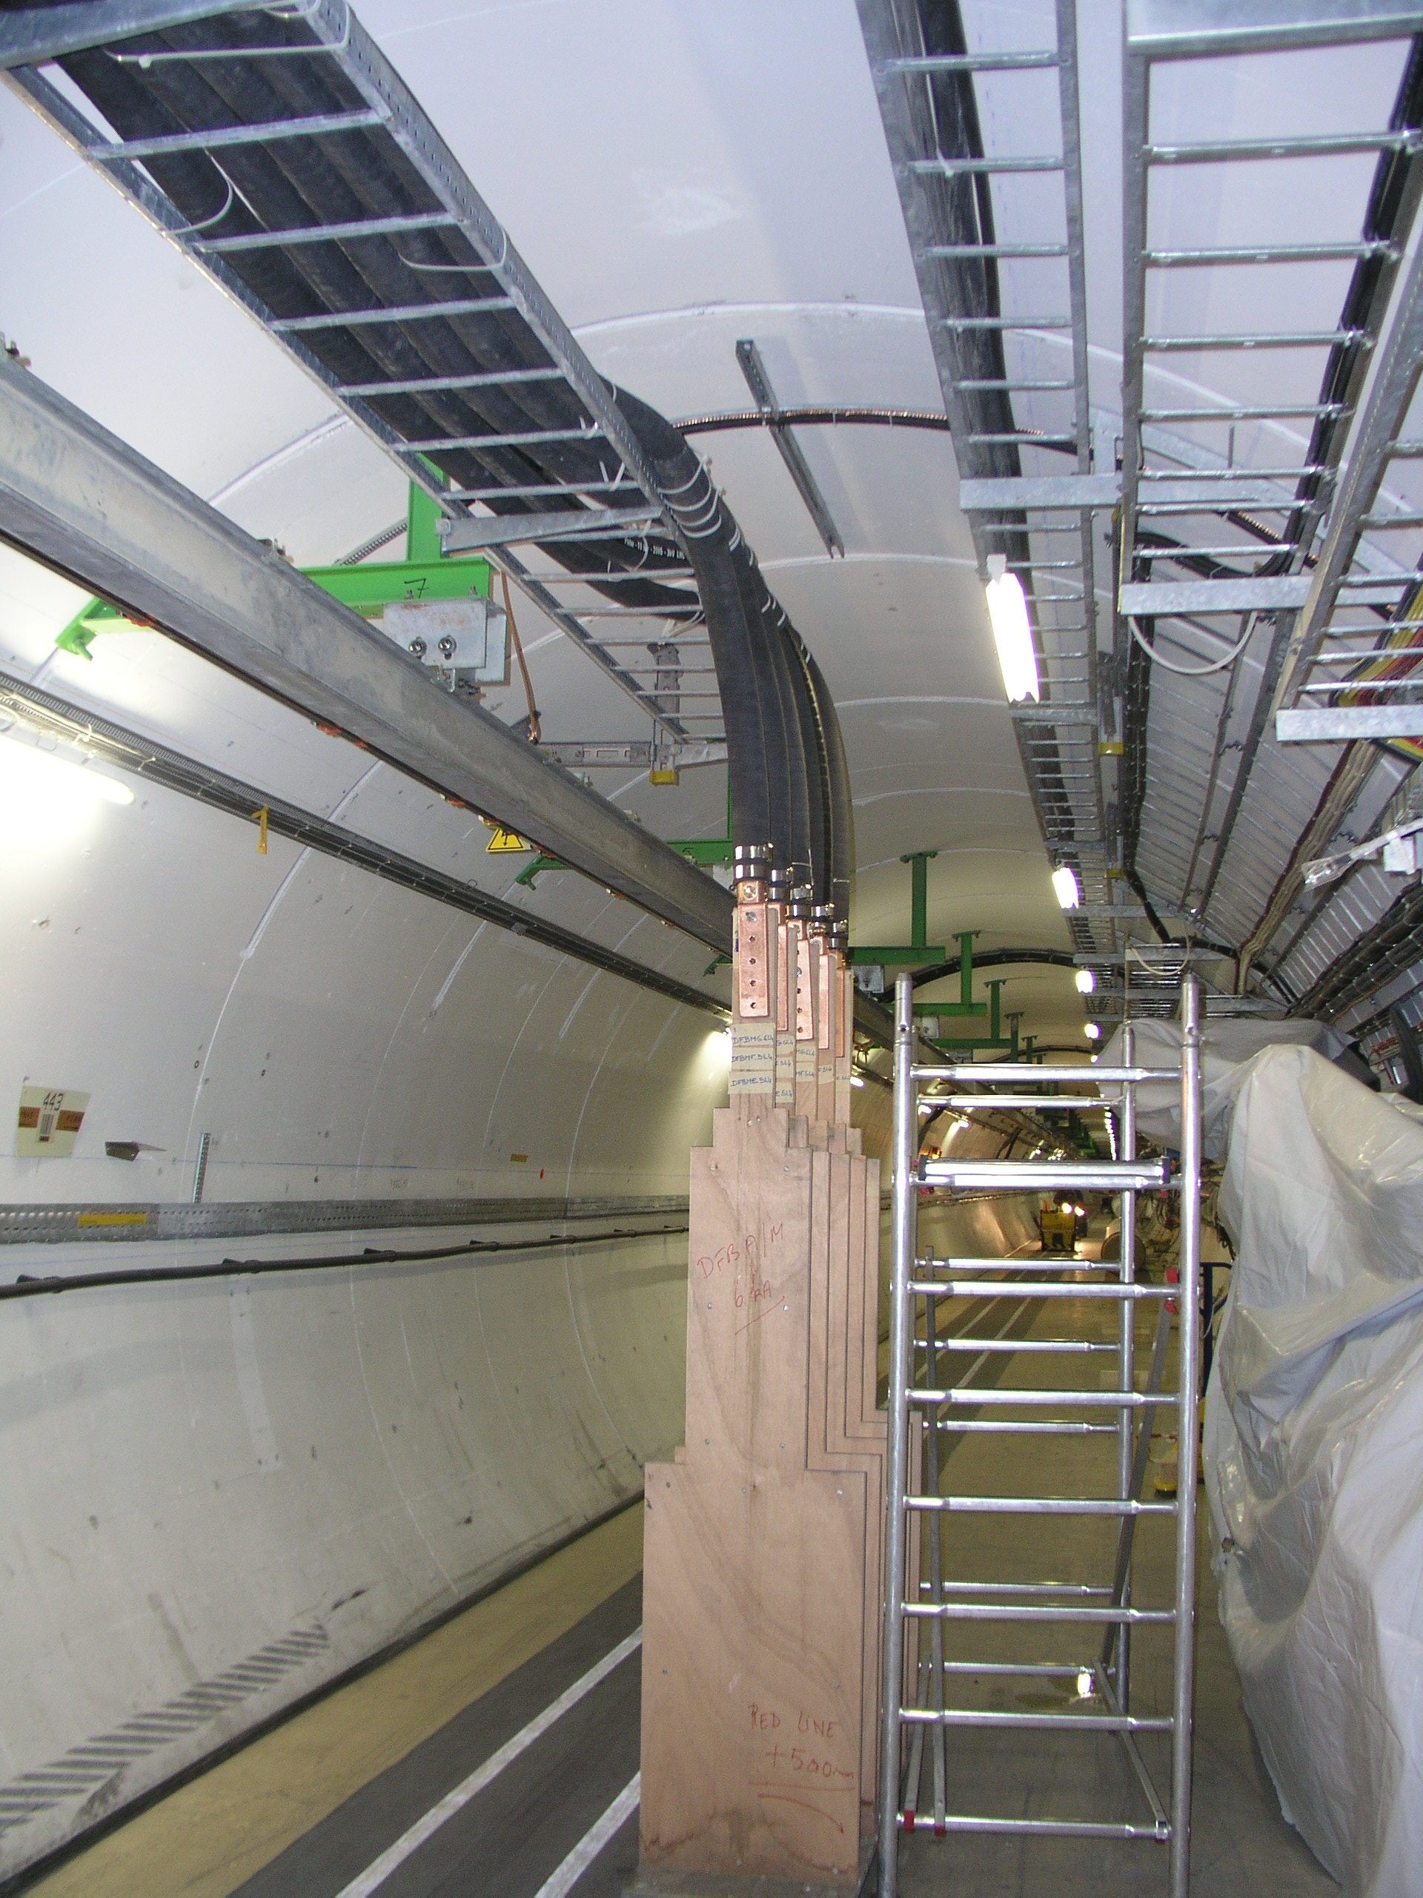
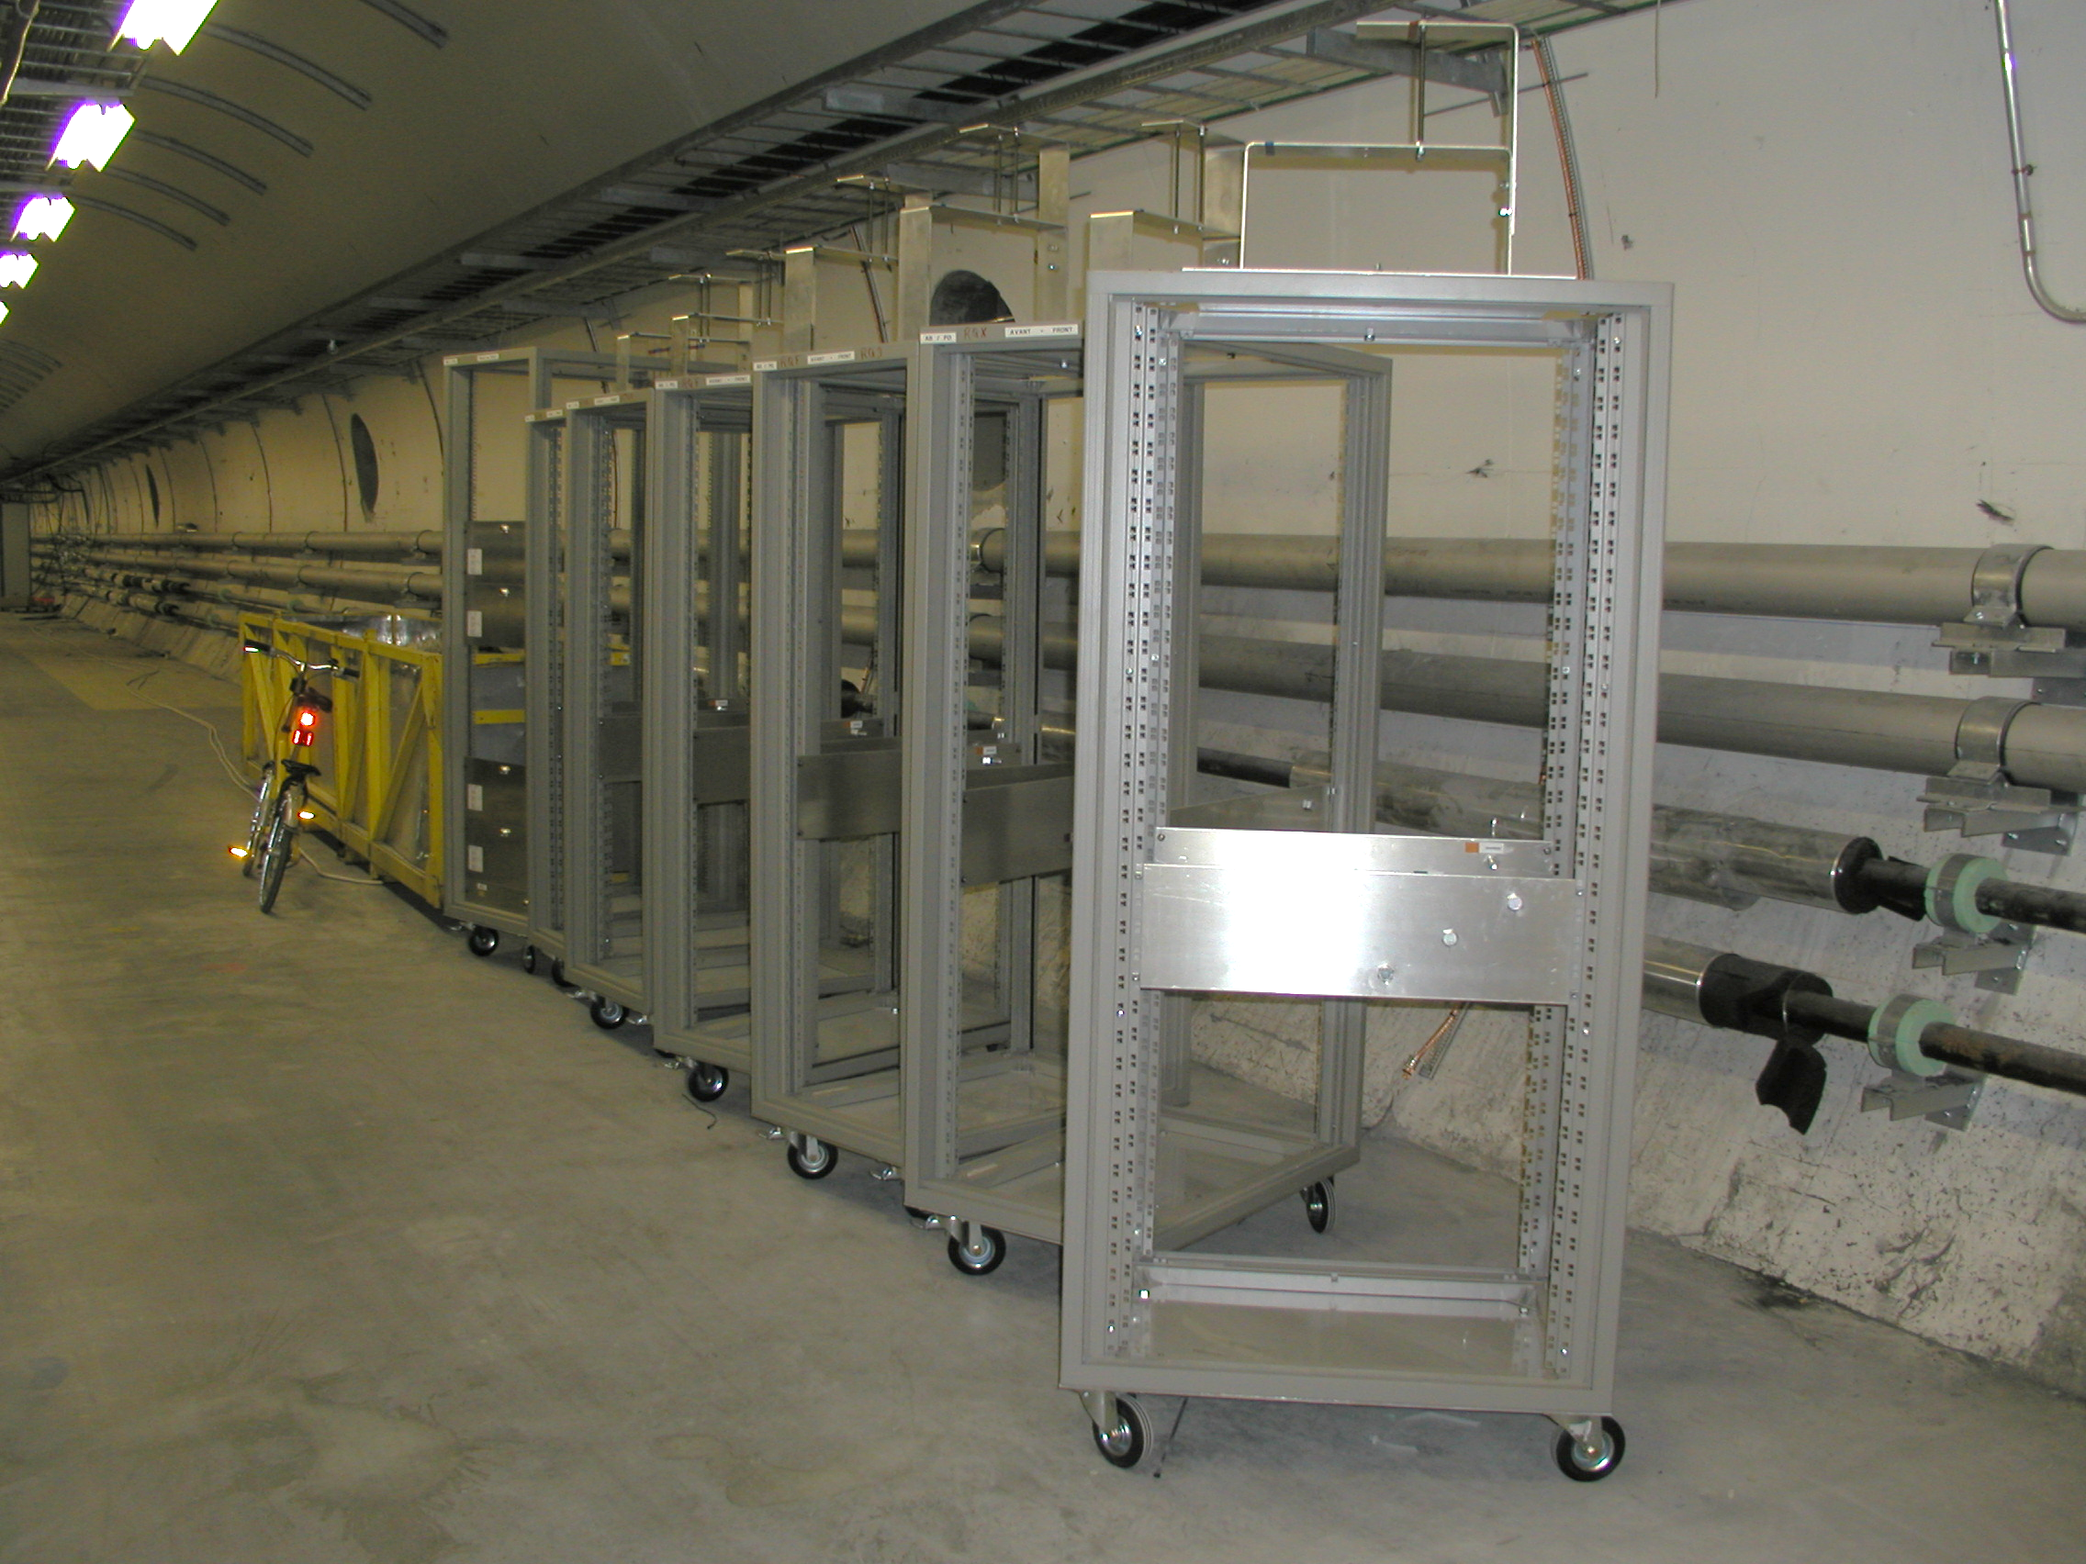
Accessibility
Accessibility to WCC support (installation & maintenance)
Space needed for installation
  Large bending radius
  Manipulation of the cable
  Demineralised water infrastructure
Cable installation to be done before placing DFH’s
Mockup DFB (LHC installation)
Mockup power converters (LHC installation)
Notes:
As experience in LHC a mockup has been installed for Current lead and power converters

Slide 19
Table of Contents
Electrical Circuit
Cable Requirements
Water Cooled Cables Specifications
Installation Constraints
Water Cooled Cable Layout
Documentation
Open Issues

Slide 20
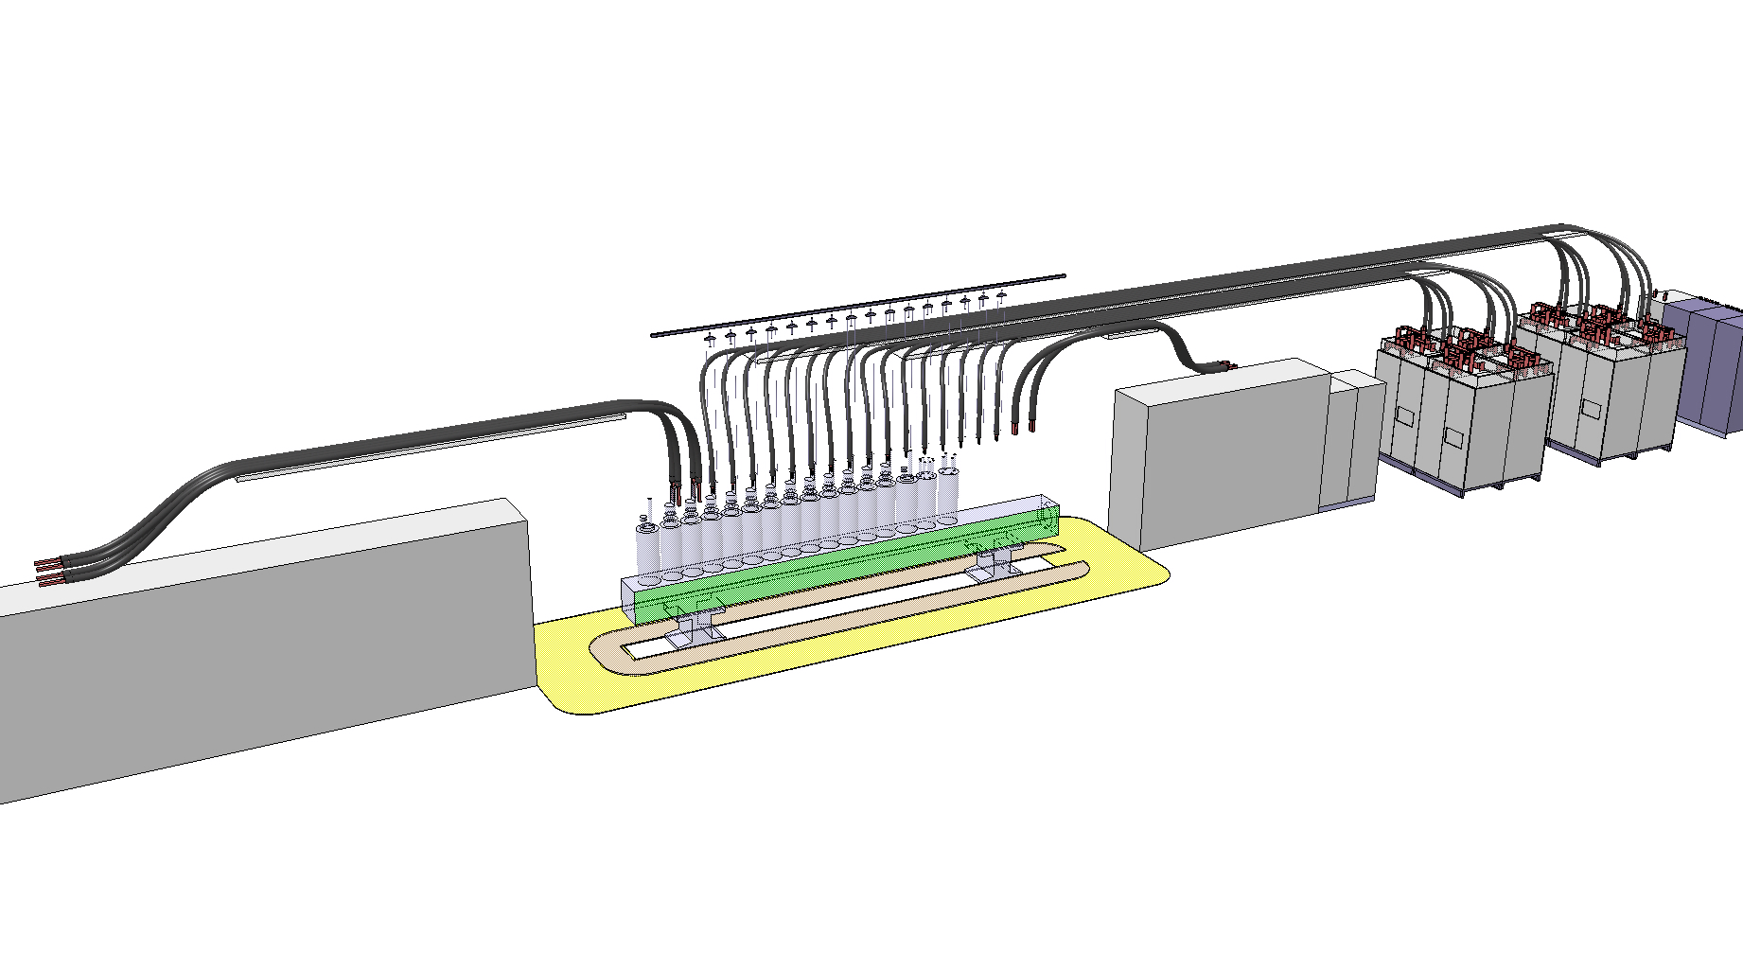
Power Converter and DFHX Layout (1/2)
Layout only for WCC
adjustable individual supports for WCC
special support for WCC
2 kA
2 kA
13 kA
18 kA
Proposed layout with max 2 cables per current lead
Notes:
Layout Integration study
Position of converter for optimization of cable length for minimize the length and the heat losses
The sequence of current lead shall be deduct from the cable layout and defined to minimize the WCC length

Slide 21
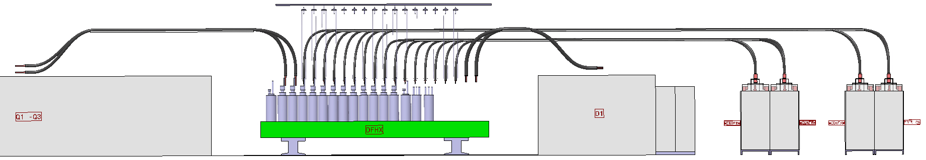
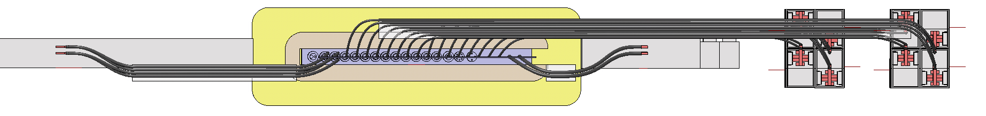
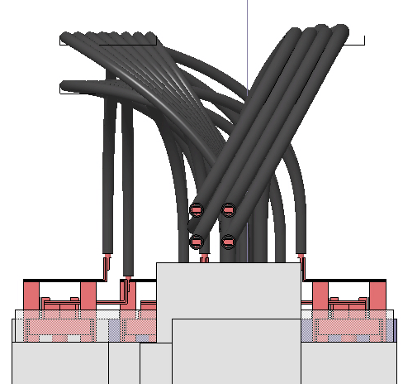
Power Converter and DFHX Layout (2/2)
Front view
Top view
Cable tray positioning constraints:
Depending on converter/DFH alignment
Maintain current leads accessible and removable (LHC)
Cables shall not exert mechanical stress on the current leads when connected
→ cable trays are not aligned in order to fulfill the constraints
Side view
Notes:
Converter layout has impact on the DC WWC layout to minimize the length and avoid overlapping of cables in proximity of Current Leads

Slide 22
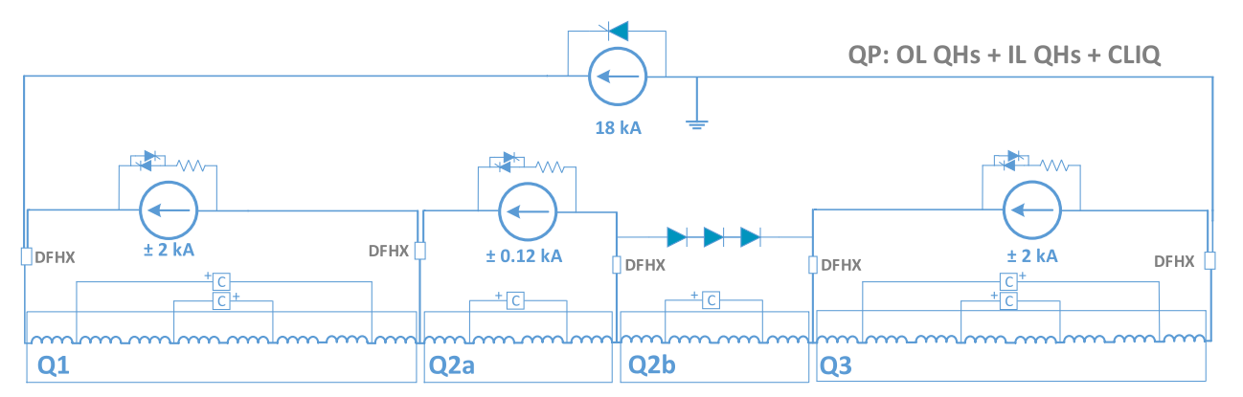
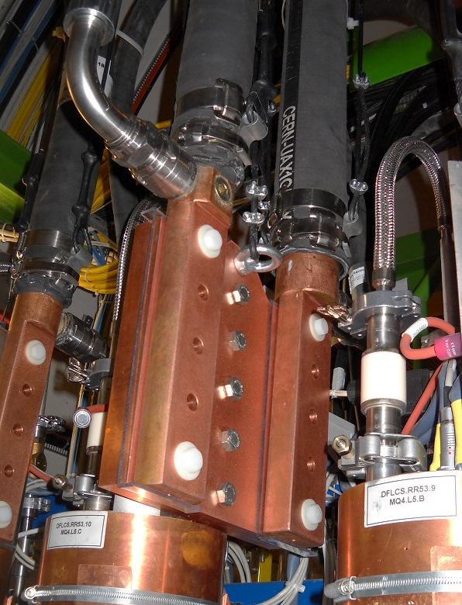
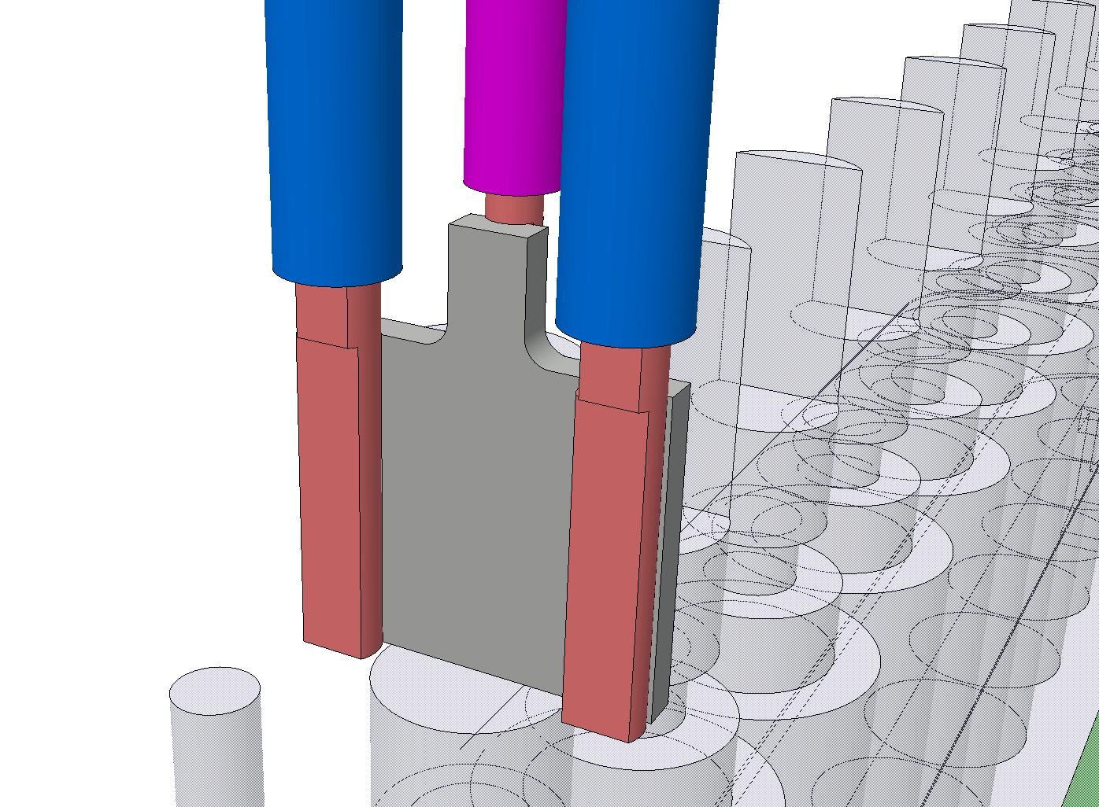
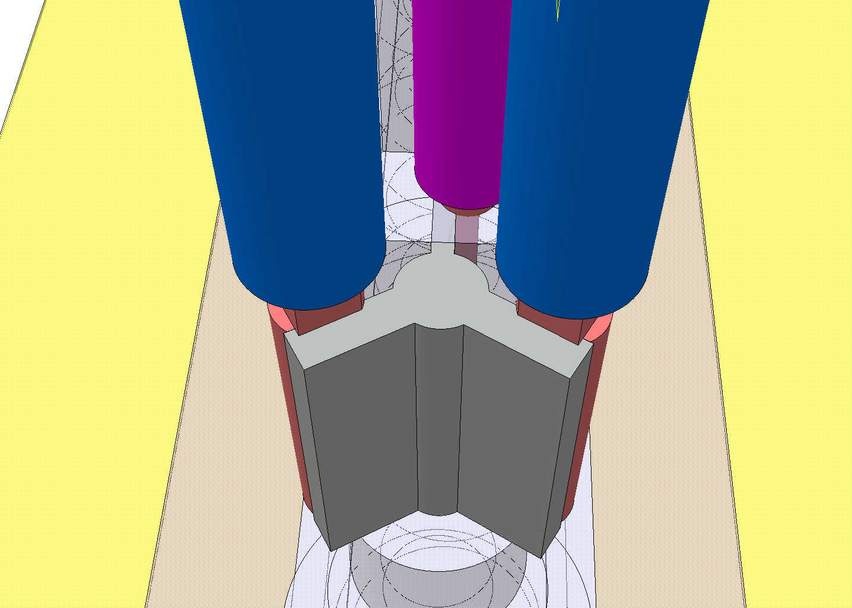
DFH Interface for 3 Cables
3 cables per current lead at DFHX
  2x1300 mm²
  1x500 mm²
DFHX – 3 cables per current lead
Applied solution for LHC
TOTEM 2 cables per current lead
HL-LHC: Solution 1
HL-LHC: Solution 2
Not to be used as discussed with Jerome Feiter

Slide 23

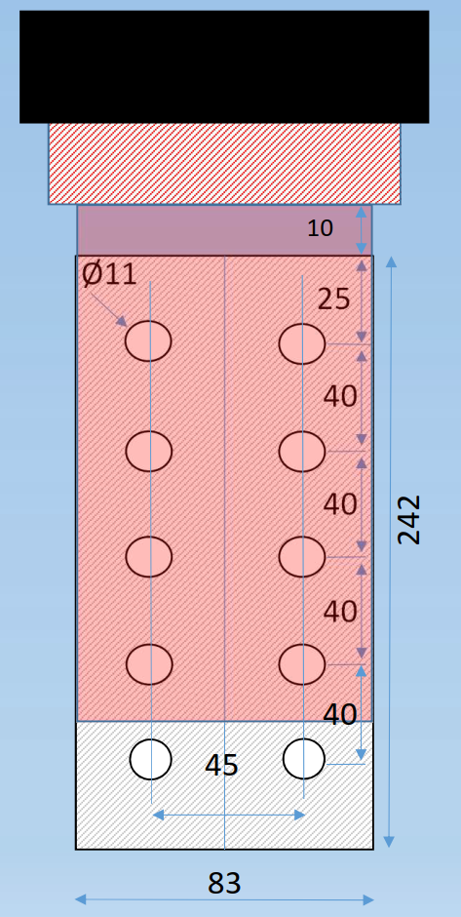
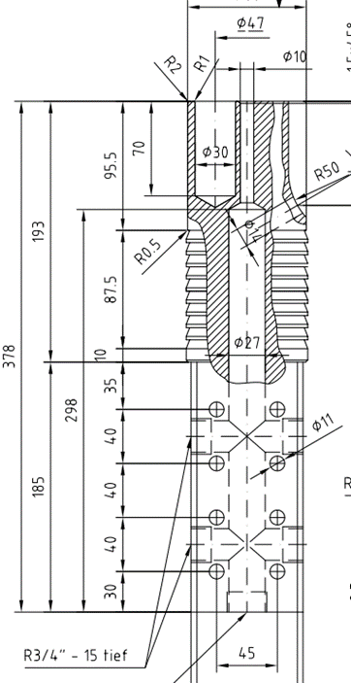
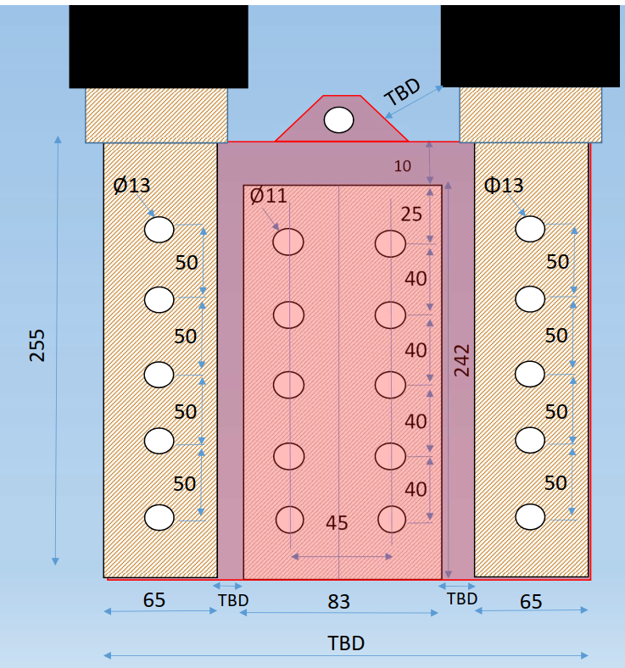

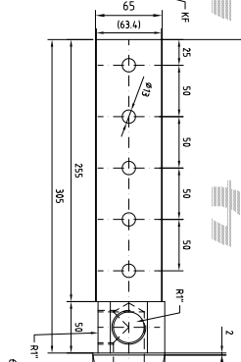
Current Lead Interface for WCC Cables
Constraint: Same Interface with Current Lead
13kA
  WCC 1x2000 mm²
18kA
  WCC 2x1300 mm²
Current Lead dimensions (WxH)
83 x 242 mm
Current density 0.89 A/mm²
S_{Lead} = 20086 mm²
Proposed solutions to be confirmed after integration study

Slide 24
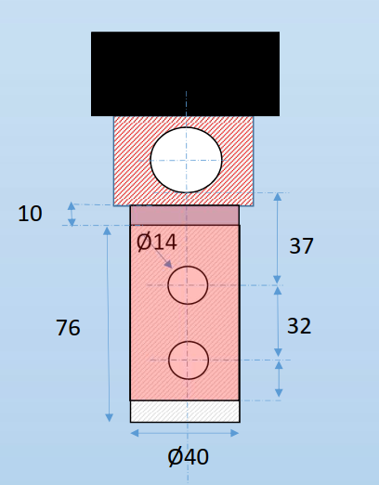

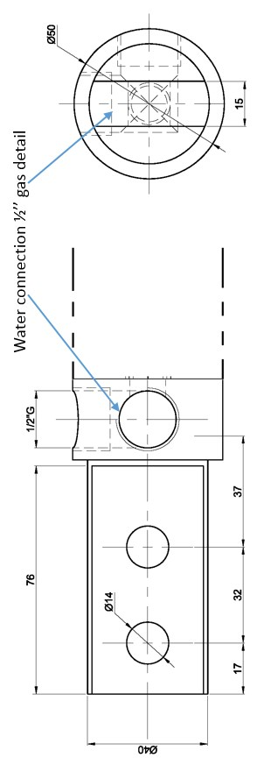
Current Lead Interface for WCC Cables
2kA
  WCC 500 mm²
Current Lead dimensions (WxH)
40 x 76 mm
Current density
0.76 A/mm²
S_{Lead} = 3040 mm²
Contact Surface
40 x 66 mm
S_{contact} = 2640 mm²
Proposed solutions to be confirmed after integration study

Slide 25
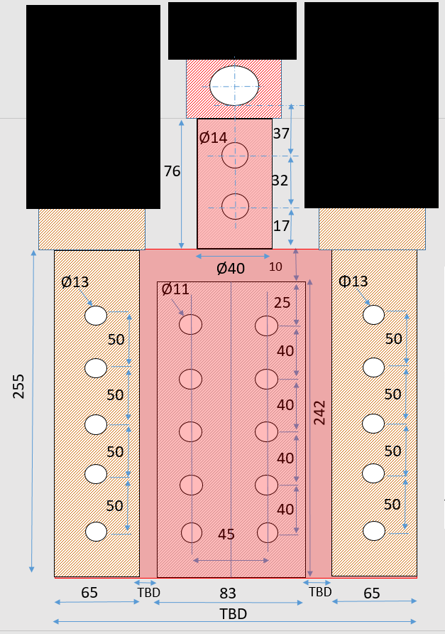
Current Lead Interface for WCC Cables
WCC not on the same plane
18kA + 2kA (TRIM)
  WCC 2x1300 mm² +1x500 mm²
Current Lead dimensions (WxH)
83 x 242 mm
Current density 0.89 A/mm²
S_{Lead} = 20086 mm²
Proposed solutions to be confirmed after integration study

Slide 26
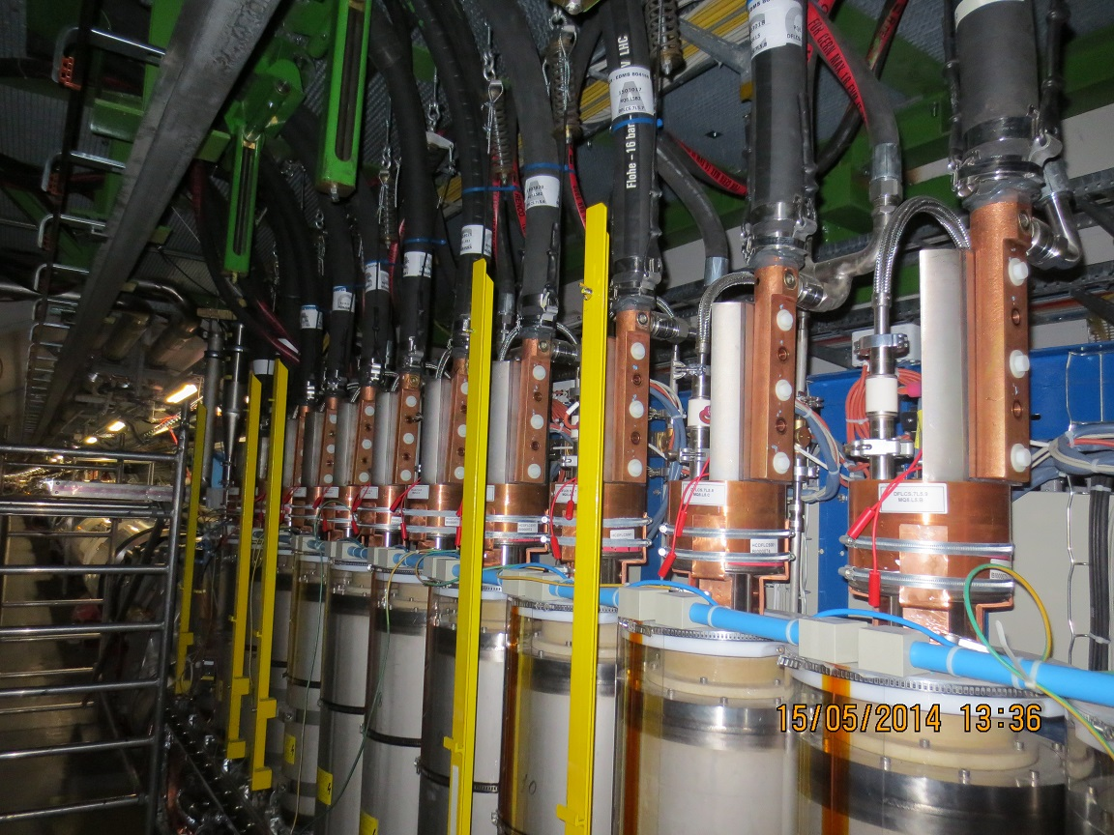
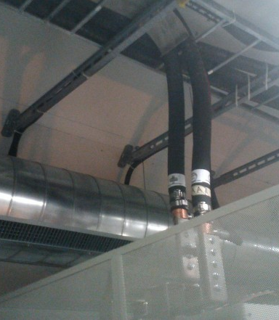
Current Leads / Converters
Arrival of cables on equipment
I – Vertical on Current Leads
II – Vertical on Converter Bus Bar
Requires Suspension / Supports to avoid stress on current lead
Dedicated Cable tray
Support (avoid damage of the hose)

Slide 27
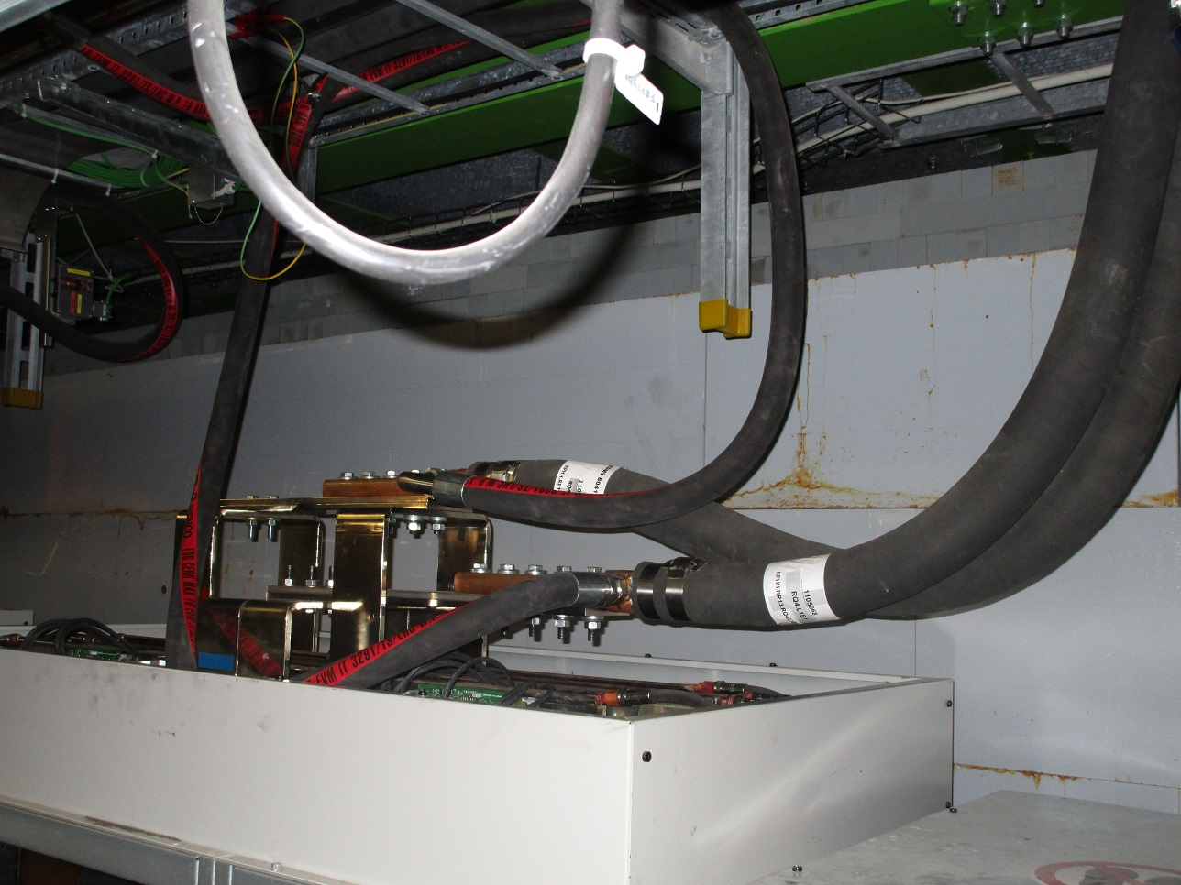
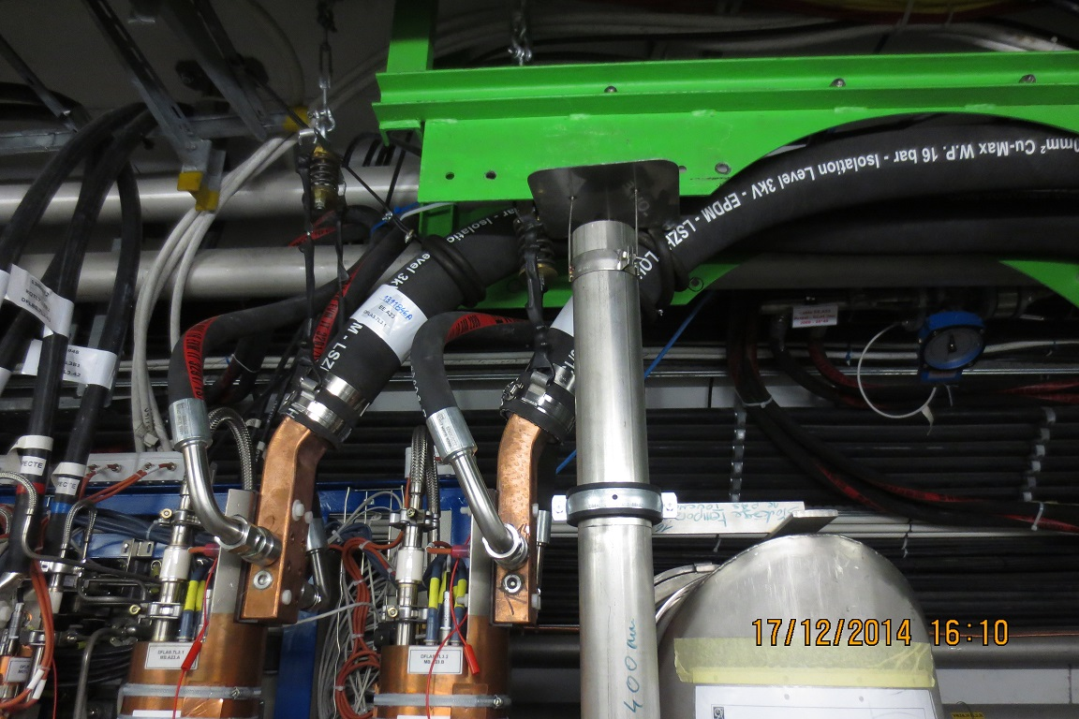
Current Leads / Converters
Interface for WCC Cables
III – Horizontal on Converter busbar
IV - Inclined on current Leads
- Less stress on bus bar
- Cable need space on Converter side
- No Suspension / Support from top
- Plates between Converter and cables
Reduce stress on current leads
Suspension / Support
Reduce space between Current lead and vault
Possible Angle 30º

Slide 28
Table of Contents
Electrical Circuit
Cable Requirements
Water Cooled Cables Specifications
Installation Constraints
Water Cooled Cable Layout
Documentation
Open Issues

Slide 29
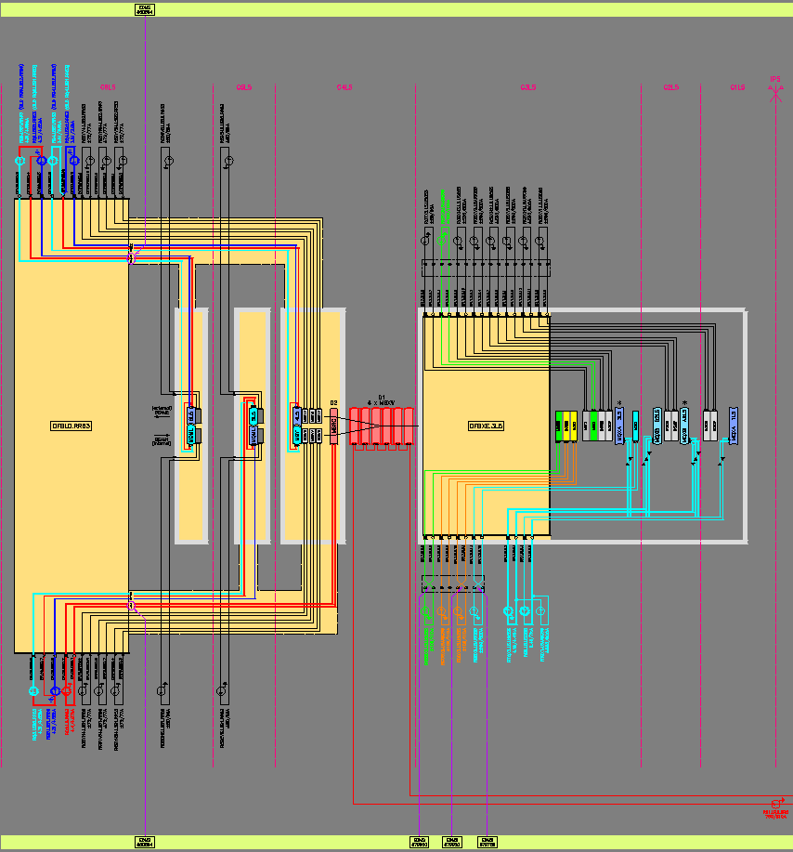
LHC DC-Scheme Example: Point 5 Left
HL-LHC DC scheme ongoing
RQ5.L5B1
RQ5.L5B2
Notes:
Drawing requested by HL-MCF and realized by EN-EL -DDO

Slide 30
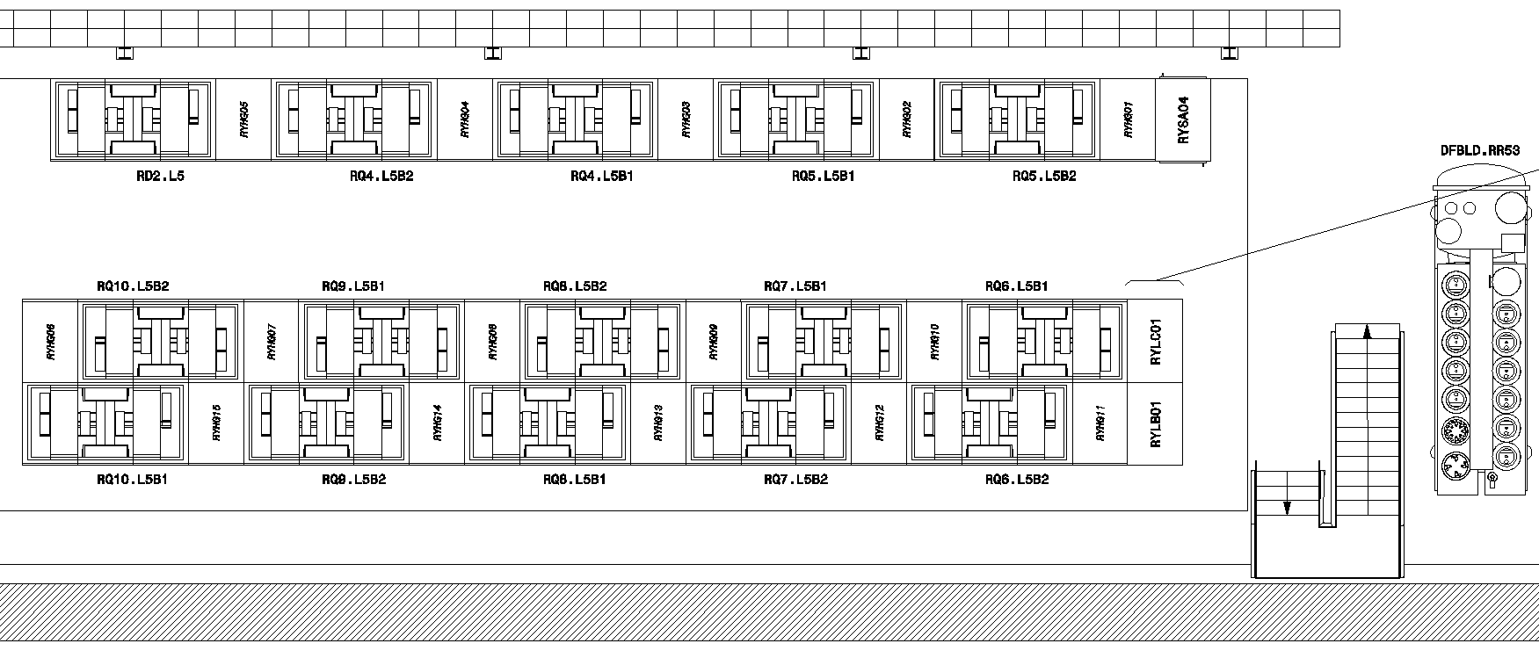
LHC Equipment Layout Example: RR53
RQ5.L5B1
RQ5.L5B2
Notes:
Equipment Layout realized and maintained by EN-EL

Slide 31
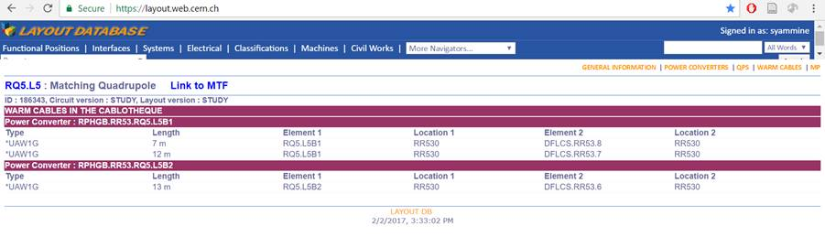
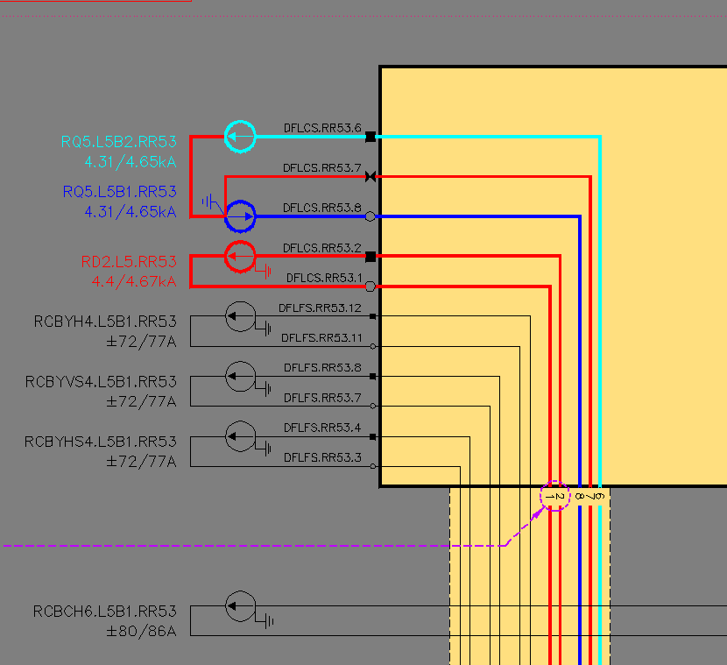
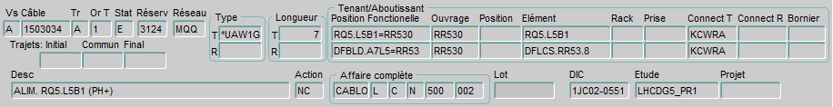
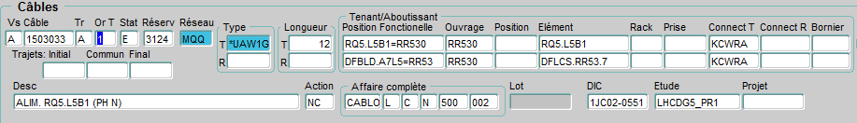
Existing Relation between Databases: Example of 2 Cables Installed at LHC RQ5.L5
Technical database – Layout Database
Database for installations – Cablothèque
DC-Scheme
DFBLD.A7L5
Elements (circuit names) make link between databases
Notes:
Circuit name makes link between databases
Elements are links between database EN-EL and electrical DC scheme
Additional field in GESMAR recently for DC Circuit Name

Slide 32
Table of Contents
Electrical Circuit
Cable Requirements
Water Cooled Cables Specifications
Installation Constraints
Water Cooled Cable Layout
Documentation
Open Issues

Slide 33
Open Issues
Sections Optimised?
  Cables adapted to electrical circuit parameters ?
  Current profile ?
  Other constraints ?
Position and size of DFH’s?
  For further studies on cabling → details on DFH’s and power converters necessary (exact position, connection technology)
Separator (Disconnector) ?

Slide 34
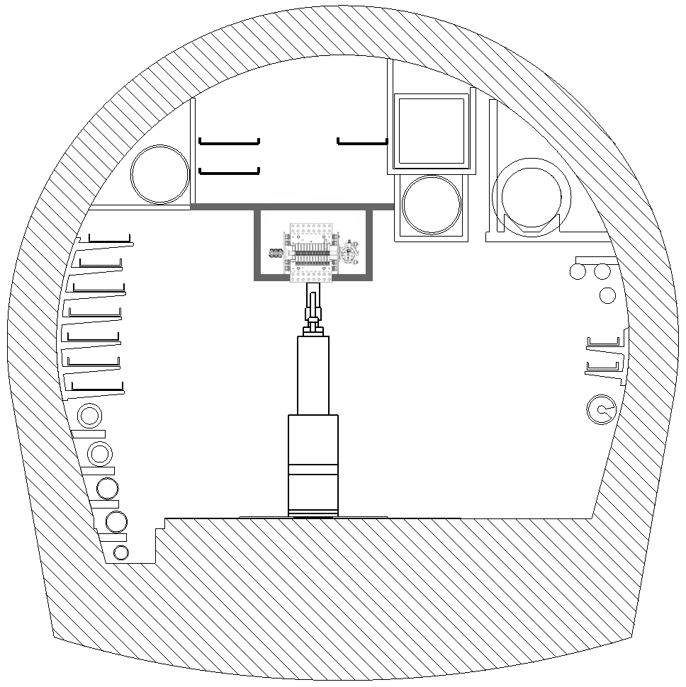
First Attempt of Separator Location (1/2)
HL-LHC UR-section
support example of separator
real-size separator
DFHX

Slide 35
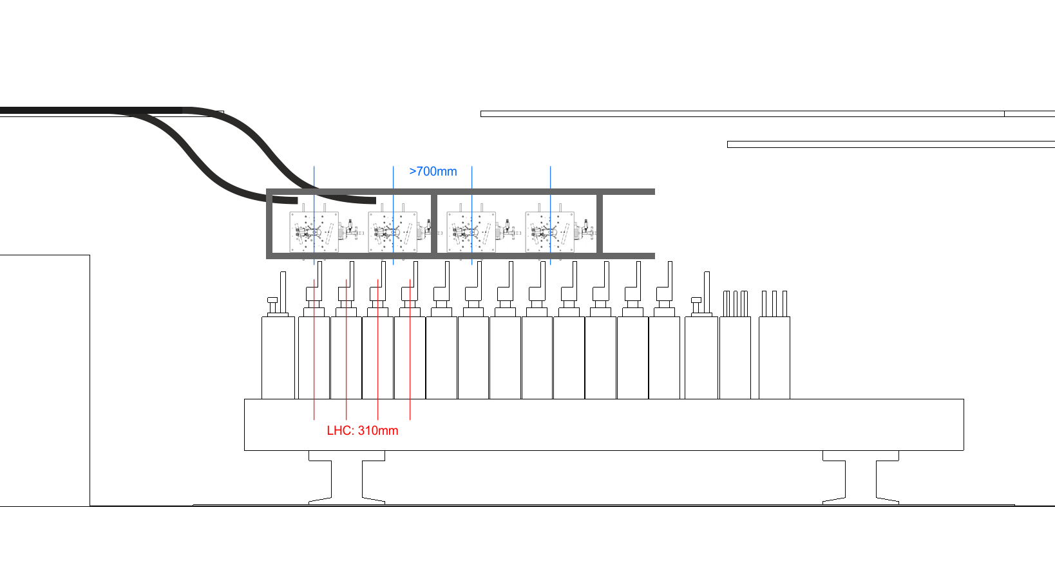
First Attempt of Separator Location (2/2)
Possible to locate separators on top of current leads?
3 cables
real-size separator
2)
2)
3)
1) separators on top of DFH

Slide 36
Open Questions (?)
1) Decision about circuit separators
  Are they needed?
  What model, which size (technical specifications)
  Adaptation to cable connection constraints: Interfaces/adaptation of standard model?
  For commissioning of DC-circuits – short-circuit test:
  How to integrate separator in the test?
2) How to connect WCC’s to separator?
  Allowable weight of cables on separator?
  Space for WCC & water flexibles sufficient?
  Accessibility to WCC guaranteed during and after installation?
3) How to support/fix separator?
  Possible conflict with WCC accessibility?

Slide 37
Thank you for your attention!

Slide 38
Additional Slides

Slide 39
Cable Bending Radius Dependence
External diameter
Hose thickness
Hose material and constitution
Applied water pressure
Cable section
Wire section
Way of winding wires to a bunch
Winding step (distance per turn of wire/bunch)
Technology: spring/no spring

