Slide 1
Using CentOS on a System-on-Chip for control of an ATCA Blade
(e.g. of the ATLAS MUCTPI)

Slide 2
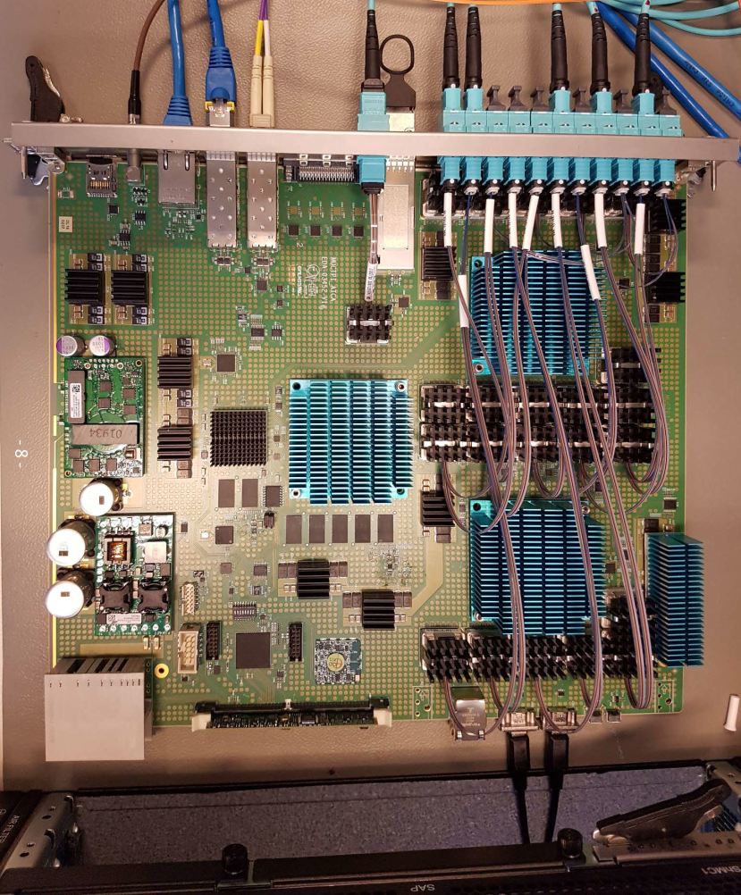
ATLAS - MUCTPI
→ Muon-to-Central-Trigger-Processor Interface
= single ATCA blade
Functionality of the MUCTPI:
Data concentration of 208 muon trigger sector inputs
Overlap removal, i.e. avoid double counting of single muons
Provide muon trigger objects to topological trigger and muon
threshold multiplicity to Central Trigger Processor (CTP)
Use of the SoC:
Configuration, control and monitoring of the board:
Hardware control of clock, power, and optical modules and configuration of FPGAs
Run control of processing FPGAs: read/write status/control
registers and memories/LUTs, read counter registers
Several versions of prototypes:
V1, V2 (available): Xilinx Zynq 7Z030,
dual ARM Cortex A9 (armv7, 32-bit), 666 MHz, 1 GByte DDR3
V3 (2019/Q2): Xilinx Zynq Ultrascale+ MPSoC ZU3eg,
quad ARM Cortex A53 (armv8/aarch64, 64-bit), 1.2 GHz, 4 GByte DDR4

Slide 3
ATLAS MUCTPI - Operating System
Yocto + Xilinx meta layer:
Builds toolchain, i.e. cross-compiler and system libraries
Builds bootloader, i.e. U-Boot
Builds Linux kernel:
  Fetches kernel sources from Xilinx: linux-xlnx
  Configures kernel, e.g. PHY, GPIO, I2C, SPI, iptables, etc.
  Adds patches and kernel modules as necessary, e.g. driver for DMA
Builds a rootfs: can be populated with potentially a lot of software, you choose what you want …
  E.g. ssh, NFS, python, iptables, etc.
Allows user software to be added in a very flexible way:
  Add your own recipe, re-use autoconf, Makefile or CMake etc.
Produces a System Development Kit (SDK):
  Provides the toolchain, i.e. the cross-compiler
  Provides the target root file system, i.e. all header and library files needed for cross-compilation
  Can be used with other buildtools, e.g. build ATLAS TDAQ in its own CMake environment
Note: Xilinx/Vivado and Xilinx/SDK are used to prepare other boot files:
Bitstream file: for programmable logic
First-Stage Boot Loader (FSBL): software to initialize hardware and to load bootloader
Device tree files: used by the Linux kernel

Slide 4
Operating System for SoC?
Different groups/projects use different operating systems:
Who will maintain those operating systems and provide long-term support?
Those operating systems are not CERN standard (CERN/IT):
Will not be allowed to connect to a technical control network, e.g. ATLAS or CMS networks
Will have to be isolated behind a networking switch and/or a host PC
Will not be maintained by experiments’ system administrators
Would be good to have a (more) standard operating system:
Could provide a platform for common software development:
  Tools: Xilinx virtual cable, FPGA configuration, etc.
  Drivers (DMA), compilers (gcc8), other DAQ software
Could eventually be maintained by system administrators
Could possibly be allowed on a technical control network

Slide 5
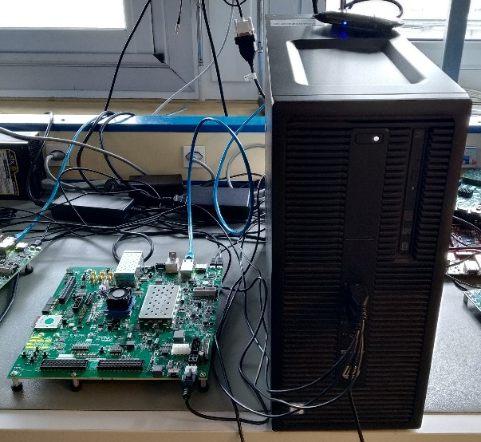
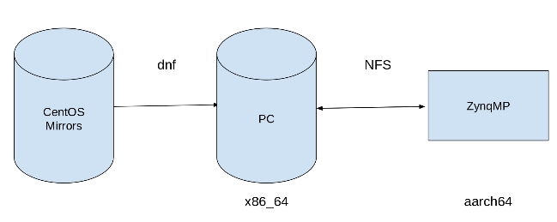
CentOS for aarch64 (1)
Create a CentOS/aarch64 root file system:
We have the following set up:
  ZCU102 evaluation board with a ZynqMP (MUCTPI V3 in 2019/Q2)
  Host PC (x86_64) running CERN CentOS 7
  ZCU102 and host PC are in a private network
  the host PC has internet access (CERN GPN)
Use dnf package manager for cross-installation into a root file
system on the host PC, install CentOS/ARM packages from
  centos.org (altarch): base, update, and extra packages
  fedoraproject.org (aarch64): Extra Packages for Enterprise Linux (EPEL)
For the full procedure, see https://twiki.cern.ch/twiki/bin/view/SystemOnChip/CentOSForZynqMP
Boot the ZynqMP with the CentOS/aarch64 root file system:
Use U-Boot, the Linux kernel, and device tree built with Yocto as before
Boot the ZynqMP and mount root file system via NFS from host PC:
  bootargs= … root=/dev/nfs rootfstype=nfs ip=192.168.1.10:::255.255.255.0:zcu102:eth0:on
  nfsroot=192.168.1.1:/home/ROOTFS,nfsvers=3 rw rootwait

Slide 6
CentOS for aarch64 (2)
Services & software running on the ZynqMP:
ssh, NFS, NTP, iptables or firewalld, network manager, java, … possibly many, many more …
Add/install additional software or services on the ZynqMP:
Use dnf packet manager on the host PC
Use yum packet manager on ZCU102 directly, if internet access available
Cross-compile on host PC with sysroot = rootfs, then install in rootfs or use additional NFS export
Compile natively on ZCU102
Results with native builds (for simplicity, because it is possible on the ZCU102):
Built ROOT for filling histograms and graphs
Built ATLAS TDAQ in its CMake environment & deployed a run control application using ROOT on ZCU102
Built and run an ATLAS Detector Control System (DCS) server using OPC-UA on ZCU102
Built and run uHAL on ZCU102 & run IPbus transactions - CMS/Zynq/IPbus project (P. Vichoudis)
Further aspects to be investigated:
Use of CERN Techlab’s ARM servers running CentOS for native builds
CentOS/armv7 for “older” 32-bit Zynq
Support for Puppet/aarch64, for system configuration, used by ATLAS SysAdmins
Experience very positive:
For our purposes, i.e. running ATLAS run control or DCS software, we have not seen any difference between CentOS on the host PC or ZCU102

Slide 7
CentOS for SoC (1)
We propose CentOS as a common platform for SoC software development:
Equivalent to CentOS/x86_64:
CERN CentOS/x86_64 (CC7) is widely deployed at CERN and other institutes
CERN CentOS/x86_64 (CC7) is maintained by CERN/IT
CERN/IT provide a local mirror and network installation for CentOS/aarch64,
see http://linux.web.cern.ch/linux/centos7/aarch64.shtml
Provides all (most?) of the software needed on the SoC:
Depends, of course, on what the SoC is used for
User-specific software can be compiled natively, or cross-compiled, if needed
A common software repository could be provided for Zynq tools and drivers, e.g. tools, drivers etc.

Slide 8
CentOS for SoC (2)
Caveat: what about the kernel?
Today, we are using a hardware-specific kernel (Xilinx), build with Yocto (or equivalently PetaLinux)
Is it possible to provide a single kernel for all SoCs?
Not sure. Depends on what the SoC is used for, e.g. real-time operations? However …
Many (most? all?) SoCs in current and future projects will use ARM-based processors:
  Even Intel/Altera Stratix 10 SoC uses ARM Cortex-A53 processor cores, but different software environment …
  If all used Xilinx Zynq Ultrascale+ MPSoC it would be easier, even if different configurations of PL part were used
Might be possible to find a kernel configuration which covers all features required:
  Add e.g. PHY, GPIO, I2C, SPI, iptables kernel support
  Use the board-specific device tree file to configure the running kernel
  Provide repository for common drivers, to be loaded after boot
In any case, CentOS root file system works with a Linux kernel,
as long as the kernel is more recent the one CentOS was built for

Slide 9
SoC Workshop
A common software platform for SoC, as well as other topics like
System administration
Network organization
Security issues
Etc.
will be discussed at the at the SoC Workshop, 12-14 June at CERN,
https://indico.cern.ch/event/799275/

