Slide 1
63U ATCA rack – cooling capabilities
Claudio Bortolin EP-ADO-PO
Michal Kalinowski EP-UAT
Jakub Durda EP-ADO-PO
14th xTCA meeting 10.05.2019

Slide 2
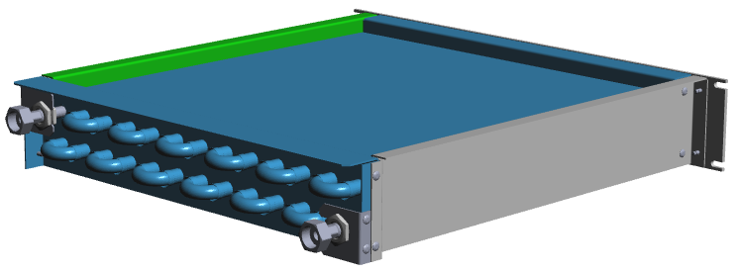
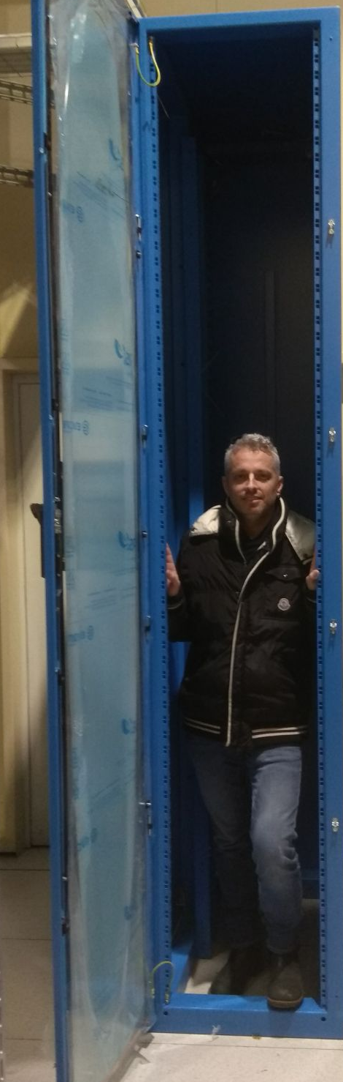
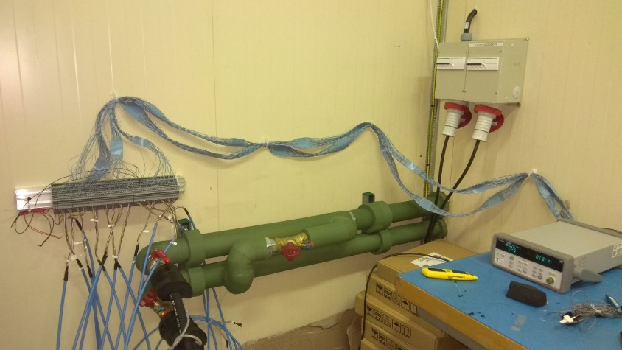
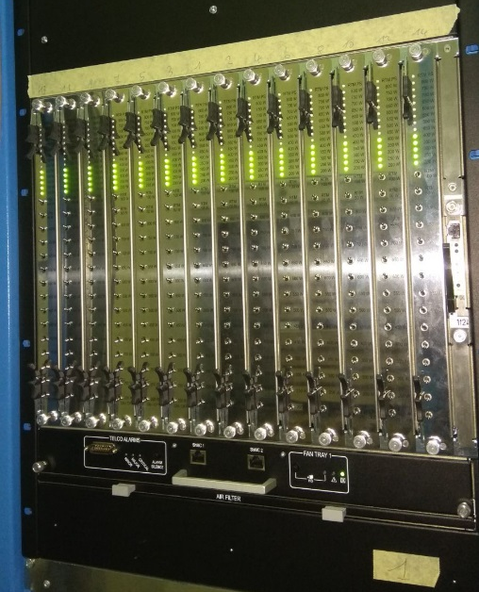
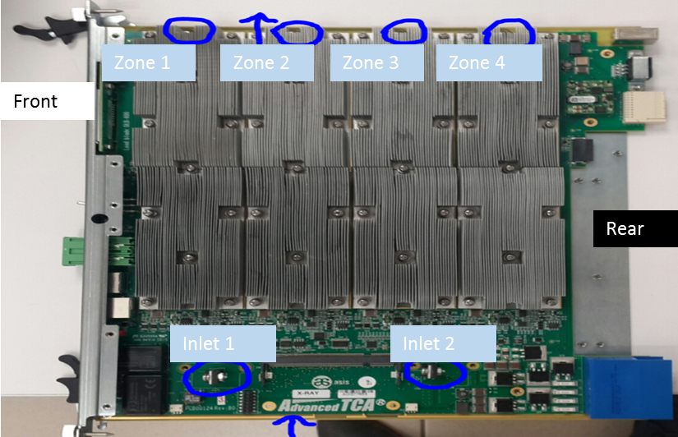
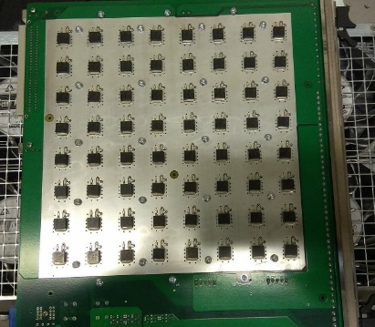
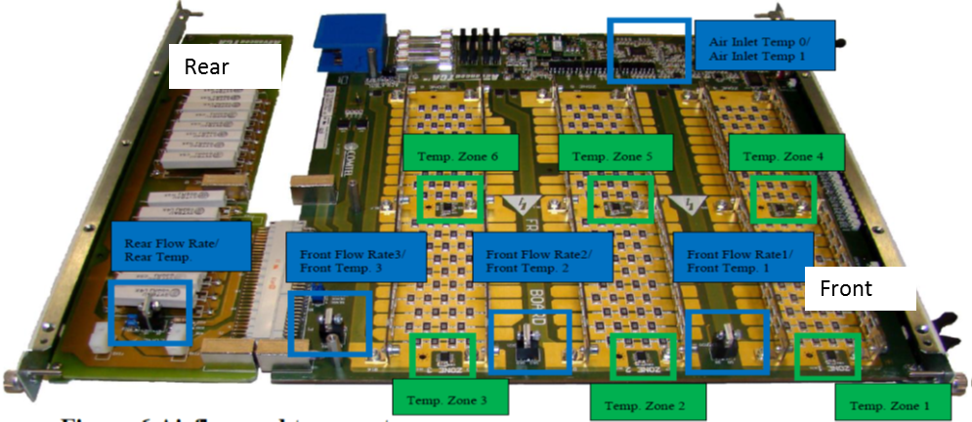
Rack configuration
Water piping are insulated for cold water tests
3x 2U heat exchangers with max. cooling capacity of 7.9 kW each
3x ATCA shelves– 2x CERN standard Schroff unit + 1x ASIS
Water chiller: max. cooling capacity 25kW
3x different set of load blades (LB):
14x ASIS LB, max power dissipation: 600W only front
14x New type Comtel LB, max power dissipation: 800W only front
14x Old type Comtel LB, max power dissipation: 50W RTM+ 300W front
ASIS LB (6 T sensors)
New type Comtel LB (no T readout)
Old type Comtel LB (6 T sensors)
Important note: The power dissipation on the load blades is spread equally on the whole board

Slide 3
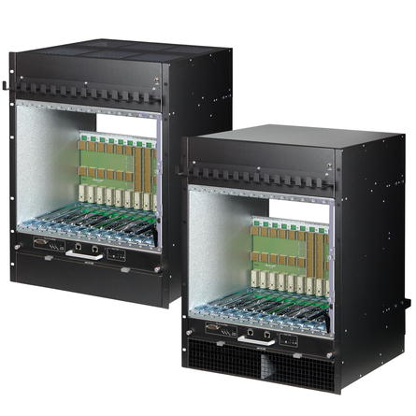
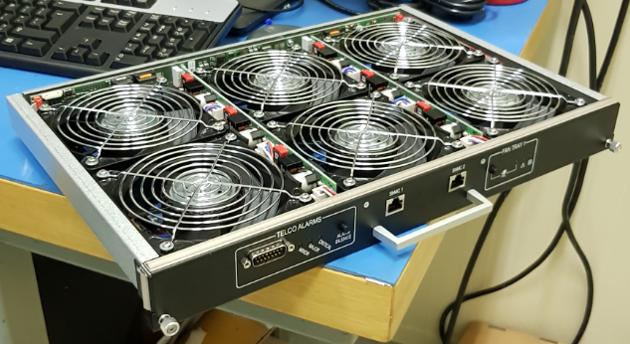
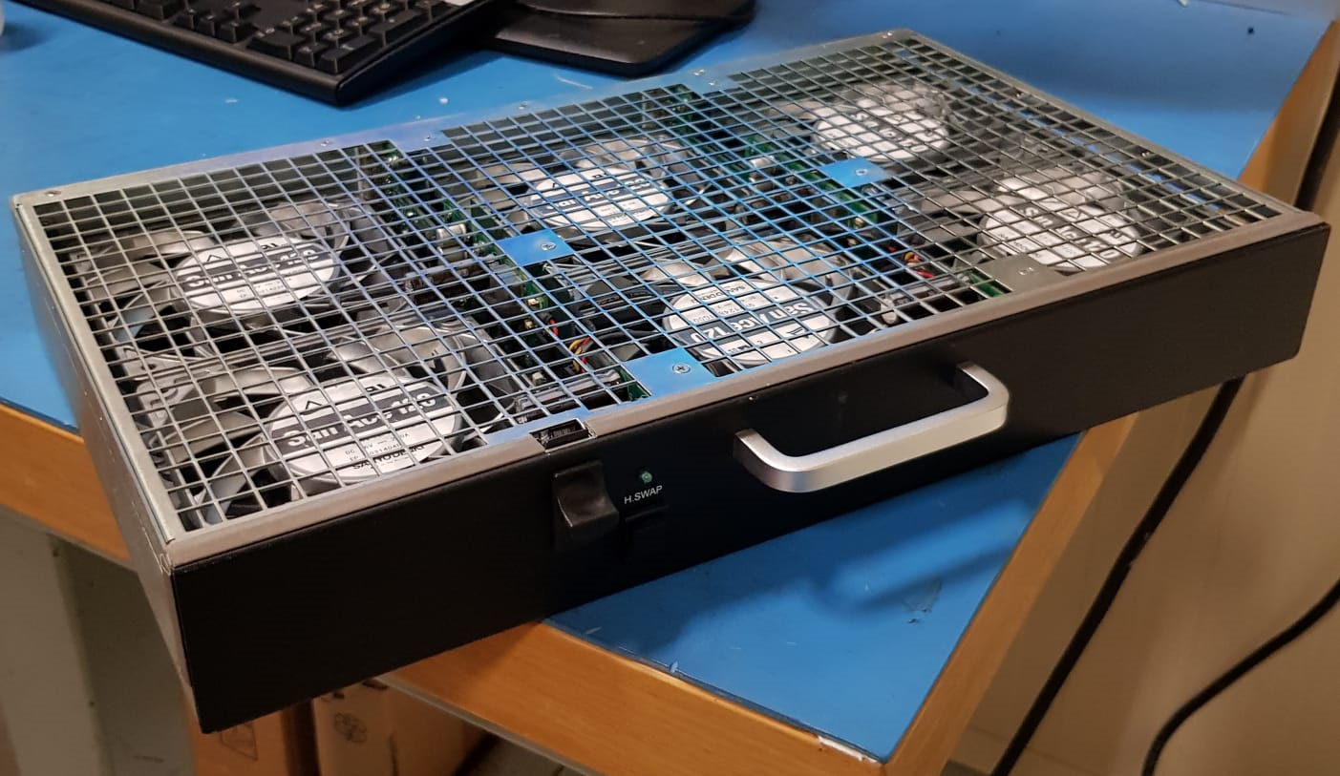
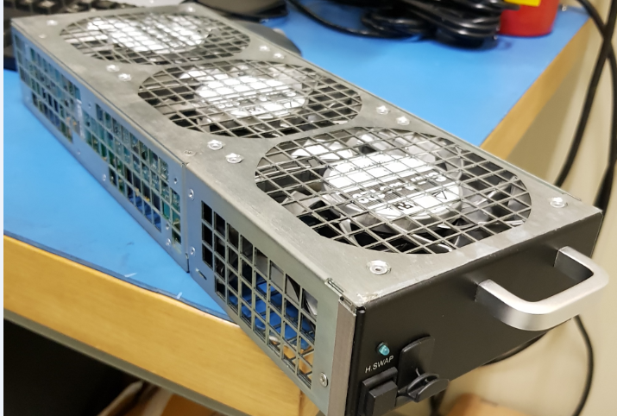
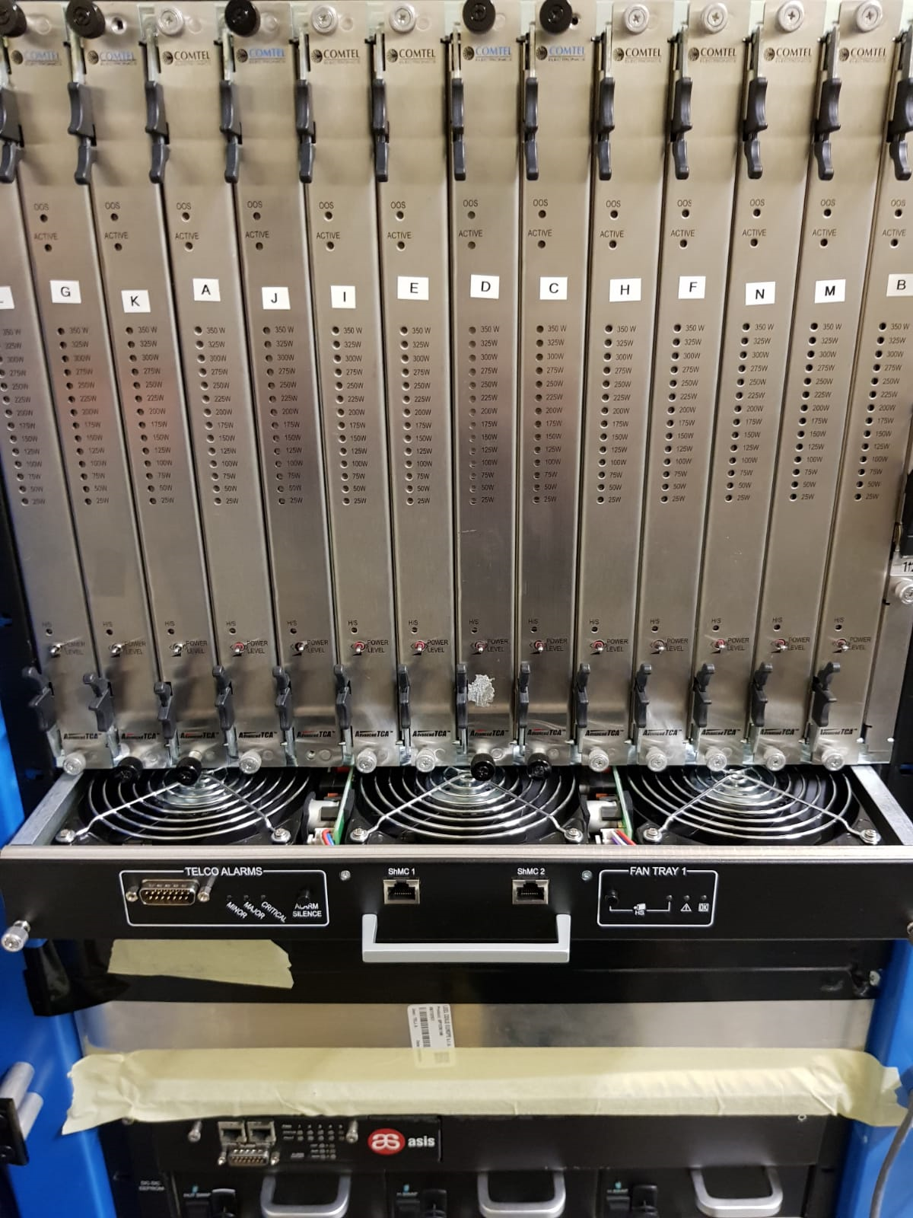
Hardware used and cooling principal
“Cooling tower”
2x CERN standard Schroff ATCA crate – each equipped with 2 fan trays (1 top and 1 bottom)
Airflow indication in the rack =>
Turbine– 4U
Turbine– 4U
1 Heat exchanger -2U
1 HX -2U
ATCA 3 – 14U
ATCA 3 – 14U
1x NOT CERN standard ASIS ATCA crate – equipped with 3 fan trays on the top and one on the bottom
1 Heat exchanger -2U
1 HX -2U
63U
ATCA 2 – 14U
ATCA 2 – 14U
Different LB sets => different cooling efficiency:
ASIS LB = a lot of heat sinks => higher air resistance => better cooling efficiency
Old Comtel LB = no heat sinks => low air resistance => high temperature peaks on axis of the fans
New Comtel LB = not equipped with any sensors => no readout
1 Heat exchanger -2U
1 HX -2U
ATCA 1 – 14U
ATCA 1 – 14U
s1
s2
s10
s11
s12
s9
s4
s6
s5
s8
s14
s3
s13
s7
Air Deflector – 2U
Air Deflector – 2U
Power supply 2 – 3U
PS2 – 3U
Power supply 1 – 3U
PS1 – 3U
Important note: To prolong the life time of the electrical equipment installed in the ATCA shelves, maximum target temperature on boards is 50C.
Power supply 3 – 1U
PS3 – 1U
free–2U
free–2U
Front view
Side view

Slide 4
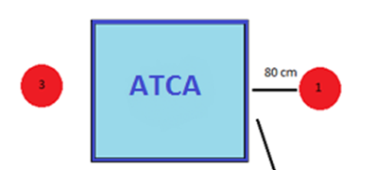
Noise reduction: soundproofing and impact on cooling
ATCA fans working at max speed
Over 100 [dB(A)]! -> needs soundproofing
Soundproofing material installed in the air corridors reduces its width from 65 [mm] to 37 [mm] – impact on cooling?
2
1
52U
Top view
Noise values (52U) | Pos. 1 Door open [dB(A)] | Pos. 1 Door closed [dB(A)] | Pos. 2 [dB(A)] | Av. max T ASIS [°C] | Av. max T Comtel [°C]
Without insulation | 102.8 | 90 | 87.5 | 49.2 | 53.1
With insulation |  | 86.3 | 84 | 51.8 | 49.4
Difference |  | -3.7 | -3.5 | 2.6 | -3.7
2
Average max T
WOS | WS
49.2°C | 51.8°C
Measured in ASIS shelves – non standard for CERN
The av. max. T is increased by 2.6K, which is not a big price to pay for reducing the noise by 3.7 [dB(A)] on the level of the rack.
Important note: All the results showed for 63U rack are taken from the tests carried out in soundproofed rack.

Slide 5
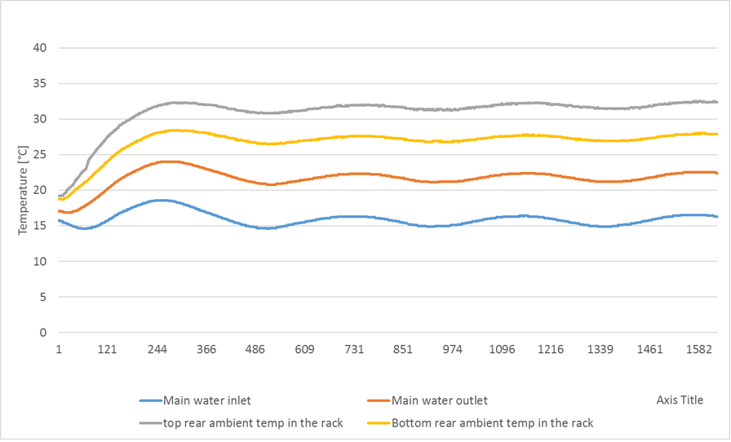



Environmental conditions and chiller operations – SR1 Laser Room
Controlled ambient temperature 19C.
Starting of the setup
$$Temperature [ºC]$$
`
$T_{water}$<15.5-16>°C
Mixed water T in USA15
Parameters measured and calculated during the tests:
ΔT – temperature difference between water inlet and outlet
Q_{r} – heat removed from the rack
P – % of total power removed
$$1200 \frac{iteration}{h}$$

Slide 6
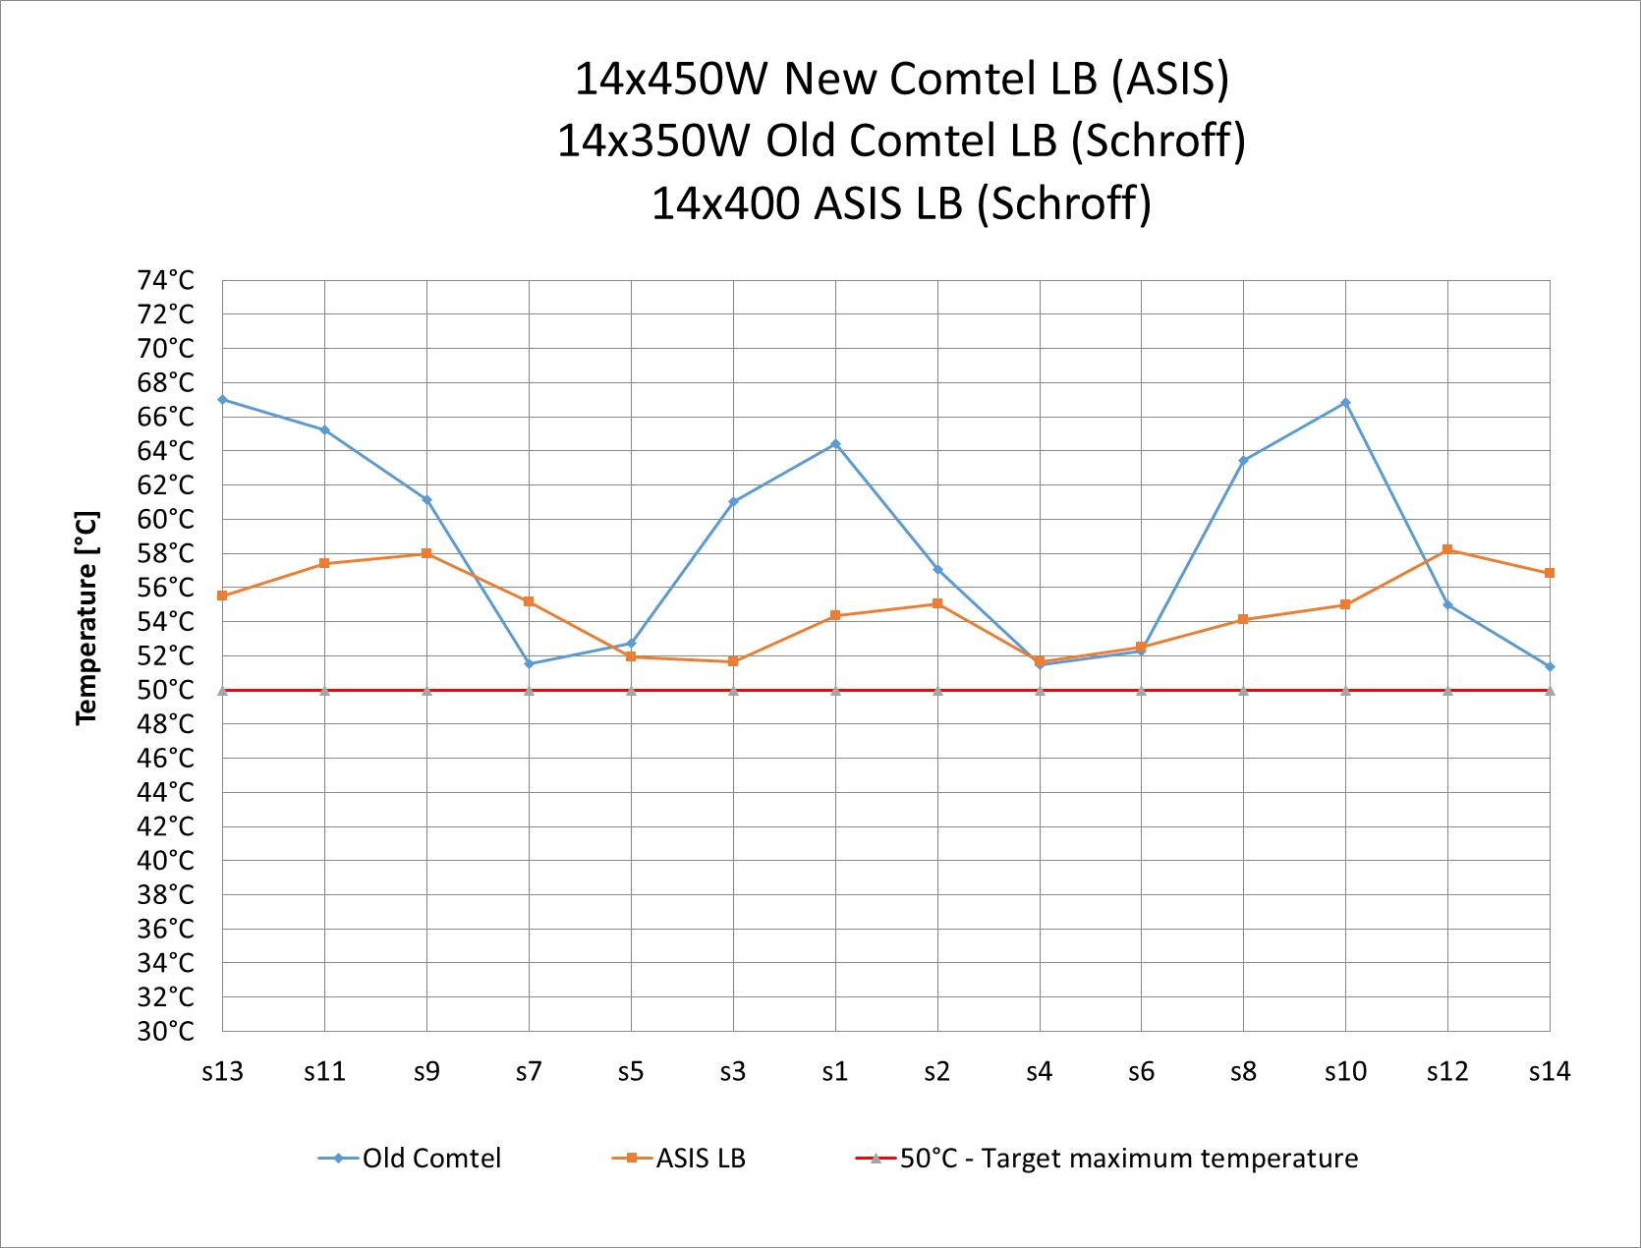
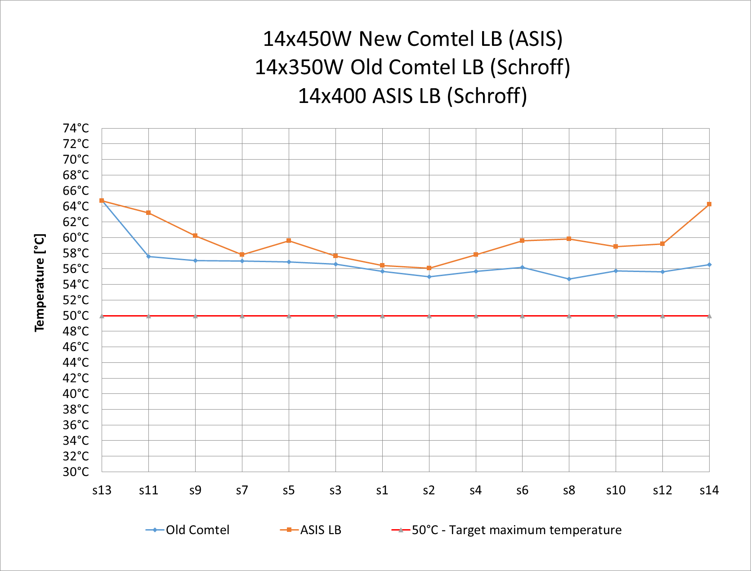
Test results with 400W/blade
14x450W New Comtel LB (ASIS)
14x(300+50)W Old Comtel LB (Schroff)
14x400W ASIS LB (Schroff)
14x450W New Comtel LB (ASIS)
14x(300+50)W Old Comtel LB (Schroff)
14x400W ASIS LB (Schroff)
With Bottom fans
Without Bottom fans
Average max T
ASIS [°C] | Comtel [°C]
54.8 | 58.6
Average max T
ASIS [°C] | Comtel [°C]
59.7 | 56.8
Flow 2.4 m³/h
ΔT = 7ºC
Q_{r} = 19.5 kW
P = 83%
Flow 2.4 m³/h
ΔT = 6ºC
Q_{r} = 16.7 kW
P = 81%
Total power in the rack 23.4 kW
Total power in the rack 20.6 kW
Temperatures in the old Comtel are less homogeneous in push-pull configuration but average T decreasing in only pull configuration.

Slide 7
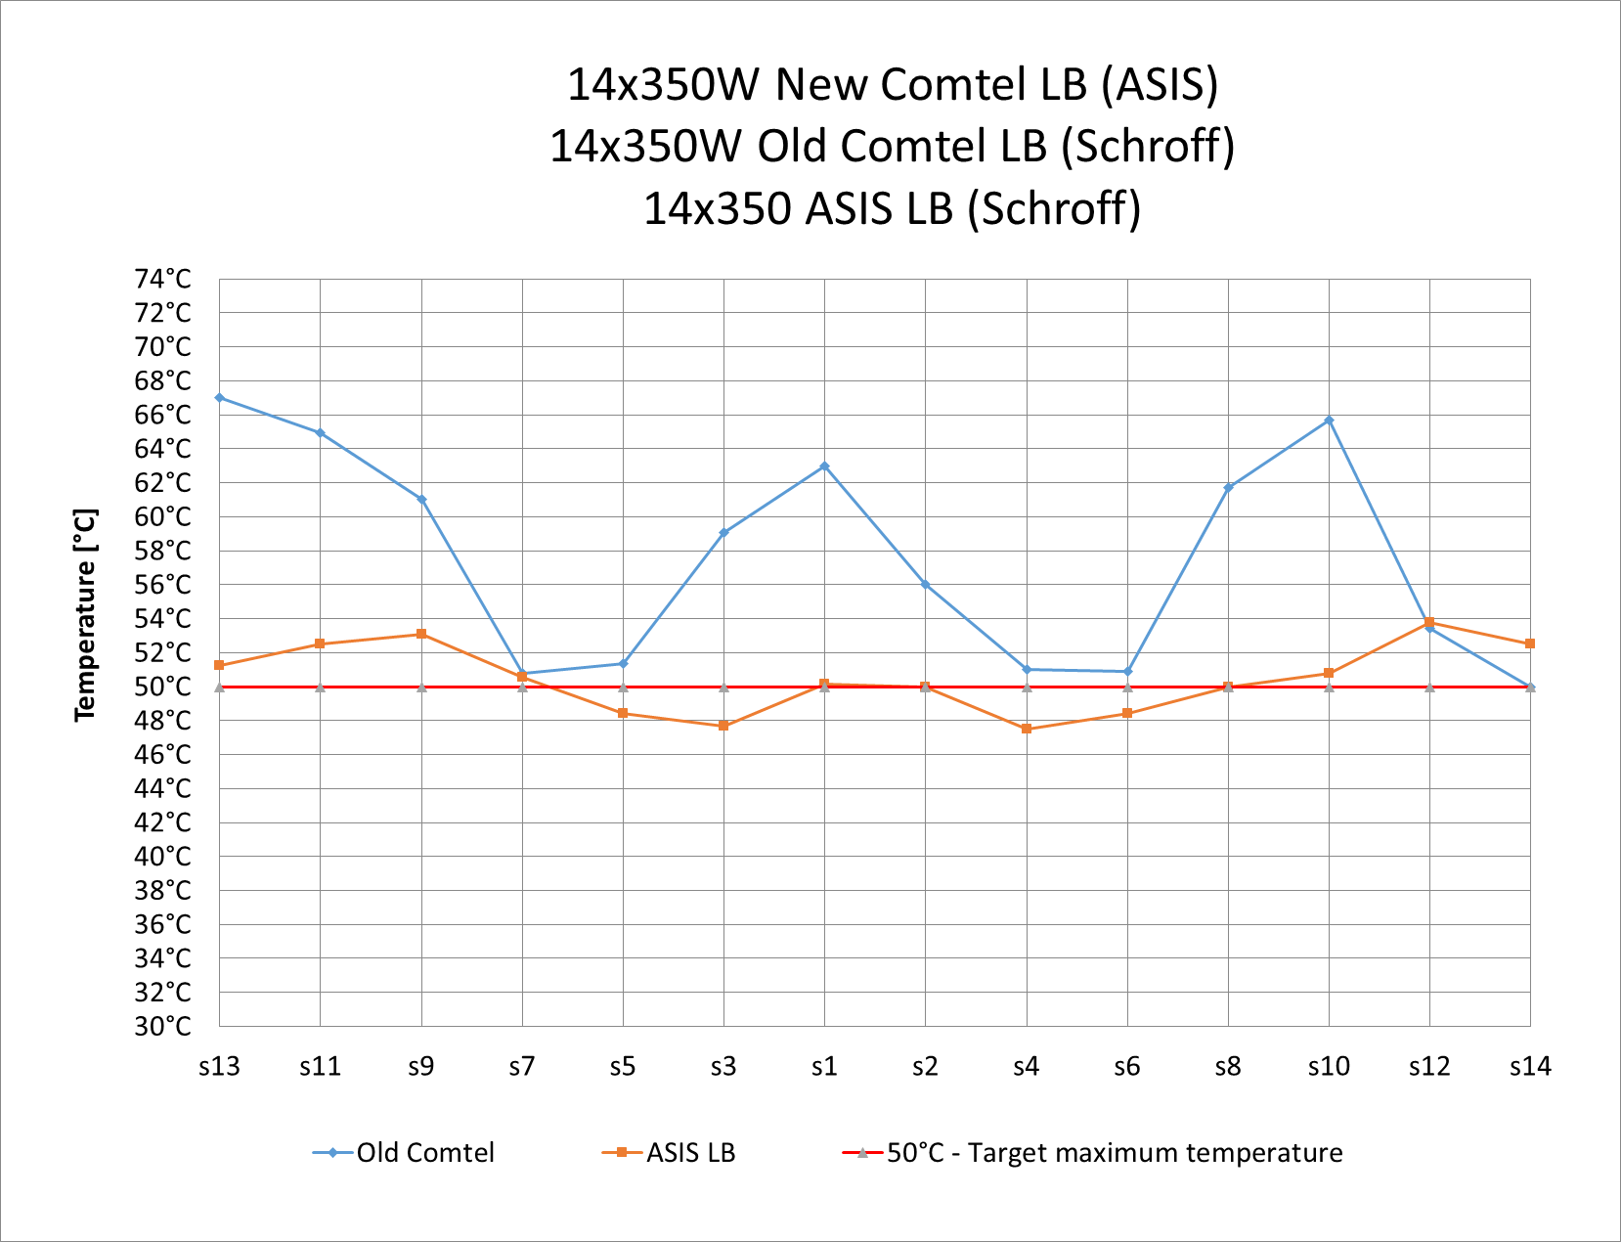
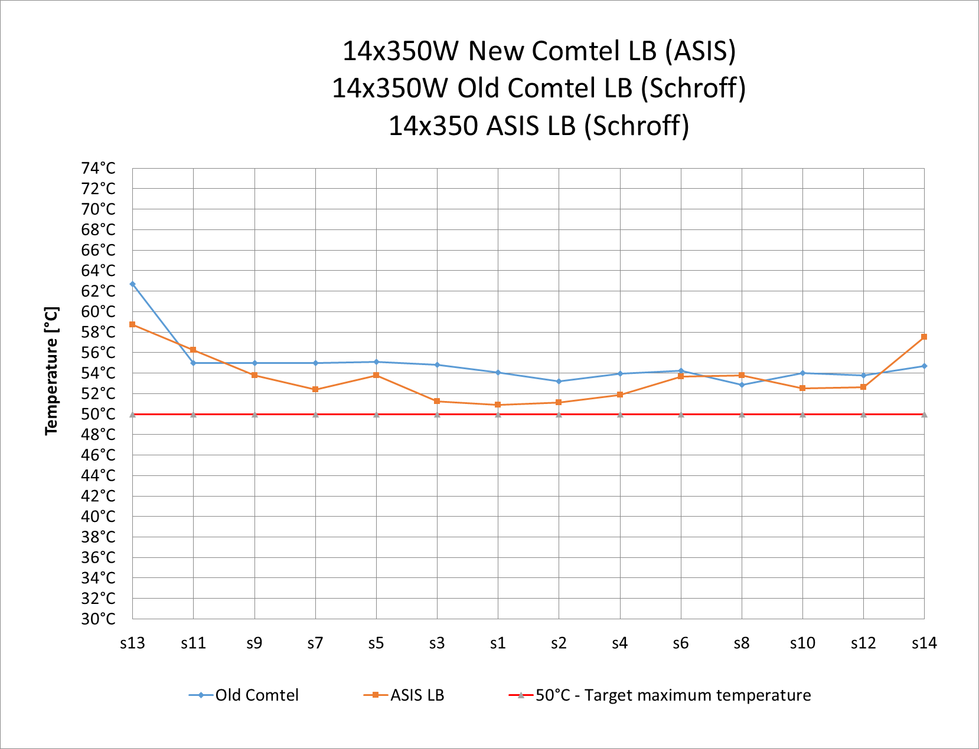
Test results with 350W/blade
14x350W New Comtel LB (ASIS)
14x(300+50)W Old Comtel LB (Schroff)
14x350W ASIS LB (Schroff)
14x350W New Comtel LB (ASIS)
14x(300+50)W Old Comtel LB (Schroff)
14x350W ASIS LB (Schroff)
With Bottom fans
Without Bottom fans
Average max T
ASIS [°C] | Comtel [°C]
50.5 | 57.6
Average max T
ASIS [°C] | Comtel [°C]
53.6 | 54.9
Flow 2.4 m³/h
ΔT = 6.4ºC
Q_{r} = 17.9kW
P = 84%
Total power in the rack 18.4 kW
Flow 2.4 m³/h
ΔT = 5.4ºC
Q_{r} = 15.1 kW
P = 82%
Total power in the rack 21.3 kW
In push-pull configuration the ASIS blades can stay within the target of 50C

Slide 8
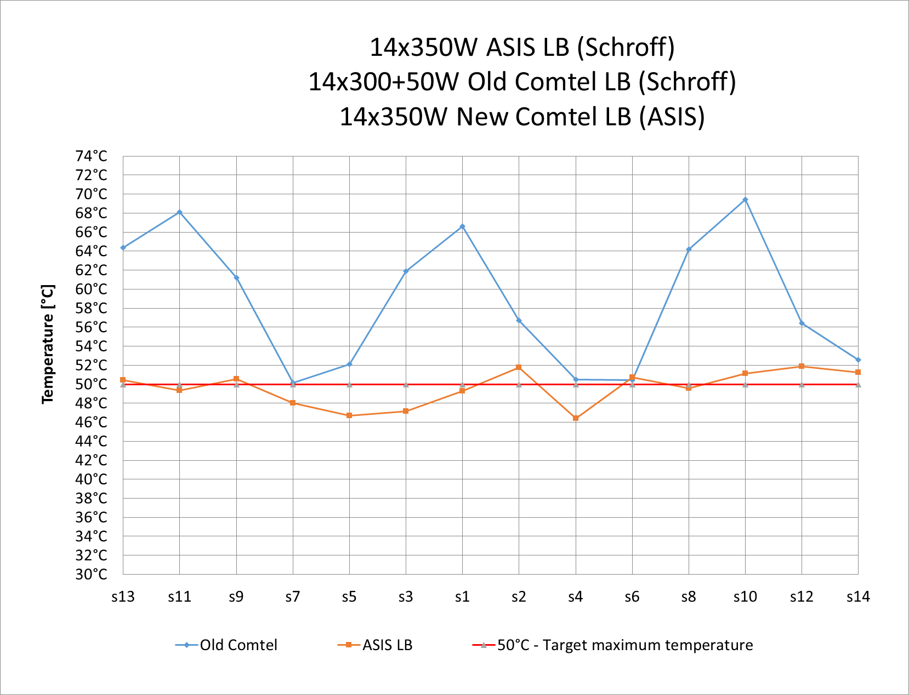
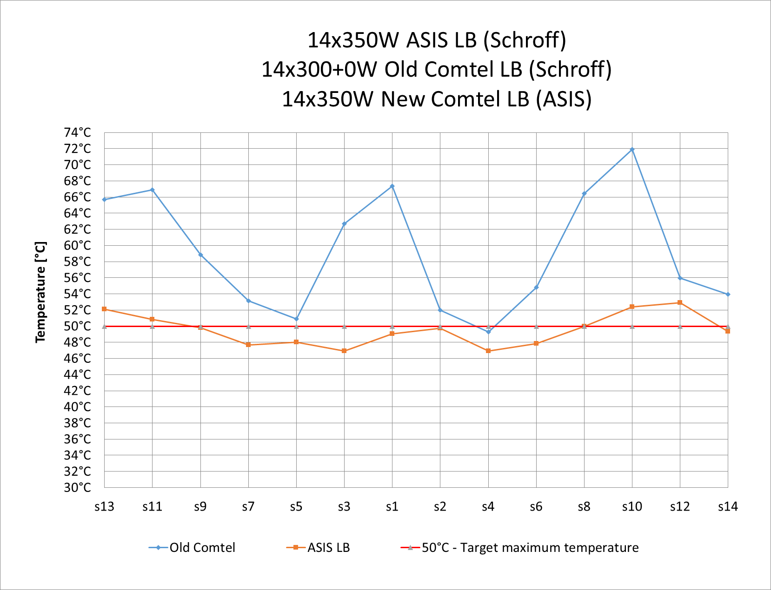
With RTM vs without RTM
With Bottom fans
14x350W ASIS LB (Schroff)
14x(300+50)W Old Comtel LB (Schroff)
14x350W New Comtel LB (ASIS)
With Bottom fans
14x350W ASIS LB (Schroff)
14x(300+0)W Old Comtel LB (Schroff)
14x350W New Comtel LB (ASIS)
Average max T
ASIS [°C] | Comtel [°C]
49.6 | 58.9
Average max T
ASIS [°C] | Comtel [°C]
49.5 | 59.3
Flow 2.4 m³/h
ΔT = 6.4ºC
Q_{r} = 17.8 kW
P = 84%
Flow 2.4 m³/h
ΔT = 6.1ºC
Q_{r} = 17 kW
P = 83%
Total power in the rack 21.2 kW
Total power in the rack 20.5 kW
The additional 50W on the RTM has negligible influence on cooling performance of the front of the board

Slide 9
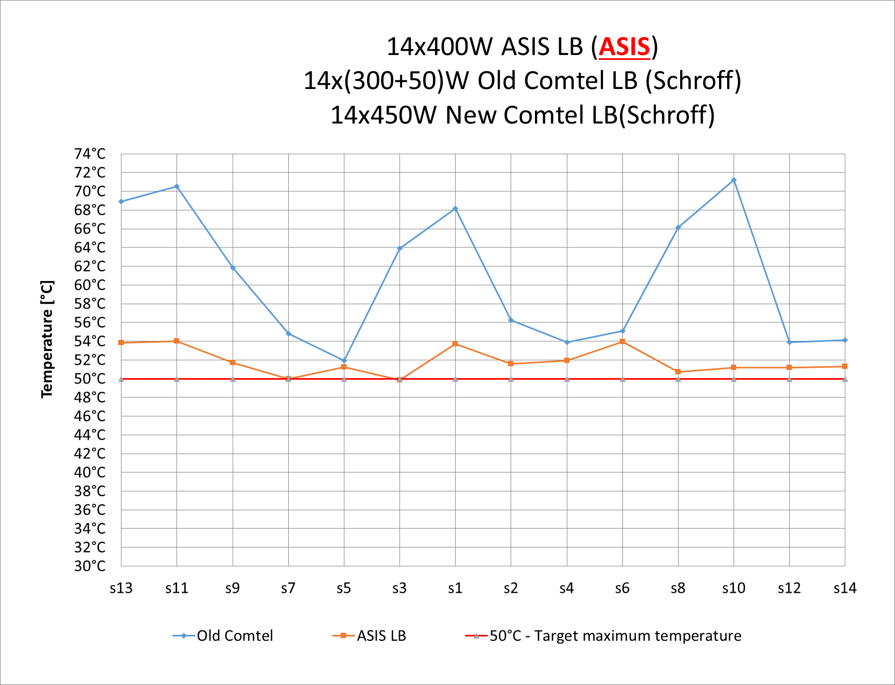
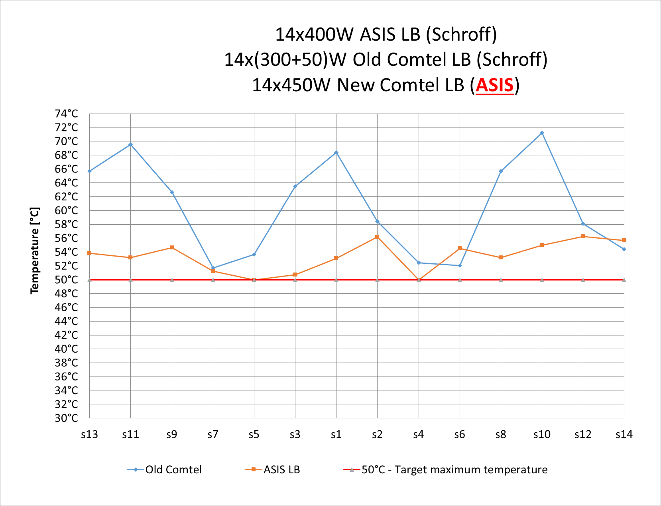
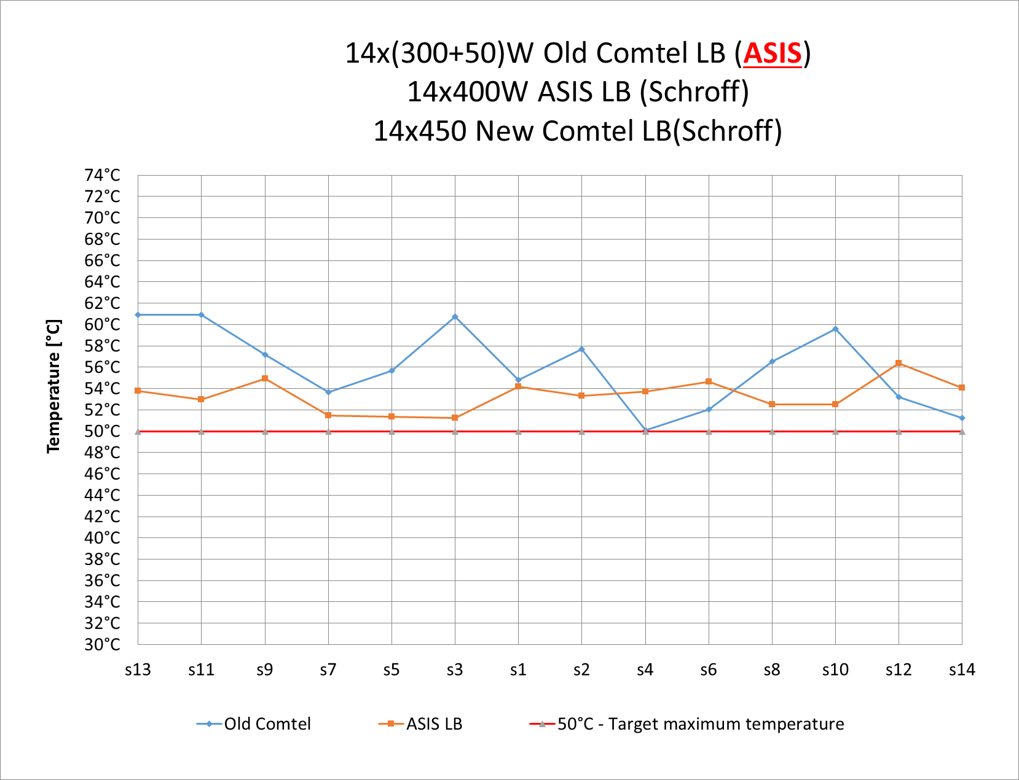
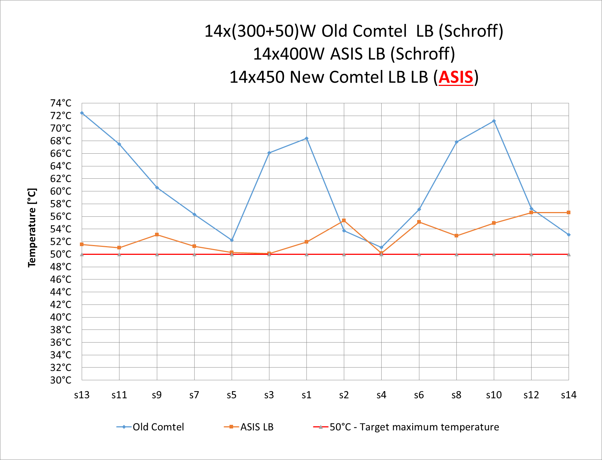
ASIS shelf vs Schroff shelf
All the tests carried out with top and bottom fans at max. speed
Average max T
ASIS [°C] | Comtel [°C]
51.9 | 60.8
Total power in the rack 23.4 kW
Average max T
ASIS [°C] | Comtel [°C]
53.4 | 60.5
Flow 2.4 m³/h
ΔT = 7ºC
Q_{r} = 19.5 kW
P = 83%
The overall cooling efficiency stays the same.
In the same power configuration changing the type of crate from Schroff to ASIS, reduce the av. max T on the concerned blades by ~1.5°C for higher air resistive blades and by ~5.1°C for less resistive ones.
Average max T
ASIS [°C] | Comtel [°C]
53.4 | 56
Average max T
ASIS [°C] | Comtel [°C]
52.9 | 61.1

Slide 10
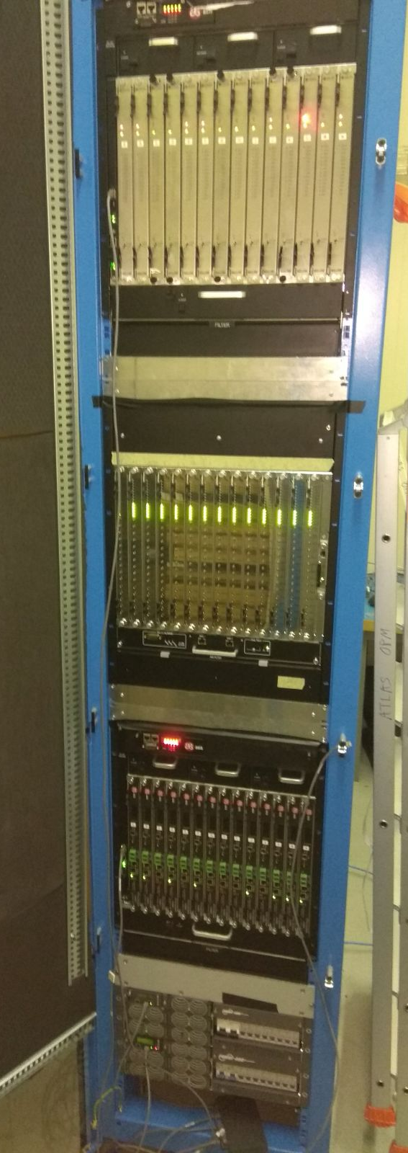
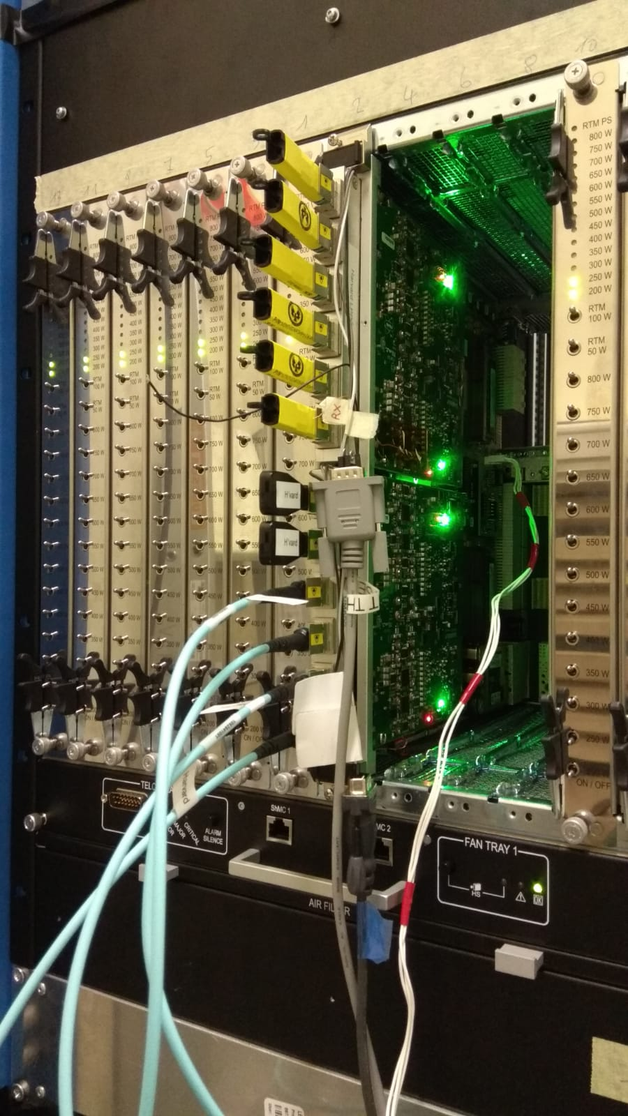
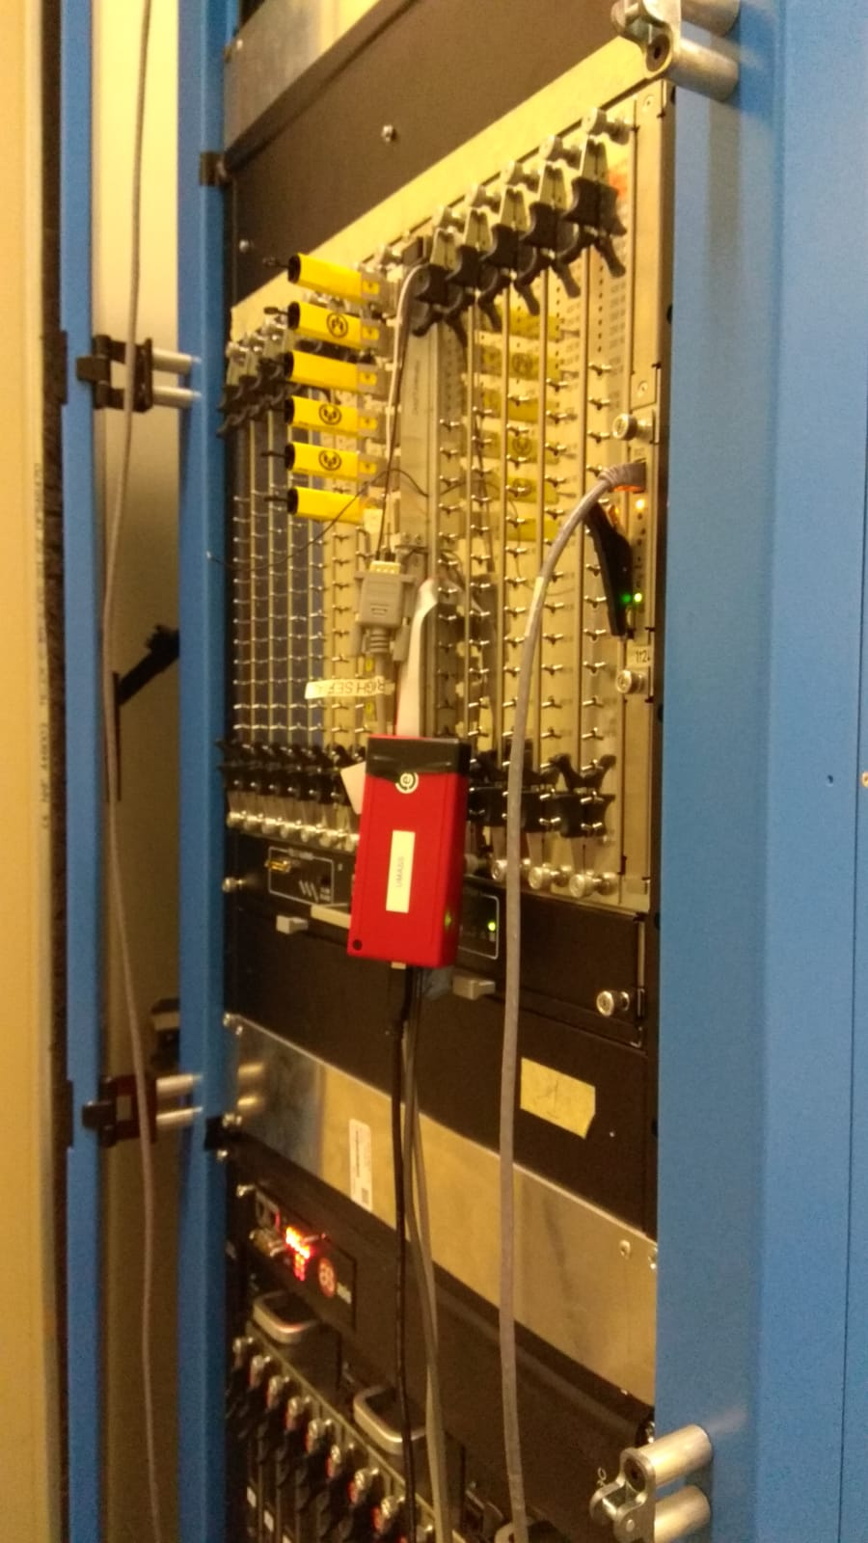
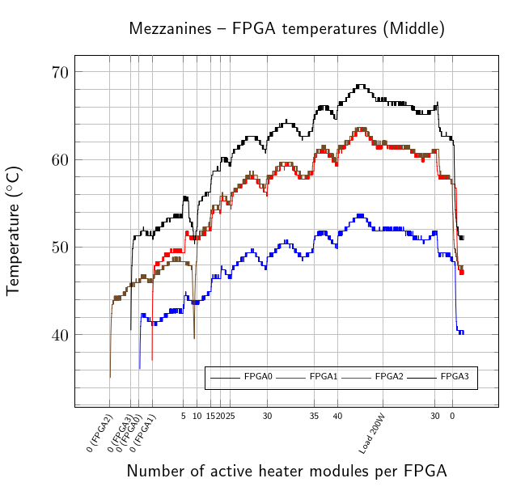
Test setup availability
The ATCA test setup is available for testing the real boards prototypes
To minimalize the impact of different air resistance between the real boards and the load blades it is advised to test the batches of minimum 3 pieces.
New Comtel LB 13x200W+Real board up to ~23W per FPGA
Thiago Costa de Paiva from University of Massachusetts Amherst results.

Slide 11
ATCA cooling - tests conclusions
Design target for boards in 63U ATCA crate is a maximum of 350W + 50W on RTM, during the design necessary margins should be taken into account
Since the air resistance and proper heat removal management (heat sinks) has a very big impact on the cooling performance of the ATCA boards– it is mandatory to test prototypes at the ATLAS SR1 test facility (for those who foresee to come close to 350W+50W requirement)
The heat removed from the rack, via the water cooling was measured to be at 80-85% of the total measured power delivered, the rest goes into the environment and has to be handled by the air conditioning (HVAC) (!)
The test system is ready for prototypes tests

Slide 12
ATCA cooling – future development
Pentair, the company that supplies CERN with Schroff shelves and heat exchangers, was asked to investigate possibility of integrating microchannel HX into the 63U ATCA rack to improve the rack cooling efficiency.
Looking into possibility of adding the 4th heat exchanger in the test facility
ASIS shelves showed better cooling performance than the Schroff ones – to be reconsidered for the long term? More tests to be carried out soon.
Due to the fact that the amount of noise generated by the ATCA shelves is extremely high, the soundproofing on the level of the rack is necessary to reduce the noise as much as possible – there is also consideration of separating the part of the counting rooms with the ATCA racks by the sound insulating wall.

Slide 13
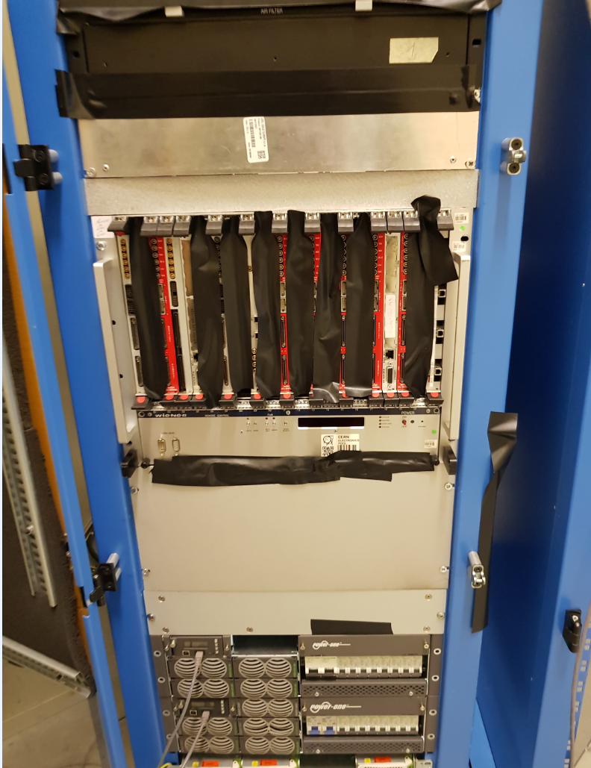
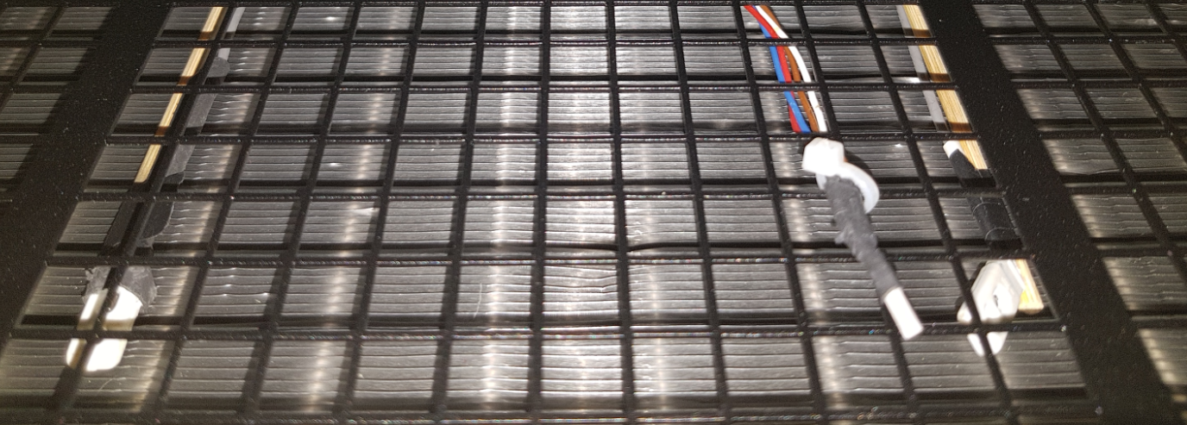
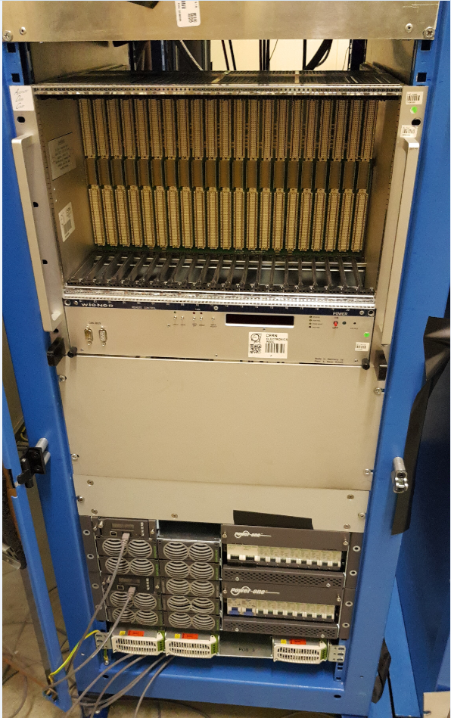
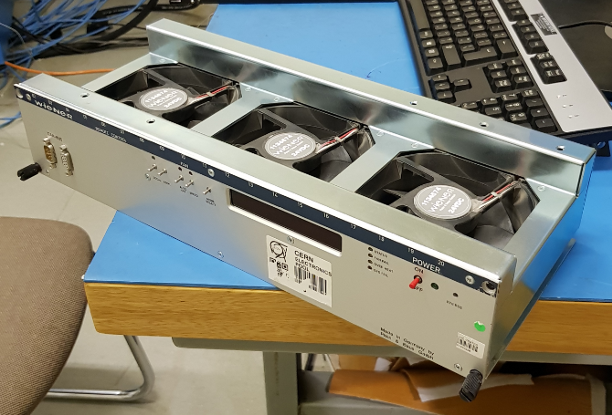
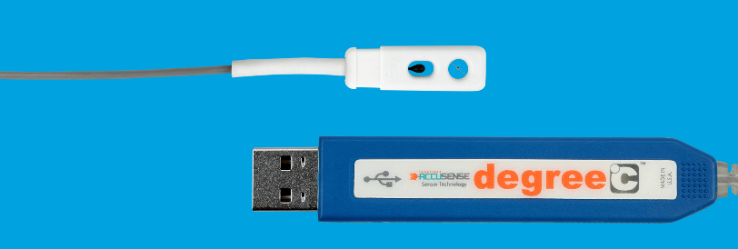
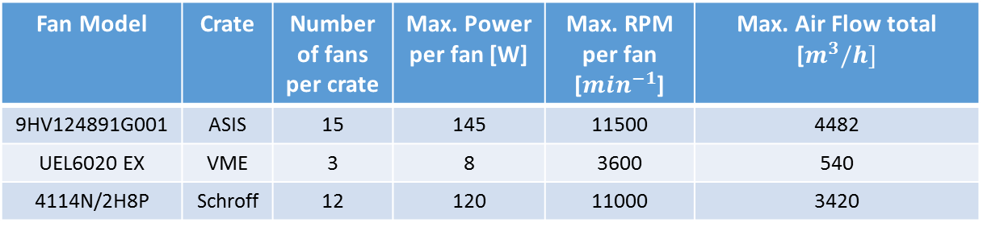
VME + ATCA tests
To evaluate a possibility of mixing two different architectures – VME and ATCA, test campaign has been launched focusing on assessment of possible aftermath of such configuration.
Fan Model | Crate | Number of fans per crate | Max. Power per fan [W] | Max. RPM per fan [$\min^{−1}$] | Max. Air Flow total [$m^{3}/h]$
9HV124891G001 | ASIS | 15 | 145 | 11500 | 4482
UEL6020 EX | VME | 3 | 8 | 3600 | 540
4114N/2H8P | Schroff | 12 | 120 | 11000 | 3420
ASIS top fan tray
Boards distributed symmetrically – gaps covered
ASIS bottom fan tray
Power Configuration:
Top: 14x Old Comtel LB – 350[W] (ASIS)
Middle: 14x ASIS LB – 400[W] (Schroff)
Bottom: 13x VME board – 0[W] (VME)
Velocity sensors are installed above the VME crate and below the ATCA crate.
VME fan tray
Blind panel
Tests were carried out with 3 different speeds of VME Fans:
-1200RPM
-2400RPM
-3600RPM
Schroff fan tray

Slide 14
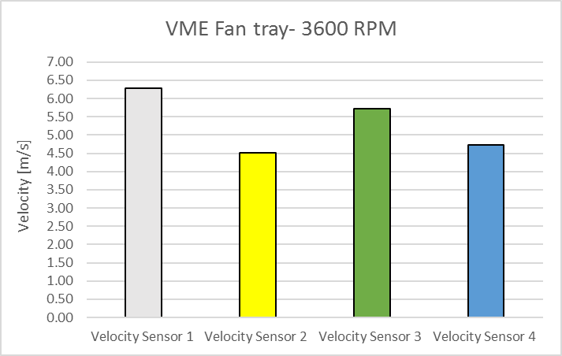
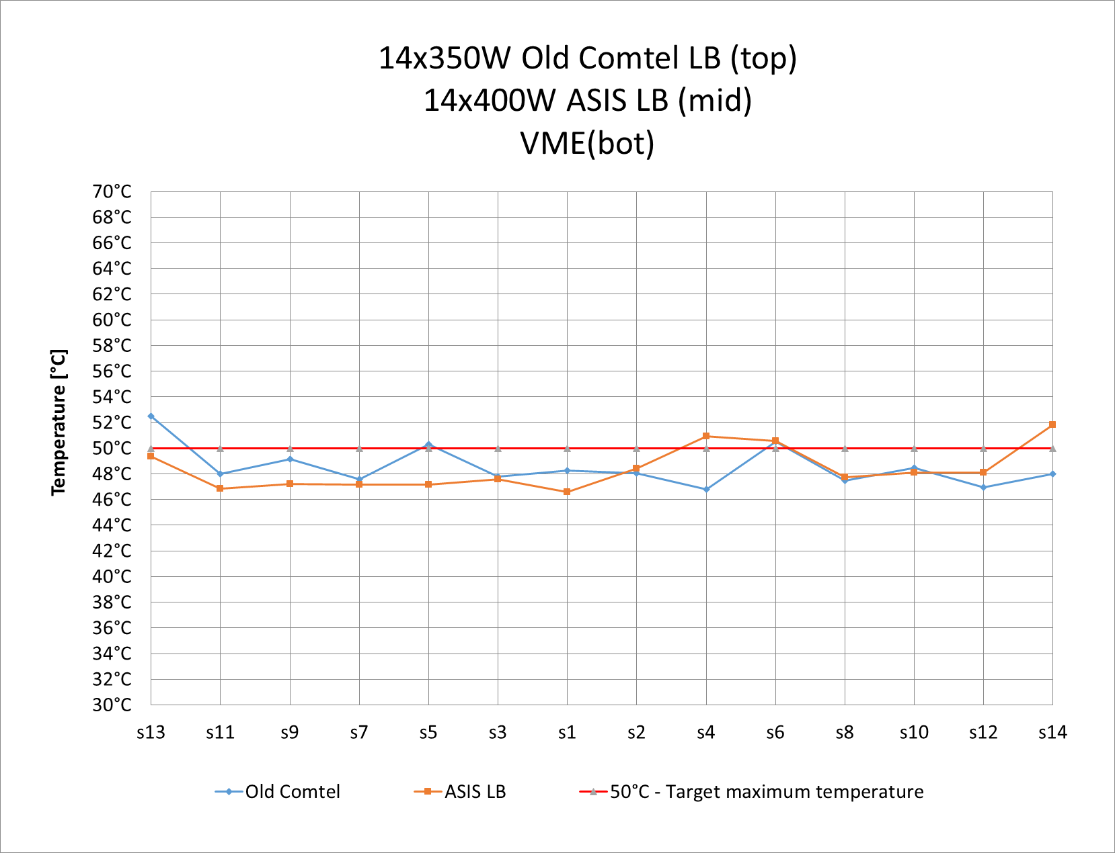
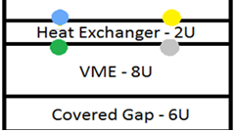
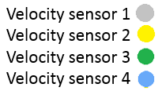
Test results – Top position – 3600RPM
With Bottom fans
14x(300+50)W Old Comtel LB (ASIS)
14x350W ASIS LB (Schroff)
0W VME
Average max T
ASIS [°C] | Comtel [°C]
48.6 | 48.4
Flow 3.0 m³/h
ΔT water = 3.1 ºC
Q_{r} = 10.9 kW
Cooling efficiency = 87%
Total power in the rack 12.5 kW

Slide 15
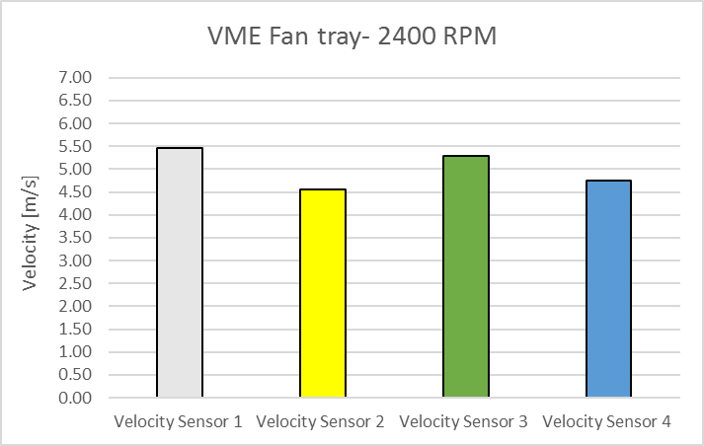
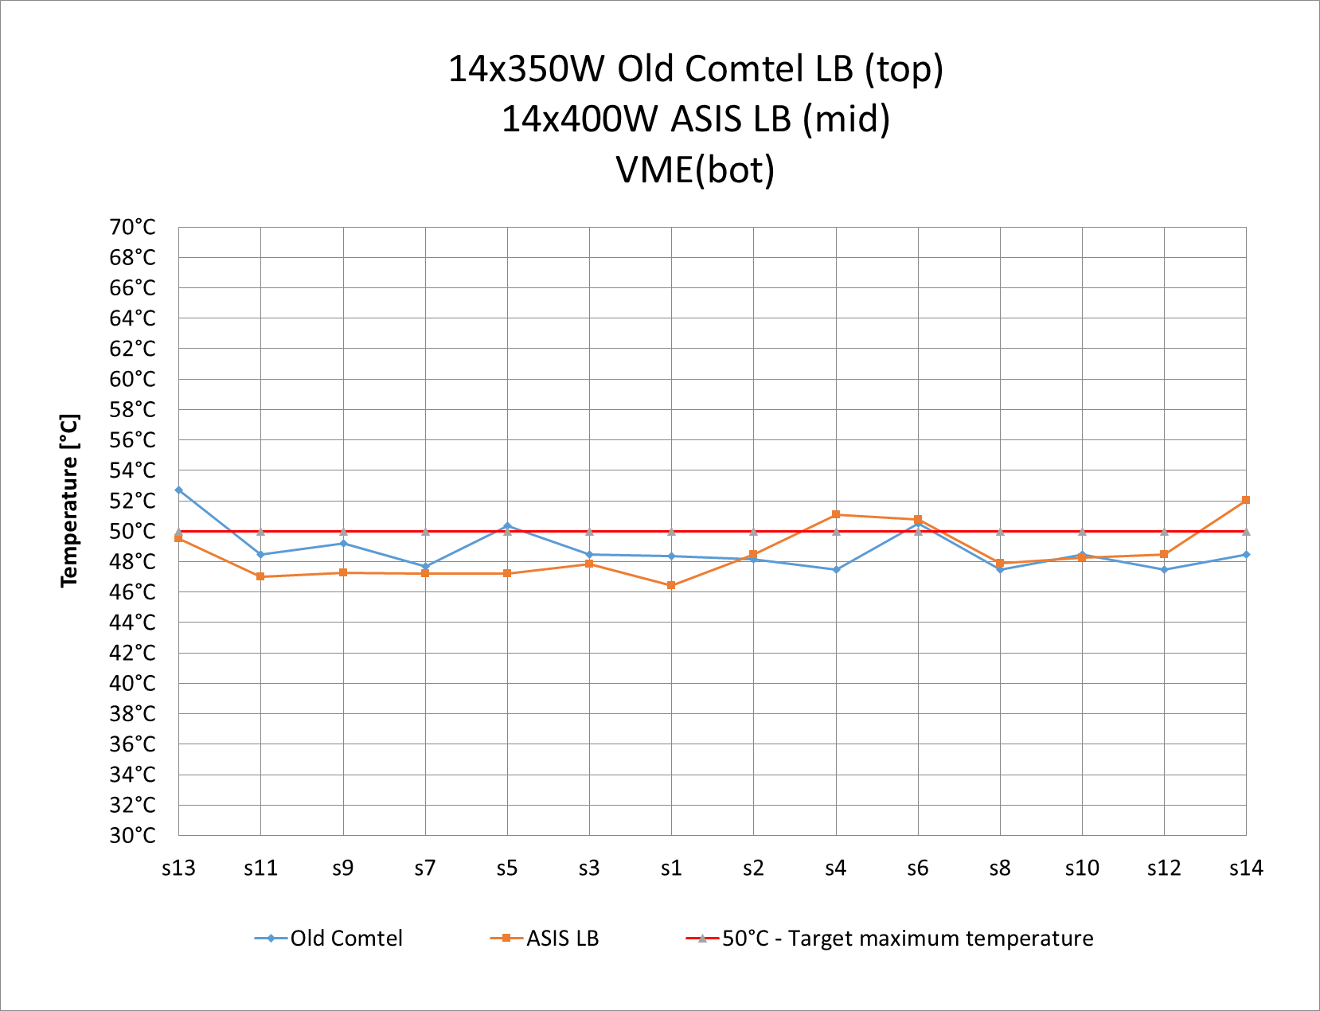
Test results – Top position – 2400RPM
With Bottom fans
14x(300+50)W Old Comtel LB (ASIS)
14x350W ASIS LB (Schroff)
0W VME
Average max T
ASIS [°C] | Comtel [°C]
48.5 | 48.8
No significant impact on the blades temperatures with lower VME fans speed

Slide 16
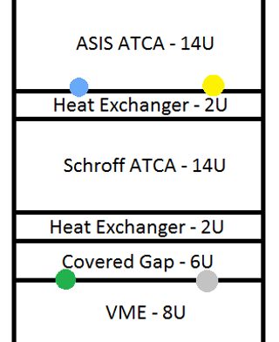
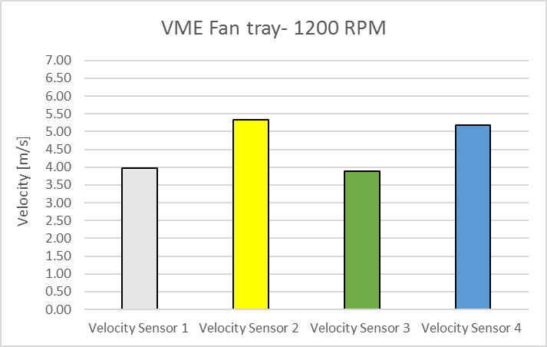
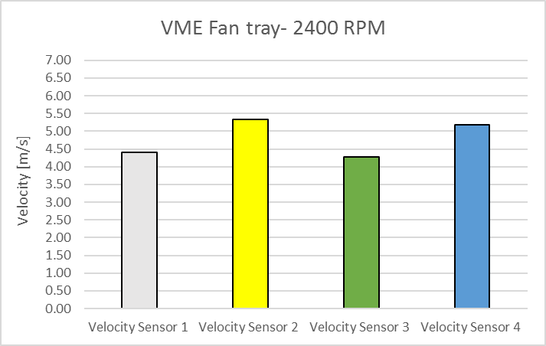
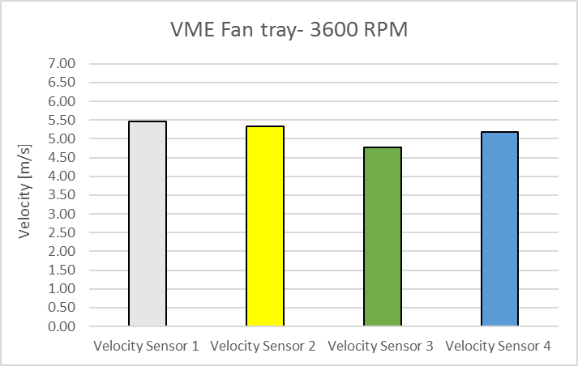
Velocity sensors – New location- Test results
Velocity sensors installed between ATCA shelves didn’t show any significant variation changing the speed of VME fans
VME fans on 3600 rpm + turbine unit airflow = ~0.6 m/s

Slide 17
VME+ATCA conclusions
The VME crate has negligible impact on the overall rack airflow and cooling efficiency – yet this solution must be treated as an exception.
As the VME fans can provide up to 0.6 m/s, running them in almost 10 times higher airflow can damage them
Long term impact of the VME crate on the ATCA fans life span is unknown, as from the ATCA crate point of view the VME is additional air resistance that has to be coped with

Slide 18
Backup slides

Slide 19
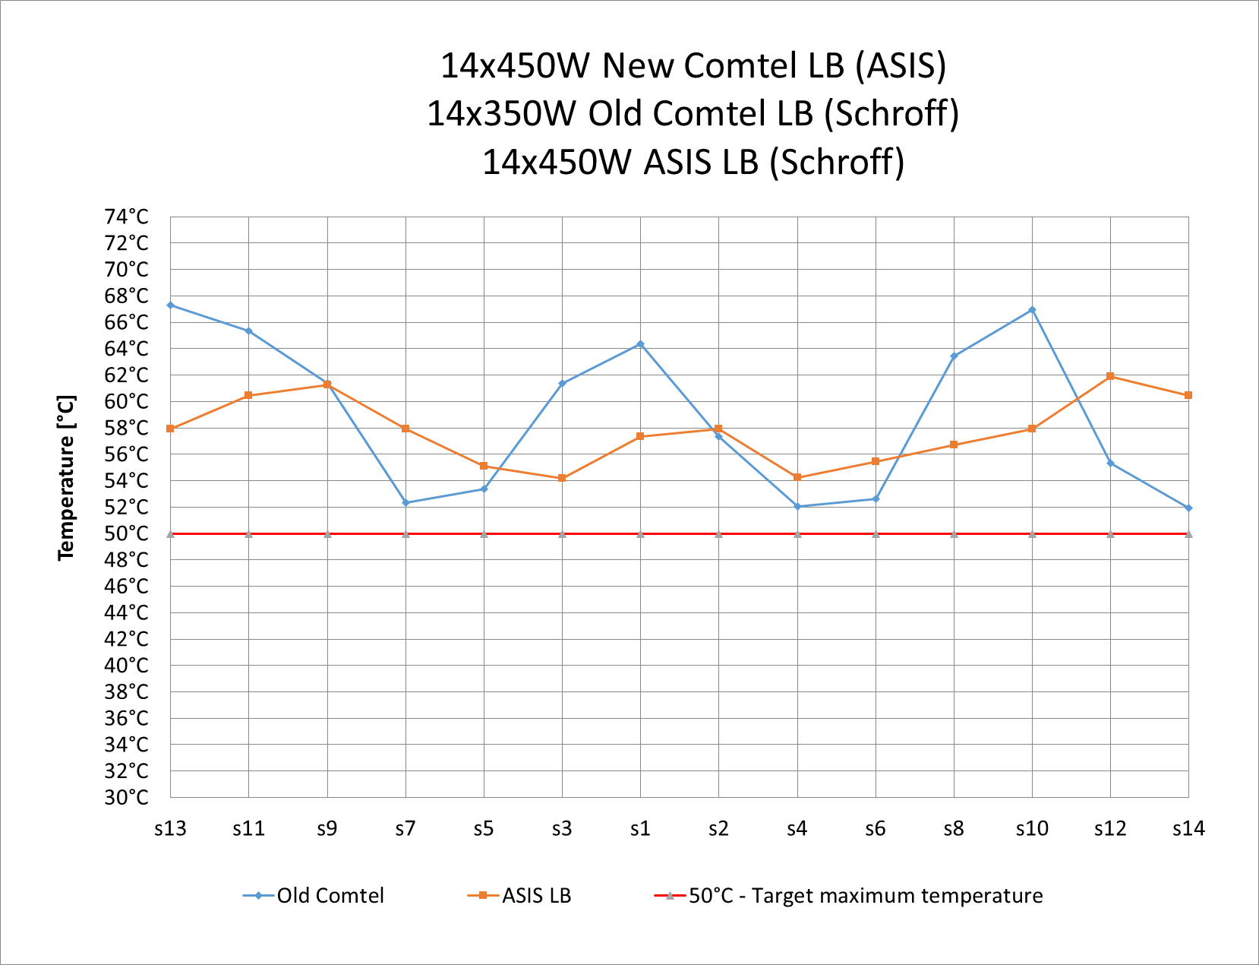
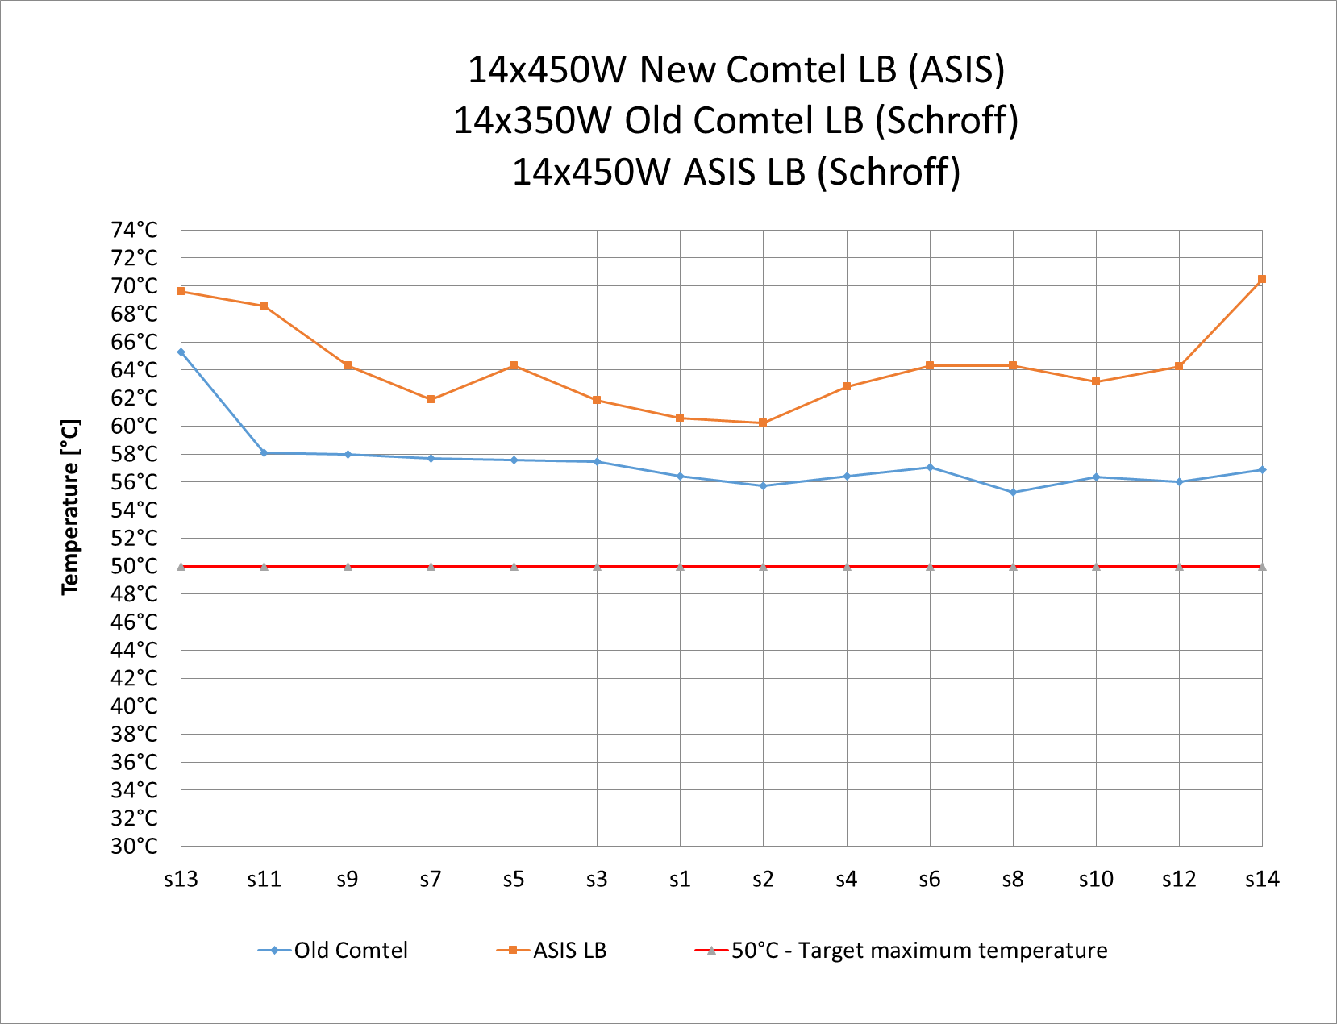
High power test results 416W/blade
14x450W New Comtel LB (ASIS)
14x(300+50)W Old Comtel LB (Schroff)
14x450W ASIS LB (Schroff)
14x450W New Comtel LB (ASIS)
14x(300+50)W Old Comtel LB (Schroff)
14x450W ASIS LB (Schroff)
With Bottom fans
Without Bottom fans
Lower air resistive LBs
Higher air resistive LBs
Average max T
ASIS [°C] | Comtel [°C]
57.8 | 59.9
Average max T
ASIS [°C] | Comtel [°C]
64.3 | 57.4
Total power in the rack 24.3 kW
Flow 2.4 m³/h
ΔT = 7.1ºC
Q_{r} = 19.8 kW
P = 82%
Total power in the rack 21.4 kW
Flow 2.4 m³/h
ΔT = 6.2ºC
Q_{r} = 17.3 kW
P = 81%
Max average power available 416W, due to the old Comtel LB limitation of 350W per blade

Slide 20
52U vs 63U
The test was carried out in following power configuration:
52U (not soundproofed):
14x350 [W] on old type Comtel LB (top)
14x400 [W] on ASIS LB (bot)
63U (soundproofed):
14x350 [W] on old type Comtel LB (top)
14x400 [W] on new type Comtel LB (mid)
14x400 [W] on ASIS LB (bot)
52U ~15kW vs 63U ~22kW
Comparison of the temperatures on the same set of blades installed in the same crate (ASIS).
Average max T
52U | 63U
49.1°C | 54°C
Soundproofed vs not soundproofed – why? The 63U rack was soundproofed from the beginning.

Slide 21
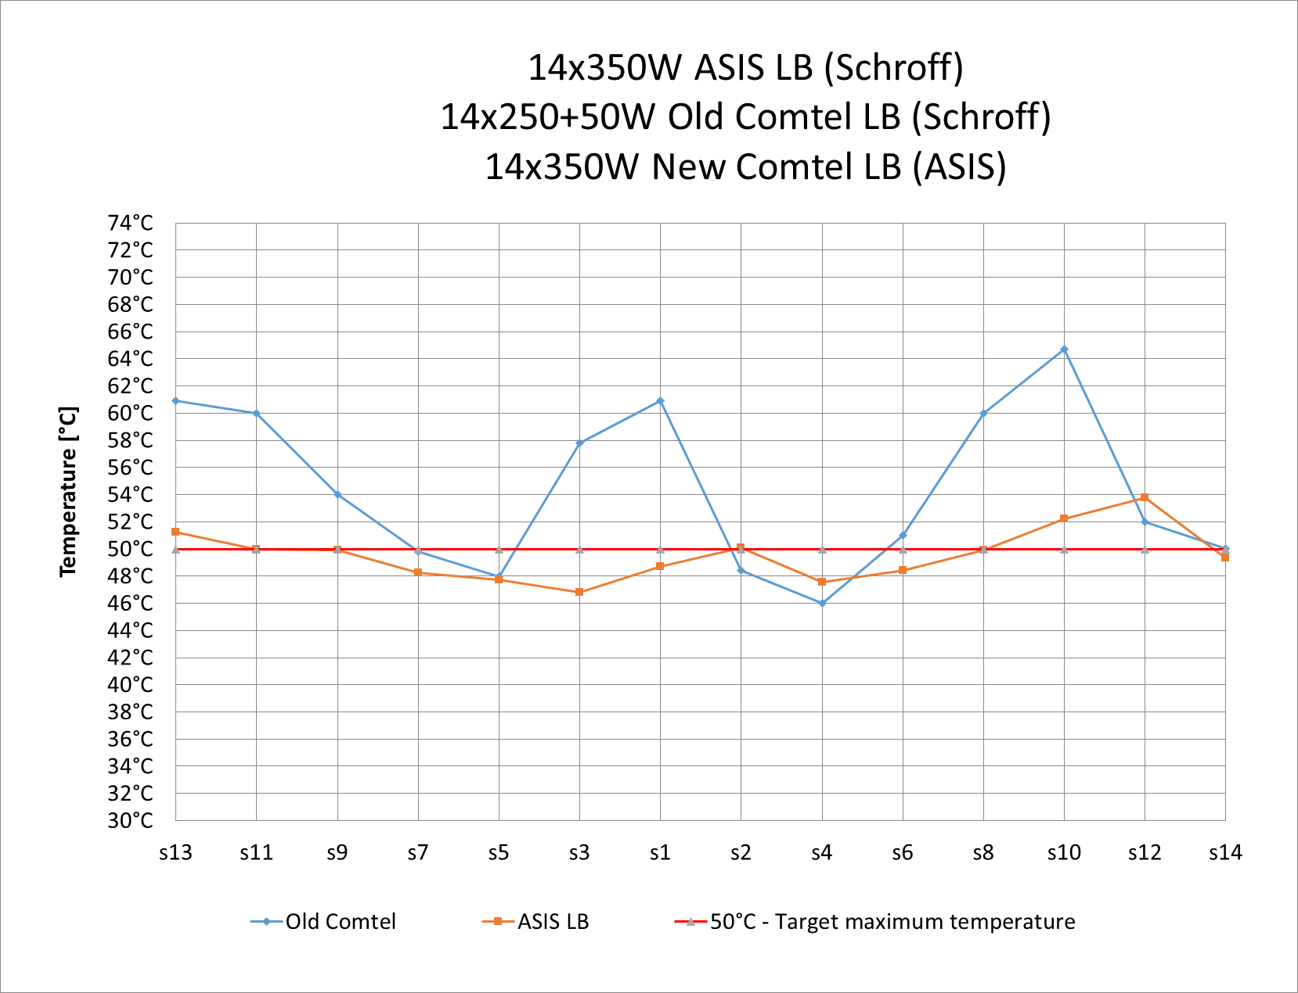
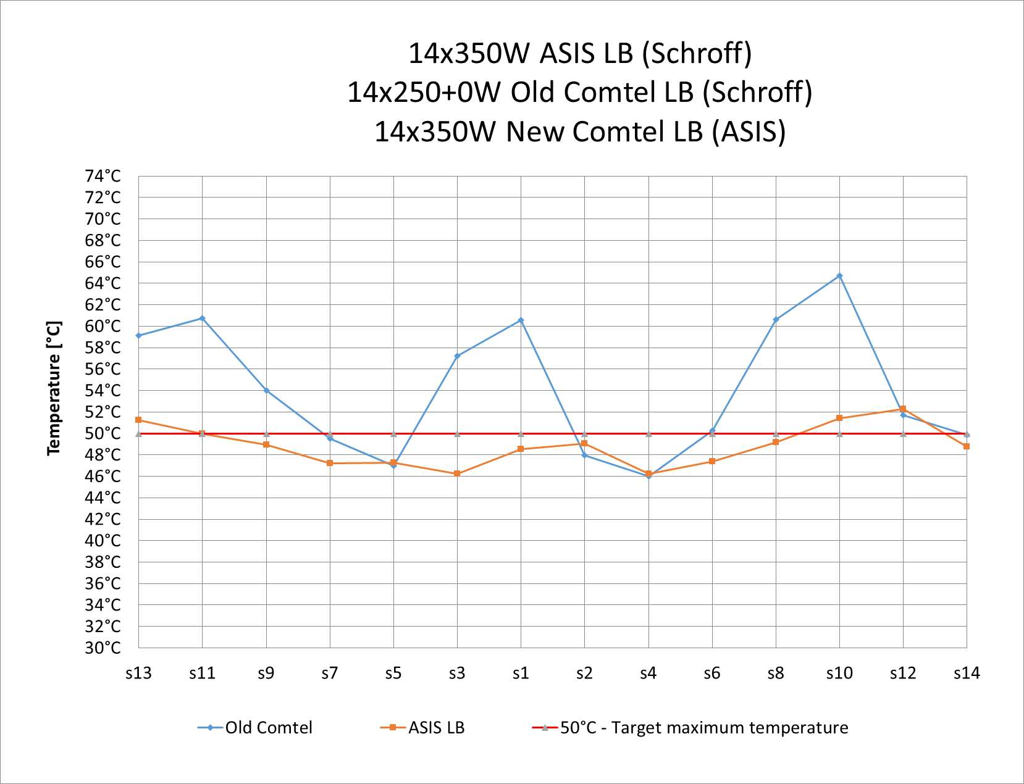
With RTM vs without RTM
With Bottom fans
14x350W ASIS LB (Schroff)
14x(250+50)W Old Comtel LB (Schroff)
14x350W New Comtel LB (ASIS)
With Bottom fans
14x350W ASIS LB (Schroff)
14x(250+0)W Old Comtel LB (Schroff)
14x350W New Comtel LB (ASIS)
Average max T
ASIS [°C] | Comtel [°C]
49.6 | 54.5
Average max T
ASIS [°C] | Comtel [°C]
48.9 | 54.2
Flow 2.4 m³/h
ΔT = 6.2ºC
Q_{r} = 17.3 kW
P = 84%
Flow 2.4 m³/h
ΔT = 6ºC
Q_{r} = 16.7 kW
P = 84%
Total power the rack 20.5 kW
Total power in the rack 19.8 kW
Additional 50W on RTM has negligible impact on other shelves cooling

