Slide 2
CERN-IPMC status
S. Baron, V. Bobillier, S. Haas, M. Joos, J. Mendez, S. Mico, R. Spiwoks

Slide 3
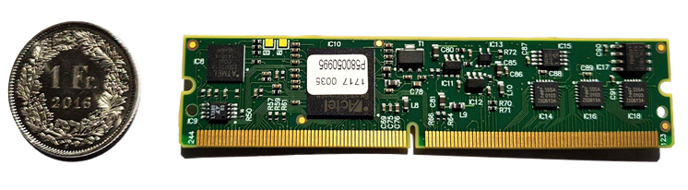
Overview
Selected as the HPM Controller for several AdvancedTCA cards
A workshop was held in October 2018
No major upgrade since the previous presentation (supported features)
But, still some news:
  New web application
  No need to sign NDA anymore*
*Except if access to the core sources is needed (expert users only)

Slide 4
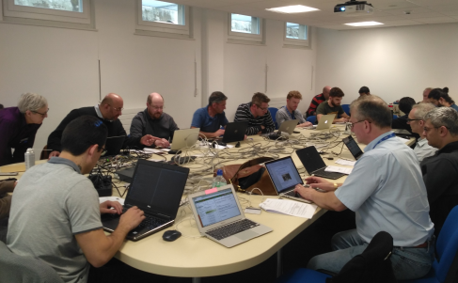
Workshop summary
Attendees: 29
CERN-IPMC presentation was divided in 2 parts:
  General introduction
  Demonstration
Slides can be downloaded there:
  https://espace.cern.ch/ph-dep-ESE-BE-ATCAEvaluationProject/PP_IPMC/Public%20documents/Workshop/
  https://indico.cern.ch/event/737733/
Web application was introduced

Slide 5
Web application
Can be accessed: https://cern-ipmc.web.cern.ch
Supports:
  Documentation section
  Remote compilation (without NDA signature)
  Template generation for sensor drivers
Being a member of the epesebe-ipmc-forum egroup is needed to access the sensor and compilation sections

Slide 6
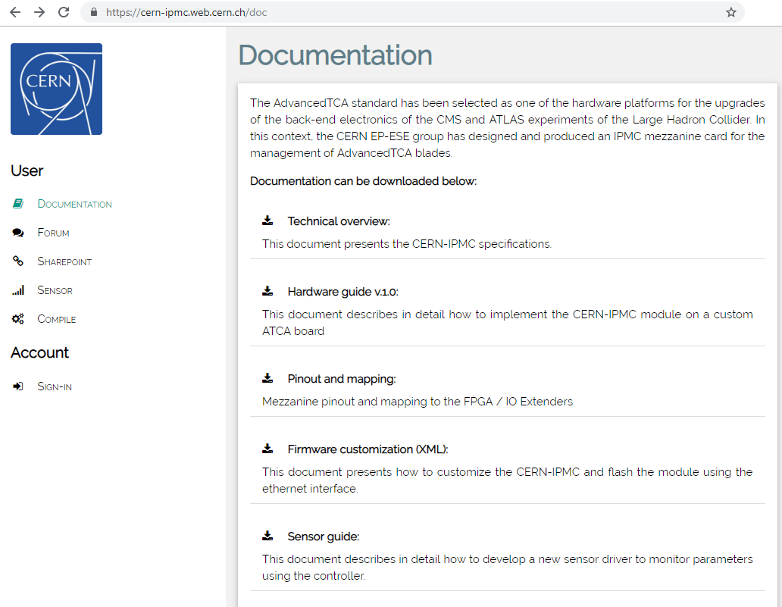
Web application
Documentations:
  Technical overview
  Hardware guide
  Pinout and mapping
  Firmware customization (XML)
  Sensor guide
  CERN-IPMC DevKit user guide
https://cern-ipmc.web.cern.ch/doc

Slide 7
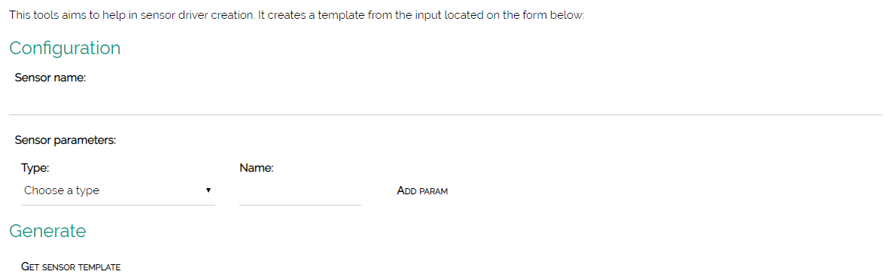
Web application
Sensor template: generates driver code (.c and .h files)
https://cern-ipmc.web.cern.ch/sensors

Slide 8
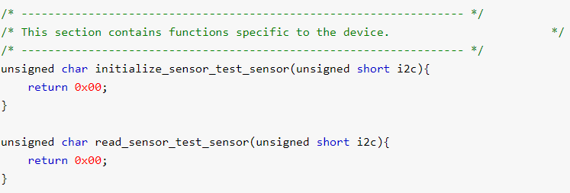
Web application
Files generated:
  Header file: can be re-used as it is.
  C file: host the init and read functions.
  XML: shows how to instantiate and instance of the sensor
How-to is documented into the sensor guide

Slide 9
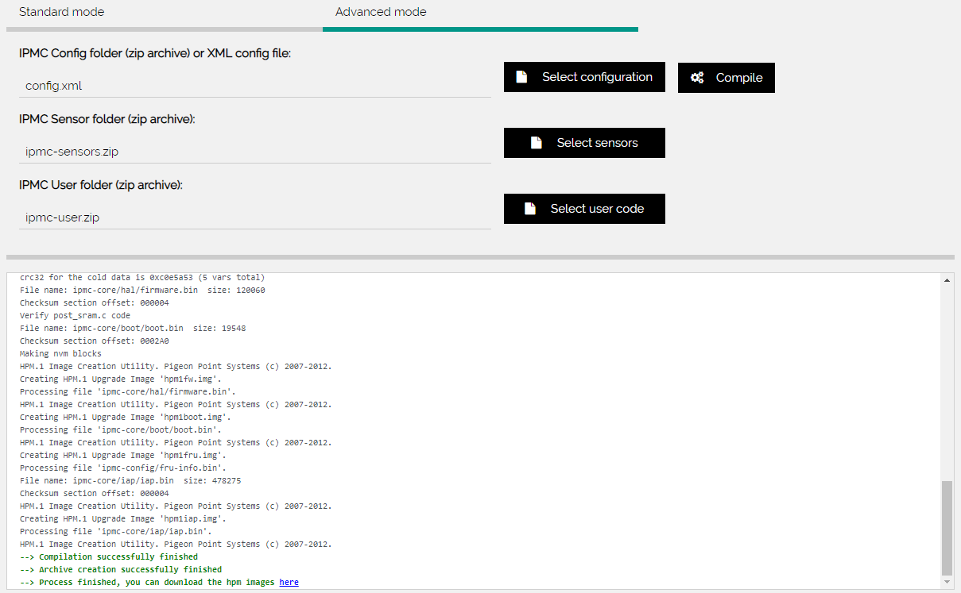
Web application
Remote compilation:
  Can be used via a web browser
  Using compile.py python script
Use statistics (2019-04-16):
  6 users since
  155 compilations
Official way to customize the IPMC
IPMC-Project, ready to be compiled, can be downloaded:
  https://gitlab.cern.ch/ep-ese-be-xtca/ipmc-project

Slide 10
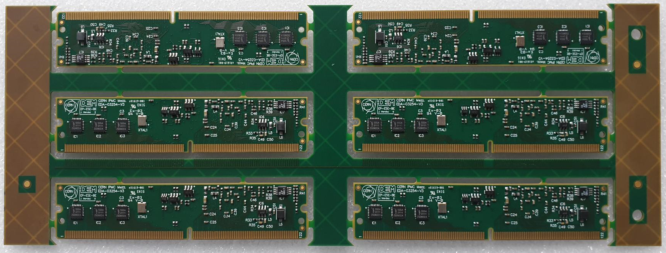
News
New feature: MAC Address management
  Stored into the EEPROM memory (not compilation dependent anymore)
  Future IPMCs will be sold with a valid address (from a CERN’s range).
  XML (LANConfig): <UseFlashedMAC />
New hardware: V3.0 is coming
  New Ethernet PHY.
  Flash memory extended
  Transparent for users
  Arrived at CERN yesterday ! Will be tested in the following days
    Works as expected !

Slide 11
Plans
Production plans:
  A first batch of 6 prototypes of the V.3.0 just arrived at CERN
  48 modules ready to be assembled
  A new production of 100 modules is planned for Q2/Q3 2019
User requests:
  Already 134 modules requested for 2019/2020
  How many do you need?
    Please, send us an e-mail in advance to describe your 2019/2020 needs.
    E-mail: epesebe-xtca-support@cern.ch

Slide 12
Thank you !

Slide 13
CERN-IPMC “foreseen orders”
Project | Contact | 2019 | 2020 | 2021 | 2022 | 2023 | Total
ATLAS eFEX | I. Brawn, D. Sankey | 36 |  |  |  |  | 46
ATLAS jFEX/TOPO | D. Bao Ta, U. Schaefer | 10 |  |  |  |  | 16
ATLAS L0MDT | E. Hazen | 10 | 10 | 60 |  |  | 80
CMS Inner tracker DTC | E. Hazen, P. Wittich |  |  | 40 |  |  | 40
CMS Outer tracker track finder | E. Hazen, P. Wittich |  |  | 192 |  |  | 192
CMS Outer tracker DTC | E. Hazen, P. Wittich |  |  | 228 |  |  | 228
ATLAS HTT | E. Lipeles, A Nikolica | 6 |  | 8 | 34 | 707 | 753
ATLAS NSW | T. Costa De Paiva | 26 |  |  |  |  | 26
ATLAS TileCal | A. Valero Biot, F. Carrio | 3 | 3 | 8 | 20 |  | 43
CMS DTH | D. Gigi | 30 |  |  |  |  | 30
Total |  | 121 | 13 | 536 | 54 | 707 | 1454
134 requested, 154 planned to be produced

