Slide 1
Alignment of the cryomodule
Report on the discussion 5th March 2018

Slide 2
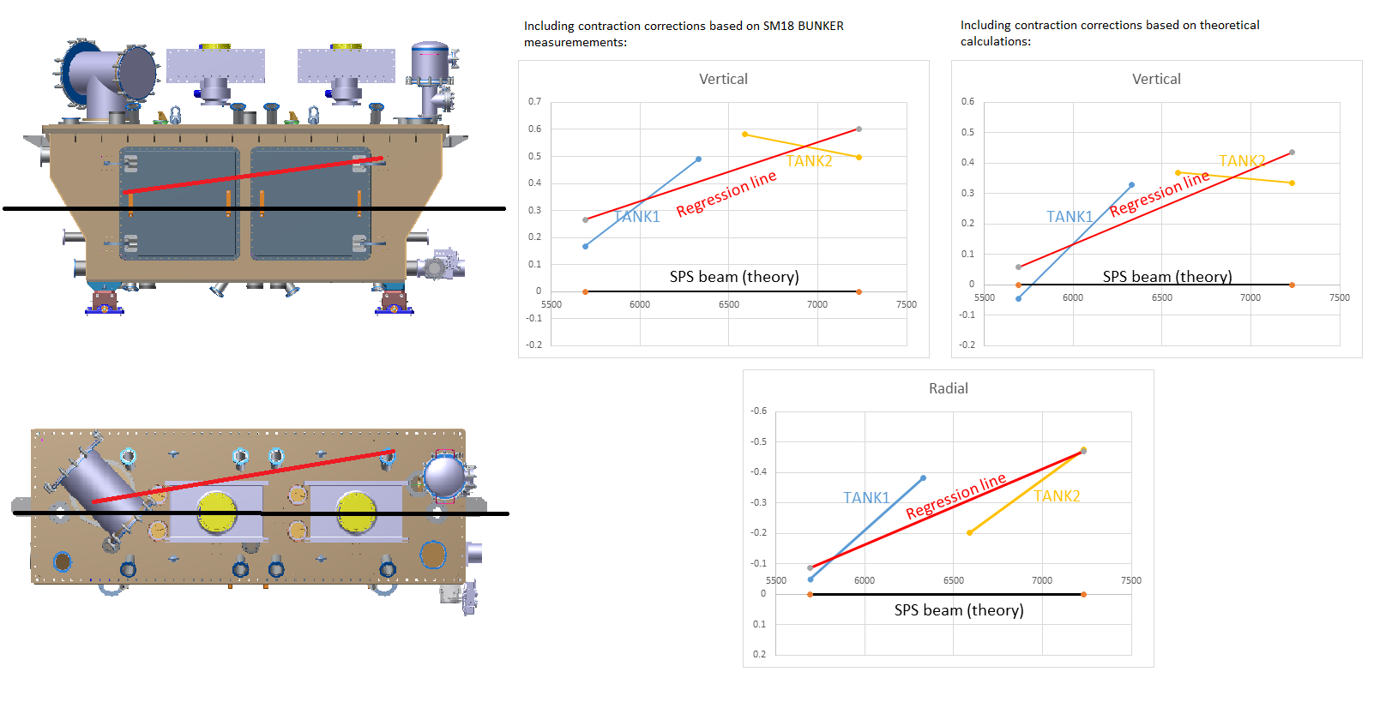
Cryomodule survey before cooldown
According to spec, max allowable misalignment should be within +/-250μm w.r.t. beam
Insufficient data on effect of vacuum cycling
No FSI observation during initial alignment
Successive cycles on insulation vacuum

Slide 3
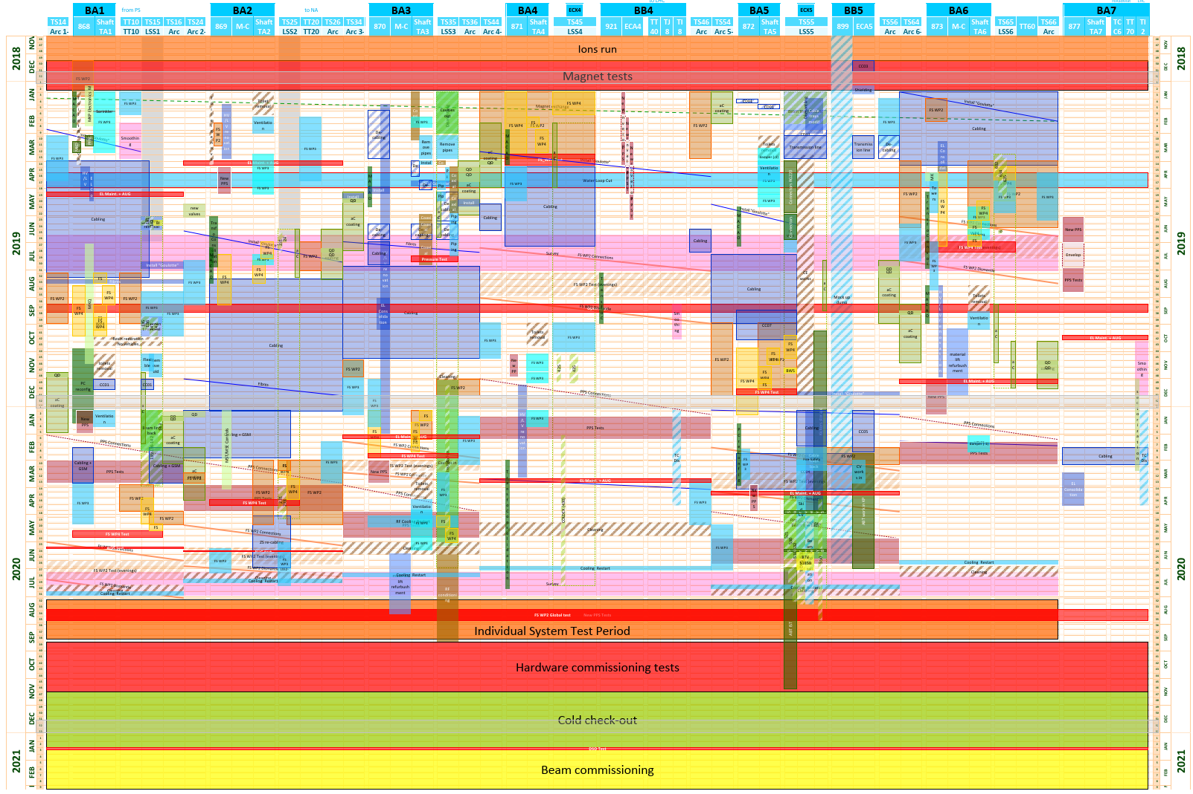
SPS General planning

Slide 4
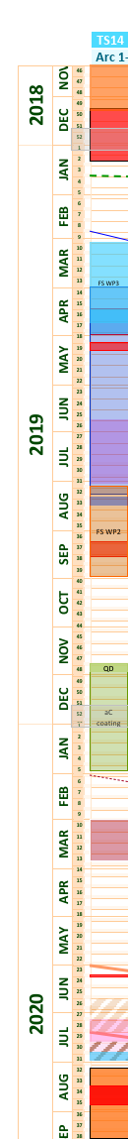
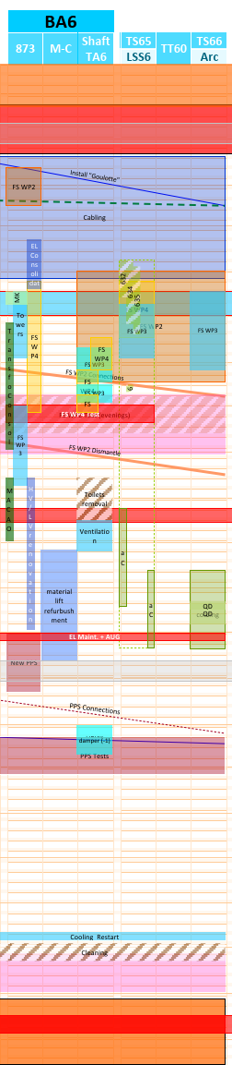
SPS BA6 Planning
Cabling :
momentarily displace table to give way behind the module (1 week)
  Then 3 weeks with cabling coactivity
Installation of Fire Safety systems:
Integration still to be confirmed
Cryogenics:
Remove Y-chamber, VB2 and flexibles Feb-Apr 2019
Repair on surface 9 months
Re-install from fall 2019 to winter 2020
Crab region rather free from heavy coactivity

Slide 5
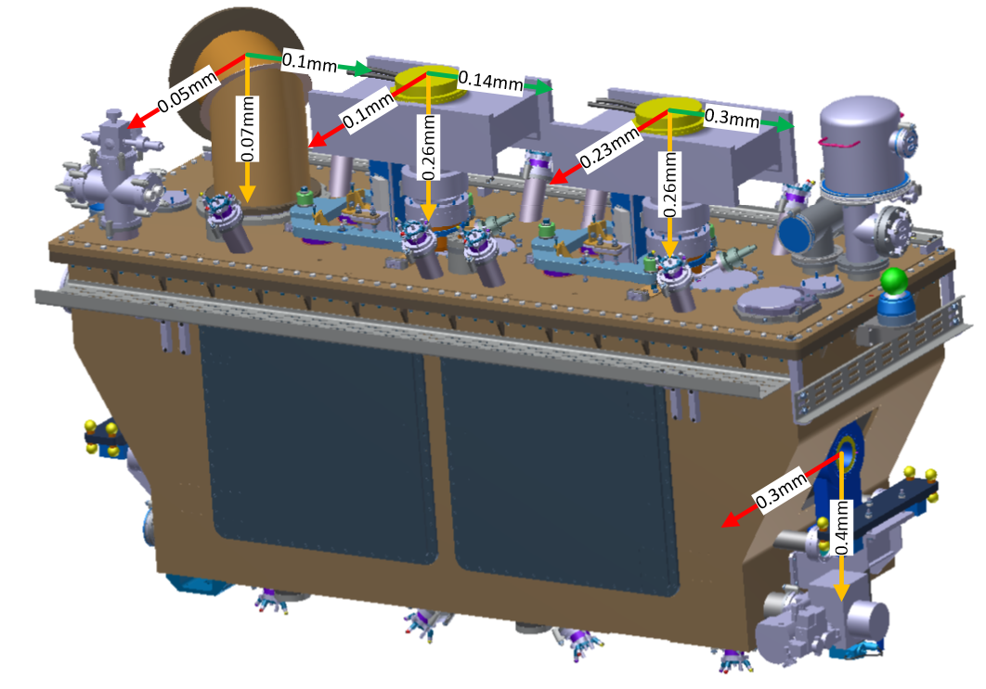
Re-alignment movement
Downstream side of cryomodule
lowered 400μm
shifted radially toward corridor side by 300μm

Slide 6

Re-alignment movement
Using jack below the jumper as the pivot point, we expect local shifts:
Jumper: 50μm in Radial, 70μm Vertical, 0.1mm in Longitudinal;
RF connection left: R0.1mm, V0.26mm, L0.14mm;
RF connection right: R0.23mm, V0.26mm, L0.3mm
Shifts only in radial-vertical directions – no expected twisting of vacuum bellows.
Shear expected:
Cryogenics jumper
RF bellows

Slide 7
Systems
SPS Beam:
Alignment is not required for taking beam, beam orbit (black line) shifted to go through the average center such that both cavities share the misalignment.
Vacuum:
no expected issue, but VSC should be present if we go for realignment
RF:
No problems expected for RF bellows, but moving them puts stress on the FPC window.
Proposed procedure: unbolt the waveguides from the CM, re-align, bolt them back.
Movement should remain 0.5 mm total, i.e. less than 0.2 mm per FPC, all axis.
With vacuum on the module, movement on FPCs is already 0.2-0.3 vertically, due to deformation of the top-plate, but waveguides can absorb 0.2+ 0.2mm

