Slide 1


Tutorial on multi-bunch simulations with PyHEADTAIL
M. Schenk, G. Rumolo
Acknowledgements
J. Komppula, K. Li
21. January 2019, update 11.03.22

Slide 2
Objectives
  Demonstrate how to install and use PyHEADTAIL multi-bunch on CERN HPC
  Provide simple, working example as starting point for new users
  Point out some pitfalls
  Give general advice based on personal experience with the code / cluster

Slide 3
Step 1: Installation
  Request CERN HPC access: G. Rumolo can add you to the e-group service-hpc-be
  More infos: https://twiki.cern.ch/twiki/bin/view/ABPComputing/Hpcpilot
  Access cluster: ssh -Y cernusername@hpc-batch
  … works from inside CERN – from outside need to go through lxplus
  Load MPI module: module load mpi/openmpi/1.8.4
  here using openmpi 1.8.4 – other MPI modules are installed and can be used as well
  Prepared a bash script (openmpi_install) to install your own PyHEADTAIL multi-bunch environment
    Predefined for openmpi 1.8.4 module preinstalled on HPC (use module load command)
    Uses Python virtualenvs
    Includes modules required for PyHEADTAIL multi-bunch, in particular mpi4py, h5py (parallel), cython, …
    Do not run installation script in auto-mode, but go through line by line to spot errors if any
    (updated and tested everything 2 days ago, worked smoothly)
  Install PyHEADTAIL from source (e.g. in /hpcscratch/user/cernusername)
    Make sure correct Python-env is activated: source /hpcscratch/user/cernusername/…/py2.7/bin/activate
    git clone https://github.com/PyCOMPLETE/PyHEADTAIL
    cd PyHEADTAIL
    git checkout feature/multibunch_feedback
    make
    Add PyHEADTAIL path to PYTHONPATH variable (e.g. line in ~/.bashrc), or do so directly in main PyHEADTAIL script

Slide 4
Step 2: Running a PyHEADTAIL multi-bunch simulation
  Once everything is installed: how to set up a multi-bunch simulation?
    Need a ‘standard’ PyHEADTAIL main file, with minor changes compared to single-bunch simulations
    Possibly additional files, such as wake table, initial bunch distributions, etc.
    Need a launcher script for the CERN HPC (SLURM)
  Both files are available in the ‘example’ folder
    Main file is based on SPS case and includes: bunchmonitor, slicemonitor, wakes, ideal bunch-by-bunch feedback, simple filling scheme, …
  In the following
    Will go through example main file first, pointing out relevant differences wrt. single-bunch PyHEADTAIL
    Will explain launcher script and useful SLURM commands

Slide 5
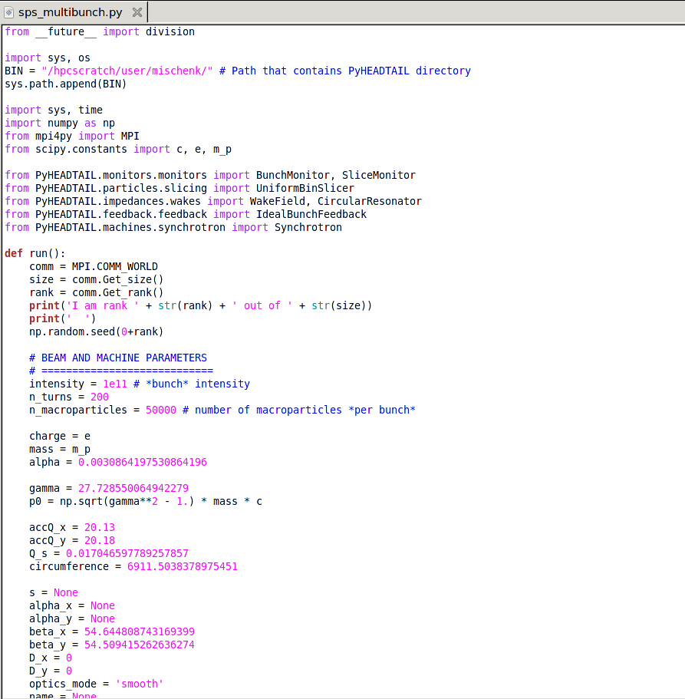
PyHEADTAIL multi-bunch main file (1/4)
Add directory that contains PyHEADTAIL folder to PATH variable for remote nodes
np.random.seed(0+rank)
  Fixed seed between simulation launches (no time dependence)
  Different seed for every node to make sure that bunch distributions are not identical between them

Slide 6
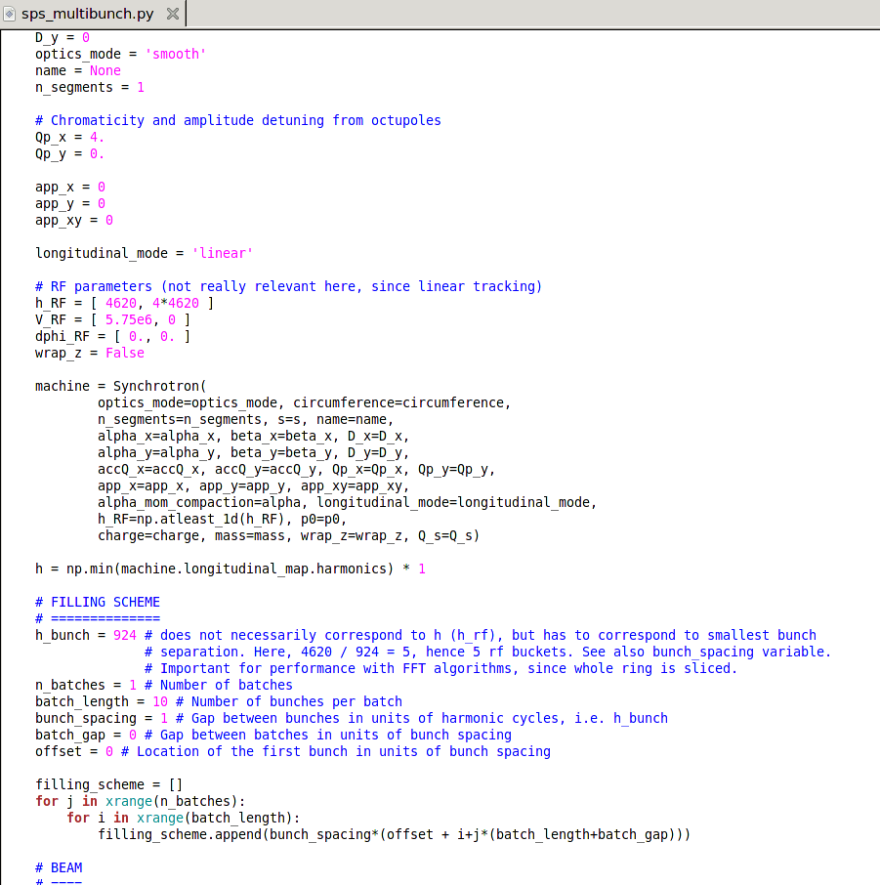
PyHEADTAIL multi-bunch main file (2/4)
Filling scheme
Units are important
h_bunch
  Performance-critical
  Not to be confused with h (rf harmonic number)
  h_bunch is a ‘harmonic number’ that corresponds to minimum bunch spacing
  Important for performance of FFT MPI algorithms since they slice up whole ring
  Example SPS: h = 4620 – if minimum bunch spacing is 5 rf buckets, can choose h_bunch = h / 5 = 924 to gain factor ~5 in performance for wake computation
  Needs to be passed on to slicers (see next slide)
Gap between batches is in units of bunch spacing

Slide 7
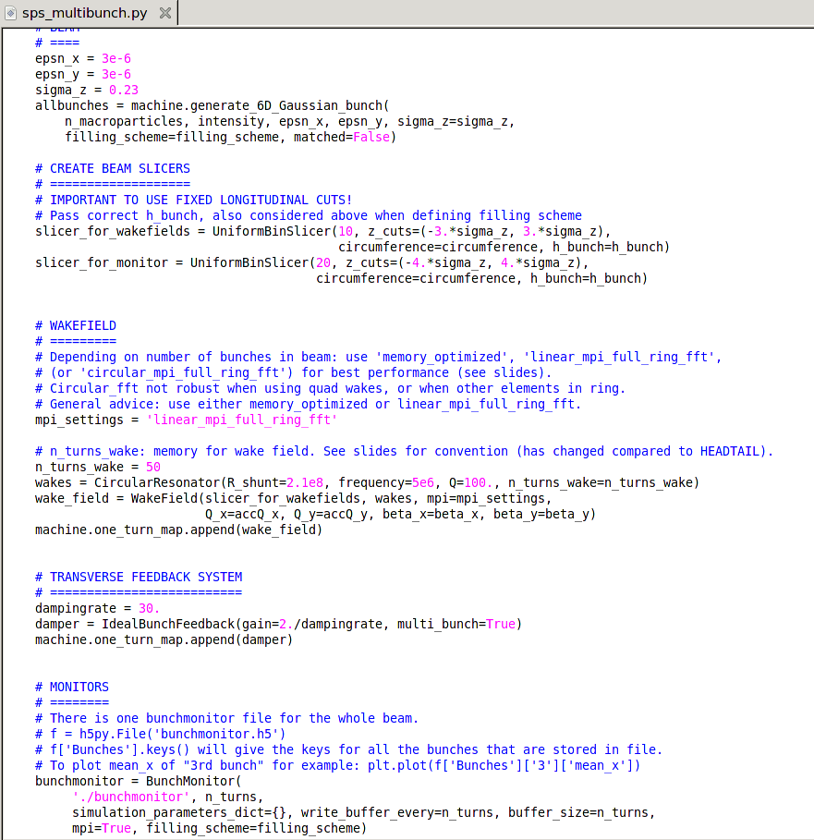
PyHEADTAIL multi-bunch main file (3/4)
Pass filling_scheme to machine.generate_...bunch()
Slicers
  Use uniform bin slicer
  Use fixed longitudinal cuts – dynamic slicing will produce incorrect results with optimized MPI algorithms (memory_optimized and FFT alg’s)
  Pass correct h_bunch variable as assumed when defining filling scheme
Wake field
  mpi_settings: choose algorithm for wake field calculation – best choice depends on number of bunches in beam (see J. Komppula’s graph next slide)
  n_turns_wake: change of convention compared to HEADTAIL. Counting n_turns_wake from source slice, not from s = 0 of machine! (see later slide)
  Wakes take beta functions and tunes: only used by circFFT algorithm, to calculate phase corrections
  Best to use either memory_optimized or linFFT
  Careful with circFFT especially with quadrupole wakes
Bunch monitor is MPI compatible (simply set mpi=True)

Slide 8
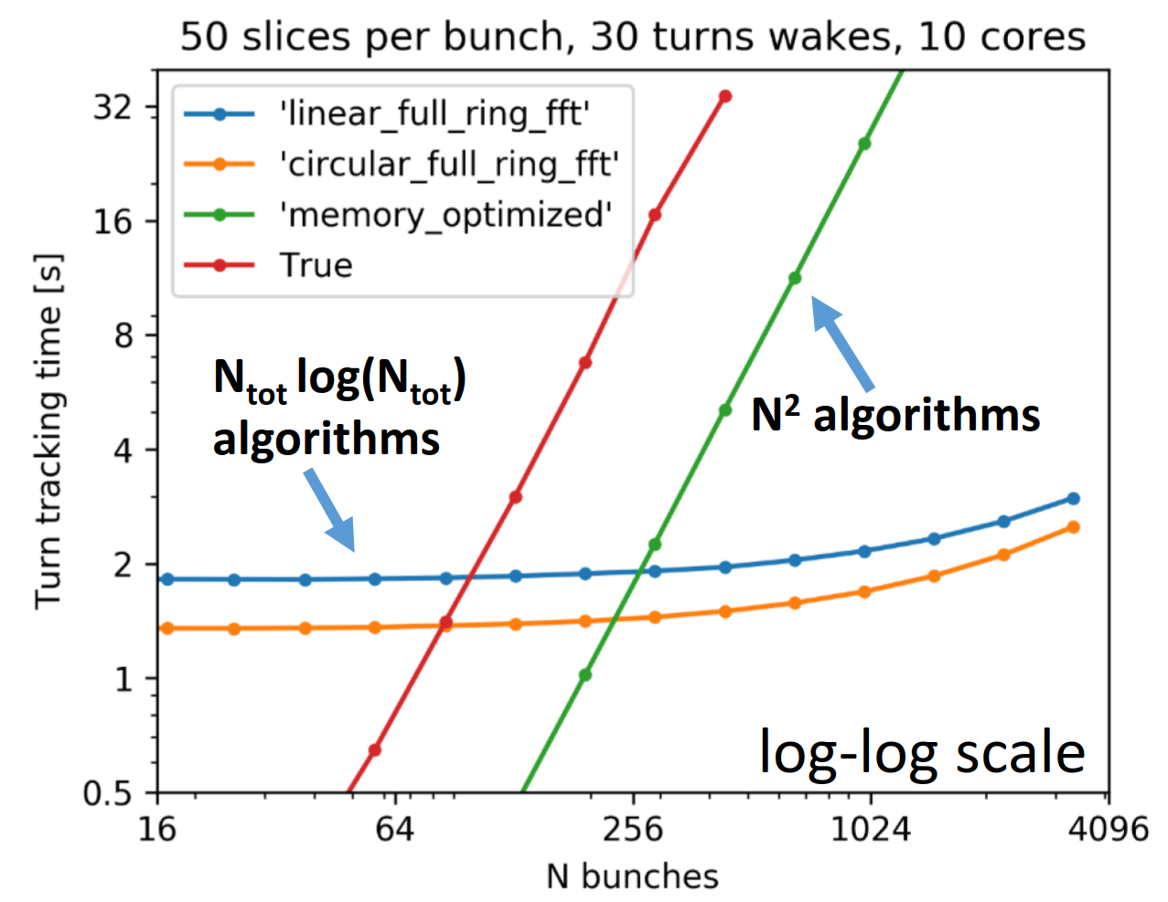
PyHEADTAIL MPI algorithms
Different algorithms available in PyHEADTAIL with various levels of optimization
Depending on number of bunches one or other algorithm may be faster
mpi_settings=
  True: simplest MPI parallel, non-optimized algorithm
  ‘memory_optimized’: memory optimized, with pre-calculated wakes
  ‘linear_mpi_full_ring_fft’: linear ‘compressed’ FFT convolution,
  slicing up whole ring (incl. empty buckets)
  ‘circular_mpi_full_ring_fft’: circular ‘compressed’ FFT convolution,
  slicing up whole ring (incl. empty buckets)
memOpt fast when using only up to a few hundred bunches, otherwise FFT algorithms more efficient
For details, see talks
  J. Komppula, Optimization algorithms for PyHEADTAIL multi-bunch simulations, PyHEADTAIL meeting #19 (15.06.18)
  N. Mounet et al., PyHEADTAIL multibunch – some theoretical considerations about convolutions with periodic gaps, PyHEADTAIL meeting #19 (15.06.18)
  J. Komppula et al., Multi-bunch status update, 131st HSC meeting (15.01.18)
  J. Komppula & K. Li, Optimized multi-bunch, PyHEADTAIL meeting #17 (19.12.17)
  J. Komppula, Optimization algorithms for PyHEADTAIL multi-bunch simulations, 15.06.18

Slide 9
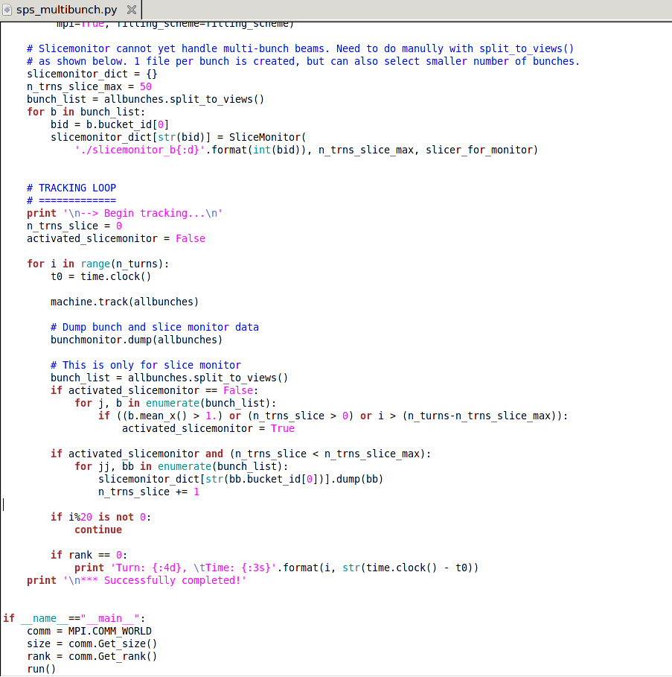
PyHEADTAIL multi-bunch main file (4/4)
Slice monitor cannot handle multi-bunch beam yet
  Implemented manually in main script here (see tracking loop), using split_to_views() method

Slide 10
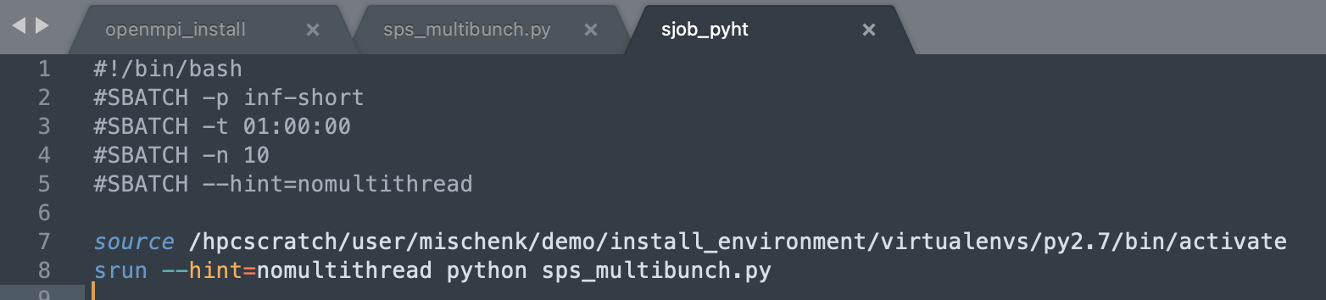
SLURM job launcher
Example batchscript

Slide 11
SLURM job launcher
Select queue
“long / short”: jobs >= 48h / < 48h
Use sinfo command to see what queues are available
(be-long, be-short, batch-long, batch-short no longer exist)
Example batchscript

Slide 12
SLURM job launcher
Example batchscript
Define time required for job to finish (HH:MM:SS)

Slide 13
SLURM job launcher
Example batchscript
Define number of cores to use
PyHEADTAIL jobs
n_cores <= n_bunches
Use integer multiple of number of cores per node (queue-specific!), otherwise occasionally faced shared memory errors

Slide 14
SLURM job launcher
Example batchscript
Flag to disable hyperthreading (HT)
Otherwise faced some issues for PyHEADTAIL jobs at times
--hint=nomultithread must be specified both as #SBATCH *and* srun argument

Slide 15
SLURM job launcher
Example batchscript
Activate your personal python 2.7 environment with modules such as h5py (mpi), etc. required by PyHEADTAIL. Don’t forget to change the path to your actual installation directory

Slide 16
SLURM job launcher
Example batchscript
Submit to SLURM
Here: sps_multibunch.py is the main PyHEADTAIL script as shown on previous slides

Slide 17
Main SLURM commands
module avail displays available (MPI) modules
module load modname load specific MPI module before submitting job (always used module load mpi/openmpi/1.8.4)
sbatch batchscript submit job specified in batchscript to queue (see example on previous slides)
squeue –u $USER display running/idle jobs for current user
scancel JOBID remove / cancel specific jobs
sinfo display available queues etc.
For further details consult SLURM documentation: https://batchdocs.web.cern.ch/linuxhpc/index.html

Slide 18

Input / output
Input files
PyHEADTAIL main file: sps_multibunch.py
SLURM launcher: sjob_pyht
Output files
Bunchmonitor.h5: Containing centroid data on all bunches
Slicemonitor_...h5: One for every bunch
slurm-…out: Logfile for job, very useful for debugging

Slide 19
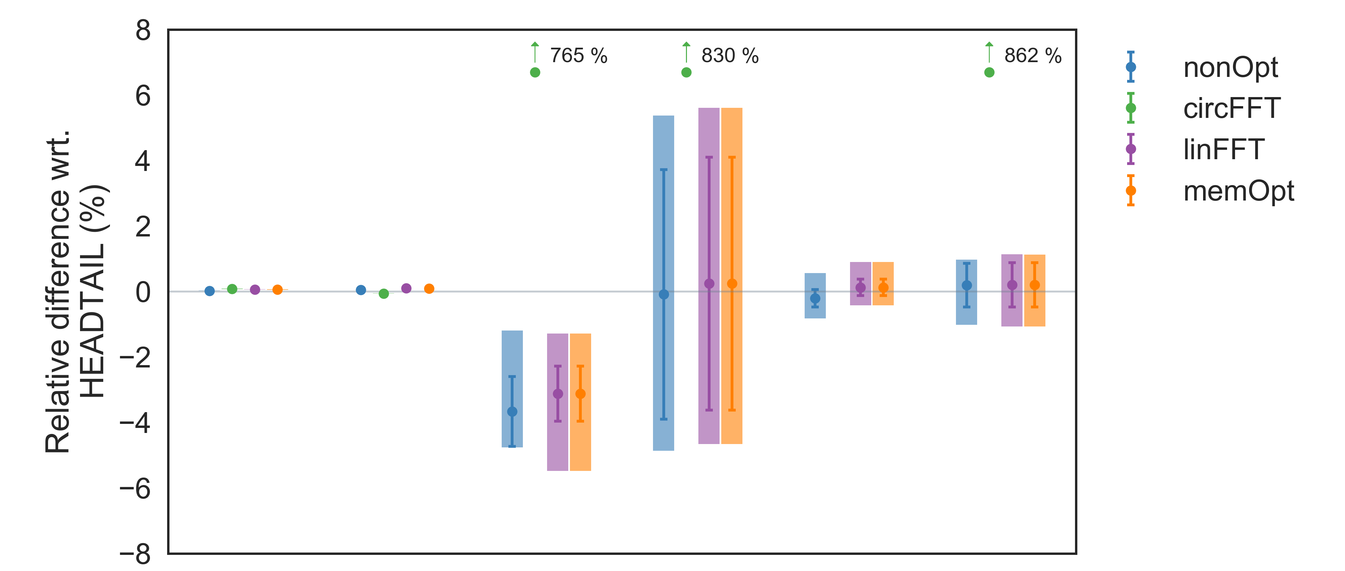
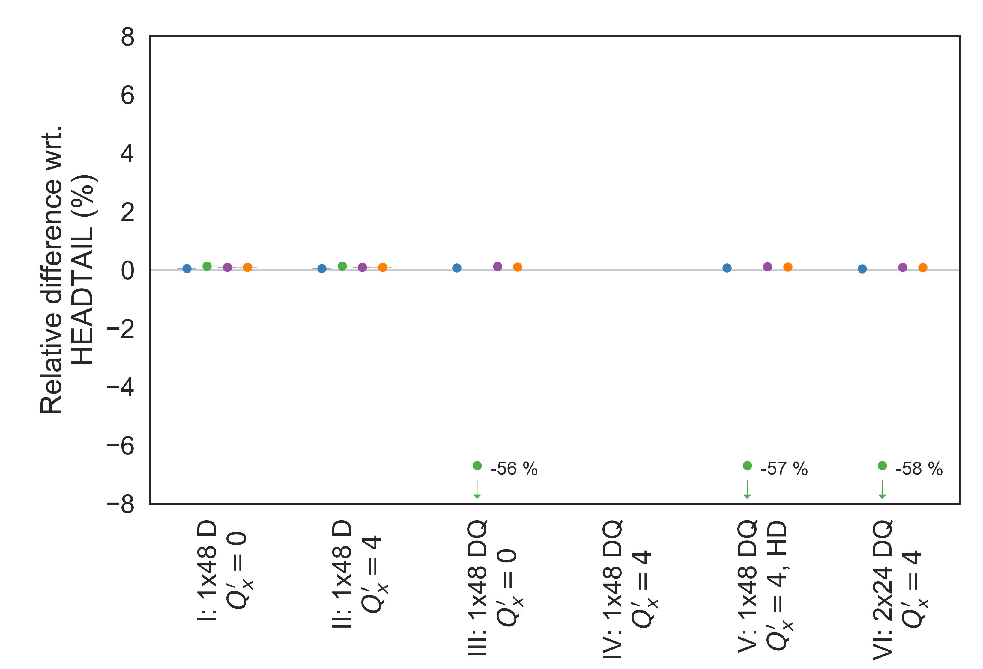
PyHEADTAIL benchmarks
Horizontal
2xn_{MP} & 2xn_{sl}
  Reasonable agreement between PyHEADTAIL and HEADTAIL in general, given fluctuations from
    Binning, esp. with low number of slices / particles, despite identical initial distribution
    Growthrate fits, esp. with quad wakes
  Growthrate differences even observed for 1b, when using dip and quad wakes (on few % level)
  Impact reduced by employing better post-processing, using more turns, larger n_{MP}, n_{sl}
  Issue when using quadrupole wakes with circFFT
  due to bug, (possibly) understood now
Vertical

Slide 20
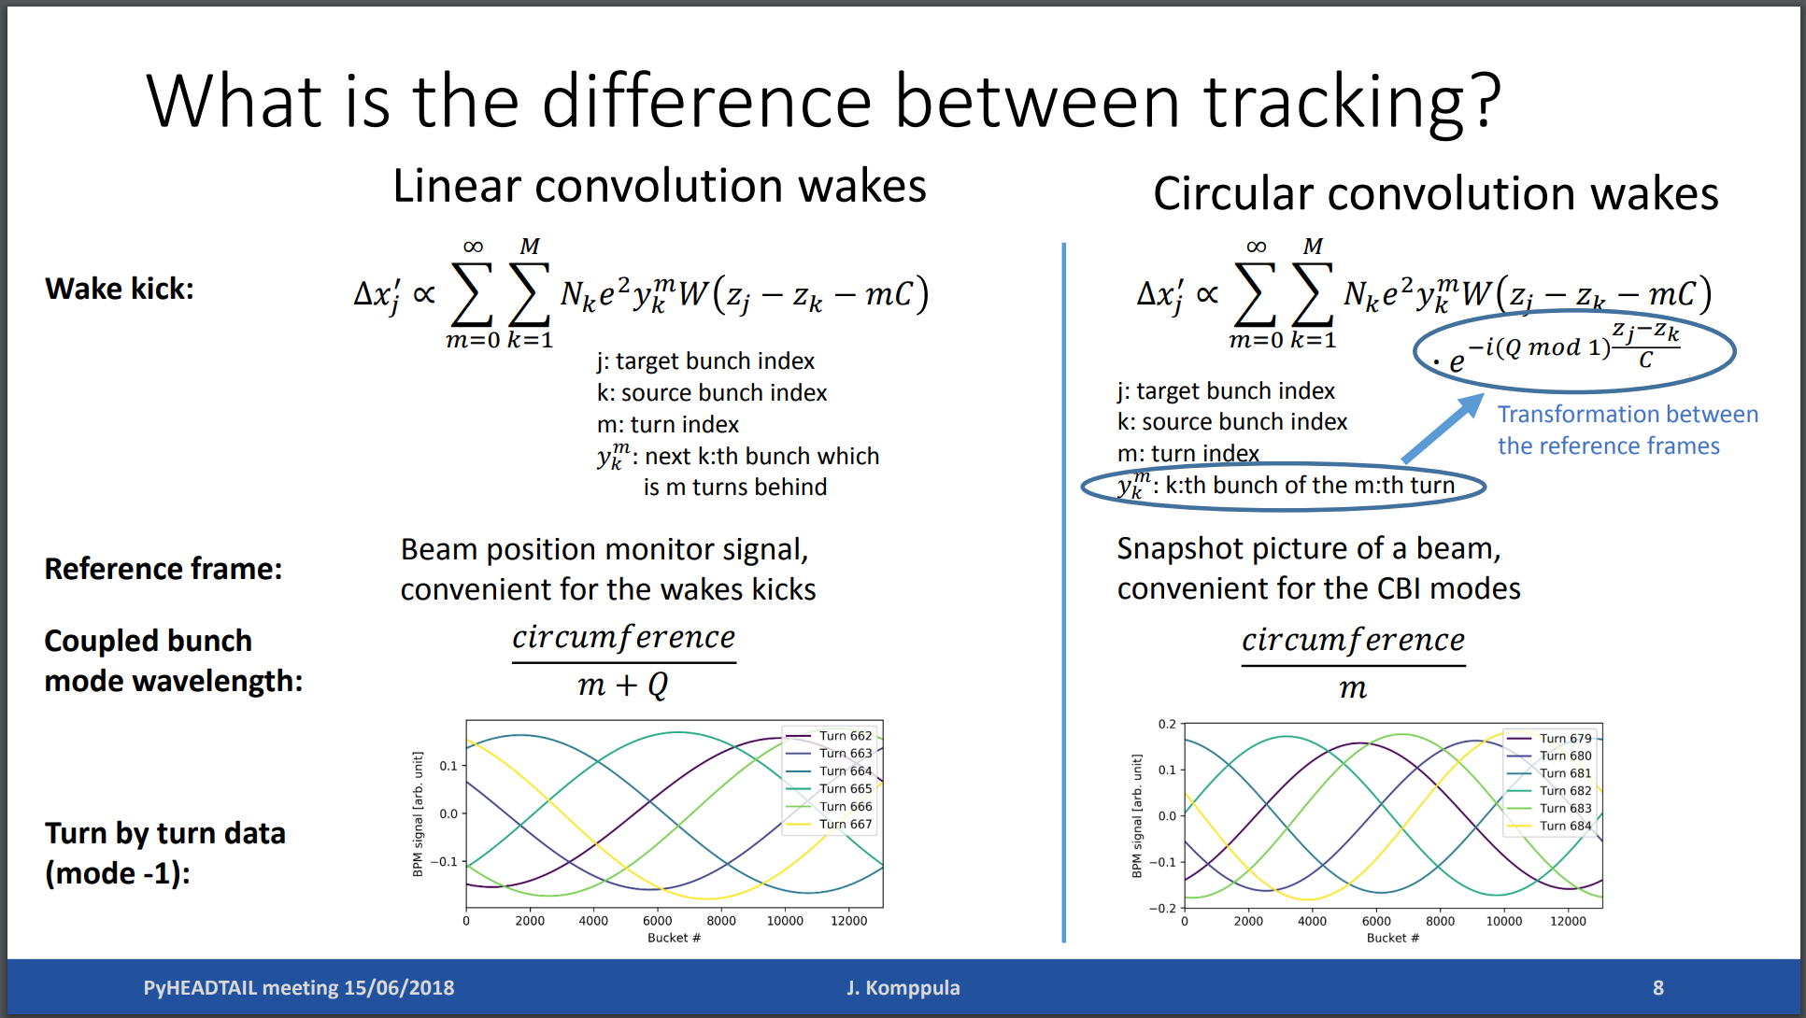
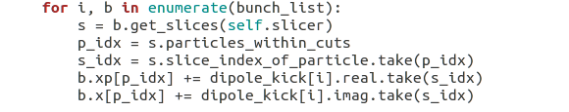
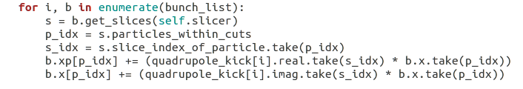
CircFFT for quadrupole wakes
  With circFFT, need to add phase terms e^{j Δθ} describing positions of bunches in the ring: reason is that we are considering different frame of reference compared to other algorithms – like a snapshot of beam
  ‘Kicks’ are complex: real part is applied to xp, imag part is applied to x, scaling with beta function required
  True for dipole wakes while for quadrupole wakes, phase term cancels out – to be verified
  (K. Li & N. Mounet, 14.12.18)
  Use linFFT or memory_optimized for all your studies, circFFT performance gain is small i.G.
J. Komppula, Optimization algorithms for PyHEADTAIL multi-bunch simulations, 15.06.18
dipole
quadrupole

Slide 21
Other hints and final remarks
Feel no multiturn
wake, even if wake
not decayed
    Fix longitudinal slicing cuts when using optimized multi-bunch PyHEADTAIL
    n_turns_wake: different multiturn convention used for optimized
    wakes compared to original PyHEADTAIL (and HEADTAIL)
      Orig.: count n_turns_wake from ‘first’ bunch
      New: count n_turns_wake from given source slice
      New definition makes more sense from physics point-of-view
      Both are equivalent as long as enough turns are considered for the wake
      (such that it decays within given number of turns)
    Run convergence studies: number of macroparticles, slices, turns …
    Post-processing: exponential fits can be problematic with quadrupole wakes
    due to decoherence – recoherence patterns
      Some ‘fluctuations’: evolution of bunch centroids may be sensitive to this effect
      Observed, in particular, when comparing HEADTAIL and PyHEADTAIL (binning/slicing, C++ vs. Python)
      Fitting procedure in frequency space can be helpful, considering only most unstable mode, use as many turns as possible
    Aperture not multi-bunch compatible yet
    Best place to put these slides and example code?
Turn i
Turn i+1
Feel multiturn
wake, if wake
not decayed
Turn i
Turn i+1

