Slide 2
A New LIU PSB Structure
G.P. Di Giovanni, B. Mikulec
LIU-PSB Technical Coordination Meeting
5th February 2019

Slide 3
Motivations for Change
  LIU moving on to a different phase → adaptation of the structure to the LS2 stage
  Our meeting organisation has been generally working well, with various changes done to cope with the project lifecycle.
  But a change of LIU organisational structure is needed to efficiently cope with LS2 phase.
  In particular the focus should be on following-up final LIU equipment readiness, NCs, installation, IST, HW and Beam commissioning,…
  There is a gap to quickly and efficiently address any non LIU major arising problems, affecting LIU work progress.
  Change from LIU-PSB Machine Coordination to LIU-PSB Technical Coordination Meeting LIU-PSB TCM (every 2w)

Slide 4
LIU-PSB LS2 Technical Coordination Meeting
Main Objectives:
  Progress in installation, issues, impacts on other activities, mitigations. Including non-LIU equipment affecting LIU work. Propose solution to conflicts/delays affecting the schedule and/or other machines.
  Deal with un-expected technical issues (e.g. during lab. tests) or non-conformities.
  IST preparatory stage.
  Detailed planning/procedures for HW commissioning to be implemented post-LS2.
  Documentation (ECR, Safety, non-conformities).
Typical Agenda:
  Report on the status of PSB Installation activities (D.Hay/J. Coupard). Mostly focusing on discussing issues and mitigations.
  Projection for the upcoming work to anticipate potential issues.
  Report on issues from each group.
Proposed Frequency: Bi-weekly
Expected Attendance:
  PSB Facility/Activity/Technical coordinators, Safety officer and PSB HW commissioning coordinators.
  Plus one representative per group (more experts of the same group if required).
  We will start with the current WP-holders mailing list, which will be modified depending on expert availabilities during LS2. If one WP-holder needs to spend most of his/her time in LS2 in the tunnel and will not be available, he/she should nominate a suitable replacement.
Chair/Co-chair: G.P. Di Giovanni/B. Mikulec

Slide 5
LIU-PSB Structure Organigram
LIU Project: PSB
IEFC
LS2C
LMC
LIU Executive Committee
LIU HW & Beam Commissioning Coordination
Chair V.Kain/G. Rumolo
PSB Shutdown Coordination
D. Hay
LIU PSB TCM
Chair: G.P. Di Giovanni/ B. Mikulec
LIU PSB BC
Chairs: G.P. Di Giovanni/C. Bracco
LIU PSB BD WG
Chair: S. Albright/F. Antoniou/C.Bracco

Slide 6
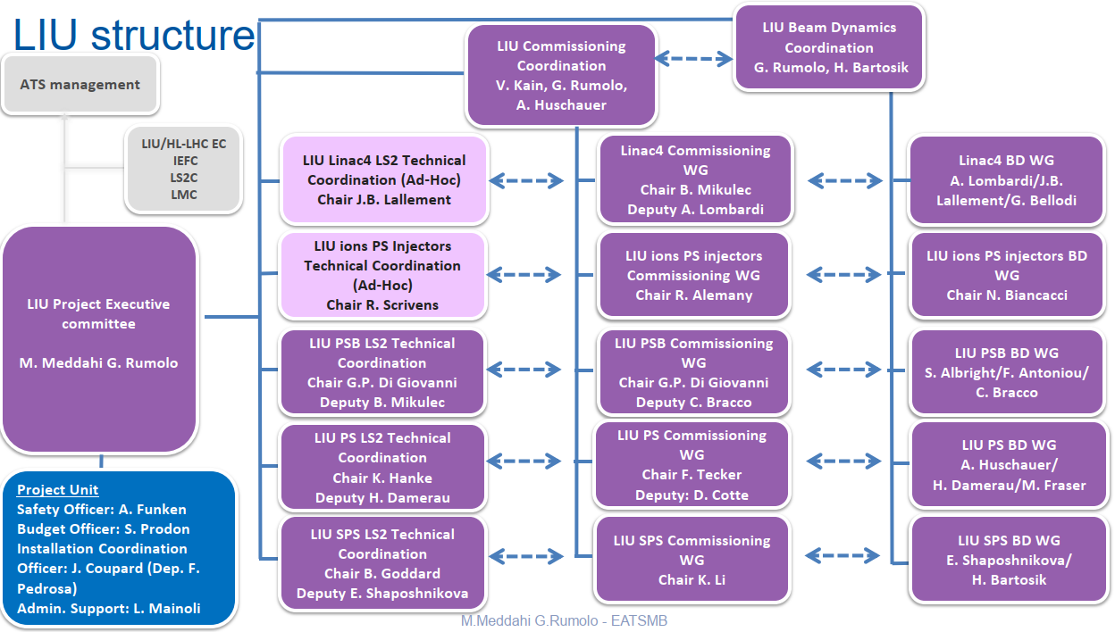
A New Structure within the LIU Project
Courtesy of M. Meddahi

Slide 7
Additional Details
Preliminary list of participants for the LS2 Technical Meeting ready:
  LS2 Technical/Activity coordinators have been contacted and are already on board.
  List includes the LIU-PSB-WP-holders.
Proposed timeslot/room for LS2 Technical Meeting.
  Every second Tuesday at 9:00 am.
  Room 37-R-022, close to the PSB.

