Slide 1



Updates for the GammaFactory POP IP
2019 01 29
LAL group

Slide 2
Laser parameters
From simulations, the preliminary laser parameters are:
            ^{(a)} possibly tunable but easier operation at fix value. Spectral shaping with sharp edge in the blue
            ^{(b)} with a coarse (+/- 15kHz) and fine tuning with a piezo stack
Feasible custom commercial laser.
Parameters | Values | Unit | Comment
central wavelength | 1030-1040 | nm | On wavelength fixed in this range
Central wavelength tunability | 0.2 | nm
spectral bandwidth ^{(a)} | 0.1-0.5 | nm | TBP limited pulse, chirped pulse ?
Pulse length | 3-15 | ps | Spectrum shap dependent, Gaussian assumption
Frep ^{(b)} | 40 | MHz
Phase jitter | <10 | fs | 10Hz-10MHz, strongly limit possible supplier
average Power | 40 | W | vary vs the spectral setting / vs TBC
Energy/pulse | 1 | uJ | vary vs the spectral setting
polarisation | circular | -
beam diameter | 1 - 2 | mm | Ajustment with telescope for coupling optimization to OC
beam quality, M² | <1.2 | -

Slide 3
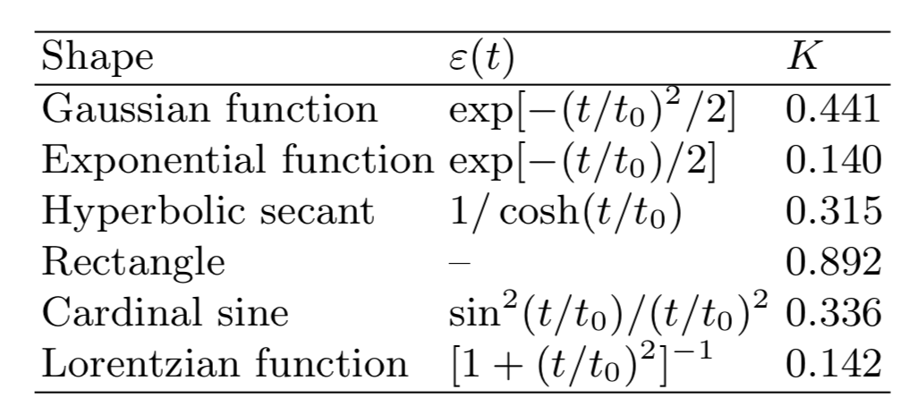

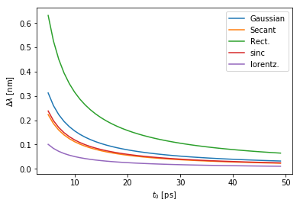


Time bandwidth product, FTL pulse versus chirped pulse
For a Fourier transformed limited pulse
m=2, quadratic phase => linear chirp
If group delay dispersion has marginal effect on ion beam cooling, pulse length t0 and spectral bandwidth can be decoupled by non-compensating the dispersion or adding dispersion

Slide 4
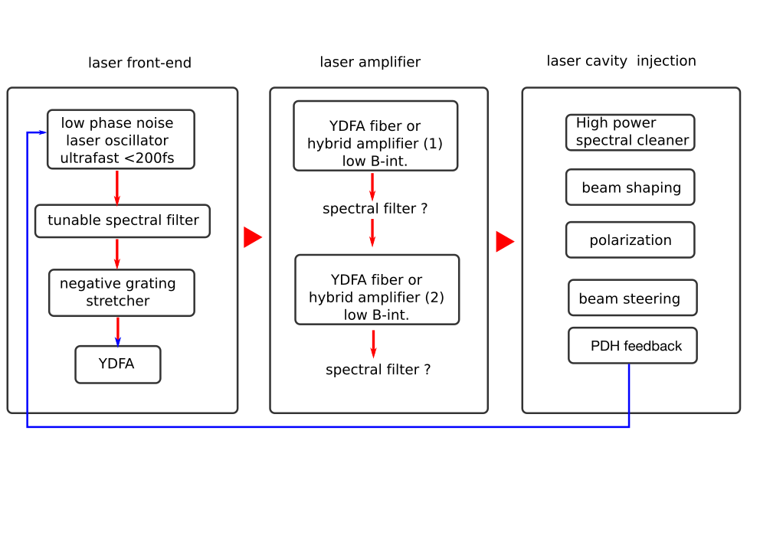









Progress in laser design considerations
Not a lot of progress, sourcing to identify supplier and laser design under discussion

Slide 5
New Optical cavity proposal
AM shows that a most simpler design with 2 mirrors (plan-concave) cavity is giving us :
The 2 mirrors OC has many advantages:
- easier alignment can be made without breaking vacuum
- minimized optomechanics under vacuum
- may be some pros for beam impedance issue
Parameters | Values 2-mirrors OC | Values 4 mirrors (3D-OC) | Unit | Comment
Crossing angle | 2.4 | 2.6 | °
waist_x @ IP | ~1.4 | ~1.9 | mm
waist_y @ IP | ~1.4 | ~1.7 | mm
Minimum waist | 1.25 |  | mm | On the coupling mirror
Max length | 3,75 | 3,25 | mm
Beam diameter M1 | 1.25 | 2 | mm
Coupling | ~ 70 | ~70 | %
Gain | >5000 | >5000 |  | Limited by oscillator phase noise
Stored power | >100 | >100 | kW

Slide 6
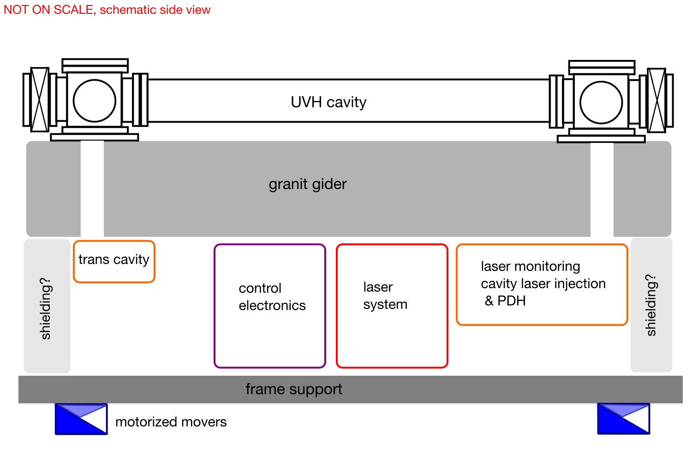
Rough integration design approach
First schematic of the interaction point system design guidelines integration :
- comes as a module in SPS, except possible chiller for the laser amplifier, power supply ?
Volume ~ 10 m³
- rack unit for laser and electronic easy to plug or un plug.
- epoxy granit ? Or honeycomb optical table, environment T°C variation and radiation must be adresse
~4.5m
~1.5m

Slide 7
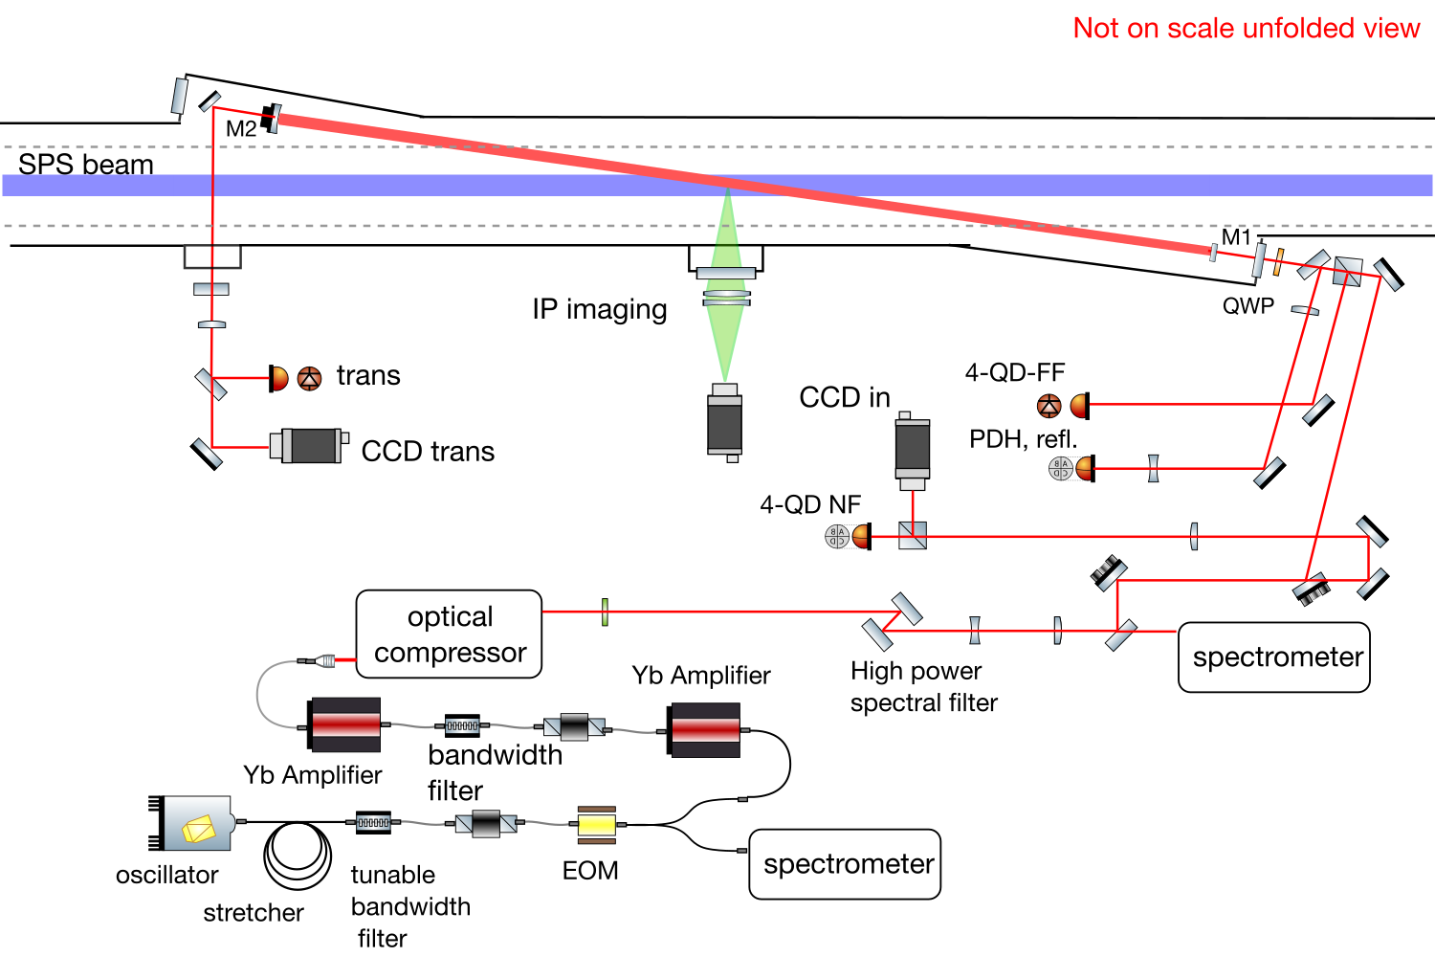
Optical scheme interaction point system

Slide 8
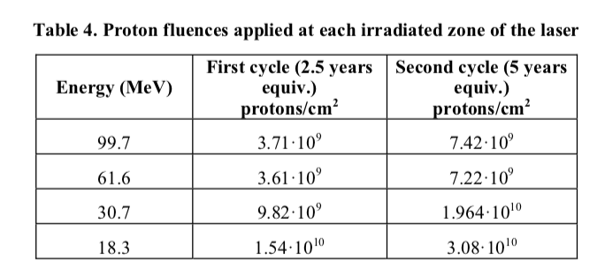
Radiation hardness issue
Long Straight Section | Position | Height | SEU 3V | SEU 5V
LSS4 | A | Beam | 20963 | 10498
 | B | Floor | 10351 | 1177
LSS6 | E | Beam | N/A | 17577
 | F | Floor | 20181 | N/A
R-factor | ΦHEH [pp/cm²] | ΦThN [pp/cm²]
0.1 | 8.88 x 10⁹ | 8.30 x 10⁸
1.9 | 8.80 x 10⁸ | 1.64 x 10⁹
0.1* | 1.50 x 10¹⁰ | 1.40 x 10⁹
1.9* | 2.04 x 10⁹ | 3.81 x 10⁹
Long Straight Section | Position | Height | TID [Gy]
LSS4 | A | Beam | 10.5
 | B | Floor | 4.8
LSS4 | C | Beam | 5.4
 | D | Floor | 3.9
LSS6 | E | Beam | 9.8
 | F | Floor | 4.0
Bibliography comparison
G. Buchs et al . « Radiation hard mode-locked laser suitable as a spaceborne frequency comb » OPTICS EXPRESS Vol. 23, No. 8 (2015)
DOI:10.1364/OE.23.009890
How it scales after one year in SPS?
Results in favor of LSS4 ?
SEU seems large special power supply and electronics required ?
What about shielding ?

Slide 9
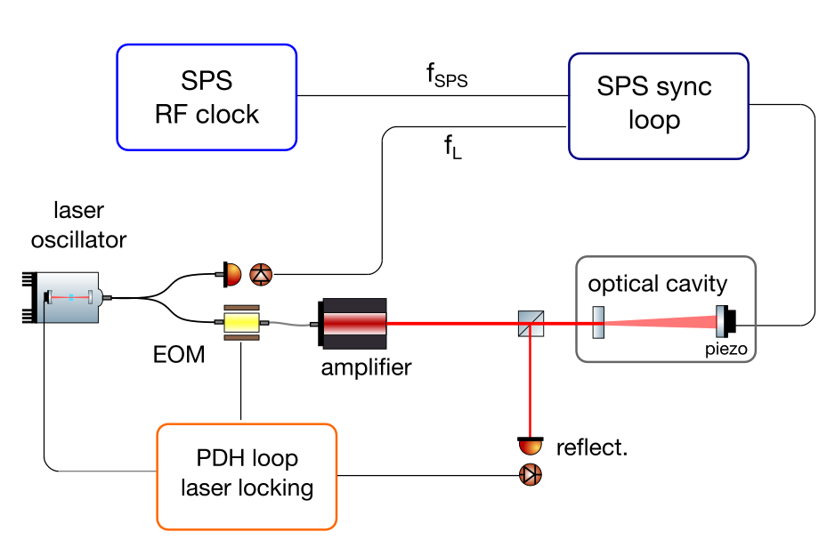
Required input from CERN SPS
To progress on the general design of the interaction point system :
  Better understanding of the radiation measurement : shielding design ?
  RF SPS reference for locking : RF signal to lock the cavity on SPS / how RF is modified
  Environment condition : temperature variation?
  Integration constraints and safety : max volume and weight for the IP system, alignment network
  Control-command and cabling

Slide 10
Next step for LAL team
Yellow Report !!
Include chirp in software to describe laser pulse - ion bunch interaction.
Optical cavity design refinement with investigation of thermal effect on the coupling mirror for the 2 mirrors OC
First proposal of a complete laser architecture and associated budget based on NKT photonics/teraxion proposal
Investigation of alternative design with NKT oscillator / teraxion (stretcher-spectral bandwidth filter) /Amplitude Amplifier
Design and test of the high energy spectral shaper (Institut Fresnel)
Visit SPS and freeze integration interfaces
Request for LAL design office time to produce first 3D model of the interaction point system

