Slide 1
Constrains on Laser system implementation in the SPS tunnel
Gamma Factory Meeting
Faculty of Physics, Astronomy and Applied Computer Science
Jagiellonian University
Krakow, Poland
28–30 January 2019
By Valentin Fedosseev (CERN, EN department)

Slide 2
Requirements for laser installation
General requirements:
Space for laser, optics, diagnostics, other electronic devices
Electrical power
Laser cooling => autonomous water circuit preferable
Temperature stability => typically better than +/- 1° C
Air purity => typically ISO 7 or better
Class 4 laser safety => Designated Laser Area with access controls + enclosed beams outside DLA (Class 1)
Specific requirements:
Synchronization to the machine timing
Integration into the CERN control system

Slide 3
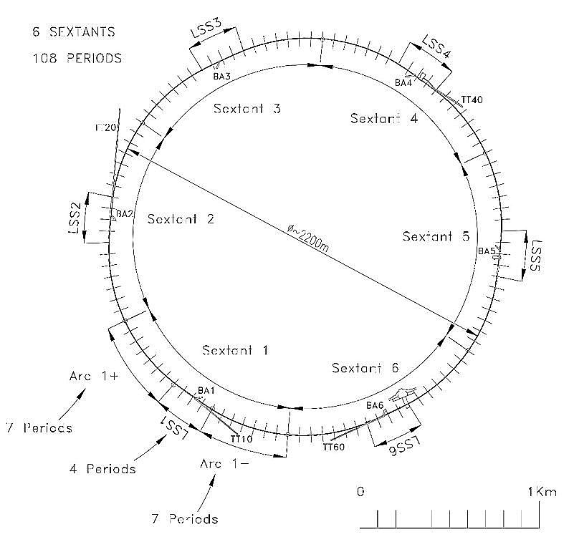
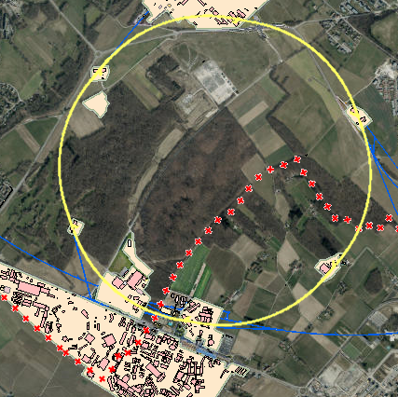
Interaction regions in SPS rings
Starights ections LSS4 and LSS6 were considered

Slide 4
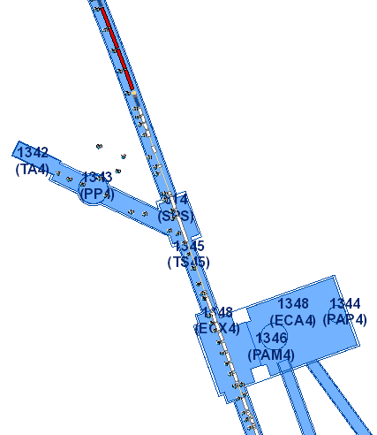
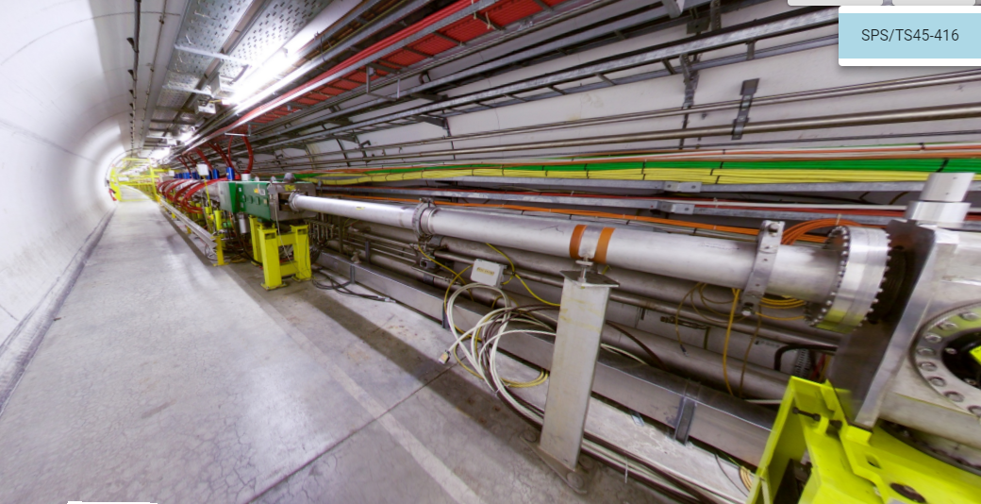
Straight section LSS4
Passage should be left free for transport.
Practically no space for laser installation next to the beam line.
LSS.416
30m

Slide 5
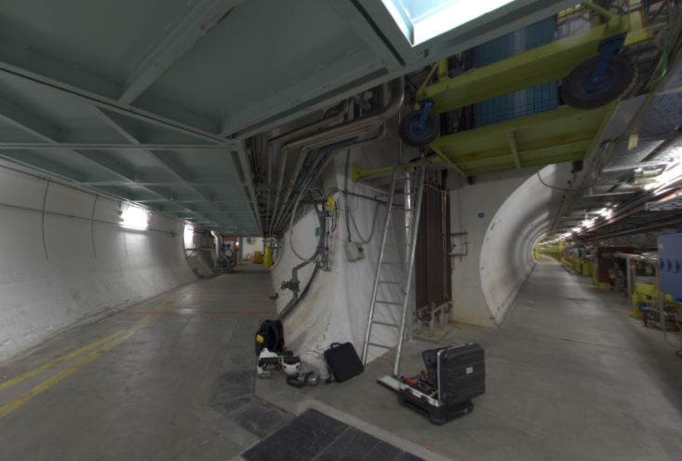
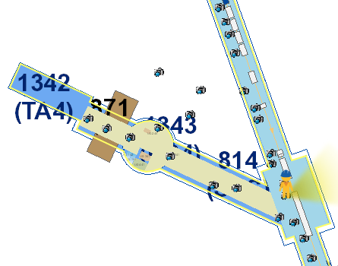
Straight section LSS4
Could it be possible to place the laser in neighbouring areas?
10m

Slide 6
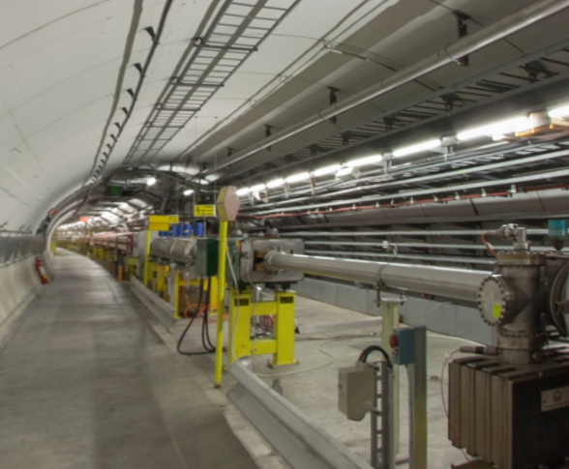
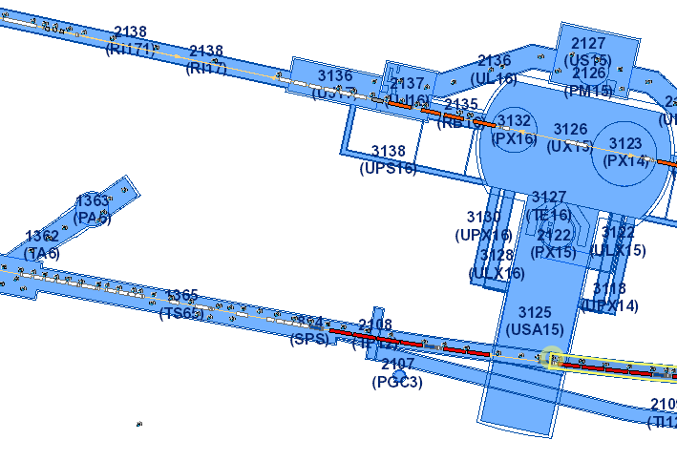
Straight section LSS6
Tunnel is larger
LSS.616
30m

Slide 7
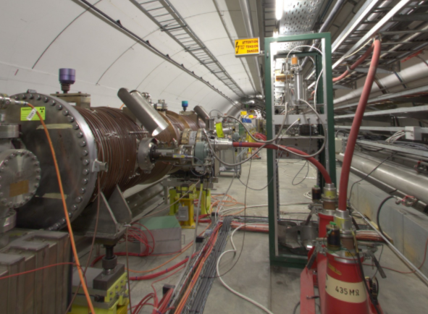
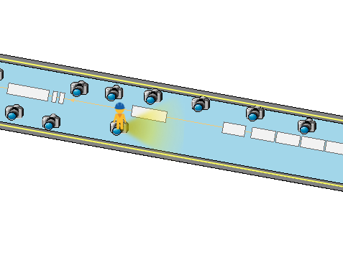
Straight section LSS6
Space behind the beam line looks free
LSS.616

Slide 8
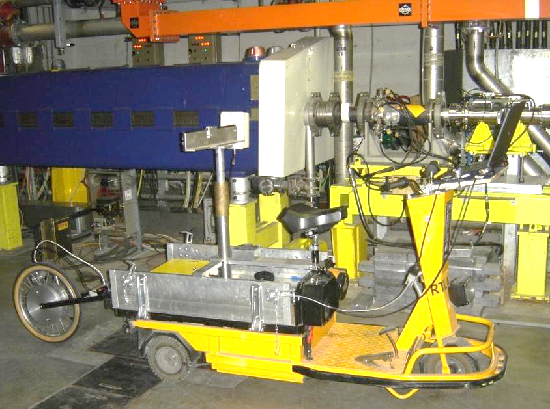

SPS Radiation Survey Results
  Measurements taken after 30 hours of cool-down:
      - 2017 Physics run (protons) from 8th May2017 to 23th Oct 2017
      - 2016 Physics run (protons) from 11th Mar 2016 to 14th Nov 2016
    Measurements taken after 2 months of cool-down - Jan 2018
Measuring probe
Plastic scintillator Vol: 200cm³
PCMx probe SAPHYMO
(plastic scintillator – 200cm³)
Distance ≈ 1m from beam line
All along the 7km of the SPS Ring (≈ 18000 measurements).
Labview registration application
Survey usually performed after 30 hours of cool-down

Slide 9
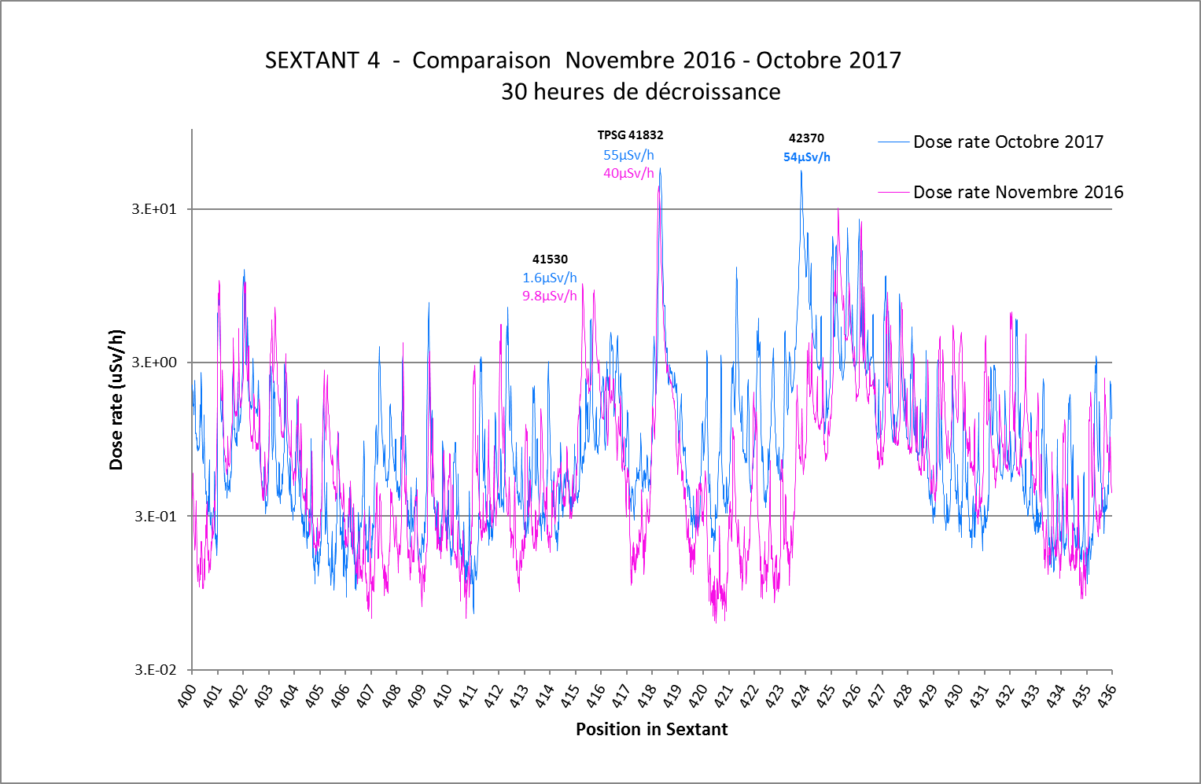
SPS Radiation Survey Results

Slide 10
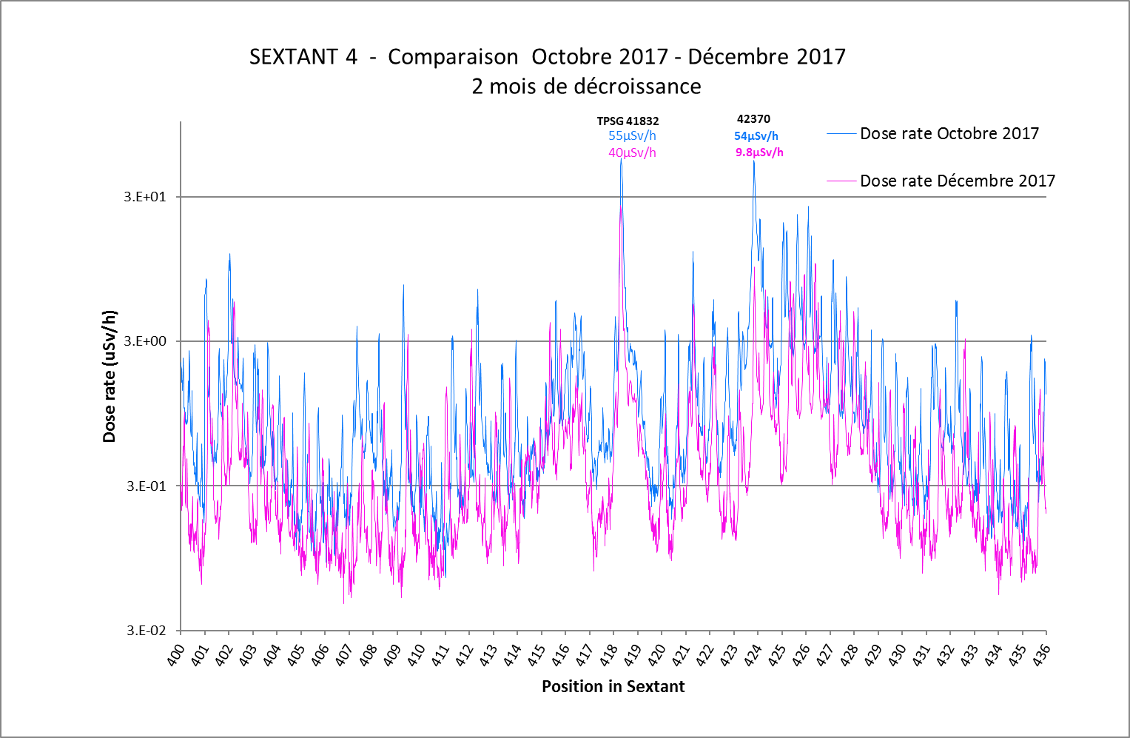
SPS Radiation Survey Results

Slide 11
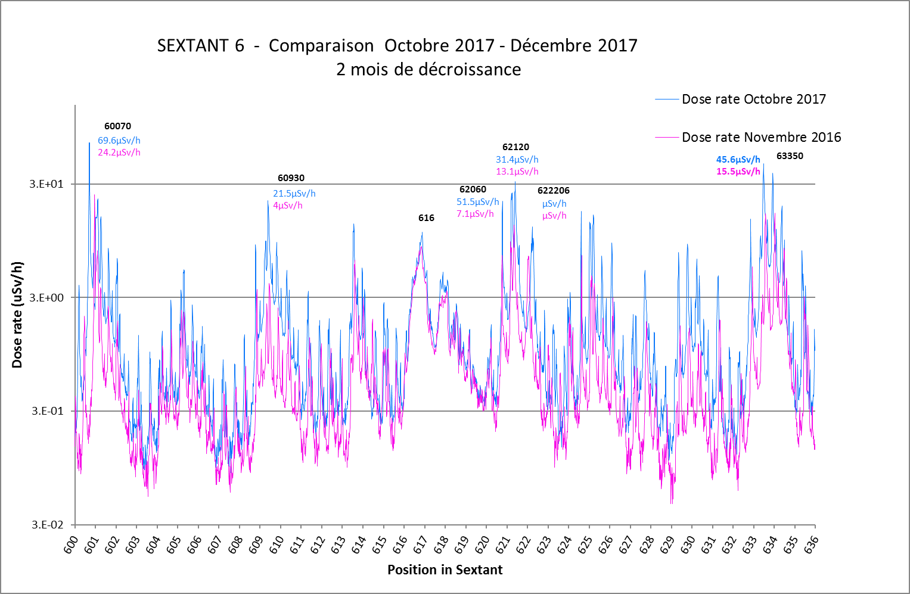
SPS Radiation Survey Results

Slide 12
SPS Radiation Survey Results
For access after 30 h cool-down:
None of the two areas is particularly problematic.
However, both areas have some small areas with higher dose rates.

Slide 13
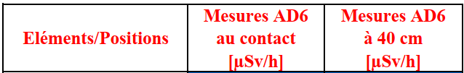
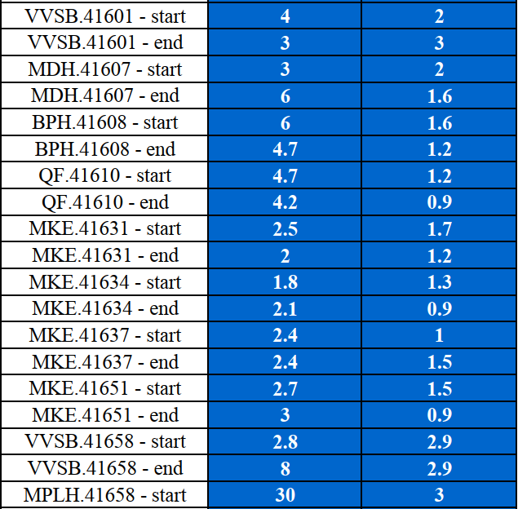
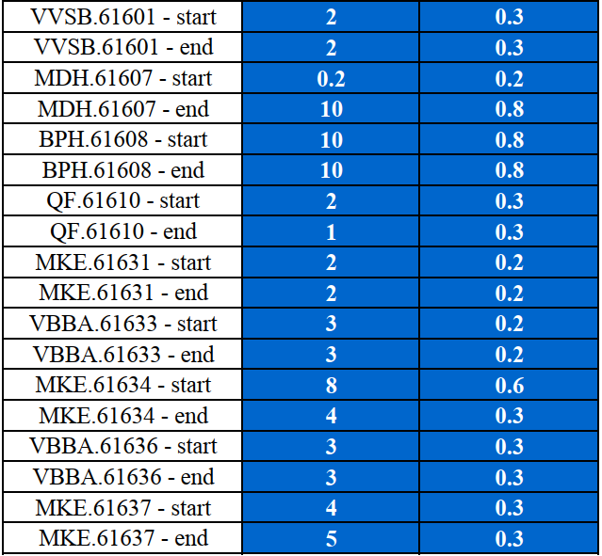
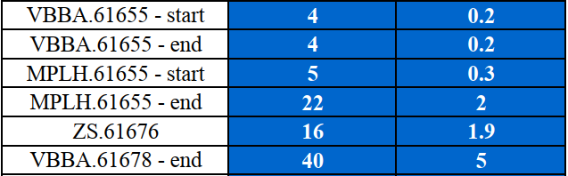
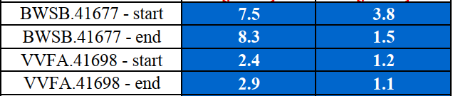
Latest Radiation Survey made on 18.12.2018
LSS6 looks slightly better regarding the radiation emitted by beam line equipment

Slide 14
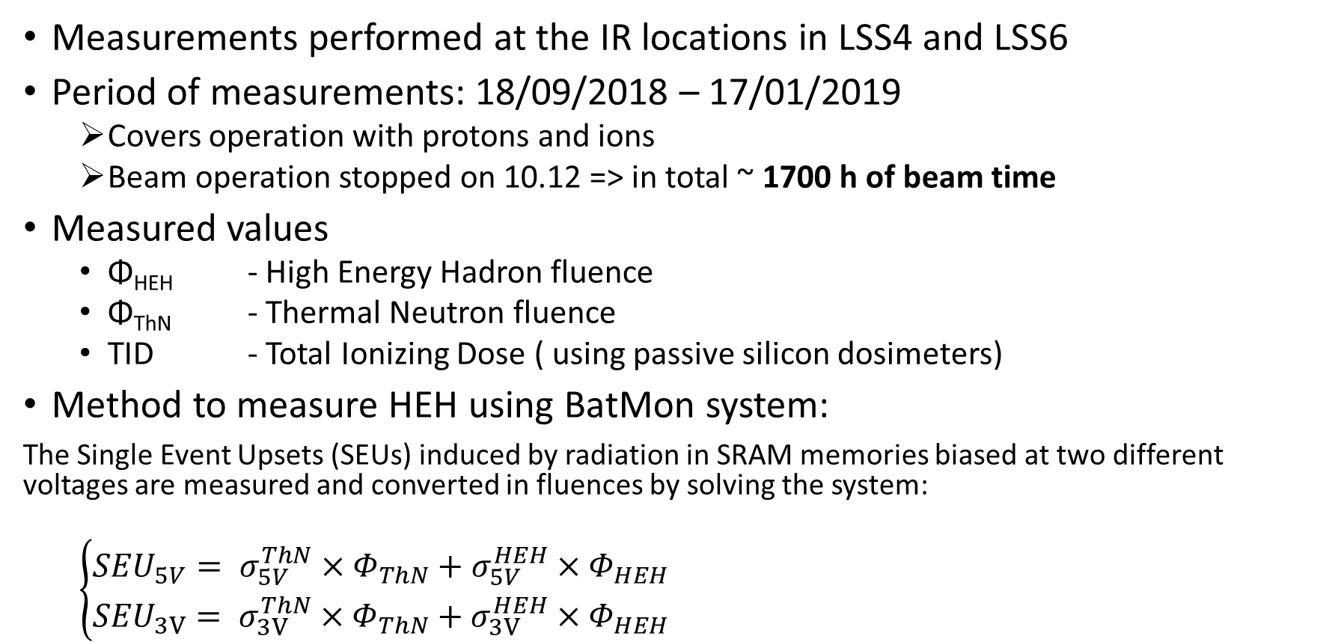
Radiation on Electronics measurements
Performed by EN/SMM-RME (EDMS document 2080251)
Measurements performed at the IR locations in LSS4 and LSS6
Period of measurements: 18/09/2018 – 17/01/2019
  Covers operation with protons and ions
  Beam operation stopped on 10.12 => in total ~ 1700 h of beam time
Measured values
  Φ_{HEH} - High Energy Hadron fluence
  Φ_{ThN} - Thermal Neutron fluence
  TID - Total Ionizing Dose ( using passive silicon dosimeters)
Method to measure HEH using BatMon system:
The Single Event Upsets (SEUs) induced by radiation in SRAM memories biased at two different voltages are measured and converted in fluences by solving the system:
  $\left\{\begin{aligned}{SEU}_{5V}= σ_{5V}^{ThN}×Φ_{ThN}+σ_{5V}^{HEH}×Φ_{HEH} \\ {SEU}_{3V}= σ_{3V}^{ThN}×Φ_{ThN}+σ_{3V}^{HEH}×Φ_{HEH}\end{aligned}\right.$

Slide 15
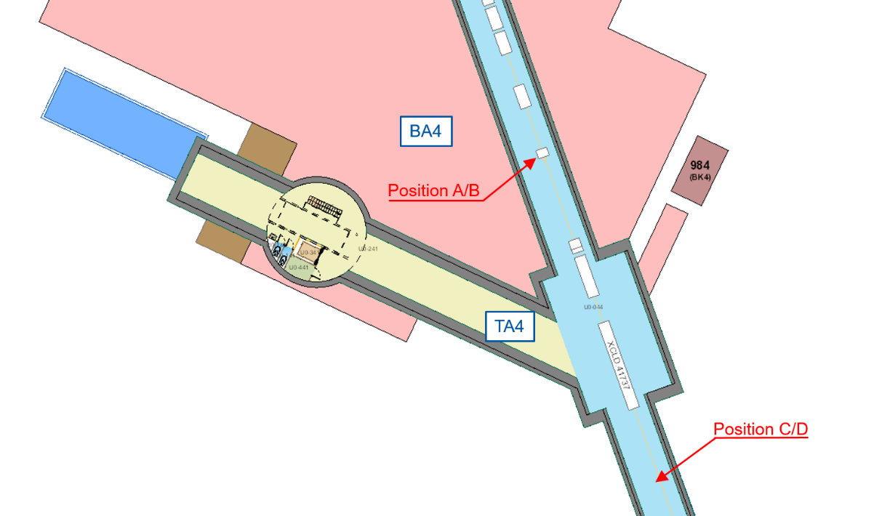
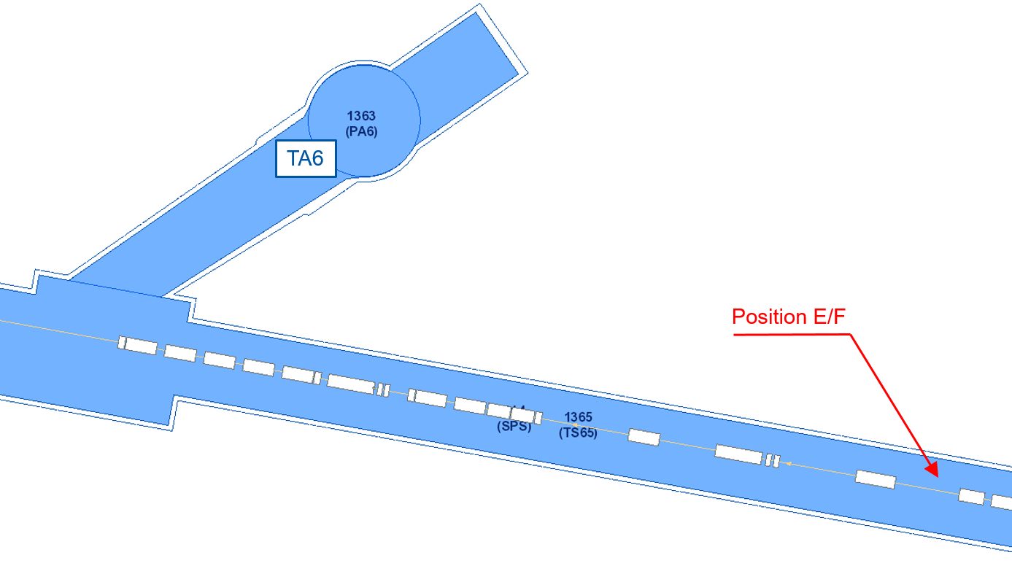
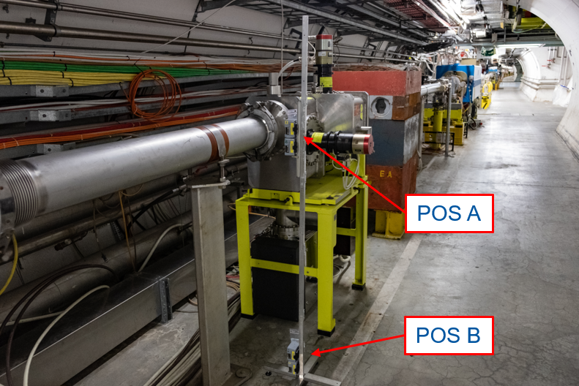
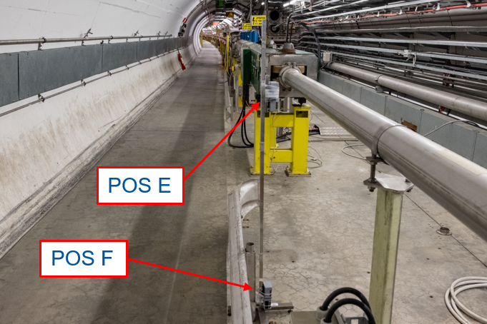
Radiation on Electronics measurements
Position of detectors in LSS4
Position of detectors in LSS6

Slide 16

Radiation on Electronics measurements
Number of SEU detected by each BatMon pair
Long Straight Section | Position | Height | SEU 3V | SEU 5V
LSS4 | A | Beam | 20963 | 10498
 | B | Floor | 10351 | 1177
LSS6 | E | Beam | N/A | 17577
 | F | Floor | 20181 | N/A
$R= \frac{Φ_{ThN}}{Φ_{HEH}}$
Summary of the fluences and the R factor measured
Long Straight Section | Position | Height | R-factor | Φ_{HEH} [pp/cm²] | Φ_{ThN} [pp/cm²]
LSS4 | A | Beam | 0.1 | 8.88 x 10⁹ | 8.30 x 10⁸
 | B | Floor | 1.9 | 8.80 x 10⁸ | 1.64 x 10⁹
LSS6 | E | Beam | 0.1* | 1.50 x 10¹⁰ | 1.40 x 10⁹
 | F | Floor | 1.9* | 2.04 x 10⁹ | 3.81 x 10⁹

Slide 17
Radiation on Electronics measurements
Summary of the measured TID for each position
Long Straight Section | Position | Height | TID [Gy]
LSS4 | A | Beam | 10.5
 | B | Floor | 4.8
LSS4 | C | Beam | 5.4
 | D | Floor | 3.9
LSS6 | E | Beam | 9.8
 | F | Floor | 4.0
Further data analysis and implications for electronics will be performed by EN/STI-BMI

Slide 18
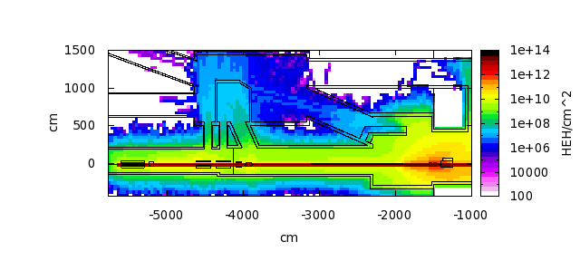
Comparison with AWAKE conditions
No visible influence of proton beam on the devices
Fluka simulation by HSE-RP
Laser room
UV beam diagnostics
Streak camera
Simulation Parameters:
3x10¹¹ p+/bunch
1 shot every 30 s
400 GeV
Experimental runs:
  4 weeks per run
  2 runs per year
Annual intensity: 4.8x10¹⁶
Digital cameras
Digital cameras
SEUs regularly detected during proton beam time

Slide 19
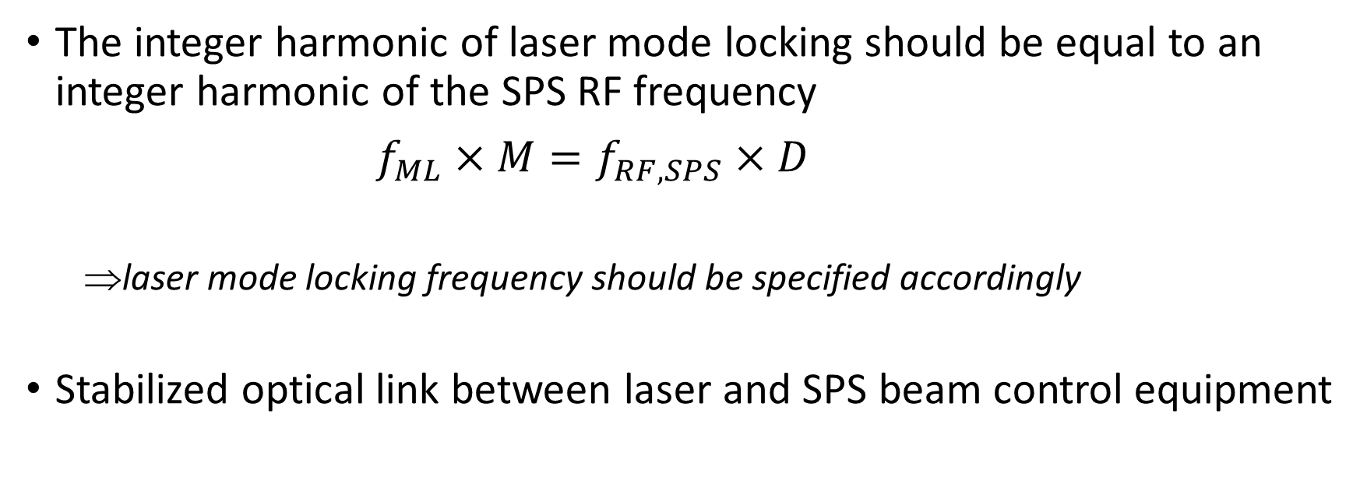
Synchronization to the machine timing
Phase stability conditions of the laser-ion interaction
The integer harmonic of laser mode locking should be equal to an integer harmonic of the SPS RF frequency
$f_{ML}×M=f_{RF, SPS}×D$
  laser mode locking frequency should be specified accordingly
Stabilized optical link between laser and SPS beam control equipment

Slide 20
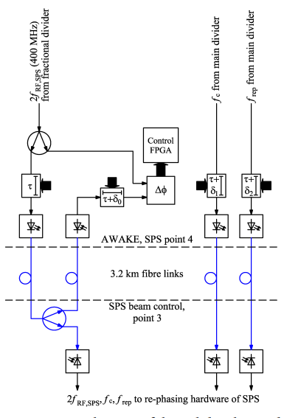
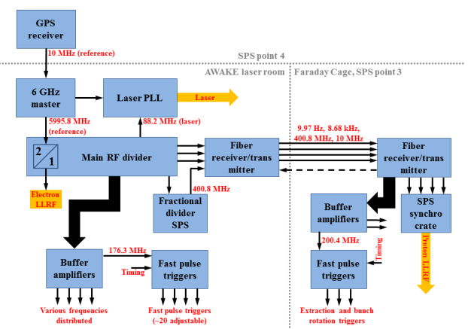



Synchronization to the machine timing
AWAKE example
$f_{ML}×25=f_{RF, SPS}×11$
$f_{RF, SPS}=200.394322(500) MHz$
$$f_{ML}=88.1735 MHz$$
(for 400 GeV protons)
H. Damerau et al., “RF Synchronization and Distribution for AWAKE at CERN” - in Proceeding of IPAC2106 [THPMY039]

Slide 21
Laser beam control and diagnostics
At CERN the accelerator control system is based on the Real-time FESA (Front-End Software Architecture) framework. => FESA classes are required for laser beam elements
Motorization of laser mirrors, translators and other movable elements
Laser shutters and dumps
Laser power/energy meters
Acquisition of laser beam images

Slide 22
Summary
Location for laser installation should fulfil certain requirements
  Space
  Air quality
  Temperature stability
  Safety (enclosure)
IR location at LSS6 offers some space near the beam line, where a laser installation could be placed,
The residual radiation conditions in both locations are acceptable for human work during the no-beam periods
Risks of laser electronics damage by HEH and thermal neutrons shall by analysed by experts. A qualified advice on possible shielding is expected
Laser synchronization is a separate task to work out.
Control of laser beam elements and diagnostics should be designed in accordance with CERN standards.

Slide 23

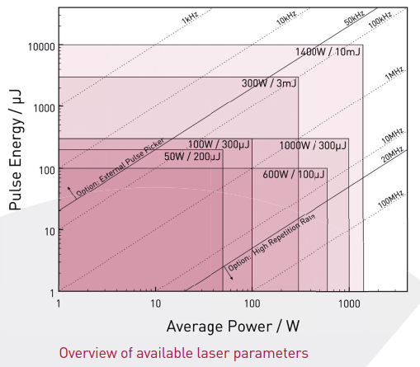
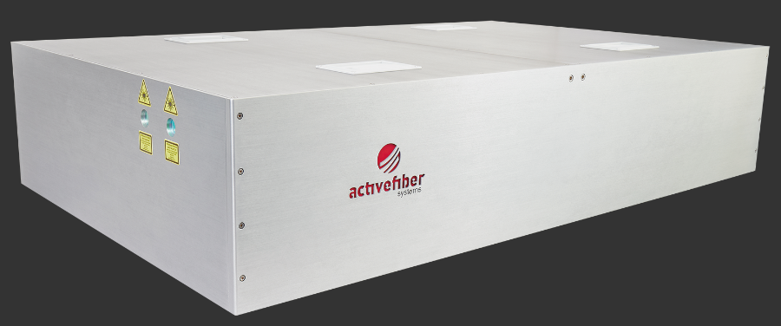
ActiveFiberSystemsGmbH(AFS)islocatedinJena,
knownasthe“cityofphotonics”inGermany.Asa
spin-offfromtheFraunhoferIOFJenaandtheInsti-
tuteofAppliedPhysicsattheuniversityofJenaAFS
representstheexpertiseofinnovativesolid-state-laser
development.

