Slide 1
The case for a Muon Collider
Carl Jolly
Graduate symposium
1

Slide 2
Contents
Future colliders
Why muons?
Muon collider complex
Particle physics case
Challenges to building a muon collider
Muon collider news
2

Slide 3
Collider comparison
Machine | Budget – according to Snowmass’21 ($) 2023 prices | Centre of mass energy (TeV) | Maximum circumference/length (km) | Completion date | Will I be dead before it runs?
FCC-ee | 13 - 20bn | 0.37 | ~100km | 2045 | No
FCC-hh | 34 – 56bn | 100 | ~100km | Construction starts in 2060s | Maybe?
CLIC | 7.8 – 13.5bn | 0.38 | ~11km
Muon collider - 3 | 7.8 – 13.5bn | 3 | ~30km | 2045* | No
Muon collider - 10 | 13.5 – 20bn | 10 | ~30km | ? | ?
* Technically limited timeline
FCC week - Funding options and integration of the FCC ee construction and operation in CERN’s financial plan Florian Sonnemann, CERN
Report of the Snowmass 2021 Collider Implementation Task Force - On the feasibility of future colliders: report of the Snowmass’21 Implementation Task Force, Roser et al
Towards a muon collider. The European Physical Journal C, 83(9), 864
3

Slide 4
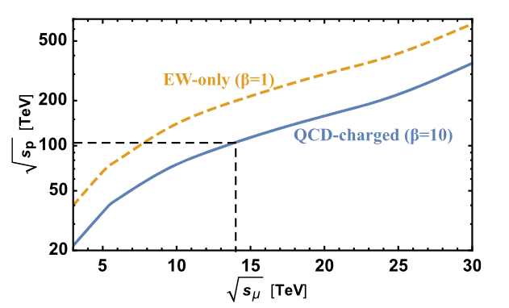
Why muons?
A lepton collider with out the drawback of synchrotron radiation.
Unlike protons the entire centre of mass energy is available for the collision.
The equivalent proton collider energy needed to match a muon collider.
Towards a muon collider. The European Physical Journal C, 83(9), 864
4

Slide 5
The obvious problem…
Why hasn’t this been done already?
Of course, muons decay in ~ 2μS
However, since the muons are accelerated their decay time is time-dilated.
The acceleration chain must be as fast as possible…
  One of many challenges
  For example the LHC ramps up in energy over many hours, the muon collider acceleration time is a few milliseconds (depending on the acceleration stage)
5

Slide 6
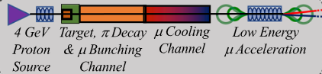
How does it work?
Muon cooling was demonstrated at the MICE experiment at ISIS.
ISIS-II scale proton source
Demonstration of cooling by the Muon Ionization Cooling Experiment – MICE collaboration, 2020
6

Slide 7
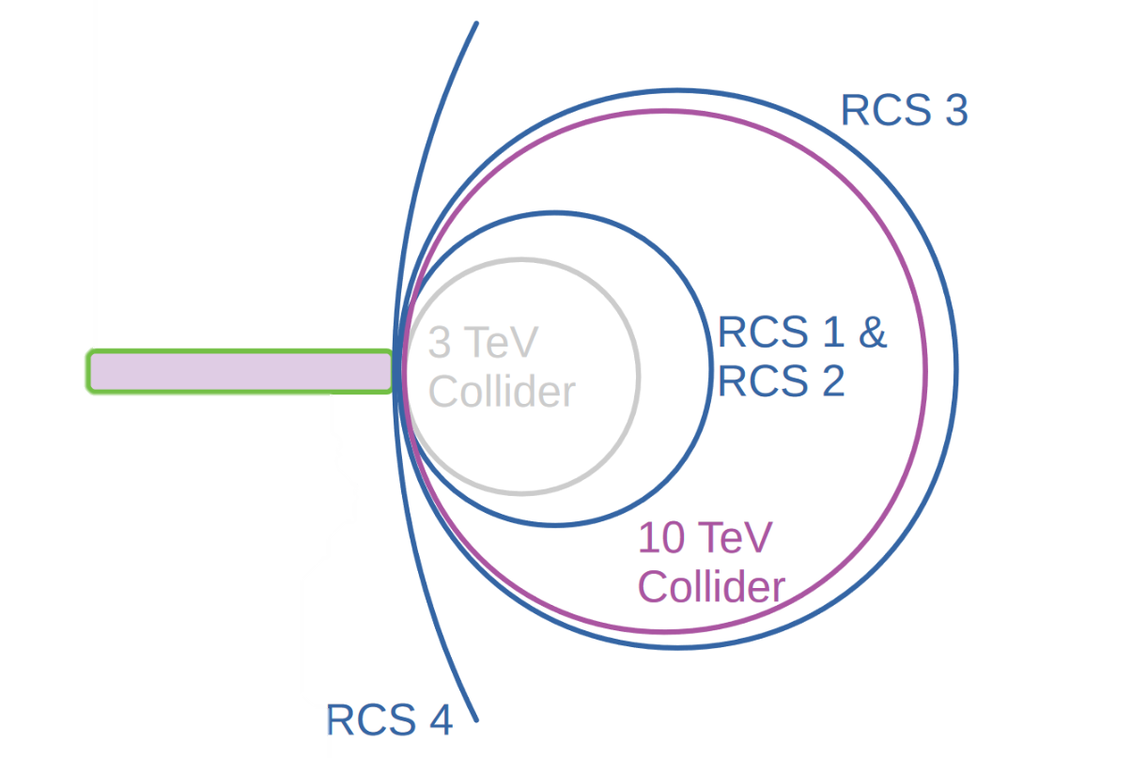
How does it work?
RCS – Rapid Cycling Synchrotron
7

Slide 8
Physics reach
High sensitivity than even FCC-hh for some BSM candidates in a 10 TeV muon collider.
Wimp candidates are accessible for 10 TeV MuC
A 3 TeV muon collider can access similar physics to CLIC and FCC-ee and some physics unique to muon-muon collisions.
Difficult to access heavy particles that carry only QCD interactions – proton colliders are better suited to this
The physics case of a 3 TeV muon collider stage, Jorge De Blas et al, Snowmass 2021
8

Slide 9
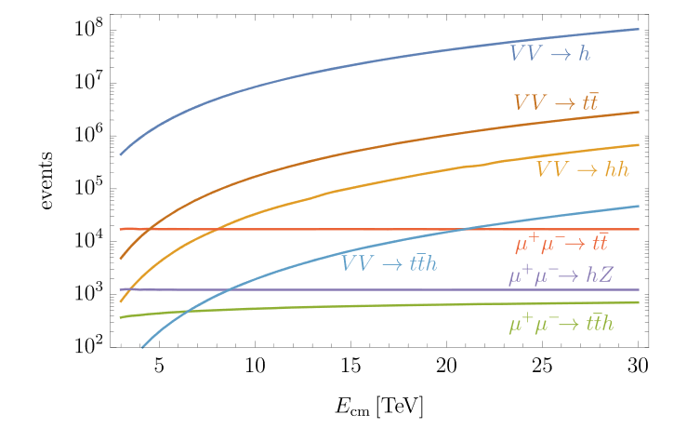
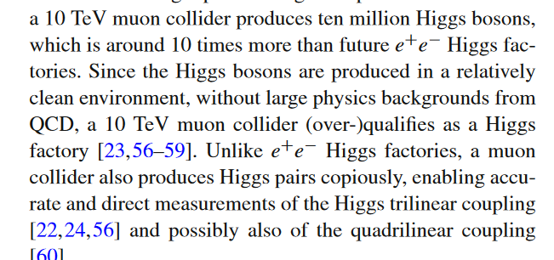
Particle physics….
High sensitivity than even FCC hh for some BSM candidates
Wimp candidates are accessible for 10 TeV MuC
Limited literature on direct new physics searches with MuC
“Extraordinarily sensitive to vector boson fusion particle production – would need to explain what this is, maybe second slide if there is time for it
Difficult to access heavy particles that carry only QCD interactions – proton colliders are better suited to this

Slide 10
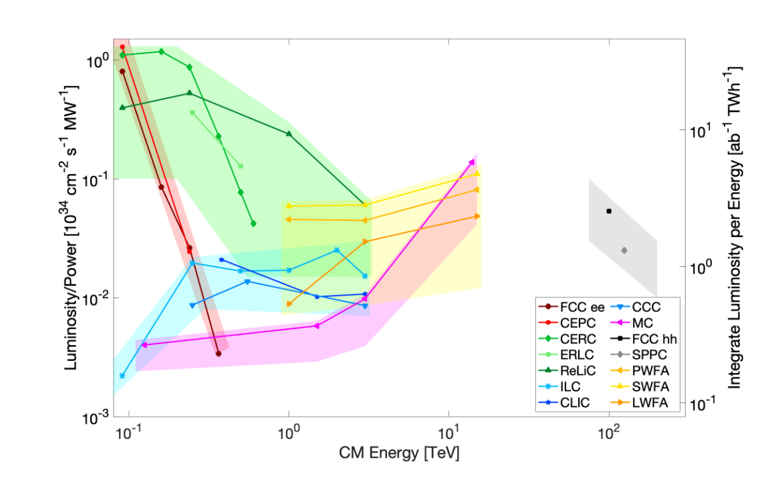
Physics reach
FCC-ee and CEPC
Muon Collider
FCC-hh
Report of the Snowmass 2021 Collider Implementation Task Force - On the feasibility of future colliders: report of the Snowmass’21 Implementation Task Force, Roser et al
9

Slide 11
The problems*
Certainly a higher risk option than FCC but… no 100km tunnel.
Magnet ramping.
Radiation load.
Neutrino flux.
Detector background.
Muon cooling + demonstrator.
ISIS-II scale high intensity proton source required.
*No particular order and not exhaustive of course.
Muon Collider Forum Report K. M. Black et al. Snowmass 2021
10

Slide 12
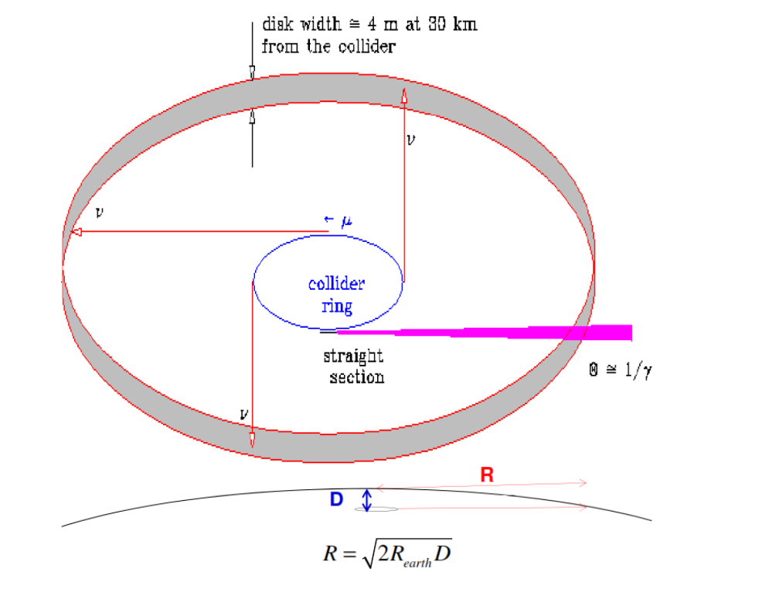
The problems*
The neutrino flux from straight sections in the collider ring
Certainly a higher risk option than FCC but… no 100km tunnel.
Magnet ramping.
Radiation load.
Neutrino flux.
Detector background.
Muon cooling + demonstrator.
ISIS-II scale high intensity proton source required.
*No particular order and not exhaustive of course.
Muon Collider Forum Report K. M. Black et al. Snowmass 2021
10

Slide 13
Summary
FCC ee physics at a lower cost
Potential for FCC hh physics in the 10 TeV collider
No 100km tunnel construction
Emphasised in the US P5 report!
11

Slide 14
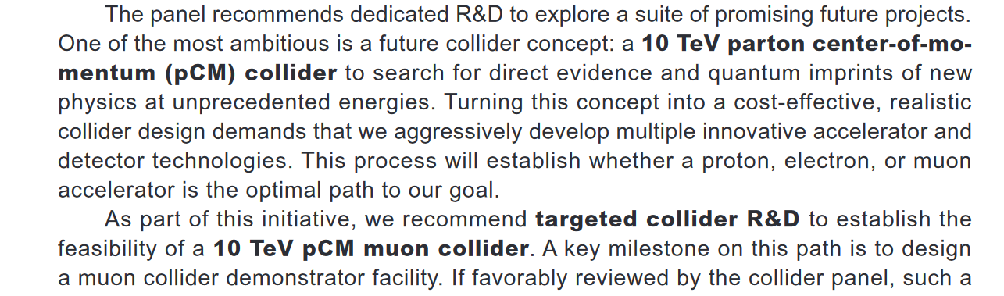
Some news
Recommendations from P5 report – sets out the US plans for particle physics over several years:

Slide 15
References
MICE collaboration. Demonstration of cooling by the Muon Ionization Cooling Experiment. Nature 578, 53–59 (2020). https://doi.org/10.1038/s41586-020-1958-9
Report of the Snowmass 2021 Collider Implementation Task Force - On the feasibility of future colliders: report of the Snowmass’21 Implementation Task Force, Roser et al https://doi.org/10.48550/arXiv.2208.06030
FCC week - Funding options and integration of the FCC ee construction and operation in CERN’s financial plan Florian Sonnemann, CERN https://indico.cern.ch/event/1202105/contributions/5431438
Accettura, C., Adams, D., Agarwal, et al. (2023). Towards a muon collider. The European Physical Journal C, 83(9), 864. https://doi.org/10.1140/epjc/s10052-023-11889-x
Muon Collider Forum Report K. M. Black et al. Snowmass 2021, https://arxiv.org/abs/2209.01318
The physics case of a 3 TeV muon collider stage, Jorge De Blas et al, Snowmass 2021, https://arxiv.org/abs/2203.07261v2
12

