Slide 1
Initial conditions for heavy-ion collisions
Raju Venugopalan
Brookhaven National Laboratory
Student Day Lecture, Quark Matter 2019, Wuhan

Slide 2
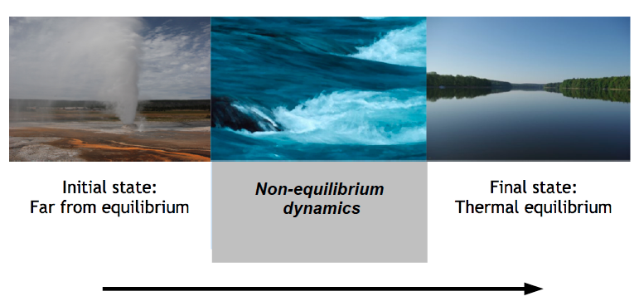
From the violence of a nuclear collision
…to the calm of a quark-gluon fluid
t
How is thermalization achieved in QCD ?

Slide 3
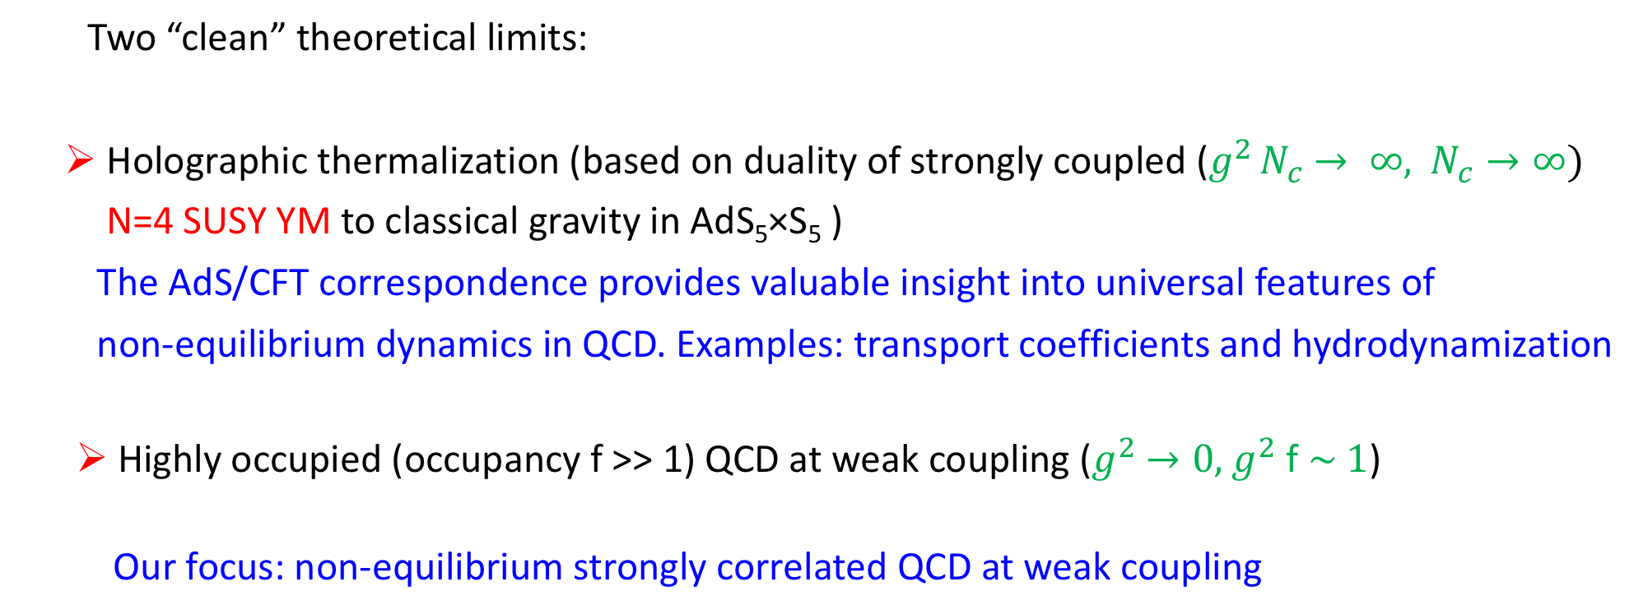
Approaches to thermalization
Two “clean” theoretical limits:
Holographic thermalization (based on duality of strongly coupled ($g^{2 }N_{c}$ $→ ∞,$ $N_{c}→∞)$
N=4 SUSY YM to classical gravity in AdS₅×S₅ )
The AdS/CFT correspondence provides valuable insight into universal features of
non-equilibrium dynamics in QCD. Examples: transport coefficients and hydrodynamization
  Highly occupied (occupancy f >> 1) QCD at weak coupling ($g^{2}$ $→0, { g}^{2}$ f $\sim 1$)
Our focus: non-equilibrium strongly correlated QCD at weak coupling

Slide 4
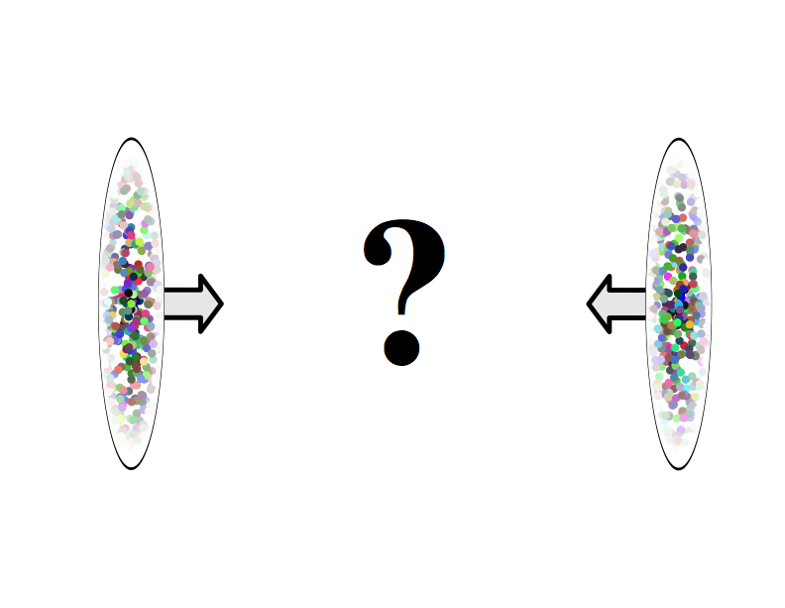
The nuclear wavefunction at high energies
?

Slide 5
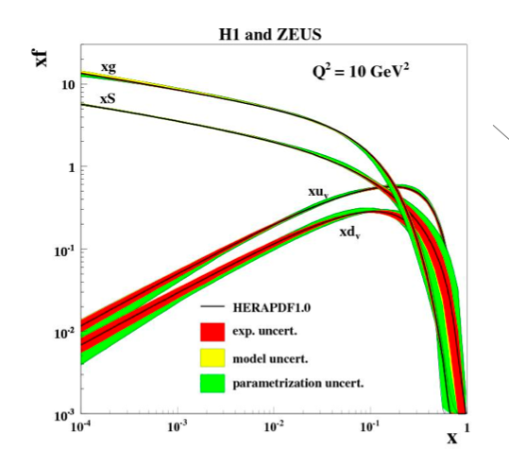

What happens when you boost a proton or nucleus to high energies ?
What the proton or nucleus ”looks like” in QCD depends on boost and resolution scale
$$1/Q^{2}$$
Low Energy
or
large x
High Energy
or
small x
Parton distributions
As the proton is boosted, “parton” fluctuations live longer and longer,
manifesting themselves as bremsstrahlung in scattering

Slide 6
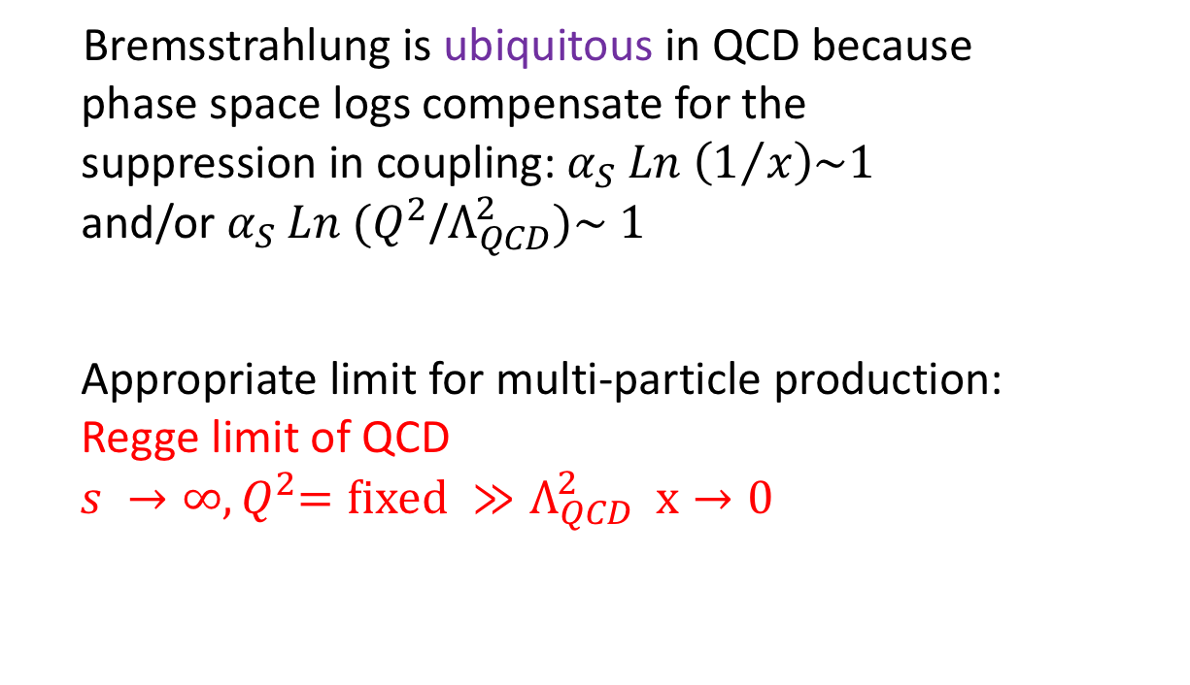
Generating strong fields by multi-particle production
Bremsstrahlung is ubiquitous in QCD because
phase space logs compensate for the
suppression in coupling: $α_{S} Ln \left(1/x\right)\sim 1$
and/or $α_{S} Ln (Q^{2}$/$Λ_{QCD}^{2})\sim 1$
Appropriate limit for multi-particle production:
Regge limit of QCD
${ s →∞, Q}^{2}=fixed ≫Λ_{QCD}^{2} x→0$
γ*
Q², x
Bremsstrahlung
linear BFKL evolution
resums large logs in x
Gluon recombination
and screening
-- “all twist” or
“death by a million cuts”
non-linear QCD evolution
A fascinating equilibrium of splitting and recombination should eventually result. It is a considerable theoretical challenge to calculate this equilibrium in detail…
F. Wilczek, Nature (1999)
Q₀², x₀

Slide 7
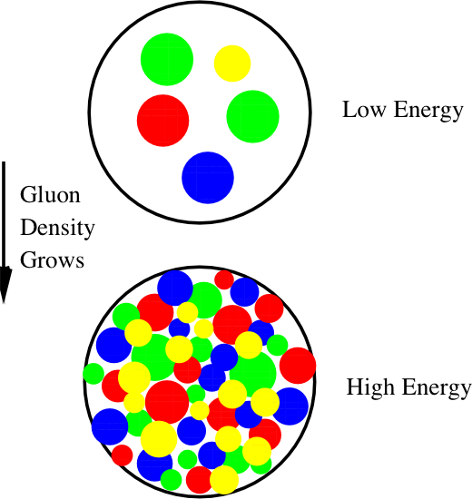
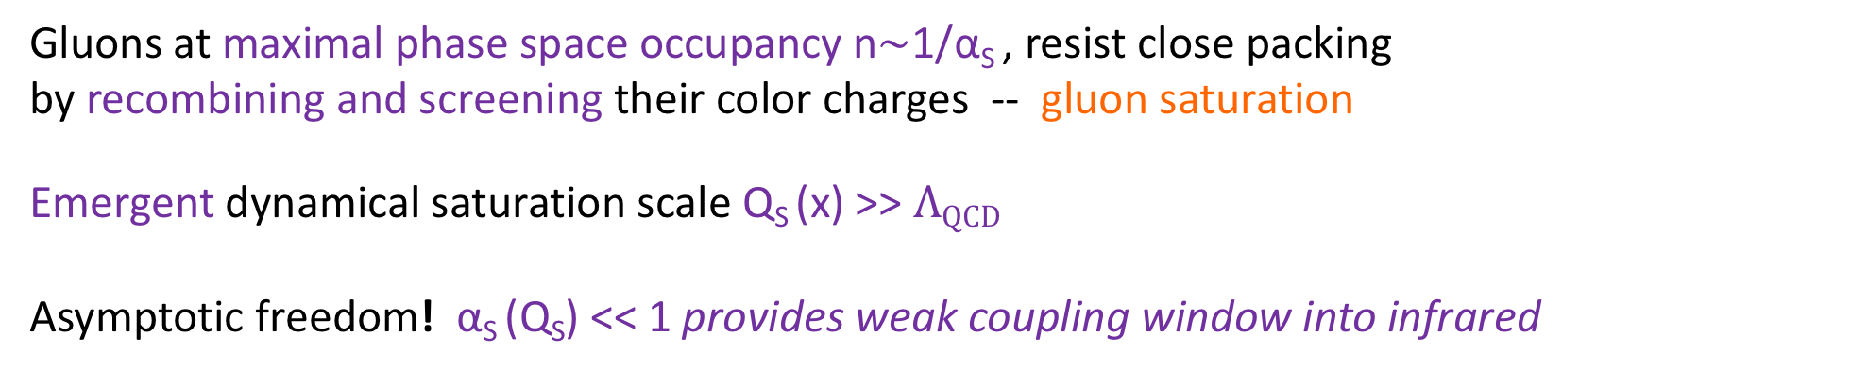
Gluon saturation
Gribov,Levin,Ryskin (1983)
Mueller, Qiu (1986)
1/Q_{S}²
Gluons at maximal phase space occupancy n$\sim$1/α_{S} , resist close packing
by recombining and screening their color charges -- gluon saturation
Emergent dynamical saturation scale Q_{S} (x) >> $ΛQCD$
Asymptotic freedom! α_{S} (Q_{S}) << 1 provides weak coupling window into infrared

Slide 8
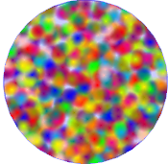
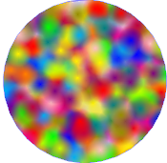
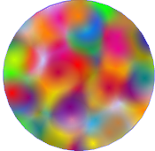
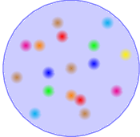
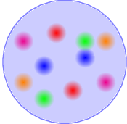

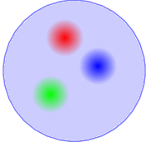

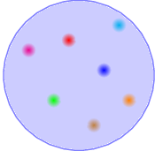
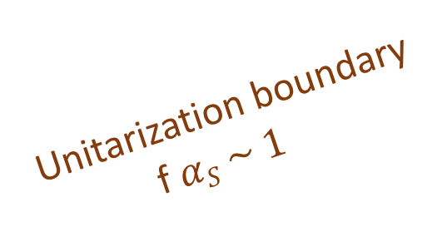
Gluon saturation
Saturation
Unitarization boundary
f$αS \sim 1$
Boost
BFKL
DGLAP
Resolution

Slide 9
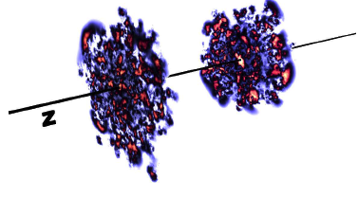
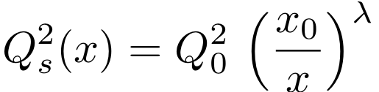
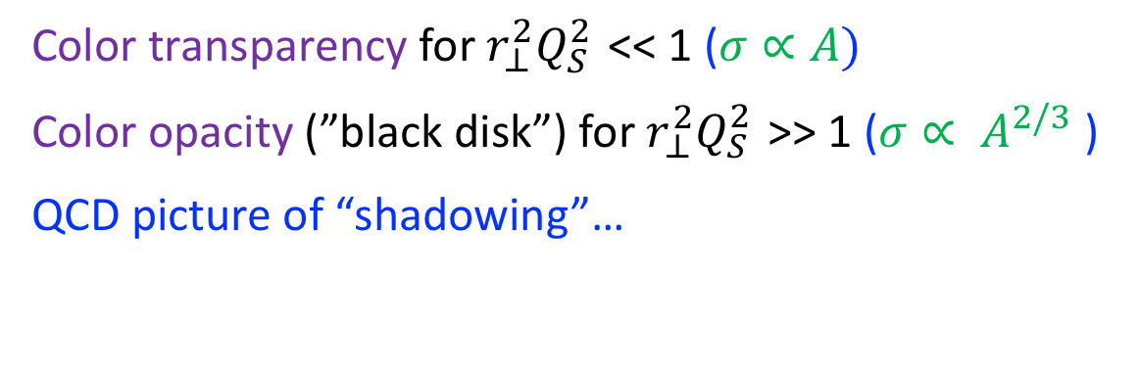
Saturation: dipole model formulation in DIS
Equivalent formulation:
Strong screening of color charge of a quark-antiquark dipole
γ*
z
r⊥
1-z
QED
QCD
Golec-Biernat Wusthoff model
Color transparency for $r_{⊥}^{2}Q_{S }^{2}$ << 1 ($σ∝A)$
Color opacity (”black disk”) for $r_{⊥}^{2}Q_{S }^{2}$ >> 1 ($σ∝ A^{2/3}$ )
QCD picture of “shadowing”…
Parameters:
Q₀ = 1 GeV; λ = 0.3;
x₀ = 3* 10⁻⁴ ; σ₀ = 23 mb

Slide 10
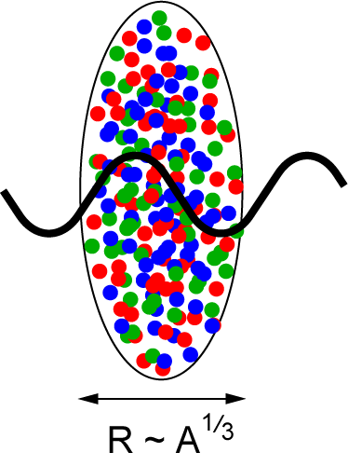
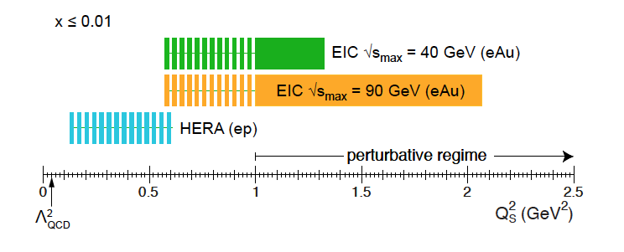
Nuclear ”oomph” of the saturation scale
Dipole couples coherently with
color charges in different nucleons
in path of its scattering: Q_{S}² ~ A^{1/3}
EIC: Electron-Ion Collider
Aschenauer et al., arXiv:1708.01527

Slide 11
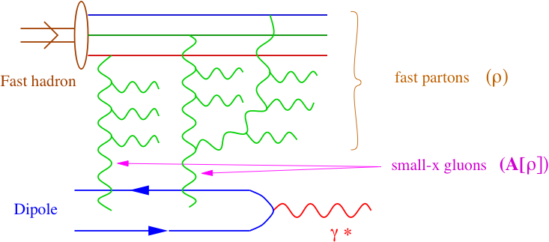
Classicalization in the Regge limit: the Color Glass Condensate EFT
“HEAVY”
Born-Oppenheimer separation
between fast and slow modes
CGC: Effective Field Theory
of classical static quark/gluon sources
and dynamical gluon fields
Remarkably, physics of extreme quantum fluctuations
becomes classical because of high gluon occupancy…
“LIGHT”
McLerran, RV (1994)

Slide 12
Classicalization in the Regge limit: the Color Glass Condensate EFT
EFT allows one to compute
many-body correlations
just as in condensed matter physics
Wilsonian RG :
2+1-D B-JIMWLK hierarchy of equations for
multi-point ”Wilson line” dipole, quadrupole, etc.
correlators -- right degrees of freedom
Universal infrared classical dynamics of QCD in the infrared?
Balitsky (1996)
JIMWLK (1997-2001): Jalilian-Marian,Iancu,McLerran,Weigert,Leonidov,Kovner
Kovchegov (1999)

Slide 13
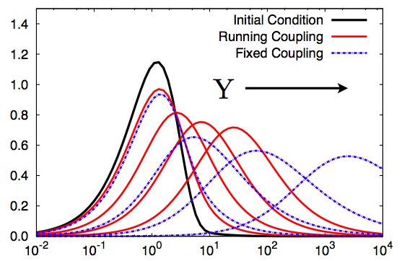
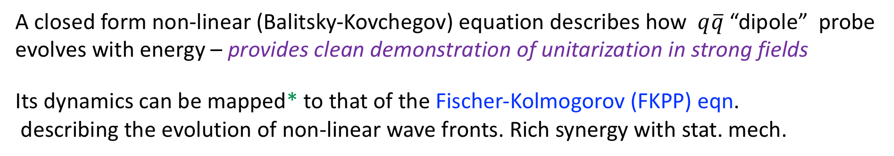
Classicalization in the Regge limit: the Color Glass Condensate EFT
Energy
Dipole wavefunction
Q_{S}(x)
Squared transverse momentum
A closed form non-linear (Balitsky-Kovchegov) equation describes how $q\overline{q}$ “dipole” probe evolves with energy – provides clean demonstration of unitarization in strong fields
Its dynamics can be mapped* to that of the Fischer-Kolmogorov (FKPP) eqn.
describing the evolution of non-linear wave fronts. Rich synergy with stat. mech.
Munier, Peschanski (2003)
* small caveat

Slide 14
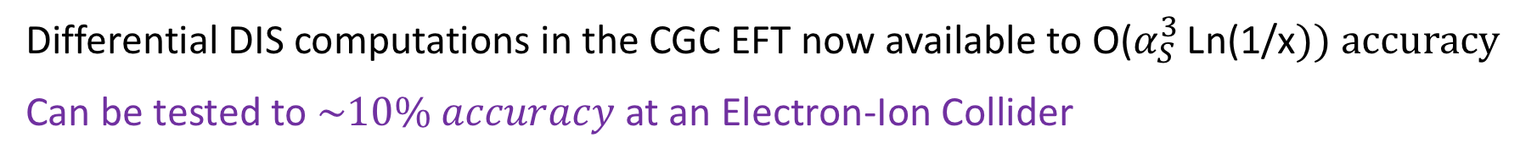
Photons and di-jets to NLO+NLLx precision in the CGC EFT
Roy, RV, 1802.09550,
and in preparation
=
Effective vertices include ”all-twist” corrections (Q_{S}²/Q²)^{n}
Compton amplitude for $eA→γ+dijets+X$
Virtual photon fluctuates into quark-antiquark dipole and a photon state
that scatters off a gluon shockwave fluctuation of nuclear target
Differential DIS computations in the CGC EFT now available to O($α_{S}^{3 }$Ln(1/x$)) accuracy$
Can be tested to $\sim 10\% accuracy$ at an Electron-Ion Collider

Slide 15

Boiling the QCD vacuum in heavy-ion collisions
Nuclei as heavy as bulls
Through collisions
Generate new states of matter
TD Lee
Nobel Laureate (1957)

Slide 16
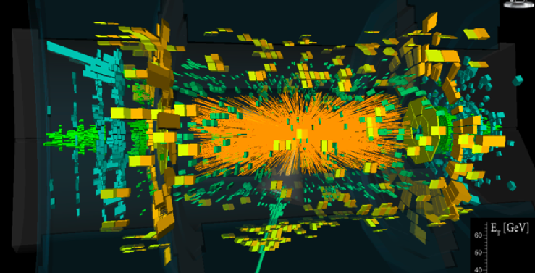
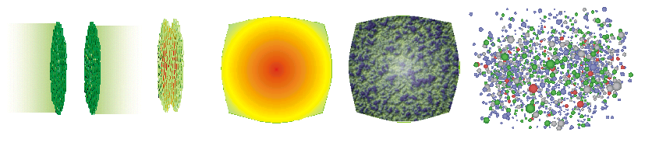
A “Standard model” model of a heavy-ion collision
HEAVY ION EVENT, ATLAS DETECTOR
Color Glass
Condensates
Overlap of
wavefunctions
Glasma
sQGP - perfect fluid
Hadron Gas
time
Glasma: Out of equilibrium QGP formed from decay of colliding CGCs

Slide 17
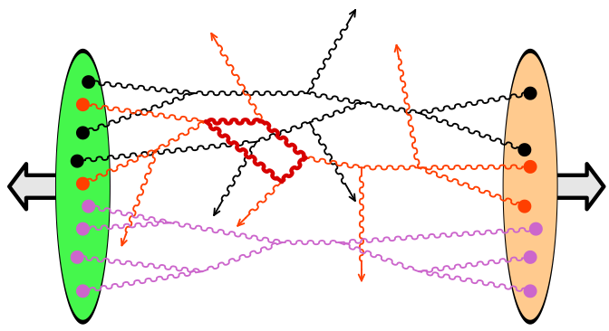
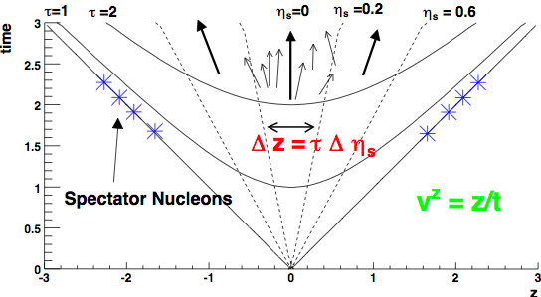
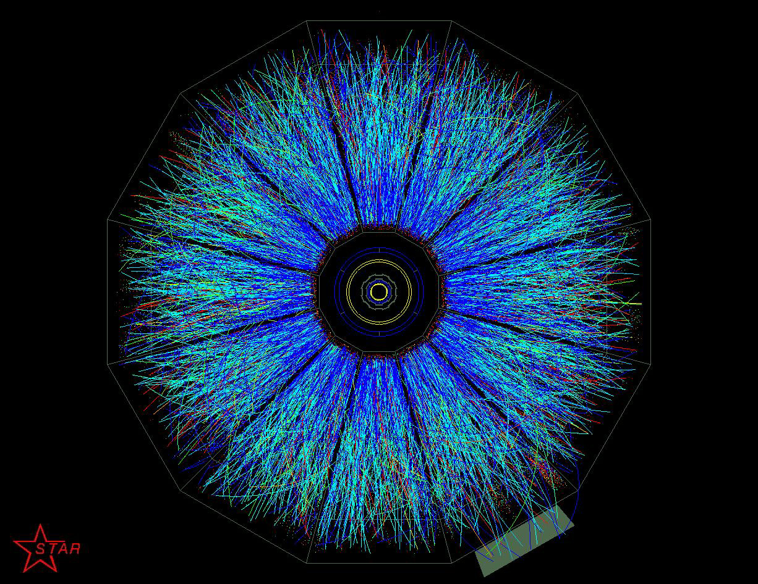
Forming a Glasma in the little Bang
Problem: Compute particle production in QCD with strong time dependent sources
“Schwinger-Keldysh” framework
Gelis,Lappi,RV
arXiv:0708.0047, 0804.2630; 0807.1306 [hep-ph]
Jeon, arXiv:1308.0263

Slide 18
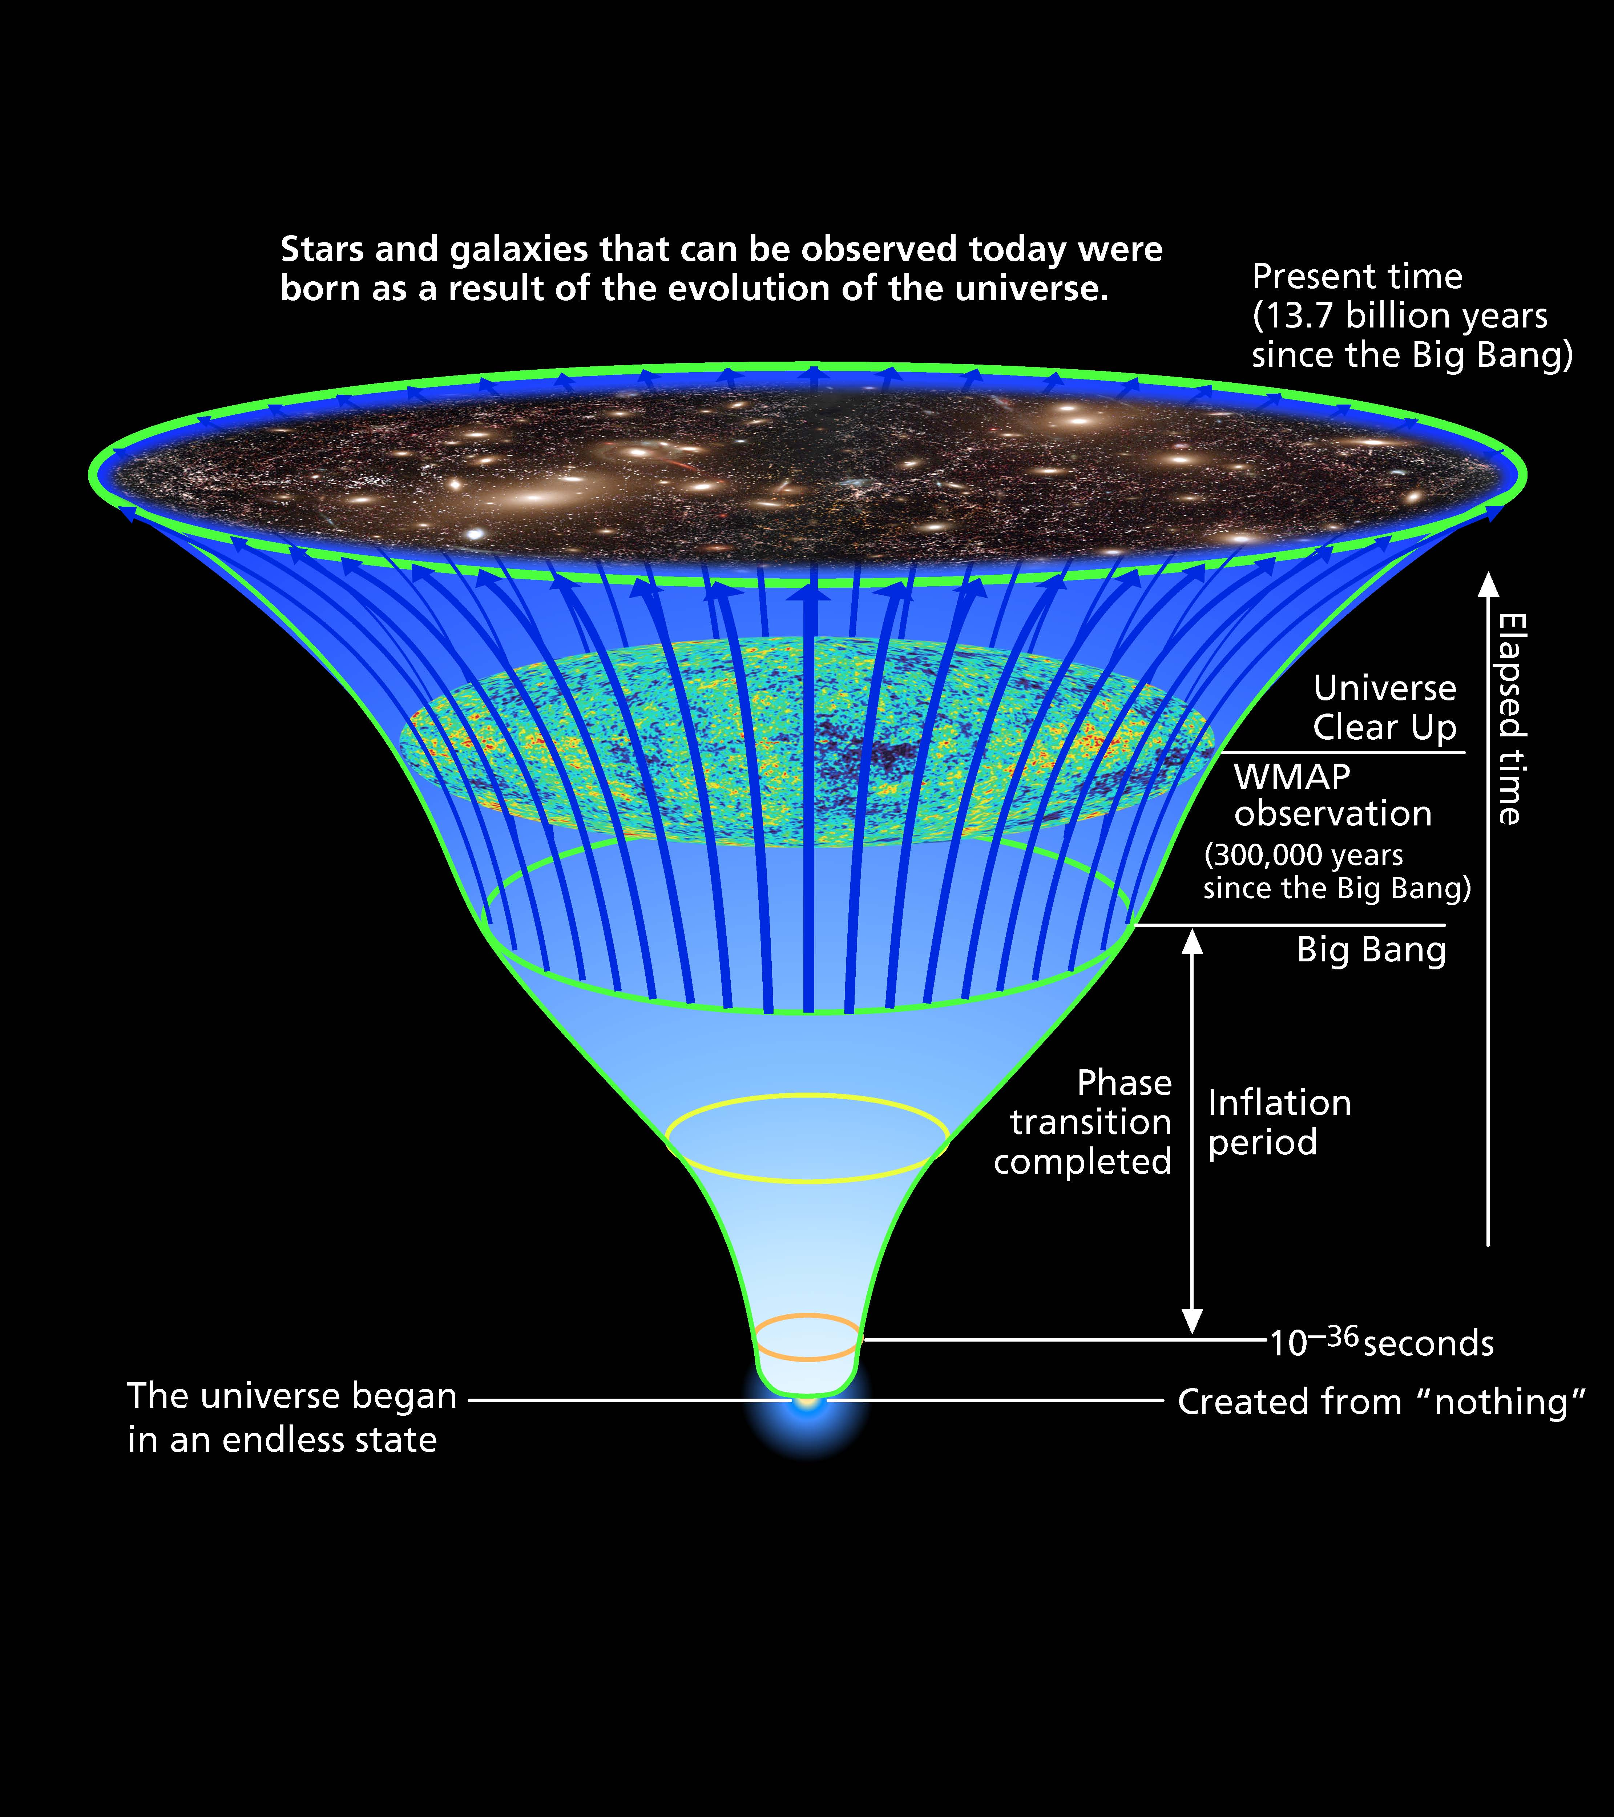
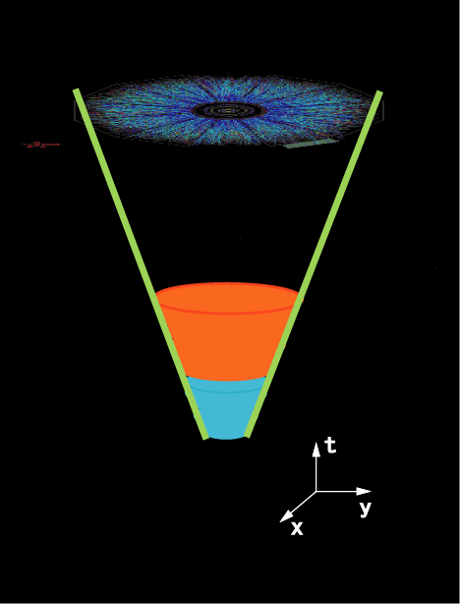
Big Bang
Little Bang
WMAP data
(3x10⁵ years)
Hot Era
QGP
Inflation
CGC/
Glasma
Plot by T. Hatsuda

Slide 19
Big Bang vs. Little Bang
Decaying Inflaton
with occupation # 1/g²
Decaying Glasma
with occupation # 1/g²
Explosive amplification of low momentum small fluctuations (preheating)
Explosive amplification of low
momentum small fluctuations
(Weibel instabilities)
Interaction of fluctuations/inflaton
-> thermalization?
Interaction of fluctuations/Glasma
-> thermalization?
Other common features: turbulence, topo;ogical defects,…

Slide 20
The Glasma at leading order
Collisions of lumpy gluon ``shock” waves
Kovner,McLerran,Weigert (1996)
Kovchegov, Rischke (1996)
Krasnitz, RV (1998)
Leading order solution: Solution of QCD Yang-Mills eqns
in presence of light-cone (valence) sources
The saturation scale Q_{S} (x,b_{T}) is the only scale in the problem

Slide 21
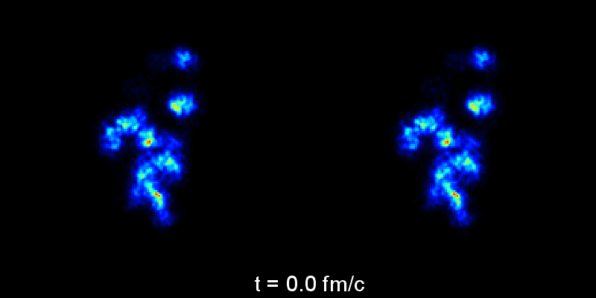
The Glasma: colliding gluon shock waves
Glasma color fields matched
to viscous hydrodynamics
Glasma color fields
Krasnitz,Venugopalan, Nucl.Phys.B557 (1999)
Lappi, Phys.Rev. C67 (2003)
Schenke,Tribedy,Venugopalan,PRL108 (2012)
Note: 1 fm/c = 3*10⁻²⁴ seconds!

Slide 22


At NLO: Decoherence from quantum fluctuations
Berges, Borsanyi, Wetterich (2004)
Dusling,Epelbaum,Gelis,RV (2011)
Gaussian random variable
“Toy” example: scalar Φ⁴ theory
Satisfies the “small fluctuation” equation
These quantum modes satisfy an “eigenstate thermalization” criteria conjectured by Berry (and developed by Srednicki and others) as essential for thermalization of a quantum fluid

Slide 23
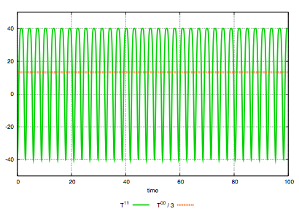
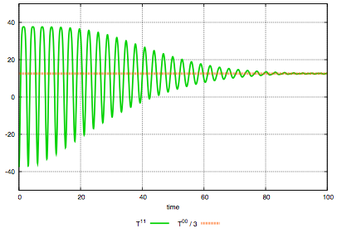
Decoherence from quantum fluctuations
Dusling,Epelbaum,Gelis,RV
arXiv:1009.4363
Energy density and pressure
without averaging over fluctuations
Energy density and pressure
after averaging over fluctuations
Conformal scalar
1+1-D Φ⁴ theory:
Such “classical-statistical” quantum averaging decoheres the classical fields
– scrambling information – resulting in a “pre-thermal” micro-canonical distribution
Strongly correlated dynamics subsequently described in terms of single particle dists.

Slide 24
From Glasma to Quark Gluon Plasma
Longitudinally expanding Glasma fields are unstable to quantum fluctuations…
leading to an explosive “Weibel” instability.
This instability leads to rapid decoherence and overpopulation of all momentum modes
Classical-statistical lattice simulations of 3+1-D gluon fields exploding into the vacuum
Berges,Schenke,Schlichting,RV, NPA 931 (2014) 348

Slide 25
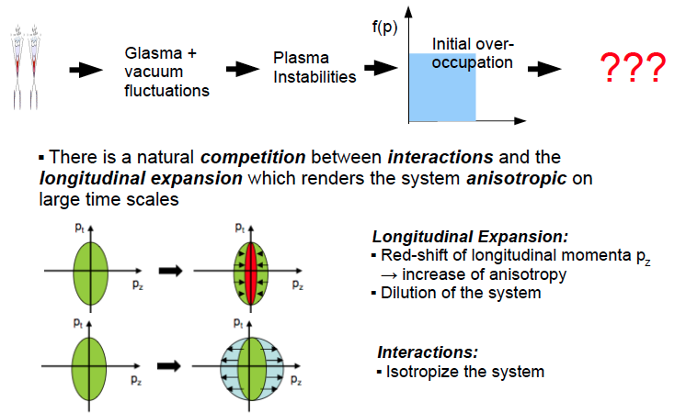
From Glasma to Quark Gluon Plasma

Slide 26
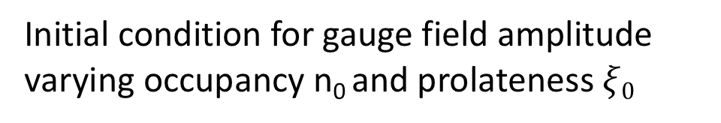
Pressure becomes increasingly anisotropic
Initial condition for gauge field amplitude varying occupancy n₀ and prolateness $ξ0$
P_{L}/P_{T} approaches universal τ^{-2/3} behavior

Slide 27
Result: universal non-thermal fixed point
Conjecture:
Moments of longitudinal momentum distribution extracted over range of time slices
lie on universal curves
Distribution as function of p_{T} displays 2-D thermal behavior

Slide 28
Overoccupied expanding Glasma: particles or fields?
For 1 < f < 1/α_{S} a dual description is feasible either in terms of kinetic theory
or classical-statistical dynamics …
Mueller,Son (2002)
Jeon (2005)
Properties independent of
initial conditions
Self-similar evolution characterized
by universal scaling exponents

Slide 29
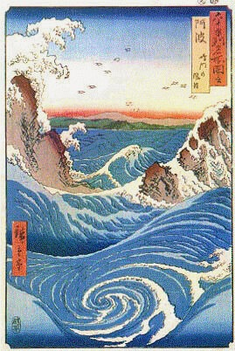
Universal turbulent attractor in QCD
“Big whorls have little whorls, which feed on their velocity,
and little whorls have lesser whorls, and so on to viscosity.”

Slide 30
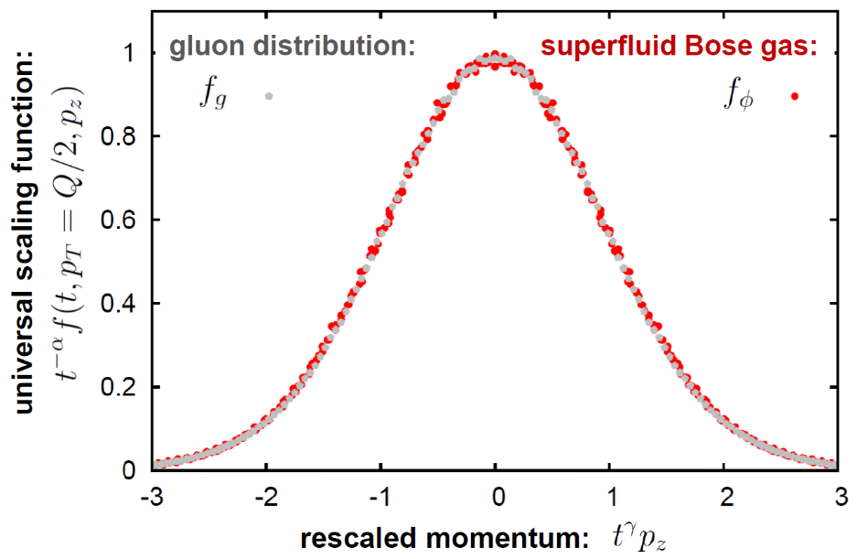

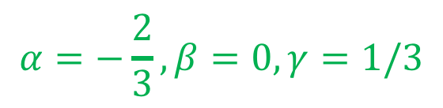
The Glasma and over-occupied quantum gases
Simulations of self-interacting scalar fields with identical initial conditions demonstrates remarkable universality of longitudinally expanding world’s hottest and coolest fluids
In a wide inertial range, scalar & gauge fields
have identical scaling exponents & functions
τ
τ
$$α=−\frac{2}{3},β=0, γ=1/3$$
τ
Berges,Boguslavski,Schlichting,RV, PRL (2015)
Editor’s suggestion

Slide 31
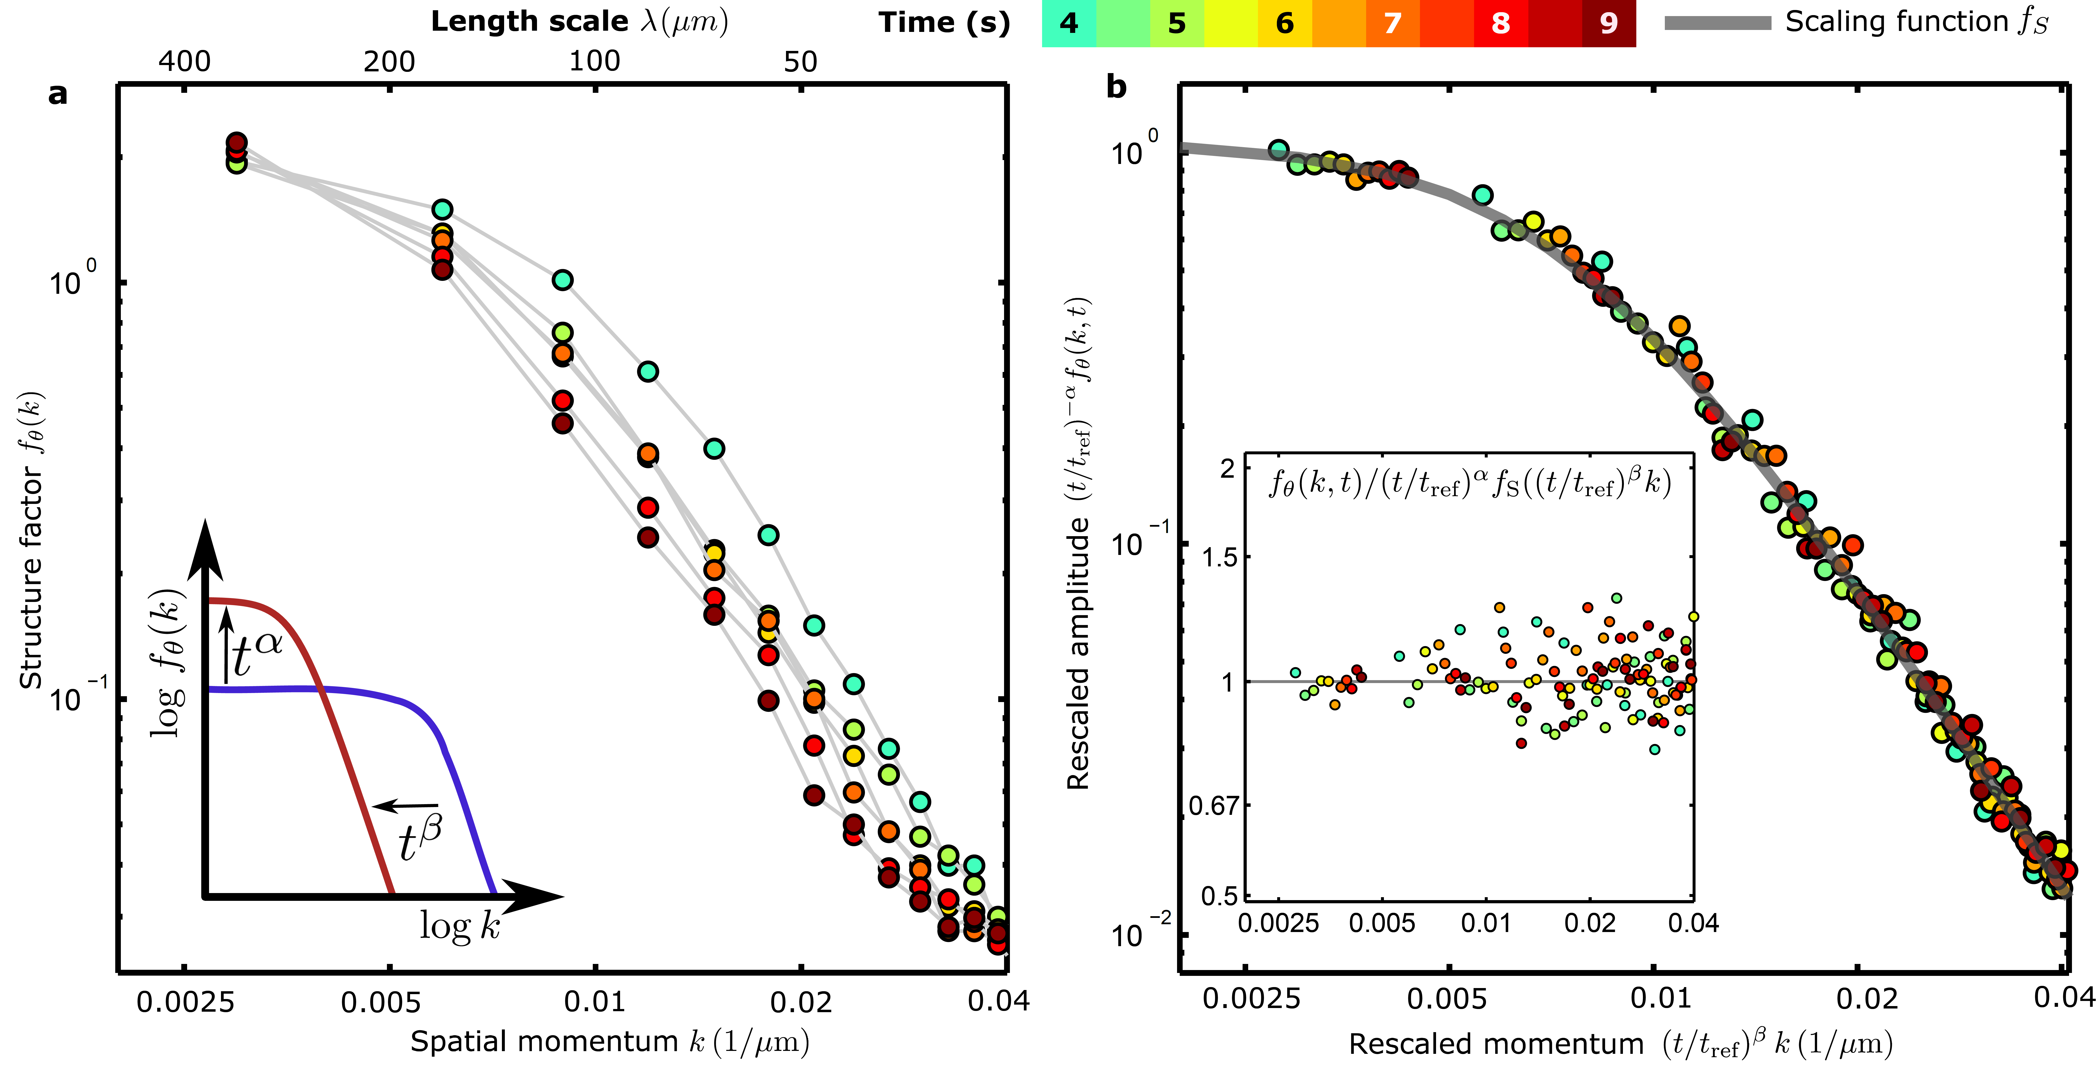
The Glasma and over-occupied quantum gases
Similar non-thermal fixed points discovered in cold atom experiments
- albeit only for static geometry so far
⁸⁷Rb BEC in a quasi 1D optical trap
α = 0.33±0.08
β = 0.54±0.06
Oberthaler BEC Labs
Prüfer et al, arXiv:1805.11881, Nature (2018)

Slide 32
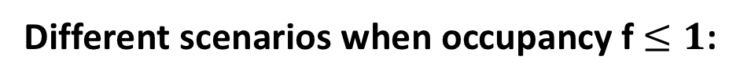
Kinetic theory of the Glasma
Different scenarios when occupancy f$≤1$:
Elastic multiple scattering dominates in the Glasma
Rescattering influenced by plasma (Weibel) instabilities
Transient Bose condensation+multiple scattering
BMSS: Baier,Mueller,Schiff,Son
DB: Bodeker
KM: Kurkela, Moore
BGLMV: Blaizot,Gelis,Liao,McLerran,Venugopalan
Gell-Mann’s totalitarian principle: Anything that is not forbidden is allowed

Slide 33
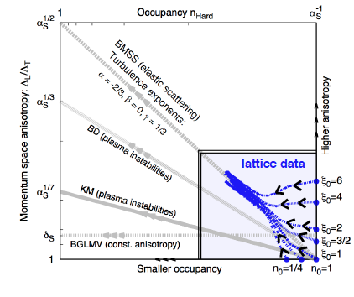
Non-thermal fixed point in overpopulated QGP
And the winner is…
bottom-up thermalization
(caveat, caveat, caveat,…)
Increasing anisotropy
BMSS: Baier,Mueller,Schiff,Son
BD: Bodeker
KM: Kurkela, Moore
BGLMV: Blaizot,Gelis,Liao,McLerran,Venugopalan
Decreasing occupancy with expansion
Berges,Boguslavski,Schlichting,Venugopalan. PRD89 (2014) 114007

Slide 34
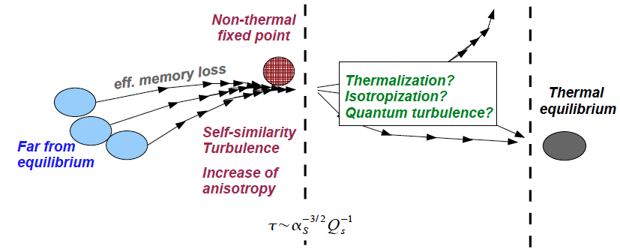
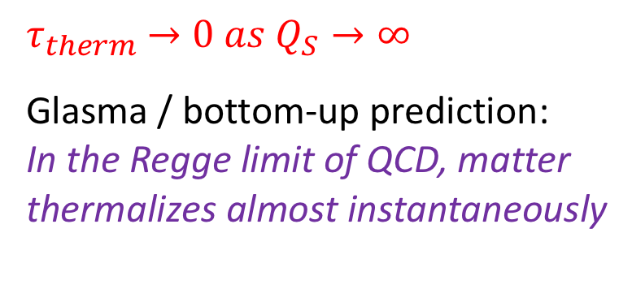
From nuts to soup: bottom-up thermalization
Quantum regime
of kinetic theory
Glasma classical regime
$τ_{therm}$ $→0 as Q_{S}→∞$
Glasma / bottom-up prediction:
In the Regge limit of QCD, matter
thermalizes almost instantaneously
Thermalized soft bath of gluons for
Thermalization temperature of

Slide 35
From nuts to soup: bottom-up thermalization
Mazeliauskas, QM 2018
arXiv:1807.05586

Slide 36
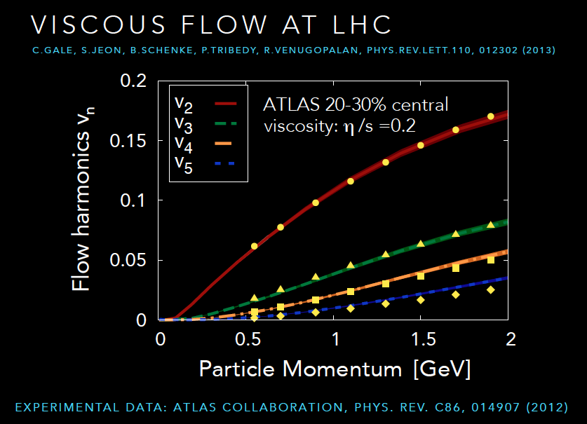
Heavy Ion phenomenology: IP-Glasma model

Slide 37
CGC to QGP: from large to small systems
Mazeliauskas, arXiv:1807.05586
Bottom-up results plotted as function of scaled “hydrodynamization” variable
match smoothly to viscous hydro even when system is quite anisotropic
Kurkela,Mazeliauskas,Schlichting,Paquet,Teaney,arXiv:1805.00961
Hydrodynamization:
Heller,Kurkela,Spalinski,Svensson,arXiv:1609.04803
Bazow,Heinz,Martinez, arXiv:1507.06595
Romatschke, arXiv:1704.08699
Strickland,Noronha,Denicol,arXiv:1709.06644
From bottom-up analysis, regime of
validity of hydro is limited for small systems:
Kurkela,Wiedemann,Wu, arXiv:1905.05139

Slide 38
Early time probes: photons from the Glasma
Potentially significant contributions to photon production from the different stages
(classical/quantum) of bottom-up thermalization of the Glasma
Garcia-Montero, arXiv: 1909.12294
However there are significant uncertainties in the computations of
both the thermal and the glasma rates

Slide 39
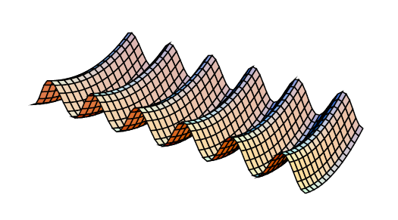
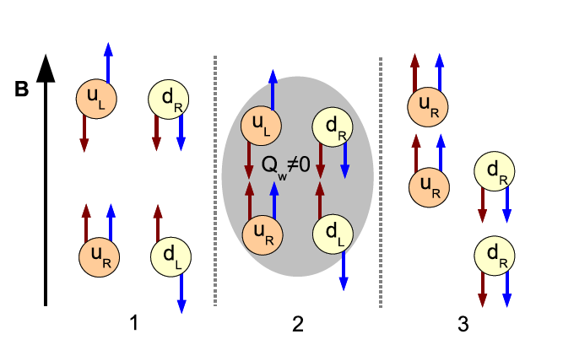
Topology in heavy-ion collisions: The Chiral Magnetic Effect
L or B
+
N_{CS} = -2 -1 0 1 2
External (QED) magnetic fields
- 10¹⁸ Gauss, of Magnetar strength!
Over barrier topological (sphaleron)
transitions … analogous to proposed mechanism
for electroweak baryogenesis
=
massless quarks
in hot medium
Topological
transition
Q_{W}= n_{L}-n_{R}
CME current
generated
Kharzeev,McLerran,Warringa (2007)
Kharzeev, Fukushima, Warringa (2008)

Slide 40
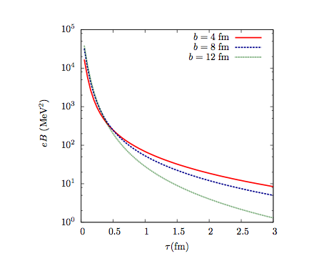
Topology in ion-ion collisions: Chiral Magnetic Effect
External B field dies rapidly. Lifetime of hot matter ~ 10 Fermi:
effect most significant, for transitions at early times
Consistent (caveat emptor!) with heavy-ion results from RHIC & LHC
Status: Kharzeev, Liao, Voloshin, Wang, Prog.Nucl.Part.Phys.88 (2016) 1
CME studies a major part of RHIC’s upcoming beam energy scan (BES II)
- possibly definitive results from comparative study of isobar collisions
BNL CME task force report: V. Skokov et al., arXiv:1608.00982

Slide 41
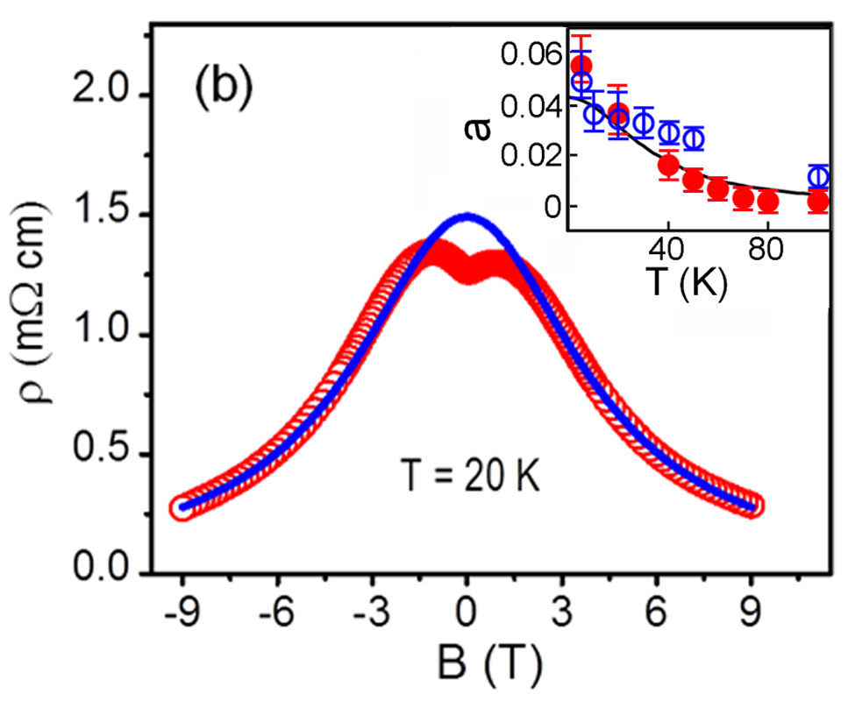
CME in condensed matter systems?
Dirac semi-metal: Zirconium Penta-Telluride
Inverse of the conductivity
Blue: CME model
Red: experimental data
Axial charge separation in external B field
Effect of chiral anomaly
Q.Li, et al, Nature Physics 12, 550 (2016)

Slide 42
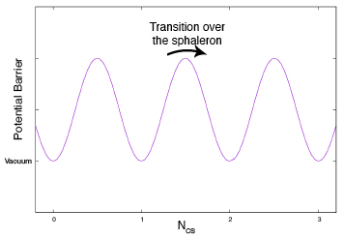
Uncovering the topology of the QCD vacuum: Sphaleron transitions
Sphaleron: spatially localized, unstable finite energy classical solutions
(σφαλεροs -``ready to fall”)
EW theory: Klinkhamer, Manton, PRD30 (1984) 2212
QCD: McLerran,Shaposhnikov,Turok,Voloshin, PLB256 (1991) 451
Distinct energy degenerate QCD vacua characterized
by topological Chern-Simons number N_{CS}
Sphaleron transition rate:
Moore, Tassler, arXiv:1011.1167

Slide 43

Overoccupied gauge fields in a box
Thermalization extensively studied in this context employing
classical-statistical simulations
Berges,Schlichting,Sexty, PRD86 (2012) 074006
Schlichting PRD86 (2012) 065008
York,Kurkela,Lu,Moore, PRD89 (2014) 074036

Slide 44

Overoccupied gauge fields in a box
Clean separation of scales develop a la thermal field theory:
Temperature (T)
Electric (Debye) screening (gT)
Magnetic screening (g² T) scales
Berges,Scheffler,Sexty, PRD77 (2008) 034504
Mace,Schlichting,Venugopalan, PRD93 (2016), 074036
Berges,Mace,Schlichting, PRL118 (2017)

Slide 45

Topological transitions in the Glasma
Distribution of Chern-Simons charge localizes around integer
values as UV modes are removed
“Cooled” Glue configurations in the Glasma are topological!
Mace,Schlichting,Venugopalan, PRD93 (2016), 074036

Slide 46

Topological transitions in the Glasma
Mace,Schlichting,Venugopalan, PRD93 (2016), 074036
Sphaleron transition rate scales with string tension squared
Very suggestive of non-trivial infrared structure
of QCD far out of equilibrium

Slide 47

Exploding sphalerons
“Exploding sphalerons”: Shuryak, Zahed, PRD67 (2003) 014006
Glasma rate
PRD 93 (2016) 074036
Arnold,Son,Yaffe,PRD55(1997)6264
Sphaleron transition rate very large in the Glasma
- much larger than equilibrium rate
Couple sphaleron background with fermions & external EM fields to simulate ab initio the Chiral Magnetic Effect!
Mueller,Schlichting,Sharma,PRL117 (2016) 142301
Mace,Mueller,Schlichting,Sharma, arXiv: 1612.02477

Slide 48



Classical-statistical simulations
Emergence of chiral magnetic wave
N. Mueller et al. PRL117, 142301 (2016)
M. Mace et al. arXiv:1612.02477
spatial distribution

Slide 49

From classical-statistical simulations to chiral kinetic theory and anomalous hydro
Results from RHIC
isobar run imminent:
exciting time for CME search !
Slide by Niklas Mueller

Slide 50
Summary
This talk covered only a small fraction of the developments in our
understanding of the Initial Stages of ion-ion collisions.
(Indeed, there is now a dedicated conference series by this name
-next edition, Weizmann Institute, Israel, January 2021)
I hope it provides some context to understanding the exciting developments
over the week and wish you a successful and enjoyable conference !

