Slide 1
Recent Activities on HV-CMOS Detectors at KIT
Ivan Peric

Slide 2
Introduction
Introduction of HVCMOS
Engineering run in aH18 process, experimental results
New foundry: TSI
ATLASPIX3
Planned new engineering run
CLIC designs
New ideas: small pixels and reduced detector capacitance

Slide 3
Introduction
HVCMOS sensors, for CLIC, Mu3e, ATLAS, COMPASS, LHCB, P2, Belle II (planned)
Motivation
For ATLAS HVCMOS sensors promise large cost saving (> 10M), simpler module production, better reliability, less material…
For Mu3e HVMOS is practically the only option since a high time resolution is needed and material budget is low (0.1% of radiation length/layer - sensor must be 50µm thin)
HVCMOS = depleted CMOS sensors with large collecting n-well electrode and pixel electronics inside

Slide 4
Pixel structure
Pixels are based on floating electronics structure – pixel electronics is placed into a deep n-well.
Deep-n-well fulfils two tasks:
1. Local substrate for electronics (isolated from p-substrate)
2. Charge collecting electrode.
The p-substrate region below the deep n-well is depleted by setting substrate to negative HV. Typical depletion: 30 – 50µm for 80 to 200 Ωcm resistivity. Typical MIP signals are typically >5000e for 200 Ωcm substrate
The substrate contacts are at the chip surface (undepleted parts of it)
Largest capacitance from p-well/n-well junction
NMOS
PMOS
HV
NMOS
PMOS
HV
p-well
n-well
p-well
n-well
Deep p-well
Deep n-well
Deep n-well
Standard process
Modified process
deep p-well
Depleted zone
Depleted zone
P-type substrate
P-type substrate

Slide 5
AMSH18 run
The milestone in our development was the combined Mu3e and ATLAS run done in AMS aH18 process
This process is compatible with the originally developed H18 (CMHV7SF) process from IBM (now Global Foundries)
For this engineering run, AMS modified the process in two aspects – high resistivity substrates were used and the deep-well layer added to isolate the deep n-well from shallow n-well. Not all designs used this option

Slide 6
MUPIX8
We had large MU3E design MUPIX8 – 1cm x 2cm. Pixel size is 80µm x 80µm. Readout is untriggered, zero suppressed
The chip is working well, detection efficiency is excellent, signal to noise ratio ~50, and time resolution 6ns (RMS) after some corrections

Slide 7
ATLASPIX1
We had three ATLAS designs, two with untriggered and one with triggered readout. Pixel sizes are 130µm x 40µm and 60µm x 50µm. Area is about 3 mm x 20 mm
The chips are also working well. Detection efficiency after irradiations (up to 2 x 10¹⁵neq/cm²) is very good (~99%). Time resolution is down to RMS 8ns.

Slide 8
Deep p-well
Deep p-well was used in one of the ATLASPIX simple chips to isolate CMOS comparator from sensor electrode. Another twin chips used no isolation and used NMOS-based comparator. Both versions of comparator worked good
The use of deep p-well simplifies the comparator design and allows full swing output which makes the design more robust

Slide 9
Sensor electronics
The chips have the following structure:
Pixel matrix contains pixels. The contain collection electrodes – n-wells – filled with electronics.
The electronics has CSA, feedback. The comparator with tune circuit is either placed in pixels (ATLASPIX) or on periphery (MUPIX)
MUPIX
Optional analog reciever
Amplifier
Analog driver
Long
Comparator
Sensor
Th
-HV
Pixel
RO cell
ATLASPIX
Digital reciever
Amplifier
Comparator
Long
Sensor
Th
-HV
Pixel
RO cell

Slide 10
Sensor electronics
The periphery contains hit buffers. Every pixel has dedicated hit buffer. They receive time stamps and store them when hit arrives
A priority logic organizes readout. The hit information is generated in the buffers: address, leading edge and tot time stamp. This information is formatted and sent serially off chip.
ScanIn
10 bit TS
Sync
Receiver
Hit
x
Hit
RdScan
x
6 bit TS
Address
ScanOut
LdPix
RdPix
TS
Data

Slide 11
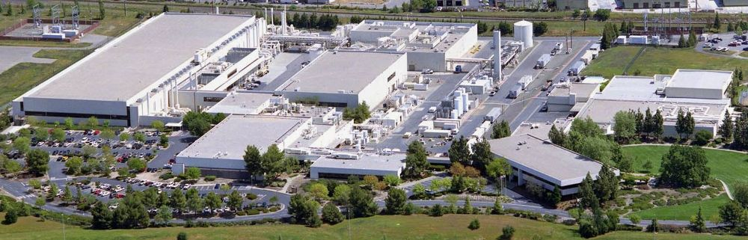
New fondry TSI
After these nice results, we received the news from AMS that that production time will be increased
AMS helped us to fine alternative produces – TSI semiconductors – that offers very similar process that is compatible in terms of design rules and transistor parameters with the H18.
TSI is very open for process changes, they agreed to use high resistivity wafers and they can make deep p-well for us
The layouts developed in IBM H18 and AMS aH18 can be used in TSI.
In contrast to aH18, TSI offers 7 metal layer option which is very useful
TSI is based in Sacramento, USA
Engineering run cost about 100k€

Slide 12
ATLASPIX3
ATLASPIX3 chip designed in TSI process.
This is a large chip 2 x 2 cm chip with 50µm x 150µm pixels. It has the same signal interface as Rd53 and it can be used to build quad modules for ATLAS
It has implemented triggered- and, as test feature, untriggered readout

Slide 13
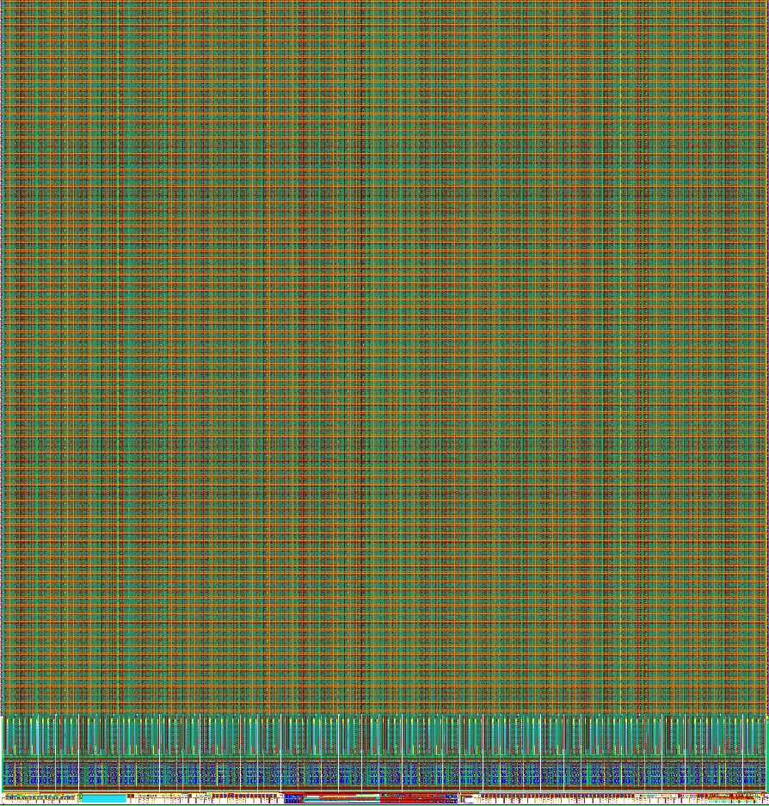
ATALSPIX3
ATALSPIX3
HVCMOS sensor for quad module
Implemented in TSI 180nm HVCMOS technology, licensed IBM/AMS H18 process
Features and data interface similar as RD53
Supports triggered readout with trigger latency up to 25µs
Interface:
Input CMD line (used for clock generation, L1 triggering with trigger tag, configuring and readback of configuration), like RD53
Output: Aurora 64b66b, 1.28Gb/s, hit words 32bits, EoE words
Supports serial powering (only one power supply)
Size: 20.2mm x 21mm
Submitted in April 2019

Slide 14

ATLASPIX3
ATLASPIX3 chip has been produced and we started with first tests this week

Slide 15
New run
We are planning two more engineering runs in TSI in 2019. A large chip for Mu3e MUPIX10 will be submitted within the first run in October.
The second run will be shared within many projects and is planned for end of December.
CLIC
LHCB
Counting pixels for hadron therapy
TBD
Small pixels
Pixel readout chip
(hybrid detectors)
Multi purpose chip (Belle II)

Slide 16
The second run will be shared within many projects.
Counting monolithic pixel sensor for hadron therapy application
Pixel matrix and test structures for LHCB
CLIC
LHCB
Counting pixels for hadron therapy
TBD
Small pixels
Pixel readout chip
(hybrid detectors)
Pixel readout chips for medical applications (readout of CdTe sensors)
Multi purpose chip (Belle II)
Large multi-purpose low power chip with 50µm x 50µm pixels, triggered and untriggered readout and geometry that would fit for instance to belle 2. Reduced detector capacitance

Slide 17
CLIC design with elongated pixels 25 x 300 um and the readout and periphery similar to ATLASPIX simple
10 bit leading edge time stamp and 7 bit TOT time stamp
The pixels would contain CSA and comparators that would be implemented as CMOS circuits and isolated by deep p-well.
CLIC
LHCB
Counting pixels for hadron therapy
TBD
Small pixels
Pixel readout chip
(hybrid detectors)
Multi purpose chip (Belle II)

Slide 18
All previously mentioned sensor would be based on the pixels with large fill factor, the deep n-well filled with electronics
Since TSI can make deep p-well we can also do low fill factor sensors. We plan following test sensor:
The pixels would have size of 25µm x 25µm size and in-pixel electronics with CSA, comparators, time measurement and priority based readout.
10 bit leading edge and 6 bit TOT time stamp would be implemented per pixel
CLIC
LHCB
Counting pixels for hadron therapy
TBD
Small pixels
Pixel readout chip
(hybrid detectors)
Multi purpose chip (Belle II)

Slide 19
New structure: Small pixels
Matrix with small pixels
25µm
n-well
p-well
n-well
n-well
Deep p-well
n-well
P-substrate (200 Ohm cm)

Slide 20
New structure – reduced capacitance
Improvements of standard HVCMOS stracture are possible
Idea: reduce capacitance by reverse biasing of deep-pwell to n-well junction
1.8V
N-well
P-well = 0V
N-well
Deep p-well
Deep n-well
P-substrate (200 Ohm cm)

Slide 21
5V
N-well
P-well = 0V
N-well
Deep p-well
Deep n-well
P-substrate (200 Ohm cm)

Slide 22
Summary
Engineering run in aH18 process, experimental results presented
New foundry: TSI
ATLASPIX3 introduced
Planned new engineering run
CLIC designs
New ideas: small monolithic pixels and reduced detector capacitance

Slide 23
Thank you

