Slide 1
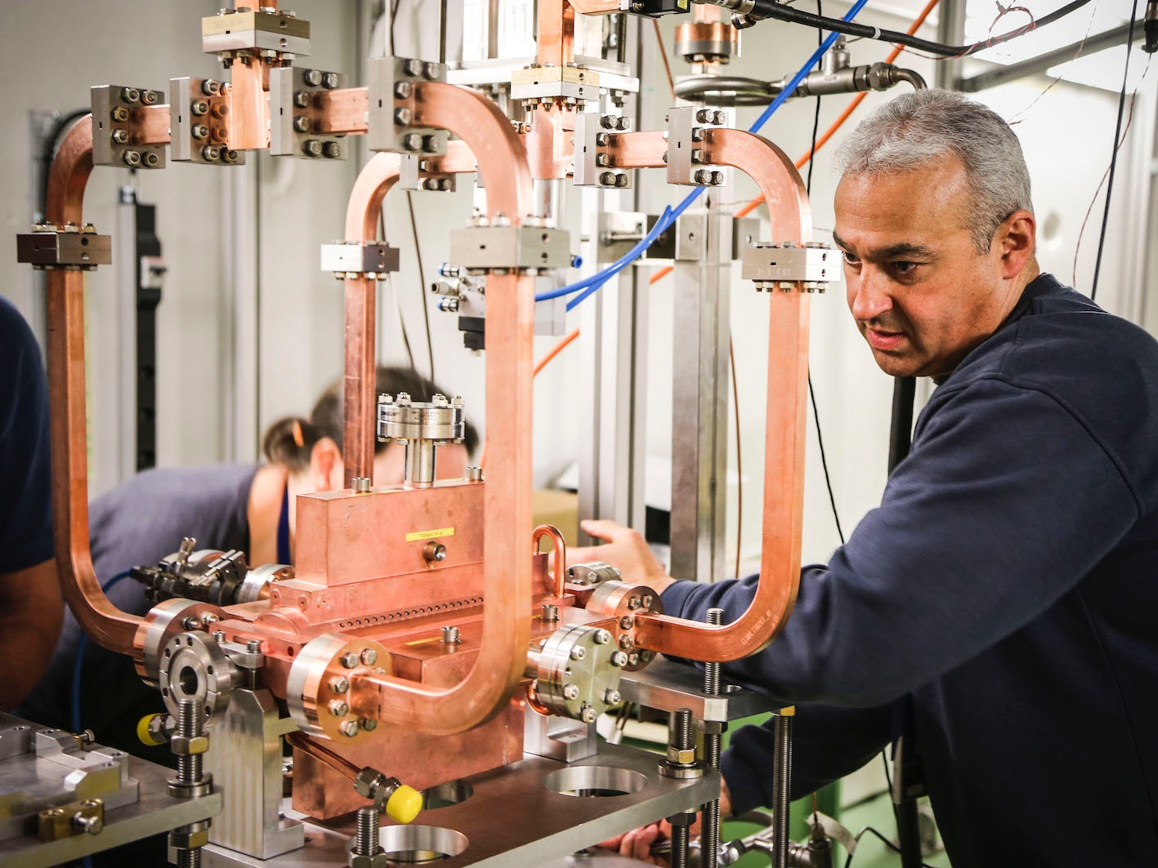
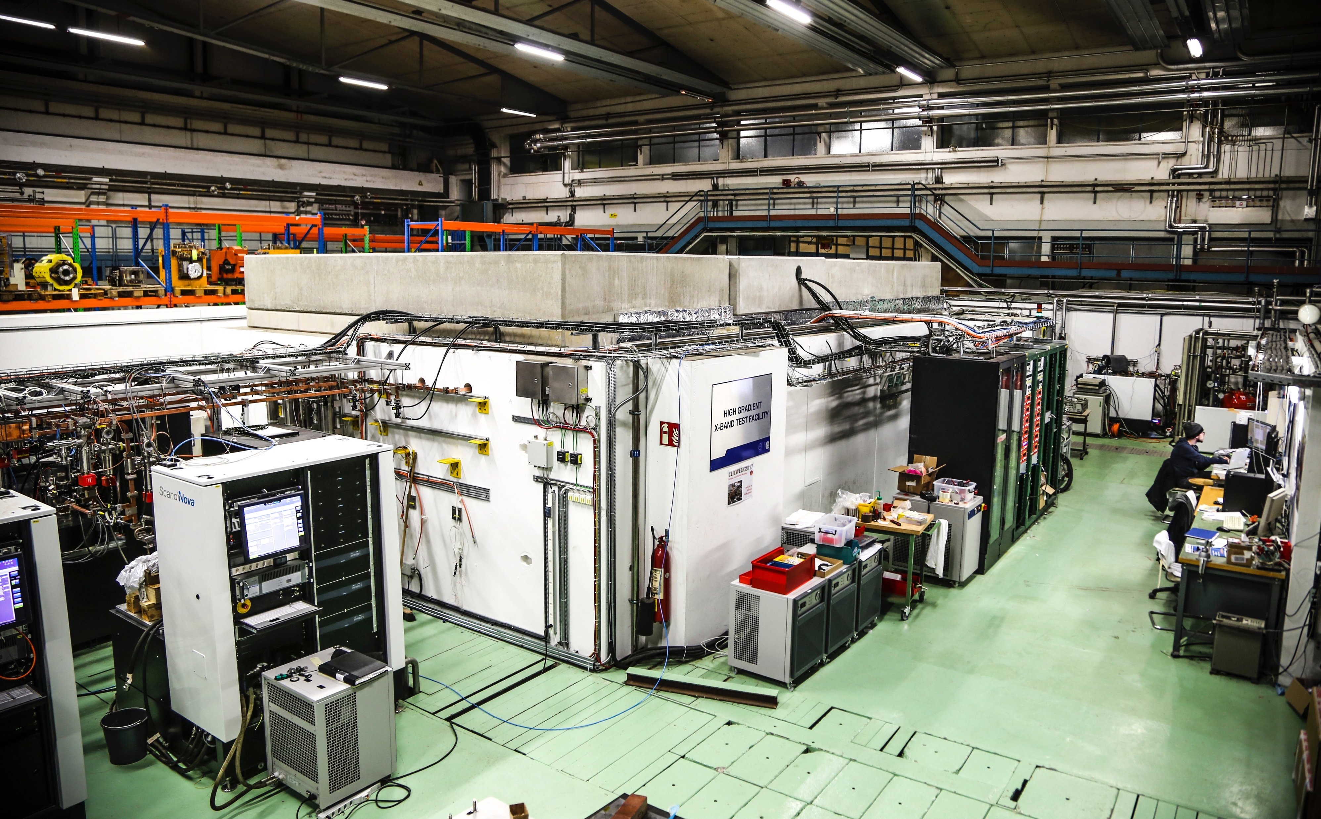
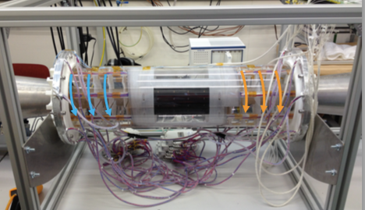
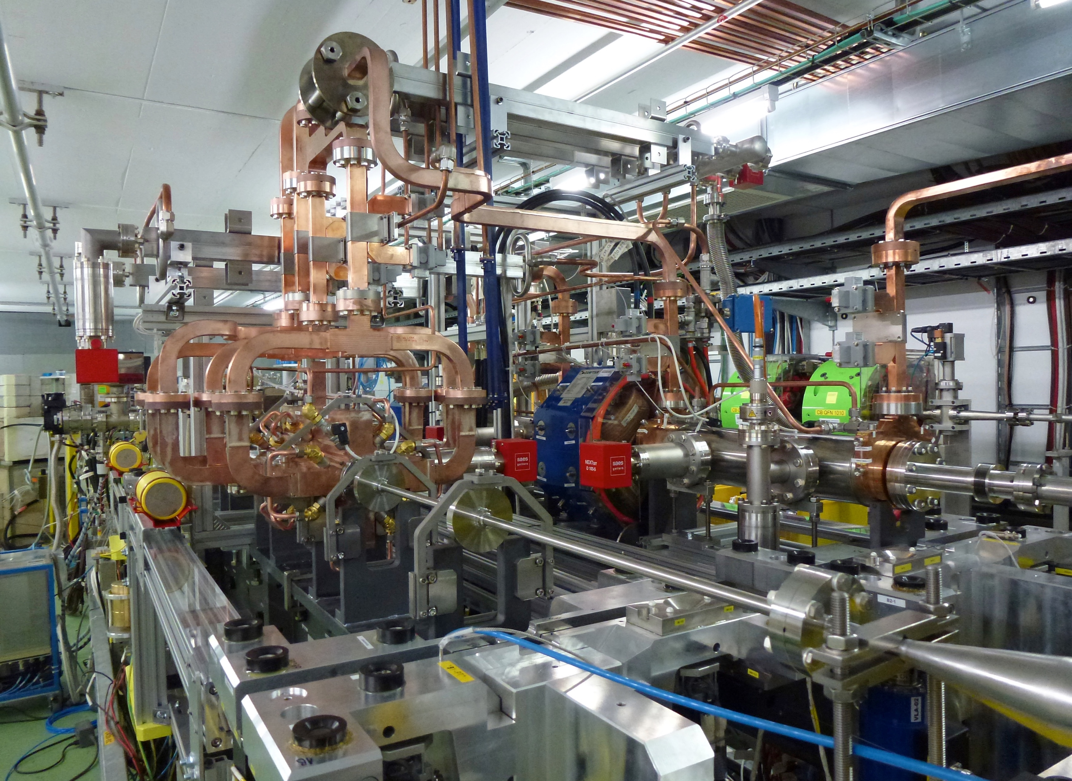
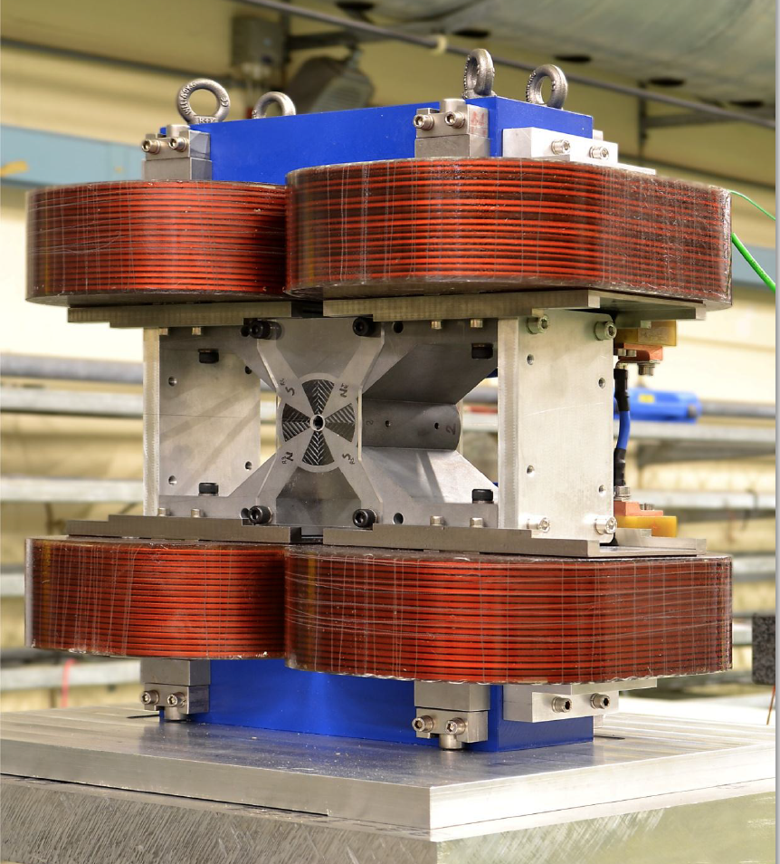
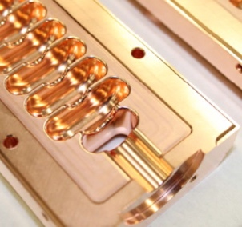
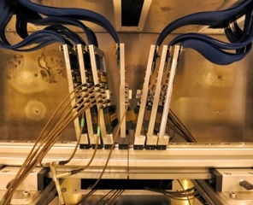
The CLIC project
CLICdp collaboration meeting August 2019
Steinar Stapnes on behalf of CLIC

Slide 2
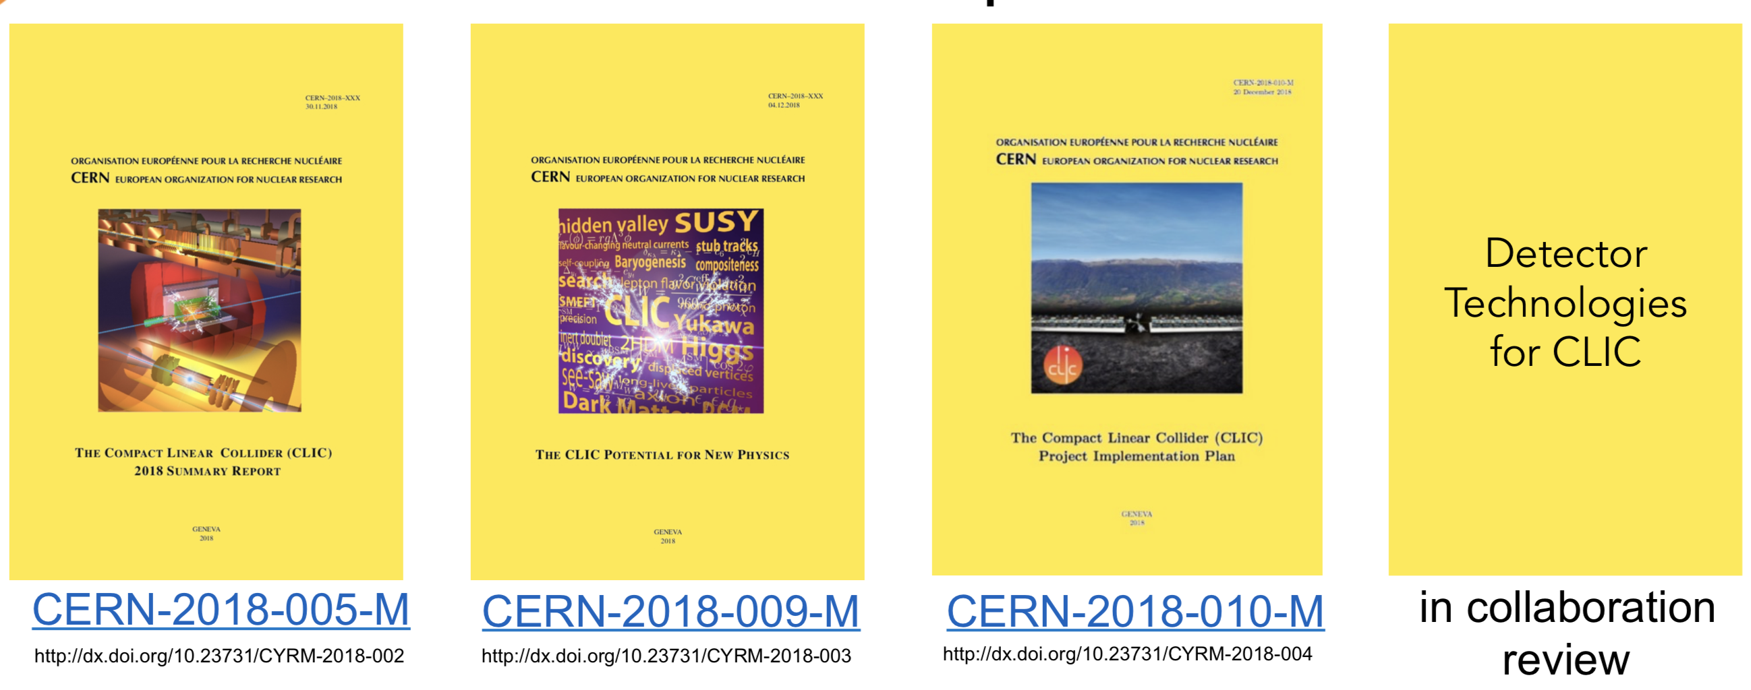
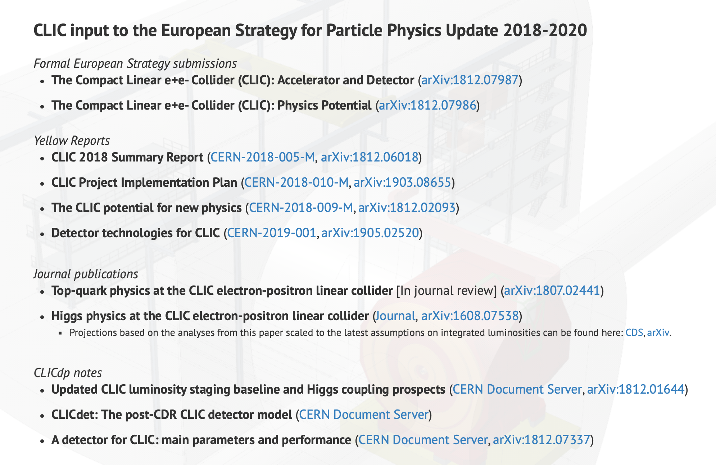
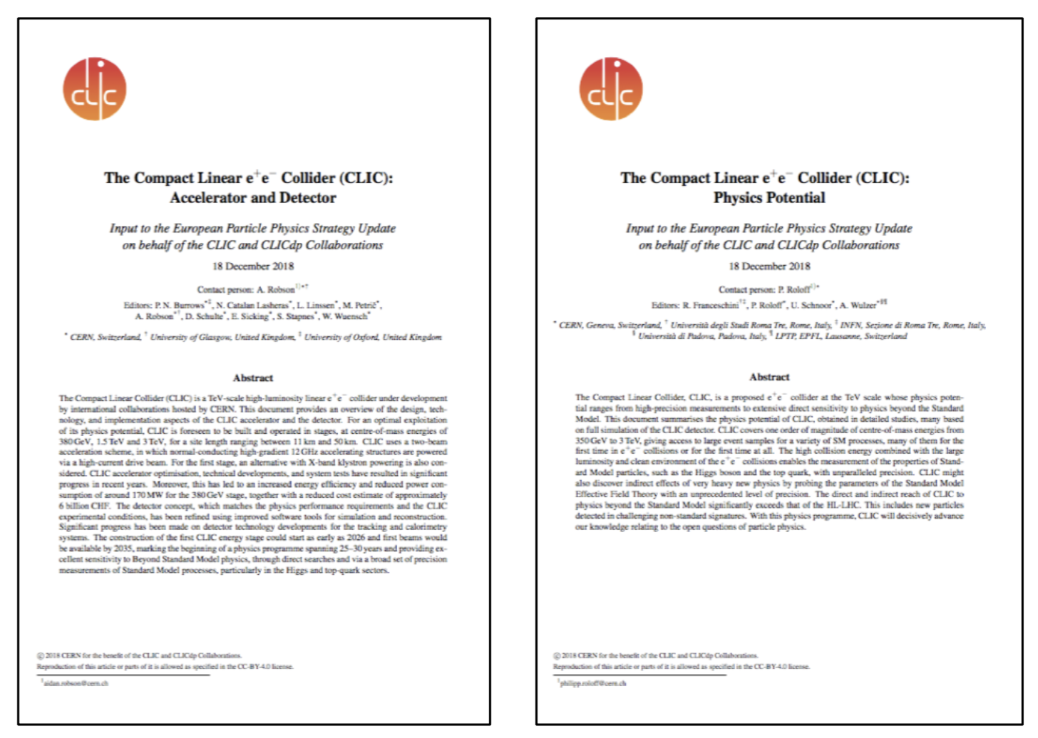
European Strategy Input
CERN-2019-001
http://dx.doi.org/10.23731/CYRM-2019-001
Link: http://clic.cern/european-strategy

Slide 3
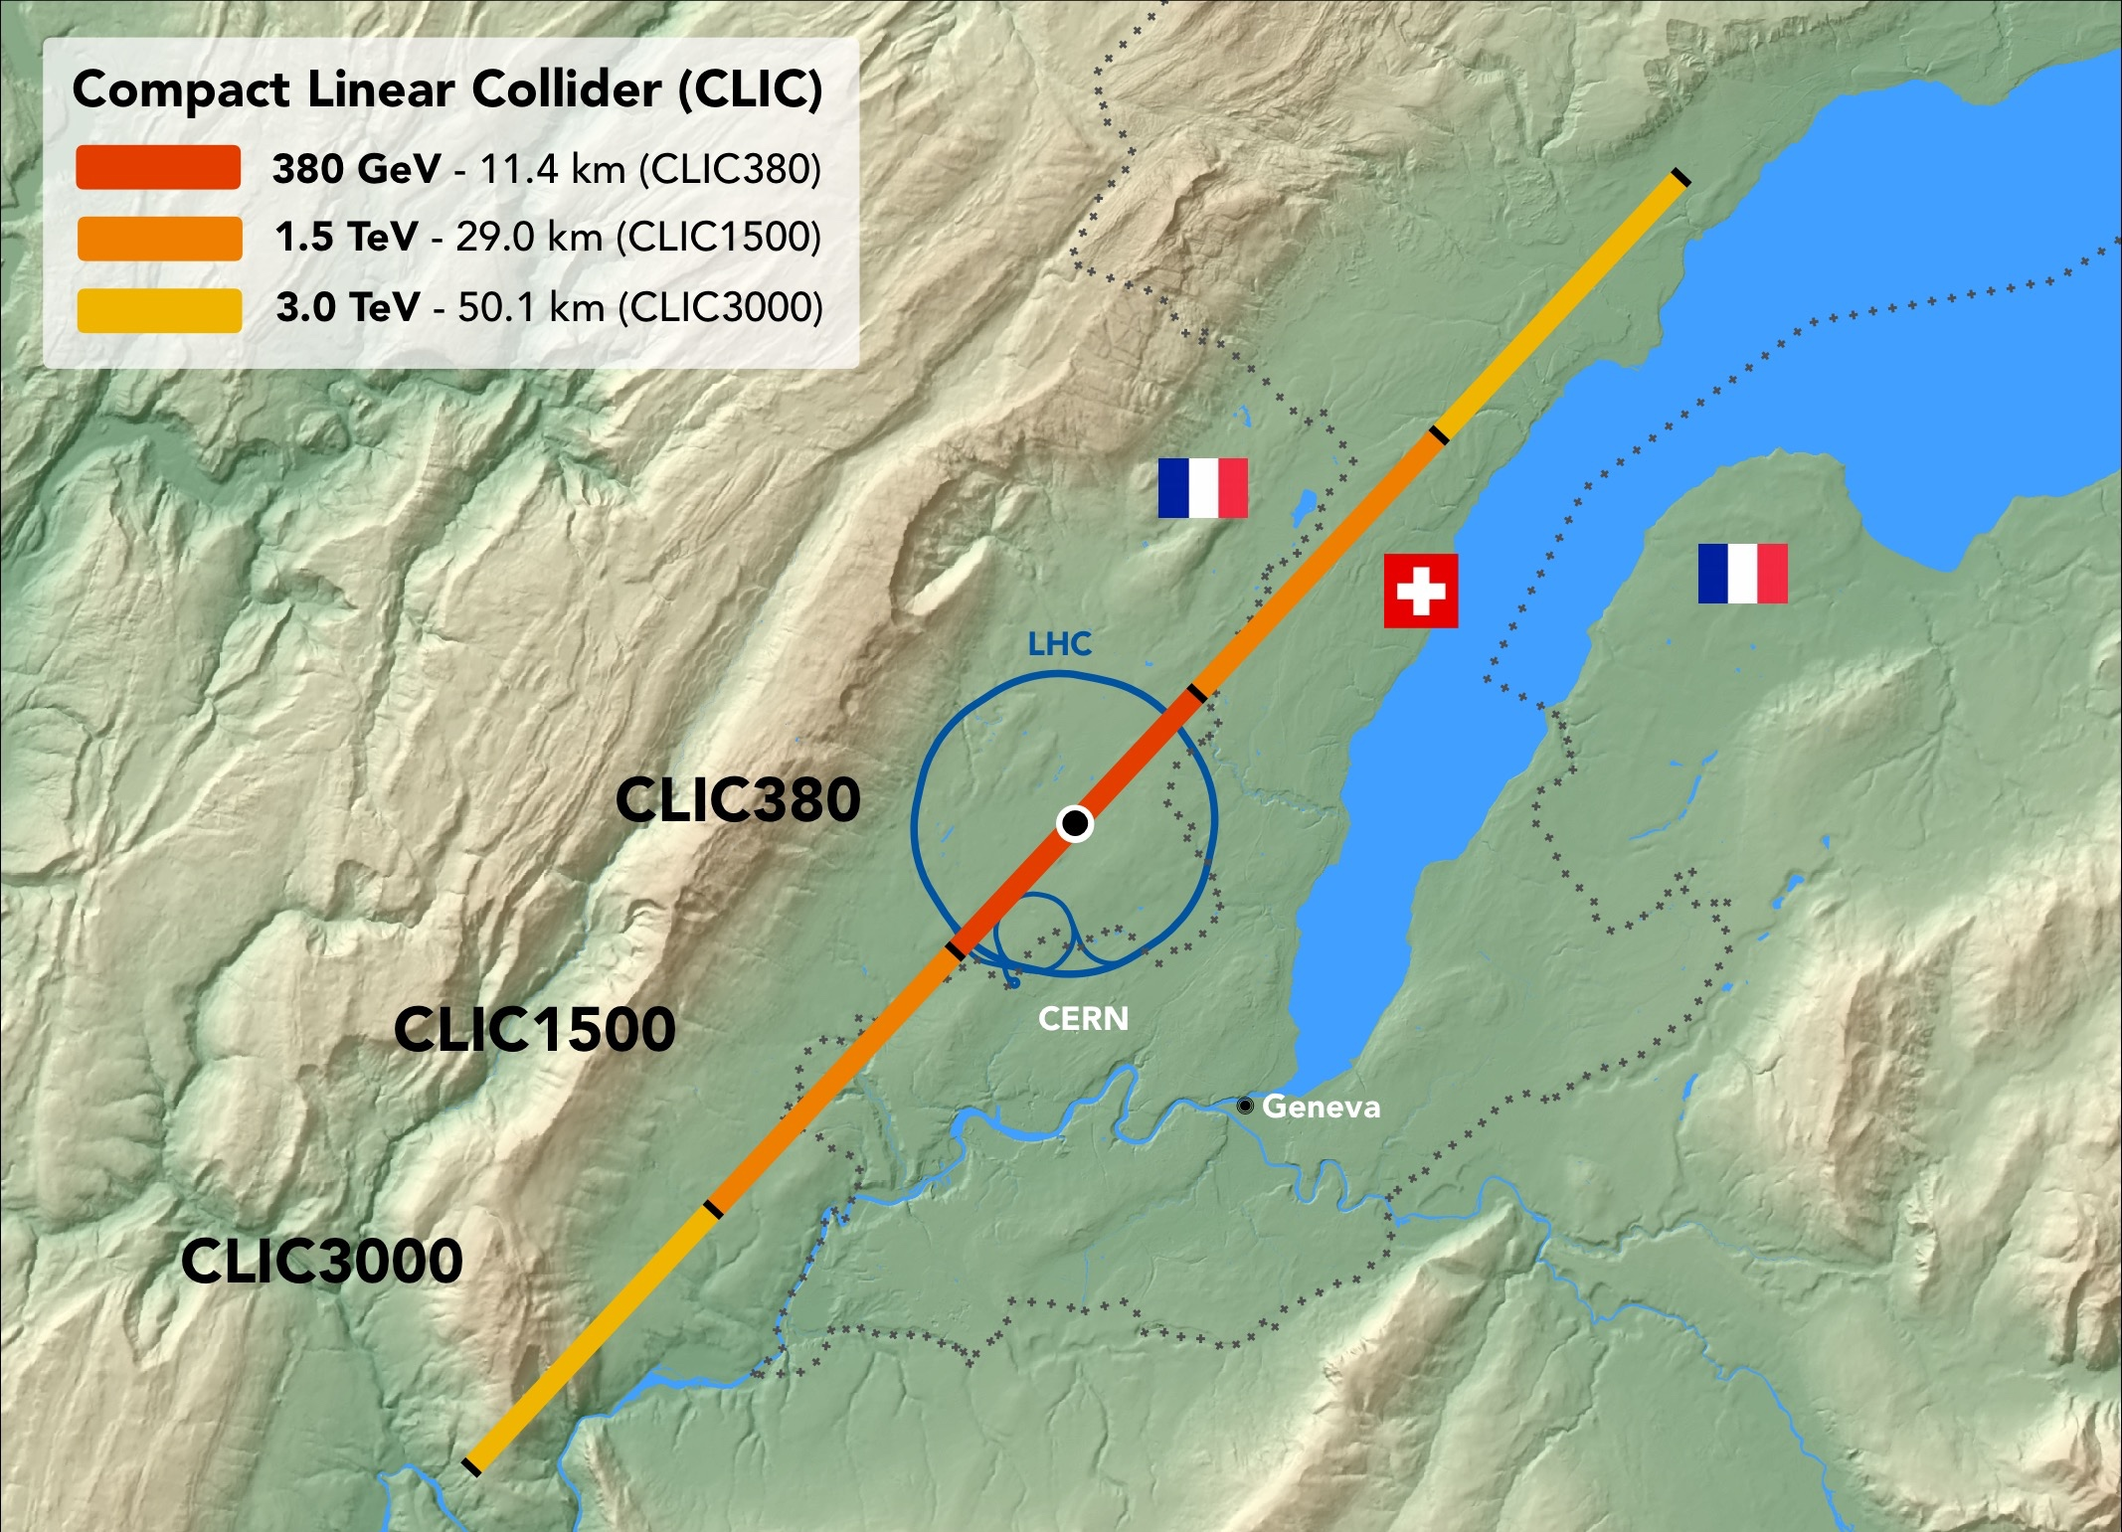
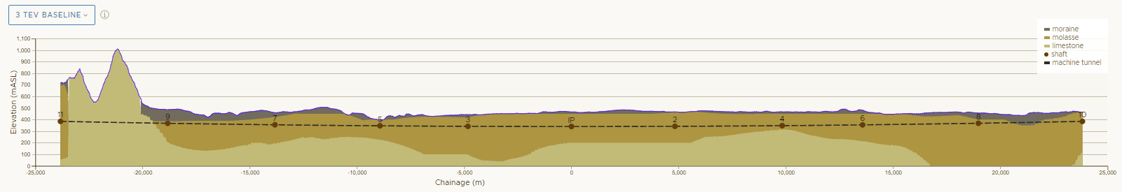
CLIC

Slide 4
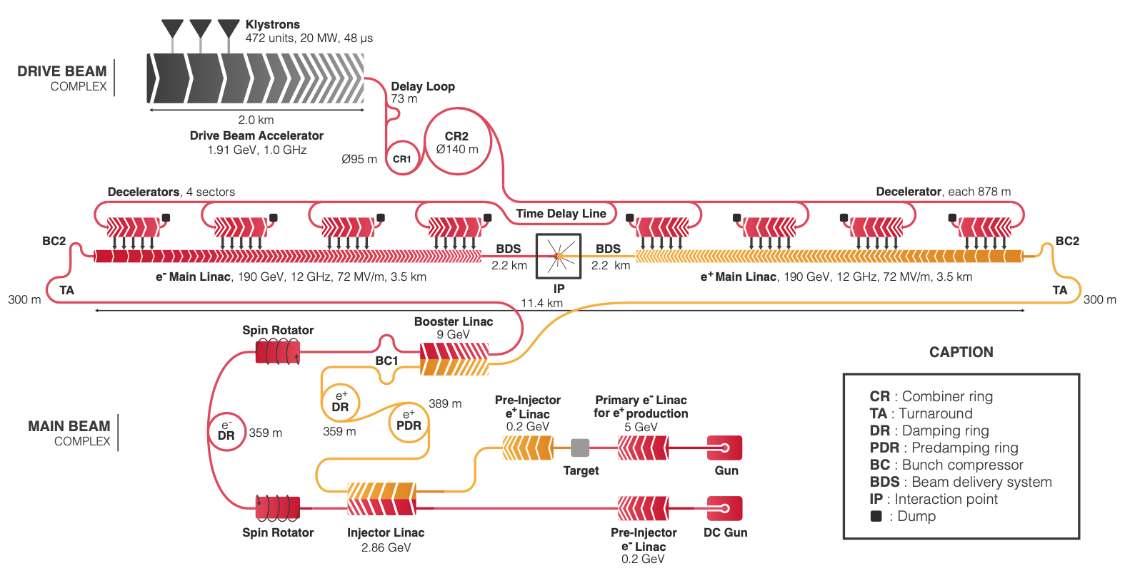
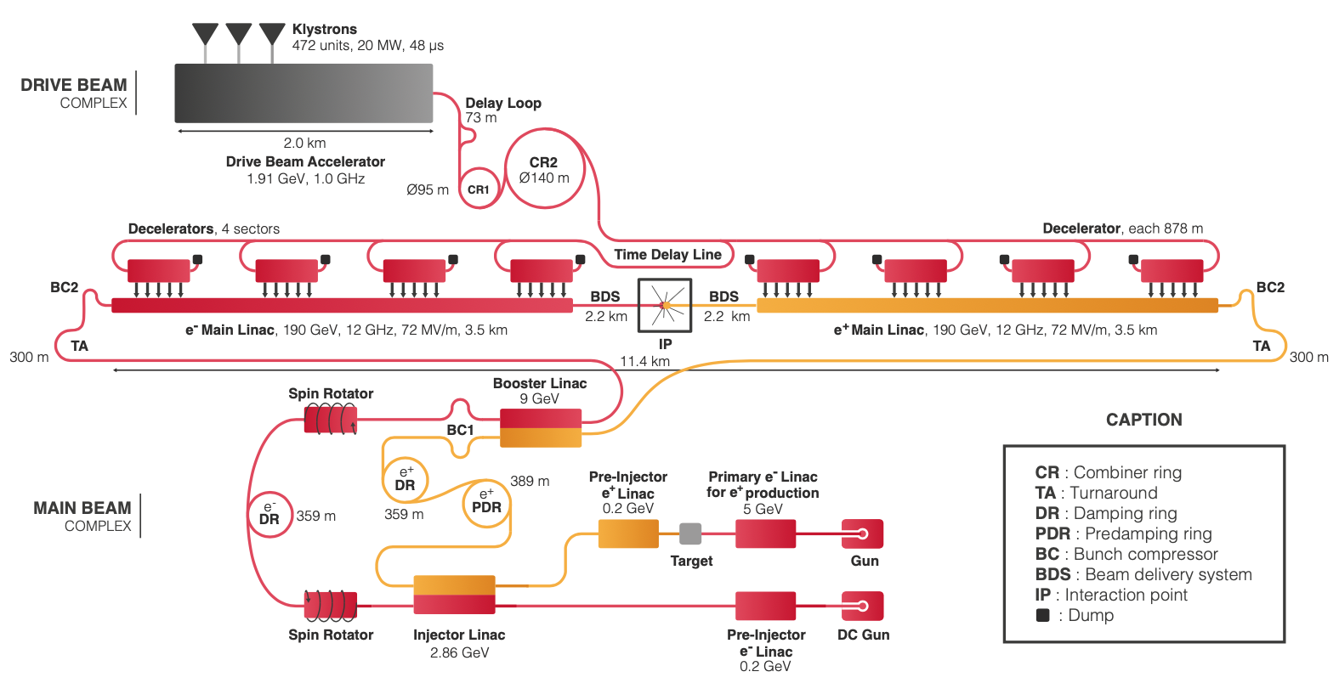
CLIC 380 GeV layout and power generation
Baseline electron polarisation ±80%

Slide 5
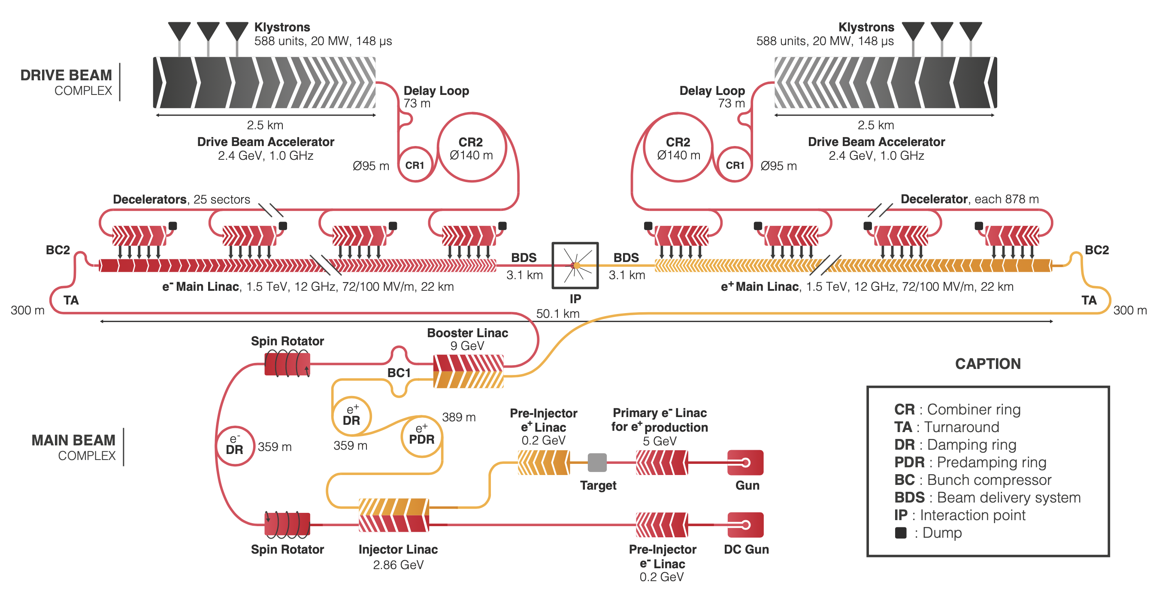
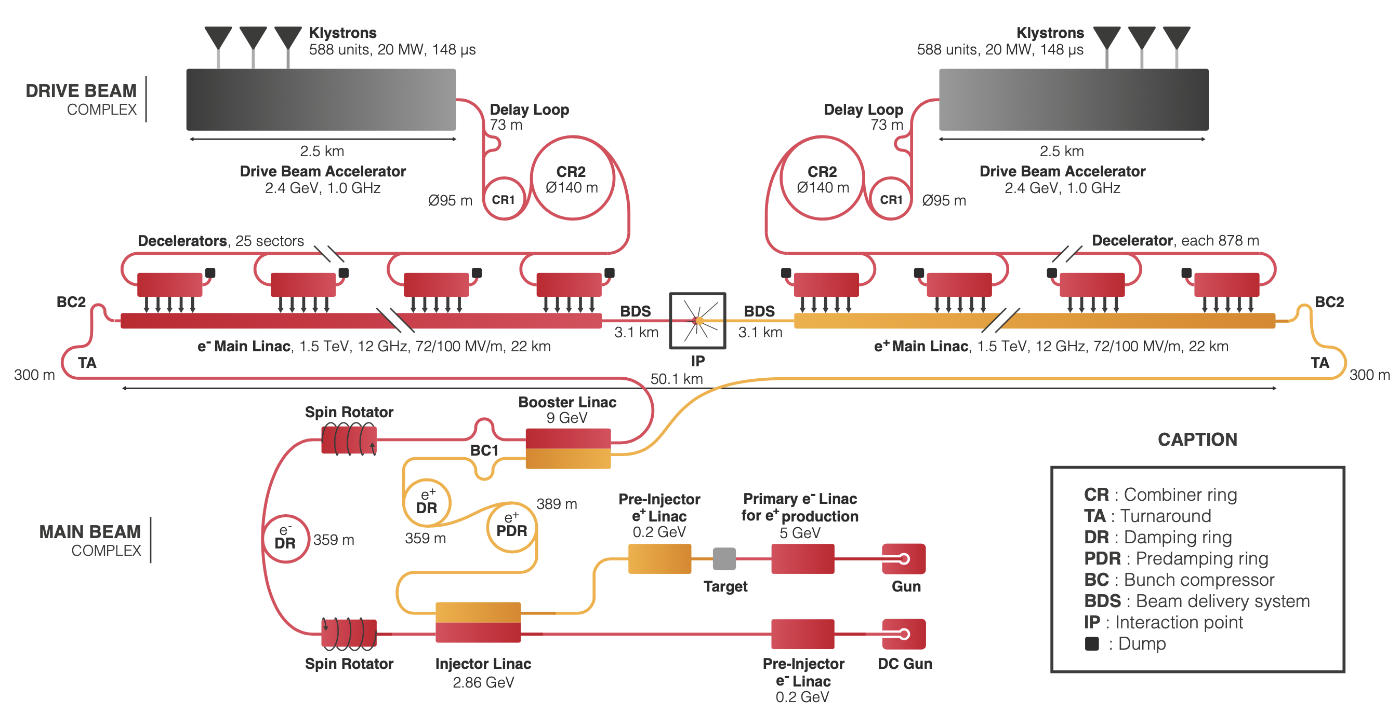
CLIC layout – 3TeV
Baseline electron polarisation ±80%

Slide 6
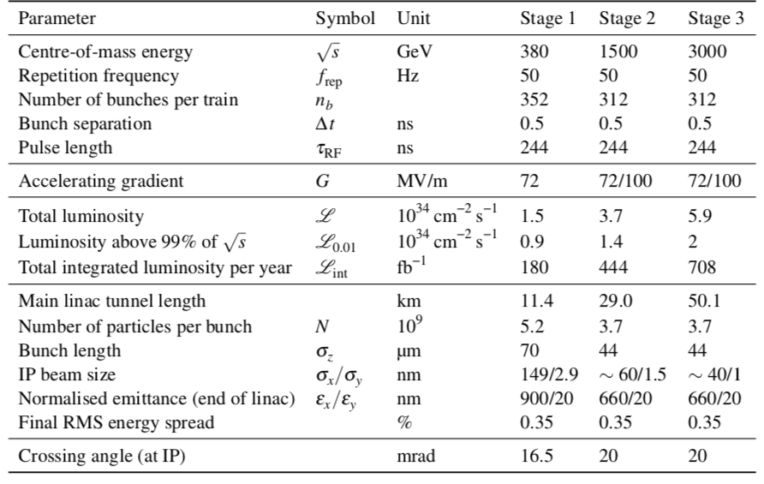
CLIC parameters

Slide 7
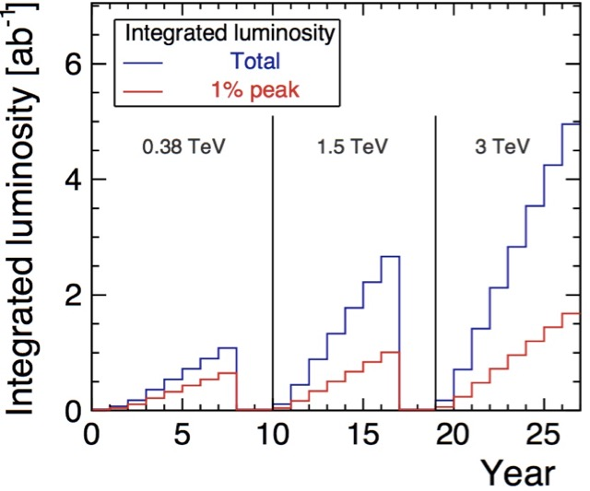
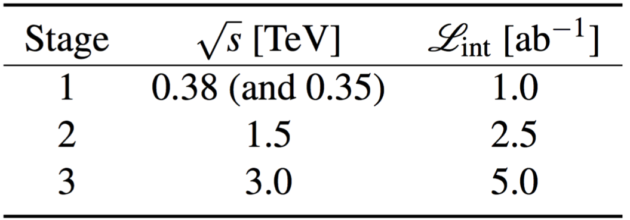
Luminosity staging baseline
increased
from
0.5+0.1ab^{–1}
1.5ab^{–1}
3ab^{–1}
Sensitivities updated for new luminosity staging baseline
Baseline polarisation scenario adopted:
electron beam (–80%, +80%) polarised in ratio
(50:50) at √s=380GeV ; (80:20) at √s=1.5 and 3TeV
Staging and live-time assumptions following guidelines consistent with other future projects:
Machine Parameters and Projected Luminosity Performance of Proposed Future Colliders at CERN
arXiv:1810.13022, Bordry et al.

Slide 8
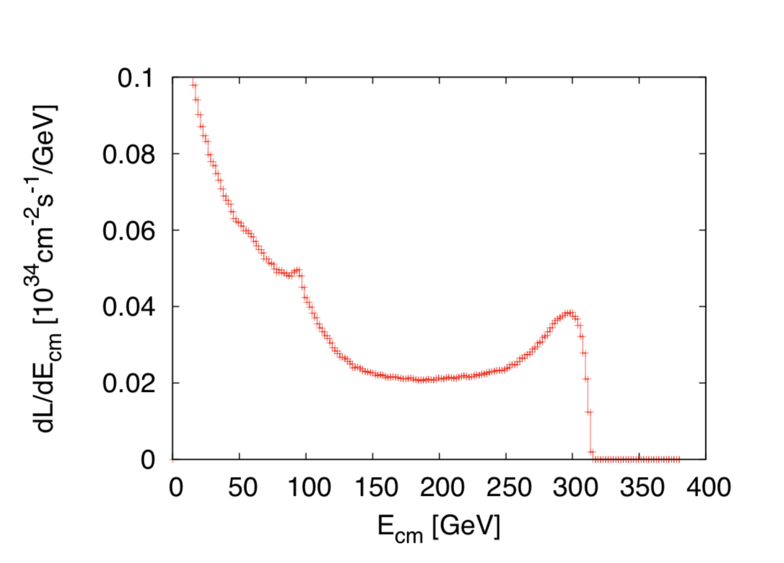
After Granada
Three questions:
Z pole performance, 2.3x10³² – 0.4x10³⁴ cm⁻² s⁻¹
  The latter number when accelerator configured for Z running (either early or end of first stage)
Gamma – Gamma spectrum (example)
Luminosity margins and increases
  Baseline includes estimates static and dynamic degradations from damping ring to IP: 1.5 x 10³⁴ cm⁻² s⁻¹, a “perfect” machine will give : 4.3 x 10³⁴ cm⁻² s⁻¹, so significant possibilities for doing better
  In addition: doubling the frequency (50 Hz to 100 Hz) would double the luminosity, at a cost of +50 MW and ~5% cost increase
Note at: http://cds.cern.ch/record/2687090 (in preparation)
Other points:
Two detectors by push-pull, or doubling BDS (beam delivery system) possible … the latter is costly (~15%) and the second collision point probably not useful at higher energies
Overlap CLIC with FCC straight session ?

Slide 9
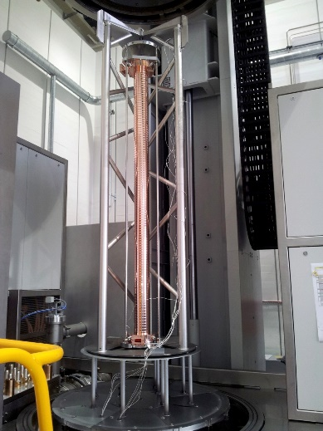
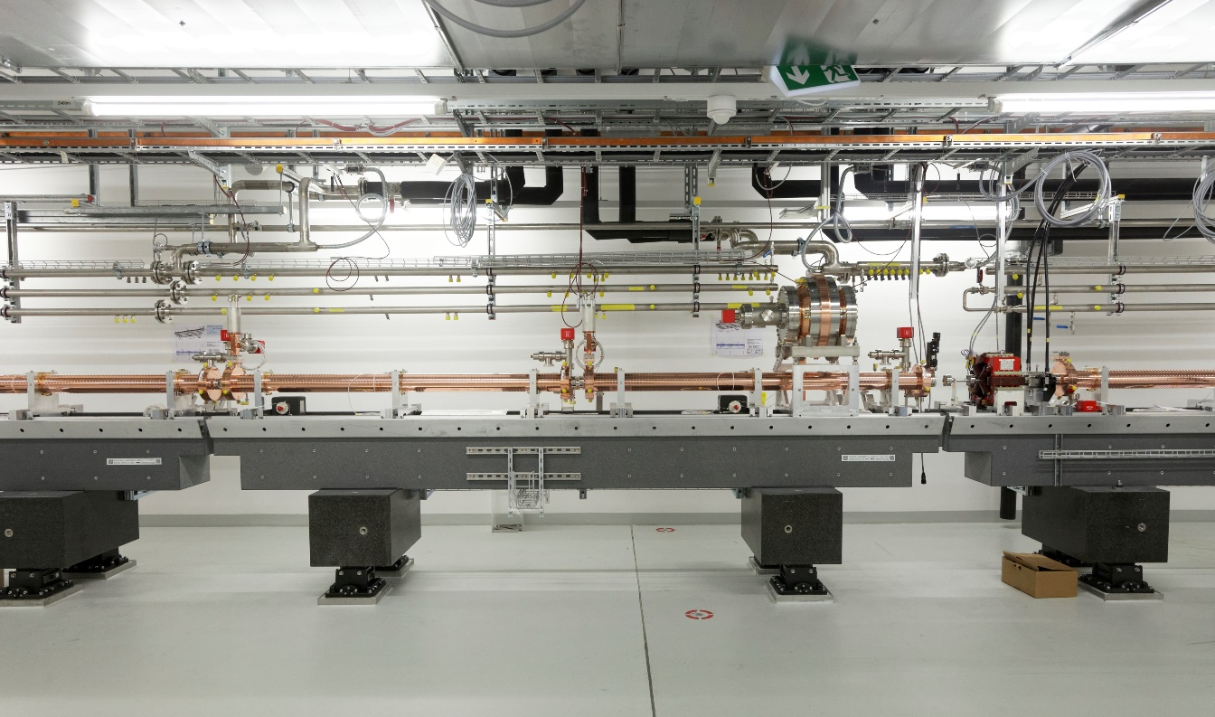
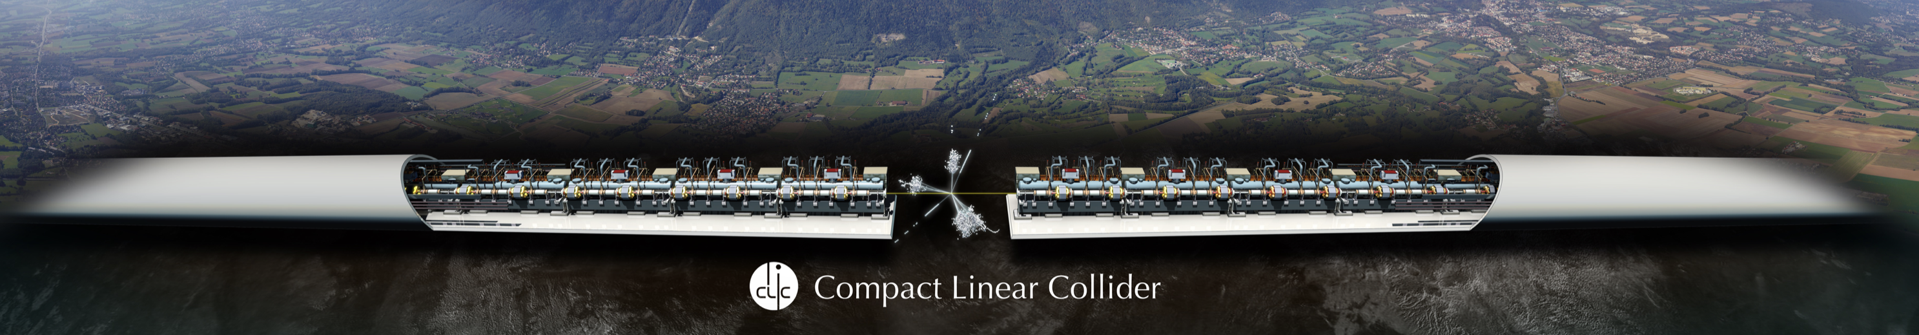
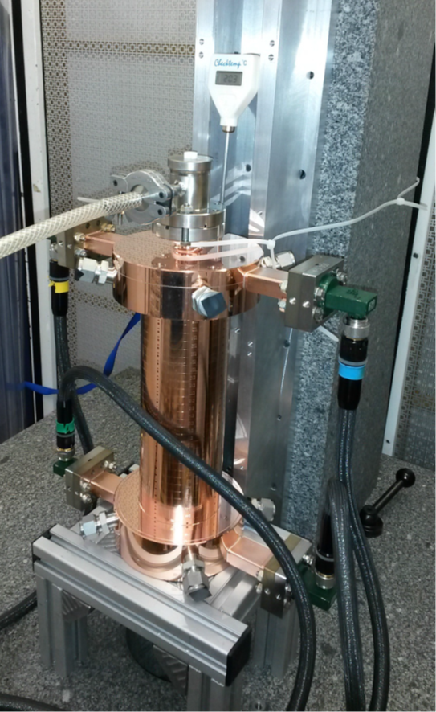

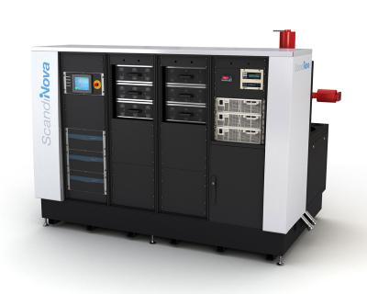
X-band NCRF technology
Swissfel: Specs similar, and reached
Prototype components
Laboratory with commercial
Accelerating structures
pulse compressors
alignment
stabilization
etc.
Full commercial supply
X-band klystrons
solid state modulators
etc.
Normal-conducting, low- emittance GeV-range facilities
Operational
SACLA
SwissFEL
Systems and 100 MeV-range facilities
XBoxes at CERN
(NEXTEF KEK)
Test stand at Tsinghua
Frascati
NLCTA SLAC
Linearizers at Electra, PSI, Shanghai and Daresbury
Deflectors at SLAC, Shanghai, PSI, DESY and Trieste
NLCTA
Smart*Light
FLASH
Gradients
X-band GeV-range facilities
Planning:
EU-Praxia
eSPS
CompactLight
XARA

Slide 10
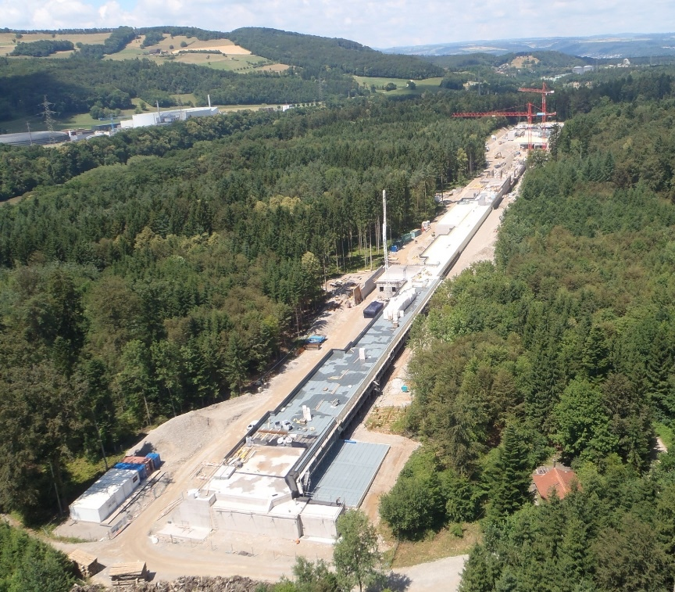
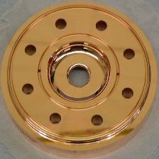
SwissFEL – C-band linac
104 x 2m-long C-band structures
(beam → 6 GeV @ 100 Hz)
Similar μm-level tolerances
Length ~ 800 CLIC structures
Being commissioned

Slide 11
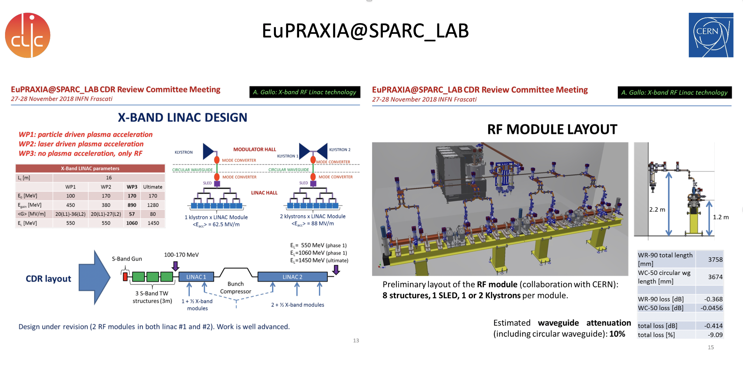
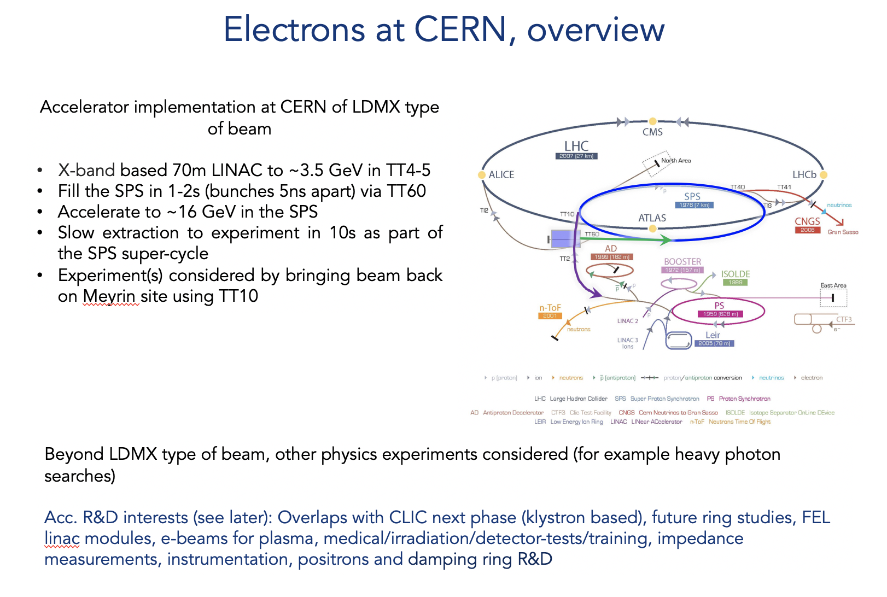

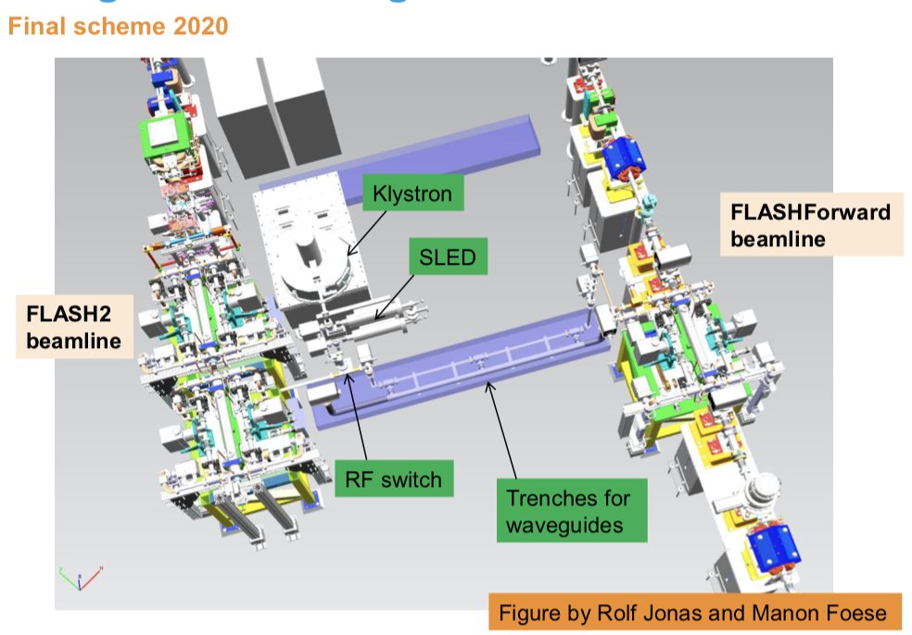
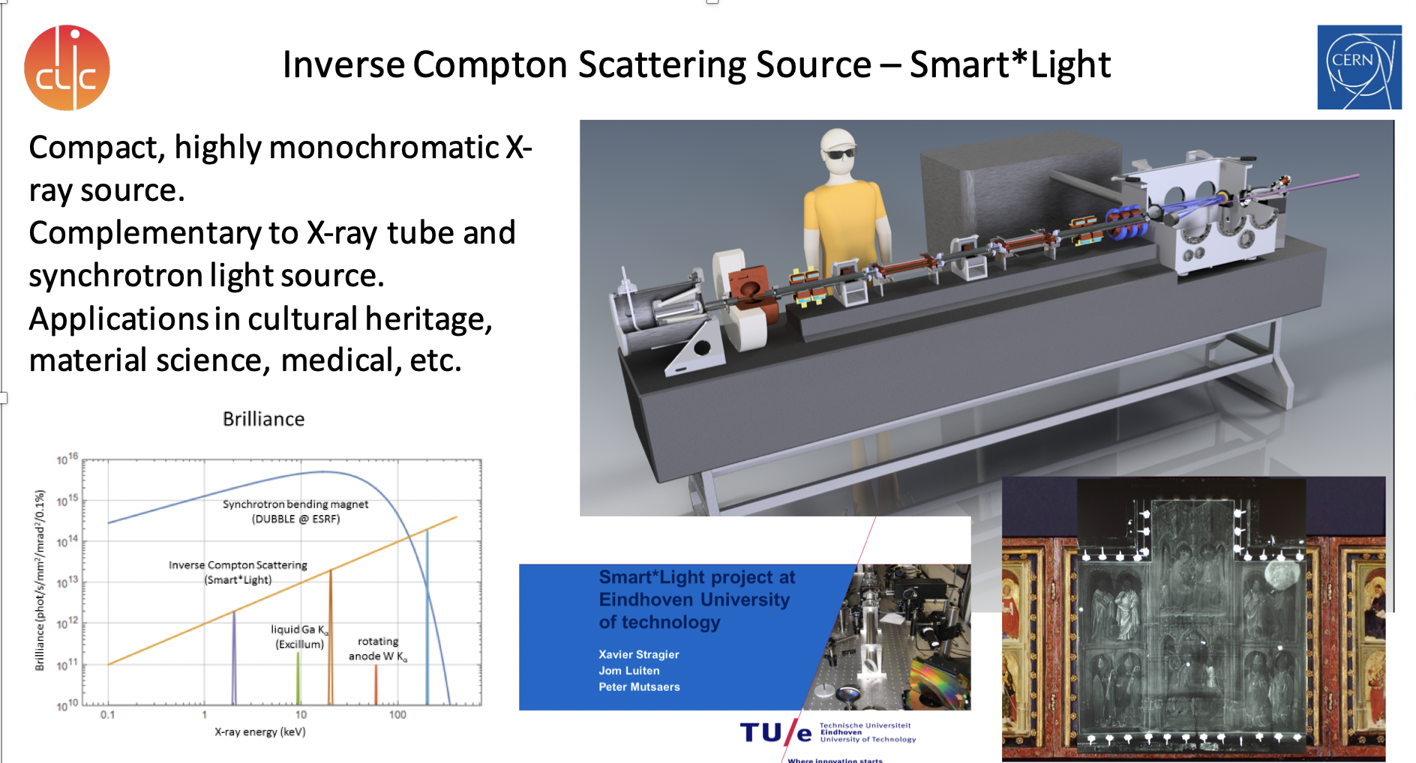
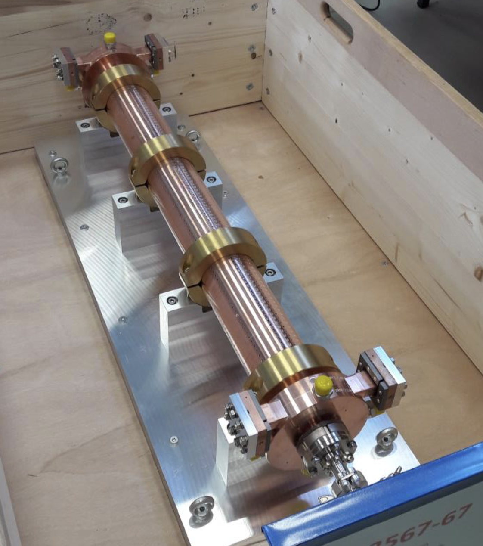
X-band
More about these initiatives (June 2019): https://indico.cern.ch/event/766929/timetable/#all
Elements in existing linacs (DESY, PSI)
Notes:
Add refs

Slide 12
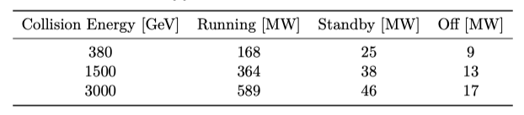
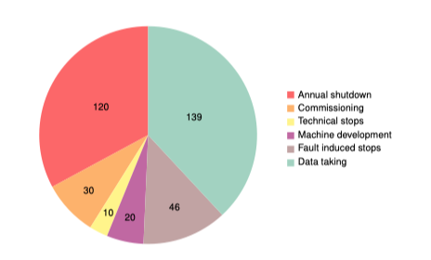
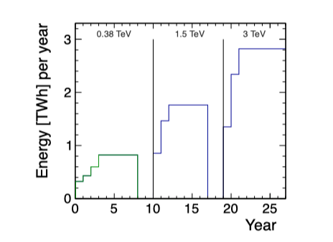
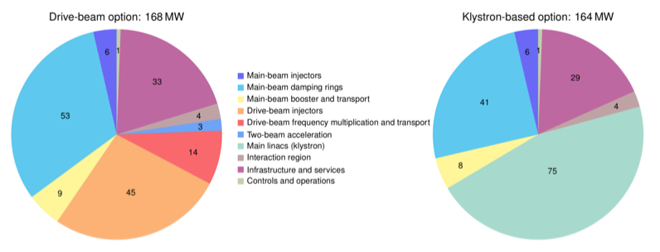
Implementing CLIC
Power estimate bottom up (concentrating on 380 GeV systems)
Very large reductions since CDR, better estimates of nominal settings, much more optimised drivebeam complex and more efficient klystrons, injectors more optimisation, etc
Further savings possible, main target damping ring RF
Will look also more closely at 1.5 and 3 TeV numbers next
From running model and power estimates at various states – the energy consumption can be estimated
CERN is currently consuming ~1.2 TWh yearly (~90% in accelerators)

Slide 13
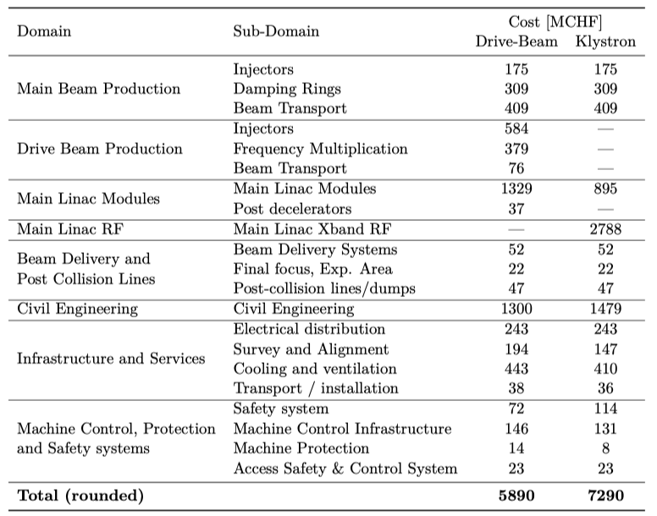
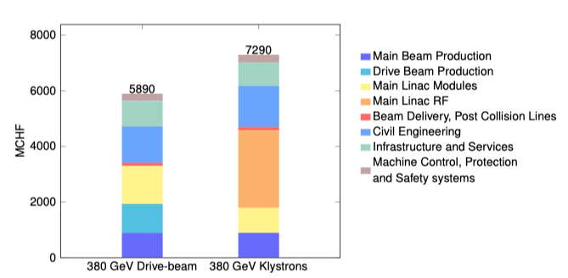
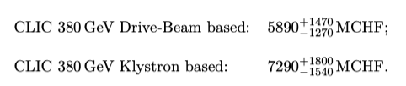
Cost - I
Machine has been re-costed bottom-up in 2017-18
Methods and costings validated at review on 7 November – similar to LHC, ILC, CLIC CDR
Technical uncertainty and commercial uncertainty estimated

Slide 14
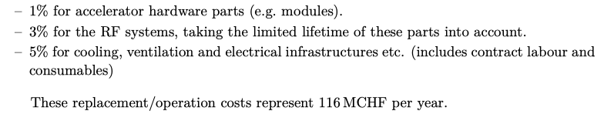
Cost - II
Other cost estimates:
Construction:
From 380 GeV to 1.5 TeV, add 5.1 BCHF (drive-beam RF upgrade and lengthening of ML)
From 1.5 TeV to 3 TeV, add 7.3 BCHF (second drive-beam complex and lengthening of ML)
Labour estimate: ~11500 FTE for the 380 GeV construction
Operation:
116 MCHF (see assumptions in box below)
Energy costs

Slide 15
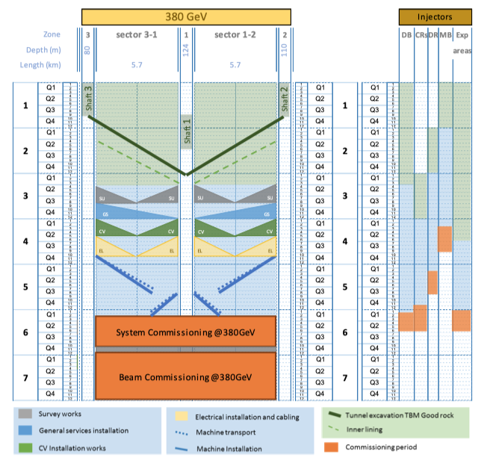
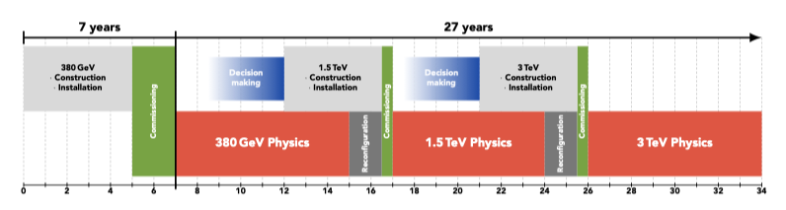
Schedule
Updated schedule:
Construction + commissioning for 380 GeV: 7 yr
Full physics programme 27 yr

Slide 16
Looong term future - NAT
Working group for use of Novel Acceleration Technologies (NAT) – plasma with various drivers, dielectrics, etc (short chapter in Project Implementation Plan document)
  Physics and accelerator parameters (luminosity in particular)
  Consider status of various studies
  Key challenges beam-quality, positrons, energy efficiency for suitable luminosities
Possible re-use of tunnel/infrastructure/drive-beams/injectors etc interesting for a LC infrastructure
The fact the actual effective ML might remain short (and hence possibly “cheap” and inter-changeable in a limited time) makes this long term perspective worth considering
Have not found any “constrains/guidance” from these very long term “hopes” that would impact the design of CLIC stages 1-3
  CLIC is laser-straight and with a “reasonable” crossing angle likely to compatible with higher beam energies and the bunch separations needed for these technologies

Slide 17
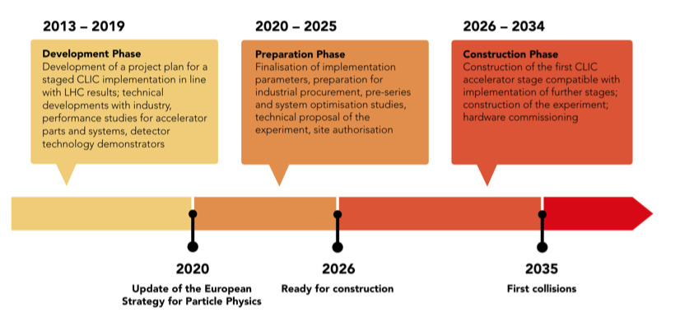
Next phase

Slide 18
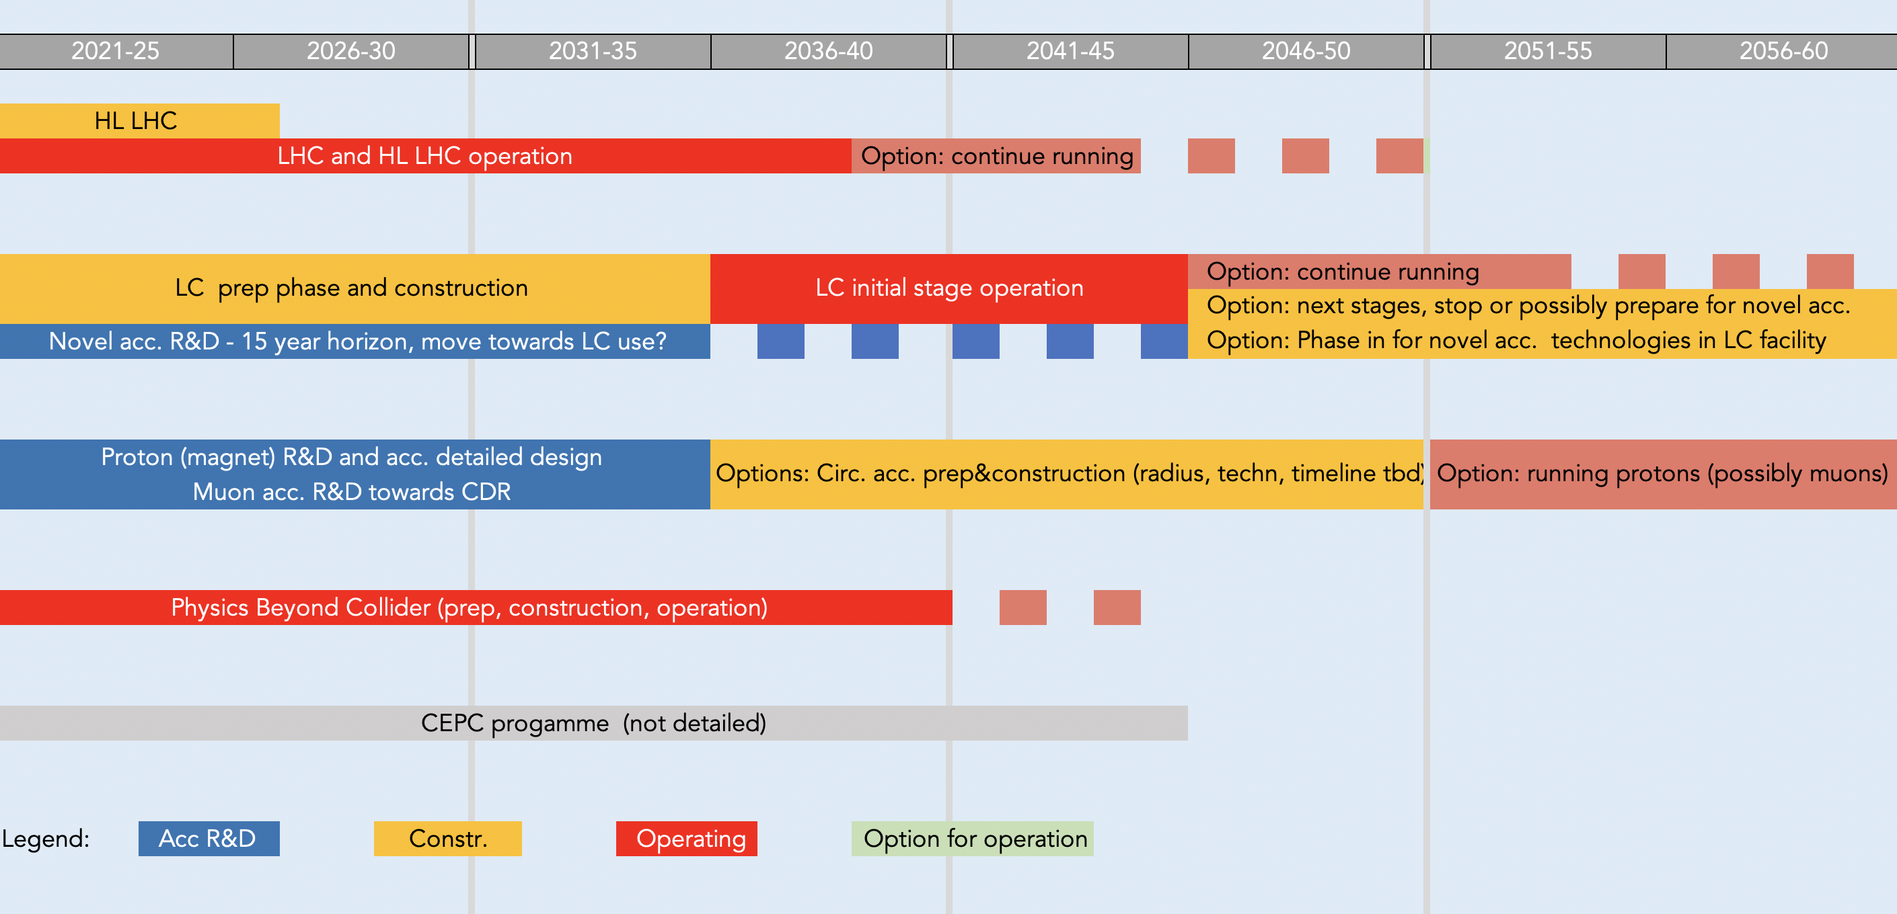
A linear collider as part of an overall strategy
HL LHC until ~2038
LC const. “ready”, affordable, provide opportunities for long term e+e- data
Acc. R&D opening for proton (possibly muon) colliders by/before 2050 – no 100 km constrain or wait for tunnel access (limited by R&D and funding)
PBC programme
CEPC development will unfold

Slide 19
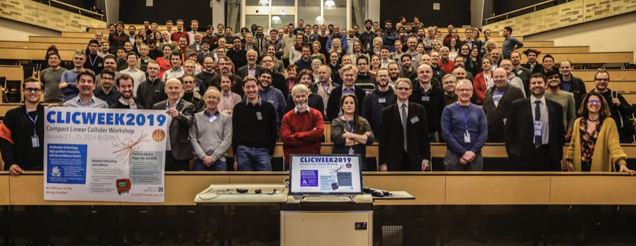
Summary
CLIC is now a mature project, ready for implementation
The main accelerator technologies have been demonstrated
The cost and implementation time are similar to LHC
The physics case is broad and profound, and being further developed (in this meeting)
The detector concept and detector technologies R&D are advanced (also in this meeting)
The full project status has been presented in a series of Yellow Reports and other publications: http://clic.cern/european-strategy
Thanks to all providing material - and more generally ALL contributors to the CLIC ESPP input/background documents , from which this material is drawn

Slide 20
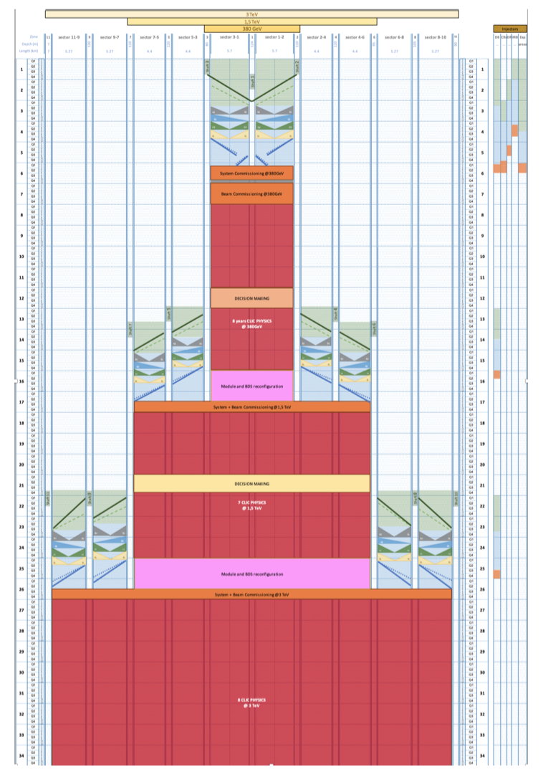
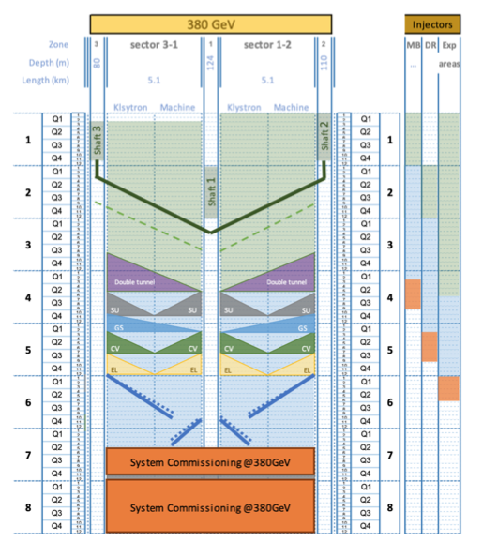
Klystron and overall schedules
More details

Slide 21
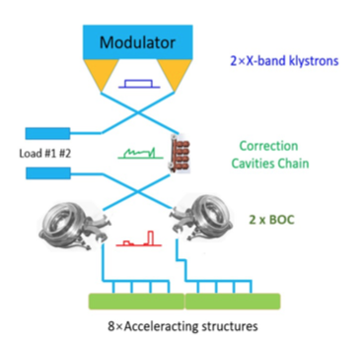
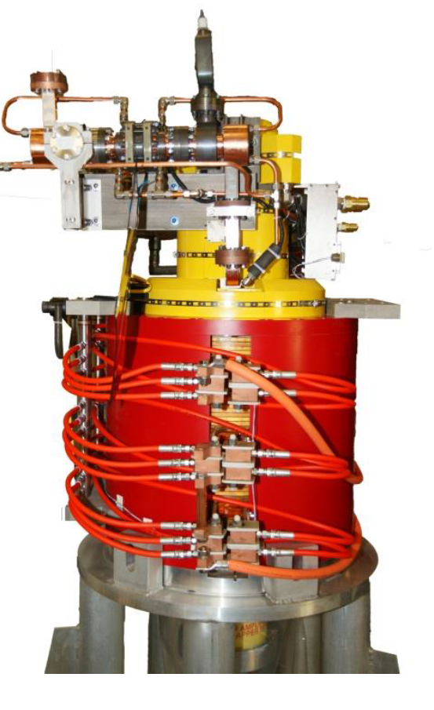
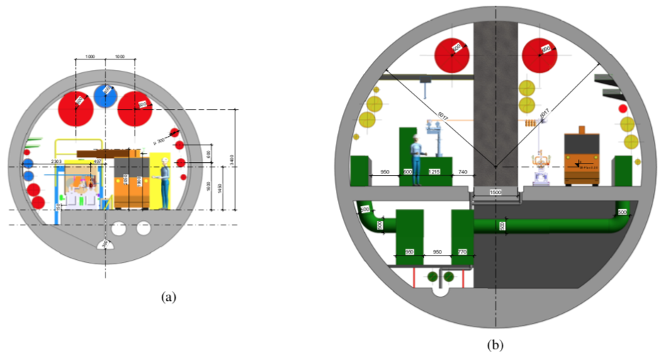




380 GeV klystron option
Replace drive-beam complex by local X-band RF power in tunnel
Larger tunnel, simpler module
Modulator
Klystron
Pulse compressor
Accelerating structures
XBOX3
Lines 1&2
Assembled X-band systems in continues operation at CERN
7
XBOX2

Slide 22



Civil Engineering and Infrastructure Studies
Important effort within:
Civil engineering
Electrical systems
Cooling and ventilation
Transport, logistics and installation
Safety, access and radiation protection systems
Crucial for cost/power/schedule

Slide 23
Power
Power estimate bottom up (concentrating on 380 GeV systems)
Very large reductions since CDR, better estimates of nominal settings, much more optimised drivebeam complex and more efficient klystrons, injectors more optimisation, etc
Further savings possible, main target damping ring RF
Will look also more closely at 1.5 and 3 TeV numbers next

Slide 24
Energy
From running model and power estimates at various states – the energy consumption can be estimated
CERN is currently consuming ~1.2 TWh yearly (~90% in accelerators)

