Slide 1



MCS in LH2 (Field-off)
Gavriil Chatzitheodoridis
PhD Supervisors: Dr. Kevin Ronald &
Prof. Paul Soler
Contents
LH2 path length method overview and results
X-Y Position from trackers and an attempt at accessing TOF space points
TOF Selection
Future work

Slide 2
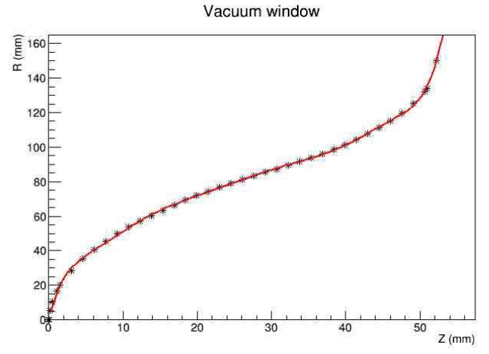

Vacuum & Absorber Al. windows
* Points: Geometry
Red line: Pol. fit
[1] [R.Connors et. al. 2014 LBNL "The Thickness Measurement of MICE Absorber Aluminum Window at LBNL, Report 1"]

Slide 3
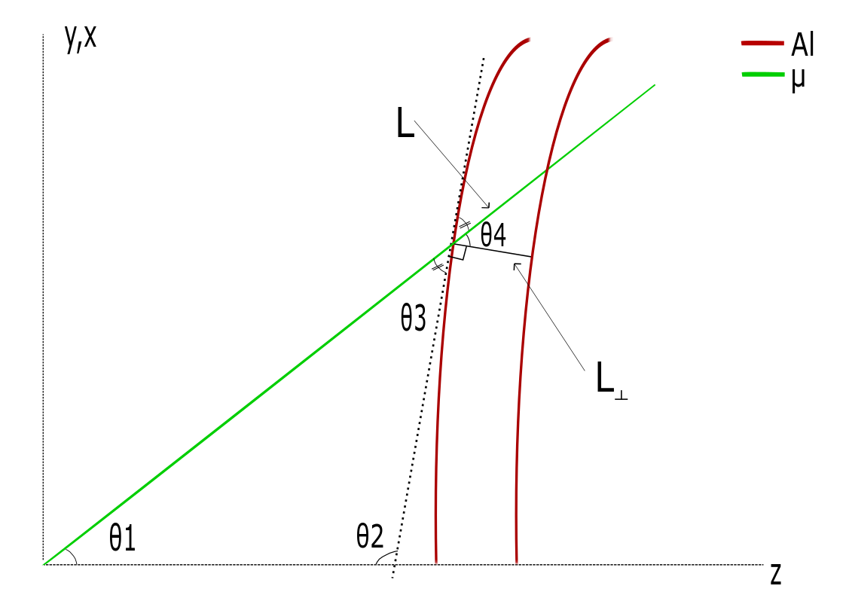
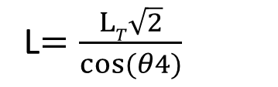
Aluminium, direction correction
Θ1=dx/dz, dy/dz
Θ2=π-(R2-R1)/(z2-z1)
Θ3=π-(θ1+θ2)
Θ4=π/2 – θ3
L$=\frac{LT\sqrt{2}}{cos⁡(θ4)}$
T

Slide 4
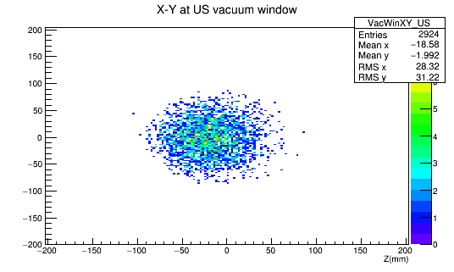
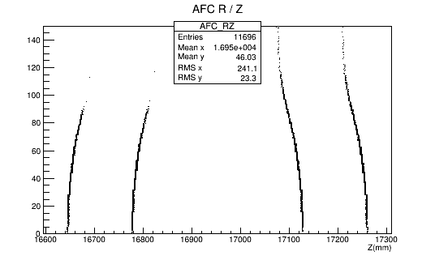
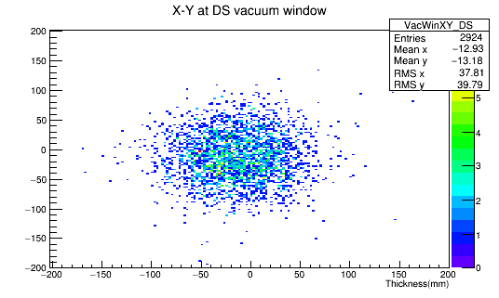
LH2 Path length method
Radius of muon-window interception
Radius (mm)

Slide 5
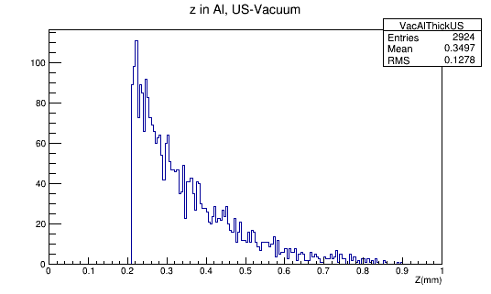
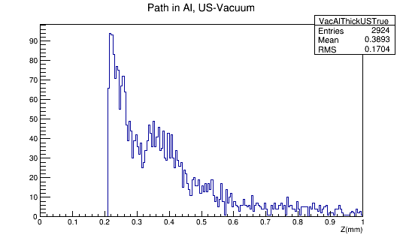
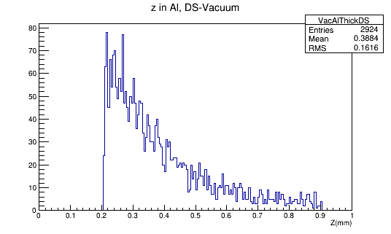
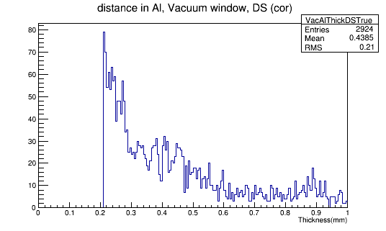
Aluminium path length
Thickness
With correction
US
DS

Slide 6
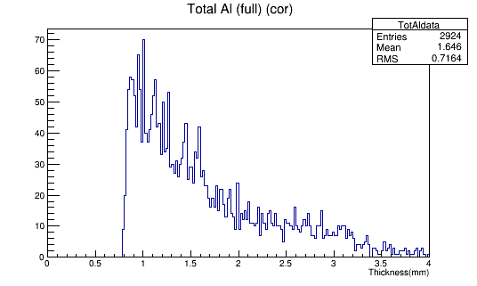
Total Aluminium path length
Total Al. in empty absorber run
Total Al. in full absorber run

Slide 7
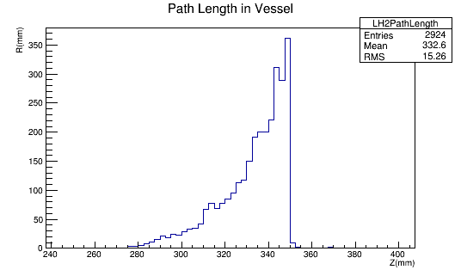
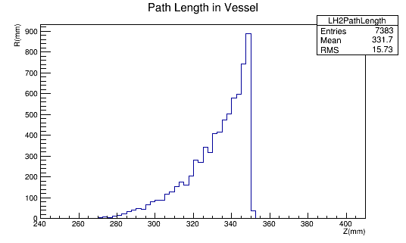
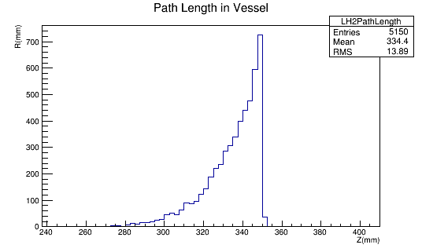
LH2 Path length - Results
170 MeV/c
200 MeV/c
240 MeV/c

Slide 8
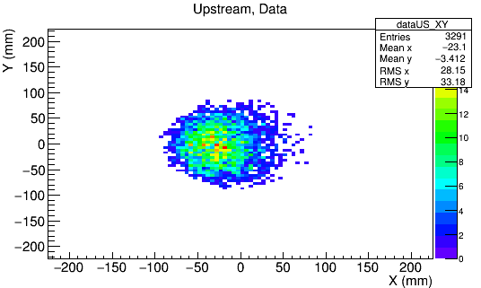
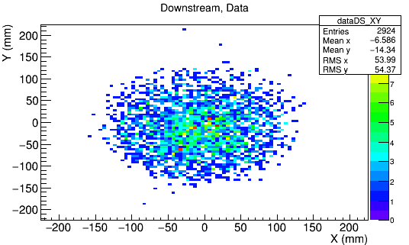
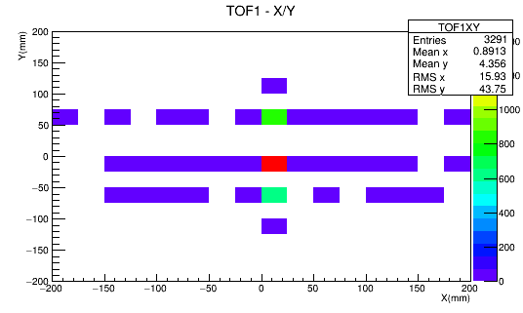
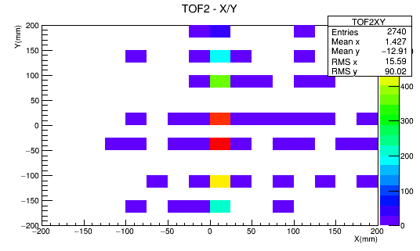
Attempt at TOF spacepoints – 170 MeV/c
US tracker, ref plane
DS tracker, ref plane
TOF1
TOF2

Slide 9
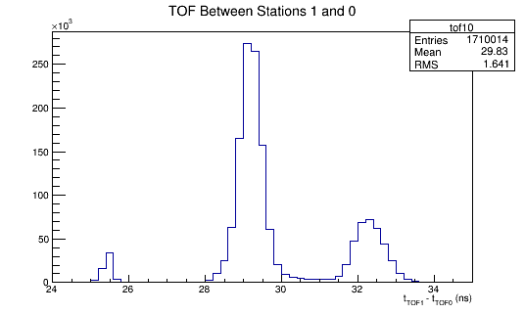
To do
TOF (momentum)
TOF & US tracker
Fiducial
Diffuser
TOF0 & TOF 1 hits.
1 US track
1 or no DS tracks
Momentum (MeV/c) | TOF (ns)
170 | 28.7→28.9
200 | 28.032→28.332
240 | 27.298→27.598
At DS-tracker:
R < 140mm
With 0.01mrad scattering
At diffuser:
R < 90mm
170 MeV/c

Slide 10
Future work
  Normalise angle distribution by LH₂ path length ( L/L_{R} )
  TOF scan to determine selection for correct momenta
  Uncertainty calculation method for path length
  Investigate the effect of different empty and full Aluminium path length on the convolution process
  Obtain TOF space points
  PID method

