Slide 1
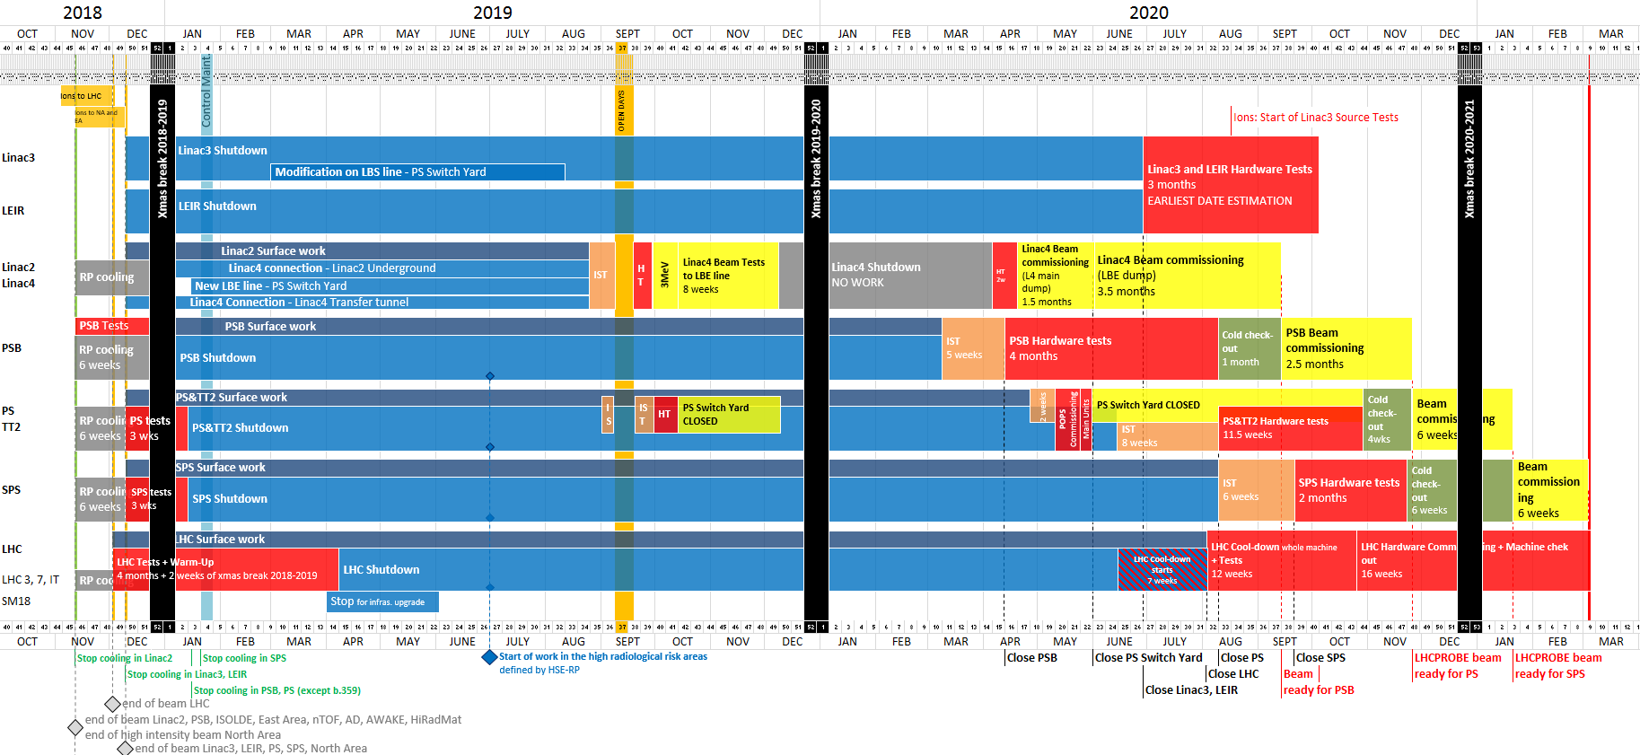
Introduction - Master Schedule v1.3
Periods with possible access restrictions
Periods with access restrictions
F. Pedrosa, PS LS2 Planning overview, LS2 Committee Meeting, 30/11/2018 (link)
More recent report at last LIU-PS Technical Coordination Meeting

Slide 2
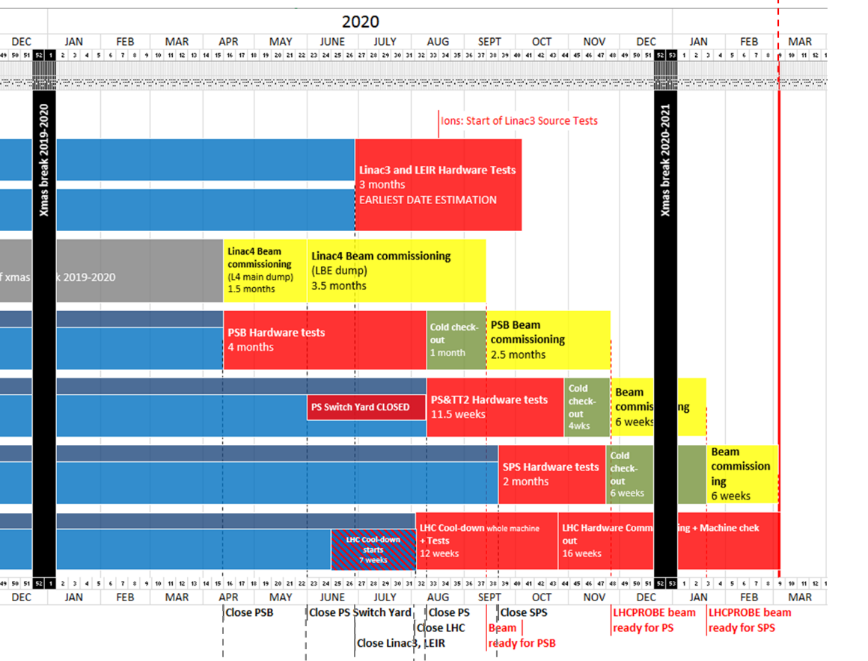
Restart schedule for the PS in 2020
LHCPROBE beam
available for LHC
Week 9
04/03/2021
Linac3
LEIR
Linac4
PSB
PS
SPS
LHC
LS2 is not 2 years for the PS!

Slide 3
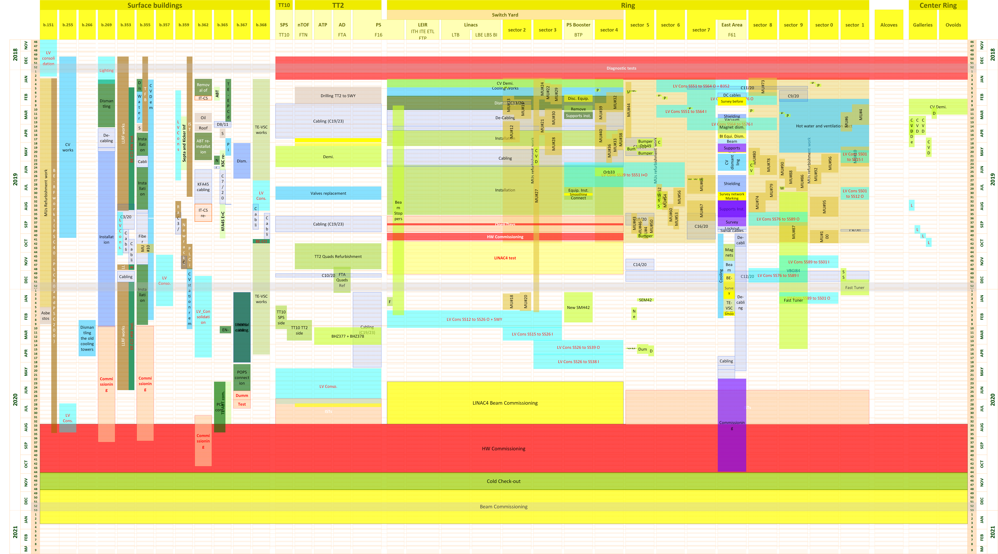
Co-activities in PS central building
F. Pedrosa, PS LS2 Planning overview, LS2 Committee Meeting, 30/11/2018 (link)
More recent report at last LIU-PS Technical Coordination Meeting

Slide 4
Preparatory work in coming weeks
Sort NIM modules
  Remove unused modules from spares cupboards
  Storage in separate cupboard or bunker
  Add modules removed from beam control during 2018
  Additional spares for 200 MHz from SPS
Clean-up racks
  \\cern.ch\dfs\Departments\AB\Groups\RF\Machines\PS\LowLevel\Infrastructure\RackPhotos\2018-12-19
  Obsolete measurement equipment
  Unused hardware
  Modules installed for MD purposes tests

Slide 5
Beam control upgrade
Updating synoptics
  \\cern.ch\dfs\Departments\AB\Groups\RF\Machines\PS\LowLevel\BeamControlUpgrade\Synoptics
List of modules for after LS2
  \\cern.ch\dfs\Departments\AB\Groups\RF\Machines\PS\LowLevel\BeamControlUpgrade\Modules
Start order material for upgrade

