Slide 1
MicroBlaze 32-bits Softcore CPU implementation in Fractional Divider
January 29th, 2019
Stéphane Rey – BE-RF-FB
Nathan Pittet – BE-RF-FB

Slide 2
FEATURES
32-bits RISC CPU running up to 200 DMIPS (600 MHz clock on Spartan-6)
32-bits Address bus extensible to 64-bits
Scalable peripherals and memory
AXI Interface (Advanced eXtensible Interface) with FPGA logic
I²C, QSPI, ethernet, UART, DMA, Timers, Interrupts, FPU,
C/C++ toolchain, RTOS capable (FreeRTOS, Linux, RREX…)
MicroBlaze
32-bits Processor Core
Ethernet
Timer
GPIO
Interrupt Controller
Cache
DMA
SPI
DDR controler
UART
I²C

Slide 3
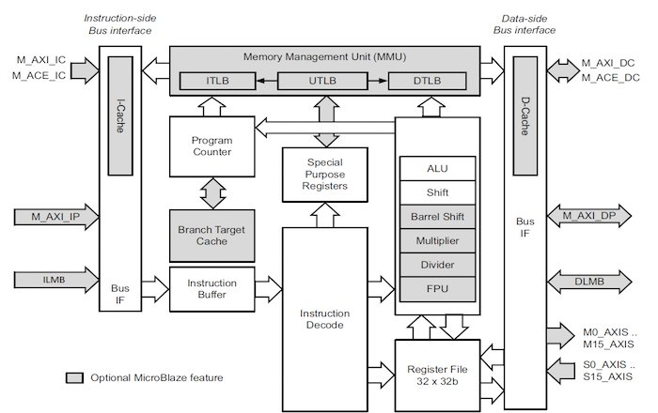
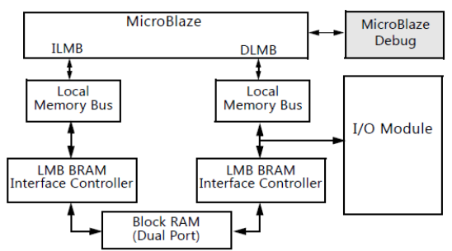
CPU ARCHITECTURE

Slide 4
BENEFITS
Easy to read and understand software (C/C++ langage)
Fast debug
Already made peripherals drivers (I²C, SPI, timers, ethernet, DMA, …)
Especially suitable for low-speed protocols and HMI peripherals (Displays, I/O devices, …), control and state machine applications

Slide 5
INTEGRATION
Communication between MicroBlaze and VHDL achieved through AXI interface
FEC
AXI
MEMMAP
VME Submap
AXI Memmap
slave
µBlaze
GPIOs
SPI, I²C
Ethernet
…
VME Interface
VME Submap
AXI
VHDL
processing
Submap
AXI Memmap
slave
FPGA

Slide 6
TOOLCHAIN
1
Cheby
sfd make import_memmap
Visual
Elite
memap.vhd
memap.xml
sfd make update_uBlaze_top
Chiptop.vhd
Ublaze_top.vhd
Ublaze.xmp
sfd make
XPS
2,6
4
uBlaze_wrapper.vhd
3
5
sfd make update_VisualWrappers
ISE
7
chiptop.bit
sourcecode.elf
8
9
SDK
sfd make
Sourcecode.elf
sfd make
update_SDKHWPlatform
download.bit
*.c
*.h
iMPACT
*.bit, *.mcs
Debug
10
To FPGA

Slide 7
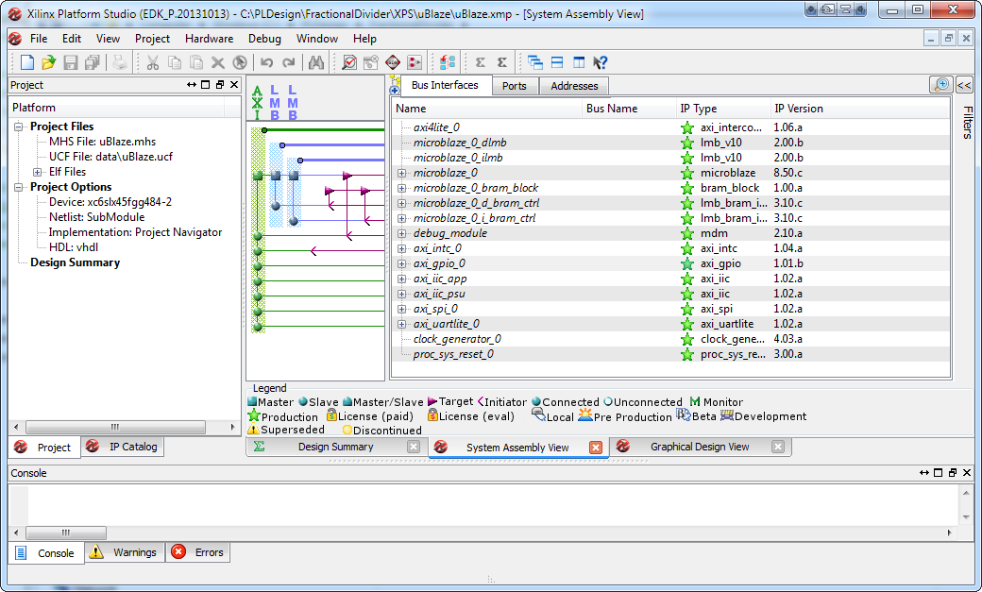
XPS – MICROBLAZE DEFINITION

Slide 8
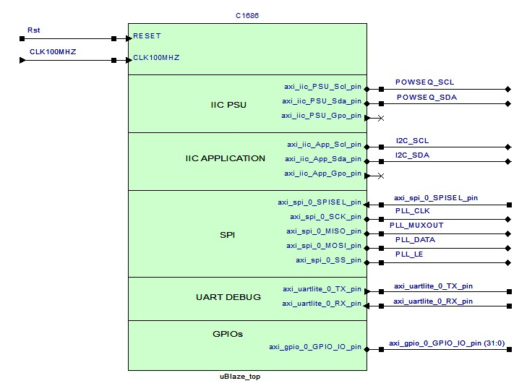
MICROBLAZE IN VISUAL ELITE

Slide 9
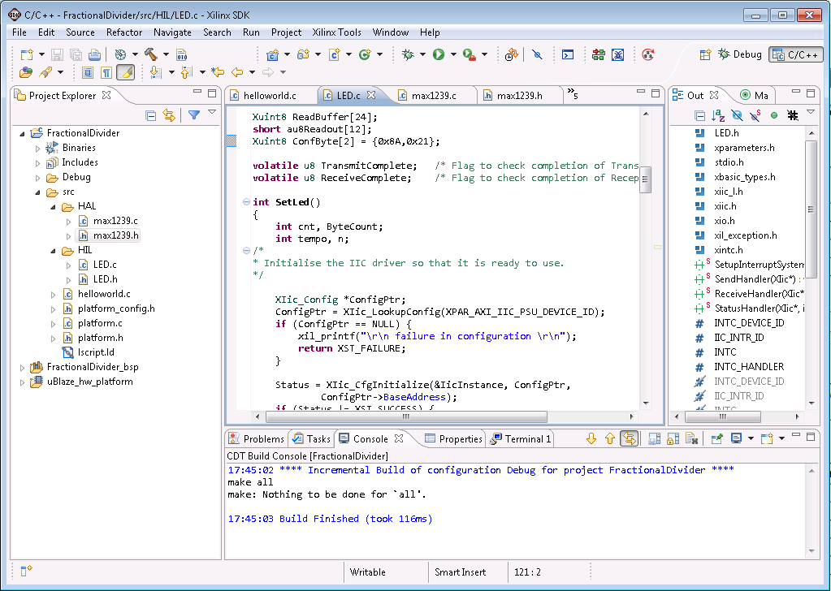
SFD – MICROBLAZE SOFTWARE

Slide 10
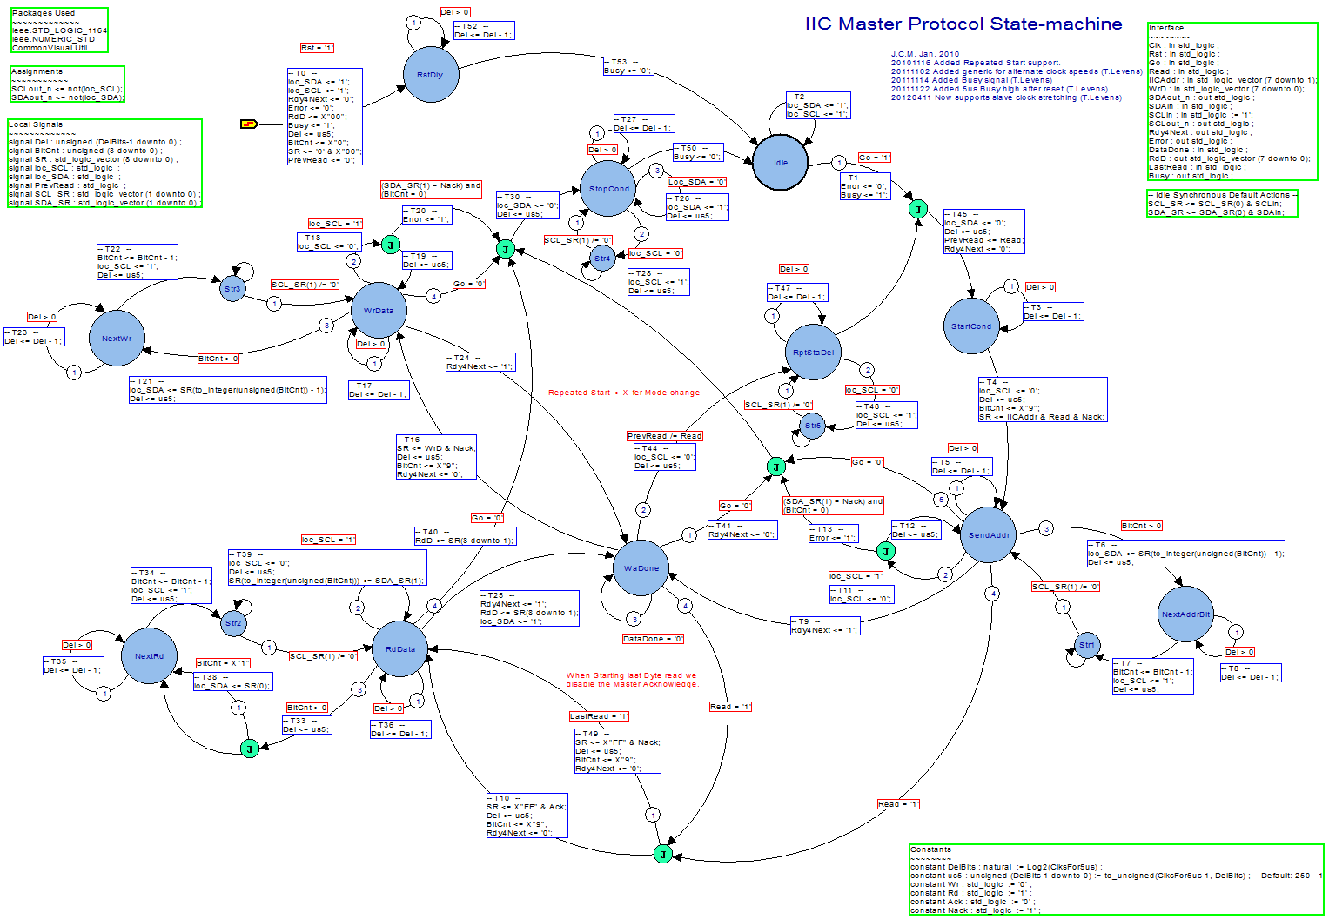
EXAMPLE : I²C USING VISUAL ELITE

Slide 11
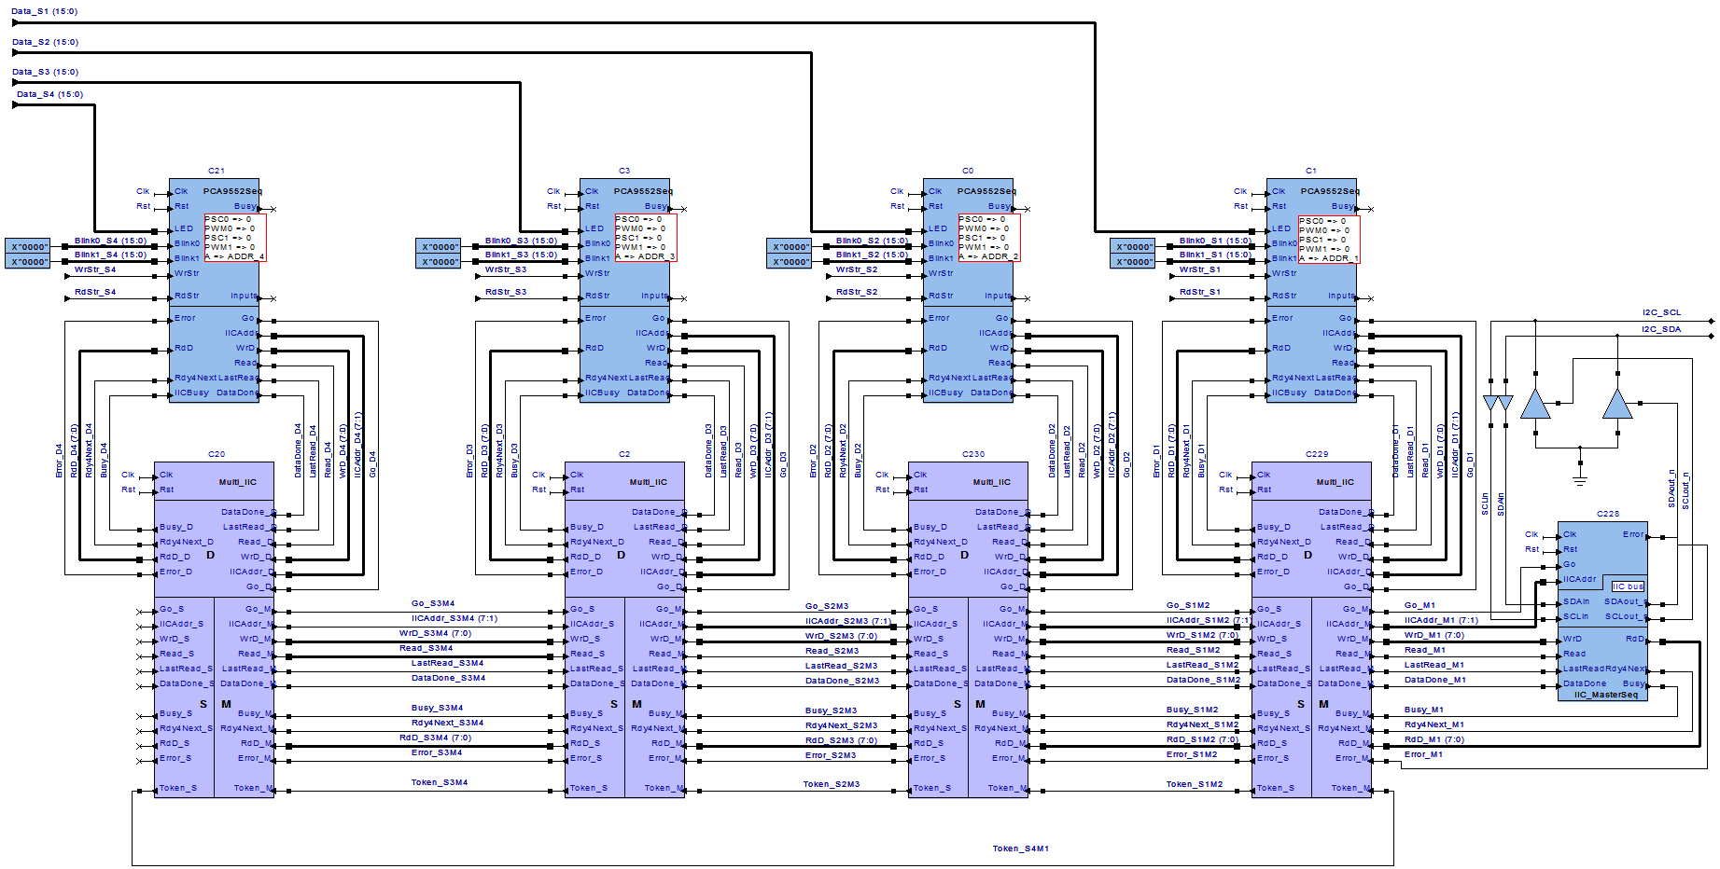
EXAMPLE : I²C USING VISUAL ELITE

Slide 12
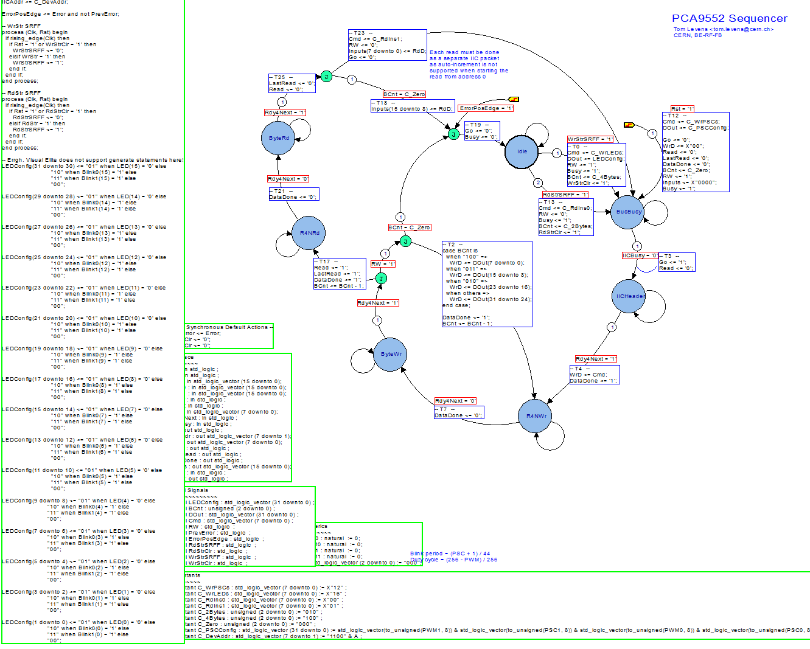
EXAMPLE : I²C USING VISUAL ELITE

Slide 13
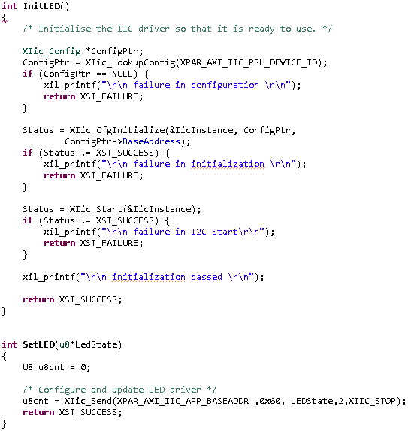
EXAMPLE : I²C USING MICROBLAZE

Slide 14
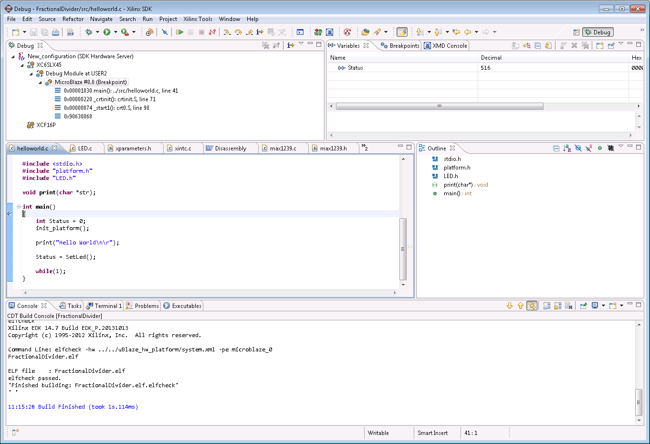
DEBUG WITH MICROBLAZE
Compilation and access to debug in few seconds

Slide 15
NEXT STEPS
Front-end to Microblaze bridge implementation
FPGA to Microblaze bridge implementation
OS (FreeRTOS, RREX) implementation

Slide 16
Thank you for your attention

