Slide 1

A hydrogen-filled TPC as an active target for a proton-radius measurement at CERN
Oleg Kiselev
GSI Darmstadt
EP seminar, CERN, 15.02.2019

Slide 2
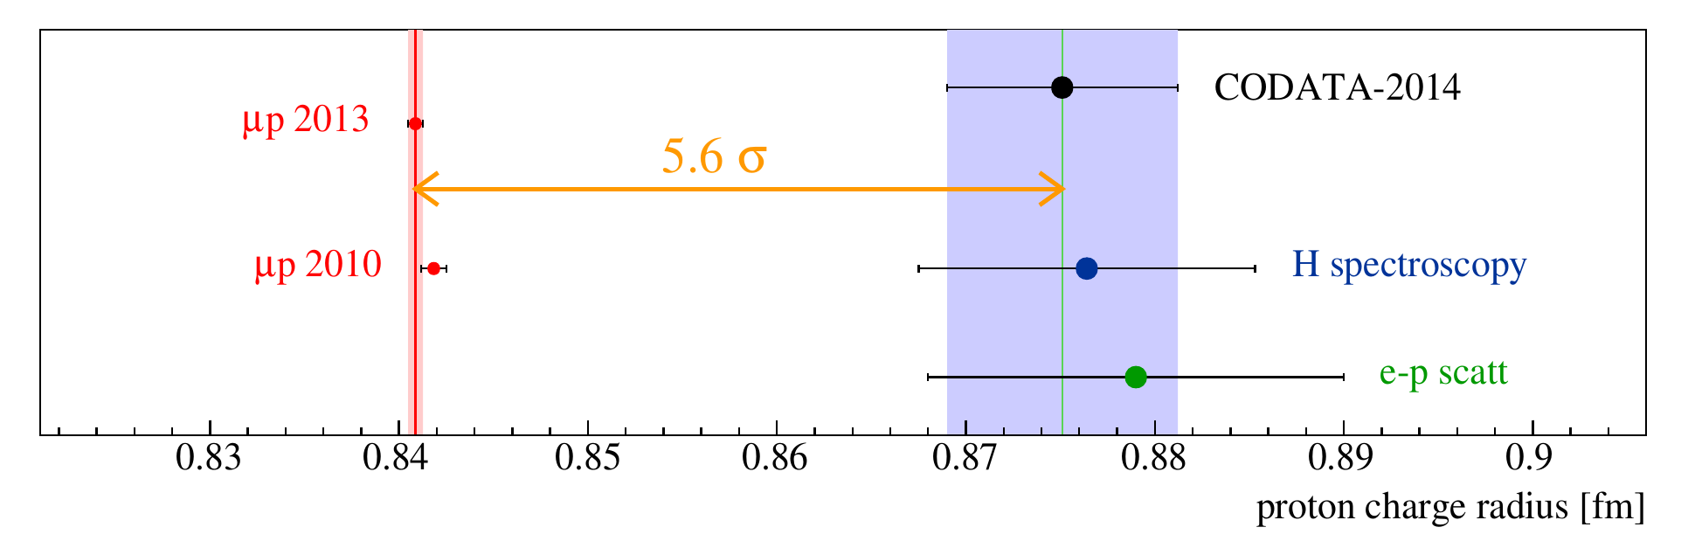
Proton radius puzzle
J. J. Krauth et al., 2017 [arXiv:1706.00696]
CODATA: ep-scattering, H- and D-spectroscopy
Too large discrepancy with muonic hydrogen experiment
Proton radius is an important value for nuclear and particle physics

Slide 3
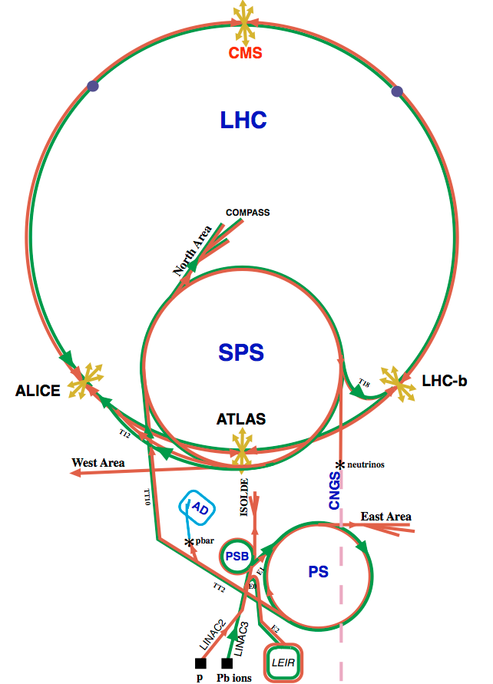
COMPASS apparatus
Versatile apparatus to investigate QCD:
Two-stage COMPASS spectrometer
1. Muon, electron and hadron beams with
momenta 20-250 GeV and intensities
up to 10⁸ particles per second
2. Solid-state polarised (NH3 or 6LiD), liquid hydrogen and nuclear targets
3. Powerful tracking (350 planes) and PID systems
(Muon Walls, Calorimeters, RICH)

Slide 4
Slope of the form factor vs radius
proton form factors G_{E} and G_{M}, shown as ratio to the dipole form factor G_{D}
High beam energy is an advantage
Muon is much heavier as electron → smaller radiative corrections
Wide Q² -range of 10⁻⁴–10⁻² GeV² to back-up possible models
Experimental challenges especially for low-Q²
With COMPASS one can measure scattering angles down to ∼0.1 mrad ↔ 10⁻⁴ GeV² and muon momentum
ratio of the cross section over the prediction for the cross
section using the standard dipole form factor.

Slide 5
High energy muons
J. Friedrich, TUM

Slide 6
New Letter of Intent
A New QCD facility at the M2 beam line of the CERN SPS: COMPASS++/AMBER

Slide 8
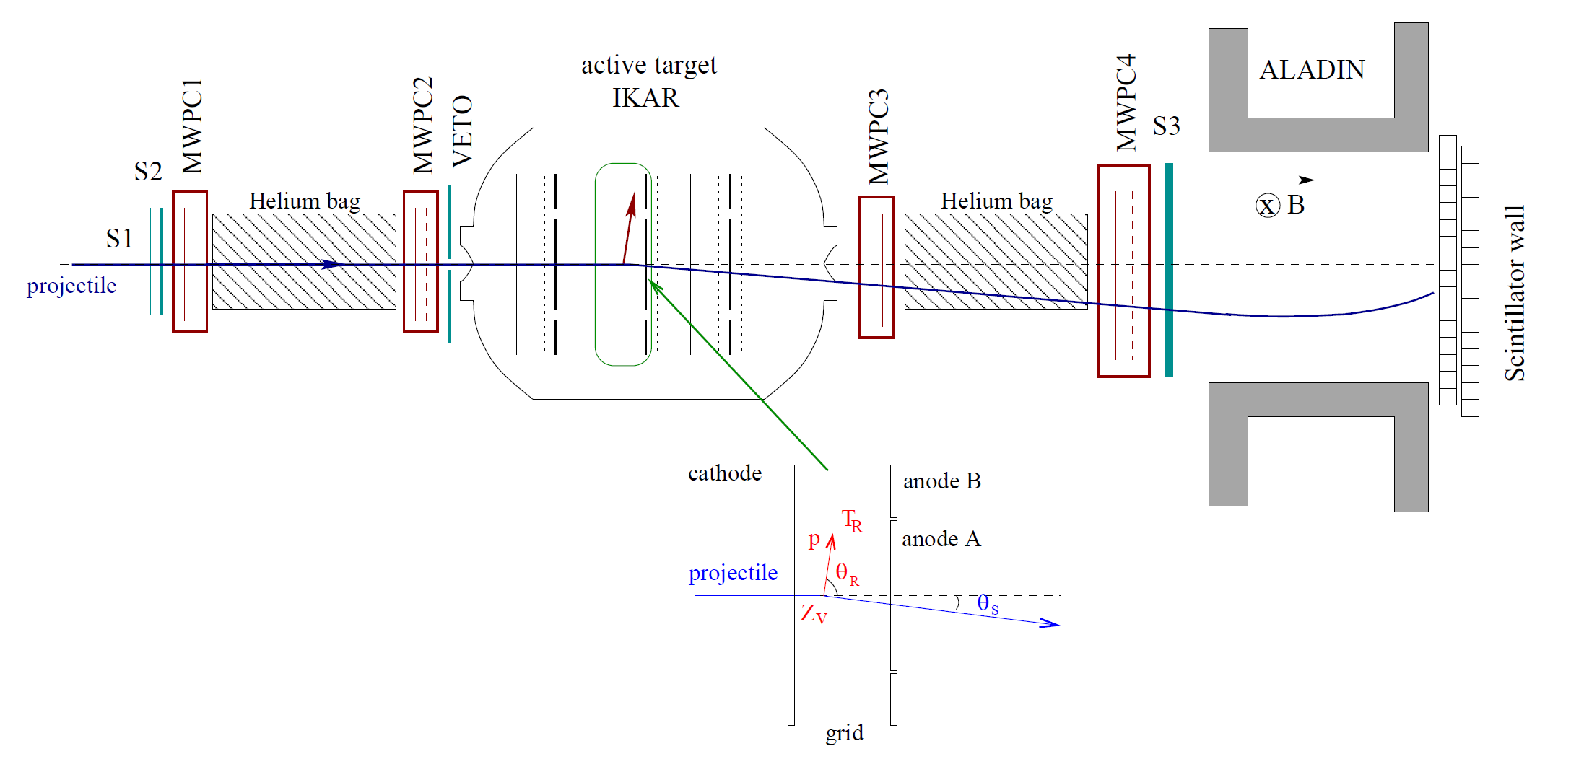
Setup with ionization chamber IKAR
Successfully used at PNPI, Protvino, CERN with protons and at GSI with radioactive ions
“Classical” ionization chamber, built at PNPI
Pressure up to 10 bar
Diameter of inner anodes – 20 cm, of outer – 40 cm
Normally filled with pure H₂ but D₂, He are also possible
6 independent detection modules in the same gas volume

Slide 9
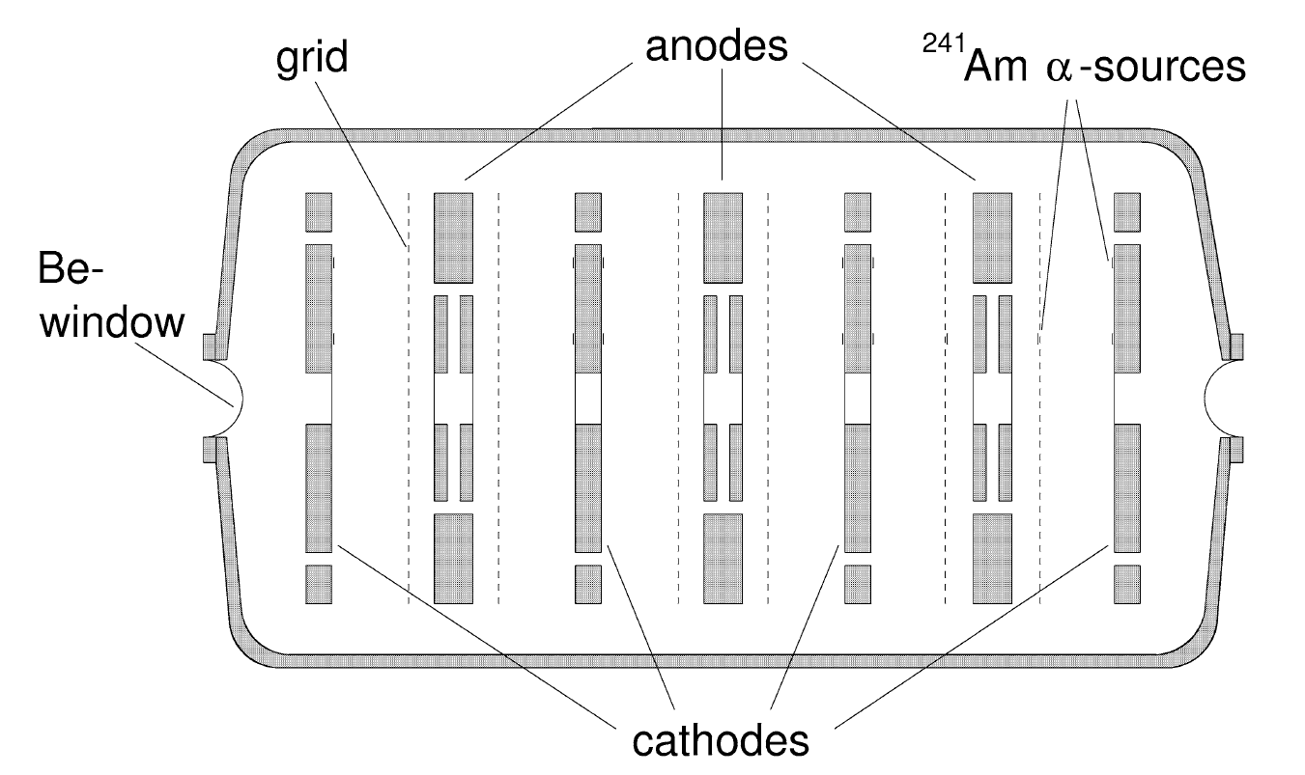
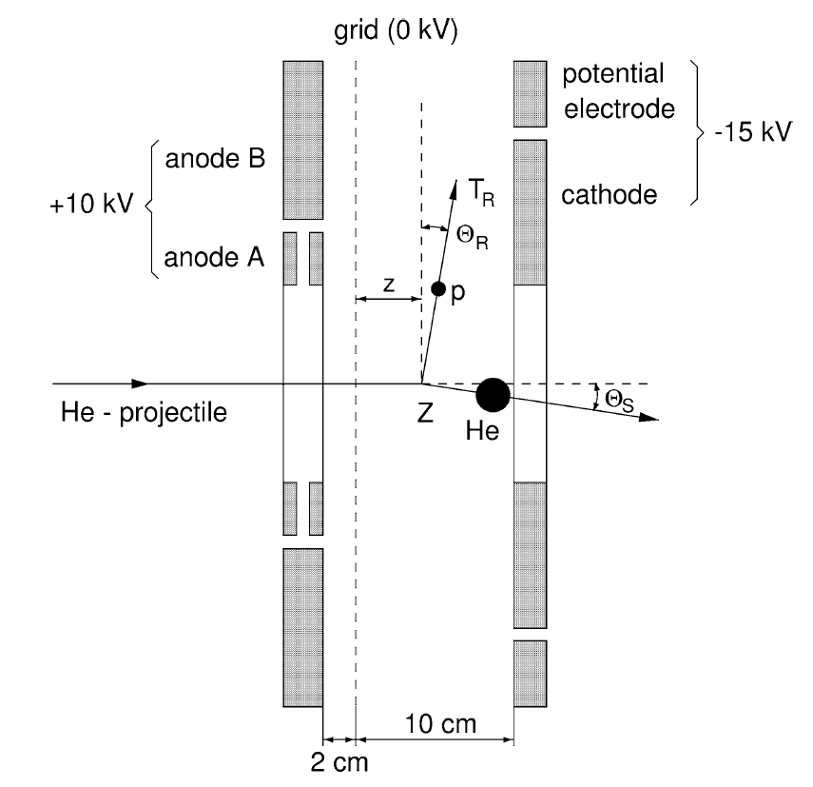
Active target IKAR
Electrodes out of Al, 140 µm
Be windows, 0.5 mm
Energy and time of drift measured by FADCs
Energy resolution – 35-40 keV
Energy threshold <100 keV
Dynamic range for protons – 5.2 MeV
Pulse shape analysis
integral - recoil energy T_{R}
risetime - recoil angle Θ_{R} (δΘ_{R FWHM} < 0.6°)
start - vertex point Z_{V} (δz_{FWHM} < 110 μm)

Slide 10
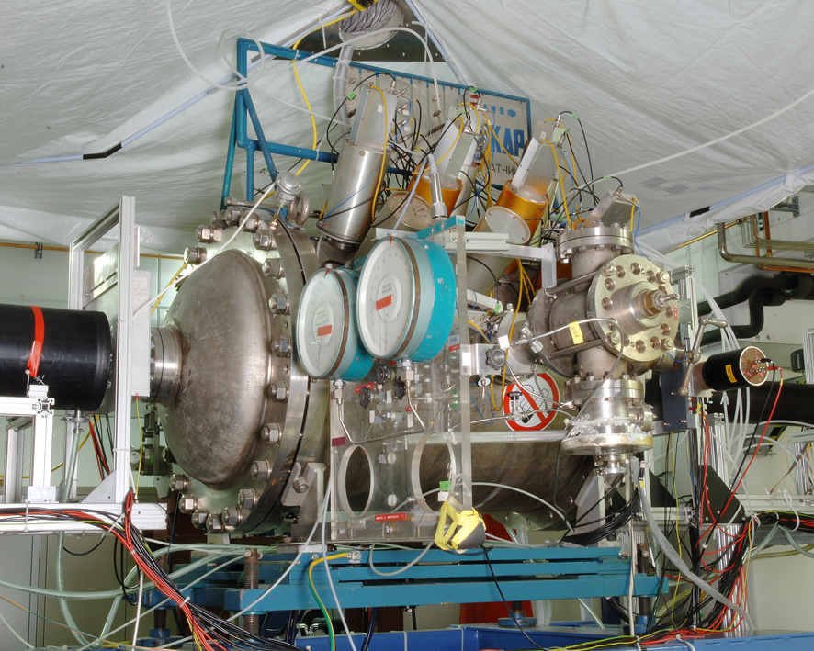
IKAR in Cave C

Slide 11
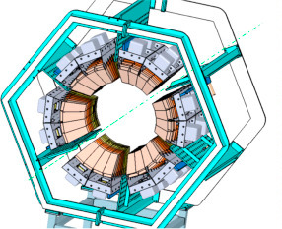

Active chamber ACTAF2/R3B inside calorimeter CALIFA
Investigation of low-lying dipole strength in inelastic α scattering
Experiments on stable nuclei show significant difference to (γ,γ‘)
Extension to unstable
nuclei in inverse
kinematics
Coincident determination of excitation and decay energy
Allows selection of decay channel
Clean separation of E1 excitation in (α,α‘γ) experiments
active target
γ
α
CALIFA

Slide 12
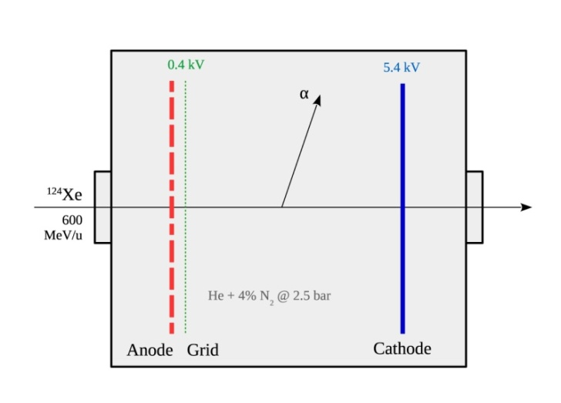
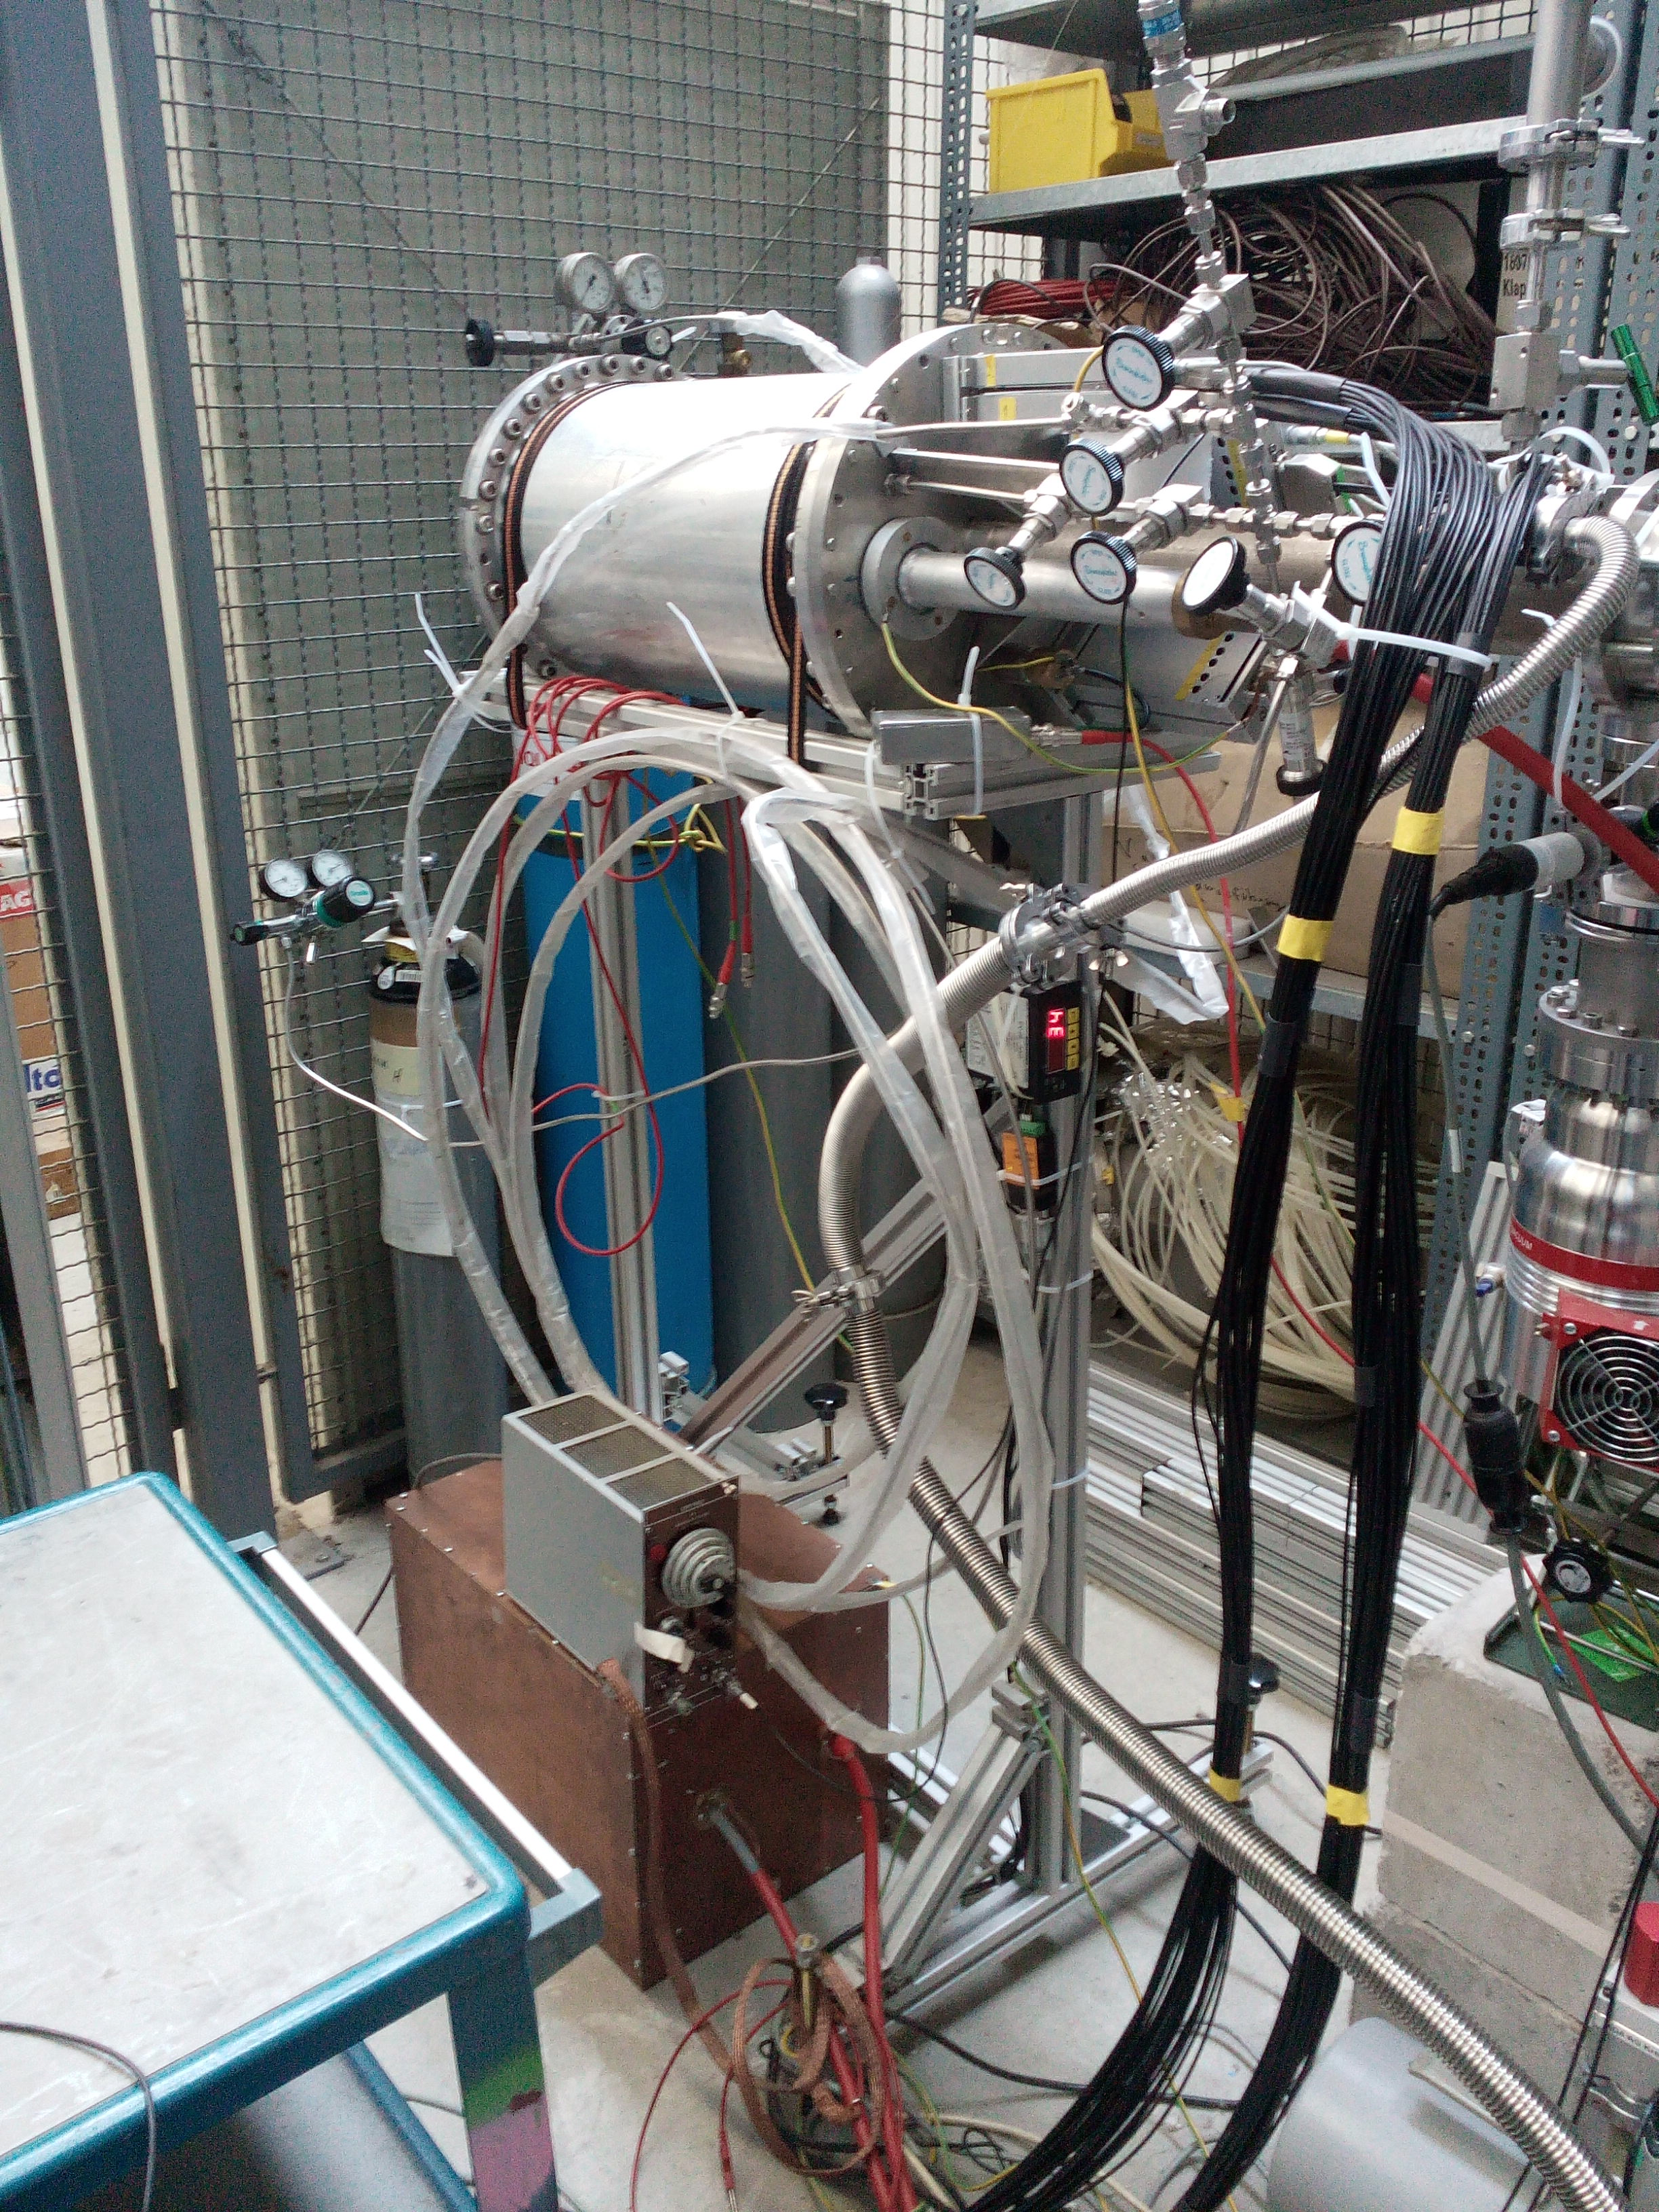
¹²⁴Xe(α,α') measurement with ACTAF2
Beam electrodes

Slide 13
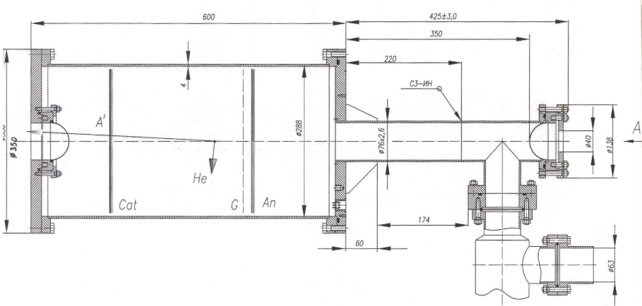
ACTAF2/R3B prototype – beam test at MAMI, 2017
Be windows of 0.5 mm thickness
Al
96% He + 4% N₂,
10 atm
T(e) = 720 MeV
stainless steel
4 Si Detectors 0.05 mm
(gaps of 50 mm)
Anode: 1.5 mm of G-10 & 0.02 mm of Cu
Cathode: 1 mm of steel & 0.02 mm of Al
z
Scintillators, 2 mm
13

Slide 14
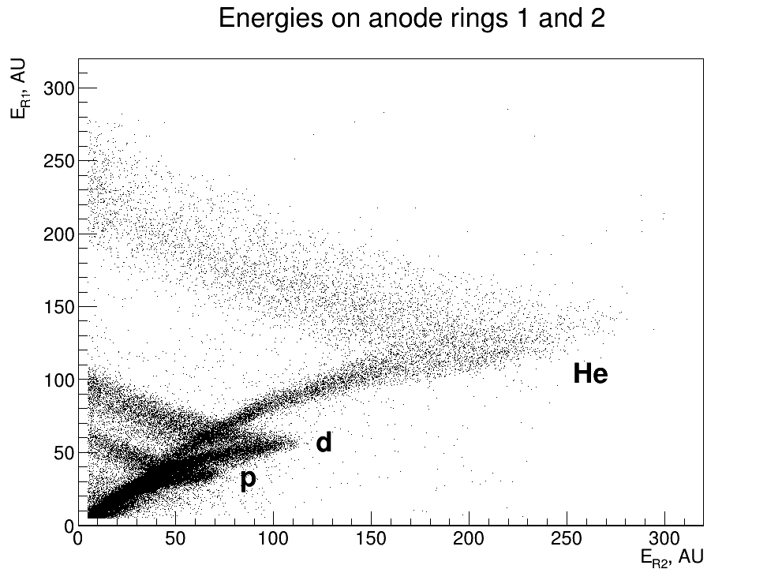
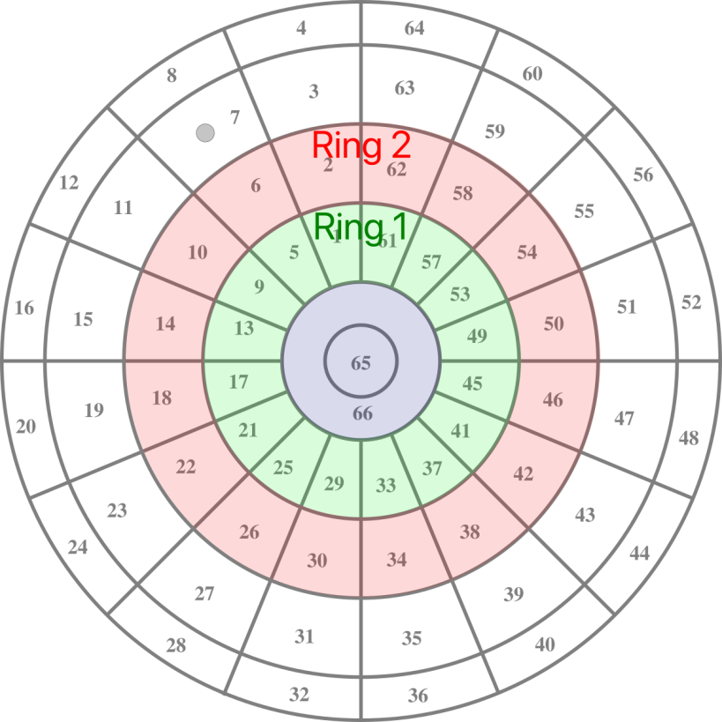
E-p scattering, energy correlations
Energies correspond to those calculated by SRIM
1 AU = 22 keV
14

Slide 15
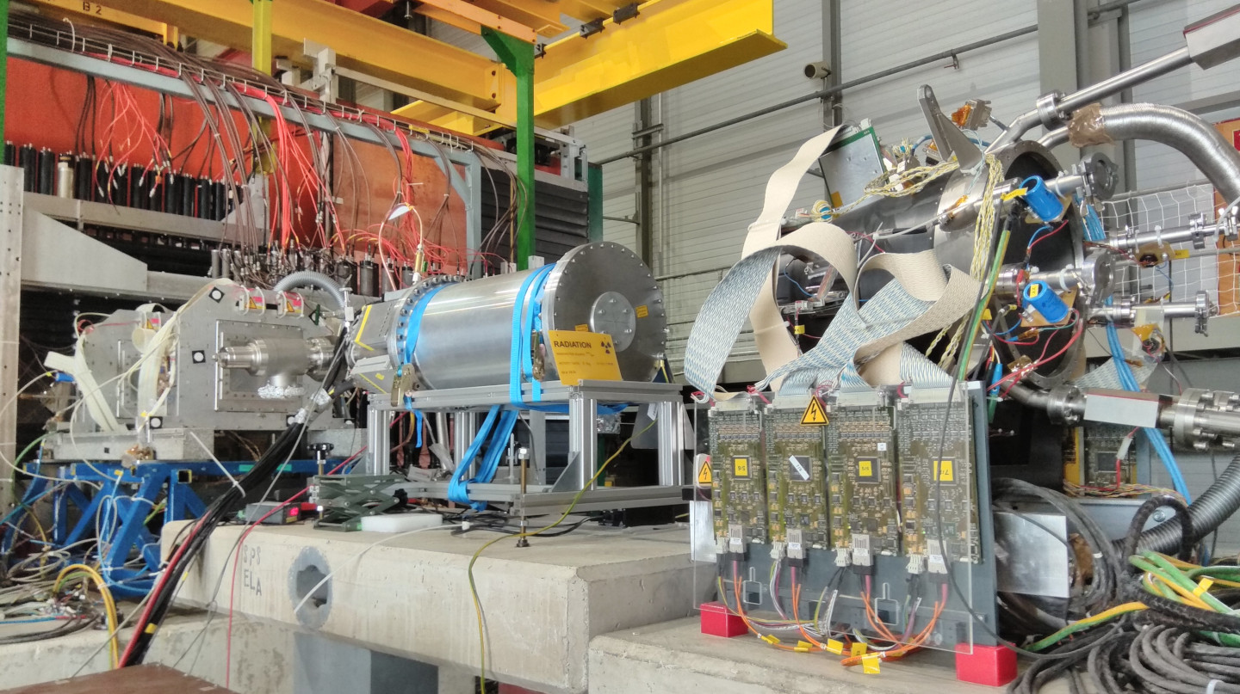
Test run with COMPASS, μ-p scattering
TPC between 4 tracking stations
Tracking via Si microstrip detectors
Muon rate – up to 2 MHz
E_{μ} = 190 GeV
Wide beam (RMS ≈ 20 cm)
Duty cycle: ~20% (spill — 5 s)

Slide 16
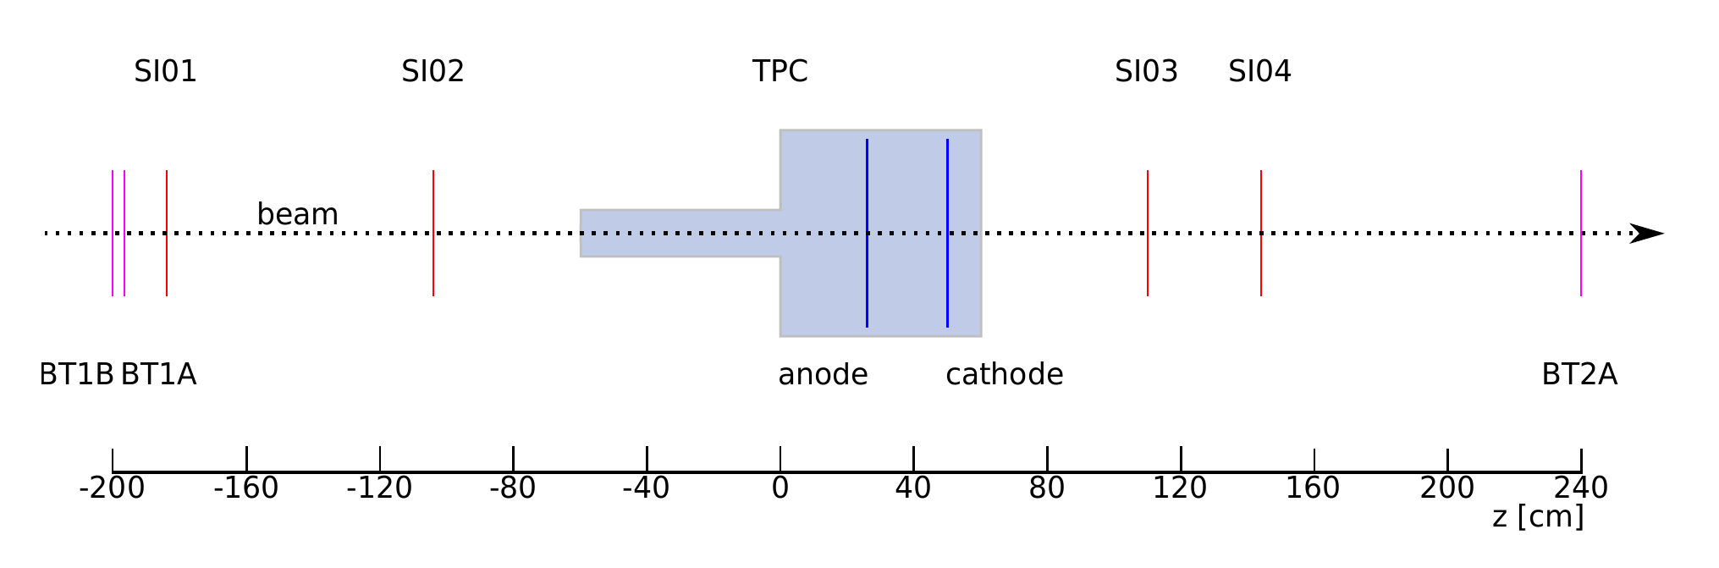
Scheme of feasibility test run, CERN, 2018
Beam rate studies, background
TPC as active target D = 200 mm
Scintillators (BT) 64x48 mm ×3
Si microstrip detectors (SI) 70x40 mm ×4, short baseline limits Q² ∼ 3x10⁻³ GeV²
TPC and the rest of the detectors use different DAQ, timestamped

Slide 17
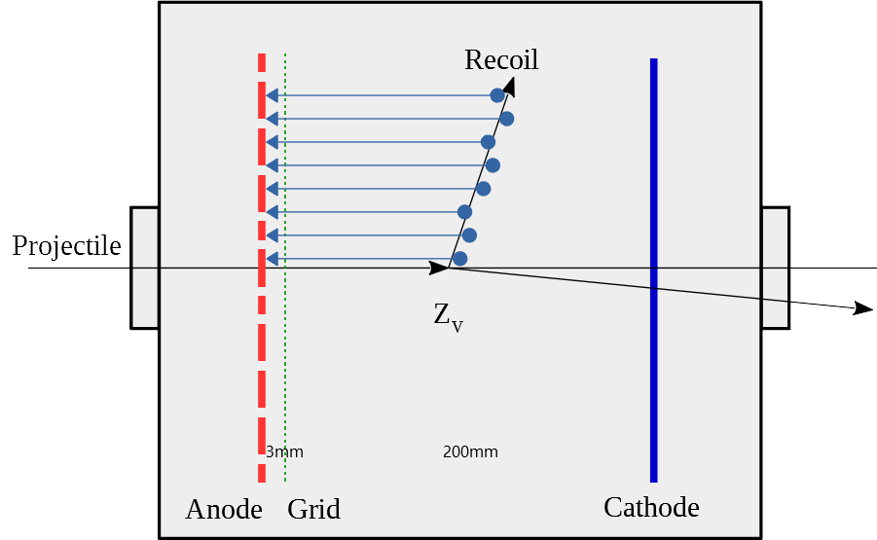
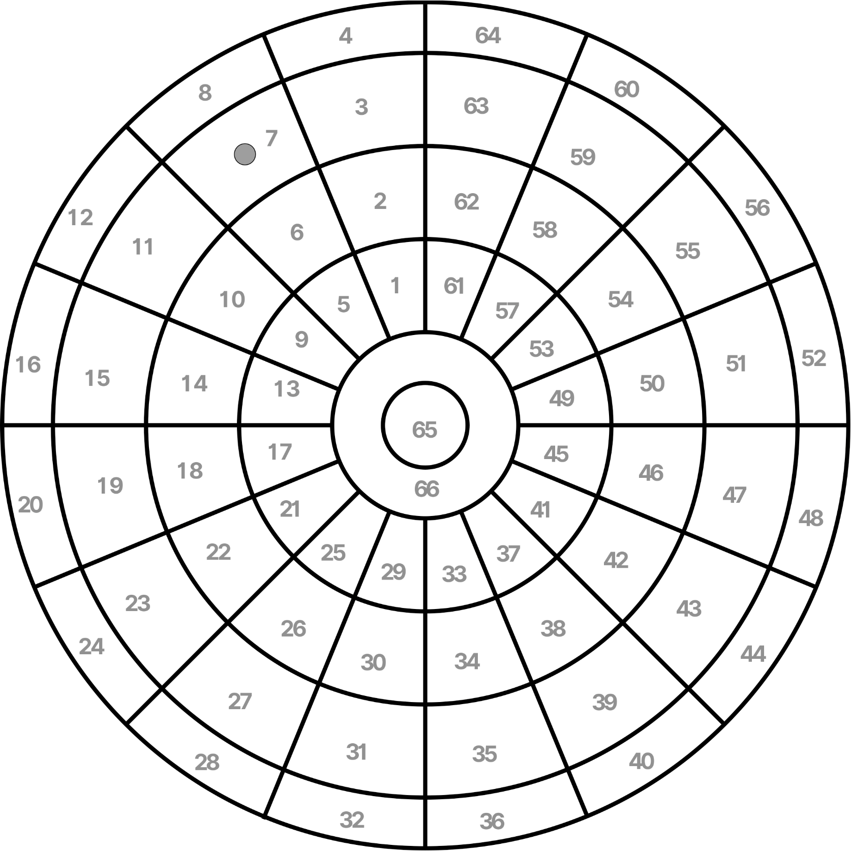
Test TPC structure
Gas: H₂ (purity 6.0)
p = 1, 4, 8 bar
L_{CG} = 220 mm
V_{C} = 18 kV
V_{G} = 1 kV
t_{CG} ≈ 60 μs

Slide 18
Preamplifier - shaper
PNPI, Gatchina
Low noise preamplifier
Best (up to now) available OA (AD891) for this setup
Signal shaping for better signal/noise
16-ch boards
No gas amplification -> very small signals

Slide 19
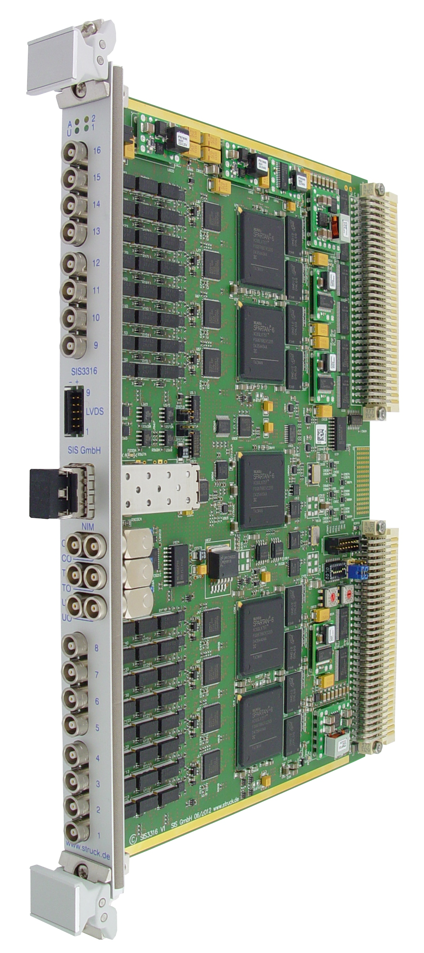
FADC
Struck SIS3316 VME FADC
14 bit @250 MHz (we use at 25 MHz)
5×16 channels
Range: -2,5 – +2,5 V
Modes: triggering or self-triggering
Clock PLL lock
Reading of raw ADC values or 2/4/8 points averaging
Energy threshold via Moving Average Window (MAW)
Readout via VME bus or optics
Raw data readout or signal processing with imbedded FPGA

Slide 20
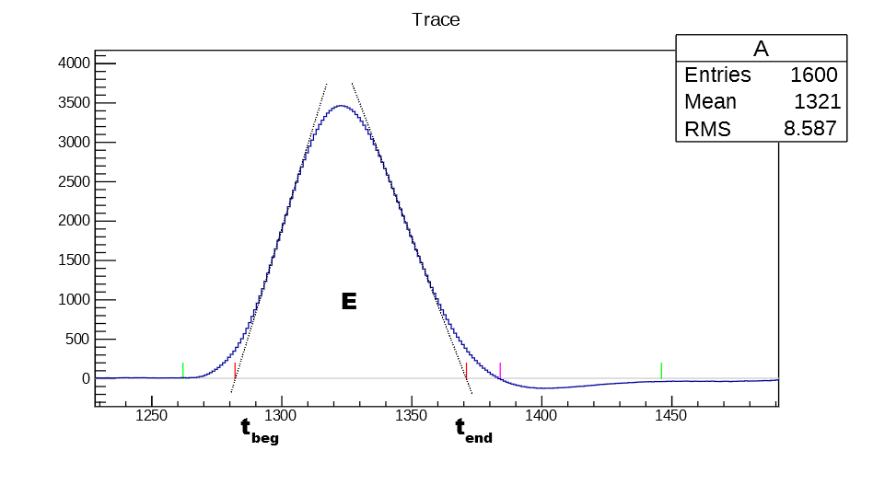
Waveforms
Waveforms have all information about the noise and signal
Energy/integral, time of signal, pile-up can be extracted

Slide 21

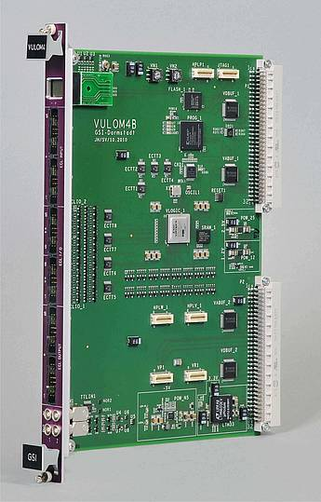
Timestamp/event syncronisation
TS @ 1.5 Hz
32 bit «watch/clock» @100 MHz
Sending to any device, saving the timestamps
Si DAQ – linear interpolation between the timestamps
Offline time stamps matching between Si and TPC events
Ch. Dreisbach, TUM
VULOM4B - logic module with FPGA

Slide 22
Events syncronyzed
Timestamp sync – TPC DAQ and Si/trigger DAQ
Files recorded independently, processed and sync offline
Width of the coincidence peak - drift time of the TPC (60 µs)
Primary vertex–Z correlation with the active volume of the TPC

Slide 23
Matched events – energy correlations
Ch. Dreisbach, TUM

Slide 24
Count rates during the test run
Detector TPC S* S_{e} Si*
Mean 16 Hz 64 kHz 640 kHz 22 kHz
Max 46 Hz 370 kHz 3.7 MHz 43 kHz
Events total: 4 600 000
With thr. 300 keV: 1 100 000 With thr. 200 keV: 3 500 000
8 bar: 4 290 000 4 bar: 310 000
* area - 10% of full anode area of TPC
TPC has a self-triggering, independent DAQ
Raw waveforms possible to store

Slide 25
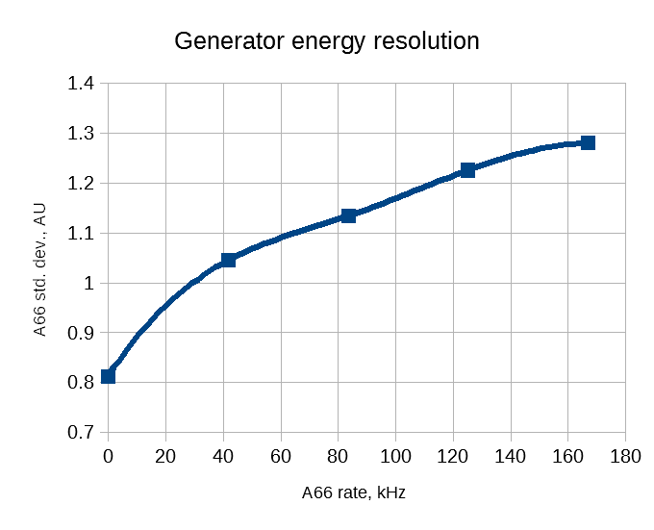
TPC energy resolution vs beam rate
Threshold 200 keV and
lower possible
Test pulses injected to all anodes at the same time
Measured vs beam intensity
At 300 kHz beam rate energy resolution ∼40 keV

Slide 26
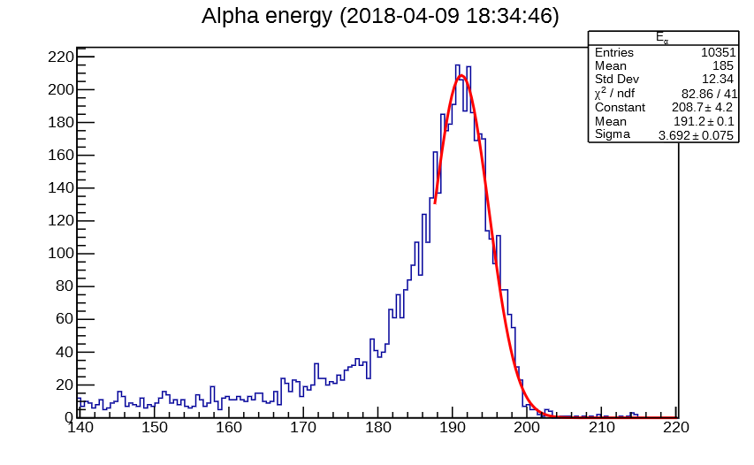
Gas quality check during each experiment
α-spectrum measured several times per day
Shift of the maximum ~1%/day (~1 ppm O₂)
Refilling – once per week

Slide 27
Vertexes from the Si tracker
All cuts applied All cuts except z position
Ch. Dreisbach, TUM

Slide 28
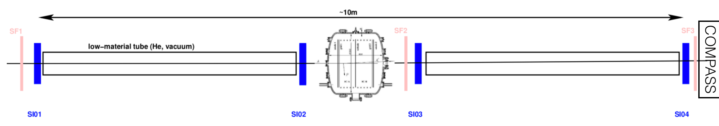
Main experiment at CERN
Beam size: σ ≈ 8 mm
Energy: 100 GeV
Scattering angles: 0.3 – 2 mrad (Q² = 0.001–0.04 GeV²/c²)
Base: 5 м — scattering 1.5 – 10 mm
Si detectors Δx < 10 µm (Δθ < 2 μrad at 5 m)
New fast electronics fro the Si detectors
Scattering trigger («kink trigger» — SciFi detector)
New active target: diameter — 800 мм, 20 bar H₂
EU ATTRACT grant is
requested (GSI – TUM)

Slide 29
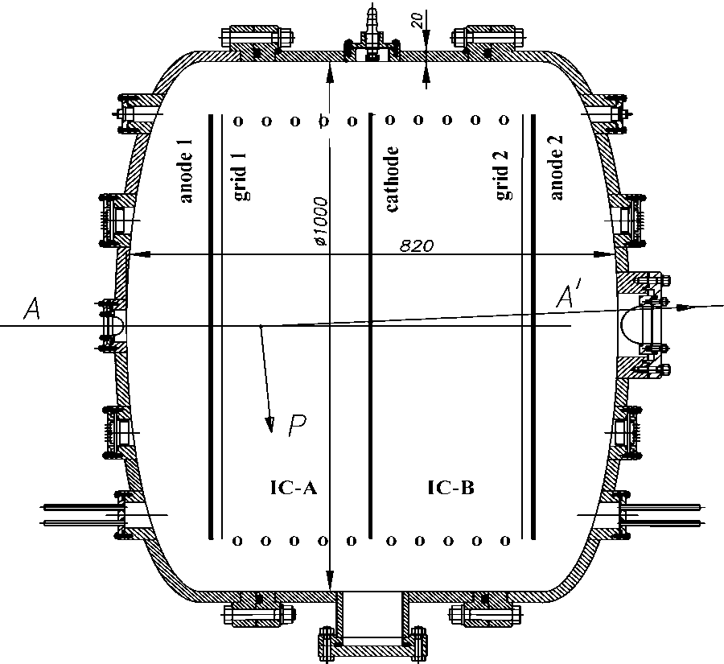
Large TPC as active target
820 mm long, inner diameter 1000 mm
Total volume 600 liters
Internal surfaces electrically polished
Gas pressure up to 20 bar
Spherical Be beam windows
HV up to 80 kV
E_{p} = 0.5 – 20 MeV
HV, pressure, temperature measurements with precision 0.01% → target density precision and drift velocity with precision 0.02%
Laser system for
drift velocity control

Slide 30
Momentum transfer requirements
Ch. Dreisbach, TUM
TPC minimum - Q² = 10⁻⁴ – 10⁻⁵ GeV²/c², depending on pressure

Slide 31
J. Friedrich, TUM

Slide 32
Plans and beam time request

Slide 33
Summary
Application of ionization chamber (without gas amplification) as an active target for the elastic proton scattering at high and intermediate energies is very powerful method to study the nuclear matter distribution
Similar technique can be used for µ-p experiments aiming the measurement of the proton radius with high precision
Test experiment shown feasibility
Background and useful rate is measured and acceptable
TPC can run with independent from COMPASS DAQ, timestamp technique is proved
Large baseline for the Si tracker and using He tubes is crucial
New SciFi detectors need to be developed
New setup can be ready for the test run in 2021 and for main run in 2022 (funding dependent)

Slide 34
Backups

Slide 37
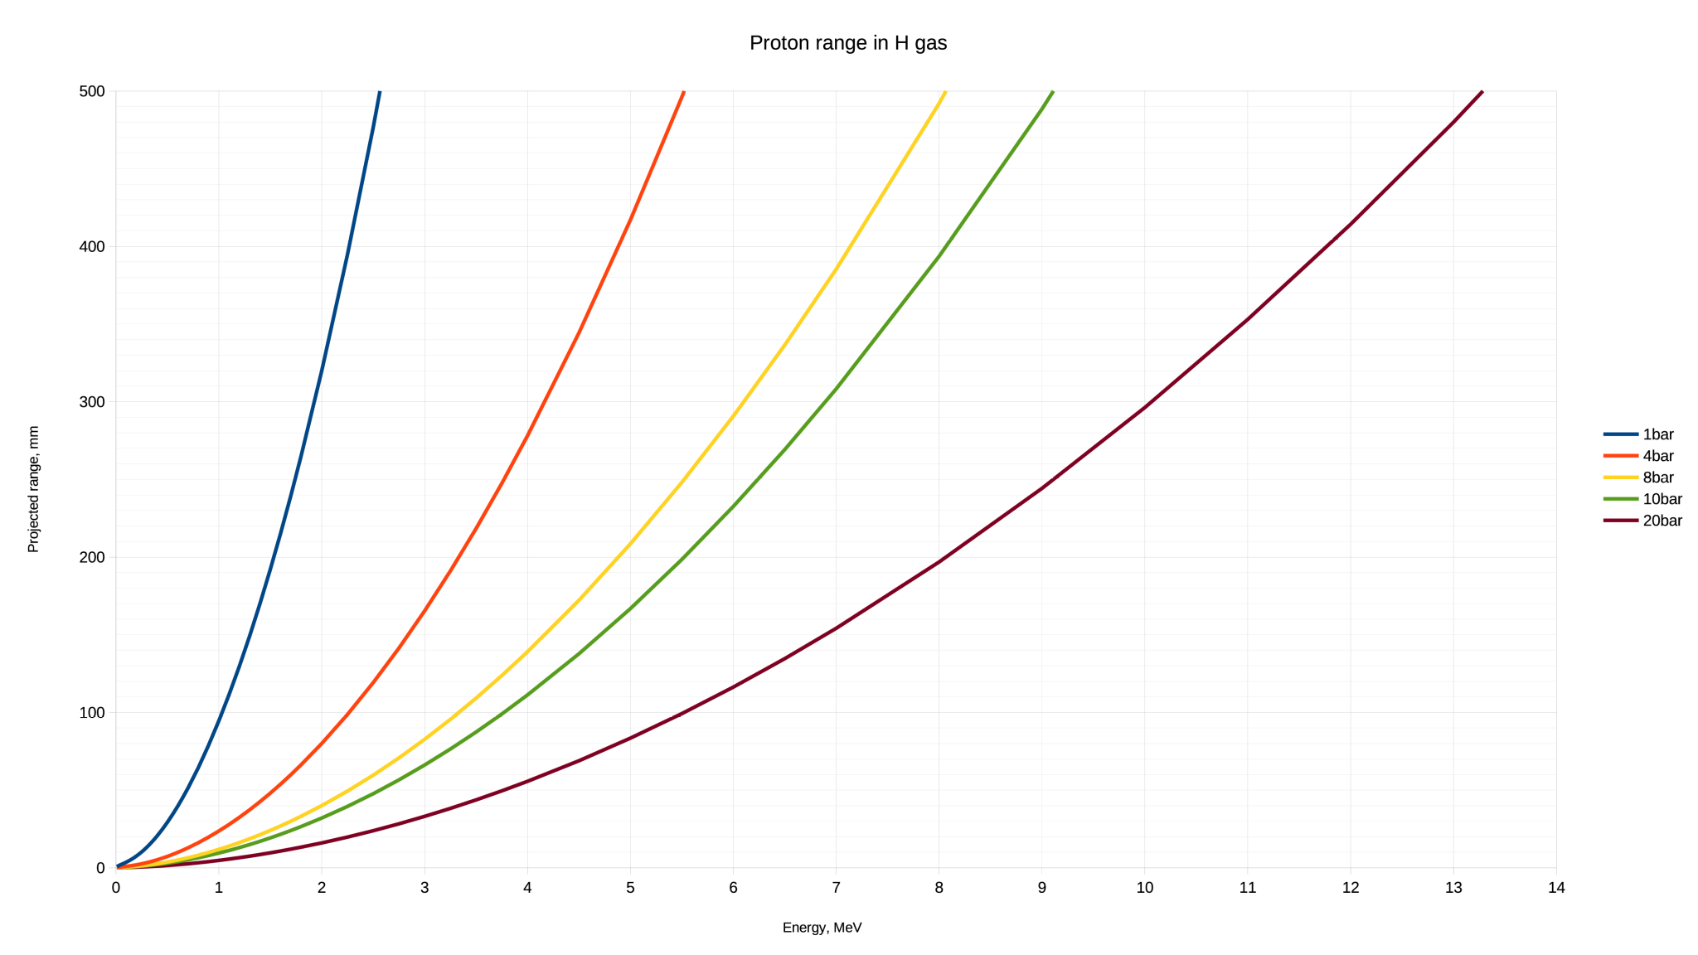
Proton range in hydrogen

