Slide 1

PS Interlocks
PS Commissioning Working Group
D.Cotte, F.Tecker
BE-OP-PS
PS C WG, 26 March 2019
Denis COTTE

Slide 2
Different possible interlocks in PS
External Condition (EC)
  Today, PS protection is already largely ensured by external conditions.
Software Interlock System (SIS)
  Most of the additional monitoring could be done by SIS.
  We do not need to act in the current cycle but activate the tail-clipper.
Beam Interlock System (BIC)
  Discussion about a possible implementation for critical systems during LS3.
  Meanwhile, only TDI (link to extraction BIC in PSB) and BHZ377(link to SPS BIC) are concerned
Warm interlock System (WIC)
Timings
  Beam Loss Monitor (BLM) in order to cut the beam in LN4.
Predefined conditions in order to trig the internal dumps.
  This is the only way to cut the beam already in the machine “cleanly”.

Slide 3
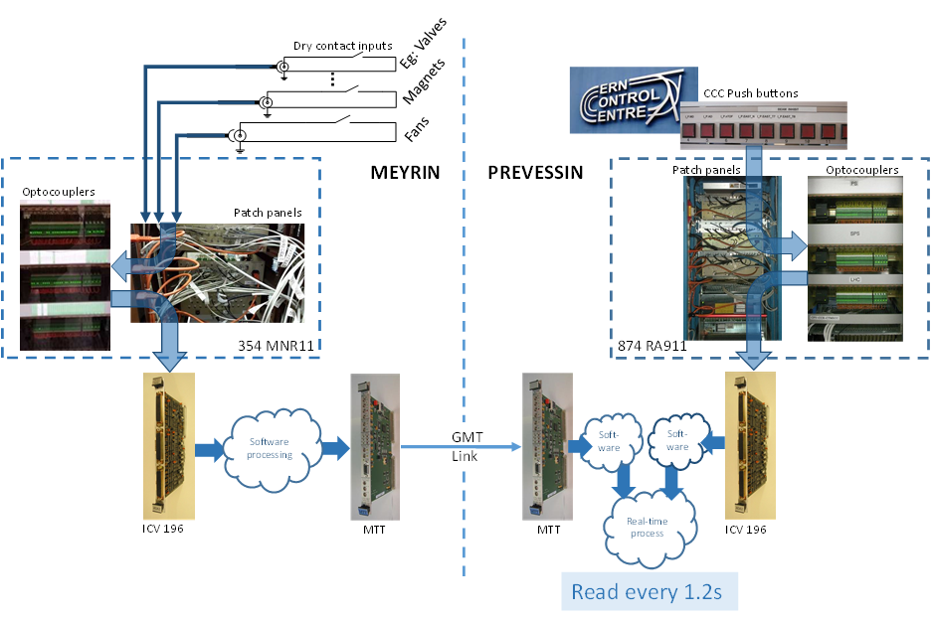
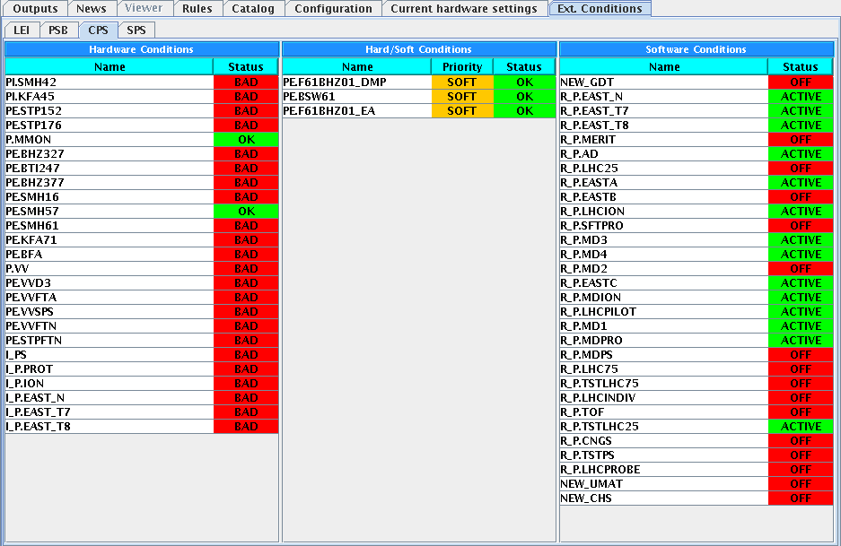
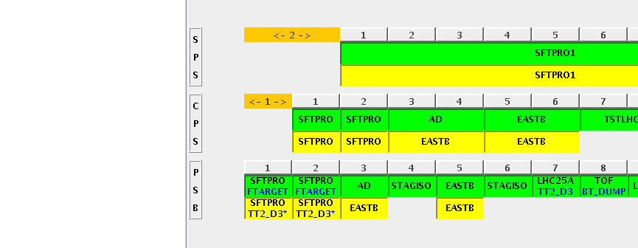
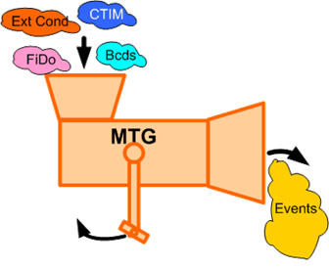
Existing EC installation
Renovation during LS2 (BE-ICS and BE-CO)
Normal, Spare, SpareDump

Slide 4
List of external conditions in PS
Status of TE-EPC equipment :
Equipements : | details | Comment
P.MMON (EIS) | Main power supply ON The only FGC with Hardware EC | POPS - FGC53
PE.SMH16 (EIS) | Extraction septum with HW EC Renovation Post-LS2 | POWM1553 (many problems with wrong pulse value in 2018)
PI.SMH42, PE.SMH57(EIS), PE.SMH61 TT2: PE.BTI247(EIS), PE.BHZ377/8(EIS), FTN.BHZ403 (EIS) | Renovation foreseen during LS2 with FGC control type. Agreement of a mixed solution SOFT-EC + SIS | EC in TT2 to be renamed with correct prefix F16 BHZ377/8 will be powered by two separate circuits
2 new external conditions for EAST AREA | Agreement of a mixed solution SOFT-EC + SIS | F61.MBXHD025 F63.MBXHD001 (name tbc)

Slide 5
List of external conditions in PS
Status of EN-STI equipment :
Equipements : | details | Comment
PE.STP152(EIS) PE.STP176(EIS) | Renovation during LS2, keep Hardware EC | Prefix to be renamed (F16) 2+1 Stoppers
FTN.TARGET | Renovation during LS2, keep Hardware EC
PE.STPFTN(EIS) | Renovation foreseen Post-LS2, Hardware EC | Prefix to be renamed (FTN)
PE.STPFTA(EIS) | Renovation foreseen Post-LS2, Hardware EC | Prefix to be renamed (FTA)
PE.STPF61(EIS) PE.STPZT8(EIS) | Renovation during LS2, keep Hardware EC | Sum of 5 Stoppers in F61 (1 EC) Sum of 5 Stoppers in T8 (1 EC) 1 in T9, 1 in T10, 1 in T11 (no EC)
PR.TDI47 PR.TDI48 | Renovation / New equipment during LS2 | 1(or 2) EC in parallel with BIC + SIS EDMS 1977845
PR.RAL12 | Renovation during LS2 Interlock with SEMGrid position (maskable) | 1 EC for maximum threshold for beam impacts (could be software or SIS) to be defined

Slide 6
List of external conditions in PS
Status of TE-VSC equipment :
Equipements : | details | Comment
P.VV | Keep Hardware EC Vacuum valves in PS Ring | Possible client for future BIC(LS3) in PS
PE.VVD3 | Keep Hardware EC FT16.VVS10 + FT16VVS20 + FT16VVS30 | Possible client for future BIC(LS3) in PS
PE.VVFTA | Keep Hardware EC Vacuum valves in FTA | Possible client for future BIC(LS3) in PS
PE.VVFTN | Keep Hardware EC Vacuum valves in FTN | Possible client for future BIC(LS3) in PS
PE.VVSPS | Keep Hardware EC FTS.VVS10 | Possible client for future BIC(LS3) in PS or to be linked to SPS BIC -> BHZ377/378 to 0A

Slide 7
List of external conditions in PS
Status of TE-ABT equipment :
Equipements : | details | Comment
PI.KFA45 | Renovation during LS2 Keep existing hardware EC
PE.BFA_CT | To be removed (Pedestal + Staircase) | Discussion about a CCR made by C.Boucly with EC part this week.
PE.KFA13-21 | Renovation during LS2 Keep existing Hardware EC | Act only on MTE type beam
PE.KFA4 | Renovation during LS2 Keep existing Hardware EC | Act only on MTE type beam
PE.BFA_MTE | Keep existing Hardware EC (Pedestal 9 only) | Could be remove in case we allow MTE beam in degraded mode.
PE.KFA71-79 | Keep existing EC | Successful test performed in order to replace EC with a PPM interlock + SIS in 2018.

Slide 8
Software Interlock System
Until 2018, SIS was used in PS for some checks.
  Monitor power converter status for critical circuits for operation (PFWs)
  Monitor power converter status of 8 Low Energy Quadrupole equipped with thermal switches in order to switch OFF all power supply powering the same quadrupole family.
  Cut TOF beam production in case the maximum proton flux to nTOF target is reached.
  Dump SPS destination beam in case of absence of TFID
  Cut a predefined user in case the KFA71 PPM interlock is present.
  Protect EAST AREA from a bad setting in switching magnet of F61.
  Handle Beam request and Beam stopper position for EAST users.
We suffered from side effect on different task trying to cut /put back the beam. This system will be reviewed during LS2. -> Action BE-CO

Slide 9
Beam Interlock System
There will be no BIS in PS, a possible implement for LS3 is under discussion.
There will be only 2 interactions of PS devices with BIS/BIC for the moment
  Interlocks from both PS internal dump in case of bad position of the dump core. -> will act on the Booster extraction BIS + EC
  Interlock from SPS BIS in case of wrong condition in TT10 line. -> will act on switching magnet F16.BHZ377/378 at the end of TT2 in order to send the beam to D3.

Slide 10
Warm Interlock System
WIC system dedicated to the protection of the auxiliary magnets in PS from overheating by switching off the power converter.
  New system in PS during LS2
  Concerns all auxiliary magnets in PS-Ring except Low Energy Quads (EDMS1701483).
  Concerns extraction lines F16 & FTN (EDMS1701477).
    not FTA
  Concerns all magnets in EAST AREA extraction lines F61, F62, F63, T8, T9, T10, T11(EDMS 2037701 under approval)
  Proposed strategy for future implementation (EDMS1836387)
    Main unit magnet during YEST22-23
    LEQ will be equipped later during LS3
    PFW ? Today only B8L is equipped with thermal switch on reference magnet.
Ready for Beam Interlock System connection. (LS3)
Commissioning part directly linked to TE-EPC IST and HWC validation

Slide 11
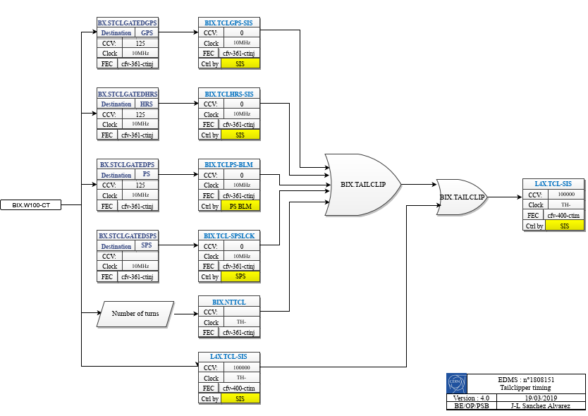
Timings for BLMs
In order to cut the beam in case of beam losses in PS-Ring or TT2
  A draft layout made by Jose Sanchez (BE-OP-PSB)
  Act on Linac4 Pre-Chopper timing L4X.TAILCLIPPER
Triggered by the new BE-BI FESA class for BLM
BLMs in EAST AREA (F61,F62, F63 and T8) won’t be interlocked.

Slide 12
Internal Dump TDI47/48
Condition to trigger the internal dump
  Protection again possible high intensity beam :
    EAST AREA again parasitic TOF bunch not extracted
    Equipment protection (ex: TIDVG issue in SPS with a maximum intensity allowed)
  Dump satellite bunches few milliseconds after extraction.(LHC type beams)
  Dump the full beam just before extraction in case of absence of TFID.
  On purpose for Machine Development(MD) or beam Setting-up.
We need dedicated time to validate the 2 new TDI before starting the beam commissioning.

Slide 13
Conclusion
PS has already a large panel of different interlocks.
During LS2, new interlock system will be deployed like WIC and 2 use cases for BIS
Some interlock will be kept and others need to be adapted to follow upgrades (SIS, BLM)
There will be 2 new intercepting devices to be validated during HWC before Beam commissioning starts.
Very soon, we will ask for a list of ISTs, and tests to be performed during HWC and Dry-Runs for all systems.
PI.SMH42 ? Can we really lose the beam @ 2GeV on a localized spot ?

