Slide 1


LHC Cryogenic Systems
Recovery time of 2018 training campaign
G.Ferlin on behalf of TE-CRG-OP section
With contributions from Benjamin Bradu

Slide 2
Agenda
How does a training quench impact CRYO
Cryo recovery time after Quench
Conclusion

Slide 3
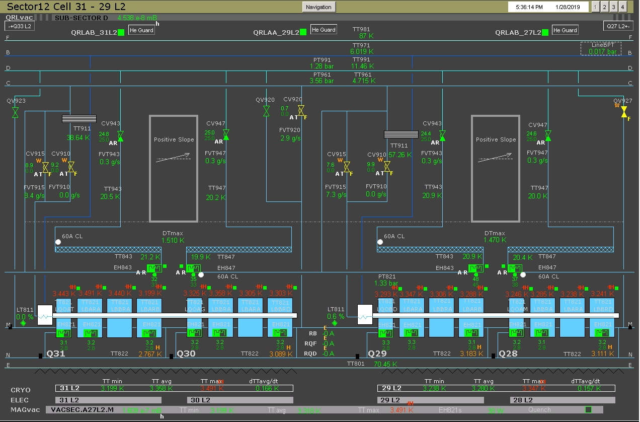
LHC cryo training quenches 2018
Typical LHC sector cell, in this case 31-29L2

Slide 4
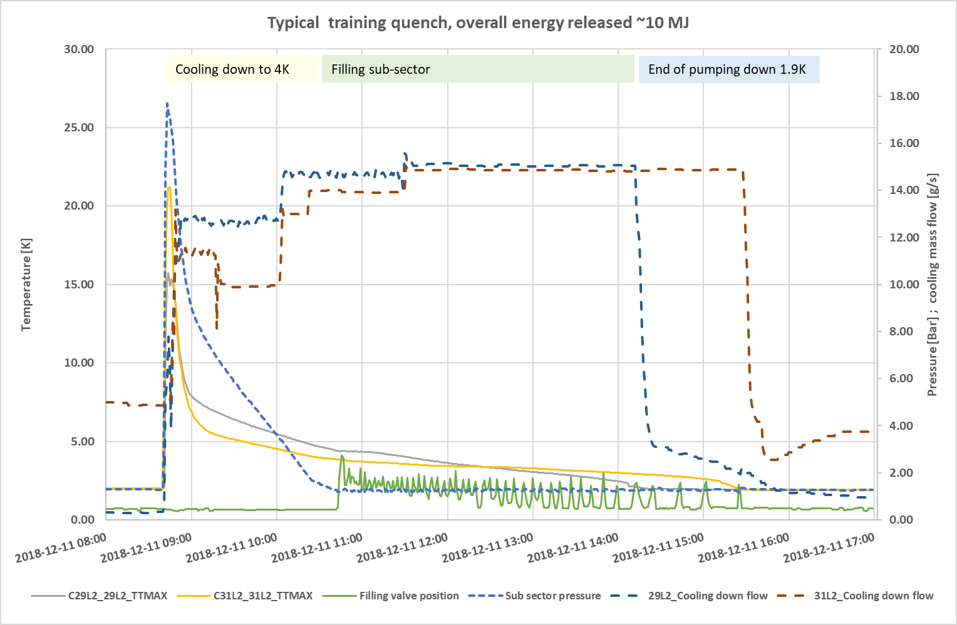
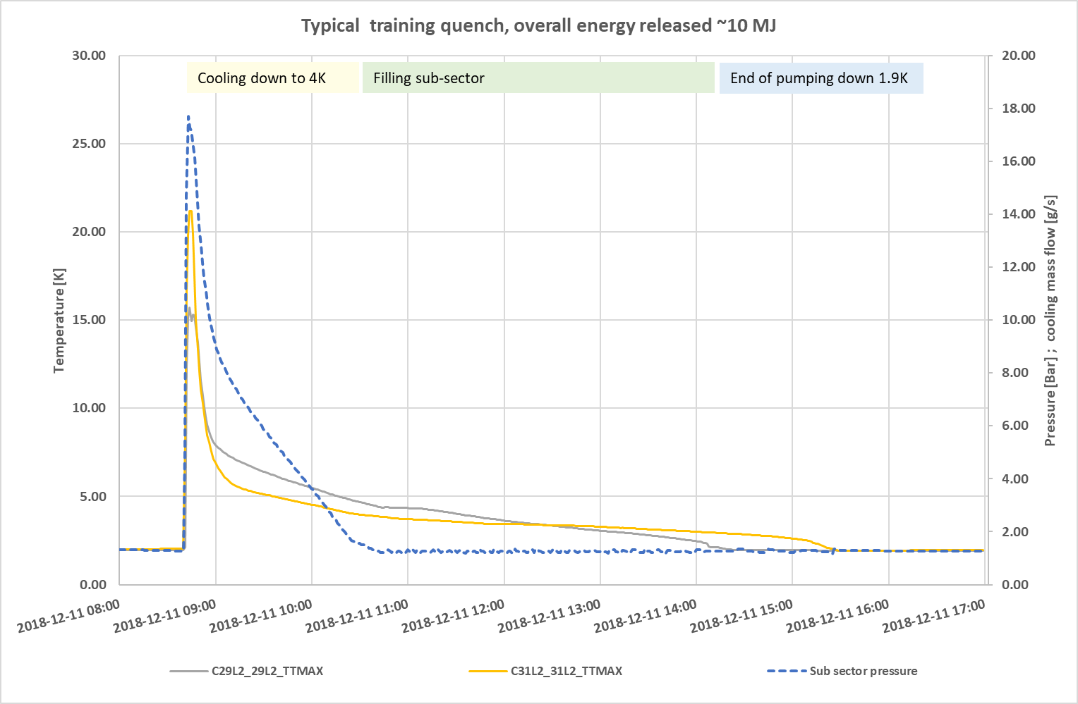
LHC cryo training quenches 2018
How does a sub-sector behave during a quench recovery

Slide 5
LHC cryo training quenches 2018
Energy released during a quench is depending of the quench current and of the quantity of secondary quenches at high current.
At high energy, during a training quench, temperature of the subsector is growing up to 20 K and the quench relief valve open.
As a direct consequence the sub sector must be re-cooled and the sub sector must be filled again. As rough estimation, between 200 and 400 kg of helium must be liquefied in the sub-sector depending of the released energy.
Energy released drive the number of sub-sector to liquefy. After the released energy, liquefaction ratio is the main parameter controlling the recovery time. A sector with lower liquefaction ratio will needs a longer time to refill!

Slide 6
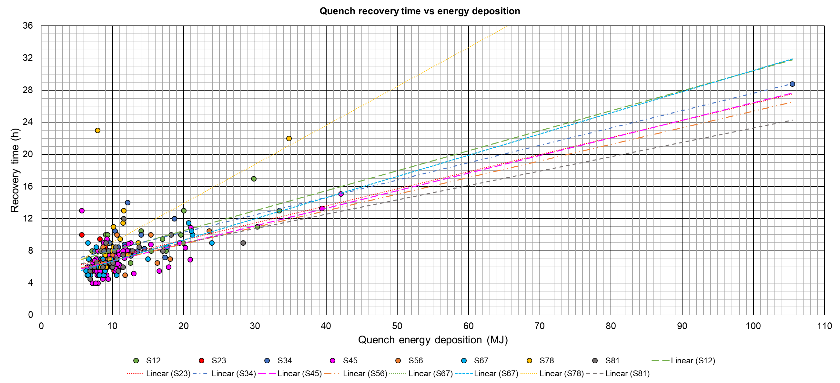
Training quench campaign 2016
All sectors plot
2016-12-14_Training Quench Campaign to 7 TeV in S34 & S45_L. Delprat – G. Ferlin

Slide 7
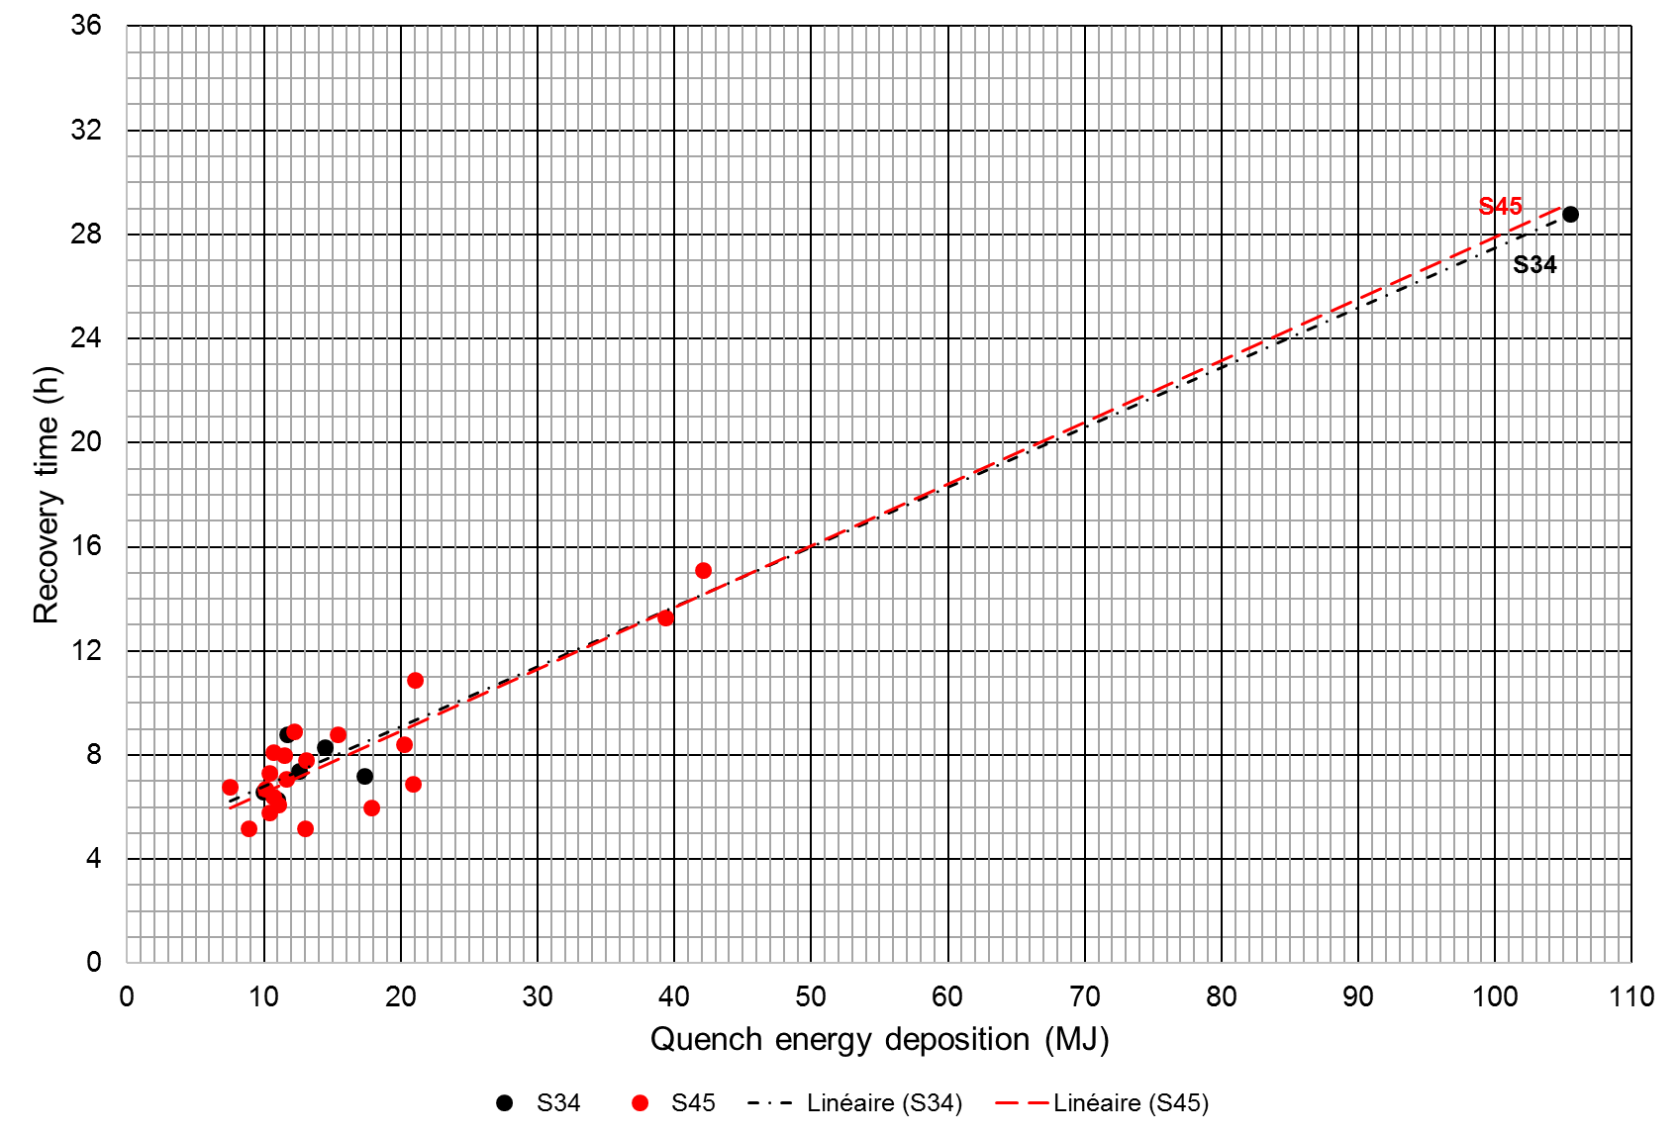
Training quench campaign 2016
Average values (taking out ≈ 40MJ & 105MJ quenches):
13 MJ of energy deposition for 8 hours of recovery
Quench recovery time versus energy deposition in sectors 34 & 45
2016-12-14_Training Quench Campaign to 7 TeV in S34 & S45_L. Delprat – G. Ferlin

Slide 8
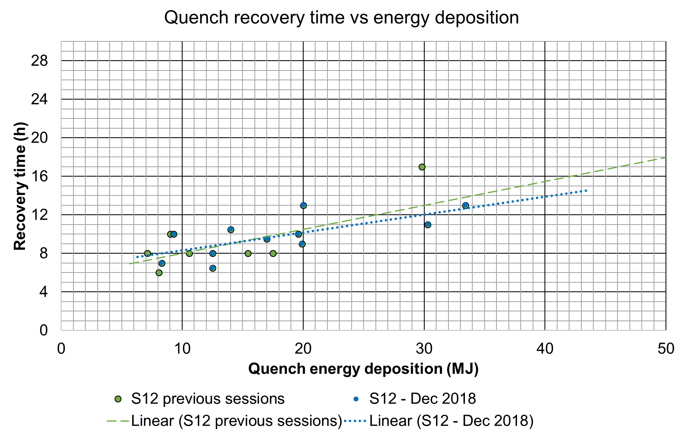
Training quench campaign 2018
Quench recovery time for sector S12 (2018 Training quench) is similar to the previous one
2016-12-14_Training Quench Campaign to 7 TeV in S34 & S45_L. Delprat – G. Ferlin

Slide 9
Conclusion
Recovery time of the 2018 training quench campaign (sector S12) do not show evidence of a shorter recovery time than the 2015/2016 campaign.
At high energy, the expected recovery delay is in the range 8 to 10 hours for a quench with 10 MJ released.
This value must be increased up to 10/12 hours for a quench in the range 20 MJ.
To prepare the Run3 reconfiguration tests, taking into account the Run2 experience, TE-CRG recommends keeping the frequency of 2 quenches by 24 hours to estimates foreseeable duration of the test campaign.
Thank you

