Slide 1
LIU-PS EVM Status
Data extraction: 5 February 2019

Slide 2
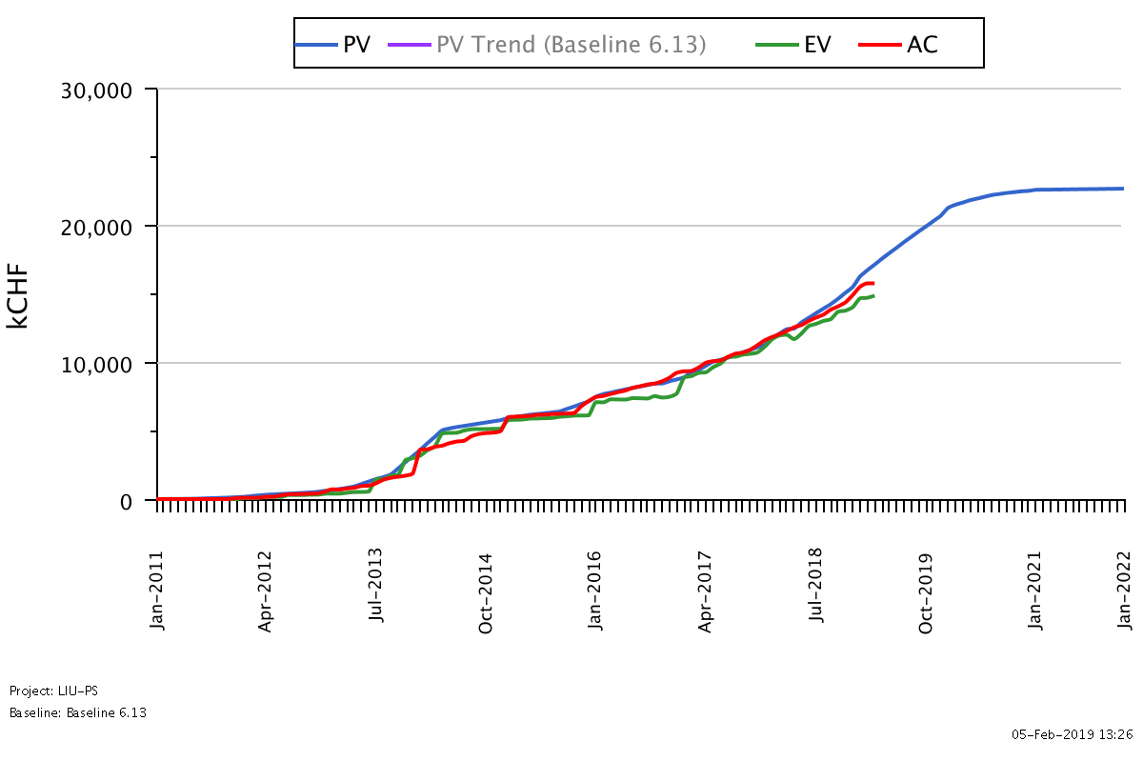
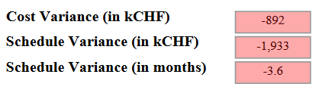
LIU-PS Dashboard
Was 3.9 on the 22.01.19
Reporting up-to-date for 53% of the workunits

Slide 3
LIU-PS Crosstab by Group

Slide 4
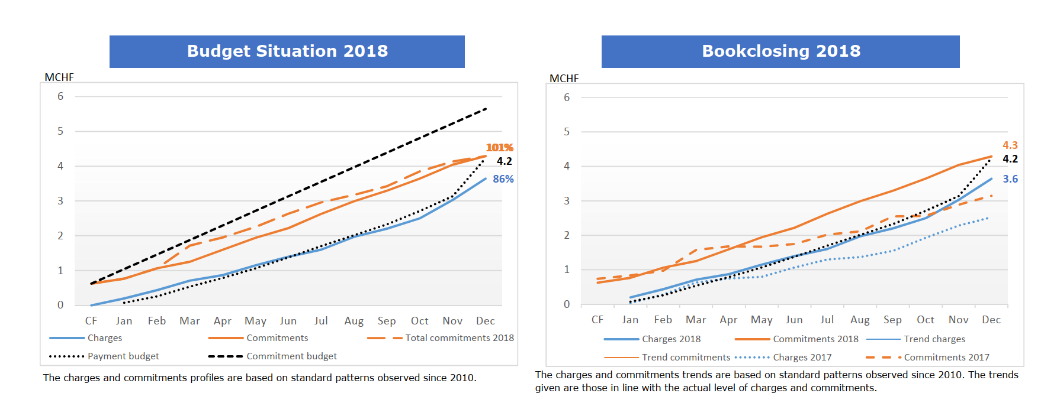
Bookclosing 2018 LIU-PS

Slide 5
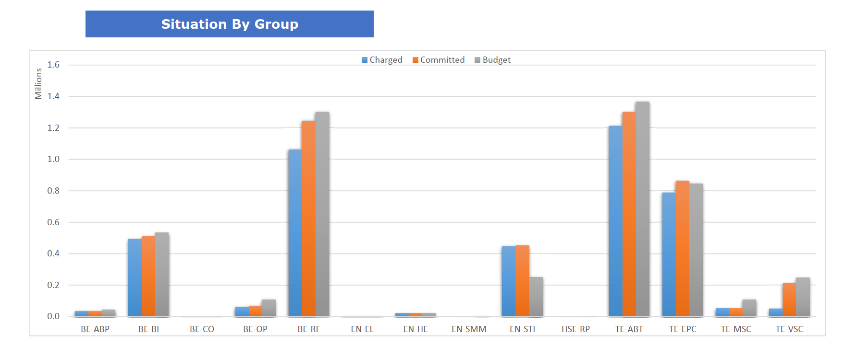
Bookclosing 2018 LIU-PS

Slide 6
Budget 2019 LIU-PS

Slide 7
Budget 2019 LIU-PS

Slide 8
Budget 2019 LIU-PS

Slide 9
Budget 2019 LIU-PS

Slide 10
Spare Slides

Slide 11
LIU-PS Crosstab – BE Department

Slide 12
LIU-PS Crosstab – EN Department

Slide 13
LIU-PS Crosstab – HSE Department

Slide 14
LIU-PS Crosstab – TE Department

