Slide 1
LIU-PS Planning report

Slide 2
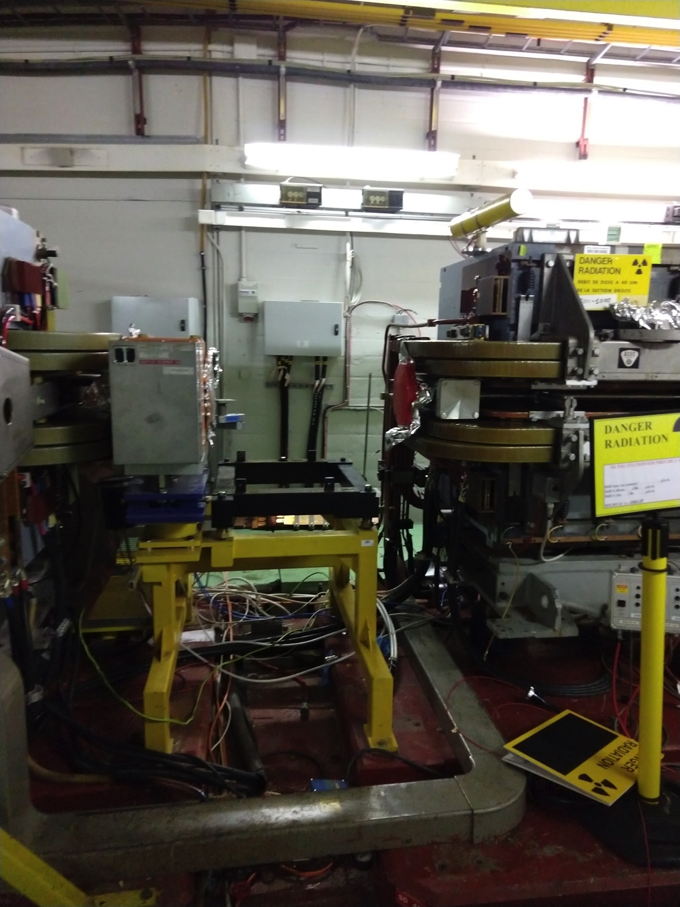
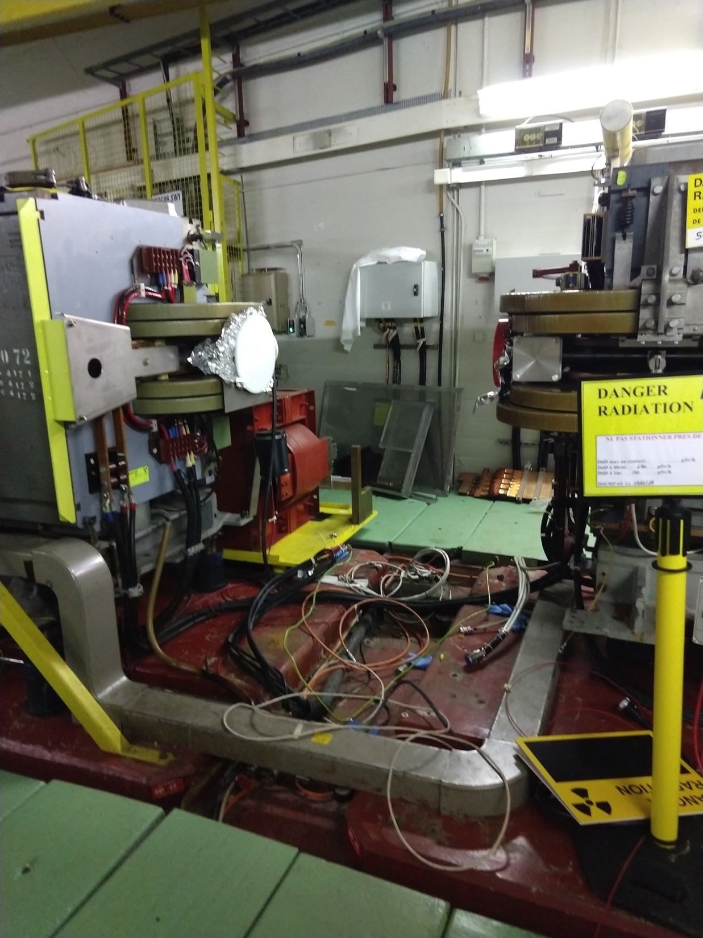
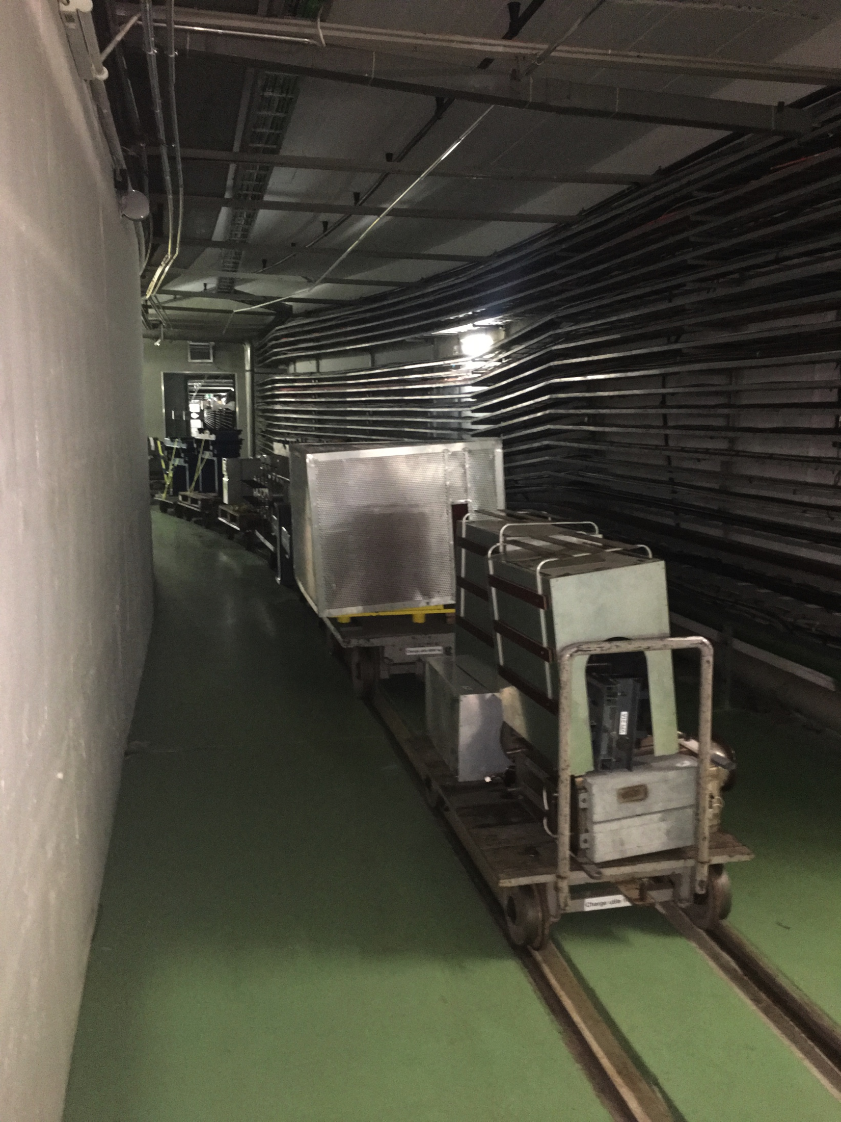
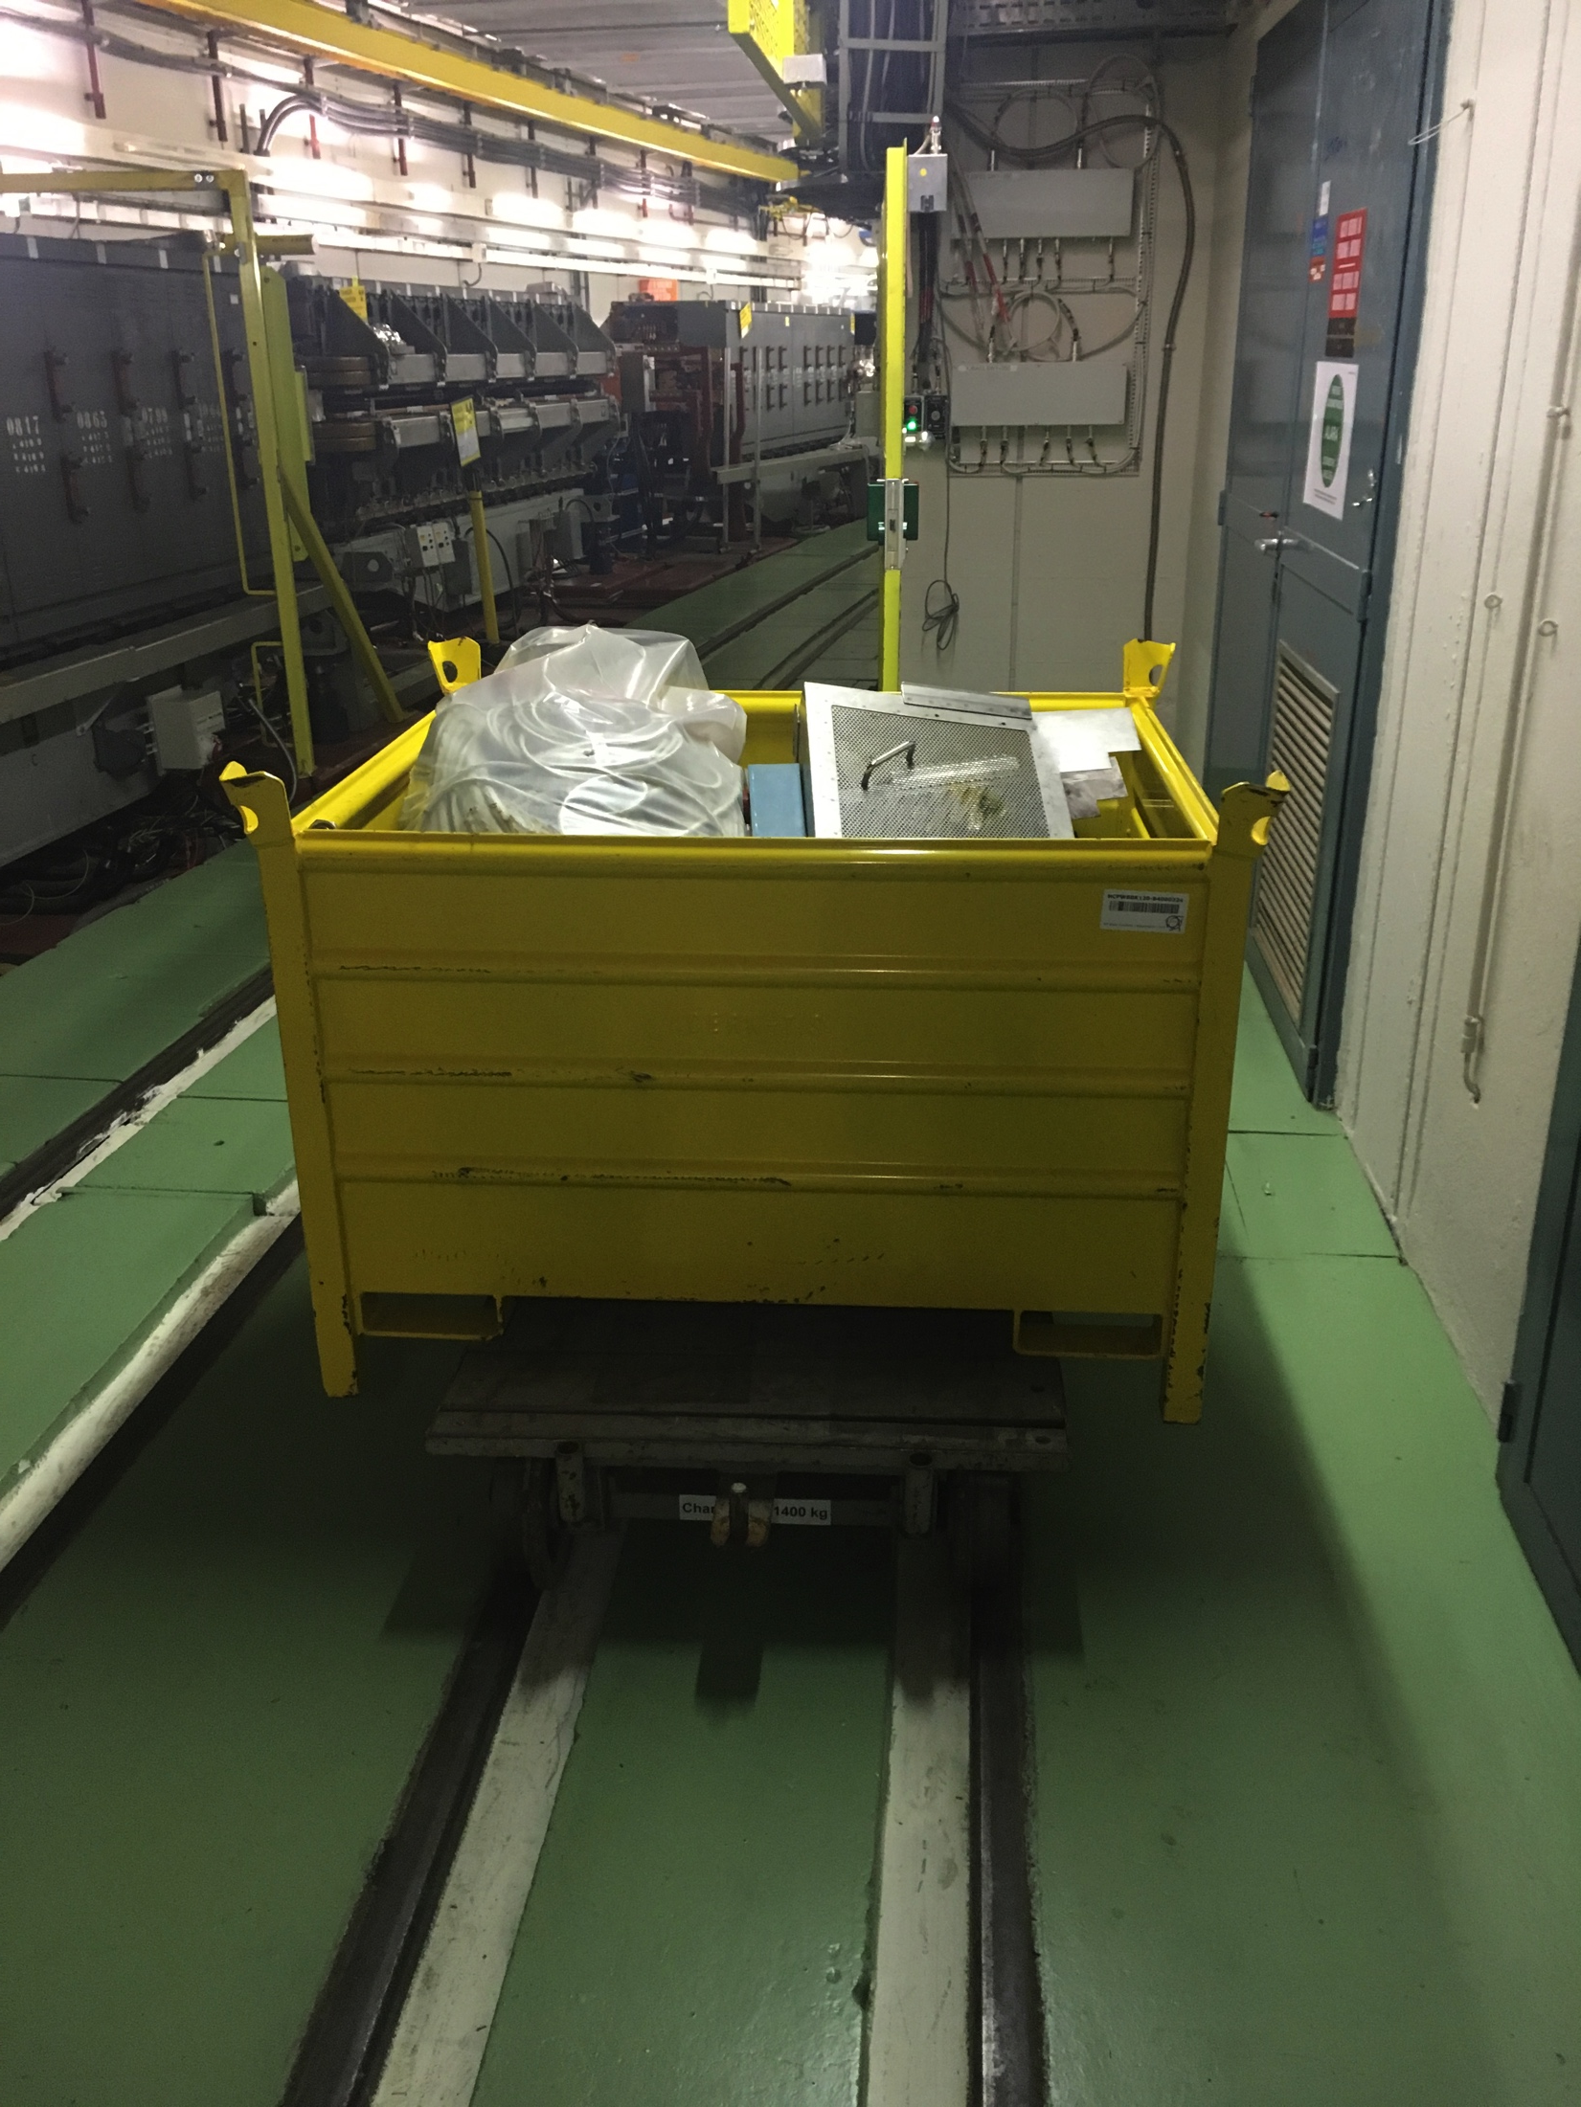
SMH42
SMH42 removed from the machine on the 21/01/2019
Some misunderstanding for the bumper removal
Removal of other parts is still ongoing
Issues:
  Some of the high radioactive equipment is still in the corridors, and all people passing by are getting unnecessary dose (storage place issue???)

Slide 3
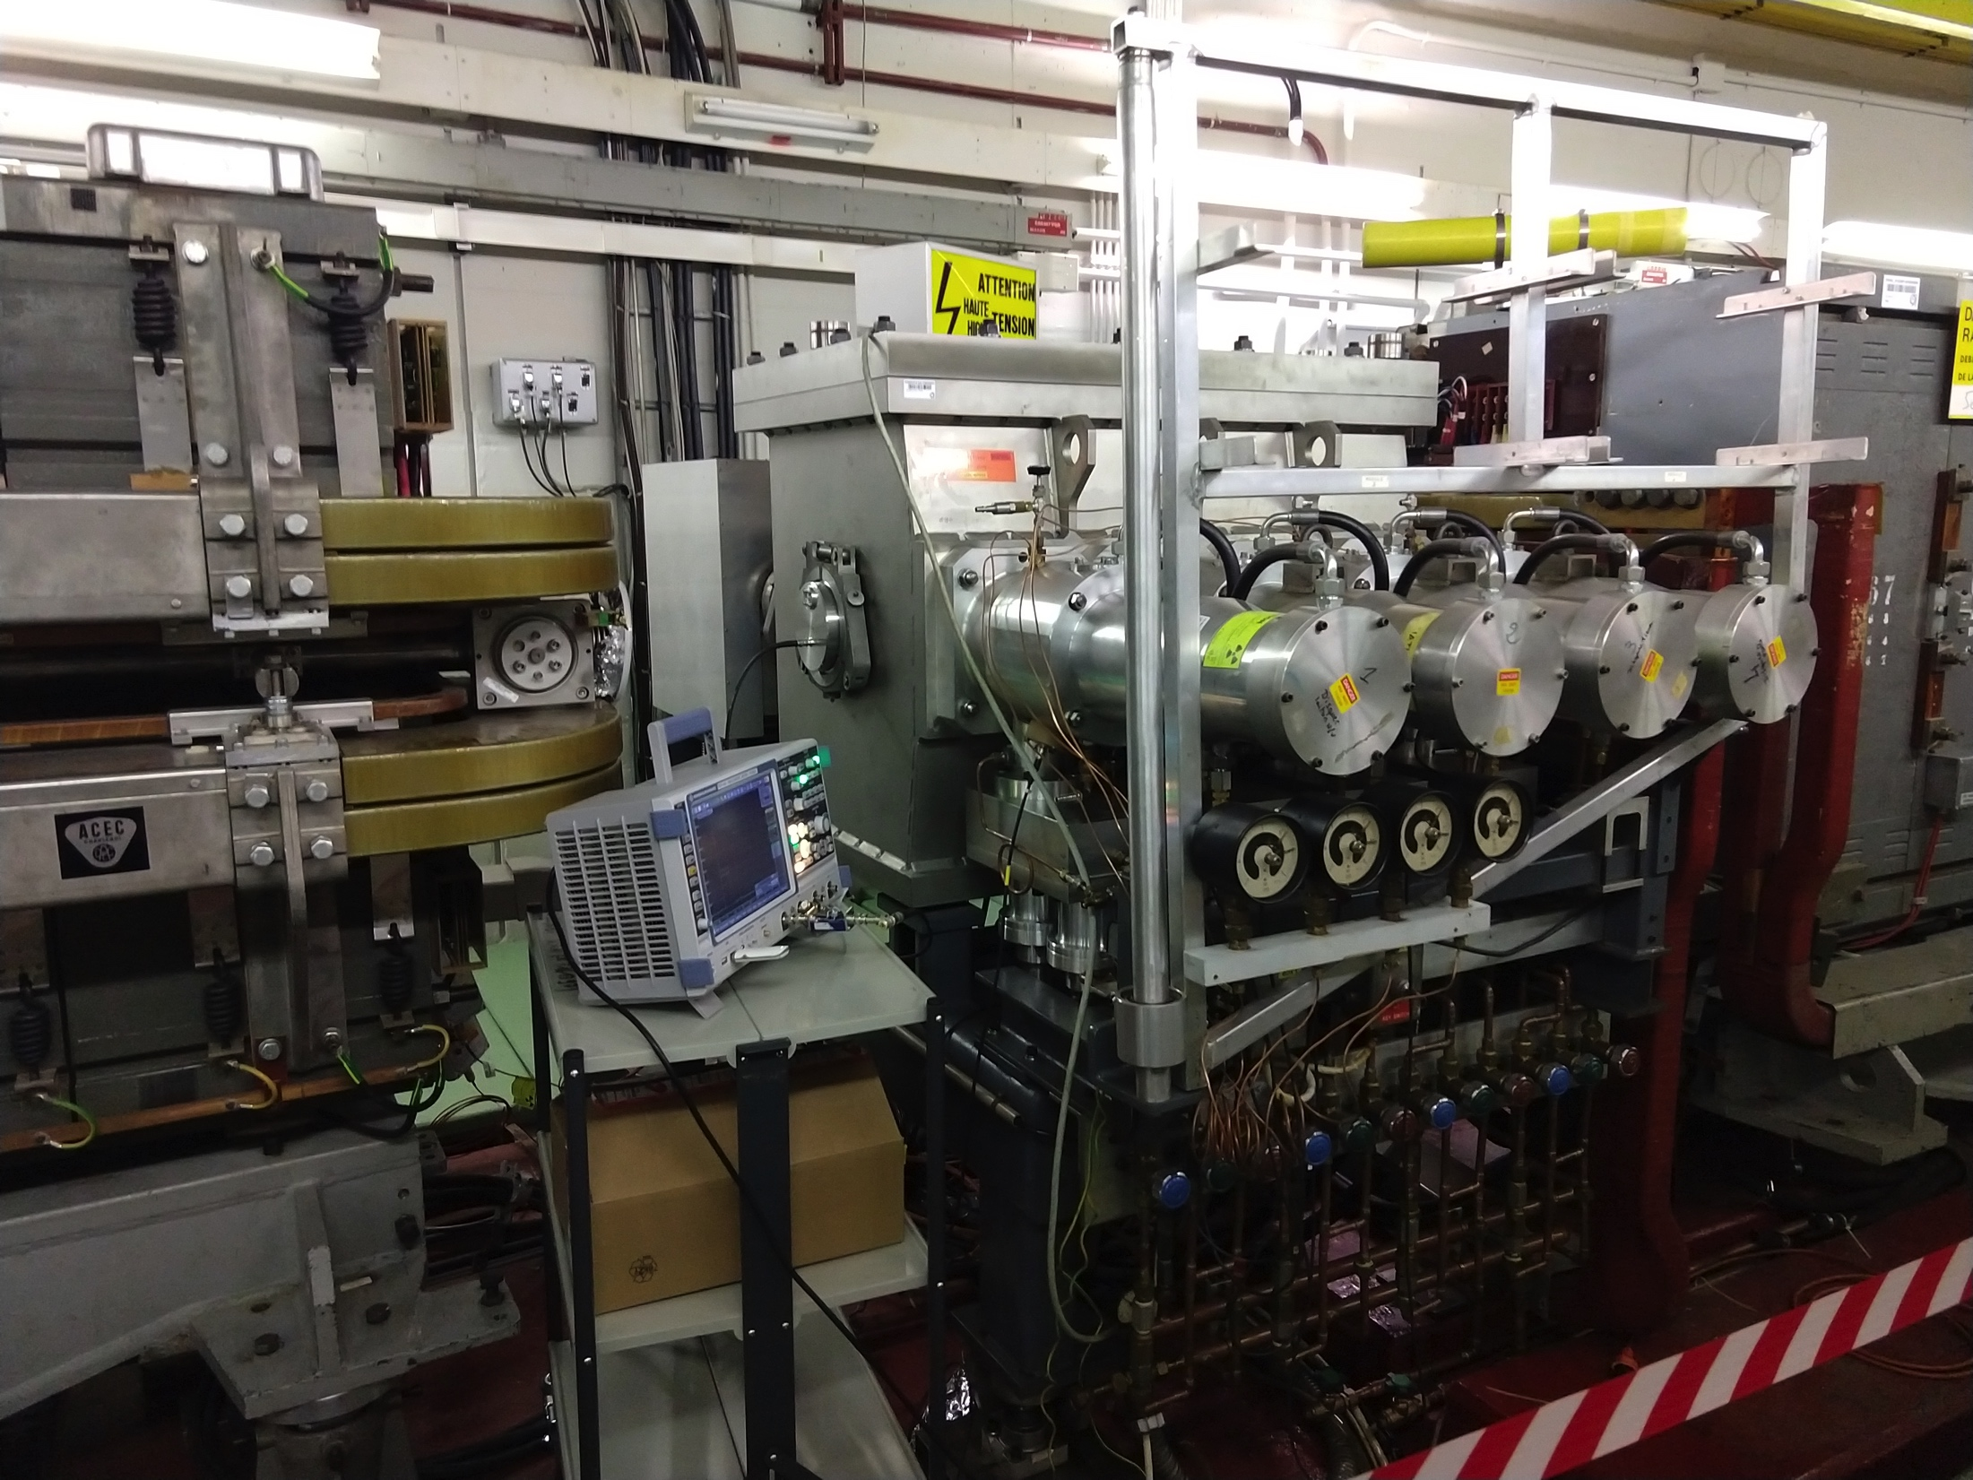
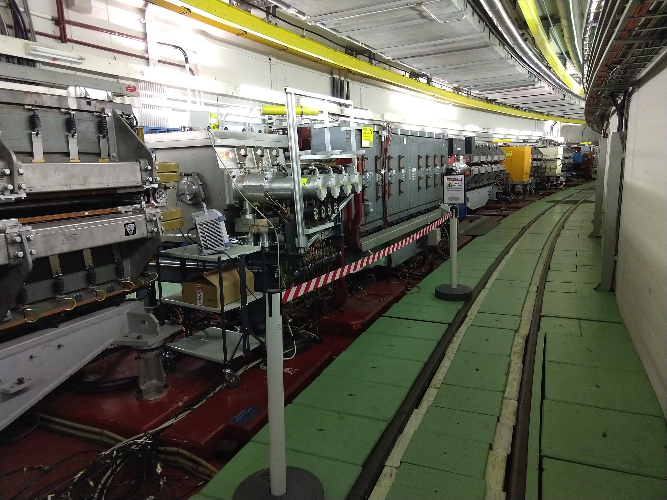
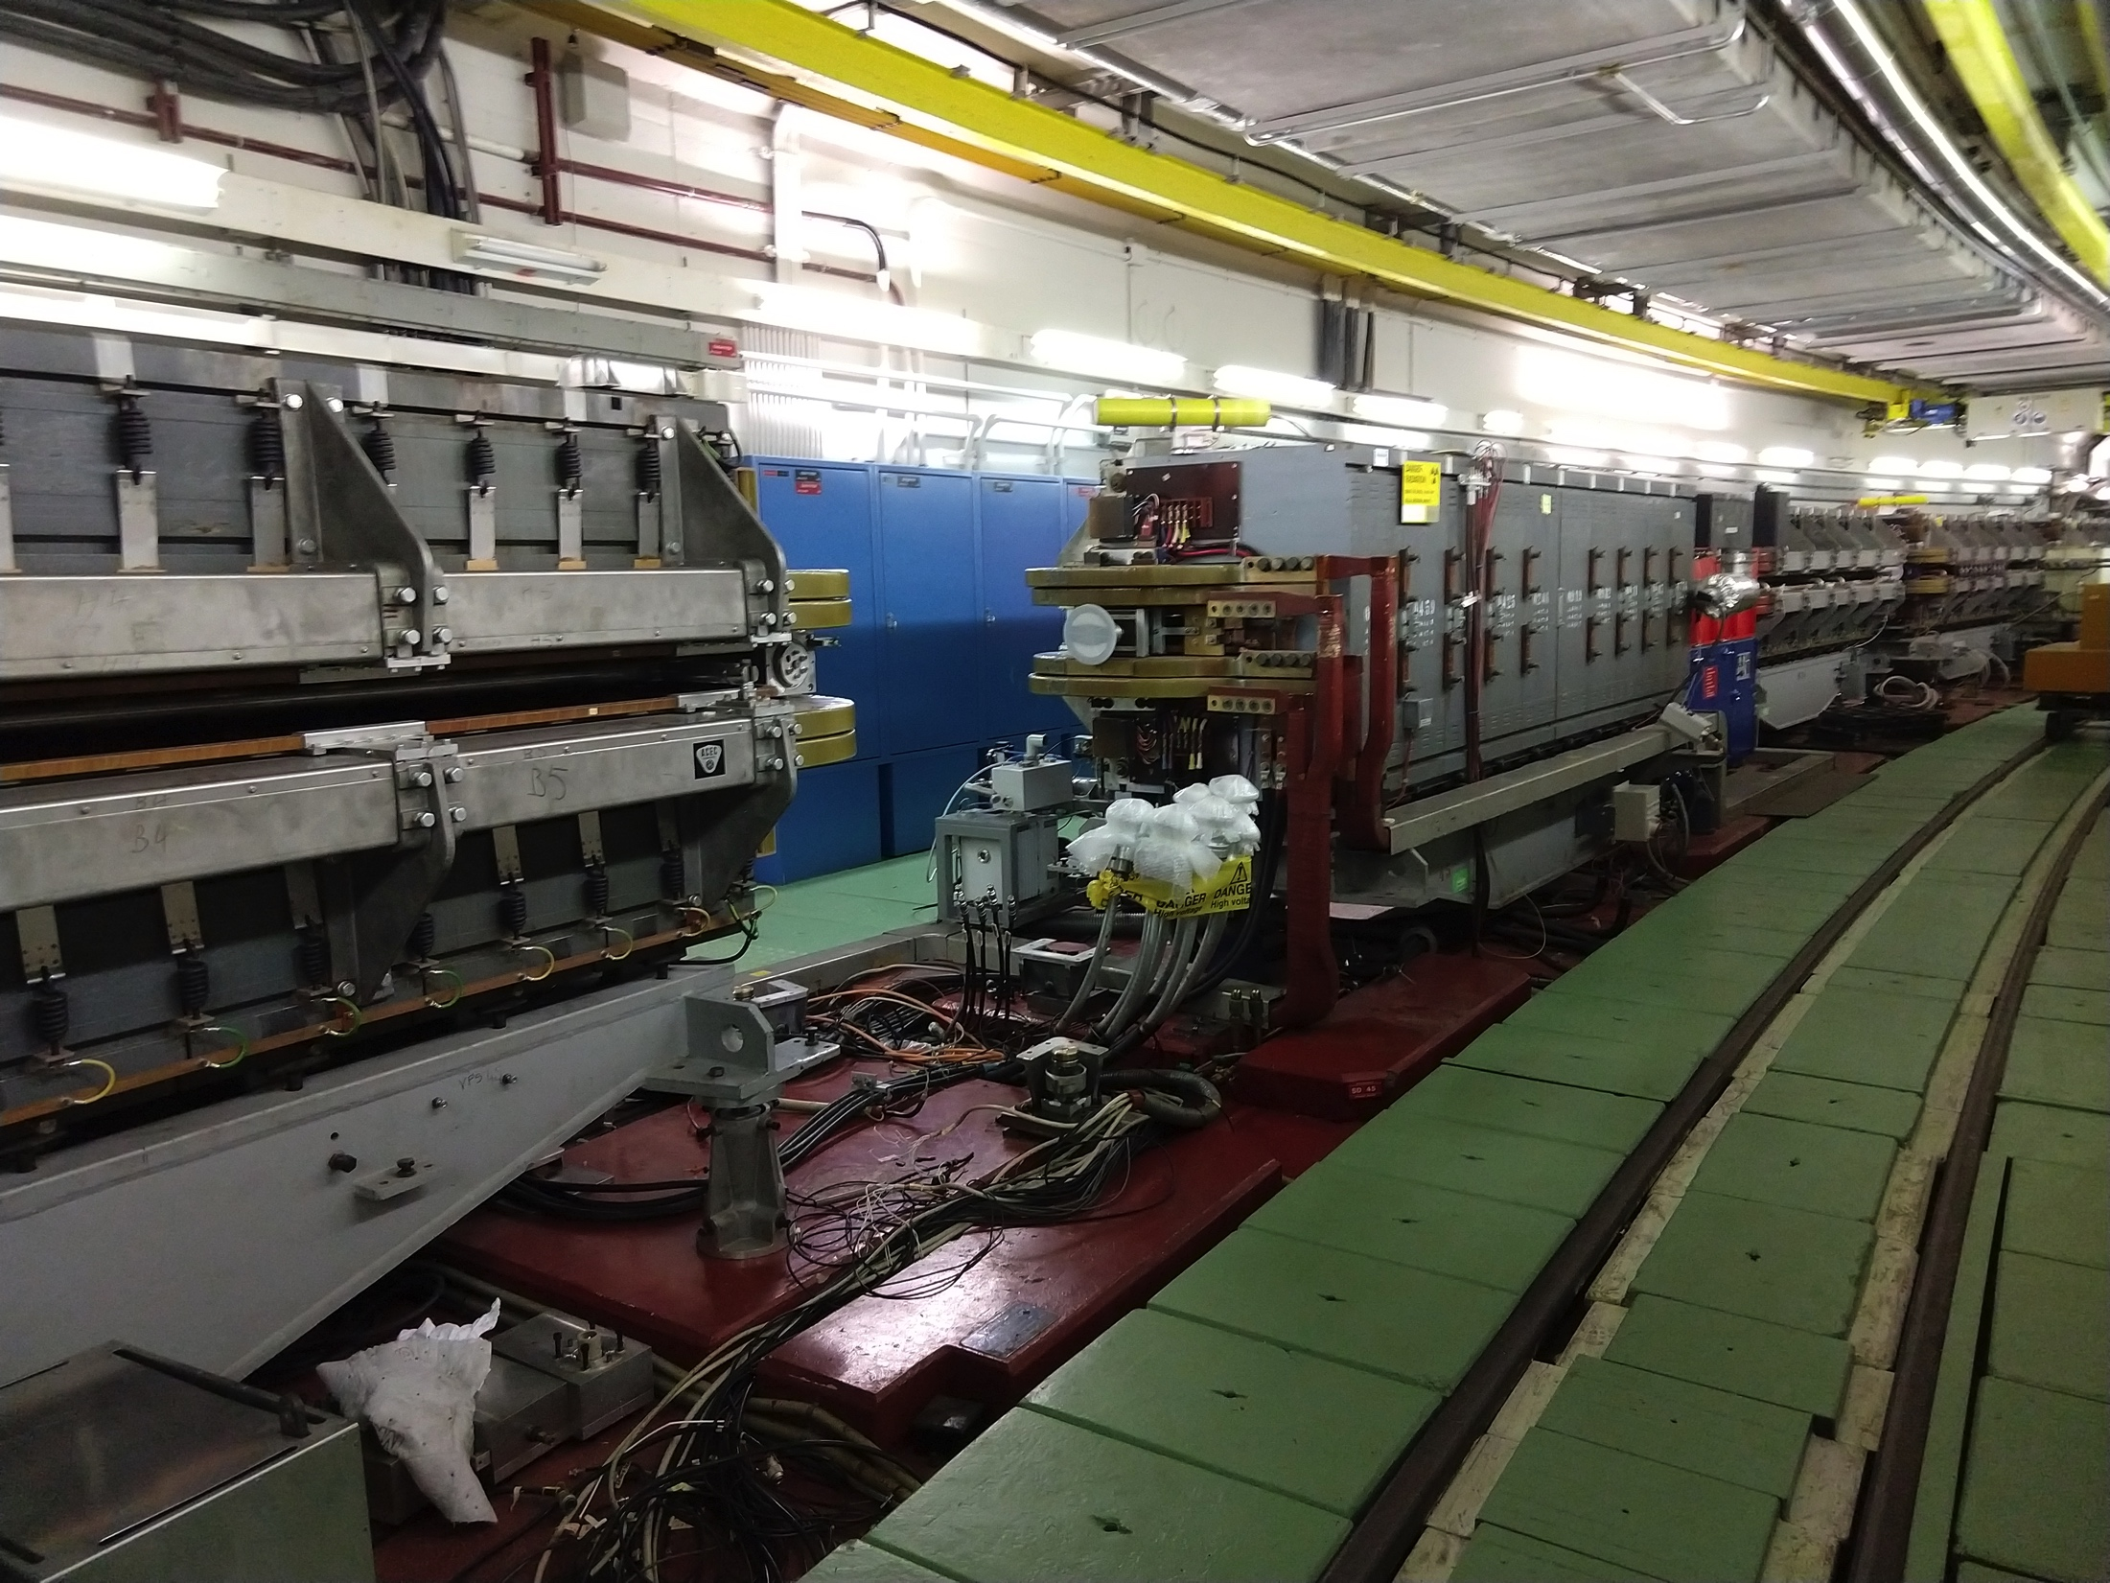
KFA45
Tests performed successfully between the 25/01/2019 and the 28/01/2019
Removal performed last Thursday
Issues:
  No issues to report

Slide 4
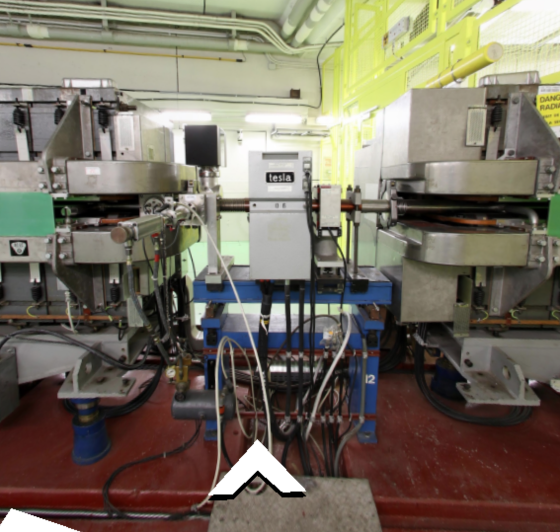
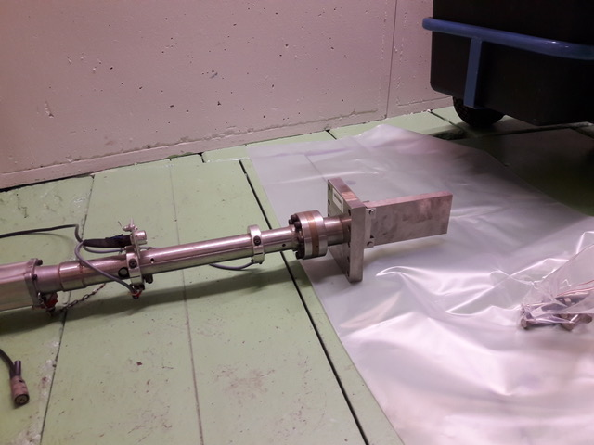
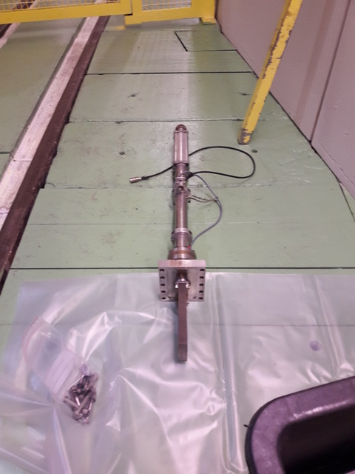
Rallentisseur
Existing rallentisseur removed on the 17/01/2019 as requested by EN-STI
From my understanding there are quite good news concerning the vacuum joints used
Issues:
  No issues to report

Slide 5
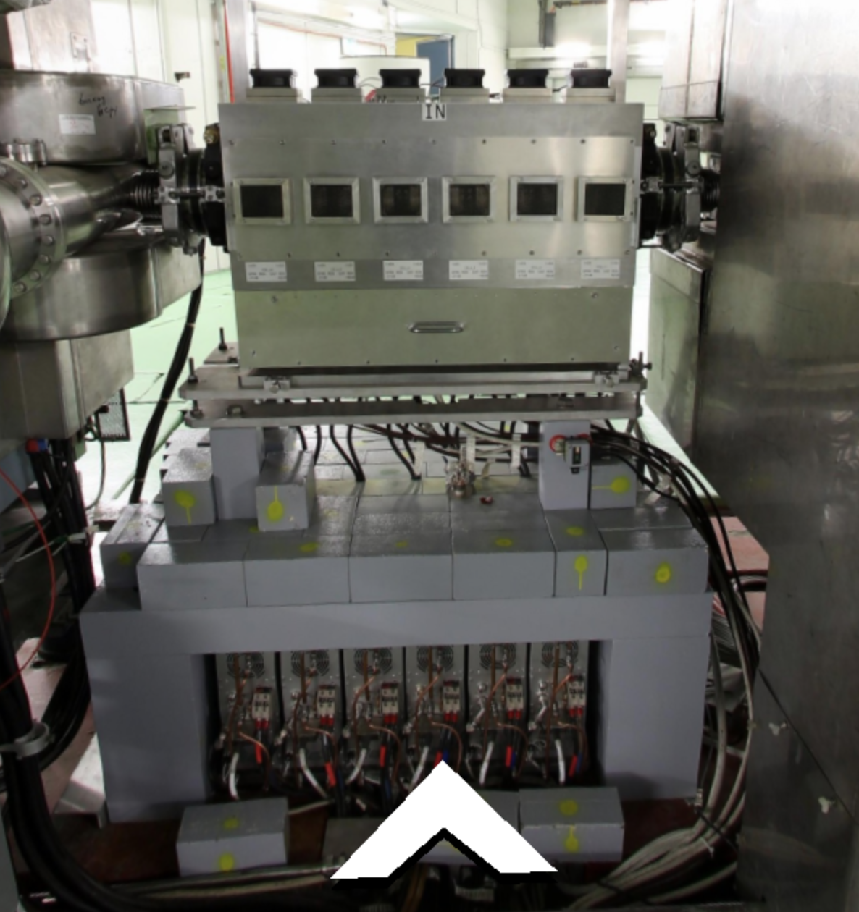
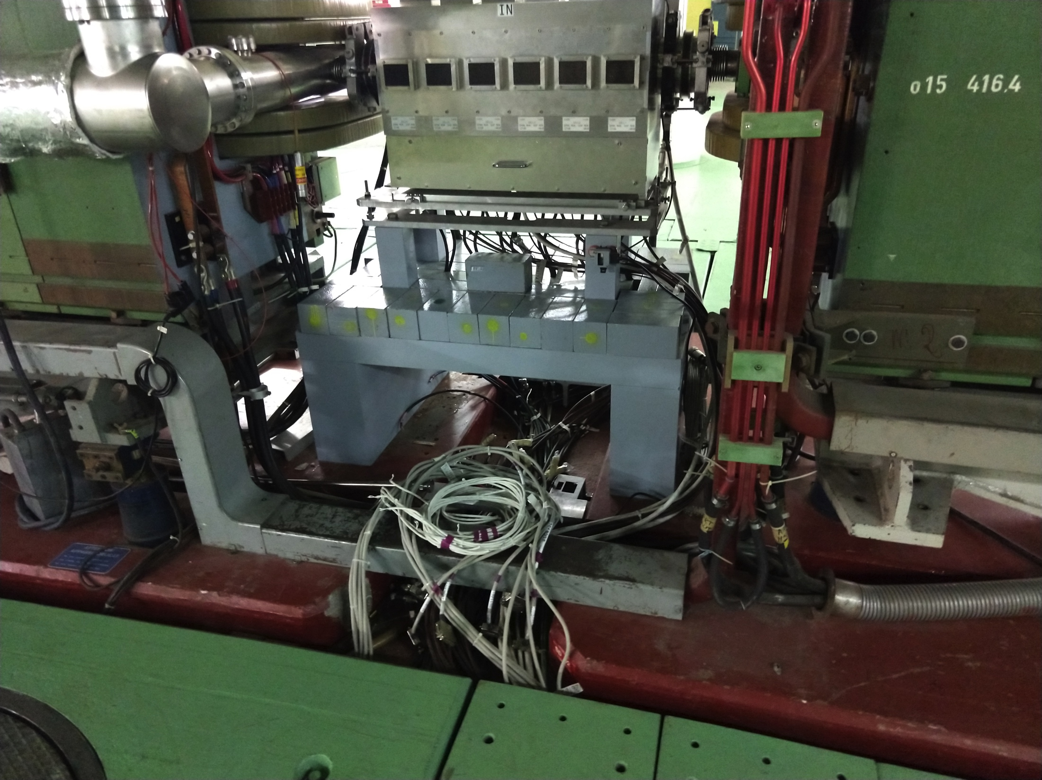
BE-RF Longitudinal Damper
Removal of all electronics and cable identification performed on time and within a day of work 16/01/2019
Lead bricks were removed and sent to waste
Issues:
  No issues to report

Slide 6
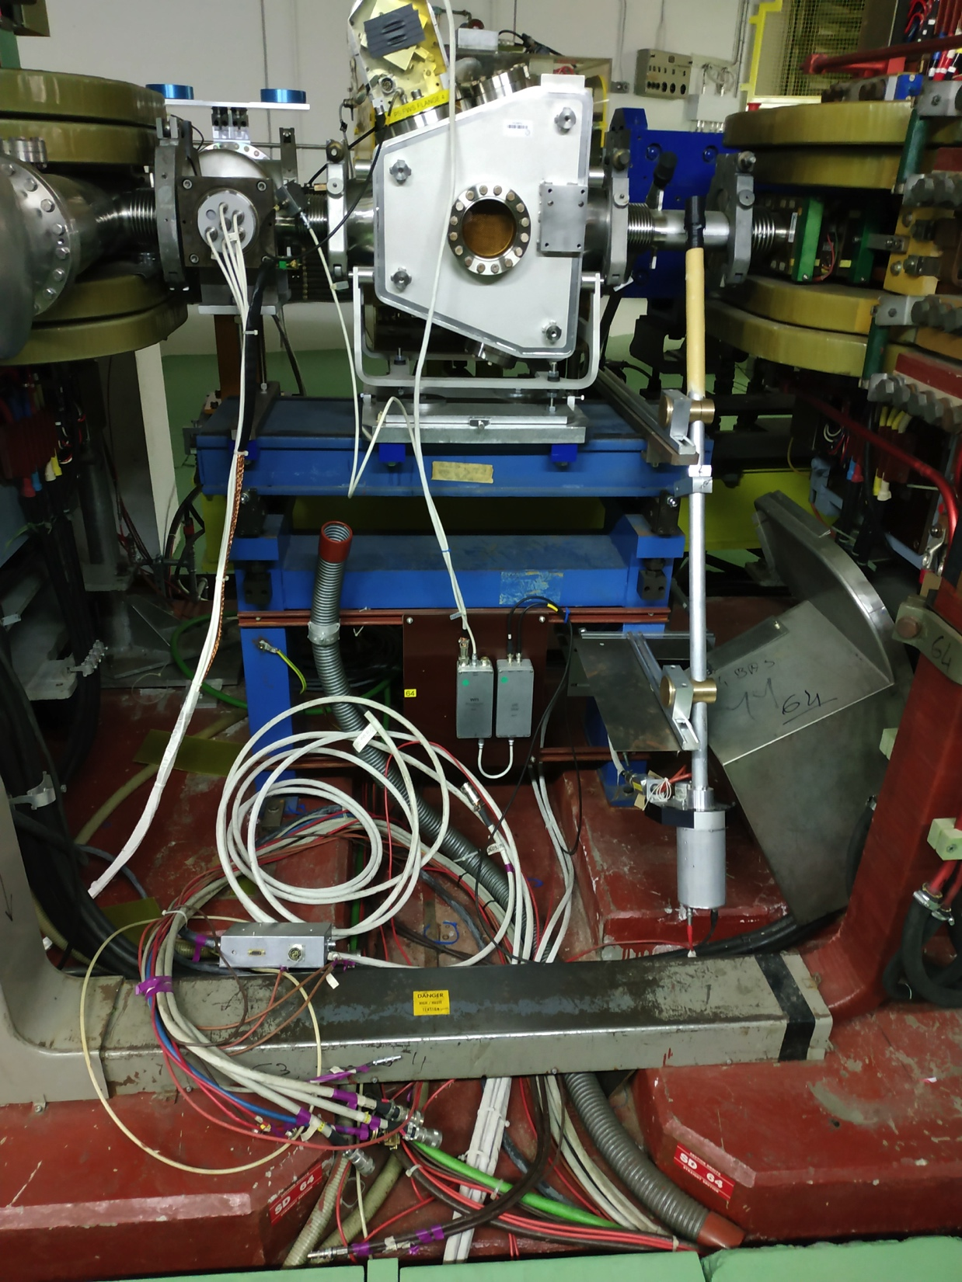
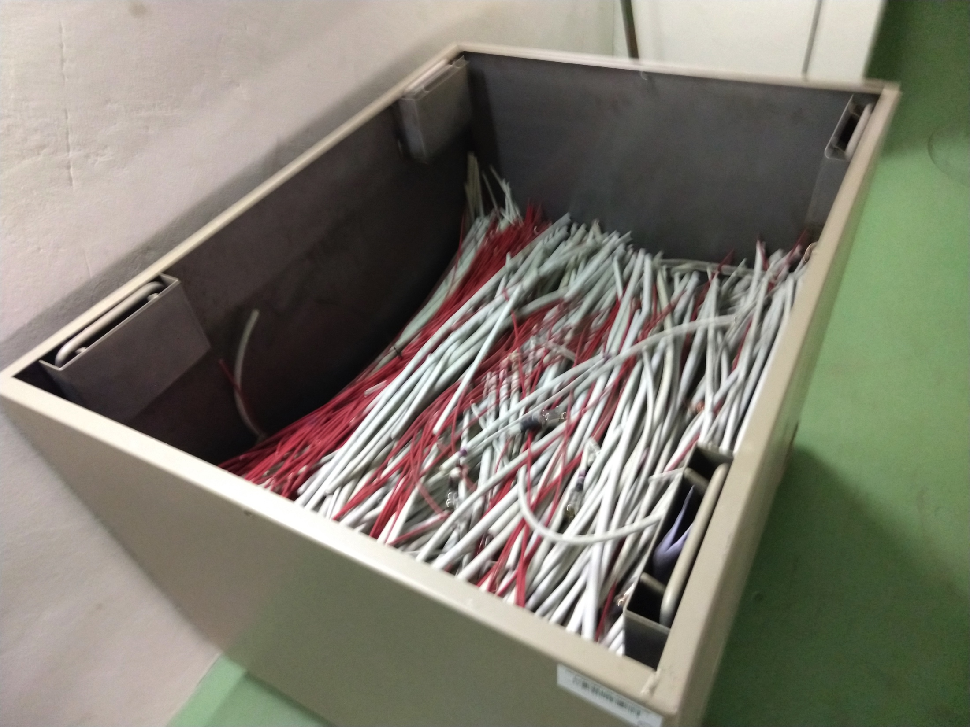
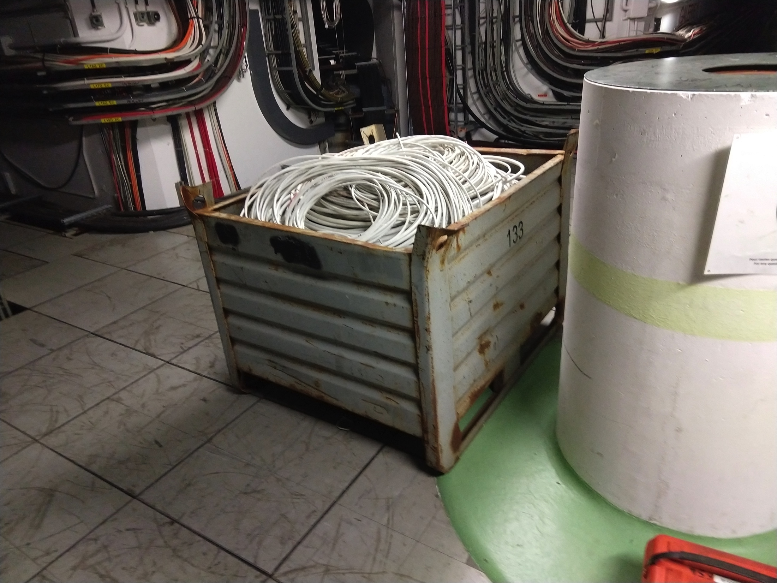
De-cabling
De-cabling campaigns went faster than initially planned
Issues:
  Some cables were left in the area even if identified as for de-cabling
    Action ongoing in the EN-EL side to try to include the removal of these cables in the installation campaigns that will take place in the same area

Slide 7
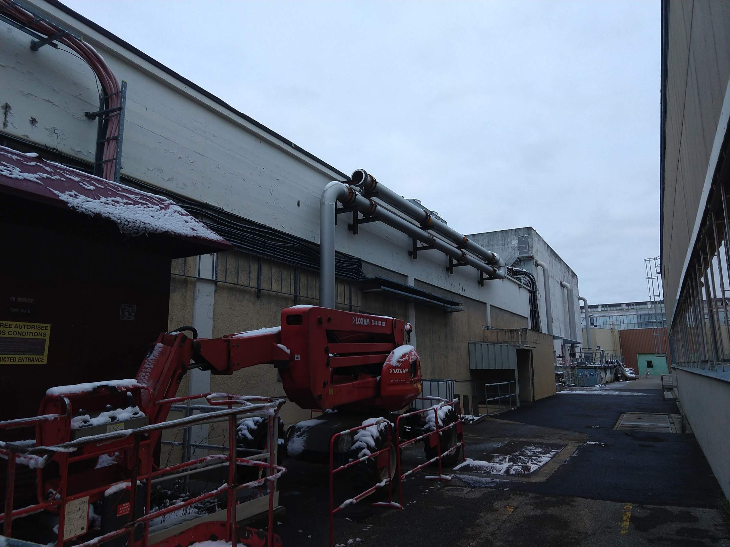
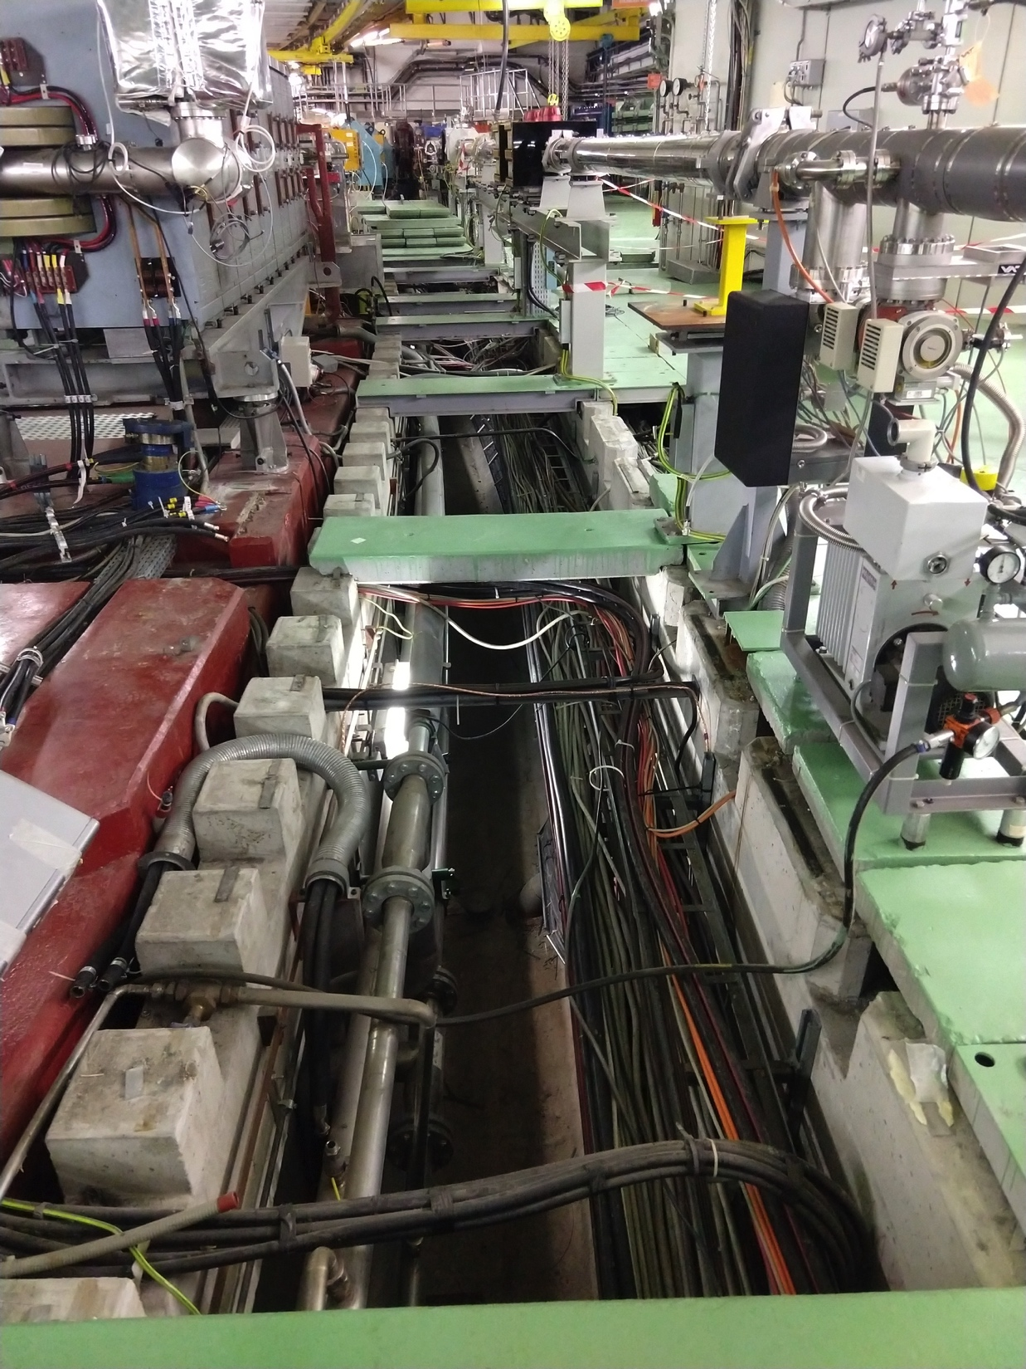
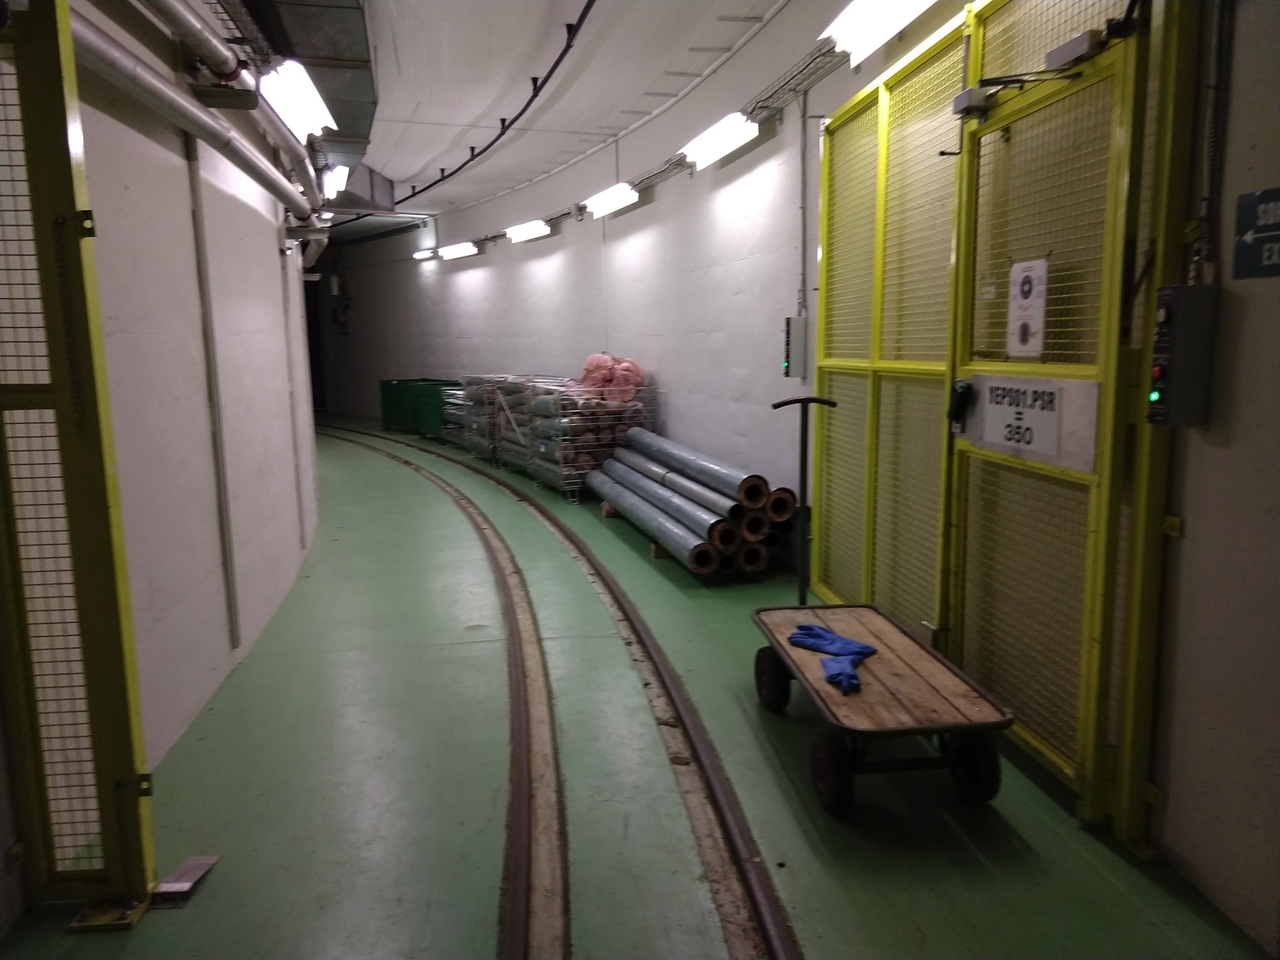
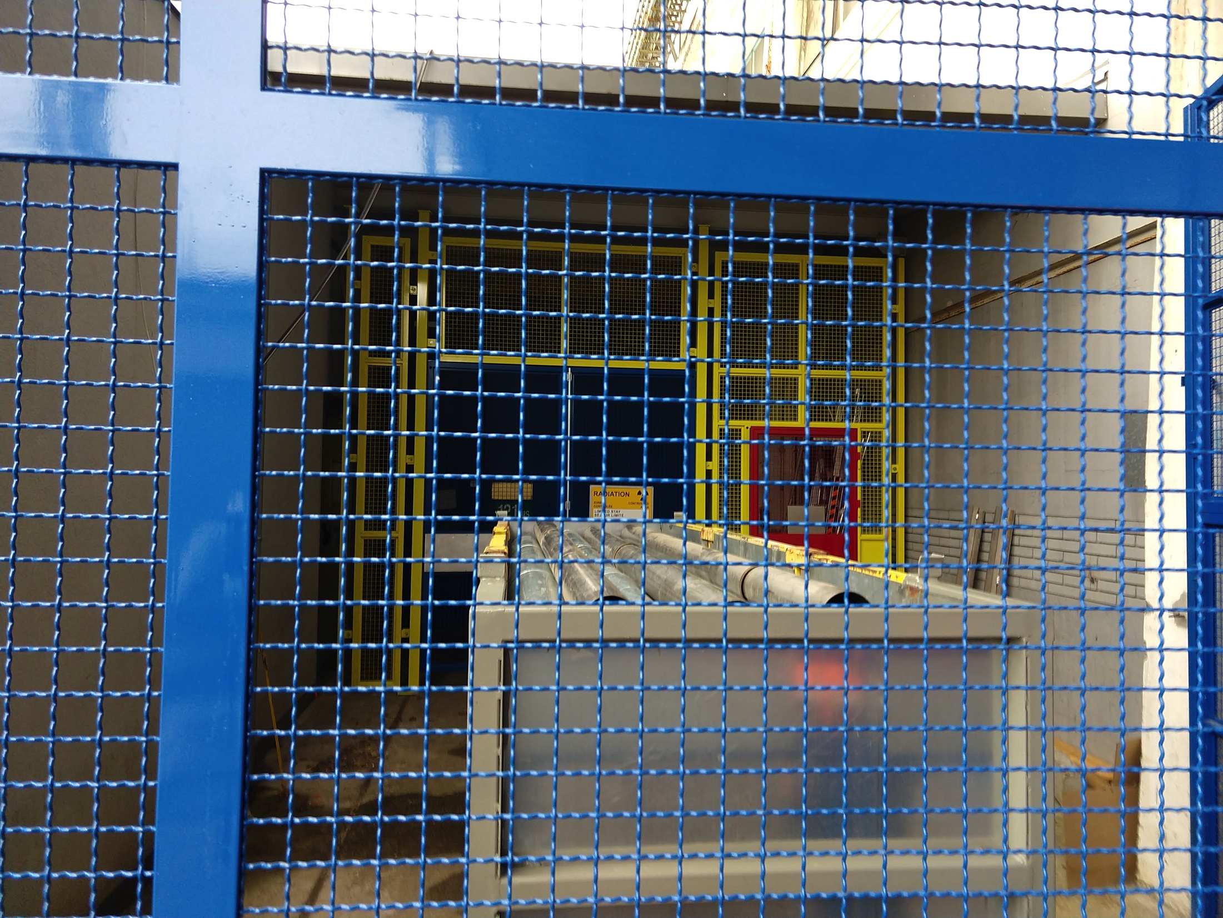
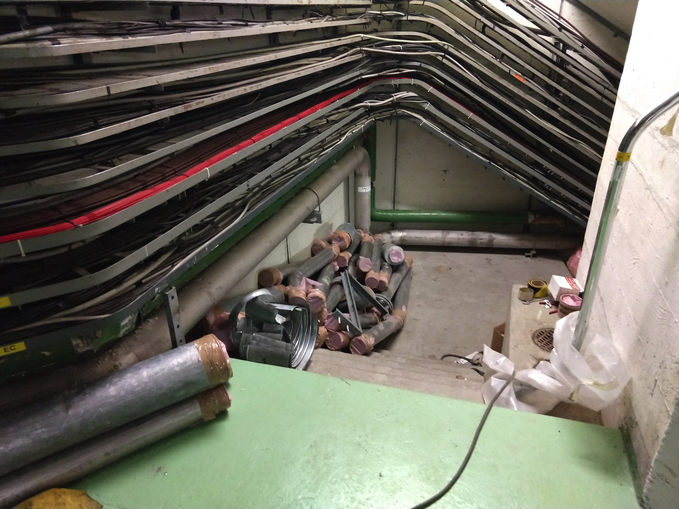
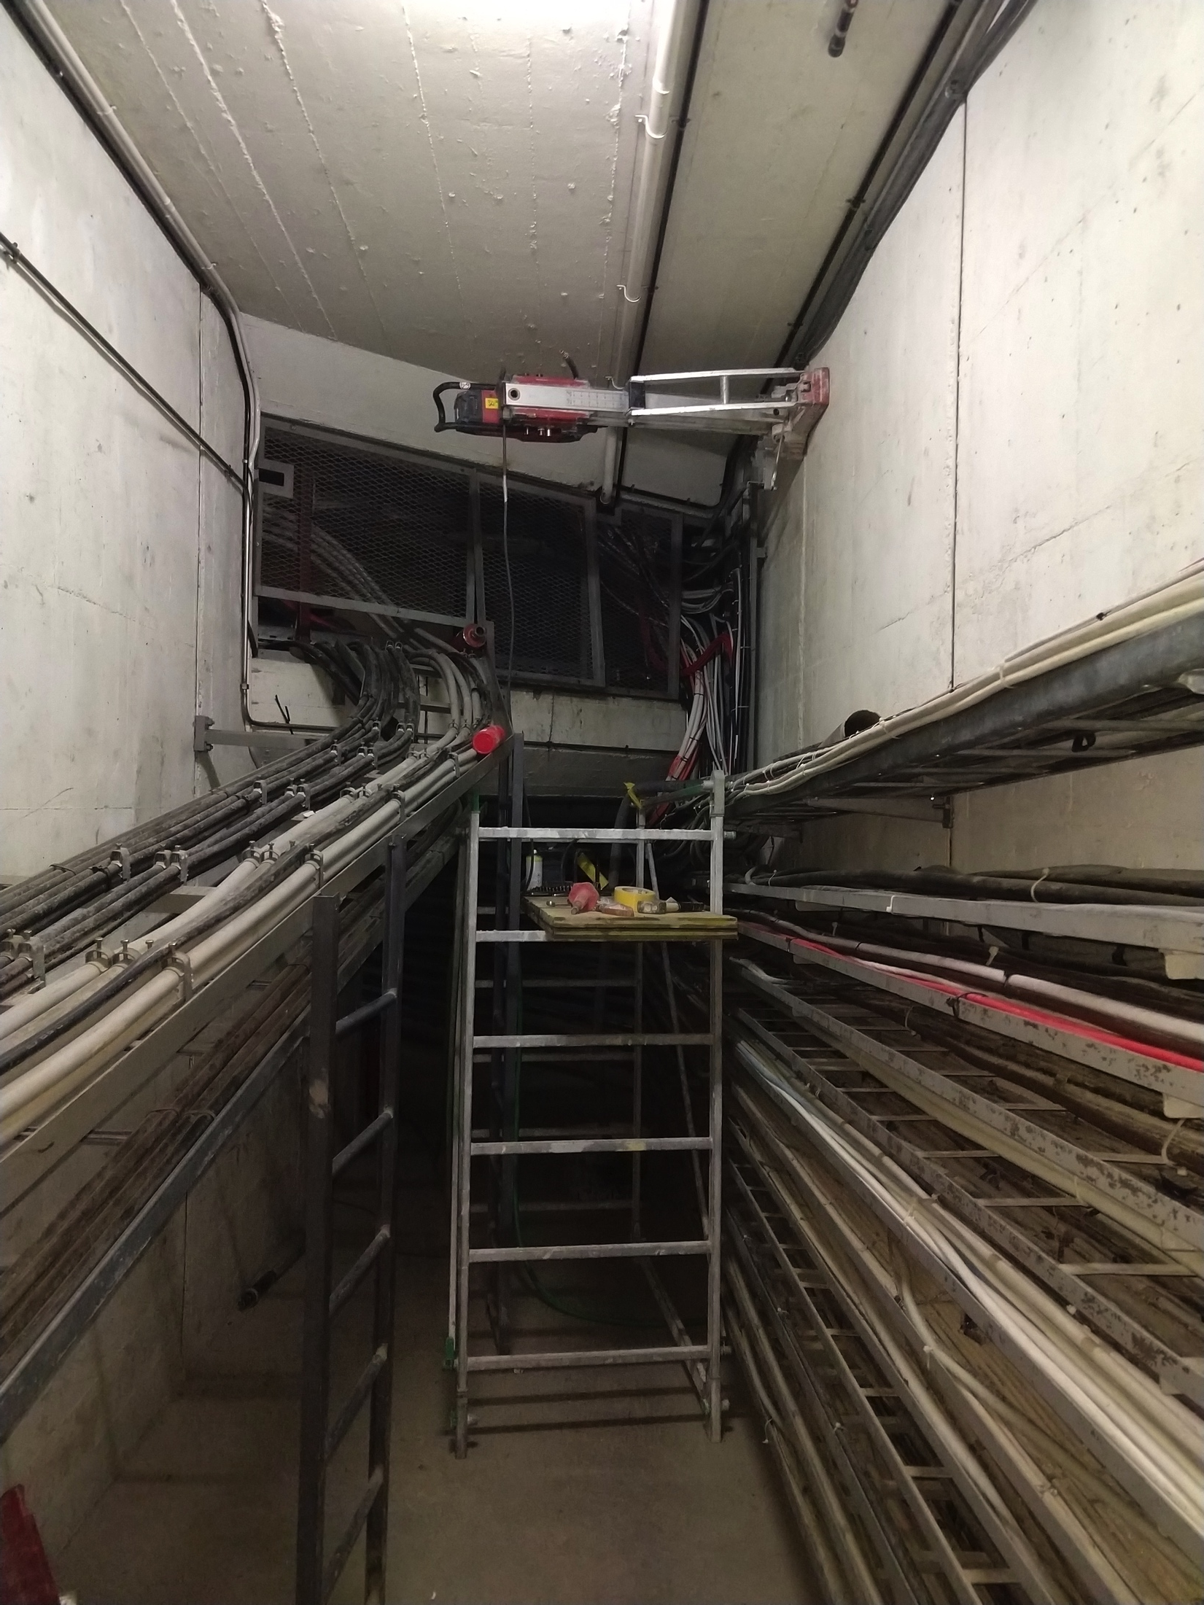
New demineralized water cooling
Works progressing well considering all the hiccups they had to overcome
Issues:
  Asbestos discovered in some supports in the PS SWY side
  Lead surveys need to be performed soon
  Integration
    In the PS SWY – solved now
    In the connection between B.355 and the gallery 1 – still to be solved (hopefully gets solved today)

Slide 8
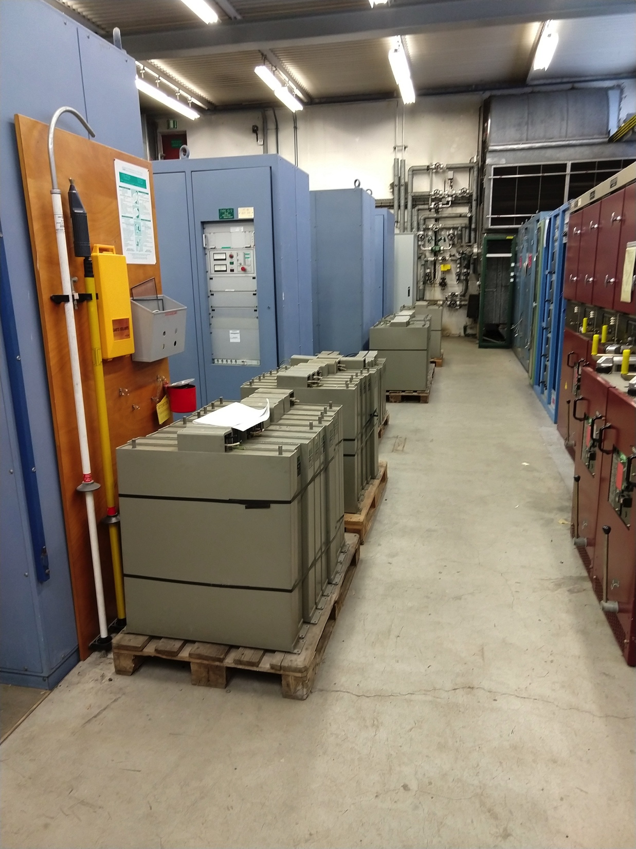
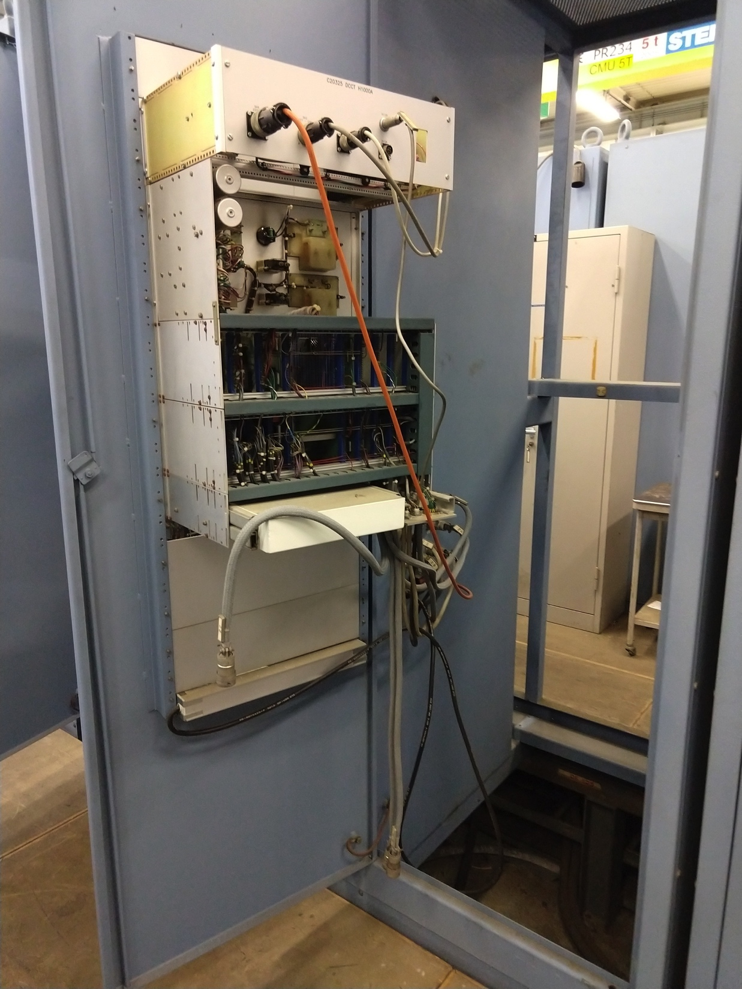
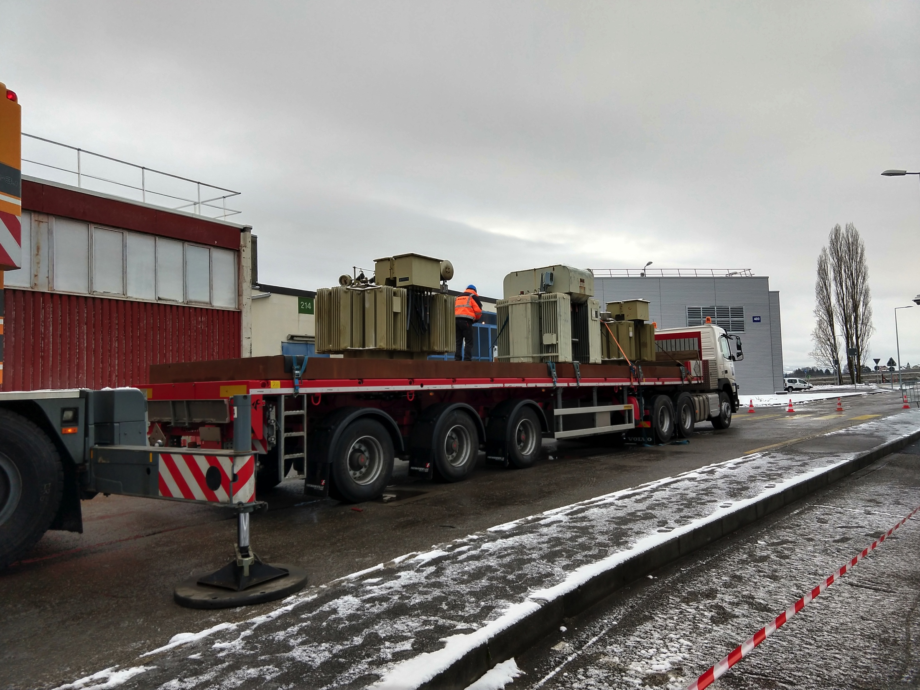
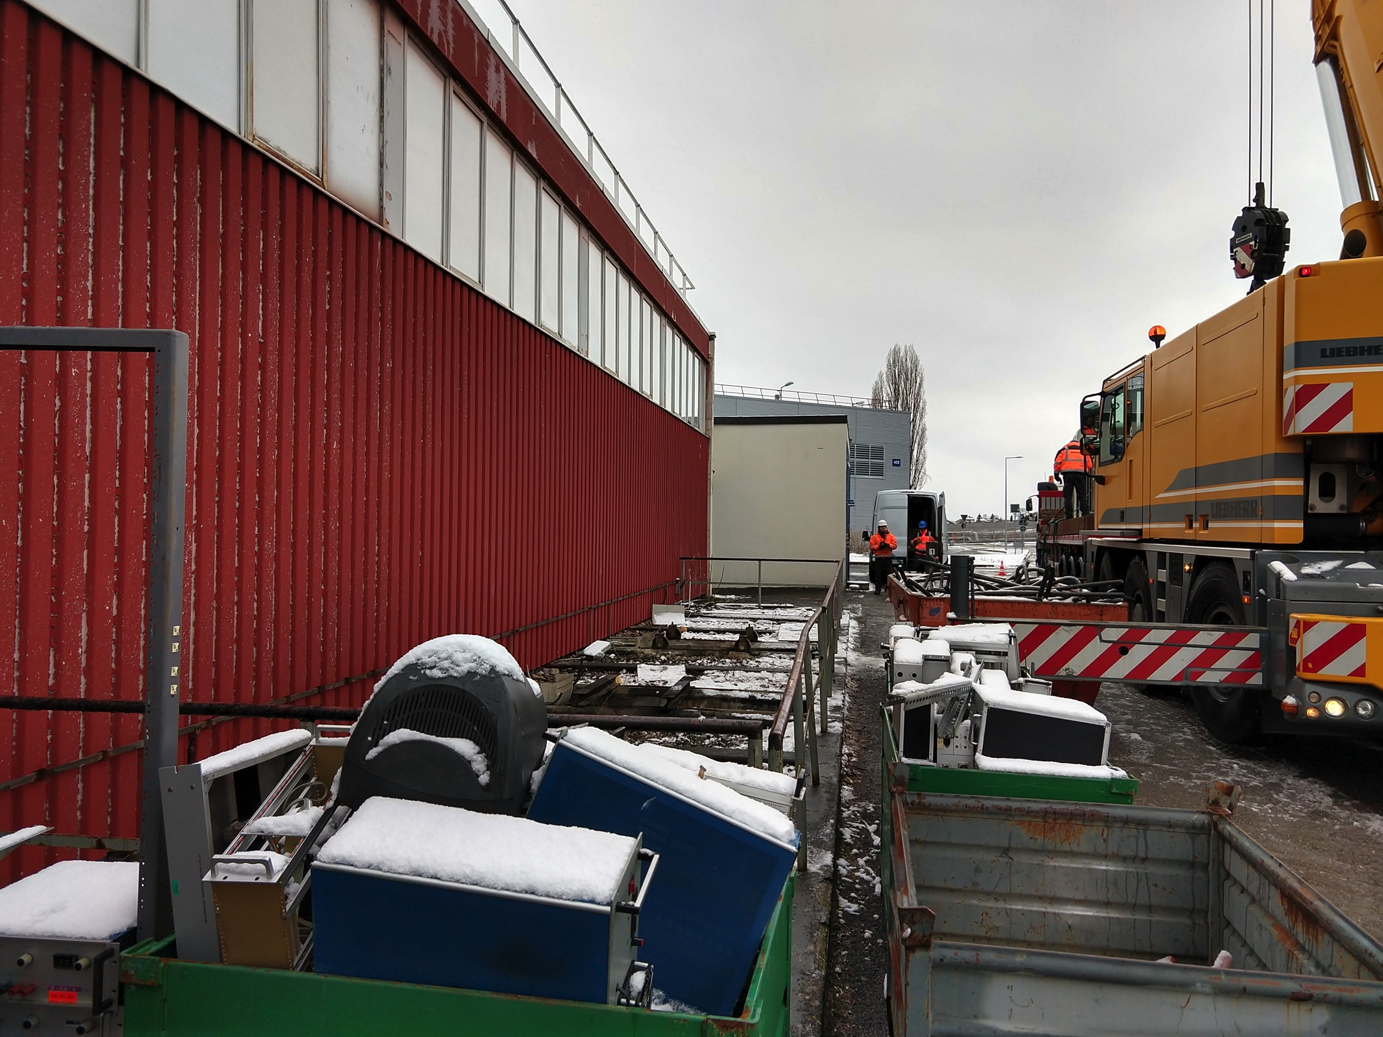
B.269
Disconnection and identification of cables already complete
Power transformers removed last Thursday (31/01/2019)
Separation between the two rooms is ongoing
Issues:
  Some minor issues with the AC cabling disconnection

Slide 9
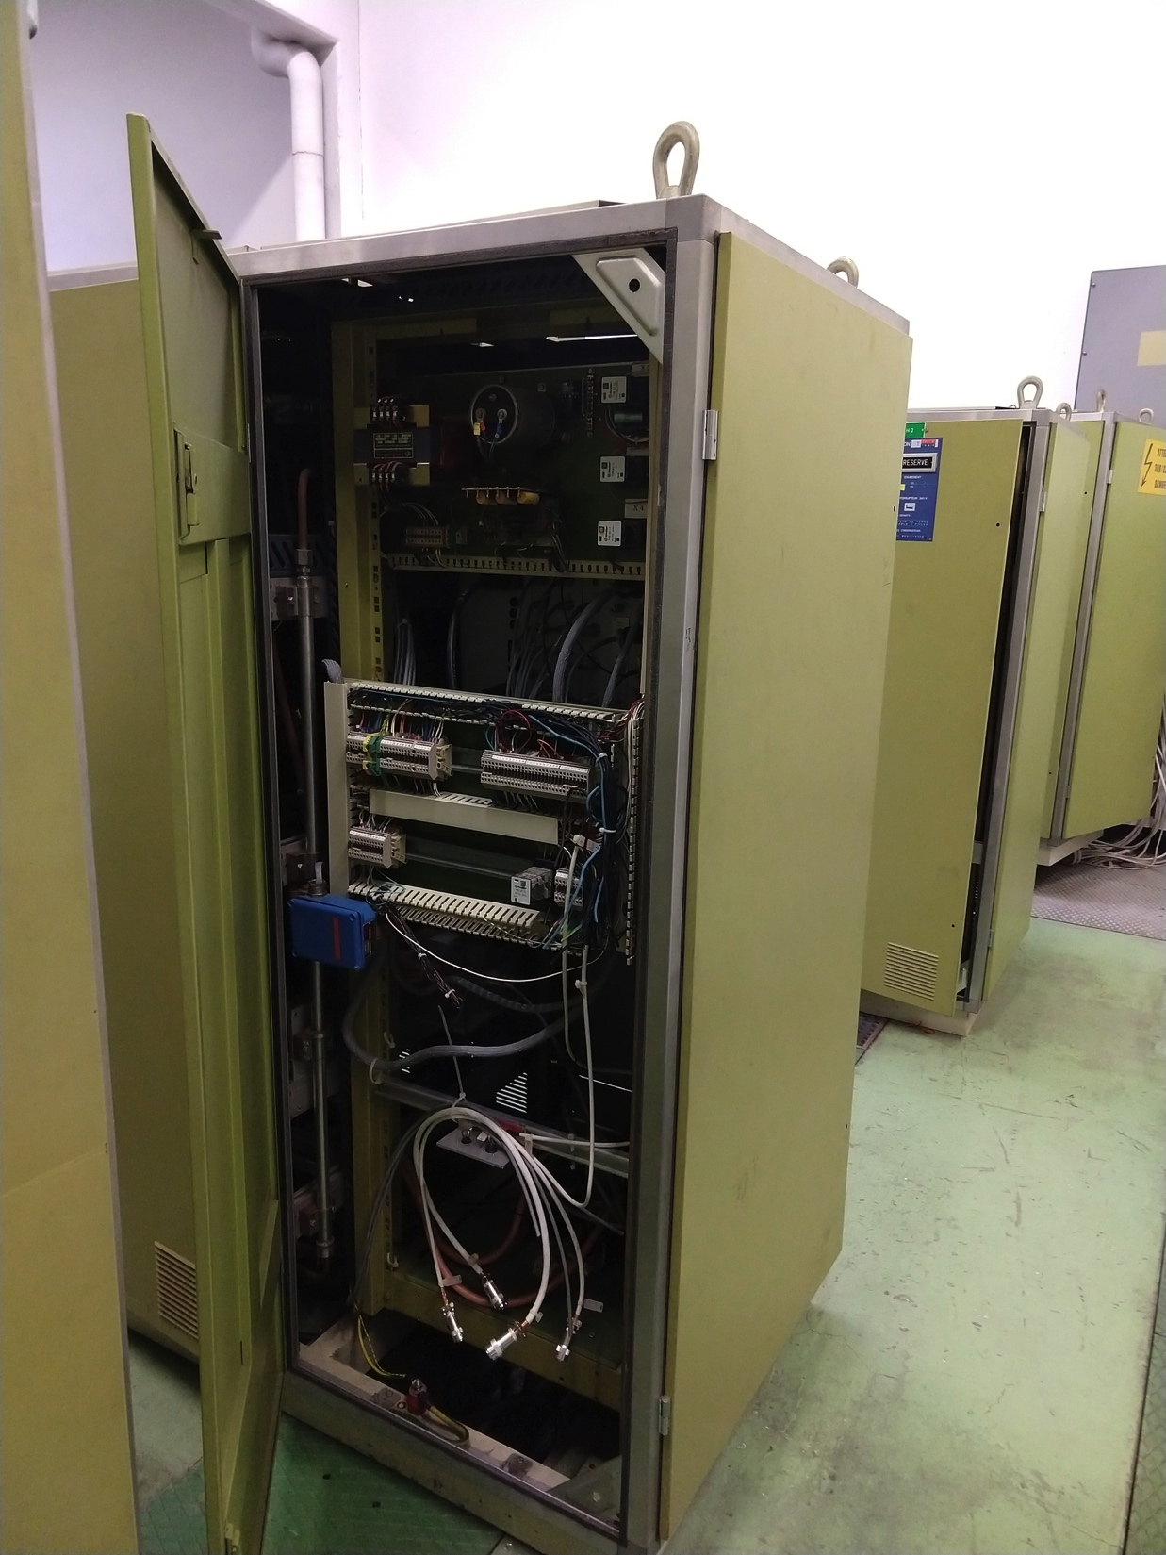
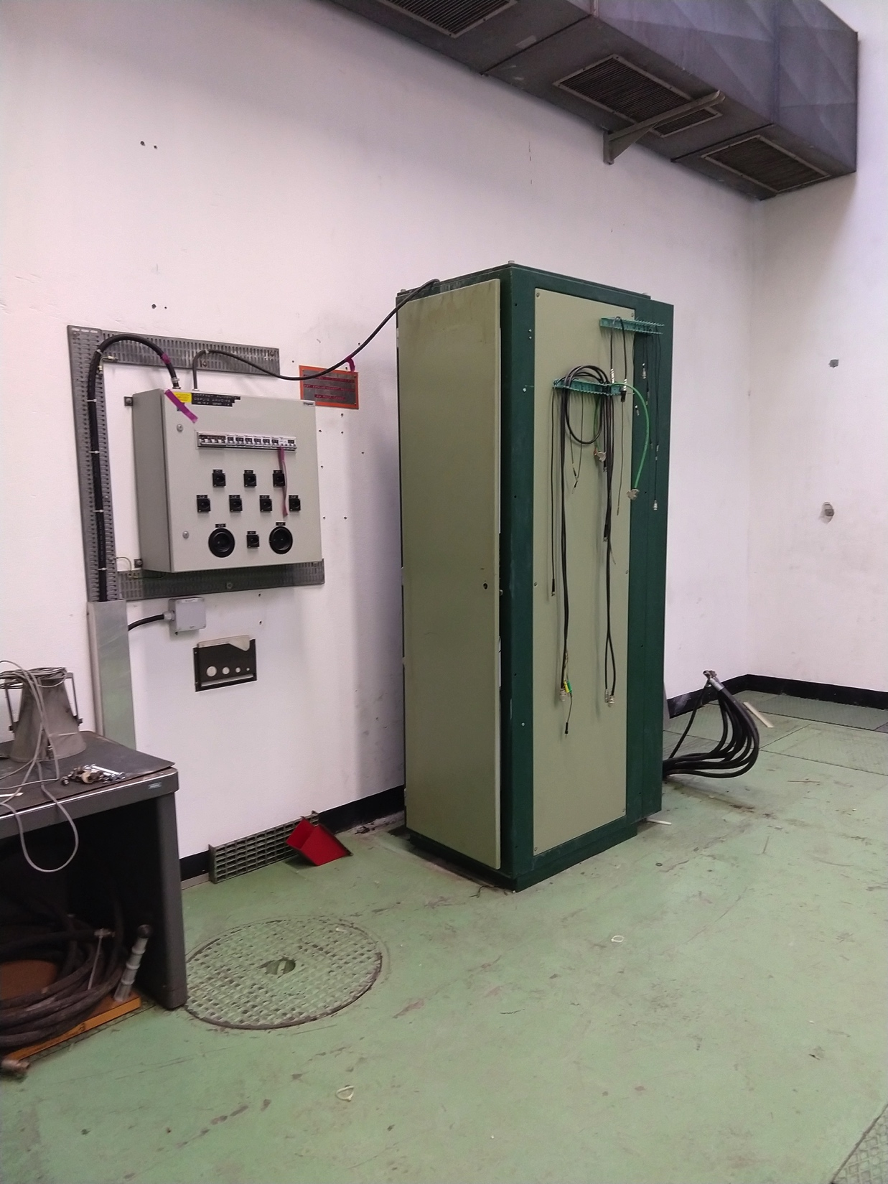
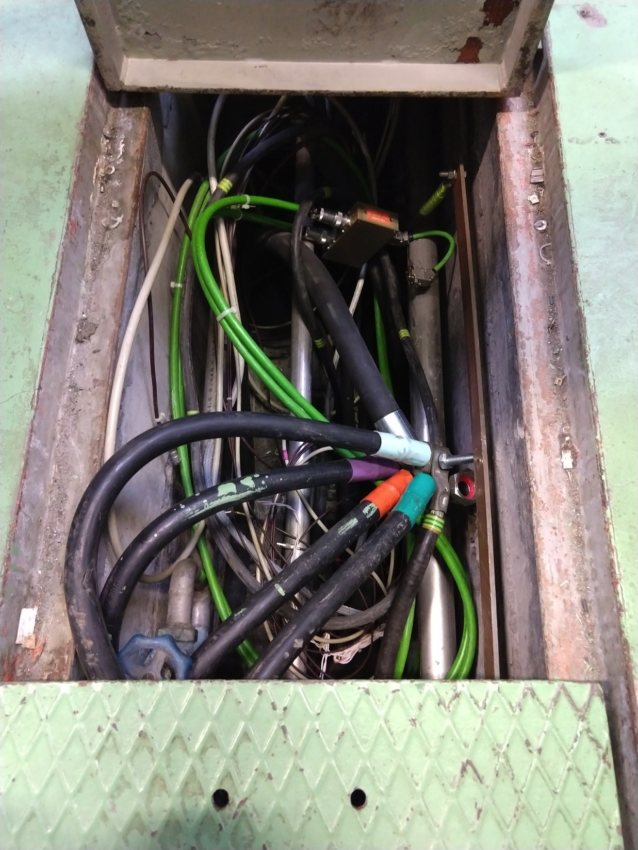
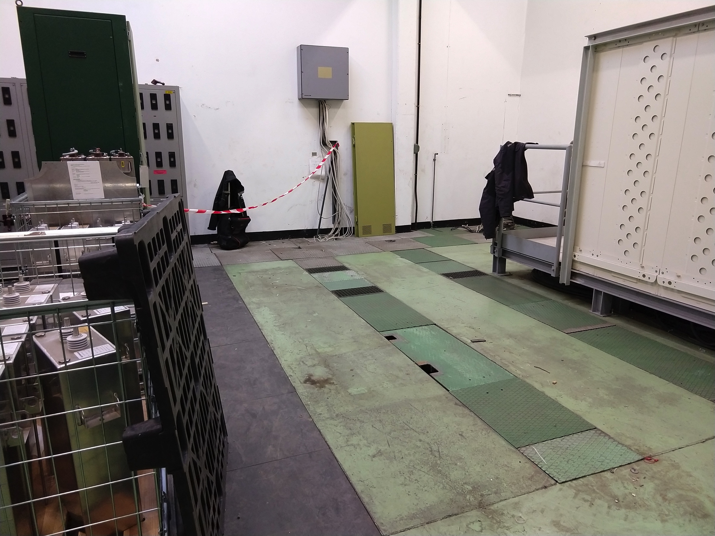
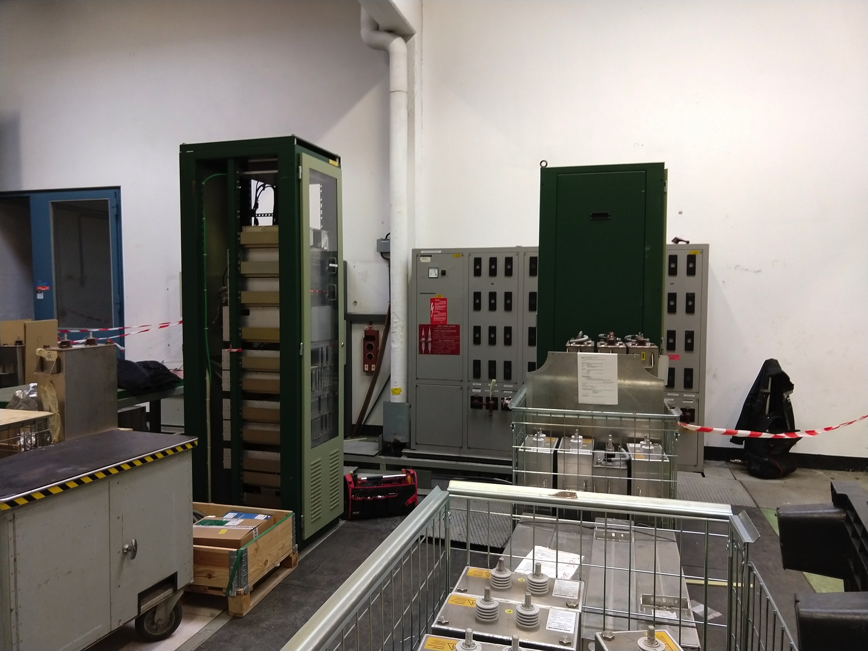
B.355
Disconnection performed
Power transformers already removed
Issues:
  One rack could not be removed as it was still connected to power
  Some cables don’t allow to close the false floor properly
  Most of the cables were not identified for future campaigns – ATC is trying to correct this
  Quite some material stored in the place where we need to install the TF racks – TE-EPC working on a solution

Slide 10
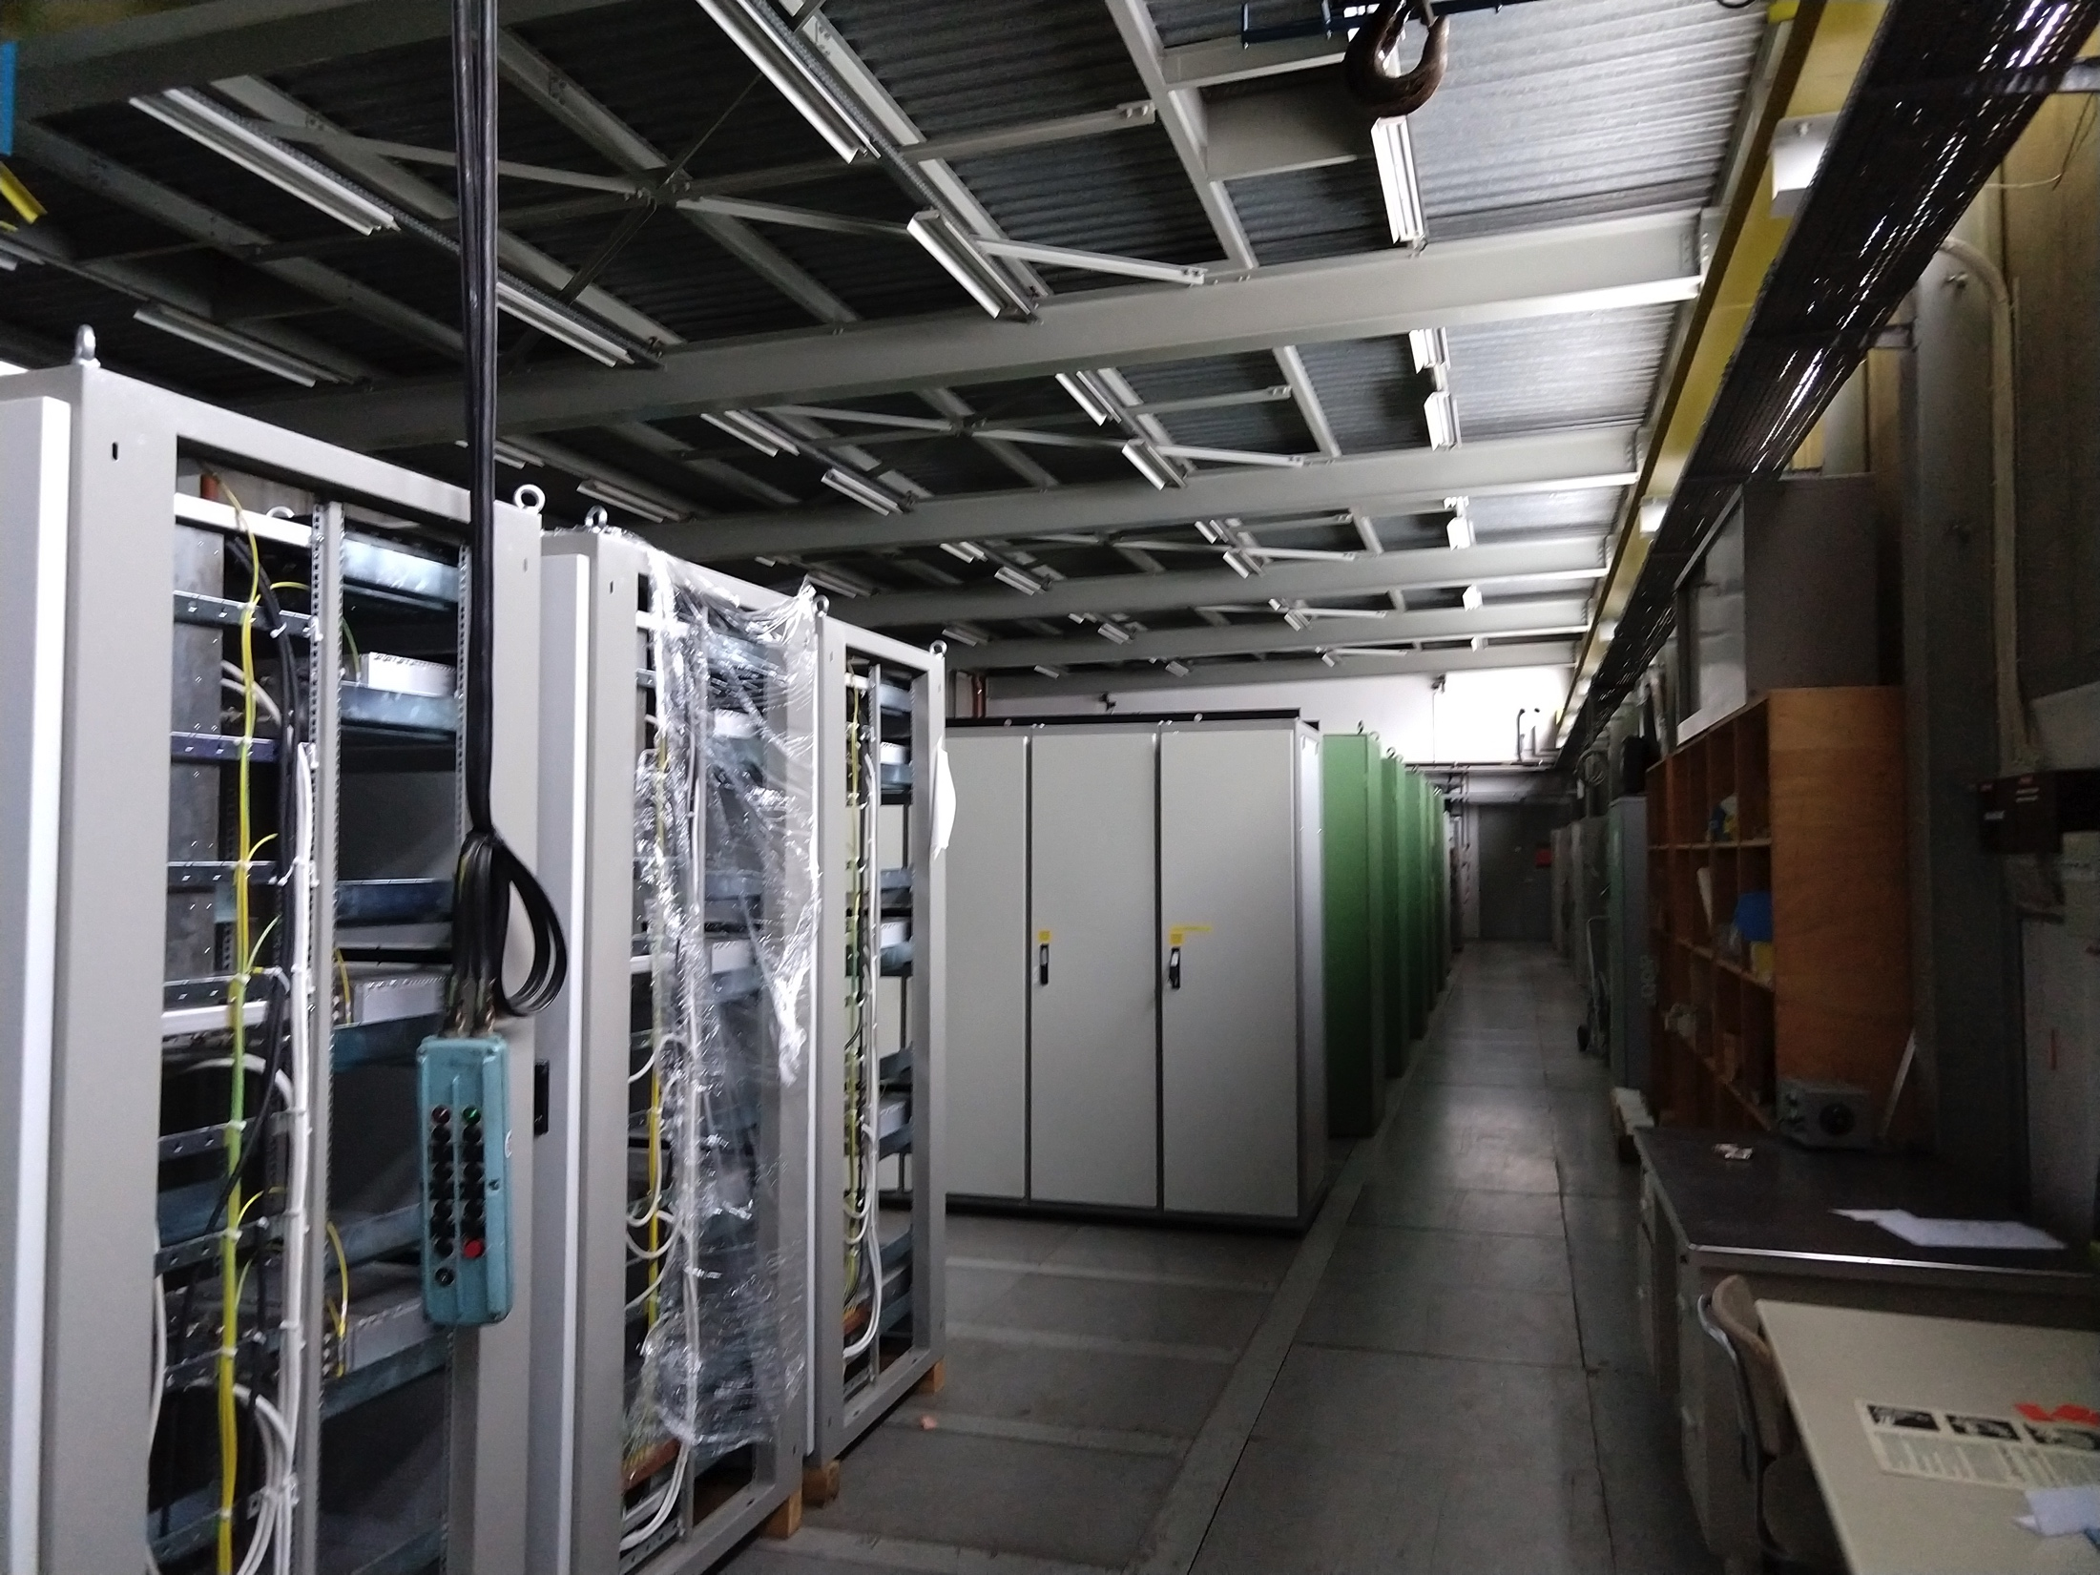
B.365
Disconnection and cable identification is still ongoing but it should be completed this week
Issues:
  Quite some material is stored in this room, so this may be a problem if not removed before we need to consolidate the false floor – TE-EPC is working on a solution for it

Slide 11
Question?

