Slide 2
PS Landau RF system checkpoint meeting summary
H. Damerau for the Landau RF System Study Group
LIU beam dynamics coordination meeting
5 February 2019
With contributions from F. Bertin, R. Calaga, L. De Mallac, N. Esfahani, G. Favia,
A. Lasheen, M. Morvillo, M. Paoluzzi, C. Rossi, E. Shaposhnikova

Slide 3
Introduction
End of 2017: Maximum intensity stuck at N_{b} ~ 2.1 · 10¹¹ p/b
  Coupled-bunch instabilities
  Significant uncontrolled emittance growth of the tail bunches
Recommendation from CMAC in Chamonix 2018, underlined again after March 2018 Cost-and-Schedule Review
  ‘Add the Landau cavity to the baseline for reaching the PS LIU intensity requirement.’
Landau cavity study working group launched in March 2018
  Study design of a dedicated RF system for Landau damping

Slide 4
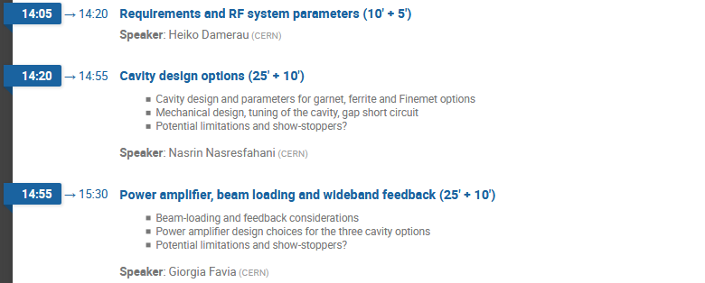
Introduction
End of 2018: N_{b} = 2.6 · 10¹¹ p/b within ε_{l} = 0.35 eVs reached
  New anode power converters for 40 MHz and 80 MHz RF
  Multi-harmonic feedbacks
Checkpoint meeting in two parts (https://indico.cern.ch/event/778836/):
Assume that dedicated system needed for Landau damping
  Technical design of Landau RF system for the PS
  Options for cavity and amplifier

Slide 5
Introduction
End of 2018: N_{b} = 2.6 · 10¹¹ p/b within ε_{l} = 0.35 eVs reached
  New anode power converters for 40 MHz and 80 MHz RF
  Multi-harmonic feedbacks
Checkpoint meeting in two parts:
Impact of improved performance with beam in 2018
  Beam measurements and simulation studies
  Potential benefits for SPS
Many thanks to all speakers!

Slide 6
Landau RF system design

Slide 7
Voltage requirement for Landau RF system
Benefits of Landau RF system at h₂/h₁ = 4 shown with beam
  No possibility for proof-of-principle beam test at h₂/h₁ = 3
  Little need for instability damping of fixed target beams
Reduced voltage requirement confirmed by simulations (BLonD)
  Optimum ratio: 0.15 (30 kV) for h₂/h₁ = 4
Final RF system design parameters:
 | Δf/f [%] | h₂/h₁ = 3, h = 63 | h₂/h₁ = 4, h = 84 | h₂/h₁ = 5, h = 105
2 GeV to 26 GeV | 5.3 | 28.49…30.04 MHz | 37.98…40.05 MHz
Transition to 26 GeV | 1.3 | 29.65…30.04 MHz | 39.53…40.05 MHz
Fixed target option | 6.8 | 28.49…30.51 MHz (h₂ = 63 and 64)
RF voltage |  | 60 kV (V₂/V₁ ≈ 0.3) | 40 kV (V₂/V₁ ≈ 0.2)

Slide 8
Design approach for Landau RF system
Main RF system design choices
  Default harmonic ratio, h₂/h₁ = 4
  Frequency range 37.98 to 40.05 MHz
  Distribute total voltage of ~40 kV over two cavities, i.e. ~20 kV per cavity
Why two RF stations?
  Improved reliability
    Conservative requirements per cavity
    Degraded operation mode for Landau damping with single cavity
  Moderate voltage per cavity allows ceramic gap
    Only beam pipe in vacuum
    Significant simplification of cavity design

Slide 9
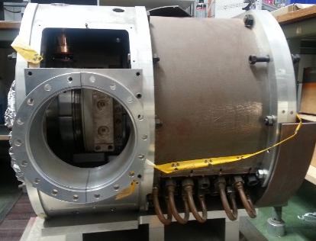
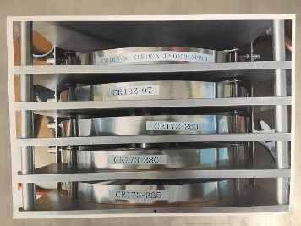
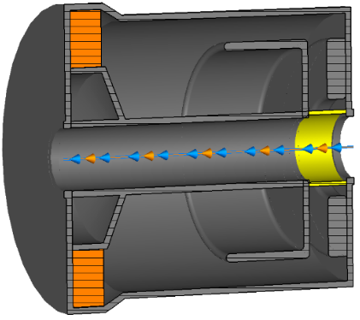
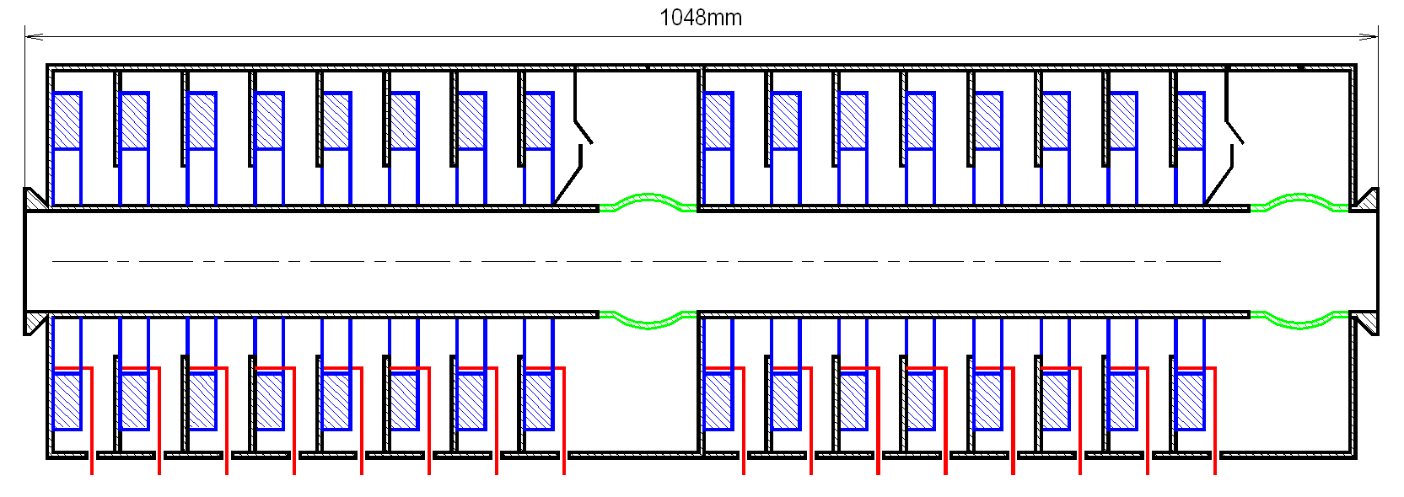
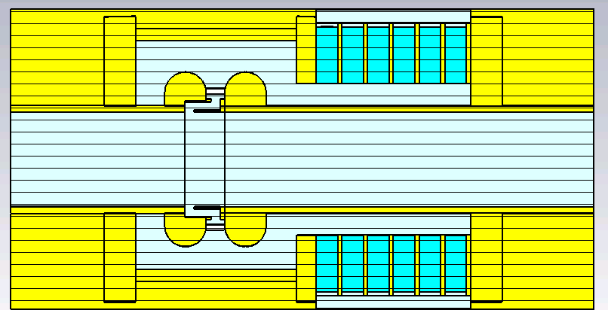
Overview of cavity options
N. Esfahani
garnet
Beam
capacitive loading
Garnet-based option:
  A coaxial resonator
  Provides the required tuning range through biasing garnet perpendicularly
  Small losses
Ferrite-based option:
Prototype of the existing 20 MHz cavities
Possibility to check the accuracy of simulation through measurements
Finemet-based option:
Wideband (low Q) option without tuning

Slide 10
 |  | Garnet-based option |  | Double gap option based on 20 MHz design | Finemet
 |  | Mushroom-like structure | Without additional capacitive loading
f (MHz) |  | 40.05 | 40.05 | ~40.05 | 40
Q unloaded |  | 8800 | 3000 | 280 | 31.8
R (kΩ) |  | 316 | 54 | 11.5 (each gap) | 1.9 (each gap)
P | Power (phase offset=0) | 17 kW | 22 kW | 30kW | 50 kW
 | Power (phase offset=30) | 55 kW | 60 kW | 68 kW | 66 kW
  Narrow-band impedance tuned with biasing
  garnet/ferrite
  Complexity: garnet biasing and tube amplifier in tunnel
  Parameters defined by length of garnet/ferrite section
  Impedance reduction with direct feedback
  No tuning is needed
  Simplicity
  Parameter defined by core characteristics
  and coupling ratio
  Direct RF feedback excluded
  Impedance covers several f_{rev} harmonics
N. Esfahani

Slide 11
Amplifier and feedback design
G. Favia
(Parameters per cavity unit) | Garnet tuned (mushroom-like loading) | Garnet tuned (no additional capacitive loading) | Ferrite tuned | Wideband Finemet cav.
Configuration | Single-gap, 20 kV | Single-gap, 20 kV | Double-gap/Central-gap 2 × 10 kV | Double gap, 2 × 10 kV
Quality factor, Q₀ | 8800 | 3000 | 280 | 31.6
Shunt impedance, R₀ | 316 kW | 54 kW | 11.5 kW/gap (5.75 kW ) | 1.9 kW/gap (3.8 kW)
Loaded shunt impedance, R_{L} | 11.5 kW | 9.8 kW | 1.9 kW | 0.95 kW/gap (1.9 kW)
Required current, I_{g} , at 0° | 1.7 A (I_{A}=3.4 A) | 2 A (I_{A}=4 A) | 5 A | 2 x 5 A (10 x I_{A}=14 A )
at 30° | 3.2 A (I_{A}=6.4 A) | 3.5 A (I_{A}=7 A) | 8 A | 2 x 6.6 A (10 x I_{A}=18 A)
Required RF power, P, at 0° | 18 kW | 20 kW | 25 kW | 50 kW
at 30° | 33 kW | 35 kW | 40 kW | 66 kW
Power amplifier | Tube (RS1084CJ) | Tube (RS1084CJ) | Tube (RS1084CJ) | Solid state (outside ring)
Beam impedance | < 1.5 kW, direct feedback | < 1.5 kW, direct feedback | < 1.5 kW, direct feedback | 1.9 kW (2 x 0.95 kW/gap)

Slide 12
Summary of cavity options
A preliminary design for an amplifier driving the three Landau system options has been developed, based on a preliminary design of the cavity
G. Favia
Garnet cavity
Ferrite cavity
Finemet
  RF tube complexity
  Coupling amplifier-cavity
  RF tube close to cavity
  Pre-amplification stage far
  Impedance reduction possible
  RF tube complexity
  NO coupling
  RF tube close to cavity
  Pre-amplification stage far
  Impedance reduction possible
  Consolidated SSA option
  NO coupling - Long feeder line
  All the amplification chain
  located far from cavity
  Impedance reduction
  NOT possible

Slide 13
Summary for cavity and amplifier options
No direct show stoppers for garnet- and Finemet-based options, tuning is difficult for ferrite cavity
Simulations benchmarked with measurements on an existing prototype 20 MHz cavity
Operation frequency of Finemet is extended to an unprecedented value of 40 MHz
Extrapolating from existing amplifiers technical design seems feasible for all three cavity options
Requirements on direct feedback of garnet and ferrite cavity options are not particularly tight
More detailed technical designs are required for decision

Slide 14
Outcome
of 2018 studies

Slide 15
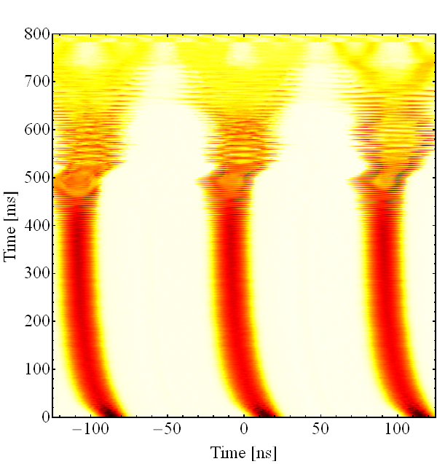
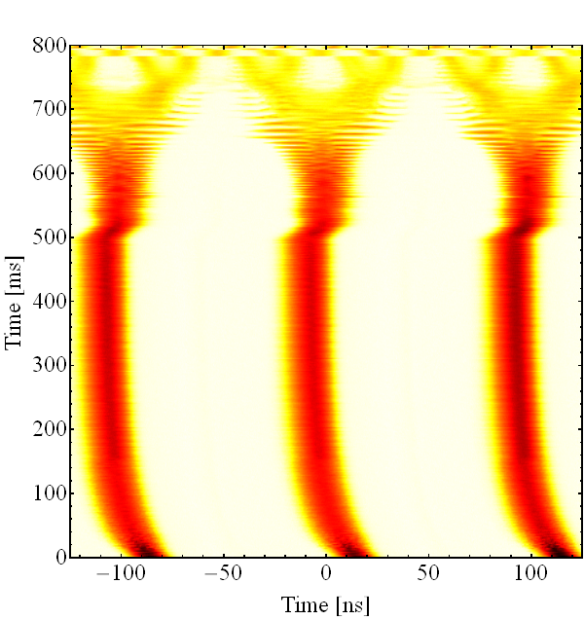
Existing 40 MHz cavity as Landau RF system
Evaluate benefit of on longitudinal stability during acceleration
  Disable coupled-bunch feedback ~225 ms after transition
  Significant stabilization due to higher-harmonic RF
  Stability margin beyond LIU baseline
  Further optimization: relative phase and voltage ratio
10 MHz only
10 and 40 MHz (in phase)
V_{h84}/V_{h21} ~0.1, 0.2 at flat-top
Feedback off
Feedback off

Slide 16
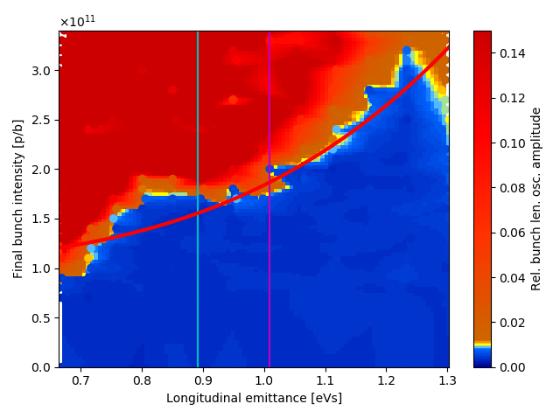
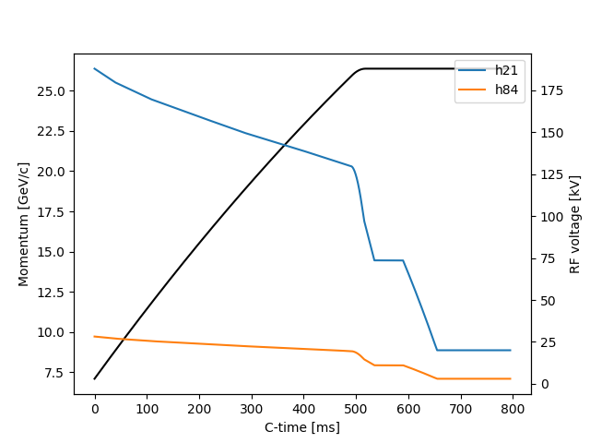
Simulations for single-harmonic case
A. Lasheen
Nominal
No BUP
Stability versus longitudinal emittance and bunch intensity
Simulations slightly too optimistic

Slide 17
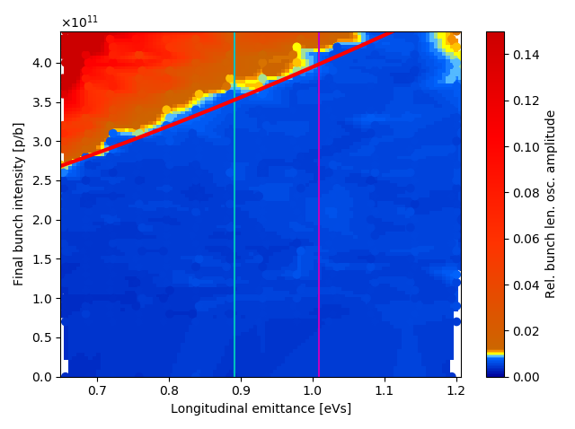
Simulations with Landau cavity
A. Lasheen
Nominal
No BUP
Stability versus longitudinal emittance and bunch intensity
Simulations slightly too optimistic
Example: RF system at 4th harmonic of main RF and at 15% voltage
Doubles stability margin
Little influence of impedance due to additional Landau RF system

Slide 18
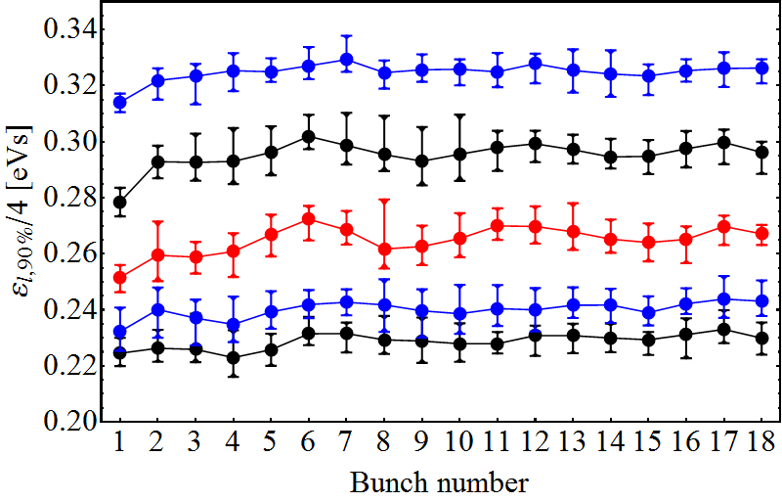
Stability margin (25 ns, 72 bunches)
Explored minimum longitudinal emittance, ε_{l} with all upgrades together
  1-turn delay feedbacks (all 10 MHz cavities)
  Multi-harmonic feedbacks (1 × 40 MHz and both 80 MHz cavities)
  Coupled-bunch feedbacks (Finemet damper and C10-86/C10-96)
  40 MHz Landau RF system (C40-78 only, acceleration and flat-top)
ε_{l} (90%) at start of flat-top, per bunch at ejection
versus controller blow-up after transition, 2.6 ∙10¹¹ p/b
Blow-up 4 with 4×4.5kV
Corresponds to nominal ε_{l} at extraction
3×4.5kV
2×4.5kV
1×4.5kV
Margin to deliver 10…15% smaller emittance
Limitations due to beam-loading (RF current) beyond
No blow-up after transition

Slide 19
Stability margin (25 ns, 72 bunches)
Longitudinal LIU baseline parameters reached at PS extraction
  Anode power converter upgrade and multi-harmonic feedbacks
  0.2 - 0.3 ∙ 10¹¹ p/b improvement from 2017 to 2018 not understood
Existing 40 MHz cavities with new anode power converters usable above ~13 GeV
  Beneficial effect on beam stability observed
Limitations with existing cavities
  Maximum RF voltage limited to <28 kV (sum of both cavities)
  Higher-harmonic operation at lower energies excluded
Smaller longitudinal emittance
  Stable at start of flat-top down to minimum emittance compatible with LIU baseline
  Potential issues with beam-loading: I_{RF} (h=84) in 40 MHz cavities
  Splitting smaller ε_{l} at flat-top

Slide 20
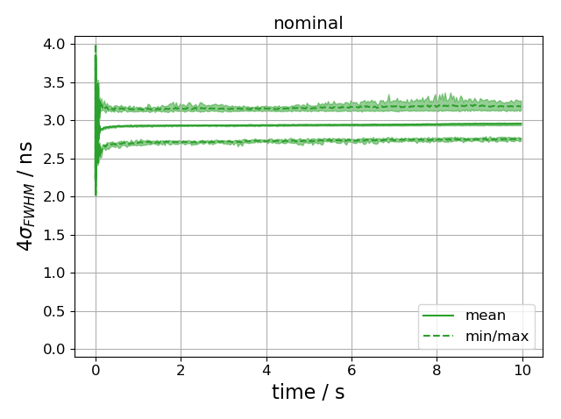
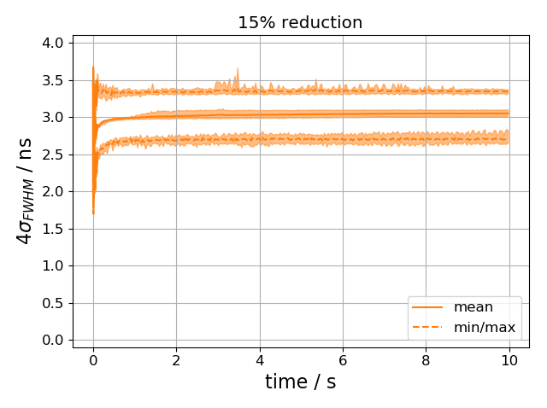
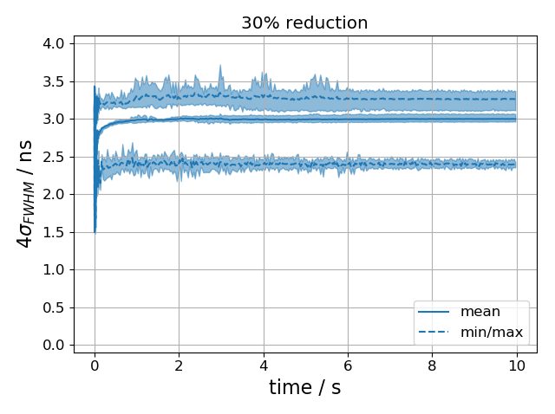
Simulated bunch lengths in post-LS2 SPS
M. Schwarz
Nominal emittance
~15% reduced emittance
~30% reduced emittance
shaded region indicate
range for different seeds
No strong instability on flat-bottom (no increase in mean bunch length)
Individual bunches become unstable (increase in maximum bunch length);
especially for very low emittance
Final mean bunch length is 3 ns in all cases
Minimum bunch length smaller for smaller emittances (filamentation?)

Slide 21
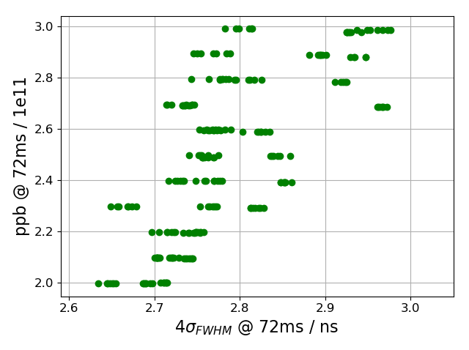
Simulated instability threshold post-LS2 SPS
M. Schwarz
48 bunches, 25ns spacing, Q20, vary bunch intensity
No strong instability up to 3.0 ∙ 10¹¹ p/b, even for very low emittance bunch!
Losses below 1% (limitation by momentum aperture was not included)
Reducing the emittance by 15% reduces capture losses by two third (critically depend on amount of halo particles)

Slide 22
Findings, comments and suggestions

Slide 23
Findings
No obvious show-stoppers for cavity and amplifier design of dedicated Landau RF system for PS
LIU-PS baseline intensity of 2.6 ∙ 10¹¹ p/b reached in 2018
  New anode power converters and multi-harmonic feedbacks
  Improvement of 0.2 - 0.3 ∙ 10¹¹ p/b since 2017 not identified
Operation of existing 40 MHz cavities during final part of accel-eration improves stability, resulting in ~15% emittance margin
Existing 40 MHz cavities can only be operated as Landau
RF system above ~13 GeV leaving a gap of 180 after transition
Longitudinal emittance and halo crucial at PS-SPS transfer
  Requires longitudinal emittance below baseline?

Slide 24
Comments and suggestions
Keep dedicated RF system for Landau damping as back-up option, no strong argument for immediate implementation
Finish conceptual RF system design
  Complete evaluation of 4-core shroud for Finemet options and tests with improved material at KEK
  Characterize garnet material; build and measure radially scaled model
Document results of cavity and amplifier design study
Consolidate present 40 MHz RF system for operational use as Landau RF system above 13 GeV
  Evaluate limitations of power amplifier and feedback chain
  Study implementation of LLRF controls and impact on
  multi-harmonic feedback strategy
  Propose and implement improvements
Continue beam dynamics study effort in view of improved
PS-SPS transfer
  Smaller longitudinal emittance? How to reduce halo?

Slide 25
THANK YOU FOR YOUR ATTENTION!

