Slide 2


B⁰ → K_{s}π⁺π⁻γ at LHCb
Boris Quintana, Olivier Deschamps, Biplab Dey, Yuehong Xie
LPC Clermont-Ferrand, CCNU

Slide 3
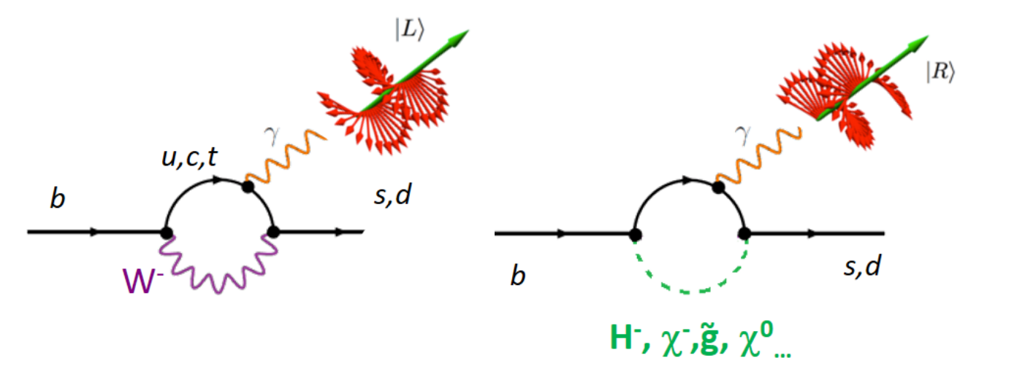
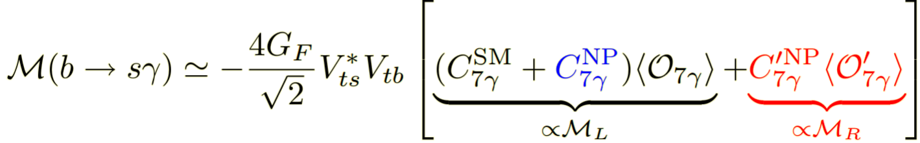
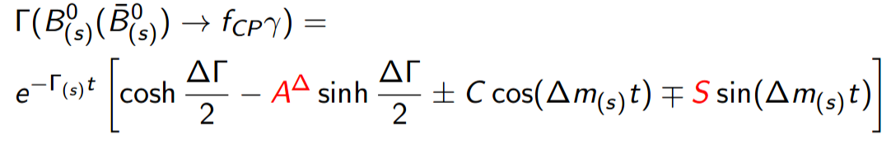
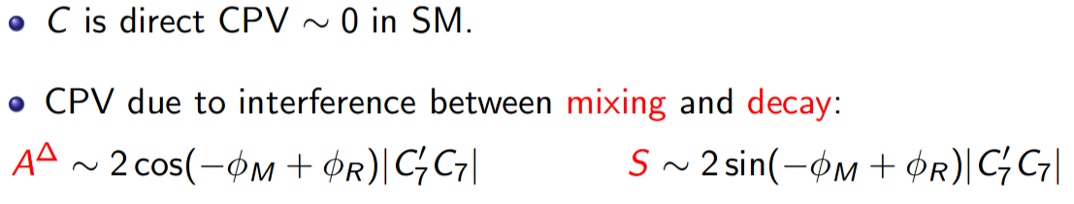
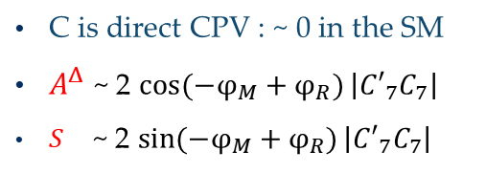

Indroduction
In the SM, b →s γ FCNC transitions occurs through
loop diagrams ➔
W-boson couples only to left-handed particles :
  b → s γ_{L} || $\overline{\text{b}}$ → $\overline{\text{s}}$ γ_{R}
In case of new physics, a significant amount of right-handed photons could be produced
Several ways to constrain C₇⁽'⁾ :
BR(B→X_{s}γ) $∝$ |C₇|²+|C′₇|²
A_{UD} $∝$ |C₇|²−|C′₇|² in 3-body decays like : B⁺→K⁺π⁺π⁻γ
Time-Dependent CPV analysis : B → Φ_{CP} γ (K _{S}⁰ π⁰ , K _{S}⁰ ρ⁰ )
C is direct CPV : ~ 0 in the SM
$A^{Δ}$ ~ 2 $\cos{(−φ_{M}+φ_{R})}\left|{C′}_{7}C_{7}\right|$
$S^{}$ ~ 2 $\sin{(−φ_{M}+φ_{R})}\left|{C′}_{7}C_{7}\right|$
$$Γ\left(B_{}^{0}\left(\overline{B_{}^{0}}\right)→ f_{CP}γ\right)=e^{−Γt}\left[\cosh{\frac{ΔΓ}{2}}− A^{Δ}\sinh{\frac{ΔΓ}{2}}±C\cos\left(∆mt\right)∓S\sin{(∆mt)}\right]$$

Slide 4
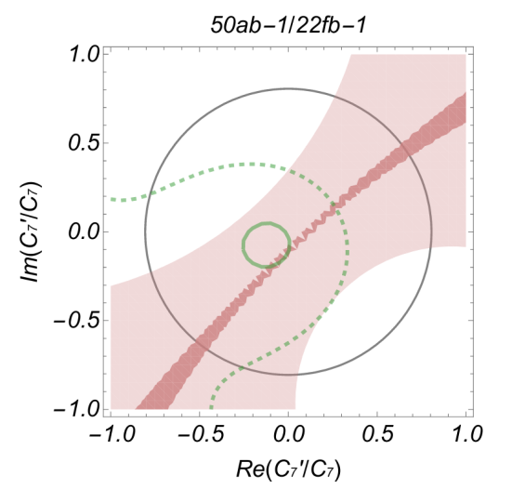
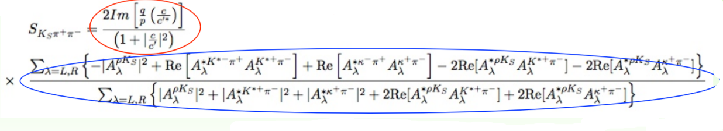
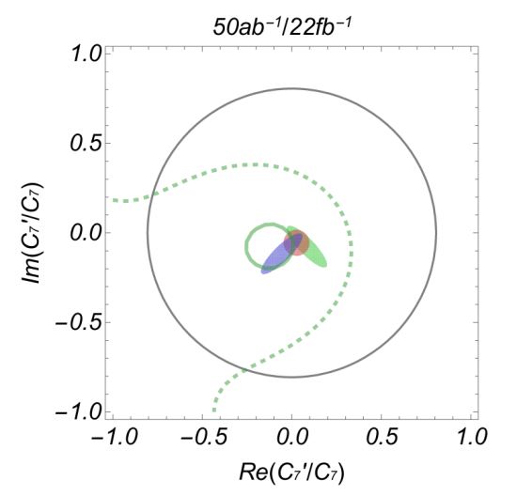
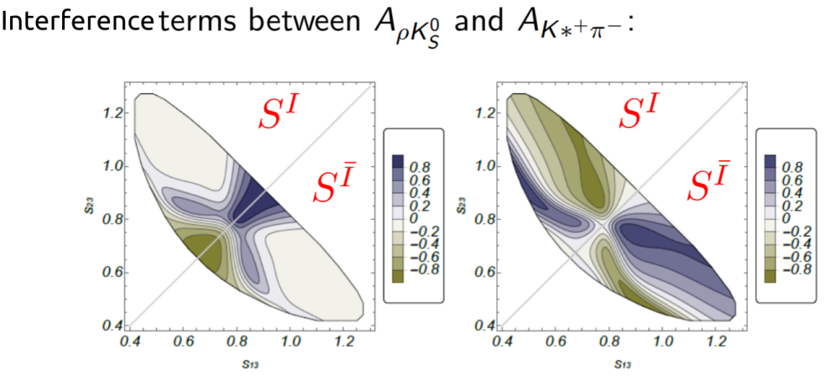

Time Dependent CPV
K _{S}⁰ π⁰
CP asymmetry in B⁰→π⁰K⁰_{S}γ decays, S_{π}0_{K}0_{Sγ}=−0.15±0.20
Expected precision at Belle II
Angular coefficients from B→K∗e⁺e⁻ at LHCb :
Current BR(B→X_{s}γ)
This mode is hardly accessible at LHCB ..
K _{S}⁰ ρ⁰
Photon polarisation
Dilution factor due to
Can constrain both Re(S) and Im(S)
arXiv:1802.09433

Slide 5
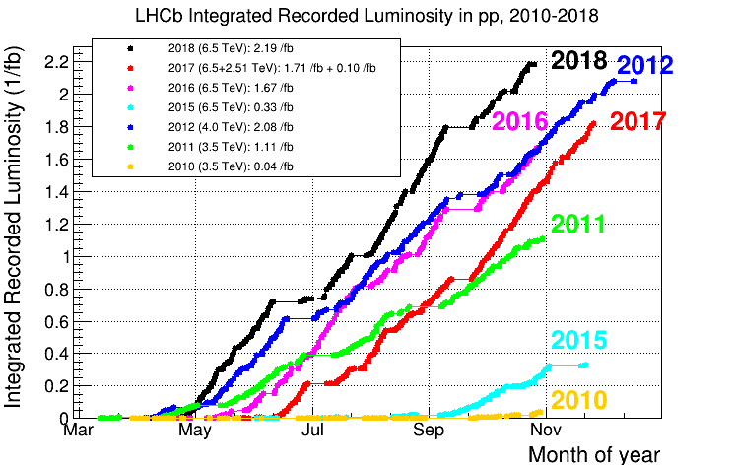
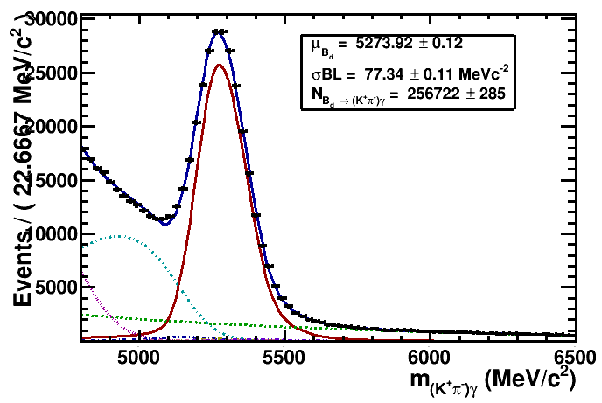
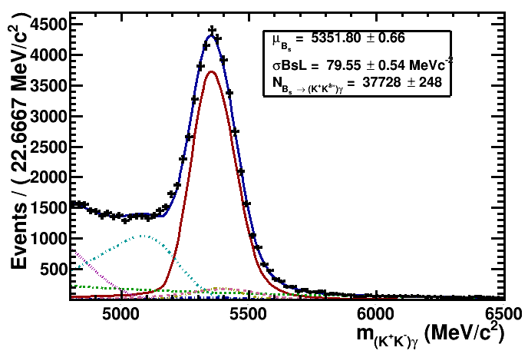
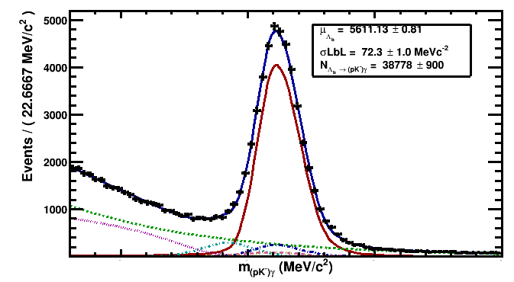

Radiative Decays @LHCb
Run I : (2010-2012)
- 7-8 TeV pp collisions
- Integrated luminosity : 3 fb ⁻¹
~2x10 ¹¹ b$\overline{\text{b} }$ in the detector acceptance
Run II (2015-2018)
13 TeV pp collisions
Integrated luminosity : 6 fb ⁻¹
Production rate increased by ~ 2
h⁺h⁻γ modes production :
B⁰ → Kπ γ
B⁰ → KKγ
Λ_{b} → pK γ
LHCb Unofficial
LHCb Unofficial
LHCb Unofficial

Slide 6
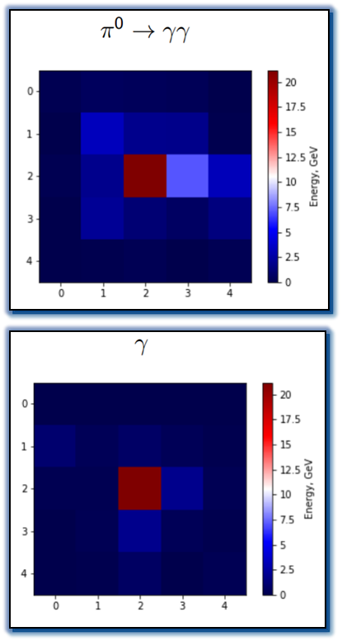
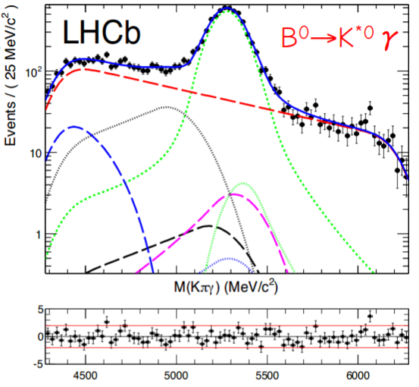
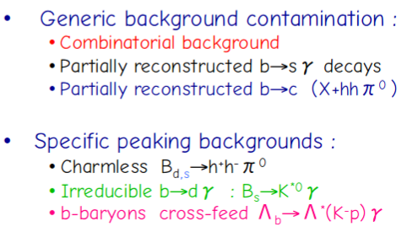
Radiative Decays @LHCb (2)
Two types of photons :
Calorimetric photons : unconverted photons (or conversion after the magnet)
Converted photon : di-electron conversion before the magnet
High calorimeter occupancy => Large combinatorial background
Polluted by high P_{T} π⁰ producing a single cluster in the Electromagnetic Calorimeter
Mass resolution driven by calorimeter resolution :
  σ_{M}(B→Xγ) ~ 90 MeV/c² => possibly numerous backgrounds under the signal peak !

Slide 7
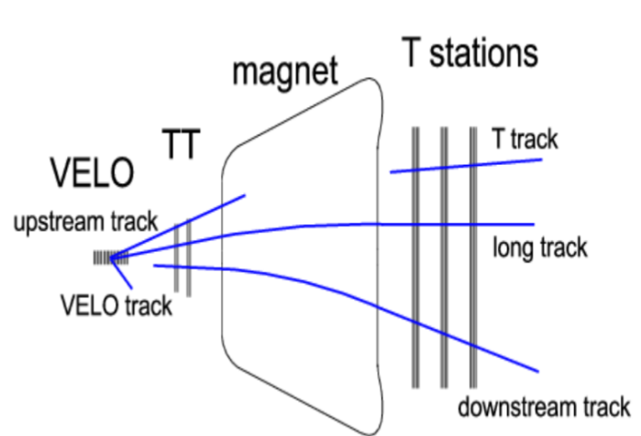
B_{(s)} → K_{s}h⁺h⁻γ
LHCb analysis based on centralized productions of reconstructed data set pre-filtered according to selections provided by working groups
B_{(s)} → K_{s}h⁺h⁻γ modes selected using a semi-inclusive pre-filtering of these modes
Pre-filter selection is based on
  kinematical criteria : P_{T}, invariant masses
  topological criteria : IP, vertex quality and separation
  relies on high-pt γ identified at L0-trigger level
  K_{s} can be either LL (Long tracks) of DD (Downstream tracks ) :

Slide 8
Analysis strategy
Analysis is in a preliminary state..
.. but the strategy has been set and applied on the control channel B⁰ → K*⁰ (→Kπ)γ :
Data from 2011-2012 & 2015-2018
Reconstruct all K_{s}h⁺h⁻γ and h⁺h⁻γ events as the modes we are willing to use
(K_{s}π⁺π⁻γ, K_{s}K⁺π⁻γ, Kπ γ, KK γ,pKγ )
  Apply particle identification to the (mis-)reconstructed hardons : h± => K±, π±, p
Apply standart cuts from radiative decay analyses
Train a BDT against combinatorial background
Use MC studies to estimate background contaminations and shapes
Fit simultaneously the (K_{s})h+h-γ that can contribute to the signal (control) mode to control directly the contamination

Slide 9
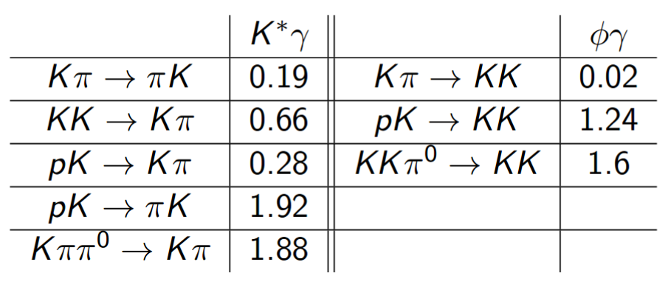



Control channel
(K_{s})h+h-γ reconstructions and PID selection :
Classify h⁺ h⁻ γ candidates according to PID information (RICH)
Use Monte Carlo and Calibration data to estimate mis-ID rate (cross-feeds)
hhγ
Reconstruction
PID selection
Exclusive samples
Data samples
$$\text{B}\text{d}\text{ →}\text{(}\text{K} \text{π}\text{) }\text{γ}$$
h₁ h₂ → Kπ
h₁ h₂ → πK
$$\text{B}\text{s}\text{ →}\text{(}\text{K} \text{K}\text{) }\text{γ}$$
Cross feeds K π
h₁ h₂ → K K
Λ_{b}$\text{→}\text{ (}\text{p} \text{K}\text{) }\text{γ}$
h₁ h₂ → p K
Cross feeds KK
+ BKG
h₁ h₂ → K p
Cross feeds PK

Slide 10
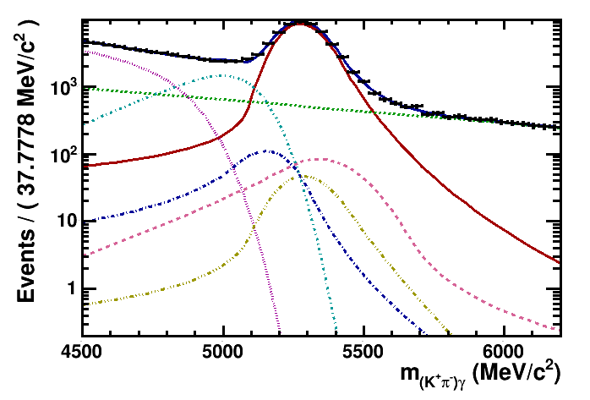
Control channel
(K_{s})h+h-γ reconstructions and PID selection :
Classify h⁺ h⁻ γ candidates according to PID information (RICH)
Use Monte Carlo and calibration data to estimate mis-ID rate (cross-feeds)
hhγ
Reconstruction
PID selection
Exclusive samples
Data samples
$$\text{B}\text{d}\text{ →}\text{(}\text{K} \text{π}\text{) }\text{γ}$$
h₁ h₂ → Kπ
h₁ h₂ → πK
$$\text{B}\text{s}\text{ →}\text{(}\text{K} \text{K}\text{) }\text{γ}$$
Cross feeds K π
h₁ h₂ → K K
Λ_{b}$\text{→}\text{ (}\text{p} \text{K}\text{) }\text{γ}$
h₁ h₂ → p K
Cross feeds KK
+ BKG
h₁ h₂ → K p
Cross feeds PK

Slide 11
Control channel
Pre selection cuts :
Momenta and IP of the B and tracks
Vertices c²
High_P_{T} photon
  Neutral identification and π⁰/γ separation on the photon
Charmed background rejection :
M(h⁺h⁻h⁰) < 1.85 GeV/c²
Require all other 2-body (hγ) and 3-body (hhγ) combinations to exceed 2 GeV/c (assuming π⁰ mass for the photon)
Also reject charmless B bkg, e.g. B→K*⁺ρ⁻→K_{s}π⁺π⁻π⁰ (with π⁰ mis-identified as γ)

Slide 12
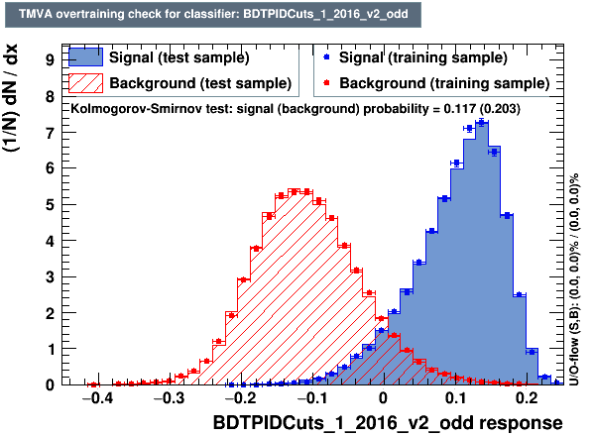
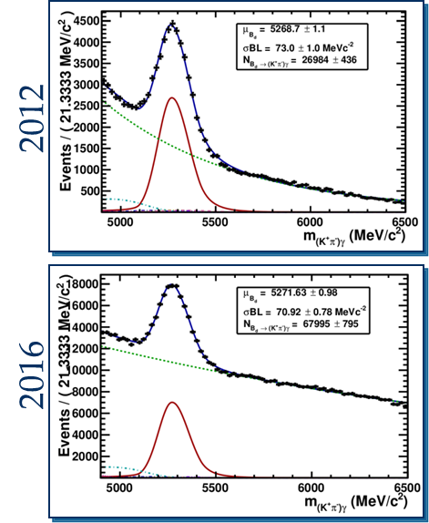
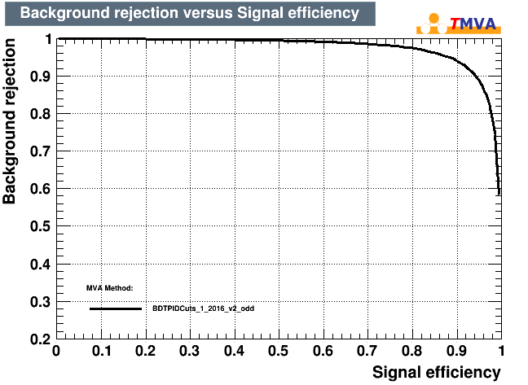
Multivariate analysis
At this stage : high amount of combinatorials
Train BDT with RHSB and MC
Variables used :
B P and η
B direction angle
Tracks P_{T}
Tracks IP
B vertex c²
B flight distance
Isolation variables

Slide 13
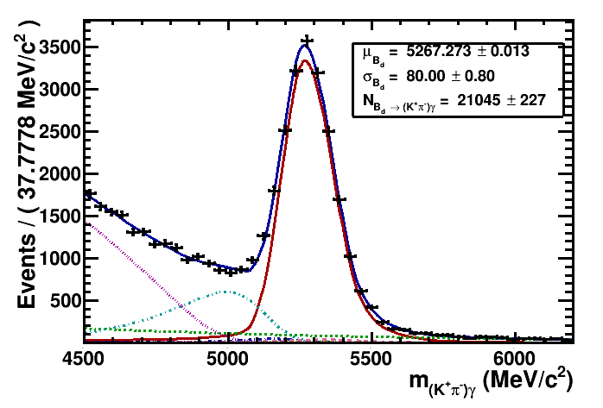
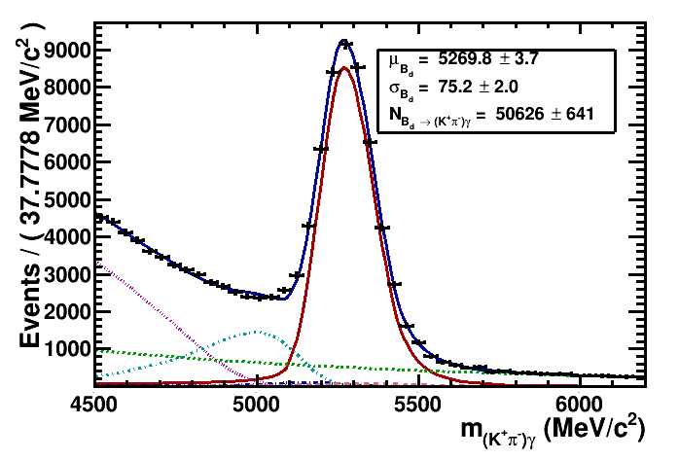
Multivariate analysis
At this stage : high amount of combinatorials

Slide 14
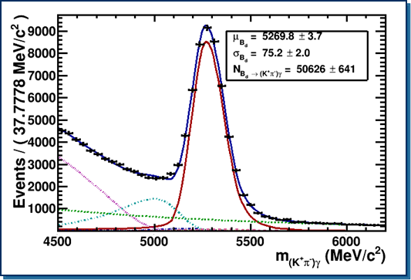
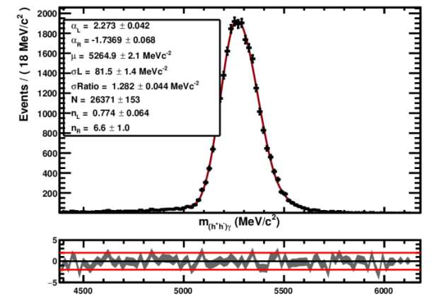
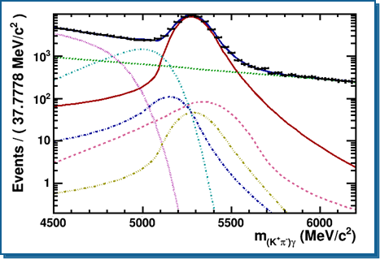

Mass fit model
Signal & peaking backgrounds:
Asymetric Bifurcated CB (µ, σ_{Left}, N ; $\frac{σLeft}{\text{σ}\text{Right}}$ , α_{Left} , n_{Left} , α_{Right} , n_{Right})
Combinatorial BKG: Exponential (shape and N free)
Inclusive partially reconstruced : B -> hh π⁰/γ + X ( X > 2)
Argus (free, µ = m_{B} – 2 m_{π} ) convoluted with Asym. Gaussian(µ=0, σ= σ_{sig})
Free parameters
Fixed on MC
K* γ MC Fit

Slide 15
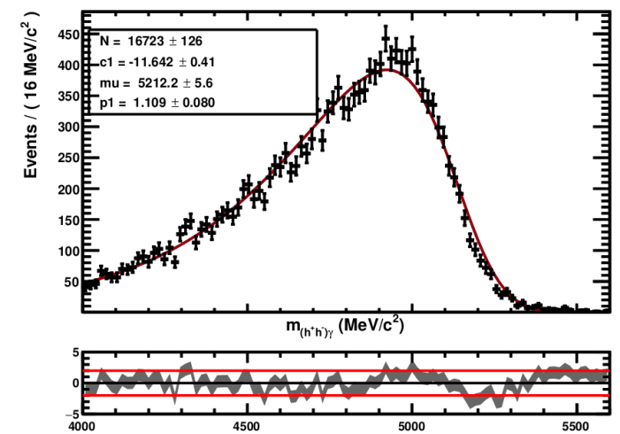
Partially reconstructed
Partially reconstruced : B -> (hhπ)_{res} γ
Shape : Argus (µ = m_{B} - m_{π} , fixed on MC, free yield) convoluted with an Asymetric Gaussian(µ=0, σ= σ_{sig})
For every shape we perform an extended maximum likelihood unbinned fit.
B_{u}-> (kππ)γ

Slide 16
Preliminary study
A first look at the data available, applying :
Rough cut-based selection inherited from previous radiative analysis :
  tighten Kinematical and Topological criteria
  Vertex isolation to reduce partially reconstructed backgrounds
  Rich-based charged particle identification : h± => K±, π±
  Neutral identification and π⁰/γ separation on radiated photon
  No dedicated tuning for DD and LL categories of K_{s}⁰
Charmed background rejection :
  M(h⁺h⁻h⁰) < 1.85 GeV/c²
  Require all other 2-body (hγ) and 3-body (hhγ) combinations to exceed 2 GeV/c (assuming π⁰ mass for the photon)
  Also reject charmless B bkg, e.g. B→K*⁺ρ⁻→K_{s}π⁺π⁻π⁰ (with π⁰ mis-identified as γ)

Slide 17
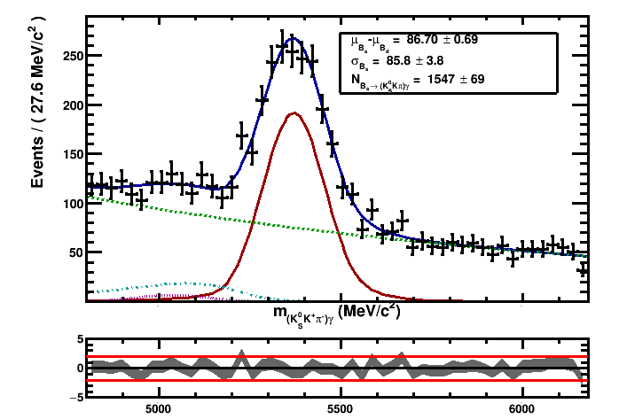
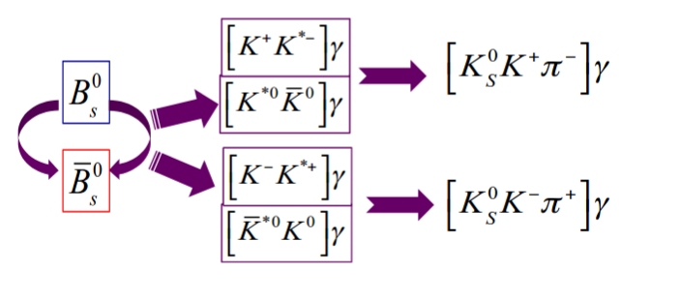
B_{s} → K_{s}Kπ γ
Unbinned likelihood fit of the K_{s}K⁺π⁻γ invariant mass in Run I + Run II
(generic model, just to have estimation of yields) :
Background contribution in the B⁰ → K_{s}ππγ mass fit
Measure B_{s} → K_{s}Kπ γ as well eventually
(1st obervation !)
LHCb Unofficial

Slide 18
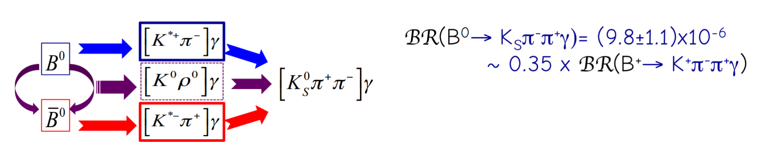
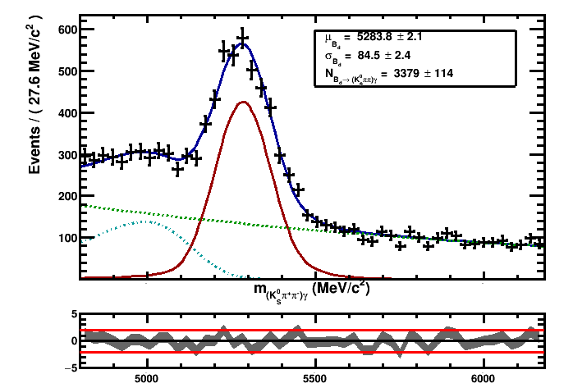
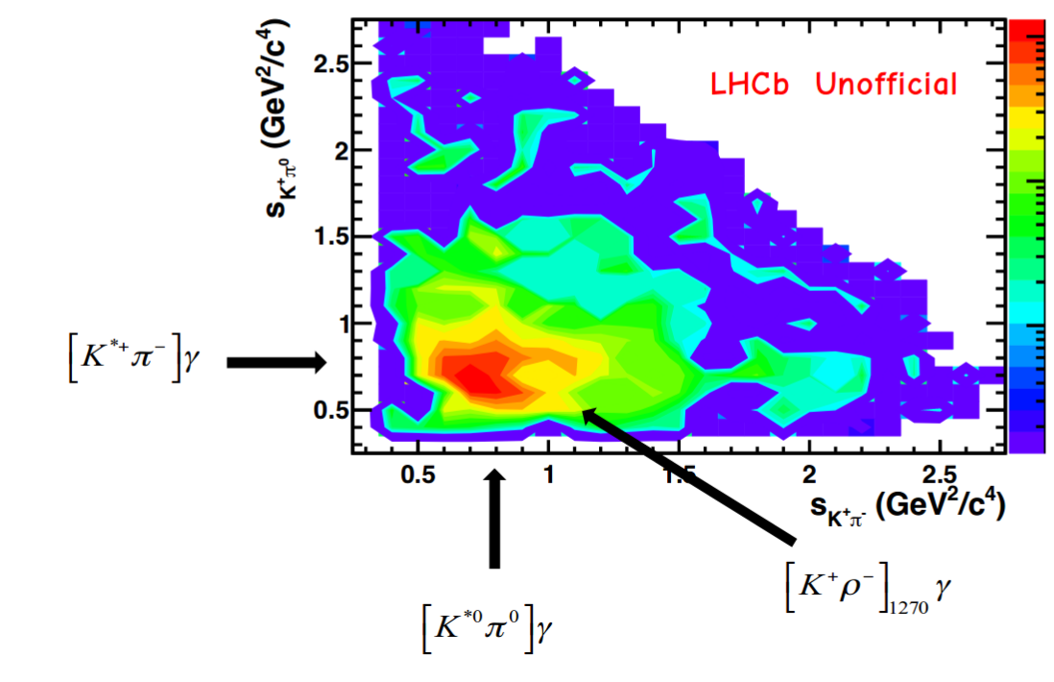
B → K_{s}π⁺π⁻γ
Unbinned likelihood fit of the K_{s}(π+π-)γ invariant mass in Run I + Run II
(generic model, just to have estimation of yields) :
LHCb Unofficial

Slide 19
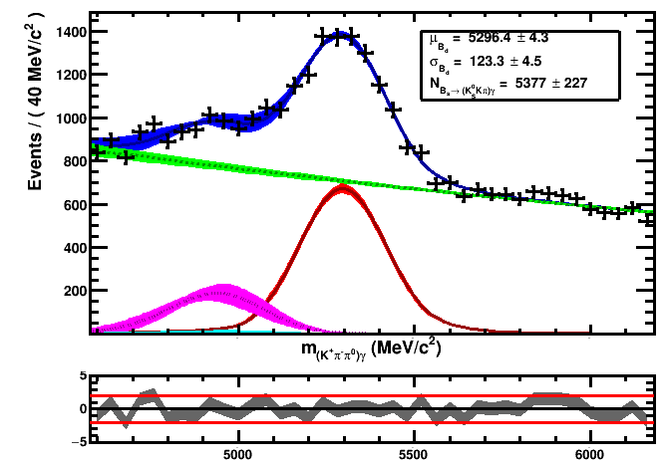

BONUS MODES
Exploratory work : B⁰$→$(K⁺π⁻π⁰)γ
BR(B⁰ $→$ K⁺p⁻p⁰g)= (41±4)x10⁻⁶
1st look at the filtered data using an equivalent selection procedure :
Huge combinatorial
B mass resolution ~120 MeV/c²
Other possible modes to look at :
B⁰$→\text{w}$(π⁺π⁻π⁰)γ, B⁰$→\text{f}$(π⁺π⁻π⁰)γ, B_{s}$→\text{f}$(Κ⁺Κ⁻π⁰)γ
LHCb Unofficial

Slide 20
Conclusion
B → K_{s}h⁺h⁻γ is feasible at LHCb (also B → h⁺h⁻π⁰γ )
Preliminary signal yields with LHCb data RunI+Run II
    B⁰ → K_{s}ππγ : ~ 3500 events (LL + DD)
    B_{s} → K_{s}Kπ γ : ~ 1500 events (LL + DD)
One order of magnitude below the charged mode B⁺→(K⁺π⁻π⁺)γ
=> But rich interference pattern between flavor-specific (K*π)⁰and CP-eigenstates (K_{s}ρ⁰) intermediate states to be exploited in the Dalitz plan for the TD CPV analysis.
Multivariate analysis to reduce the high combinatorial contribution is being developed…
Aim for BR measurements before the end of the year.
Thank you

Slide 21
BACK UP

Slide 22
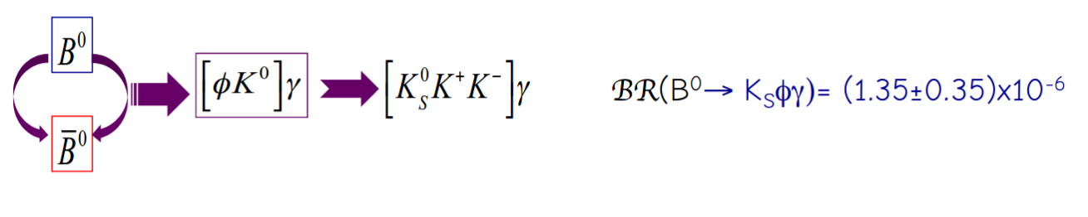
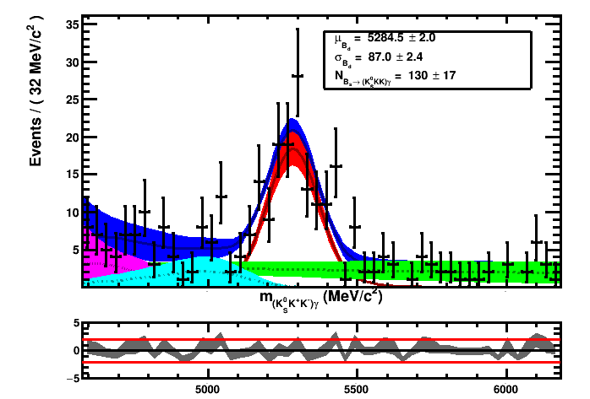
B_{(s)} → K_{s}(K⁺K⁻)γ
Unbinned likelihood fit of the K_{s}(K+K-)γ invariant mass in Run I + Run II
(generic model, just to have estimation of yields) :

