Slide 1
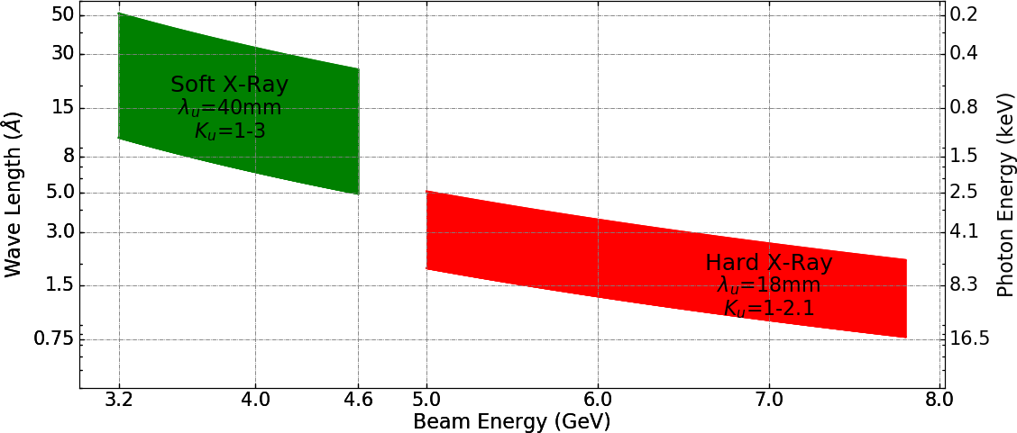
WP4: Task3 - Modulator and Klystron technology
Status
Soft FEL
Linac energy gain : >2 GeV
Repetition rate 1000 Hz
Hard FEL
Linac energy gain : >4.5 GeV
Repetition rate 100 Hz
A. Aksoy 11Dec.2018
XLS WP4 Meeting 28/02/2019 M.Jacewicz

Slide 2
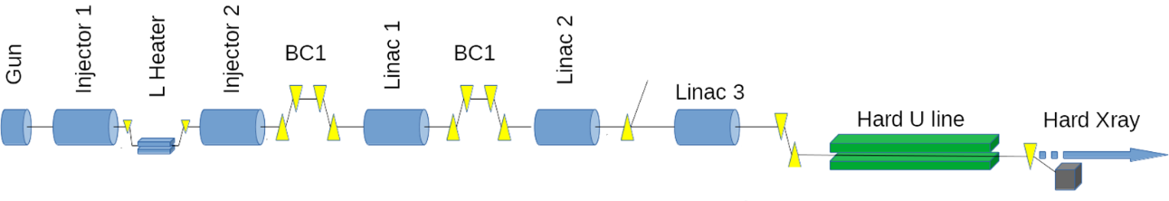
WP4: Task3 - Modulator and Klystron technology
Hard FEL
Linac energy gain : 4.5 GeV
Repetition rate 100 Hz
Baseline for RF unit:
1 modulator
1 klystron -> 50 MW, 1.5 us
1 SLED compressor -> ~160 MW
4 ACS modules -> 65 MV/m gradient
Power per single structure from klystron 10 MW
Total: 20 RF units
Klystron average power in this configuration is 7.5 kW with duty cycle 0.015%

Slide 3
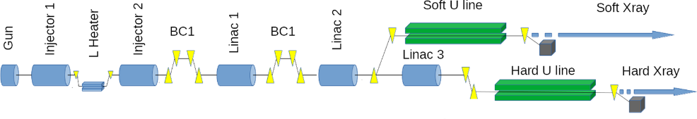
WP4: Task3 - Modulator and Klystron technology
Soft FEL
Linac energy gain : 2 GeV
Repetition rate 1000 Hz
Original design in proposal …
… not feasible

Slide 4
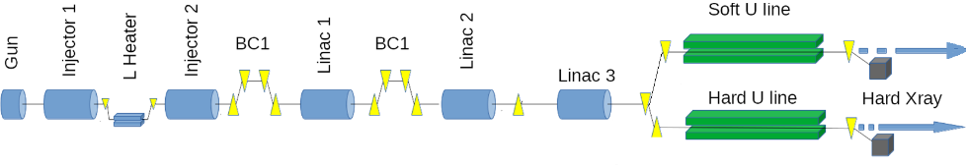
WP4: Task3 - Modulator and Klystron technology
Soft FEL
Linac energy gain : 2 GeV
Repetition rate 1000 Hz
Smart solution would be to still use the same 20 RF units…
.. but with lower gradient → 30 MV/m
Run klystrons at 10 MW peak power but increase the rep rate keeping average power same as in previous case.
What happens to the electron beam at this gradient ??
Is it feasible from the beam dynamics perspective?
We still do not know …

Slide 5
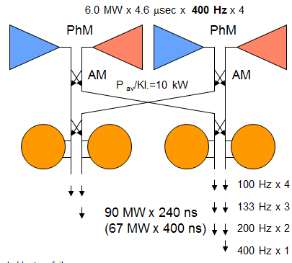
WP4: Task3 - Modulator and Klystron technology
Soft FEL
Linac energy gain : 2 GeV
Repetition rate 1000 Hz
Plan B, modular system à la X-Box3 switching …
… full power to:
→ 4 modules at 200 Hz or
1 module at 800 Hz
Dual-X-band modulator

Slide 6
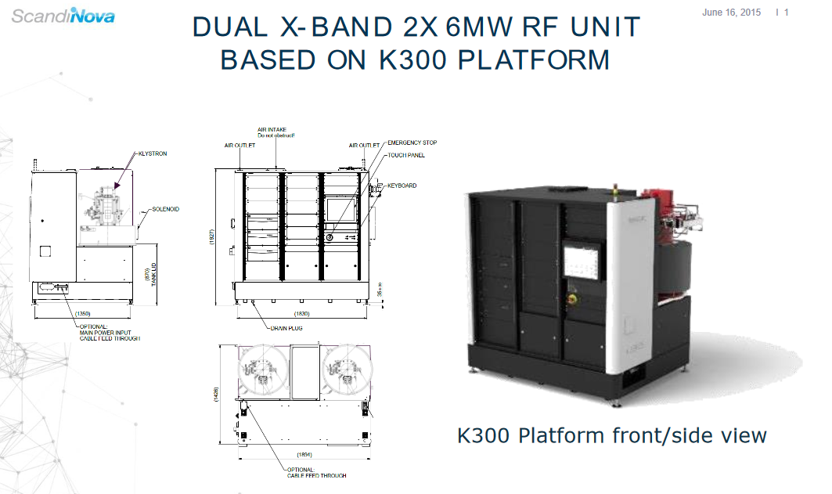

Slide 7
Update on X-band klystrons from CLIC workshop
  CPI VKX-8311
  CANON (former Toshiba) E3768I (11.424 GHz)
  BVERI, Beijing, China (11.424 GHz, 10 Hz) – commercial prototype
  High efficiency (~70%) HEX klystron at CERN – design stage
    8 MW (400 Hz)
    50 MW (100 Hz?)
  Strong development of design and optimization tools
    → maybe suitable to study question of high rep rate/low power operation, find a good work point?

