Slide 1
WP4 progress meeting
Thursday Feb 28 2019
A. Gallo
INFN-LNF, Frascati, Italy
On behalf of the EuPRAXIA@SPARC_LAB RF and LINAC team (*)
(*) D. Alesini, M. Bellaveglia, S. Bini, B. Buonomo, F. Cardelli, E. Chiadroni, G. Di Raddo, R. Di Raddo, M. Diomede, M. Ferrario, A. Gallo, A. Ghigo, A. Giribono, V. Lollo, L. Piersanti, B. Spataro, C. Vaccarezza, (INFN-LNF)
and with the contribution of N. Catalan Lasheras, A. Grudiev, W. Wuensch (CERN)

Slide 2
SUMMARY
Unification of the RF modules of the Eupraxia@Sparc_Lab and CompactLight design studies;
Very preliminary considerations on increasing the rep rate of the RF power sources for both projects; discussion involving Toshiro Anno (Canon), Claude Van Daele (CPI) and Mikael Lindholm (Scandinova)
Progress on the accelerating section RF coupler design
2

Slide 3
Using the CompactLight accelerating section for EUPRAXIA@SPARC_LAB
EUPRAXIA@SPARC_Lab <a>=3.5 mm
Freq. of 2π/3 mode [GHz] | 11.9942
Average iris radius <a> [mm] | 3.5
Total length of the TW structure L_{s} [m] | 0.9
RF pulse [µs] | 1.5
Average gradient <G> [MV/m] | 65
Linac Energy gain E_{gain} [GeV] | 1
Linac active length L_{act} [m] | 18
Unloaded SLED Q-factor Q₀ | 180000
External SLED Q-factor Q_{E} | 21600
Iris radius a [mm] | 4.0-3.0
Group velocity v_{g} [%] | 3.7-1.5
Effective shunt Imp. R_{s} [MΩ/m] | 389
Filling time t_{f} [ns] | 130
Input power per structure P_{k_s} [MW] | 9.8
Structures per module N_{m} (input power per module P_{k_m} [MW]) | 4 (39)
Total number of structures / klystrons | 20 / 5
Best effective shunt impedance
EUPRAXIA@SPARC_Lab <a>=3.2 mm
EUPRAXIA@SPARC_Lab old working point
(optimization of RF power splitting)
Linac active length=18 m (was 16 m of the old working-point), but 16 structure interconnections eliminated
Linac energy on crest = 1.17 GeV with 5 klystons ( in the old WP was 1 / 1.1 GeV with 4 / 5 klystrons)
3

Slide 4
Using the CompactLight accelerating section for EUPRAXIA@SPARC_LAB
The X-band linac baseline shown in the EUPRAXIA@SPARC_LAB Conceptual Design Report is based on 4 modules hosting 8 x 50 cm long TW cavities each (16 m of active length), powered by 4 or 5 klystrons in total. We are proposing to change this baseline for a new one based on 5 RF modules of the type designed for Compact Light, hosting 4 x 90 cm long TW cavities (18 m of active length).
Potential advantages are:
Waveguide distribution network simplified (less accelerating sections per module);
Linac filling factor improvement (active length / real length)
Wider average iris radius (3.5 mm vs. 3.2 mm, larger beam stay-clear)
Larger operational gradient (65 MV/m)
Larger final energy (1170 MeV vs. 1102 MeV)
Fully synergic with CompactLight design study
while potential drawbacks are:
Fabrication of longer structures;
Larger UHV residual pressure in the center of accelerating sections;
…..
The proposal will be discussed in the next collaboration meeting @ LNF, on March 8th 2019
4

Slide 5
REMINDER: CompactLight Preliminary Specification
 | Soft x-ray | Hard x-ray
Photon energy [keV] (min-max) | 0.25 - 2 | 2 - 25
Wavelength [nm] (max-min) | 5 - 0.6 | 0.6 - 0.05
Repetition rate [Hz] | 1000 | 100
Maximum pulse energy [mJ] | Not specified | 1 (at 25 keV, less at other energies?)
Number of photons | Not specified | 2.5 x 10¹¹ at 25 keV
Pulse duration [fs] | 0.1 – 50
Polarisation | Variable, selectable | Not specified
Two-colour pulses: time separation [fs] | -20 -> +40
Two-colour pulses: photon energy variation (max. of E2/E1) | 2 (270-530eV), 1.2 for the rest of the range | 1.1
The table separates the FEL output requirements into the two regimes of operation (soft/hard x-ray) to show which parameters are required in combination.

Slide 6
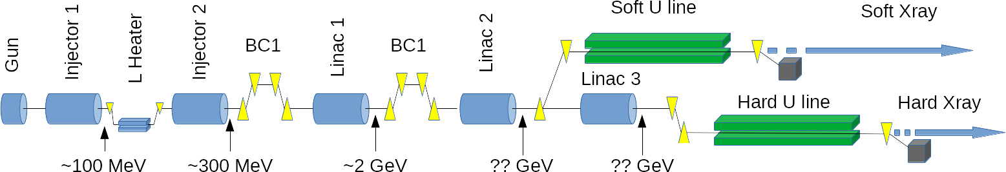
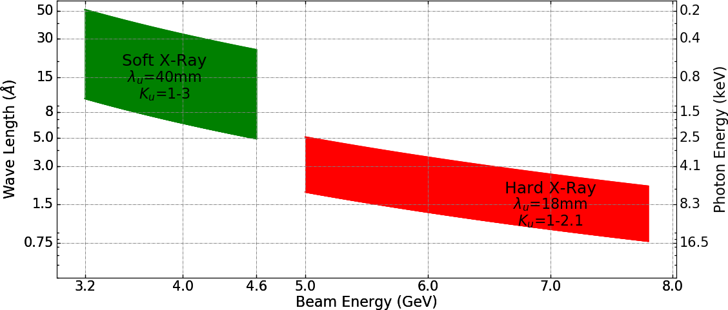
Compact Light FEL Specification
Low energy, high rep rate
High energy, low rep rate

Slide 7
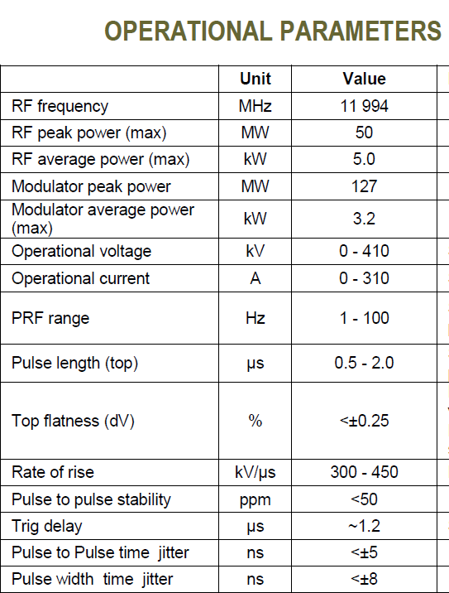
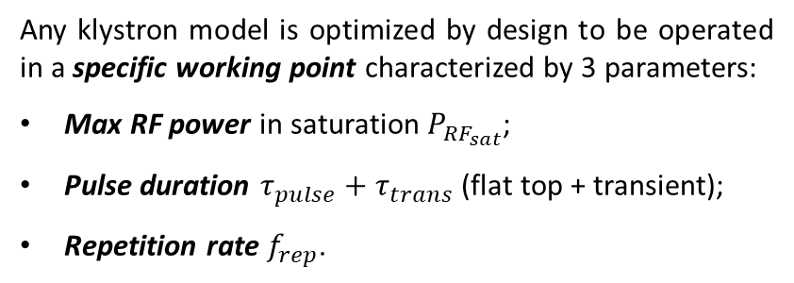
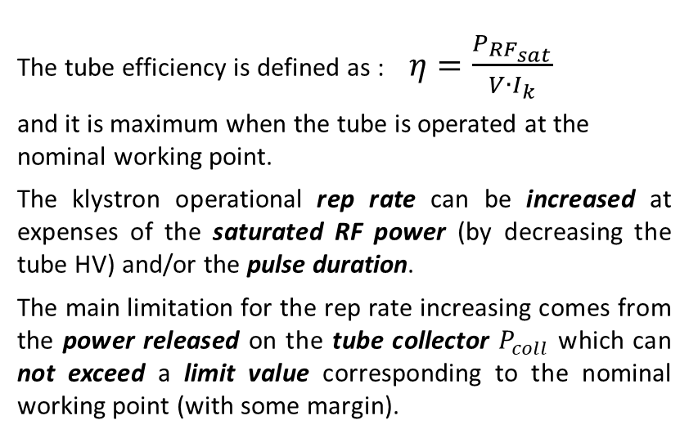
Towards higher rep rate operation of the RF power sources
Any klystron model is optimized by design to be operated in a specific working point characterized by 3 parameters:
Max RF power in saturation $P_{{RF}_{sat}}$;
Pulse duration $τ_{pulse}+τ_{trans}$ (flat top + transient);
Repetition rate $f_{rep}$.
CPI VKX-8311A
The tube efficiency is defined as : $η=\frac{P_{{RF}_{sat}}}{V∙I_{k}}$
and it is maximum when the tube is operated at the nominal working point.
The klystron operational rep rate can be increased at expenses of the saturated RF power (by decreasing the tube HV) and/or the pulse duration.
The main limitation for the rep rate increasing comes from the power released on the tube collector $P_{coll}$ which can not exceed a limit value corresponding to the nominal working point (with some margin).
7

Slide 8
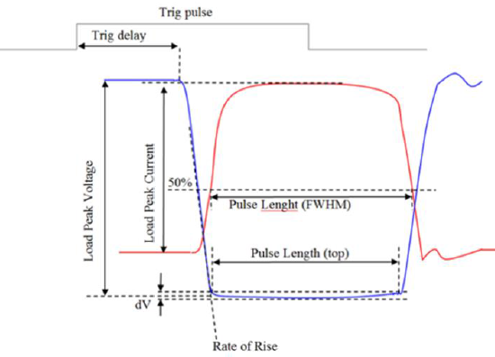
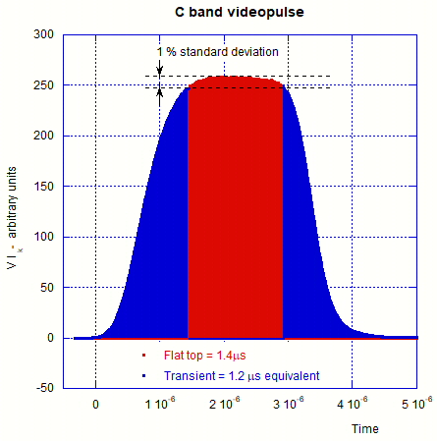
Scandinova modulator pulse for C-band klystron
mainly depends on the modulator characteristics
8

Slide 9
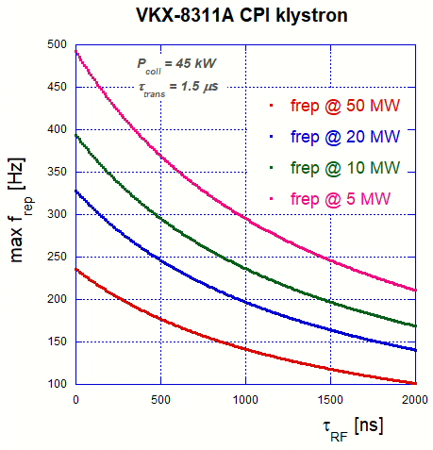
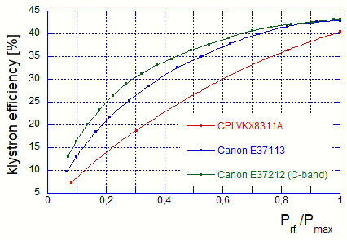
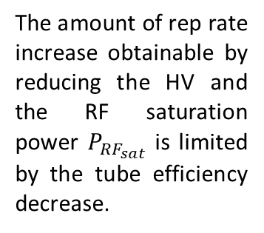
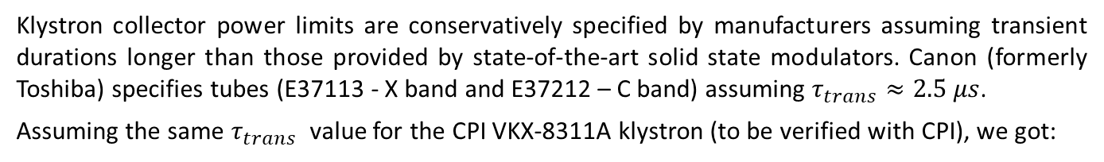
Klystron collector power limits are conservatively specified by manufacturers assuming transient durations longer than those provided by state-of-the-art solid state modulators. Canon (formerly Toshiba) specifies tubes (E37113 - X band and E37212 – C band) assuming $τ_{trans}≈2.5 μs$.
Assuming the same $τ_{trans}$ value for the CPI VKX-8311A klystron (to be verified with CPI), we got:
Since the limit imposed by $P_{coll}$ can not be overcome, the rep rate can only be increased at the expenses of the RF saturation power (HV working point) and/or RF pulse duration.
The amount of rep rate increase obtainable by reducing the pulse duration depends very much on the actual value of the dead time τ_{trans}, which is a characteristics of the modulator.
Klystron efficiency vs. power derating
The amount of rep rate increase obtainable by reducing the HV and the RF saturation power $P_{{RF}_{sat}}$ is limited by the tube efficiency decrease.
9

Slide 10
1st scenario: pulse shortening
rep rate increase limited by modulator dead time (≈1.5 µs)
50 MW, 1.5 µs, 100 Hz
50 MW, 140 ns, 220 Hz
KLYSTRON
KLYSTRON
MODE CONVERTER
MODULATOR HALL
MODE CONVERTER
MODULATOR HALL
CIRCULAR WAVEGUIDE
CIRCULAR WAVEGUIDE
MODE CONVERTER
MODE CONVERTER
SLED
SLED removed
LINAC HALL
LINAC HALL
1 klystron x LINAC Module
<E_{acc}> = 65 MV/m
1 klystron x LINAC Module
<E_{acc}> = 30 MV/m
Linac energy downgraded to ≈ 45% of the max value @ 220 Hz rep rate;
Not flexible: as soon as the SLED is removed the gradient is reduced by a factor ≈2.2;
Klystron operated always at its nominal working point (good!);
Max rep rate very much dependent on modulator dead time τ_{trans}
10

Slide 11
2nd scenario: klystron peak power reduced
rep rate increase limited by klystron inefficiency at reduced HV values
50 MW, 1.5 µs, 100 Hz
1.5 µs, 10 MW, 200 Hz
1.5 µs, 5 MW, 250 Hz
KLYSTRON
KLYSTRON
MODE CONVERTER
MODULATOR HALL
MODE CONVERTER
MODULATOR HALL
CIRCULAR WAVEGUIDE
CIRCULAR WAVEGUIDE
MODE CONVERTER
MODE CONVERTER
SLED
SLED
LINAC HALL
LINAC HALL
1 klystron x LINAC Module
<E_{acc}> = 65 MV/m
1 klystron x LINAC Module
<E_{acc}> = 29 MV/m @ 200 Hz
<E_{acc}> = 20.5 MV/m @ 250 Hz
Linac energy downgraded to ≈ 30% of the max value @ 250 Hz rep rate;
Flexible: different compromises between rep rate and RF peak power explorable;
Klystron operated in a wide range of working points (realistic?)
11

Slide 12

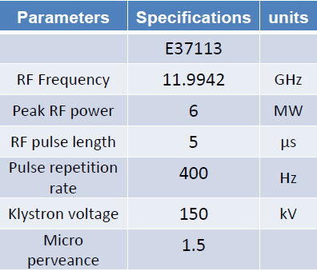
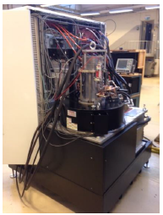
3rd scenario: high rep rate – reduced peak power klystrons
rep rate increase based on dedicated tubes, in substitution of or in addition to high peak power ones
Canon
6 MW, 1.5 µs,
1 kHz
50 MW, 1.5 µs,
100 Hz
RF smart combiner / switch
Canon E37113
CPI VKX-8311A
MODE CONVERTER
MODULATOR HALL
CIRCULAR WAVEGUIDE
MODE CONVERTER
SLED
LINAC HALL
2 klystrons x LINAC Module
<E_{acc}> = 65 MV/m @ 100 Hz
<E_{acc}> = 23 MV/m @ 1 kHz
6 MW, 1.5 µs, 1 kHz operation probably possible
1 kHz rep rate capability, with linac energy up to ≈ 35% of the max value;
Switching or combining 2 sources would preserve high gradient at low rep rate;
If source combination is possible, gradients > 30 MV/m available at rep rates ≤ 250 Hz;
CPI will probably announce a new tube capable of delivering 10 MW, 1.5 µs, 1 kHz (≈ 30 % gradient increase wrt E37113)
12

Slide 13
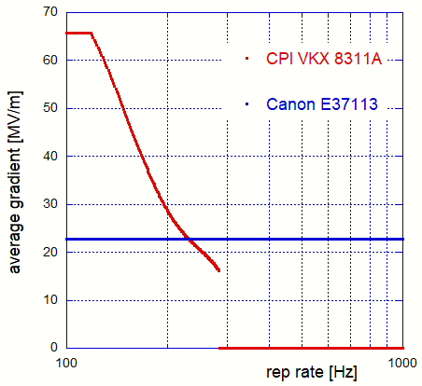
3rd scenario: high rep rate – reduced peak power klystrons
rep rate increase based on dedicated tubes, in substitution for or in addition to high peak power ones
6 MW, 1.5 µs,
1 kHz
50 MW, 1.5 µs,
100 Hz
RF smart combiner / switch
Canon E37113
CPI VKX-8311A
MODE CONVERTER
MODULATOR HALL
CIRCULAR WAVEGUIDE
MODE CONVERTER
new CPI high rep rate kly
SLED
LINAC HALL
2 klystrons x LINAC Module
<E_{acc}> = 65 MV/m @ 100 Hz
<E_{acc}> = 23 MV/m @ 1 kHz
This study is very rough and need to be continued more rigorously, but we need:
more precise requests and specifications by FEL users
more technical data from klystron producer
more experimental data from existing power plants (high rep rate tests @ X boxes?)
maybe new creative ideas to better exploit the existing hardware …
13

Slide 14
Study on couplers for EuPRAXIA@SPARC_LAB

Slide 15
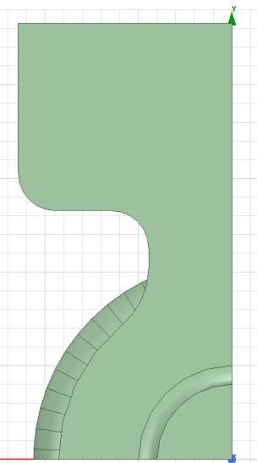
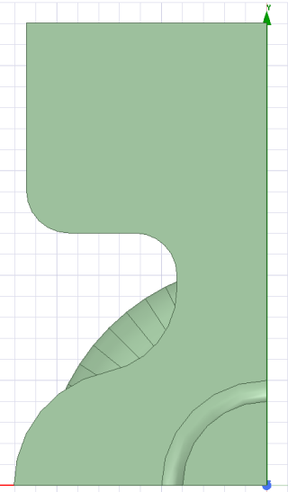
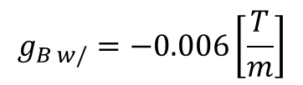
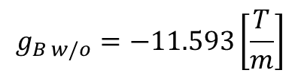
Slot coupler (z-type, input, 80 MV/m)
ΔT < 19° C
r=2mm
W/O racetrack
a₁=3.629 mm
Equivalent focusing/defocusing quadrupole gradient on the x plane at the center of the coupler:
$$g_{B w/o}=−11.593\left[\frac{T}{m}\right]$$
ΔT < 25° C
$$g_{B w/}=−0.006\left[\frac{T}{m}\right]$$
W/ racetrack
58 MW input power, 100 ns pulse length (70 MW and 130 ns for XLS)

Slide 16
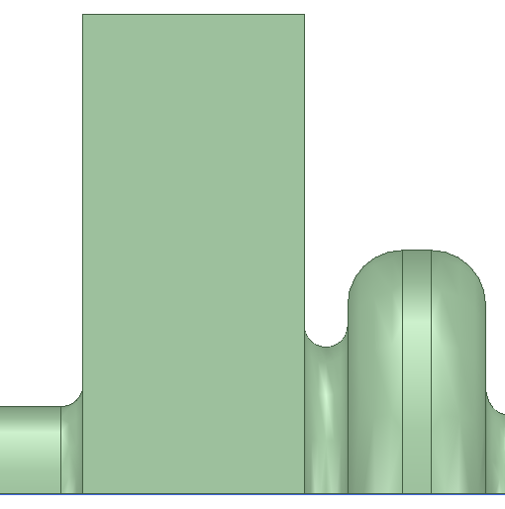
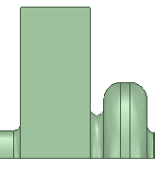
Waveguide coupler (input, 80 MV/m)
waveguide
ΔT < 10° C
r=2mm
W/O wg tapering
Matching cell
ΔT < 11° C
W/ wg tapering
r=2mm
58 MW input power, 100 ns pulse length

Slide 17
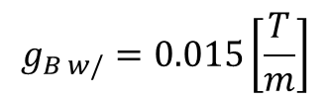
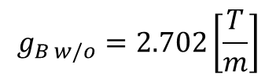
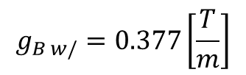
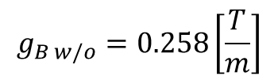
Waveguide coupler (input, 80 MV/m)
Equivalent focusing/defocusing quadrupole gradient on the x plane at the center of the:
Waveguide
Matching cell
$$g_{B w/o}=2.702\left[\frac{T}{m}\right]$$
$$g_{B w/o}=0.258\left[\frac{T}{m}\right]$$
$$g_{B w/}=0.015\left[\frac{T}{m}\right]$$
$$g_{B w/}=0.377\left[\frac{T}{m}\right]$$

Slide 18
Couplers comparison (slot vs waveguide)
 | ΔT [°C] | g_B [T/m]
slot | < 25 | -0.006
waveguide | < 11 | 0.015 (waveguide), 0.377 (matching cell)
Work in progress:
Calculate g_{B} (and g_{E}) along z
Calculations considering the injection phase
Calculate the integrated gradients

