Slide 1


Cost Model
Tentative proposal for a XLS PBS
28th february 2019
C. Rossi

Slide 2
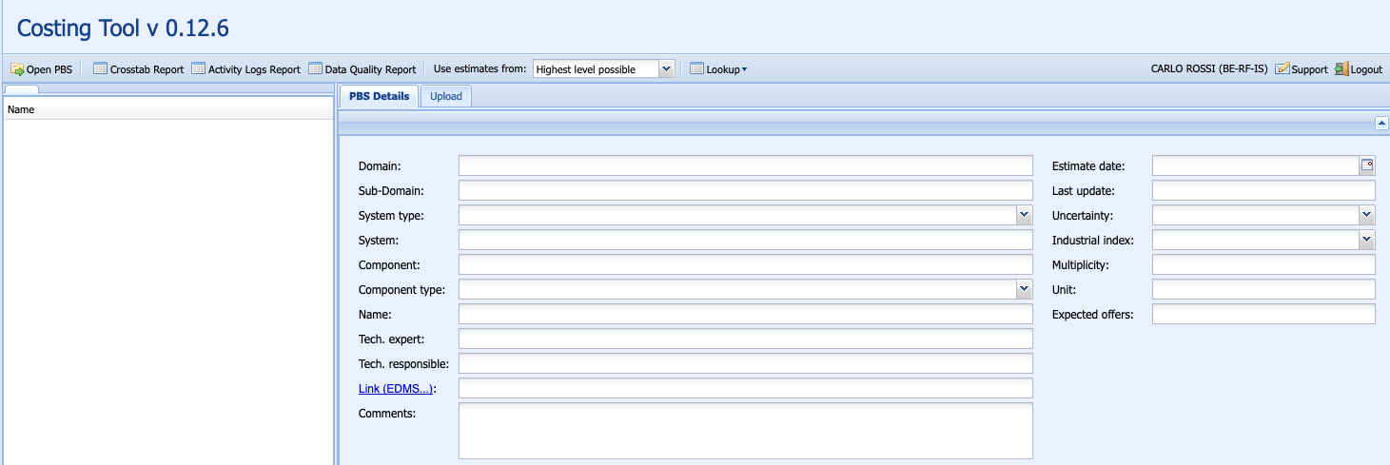
The CLIC costing exercise…
When the first CLIC costing exercise was done in 2012, a specific costing tool was created.

Slide 3
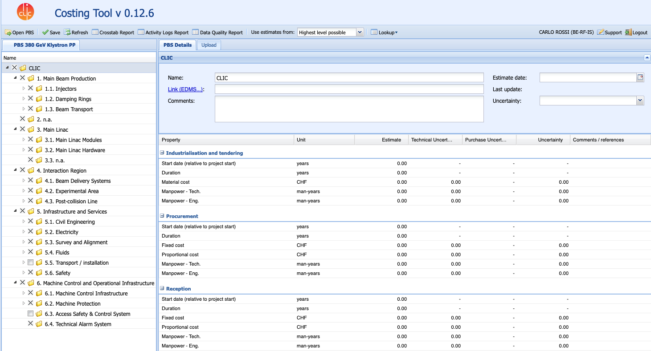
The CLIC costing exercise…
A tree structure, called PBS, is provided to the costing tool. 6 levels for CLIC.

Slide 4
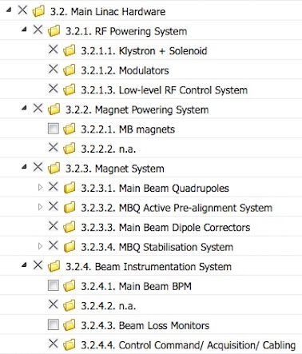
The CLIC costing exercise…
A tree structure, called PBS, is provided to the costing tool. 6 levels for CLIC.

Slide 5
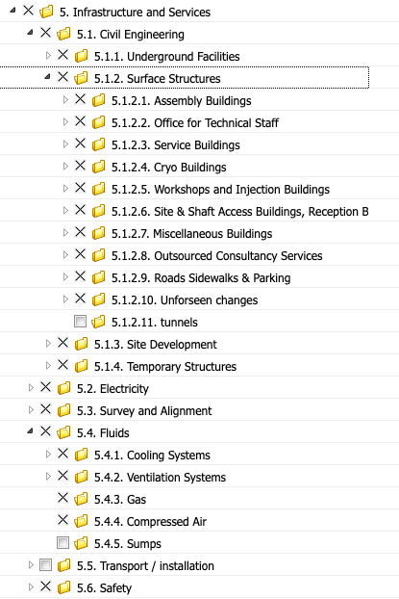
PBS for the klystron-based accelerator
Persons responsible for each node have been identified.
The CLIC PBS include all costing for the project.

Slide 6
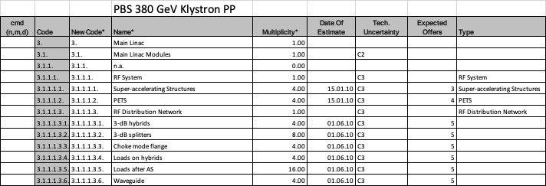
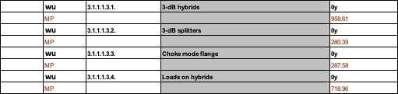
PBS for the klystron-based accelerator
The tool is fed with the costing information, through an Excel spreadsheet for ex.

Slide 7
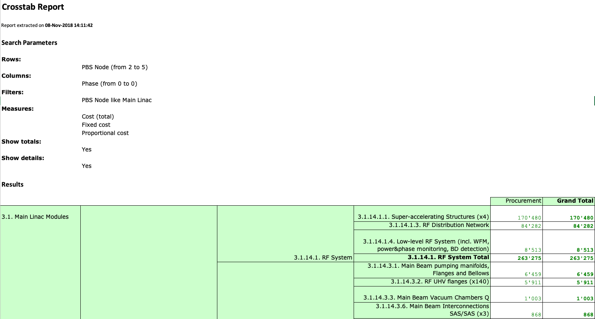
PBS for the klystron-based accelerator
And provides detailed and aggregated cost figures

Slide 8
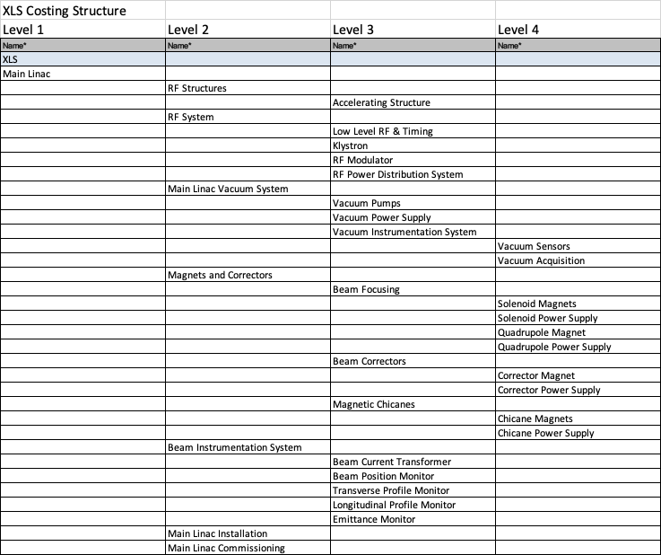
Proposed approach for XLS
Use the same kind of structure, in case with less details, and decide if to adopt the same costing tool or not.

Slide 9
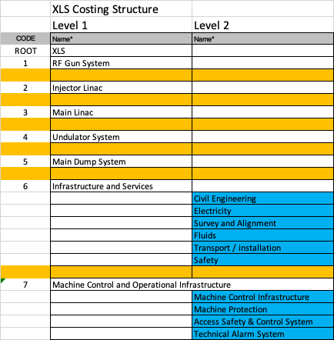
Proposed approach for XLS

Slide 10
Other ingredients …
Establish a shared strategy for cost estimates, including :
Properly document the origin of each cost estimate;
Provide estimate for cost uncertainties (quantified and discussed);
Include offers from industrial partners;
Provide indication of technical uncertainties (impact on cost uncertainty).
Tight collaboration between the costing team and cost node owners (work package holders ?) is necessary.

