Slide 2
Smaller longitudinal emittance at PS-SPS transfer
LIU Beam Performance meeting
5 February 2019
H. Damerau
Many thanks to A. Lasheen, M. Schwarz, E. Shaposhnikova

Slide 3
Introduction
  Motivation for smaller ε_{l} at PS-SPS transfer:
  Measurements in PS at 2.6 ∙ 10¹¹ p/b show (link)
    Stable beam at start of flat-top with ~0.3 eVs_{FT} instead of nominally 0.35 eVs_{FT}
  Recent simulation (M. Schwarz, link) at flat-bottom indicate
    Good agreement with measurements for pre-LS2 SPS
    Loss reduction at PS-SPS transfer with 15% smaller ε_{l}
    Longitudinal stability margin with post-LS2 SPS
  How far can ε_{l} be reduced at PS-SPS transfer?
  Consequences of smaller ε_{l} in PSB/PS?

Slide 4
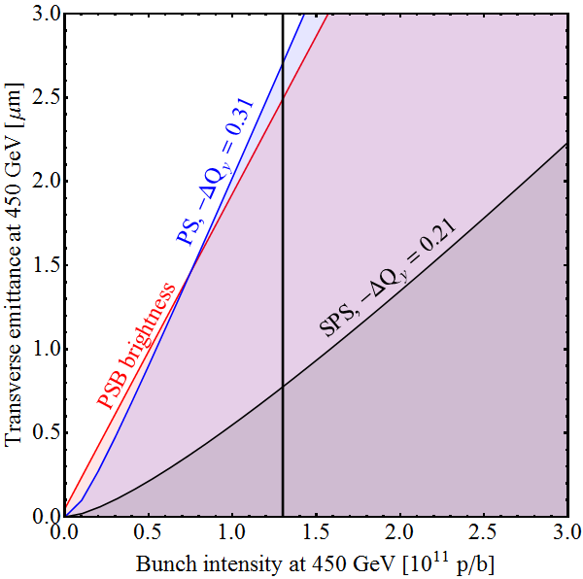
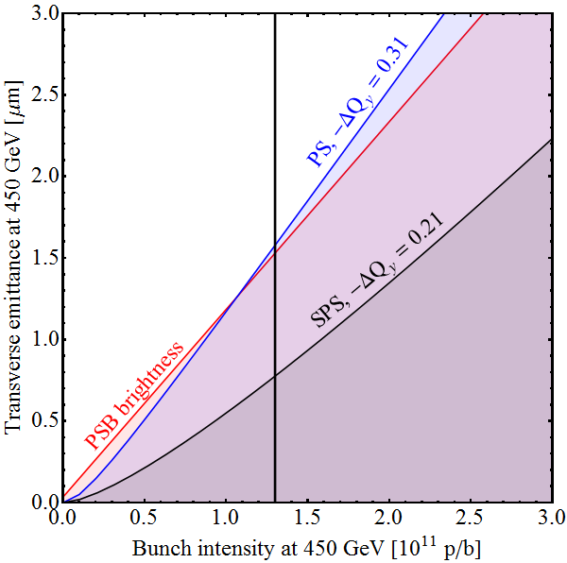
Expected performance
1.4 GeV, pre-LS2, operational conditions
Standard, 72b → 2.7 μm
BCMS→ 1.6 μm
  Operational BCMS beam closed to predicted limits;
  see H. Bartosik, Evian 2019, link (slide 16)

Slide 5
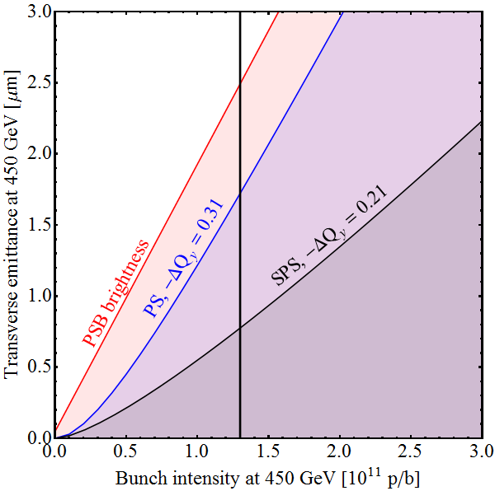
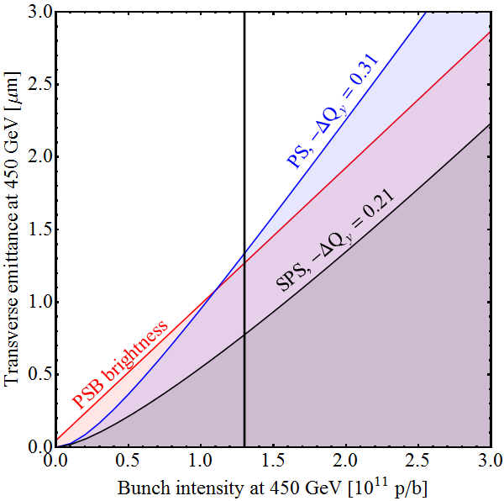
Expected performance
1.4 GeV, pre-LS2, where we should be according to RLIUP
Standard, 72b → 2.5 μm
BCMS → 1.3 μm
  Important blow-up at PSB-PS transfer with BCMS
  (ε_{l} = 1.5 eVs from PSB)

Slide 6
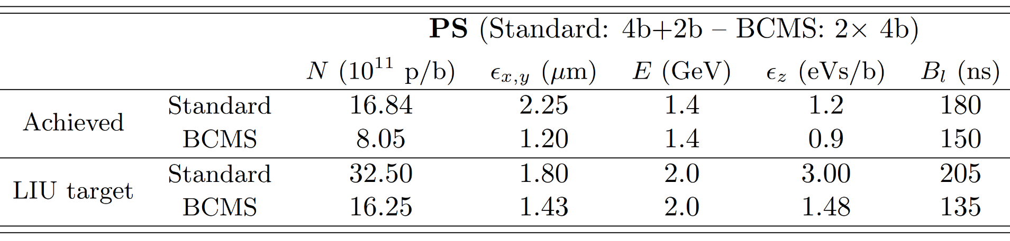
Smaller longitudinal emittance from PS?
LIU baseline parameters after at injection into PS (EDMS 1296306 v.2)
Bunches split in PS by 12 (standard triple splitting) or 6 (BCMS)
  ~0.25 eVs_{FT}/bunch at extraction already at injection
Assume ~20% (un-)controlled blow-up (RF manipulations, transition),
~5% at flat-top (synchronization, splitting, 80 MHz impedance)
Longitudinal emittance below 0.3 eVs_{FT}/bunch not covered by present LIU baseline
ε_{l} in foot-tangent (FT) definition

Slide 7
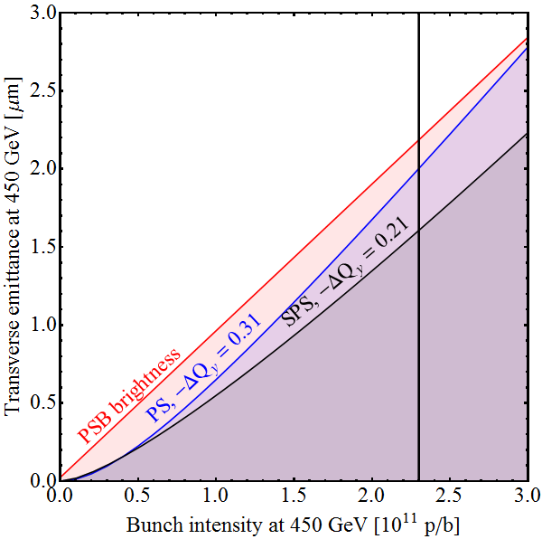
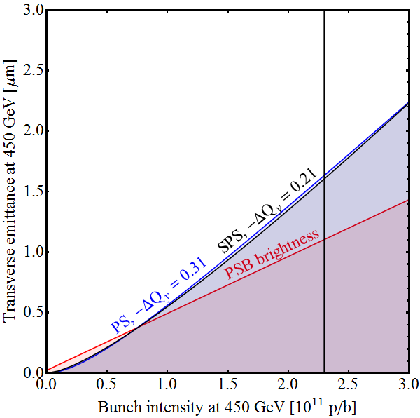
Expected performance
2.0 GeV, post-LS2, LIU baseline, 0.35 eVs_{FT} at PS ejection
Standard, 72b → 2.2 μm
BCMS→ 1.6 μm
ε_{l} = 3.0 eVs_{FT} at PS inj.
ε_{l} = 1.5 eVs_{FT} at PS inj.

Slide 8
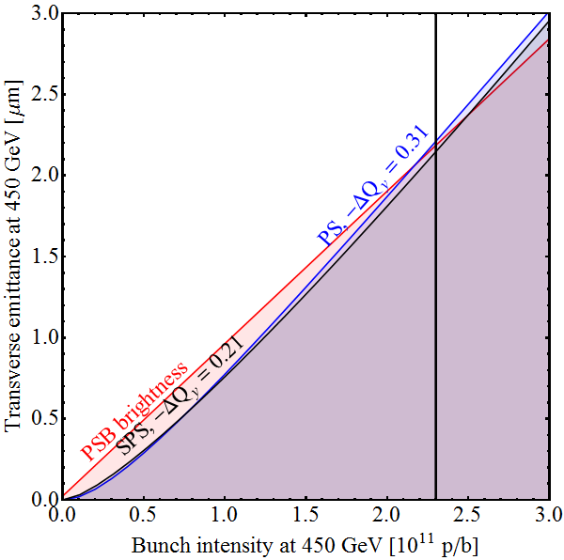
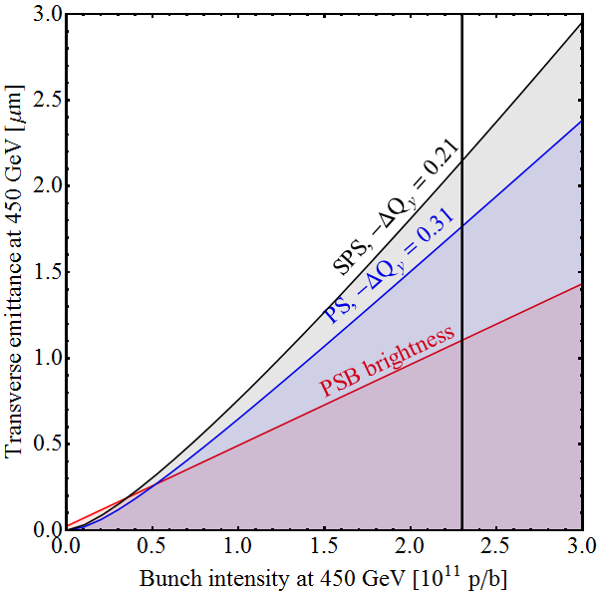
Expected performance with small ε_{l}
2.0 GeV, post-LS2, 0.25 eVs_{FT} at PS ejection (if stable)
Standard, 72b → 2.2 μm
BCMS→ 2.1 μm
ε_{l} = 2.4 eVs_{FT} at PS inj.
ε_{l} = 1.2 eVs_{FT} at PS inj.
  Smaller ε_{l} in PS as backup option for standard beam?
  Unfavourable for BCMS due to SPS space charge limit

Slide 9

THANK YOU FOR YOUR ATTENTION!

